Slide 1
Nearer, Still Nearer
MORRIS
9.10.9.10
Words: | Lelia N. Morris (1898)
Music: | Lelia N. Morris (1898)
4/4
D^{b}/F - MI
Verses: 4
Lead - | MI
Alto - | DO
Tenor - | SOL
Bass - | DO
PDHymns.com

Slide 2
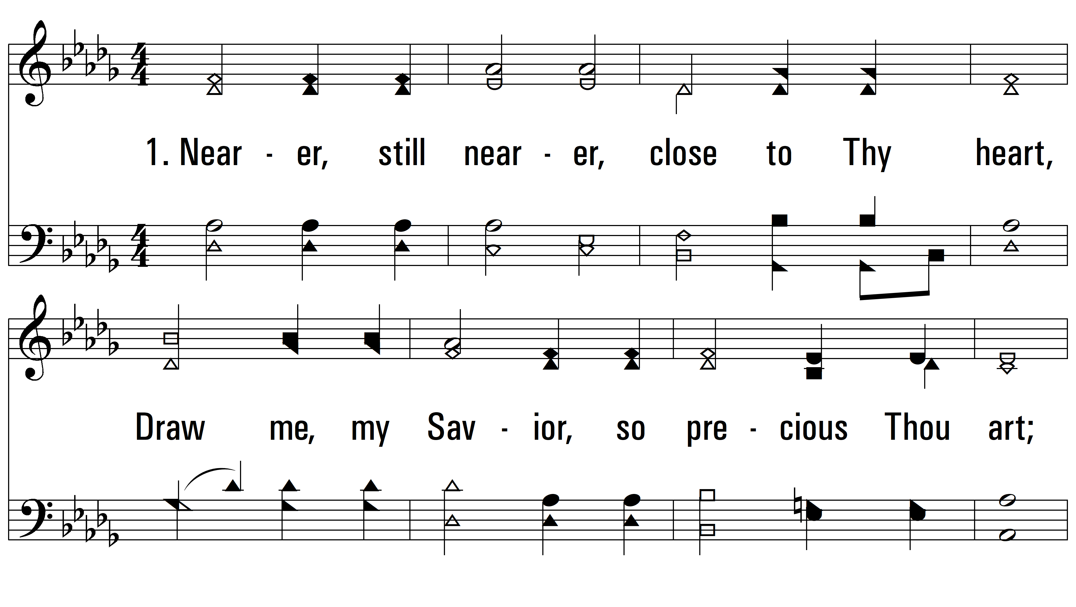
vs. 1 ~ Nearer, Still Nearer

Slide 3
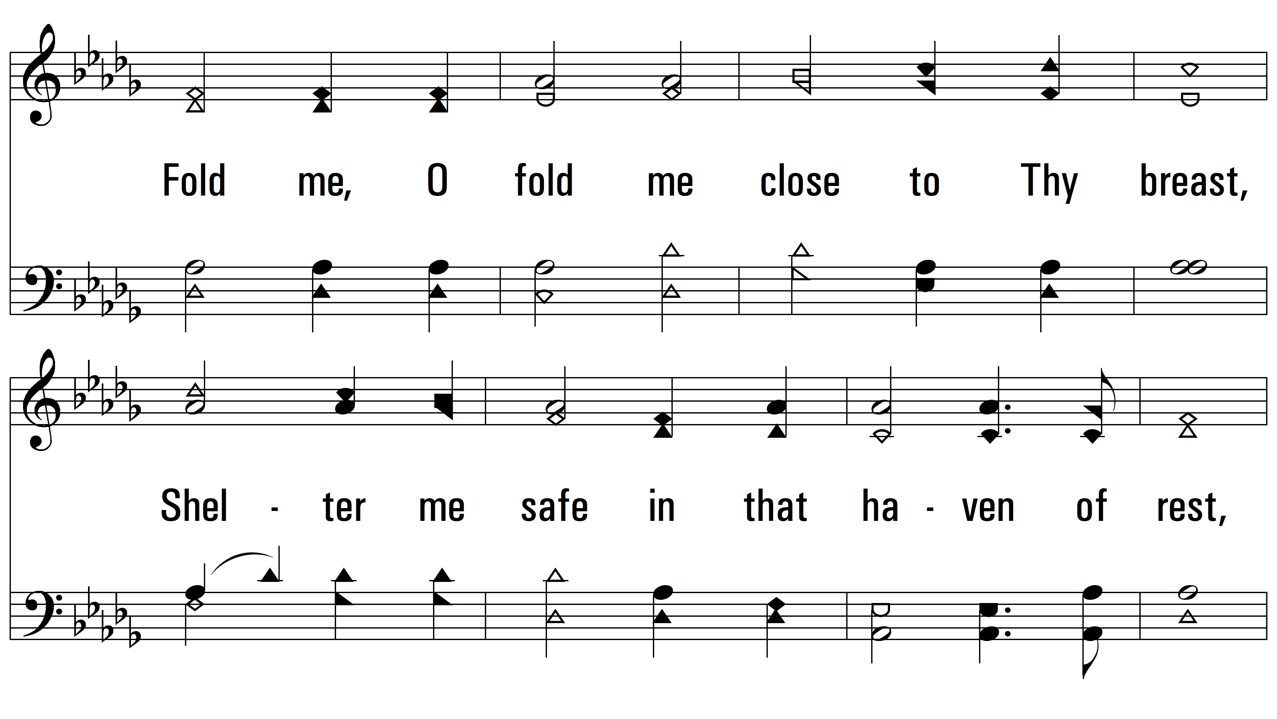
vs. 1

Slide 4
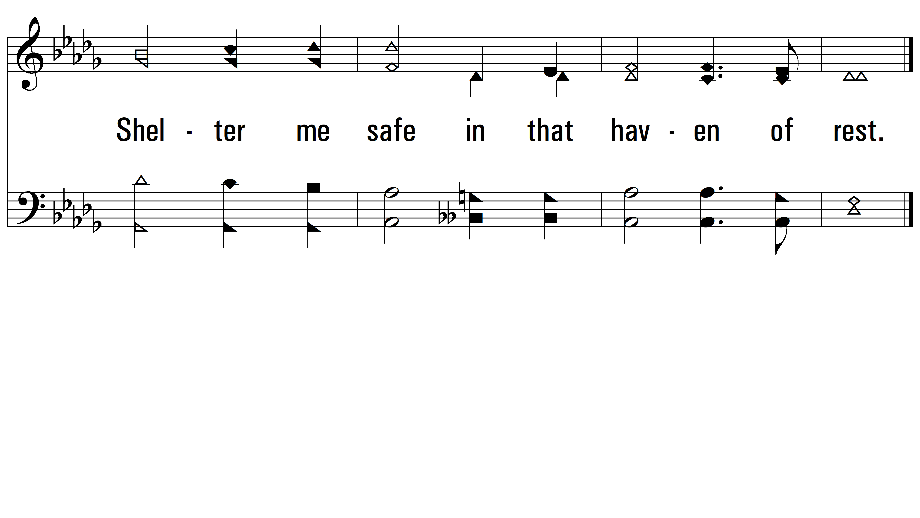
vs. 1

Slide 5
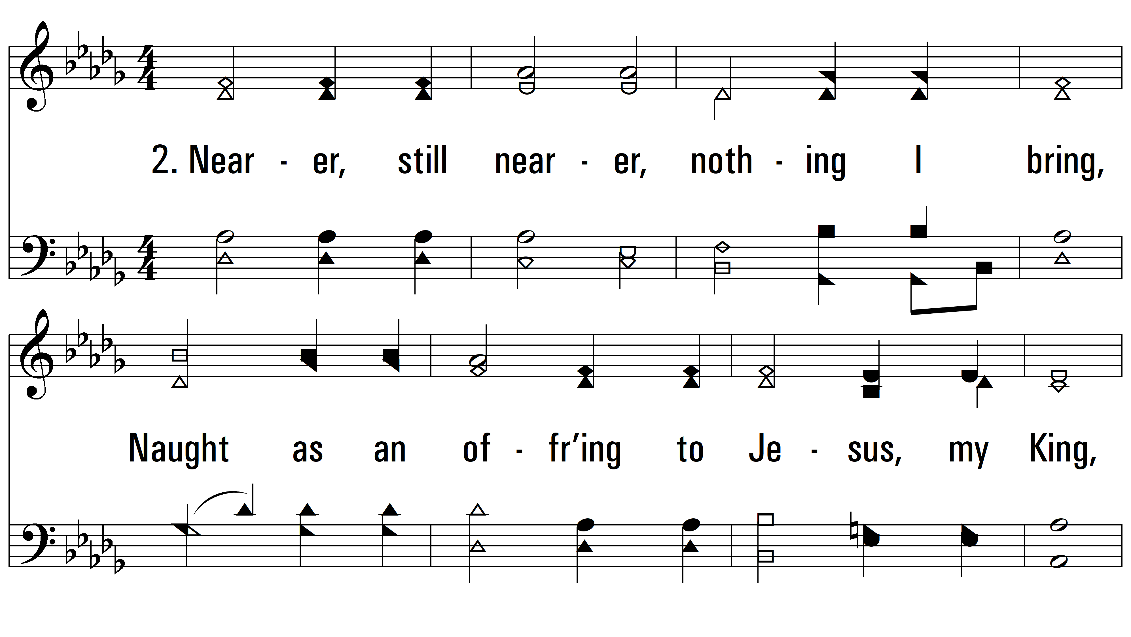
vs. 2 ~ Nearer, Still Nearer

Slide 6
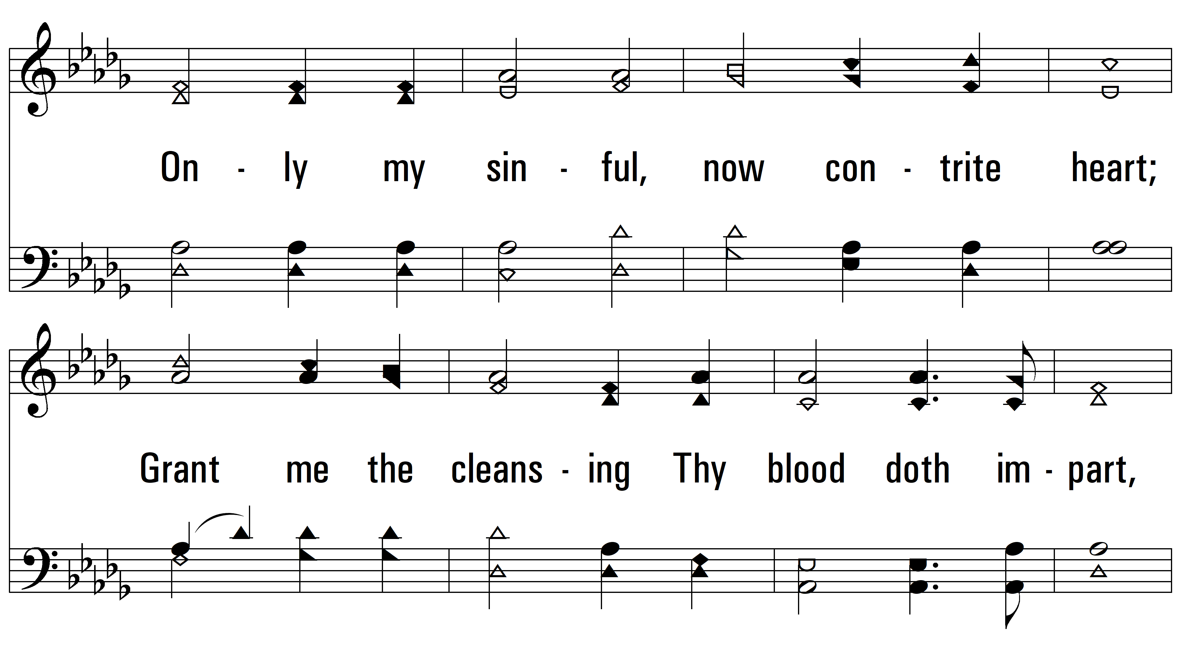
vs. 2

Slide 7
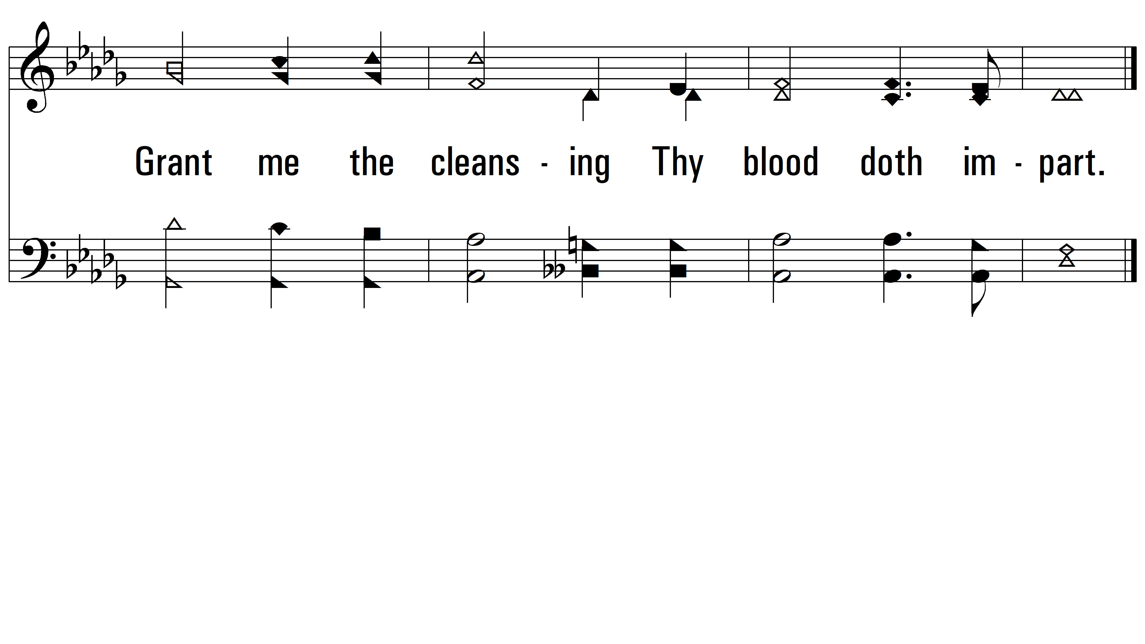
vs. 2

Slide 8
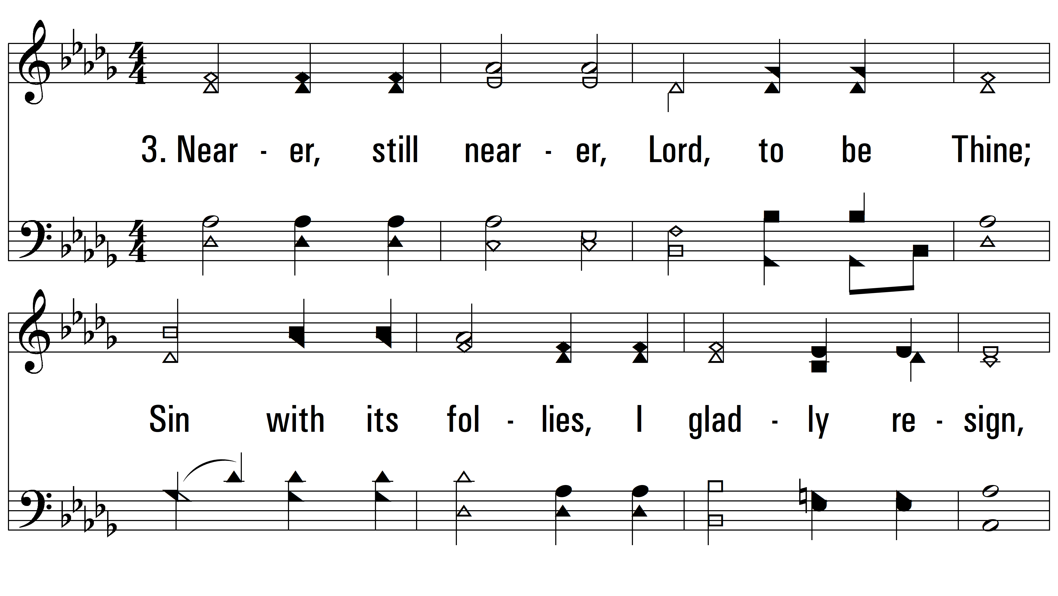
vs. 3 ~ Nearer, Still Nearer

Slide 9
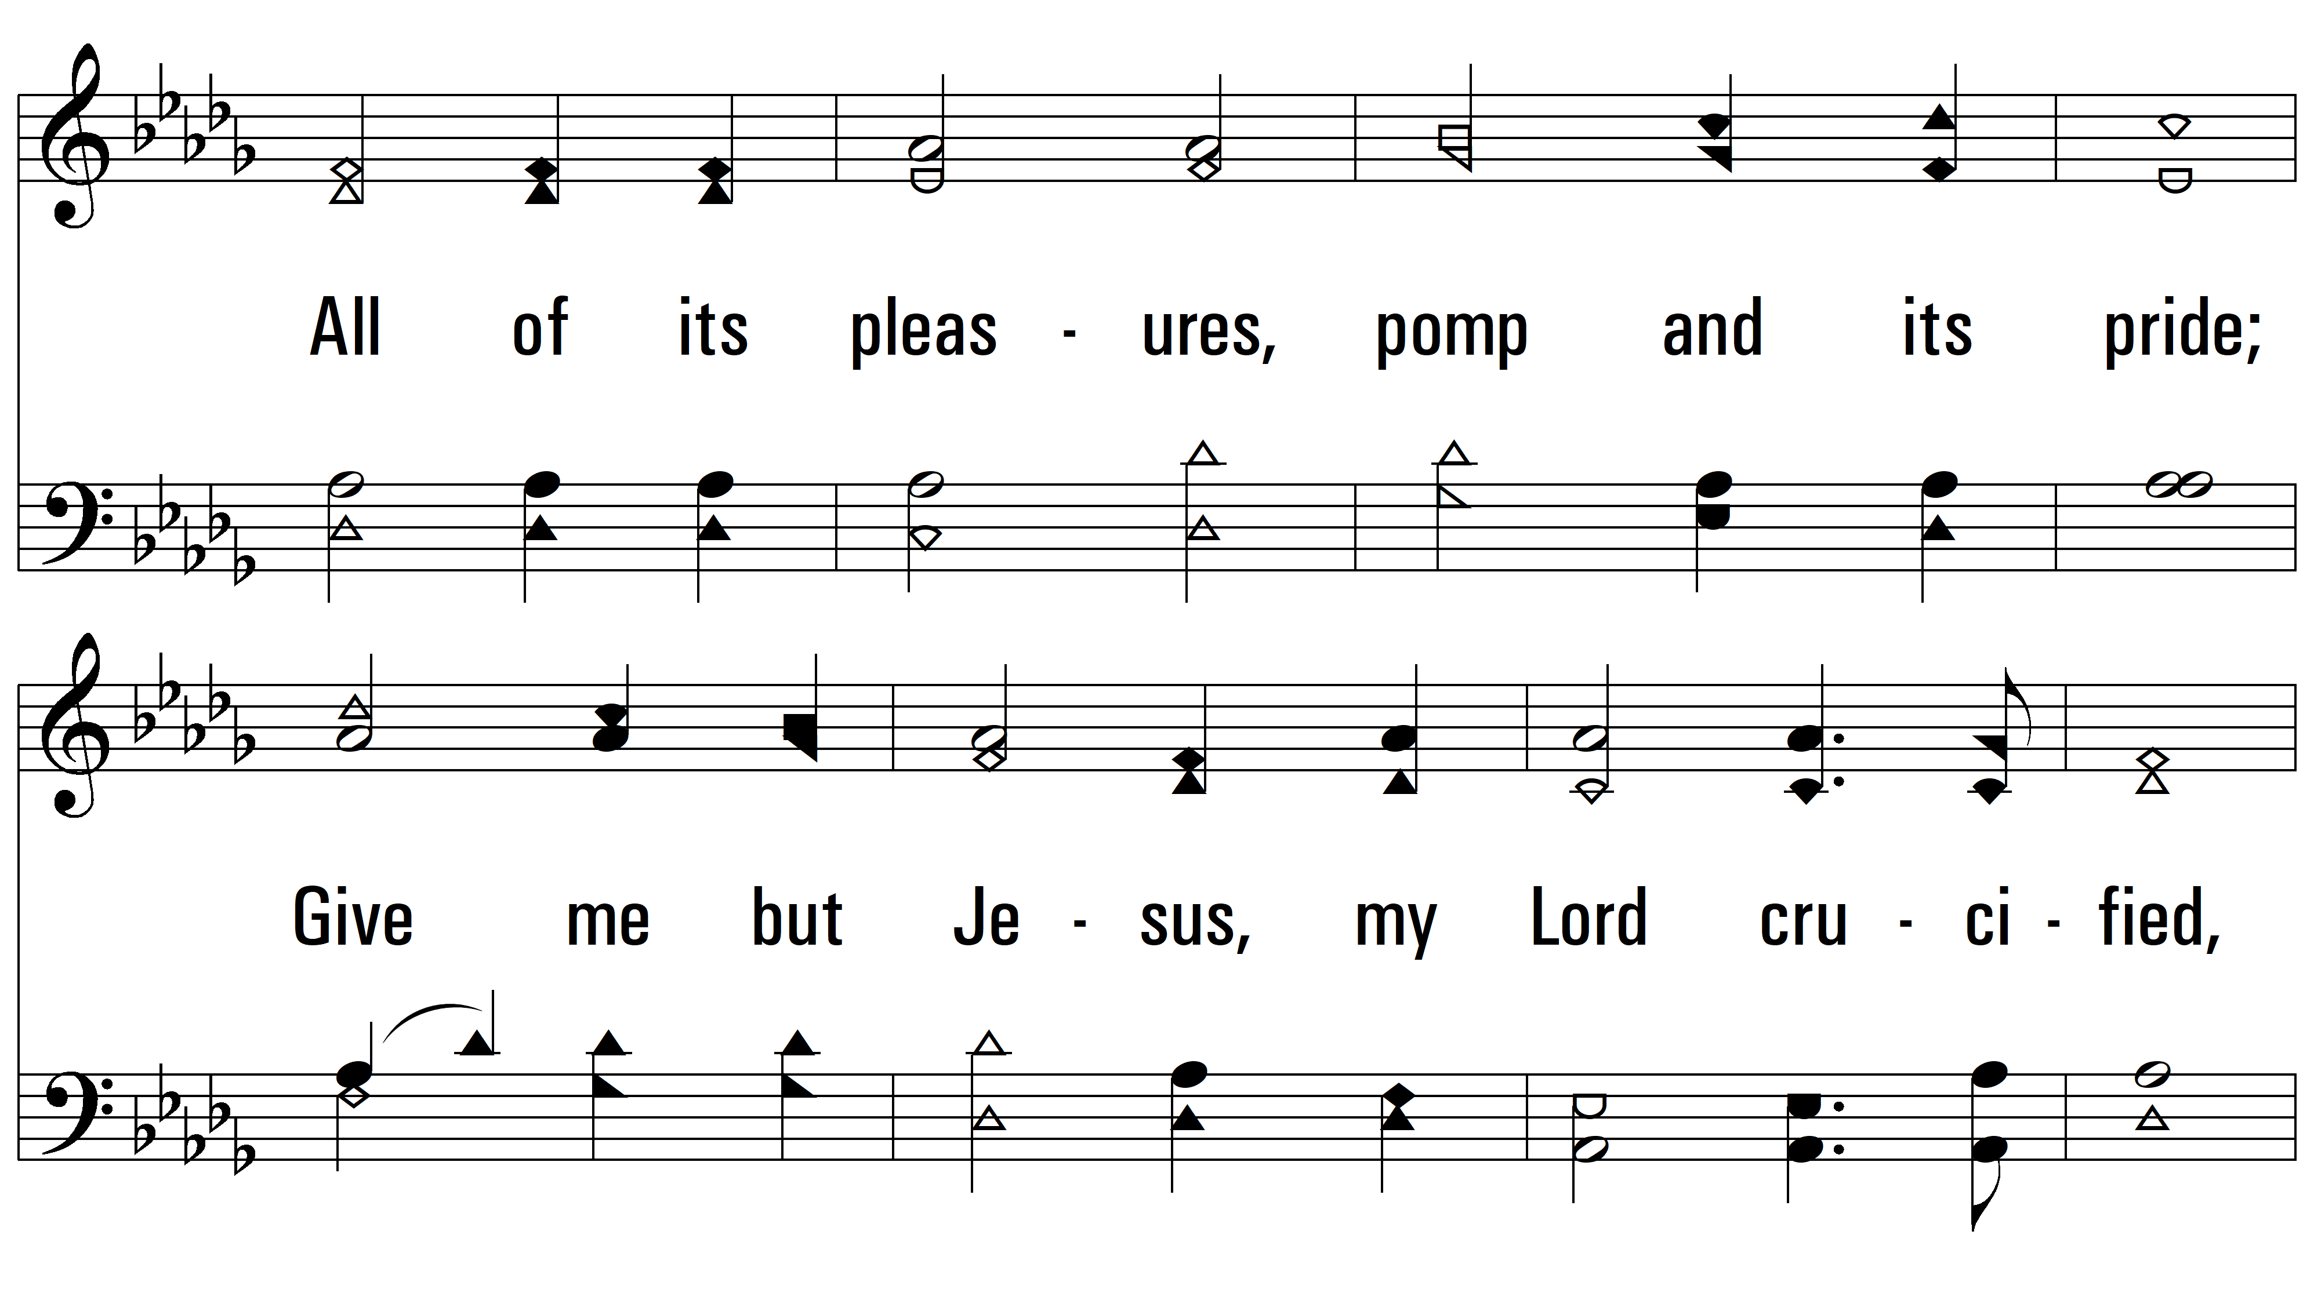
vs. 3

Slide 10
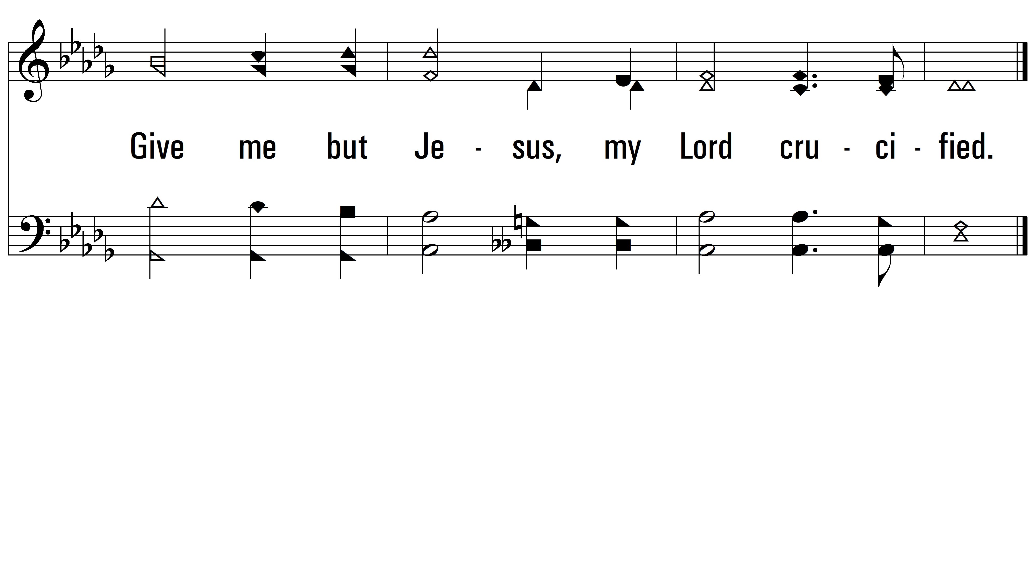
vs. 3

Slide 11
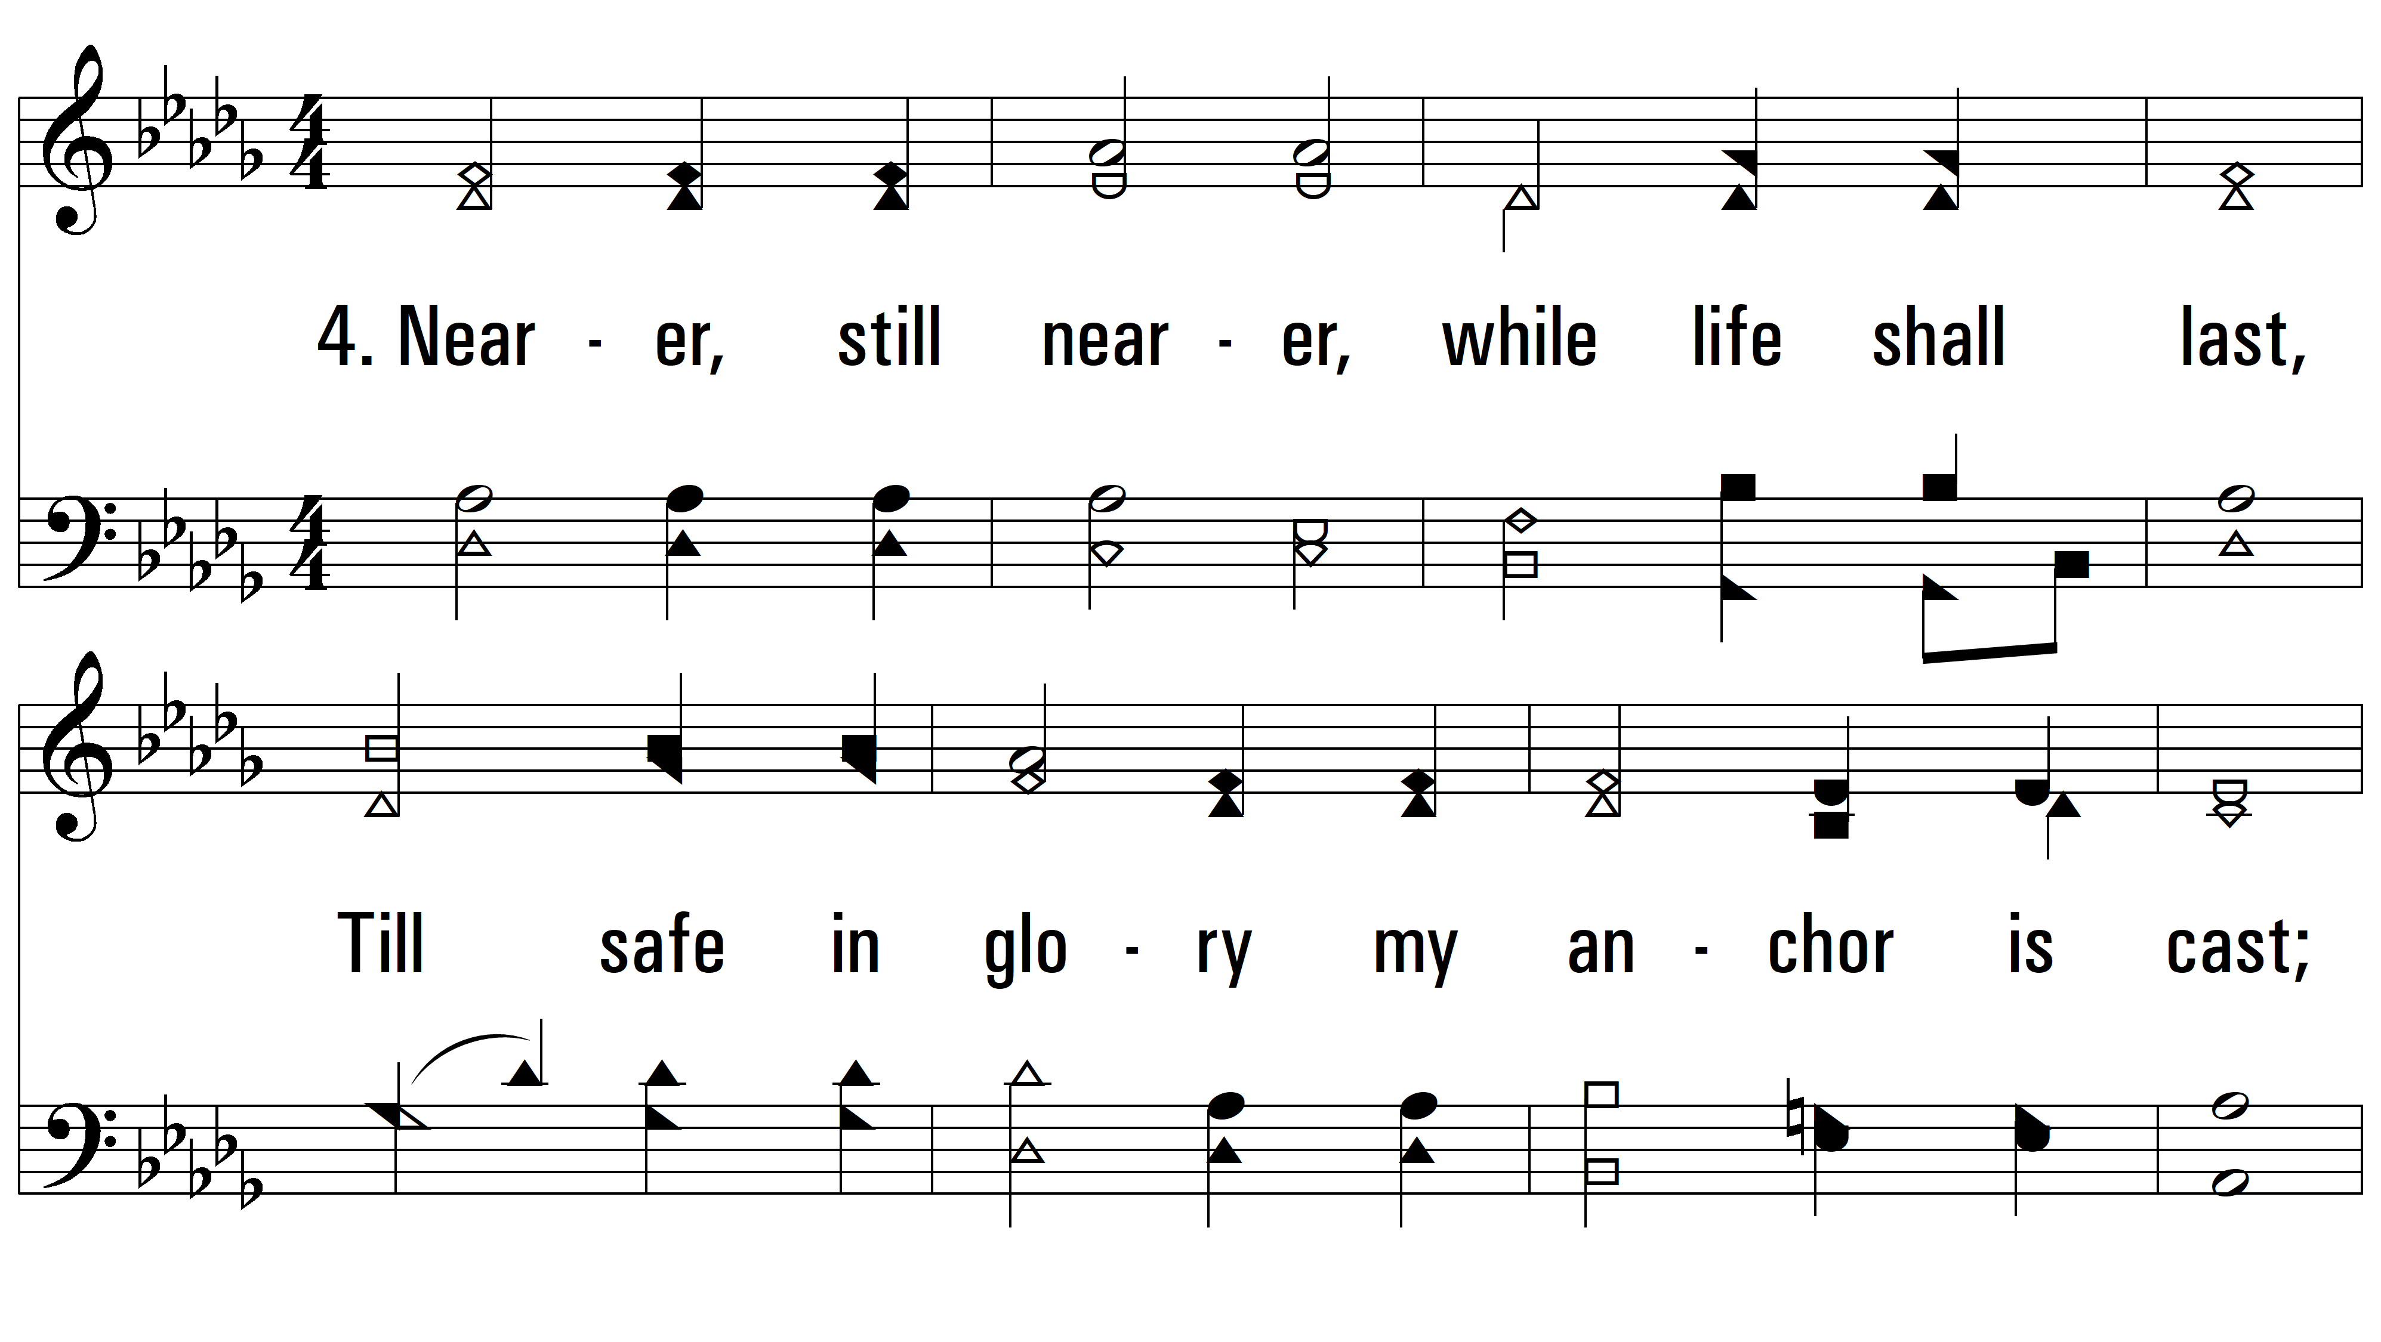
vs. 4 ~ Nearer, Still Nearer

Slide 12
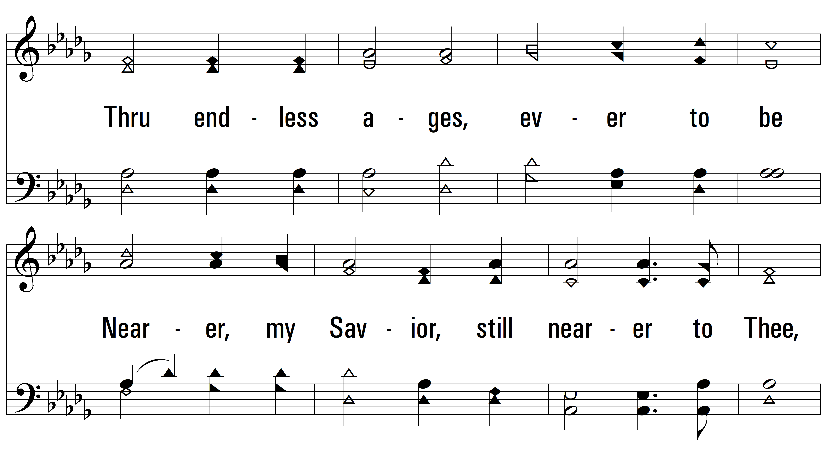
vs. 4

Slide 13
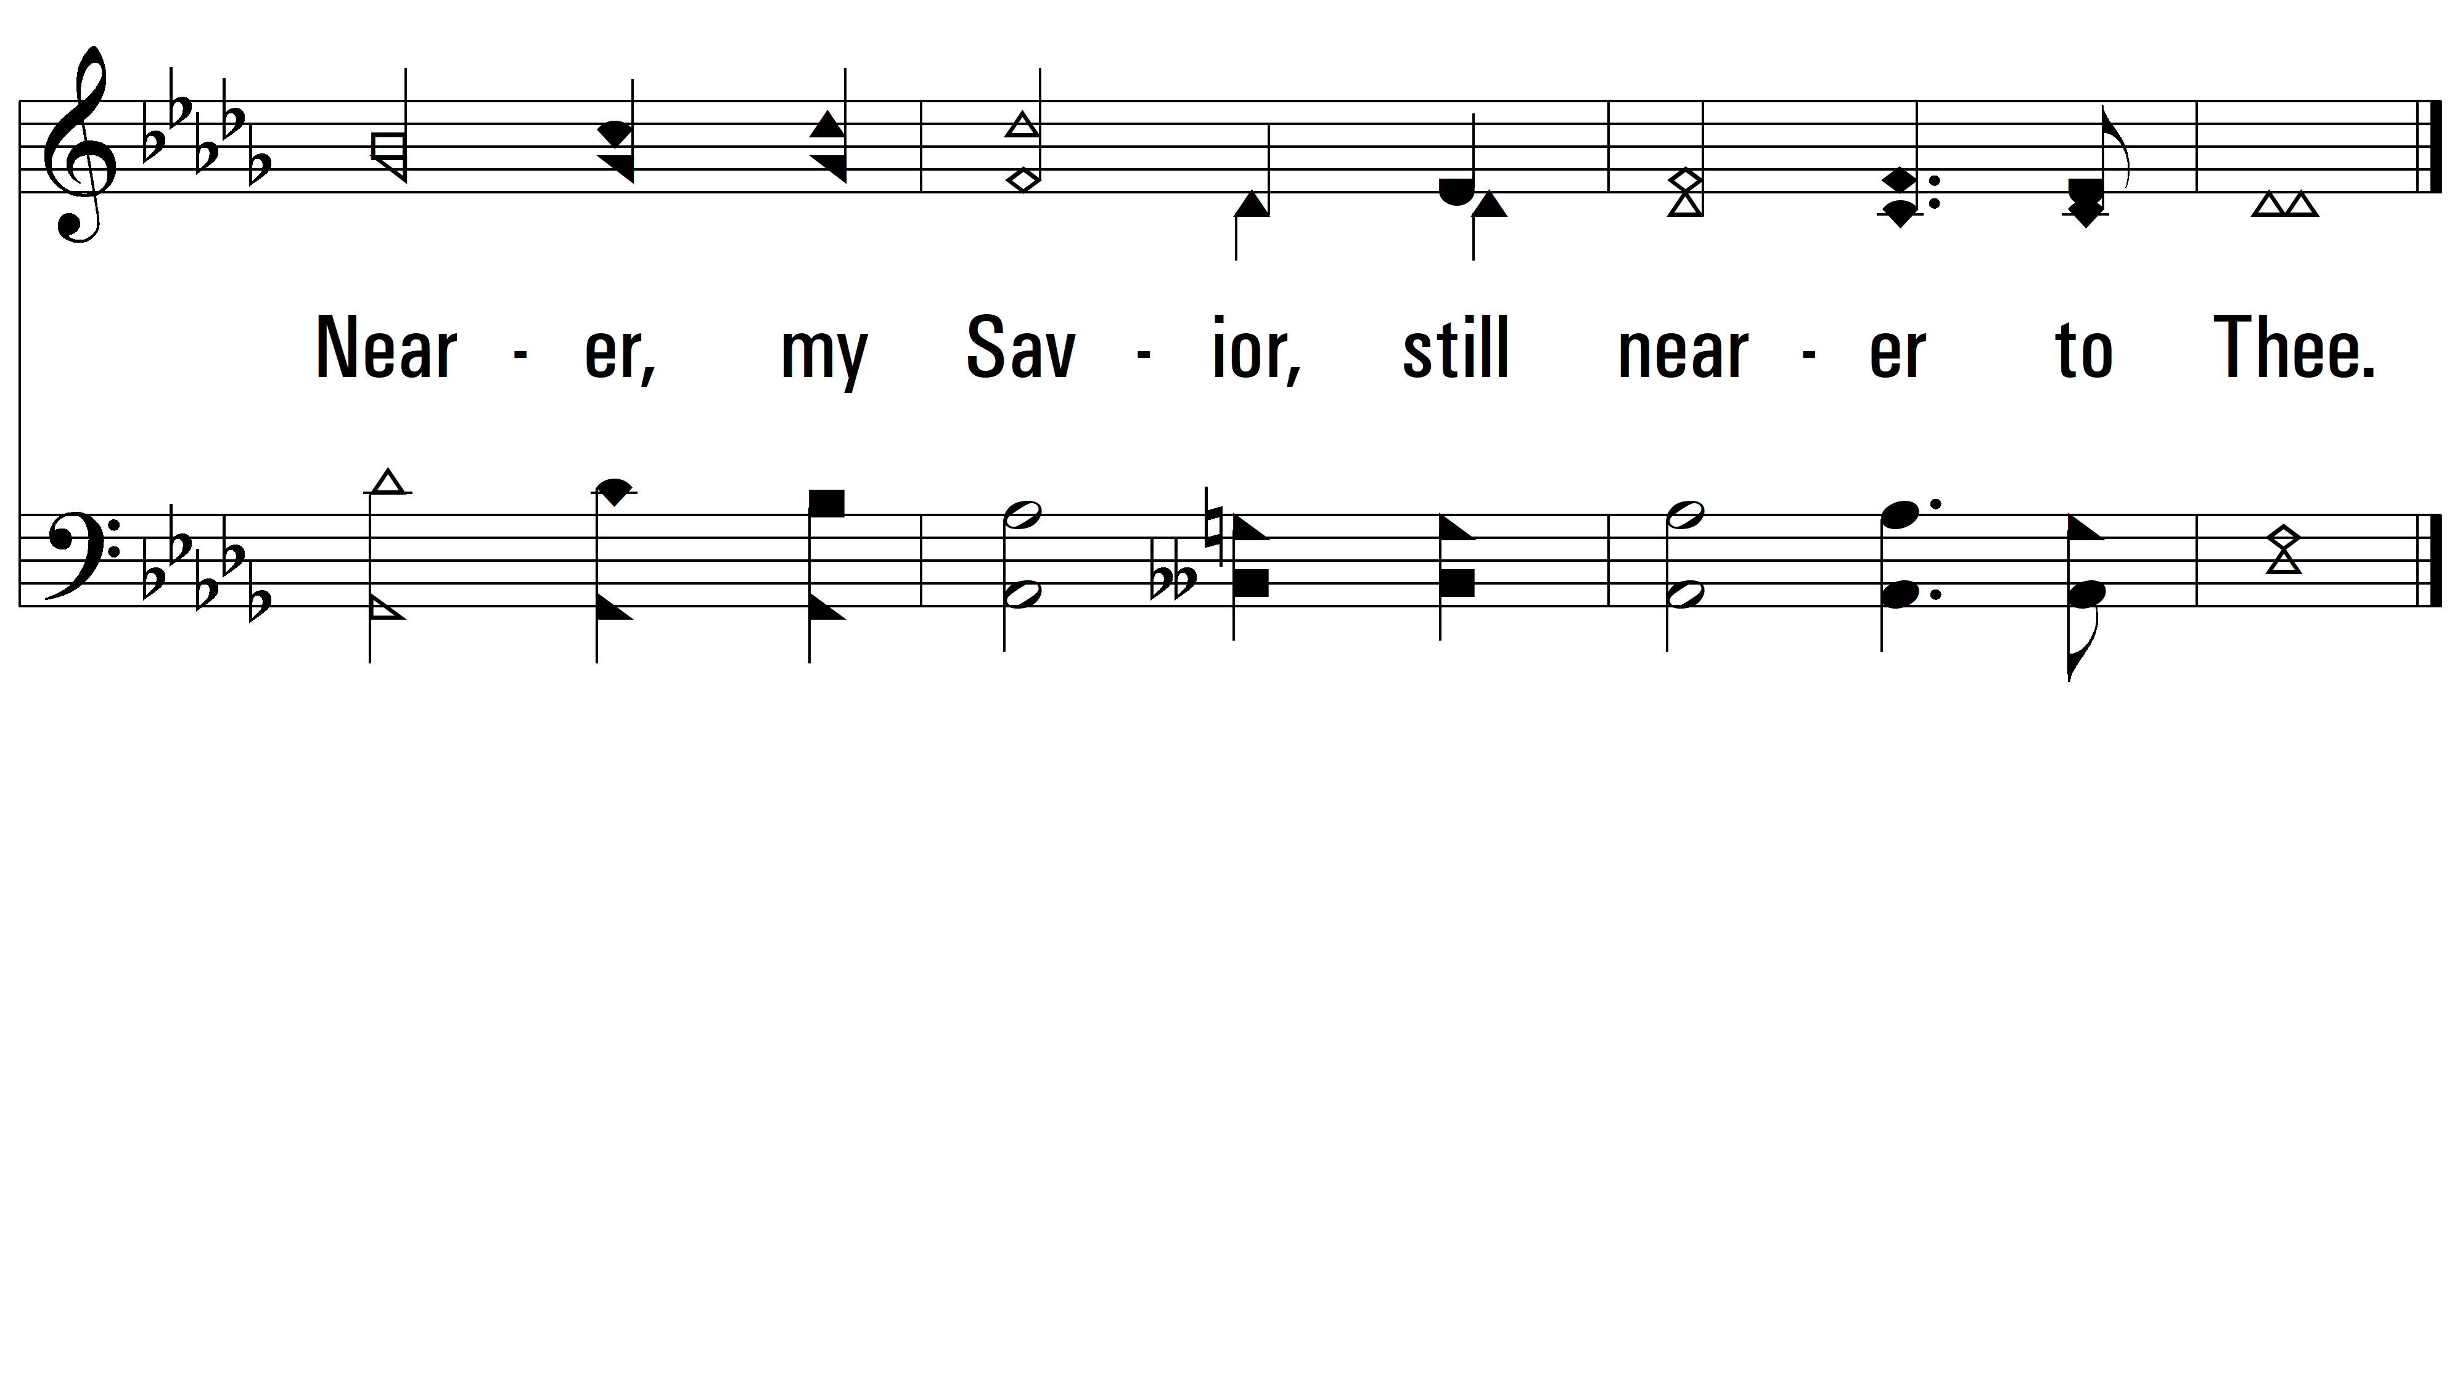
vs. 4
PDHymns.com
END

