Slide 1
More Love To Thee
Words: | Elizabeth Prentiss (1856)
Music: | W. H. Doane (1870)
4/4
A^{b}/E^{b} - SOL
Verses: 4
Lead - | SOL
Alto - | MI
Tenor - | DO
Bass - | DO
PDHymns.com

Slide 2
vs. 1 ~ More Love To Thee

Slide 3
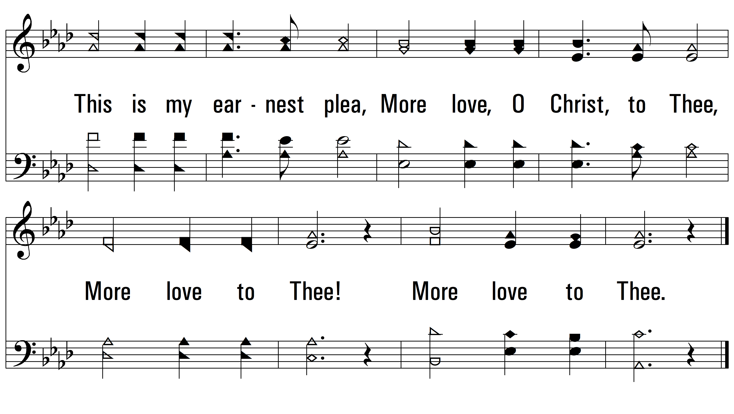
vs. 1

Slide 4
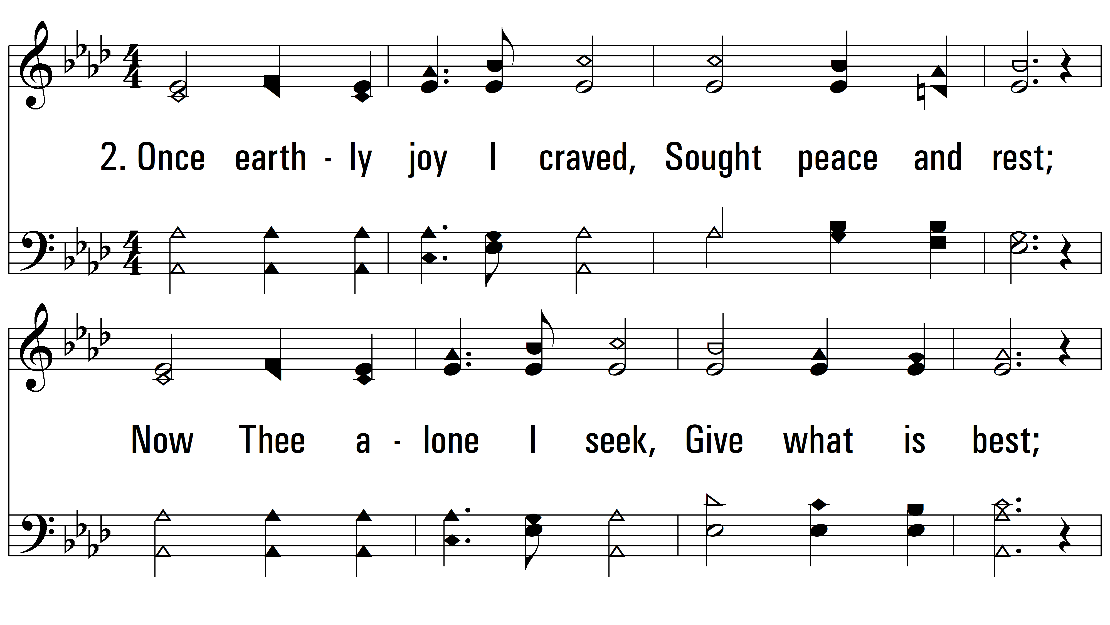
vs. 2 ~ More Love To Thee

Slide 5
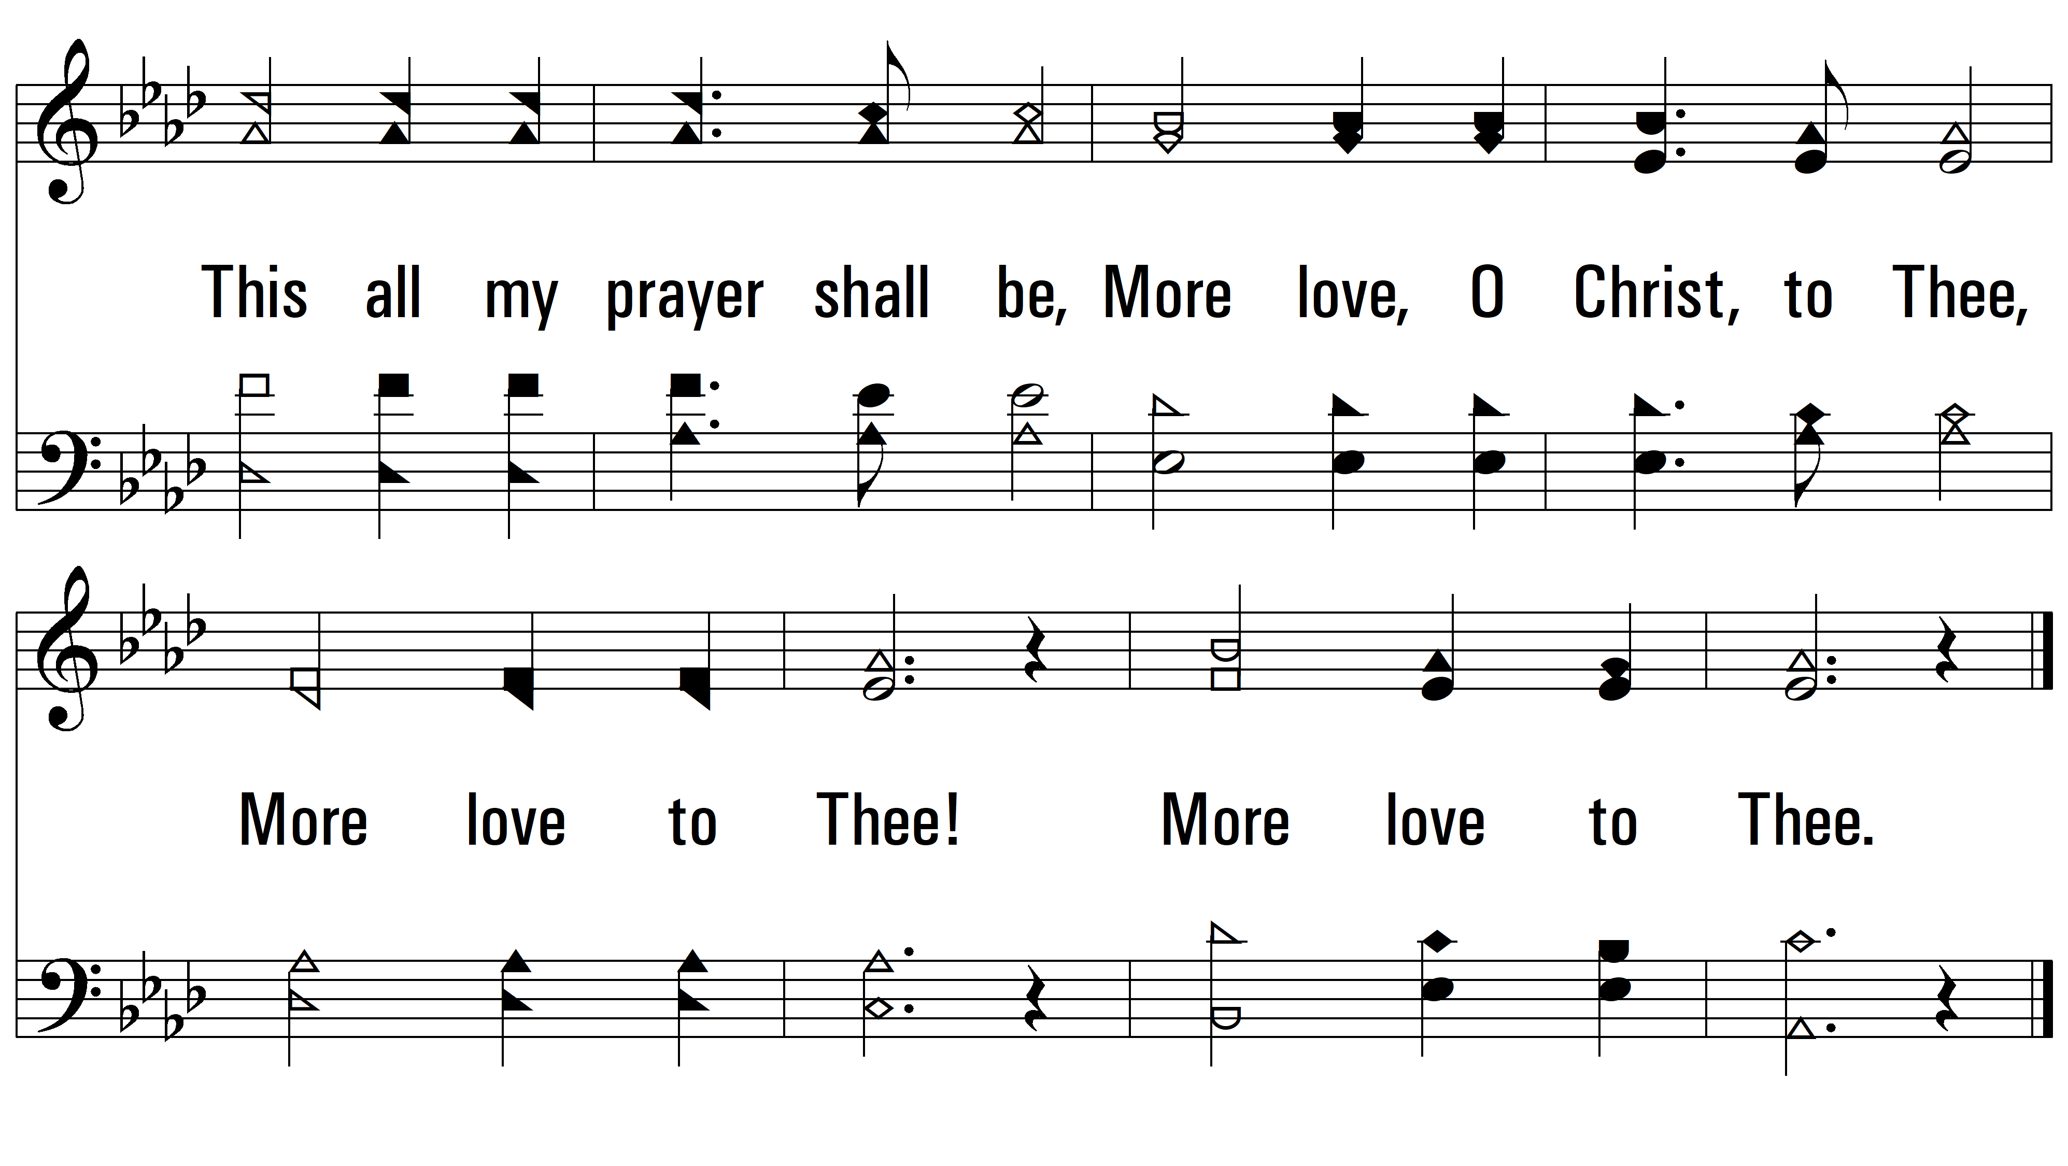
vs. 2

Slide 6
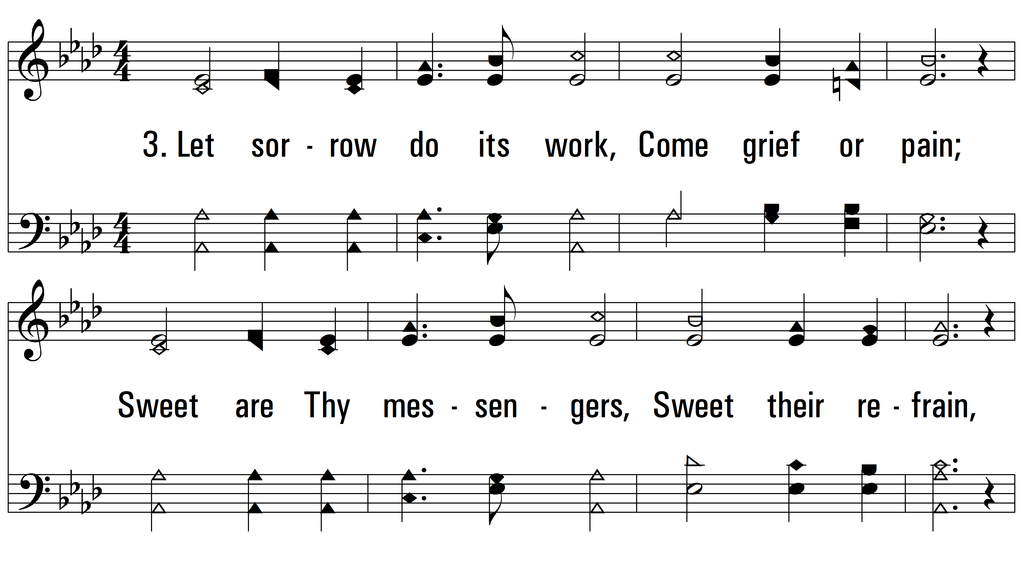
vs. 3 ~ More Love To Thee

Slide 7
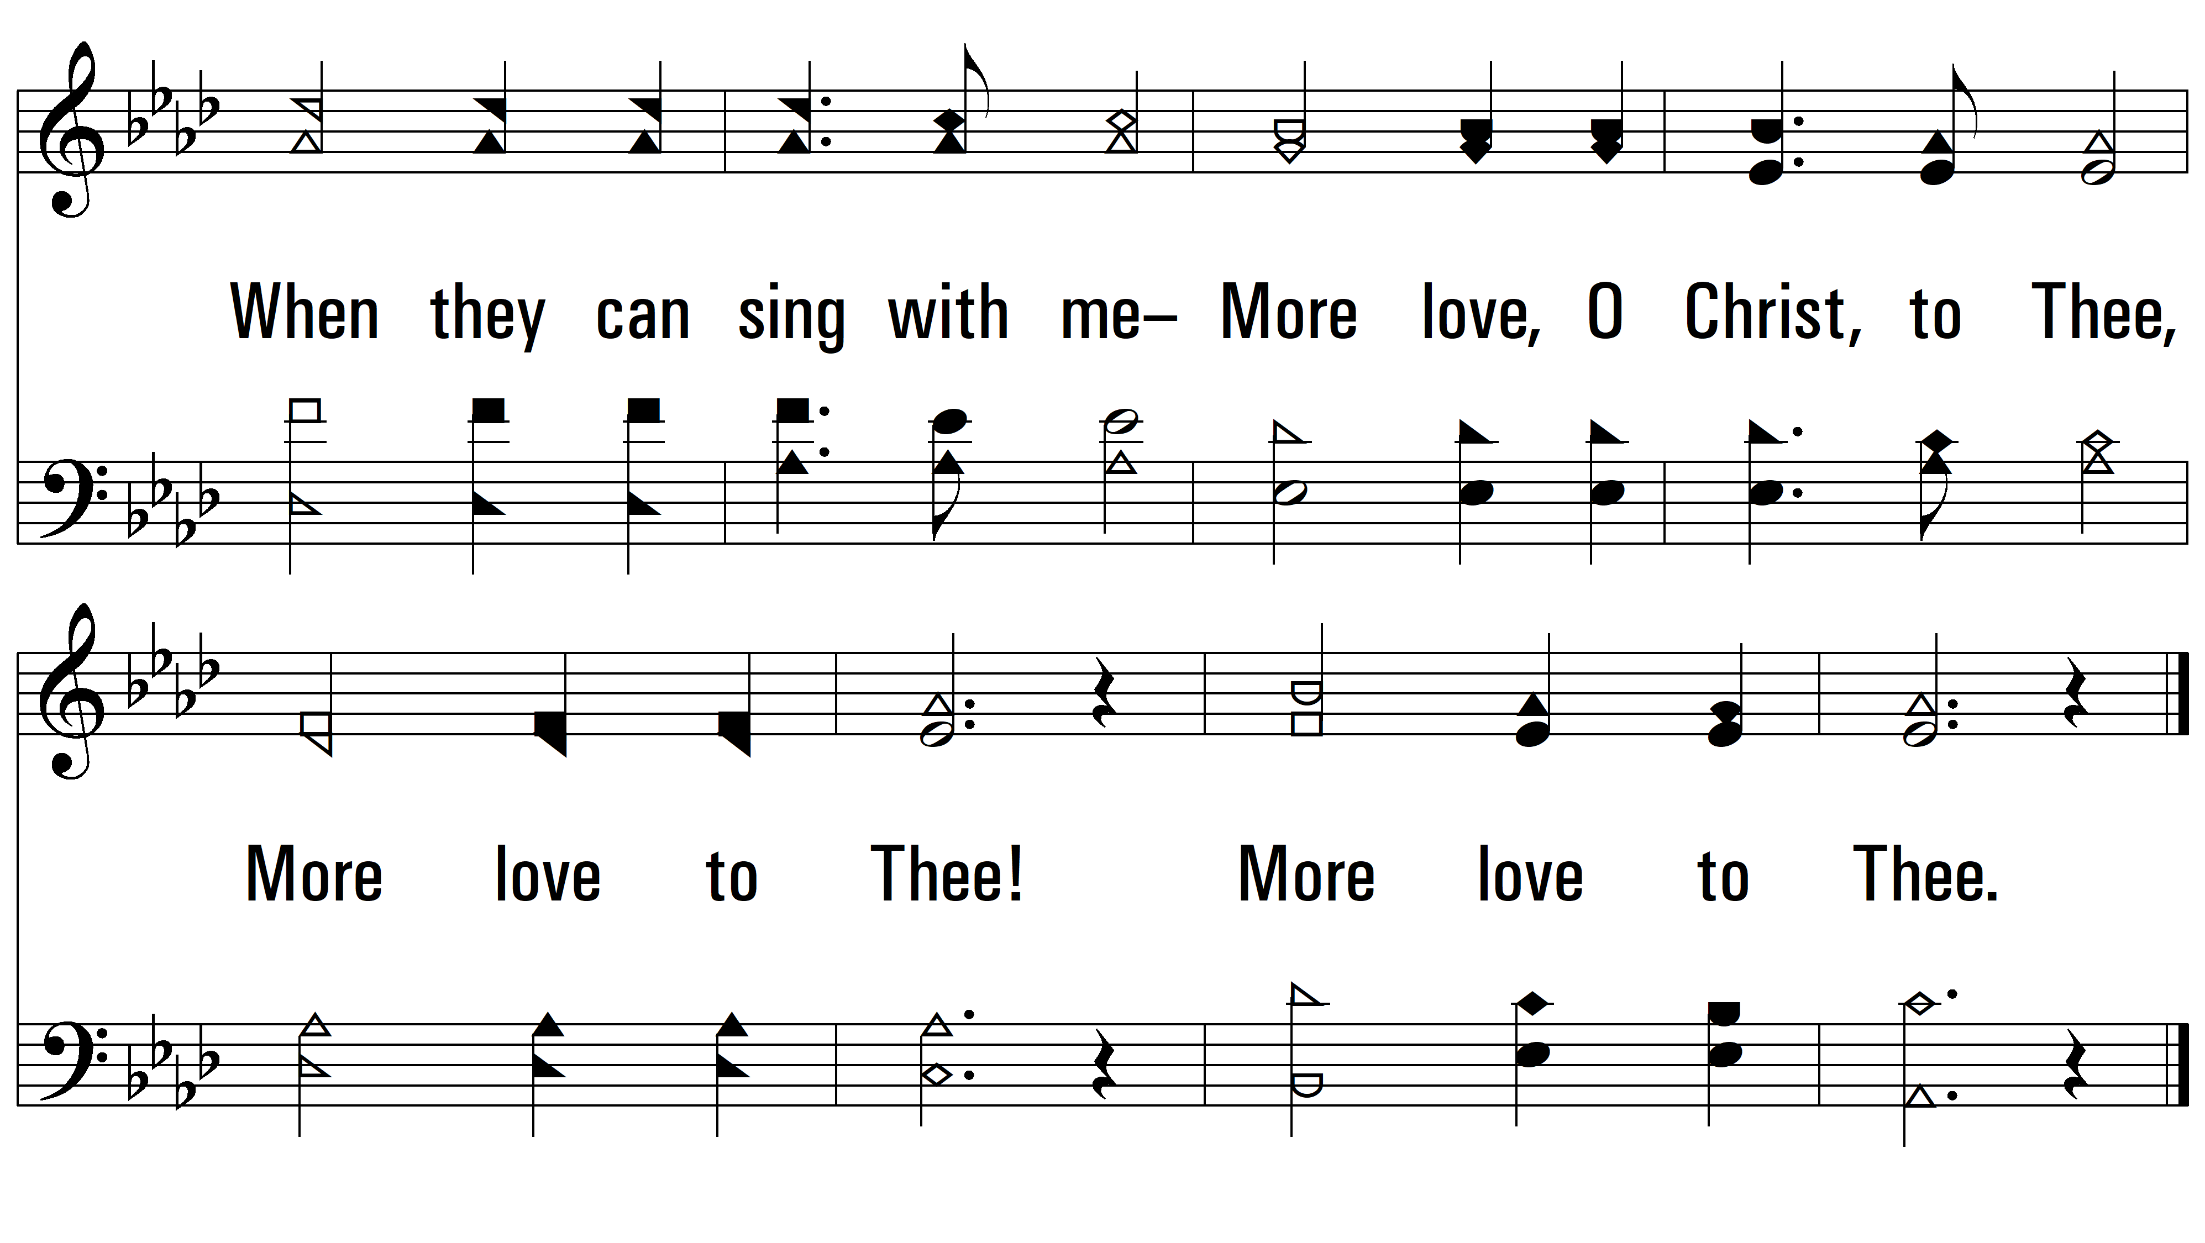
vs. 3

Slide 8
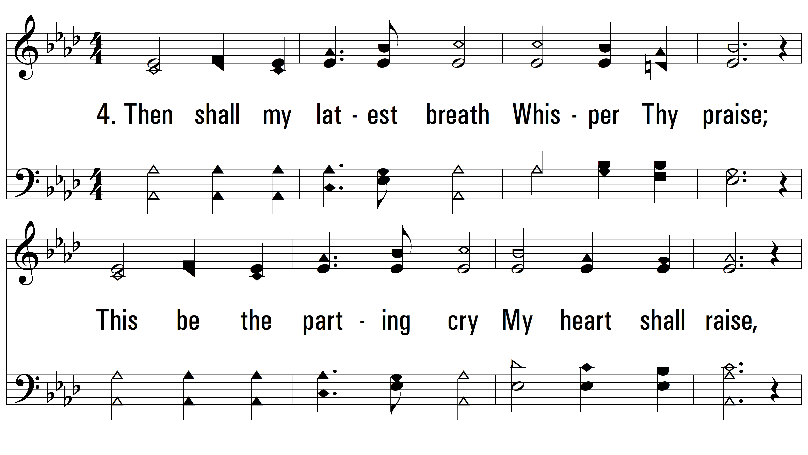
vs. 4 ~ More Love To Thee

Slide 9
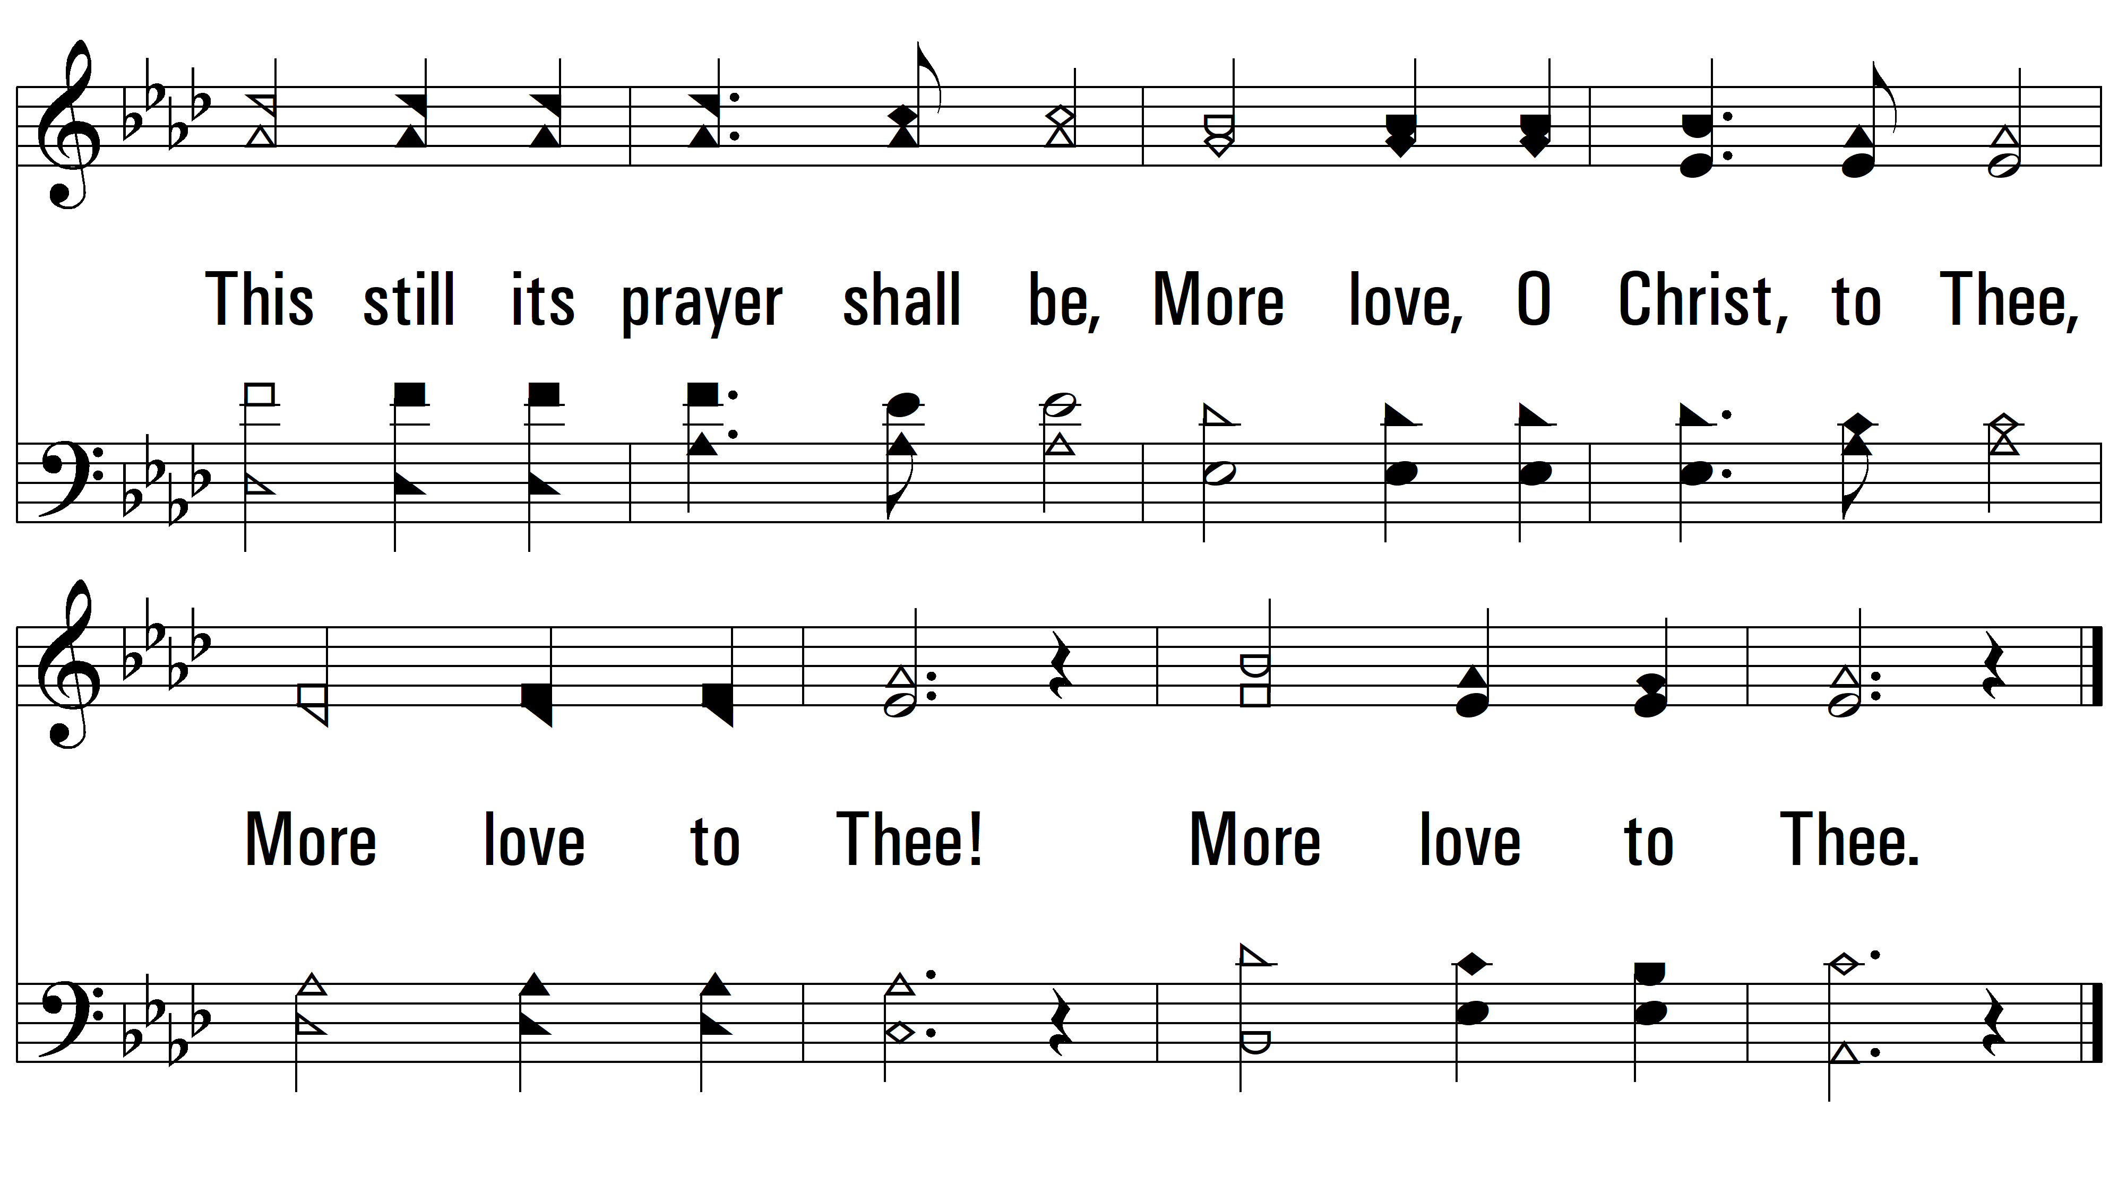
vs. 4
PDHymns.com
END

