Slide 1
Master, The Tempest Is Raging
(Peace Be Still)
Words: | Mary A. Baker (1874)
Music: | H. R. Palmer (1874)
6/8
C/G - SOL
Verses: 3/Chorus
Lead - | SOL
Alto - | MI
Tenor - | DO
Bass - | DO
PDHymns.com

Slide 2
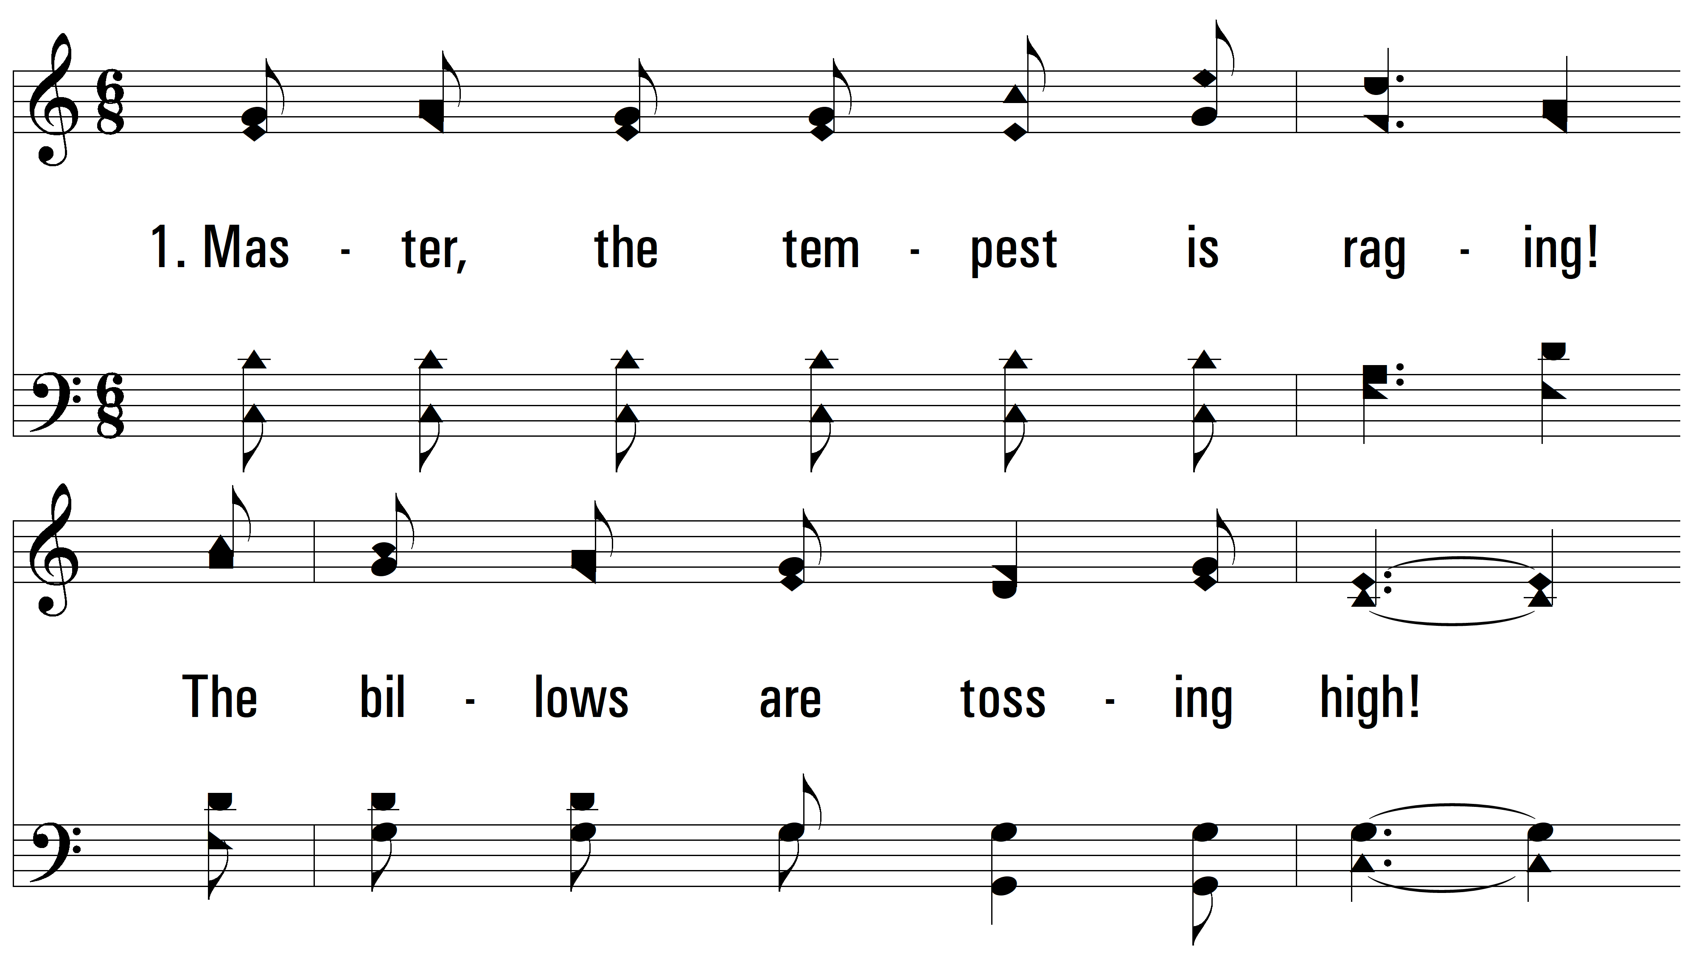
vs. 1 ~ Master, The Tempest Is Raging

Slide 3
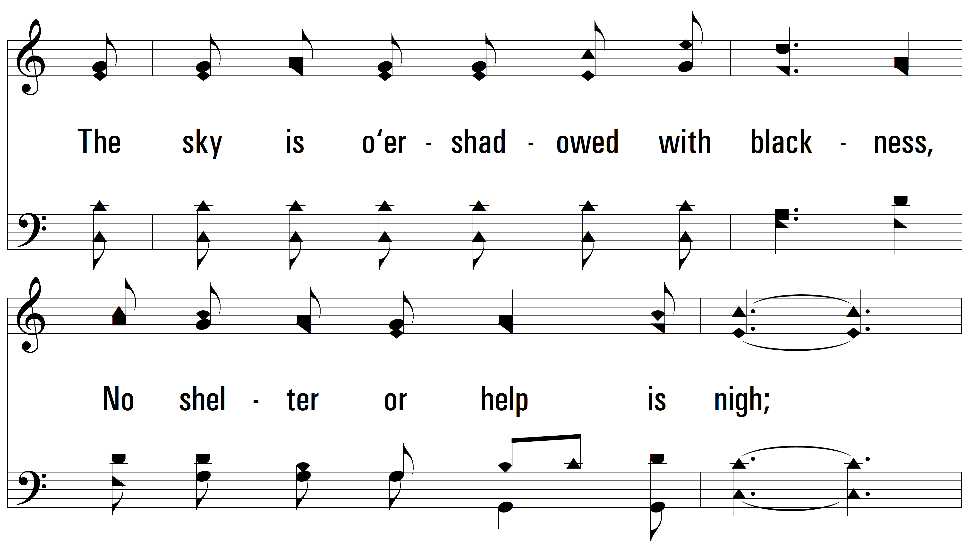
vs. 1

Slide 4
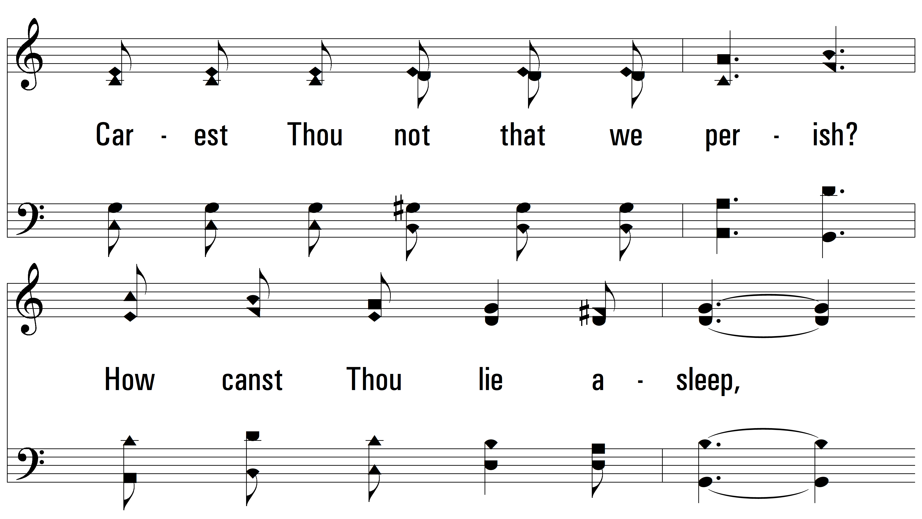
vs. 1

Slide 5
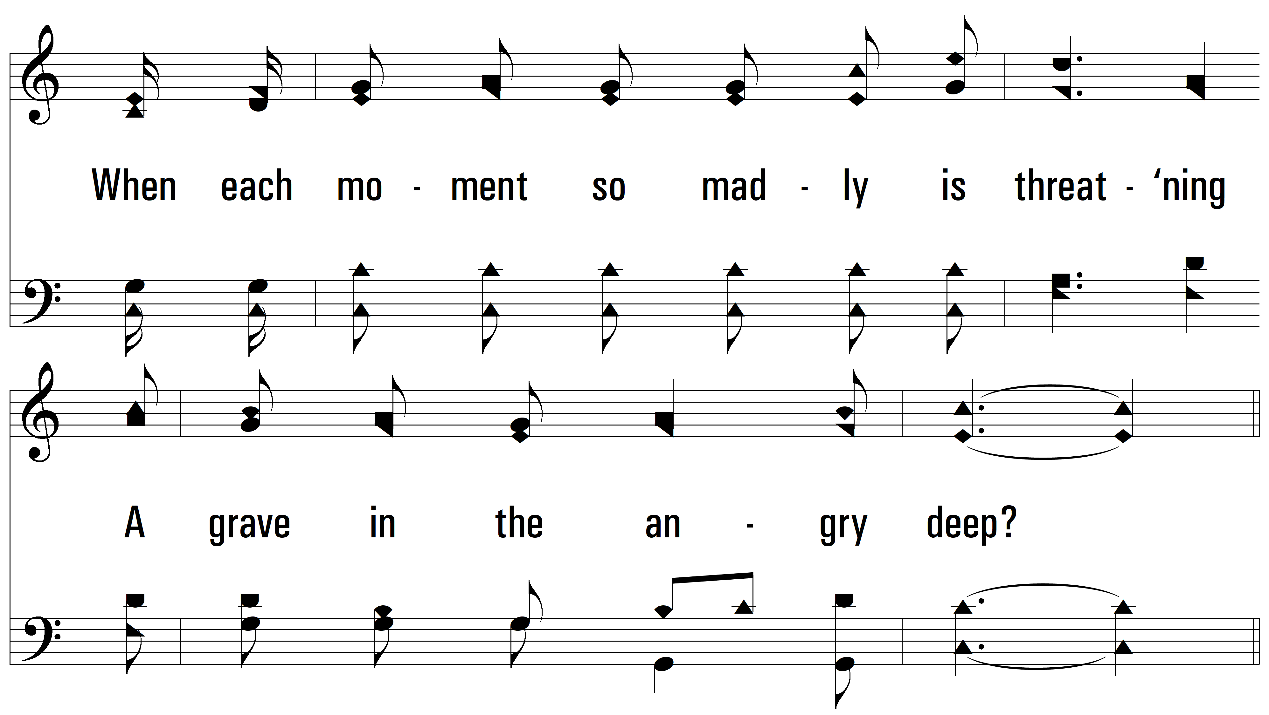
vs. 1

Slide 6
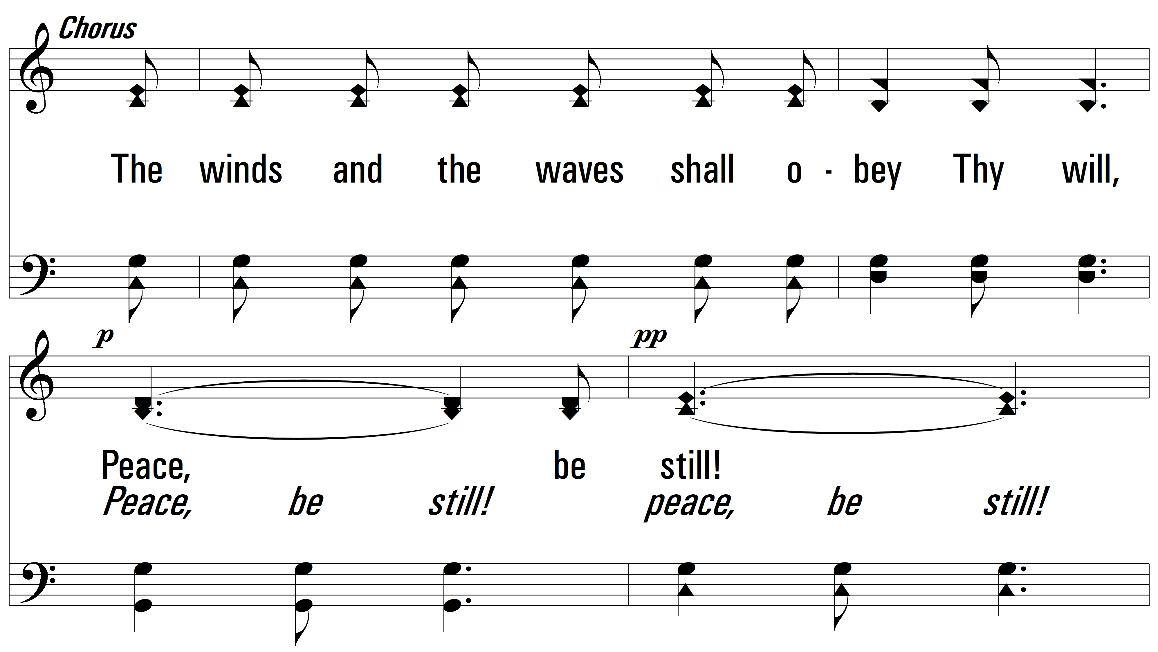
vs. 1

Slide 7
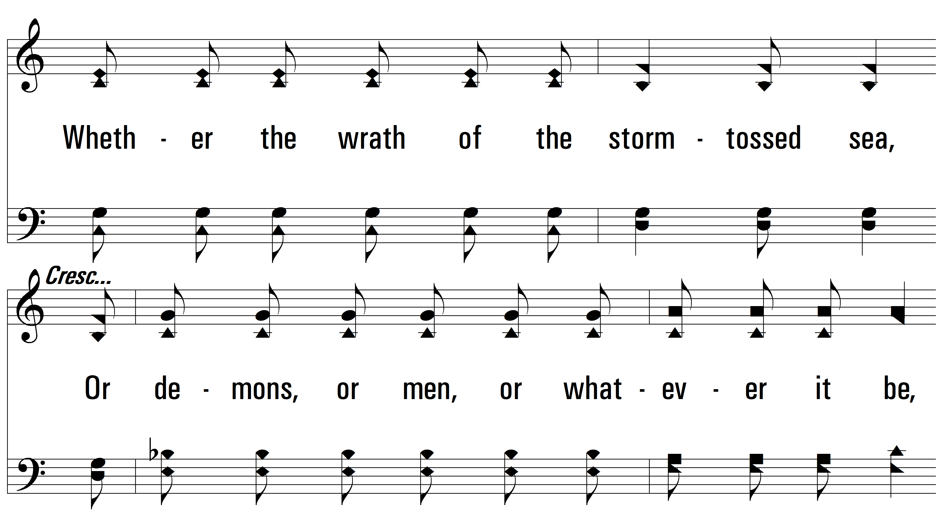
vs. 1

Slide 8
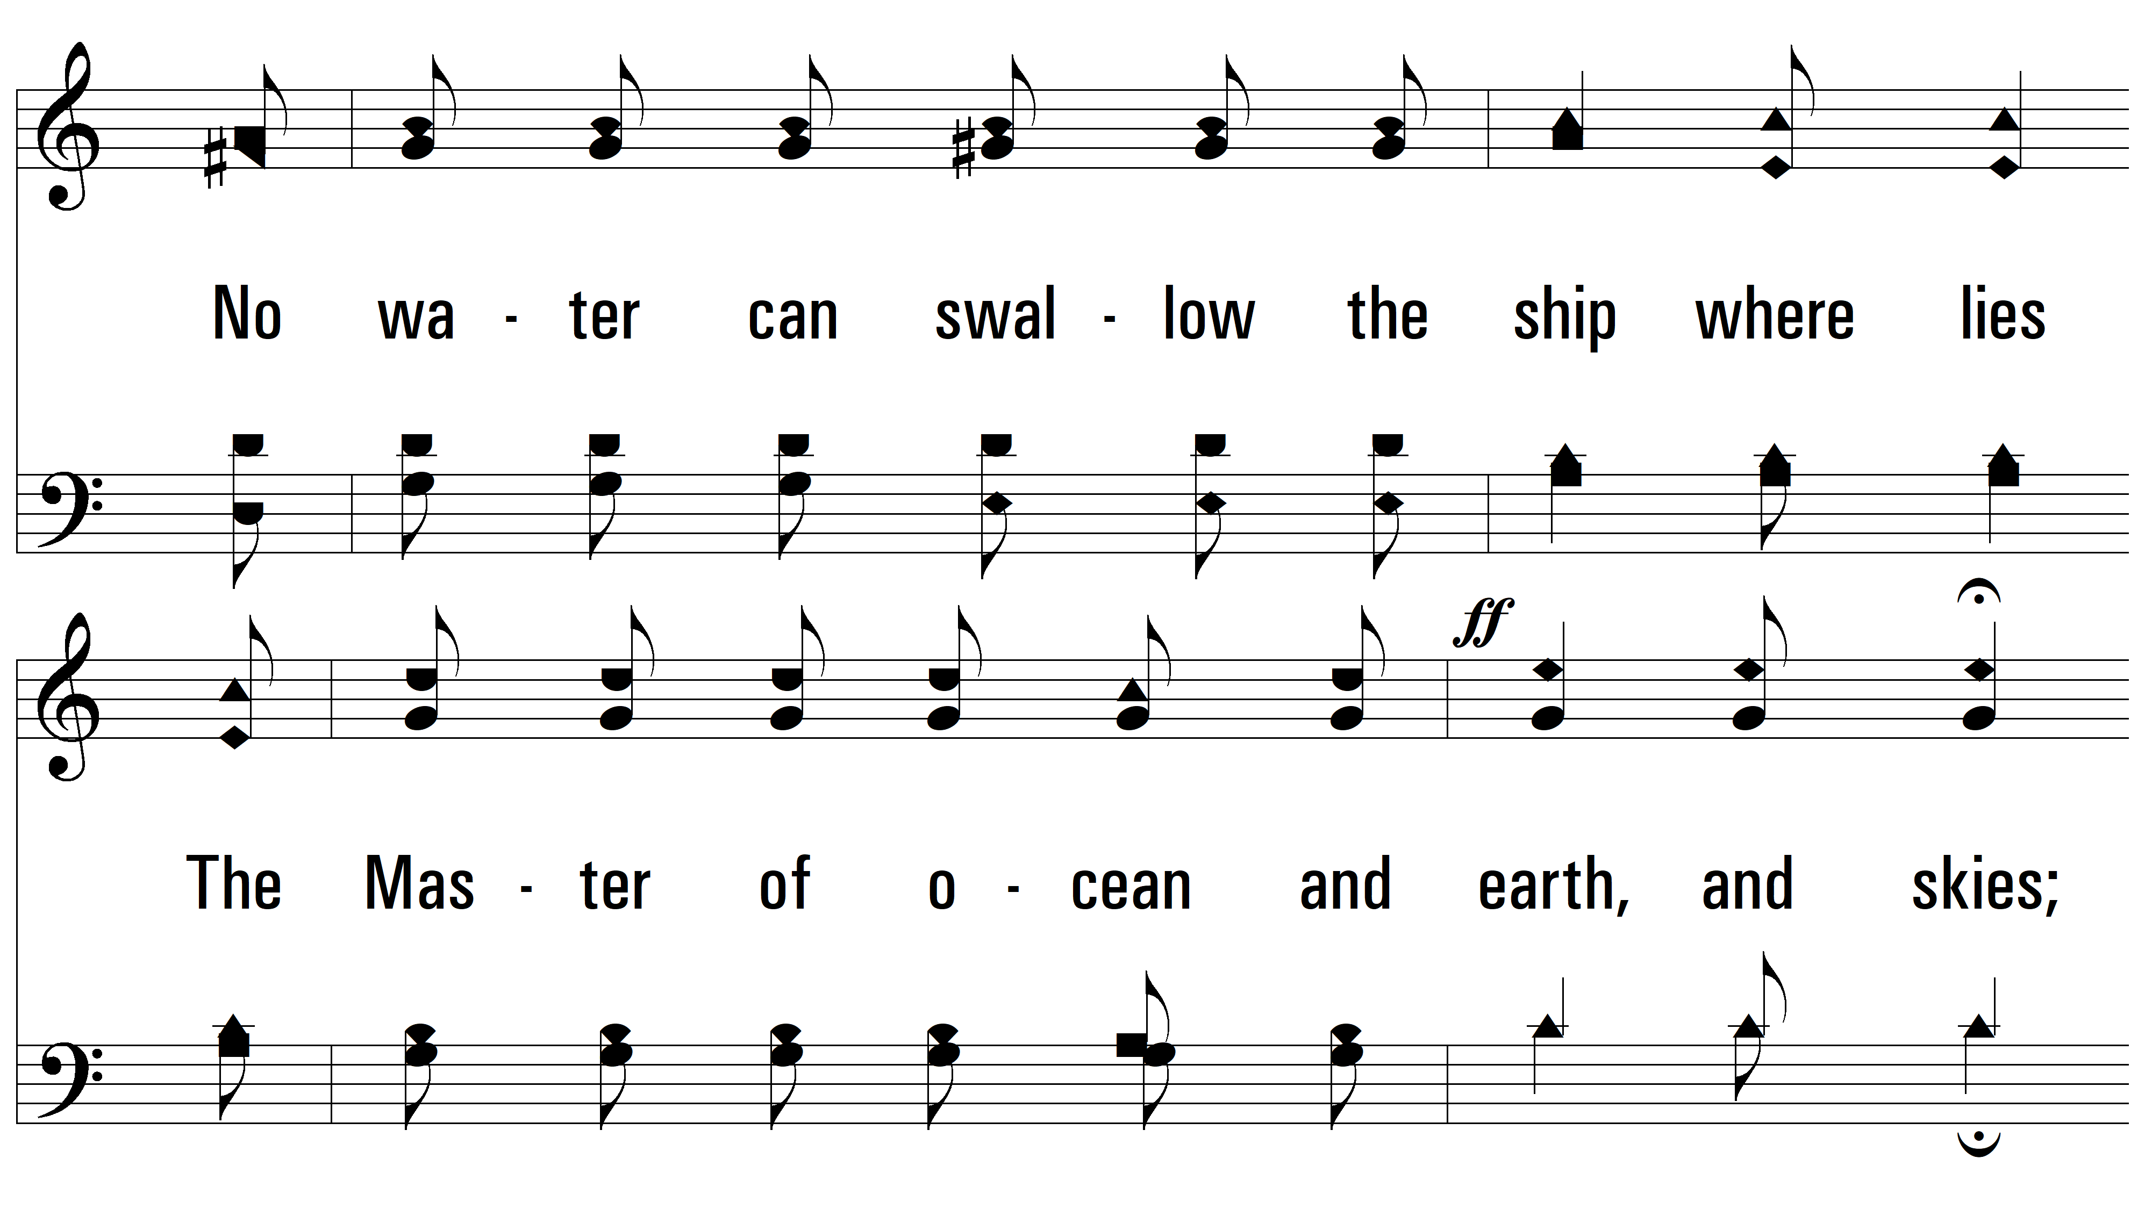
vs. 1

Slide 9
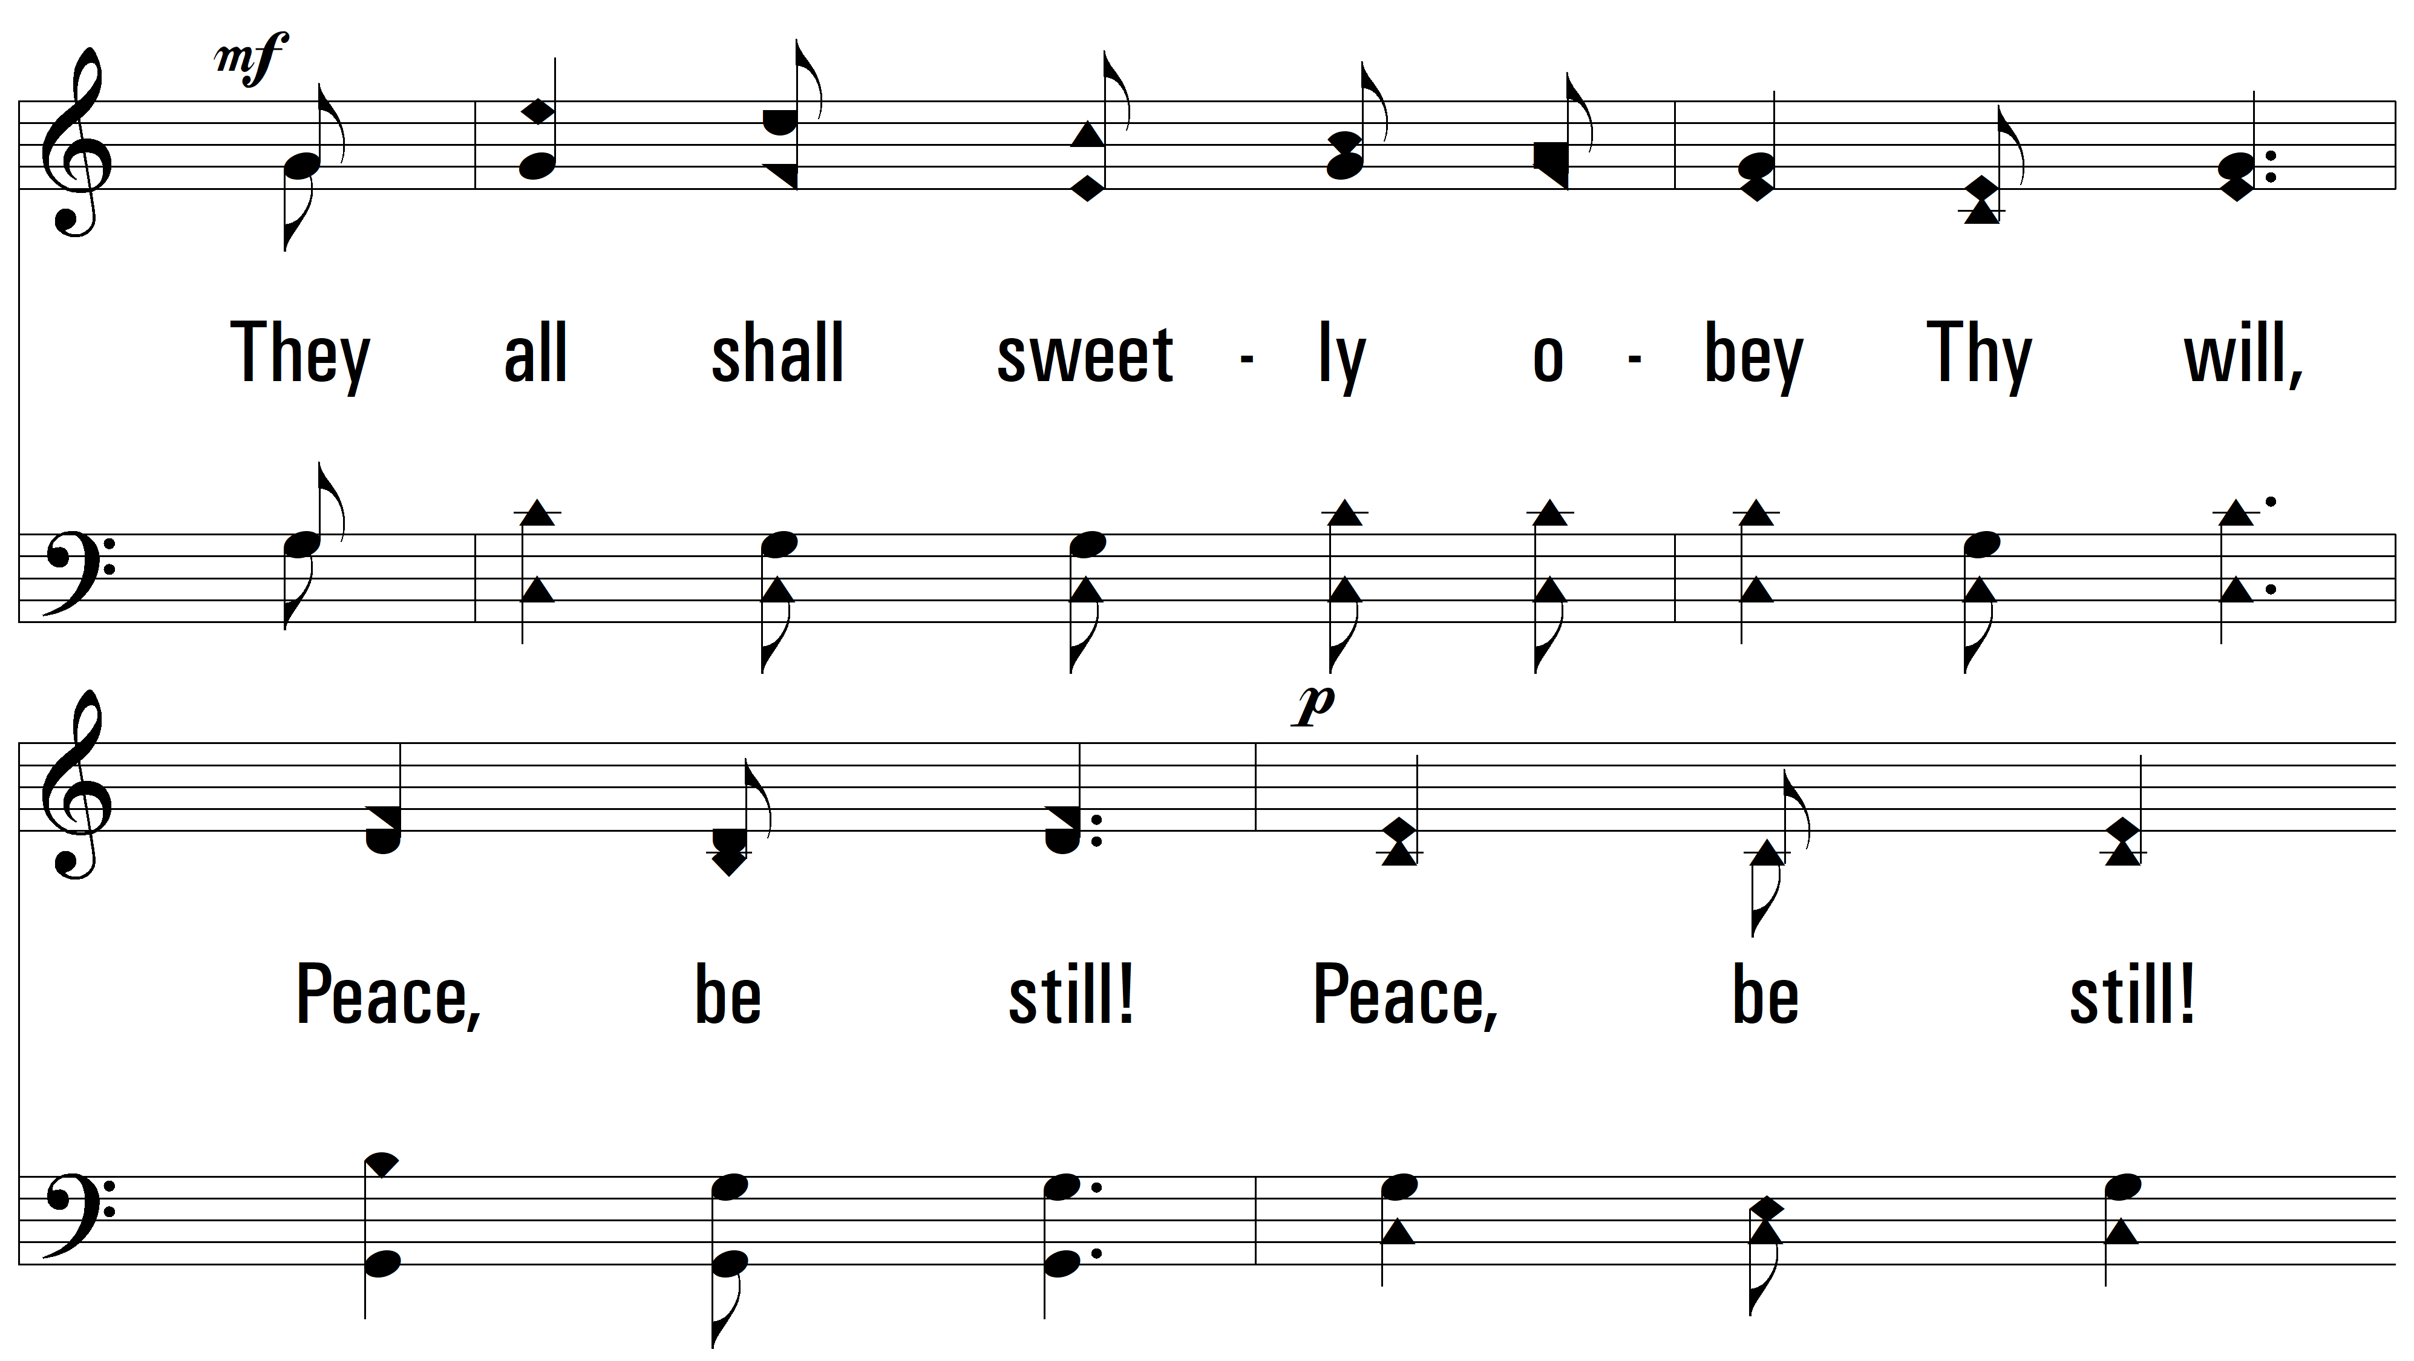
vs. 1

Slide 10
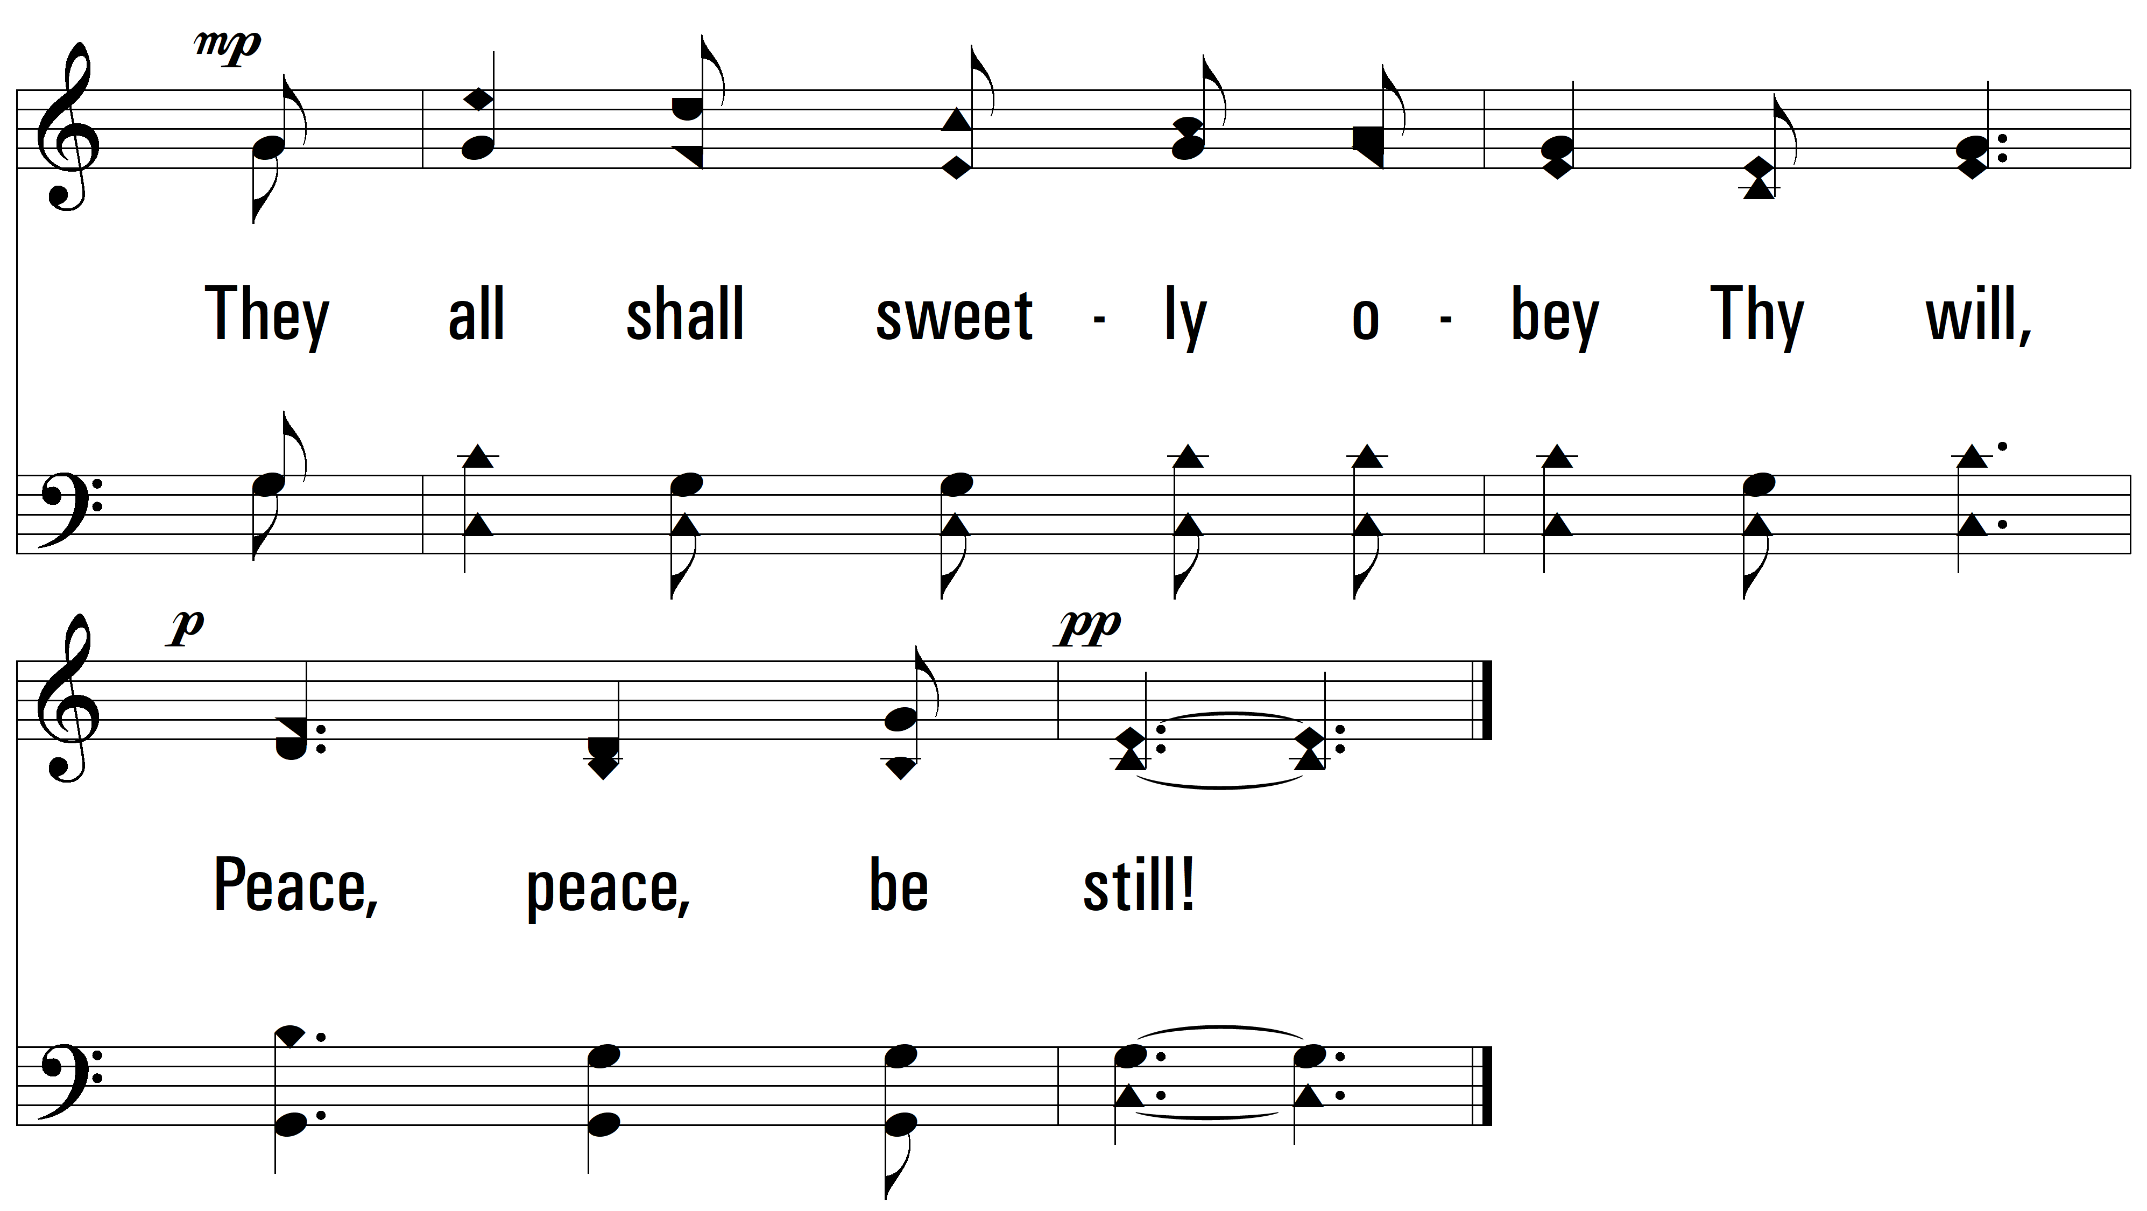
vs. 1

Slide 11
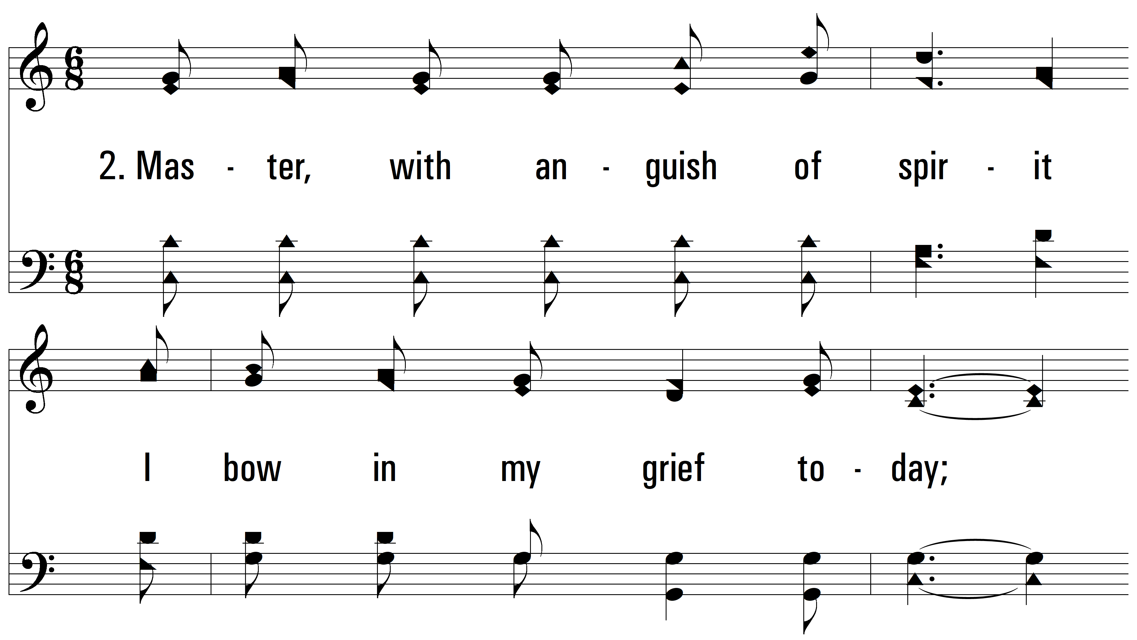
vs. 2 ~ Master, The Tempest Is Raging

Slide 12
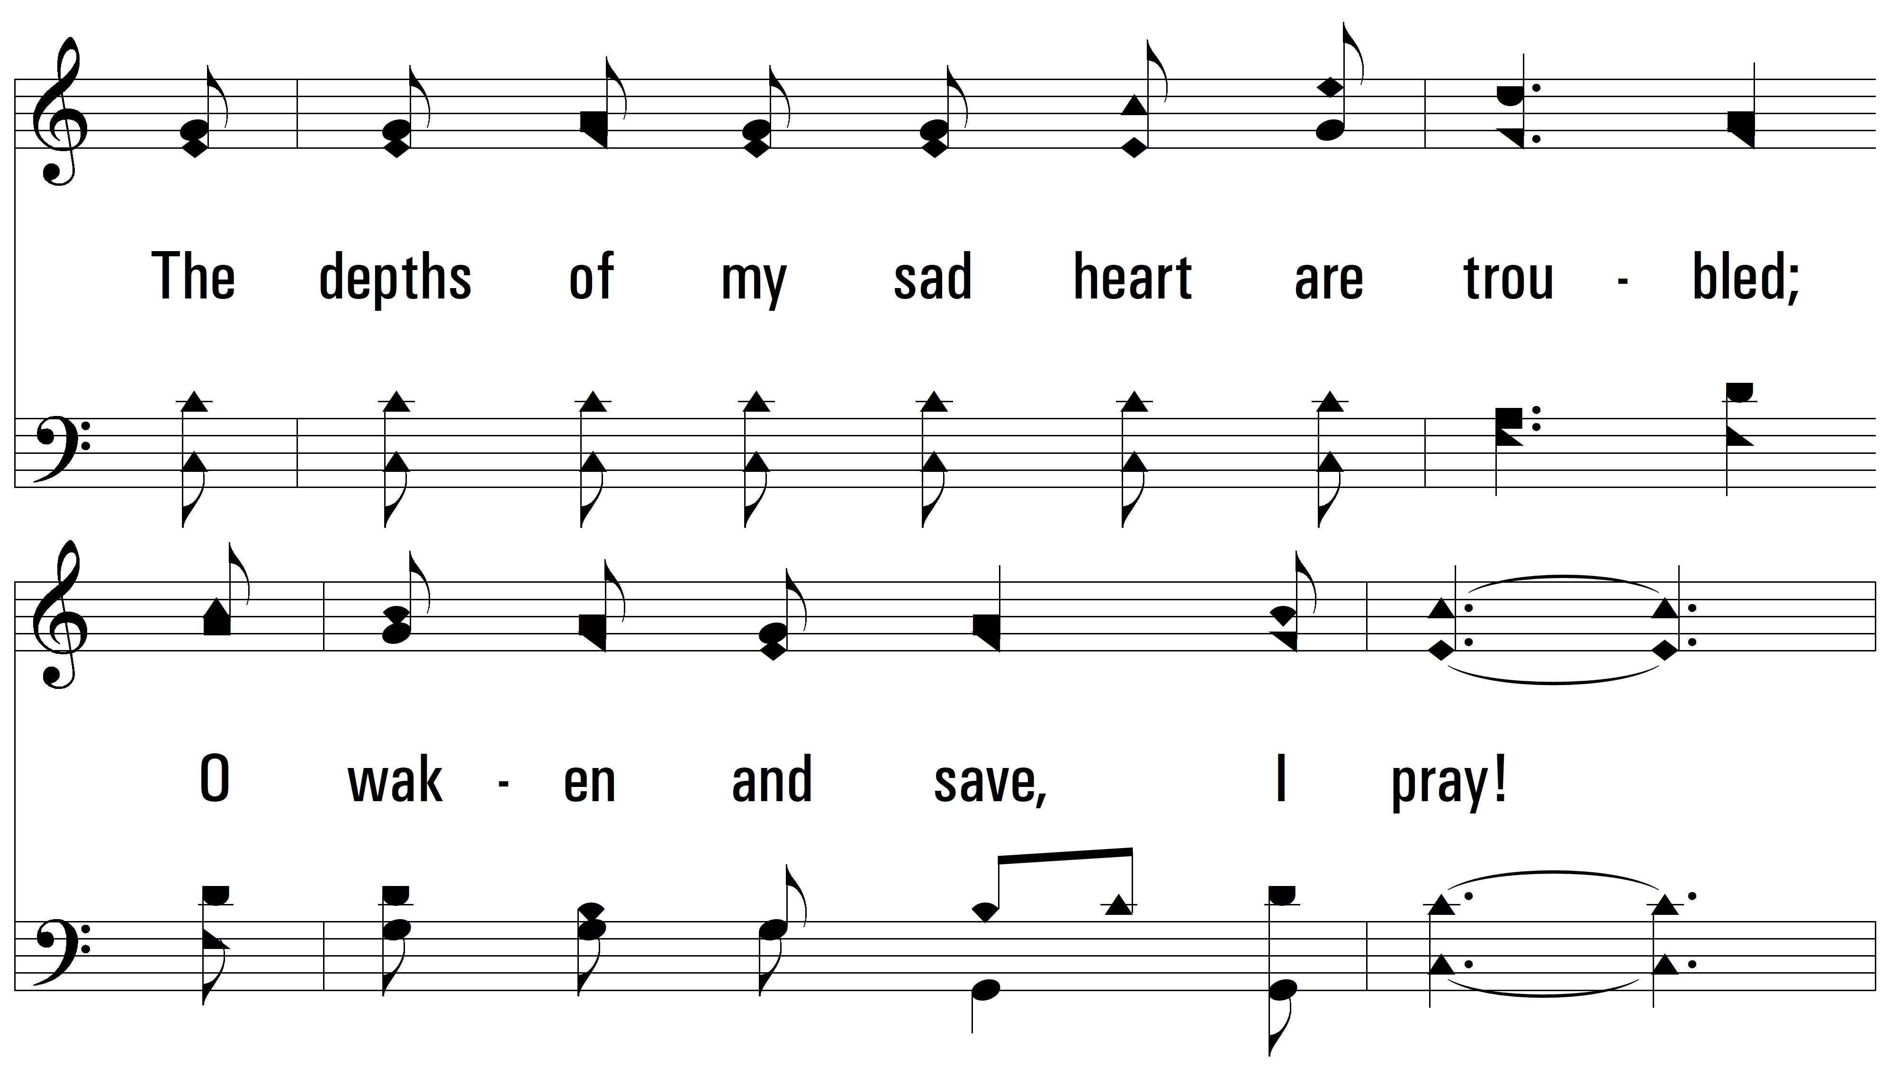
vs. 2

Slide 13
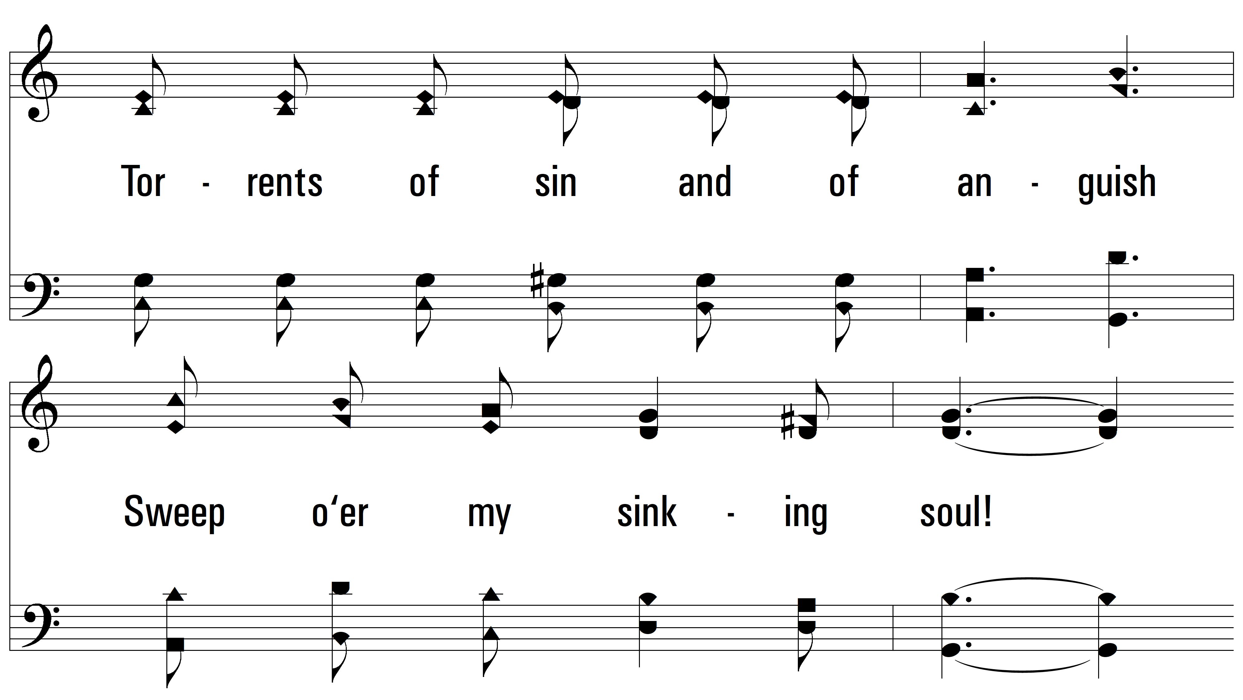
vs. 2

Slide 14
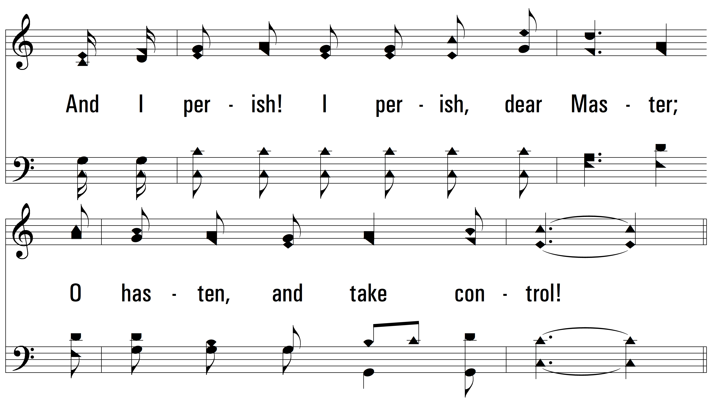
vs. 2

Slide 15
vs. 2

Slide 16
vs. 2

Slide 17
vs. 2

Slide 18
vs. 2

Slide 19
vs. 2

Slide 20
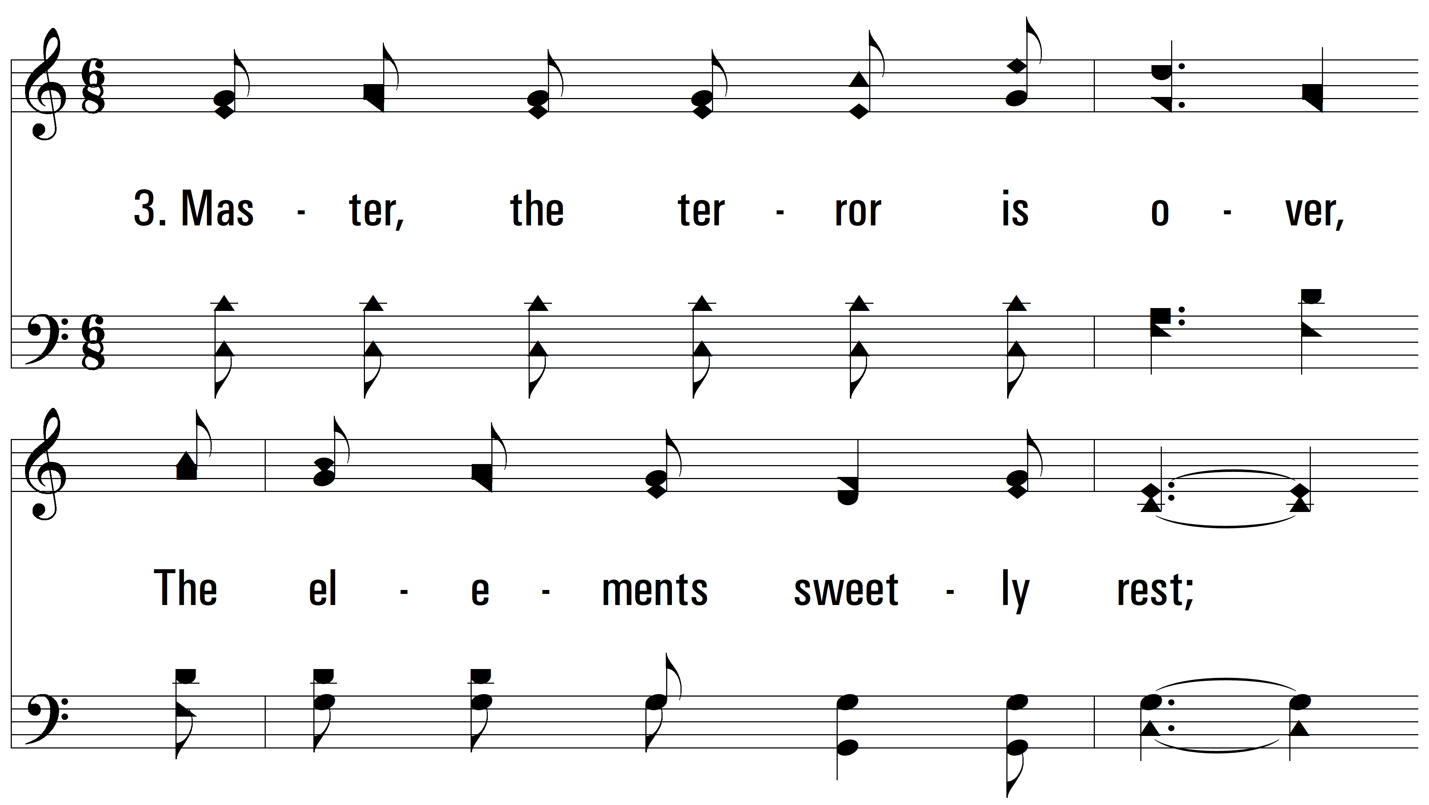
vs. 3 ~ Master, The Tempest Is Raging

Slide 21
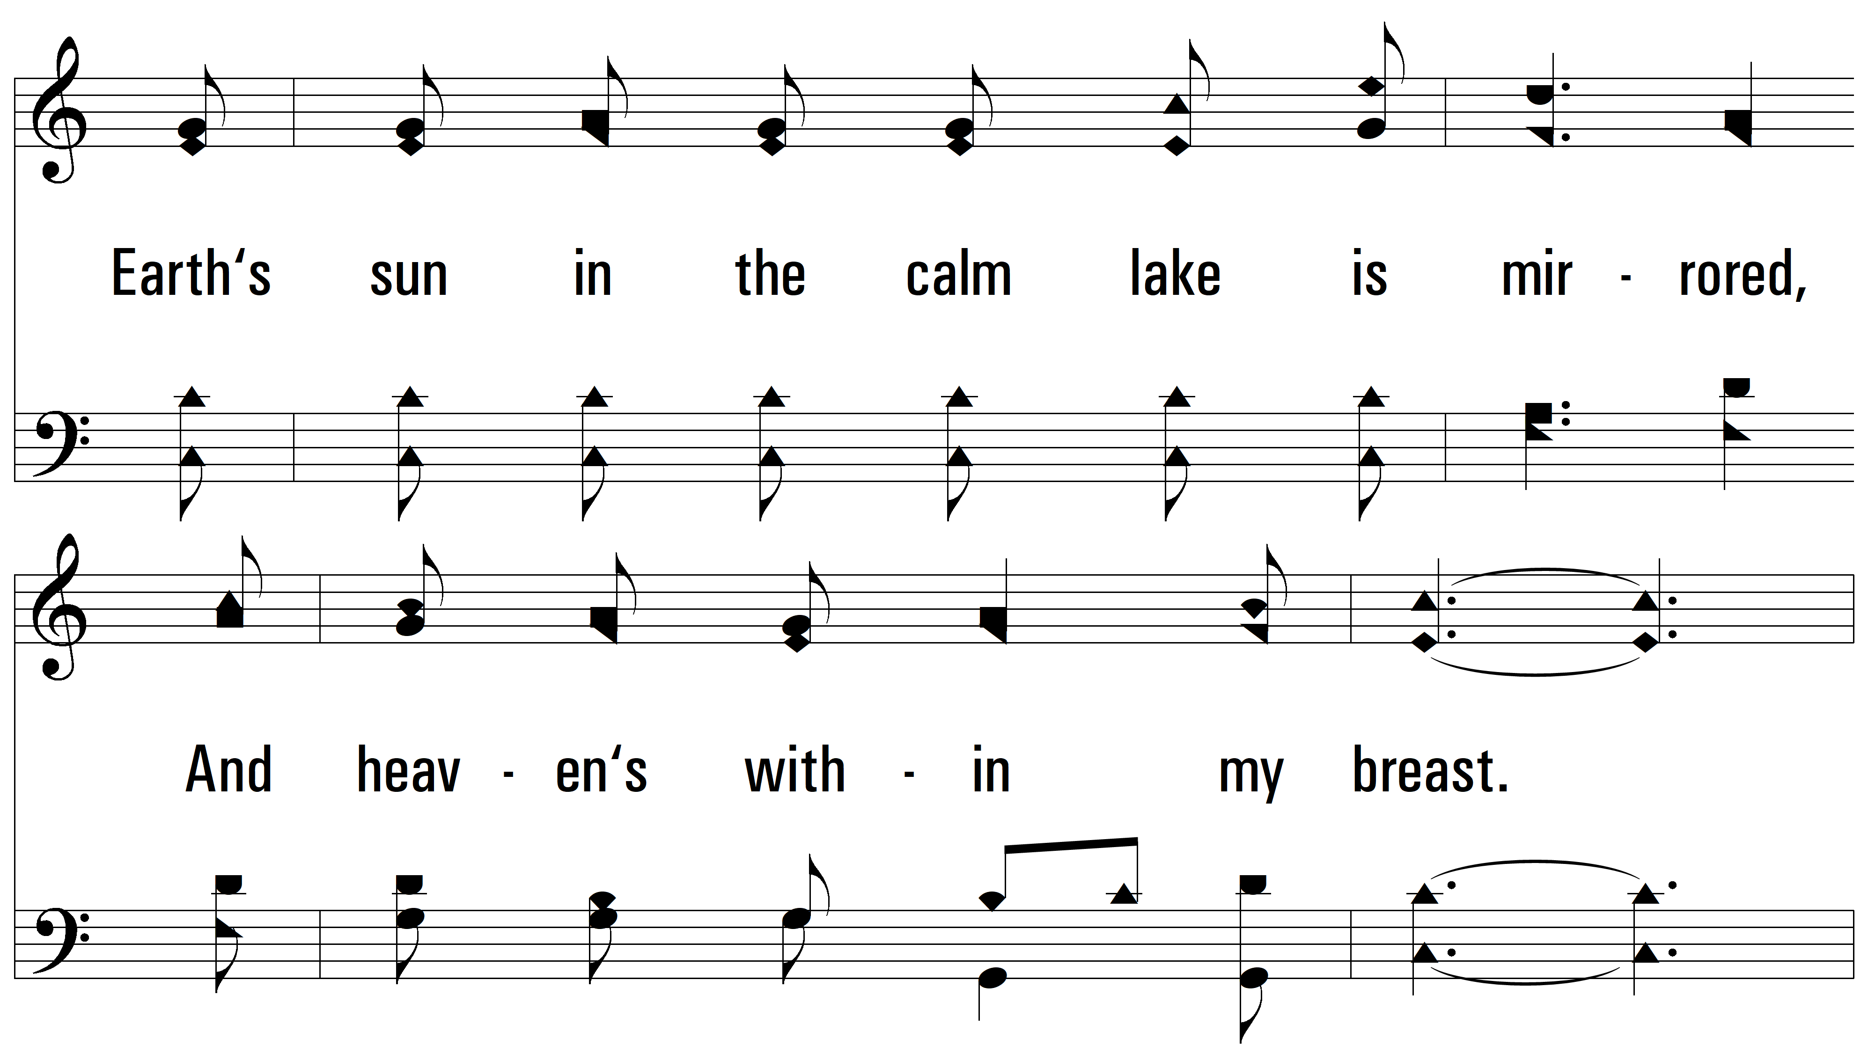
vs. 3

Slide 22
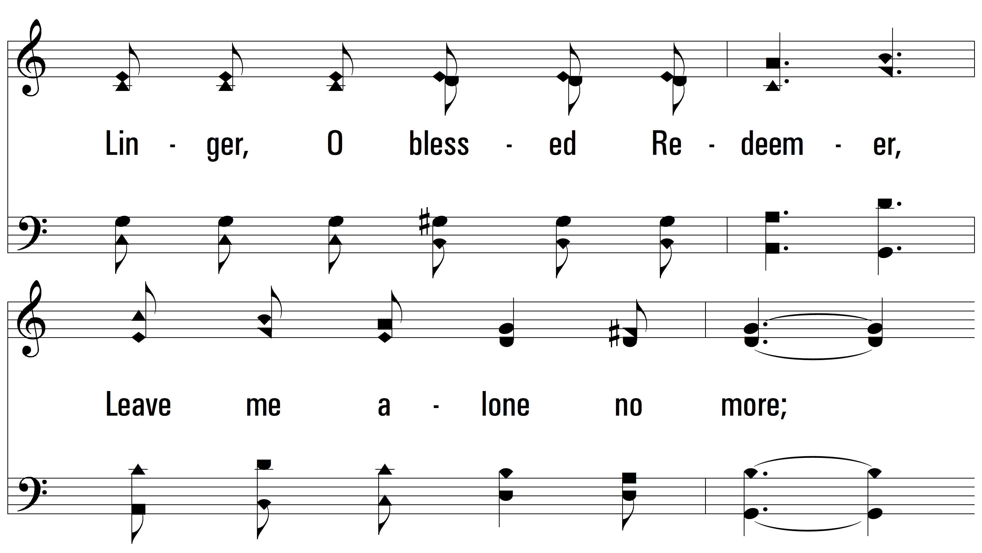
vs. 3

Slide 23
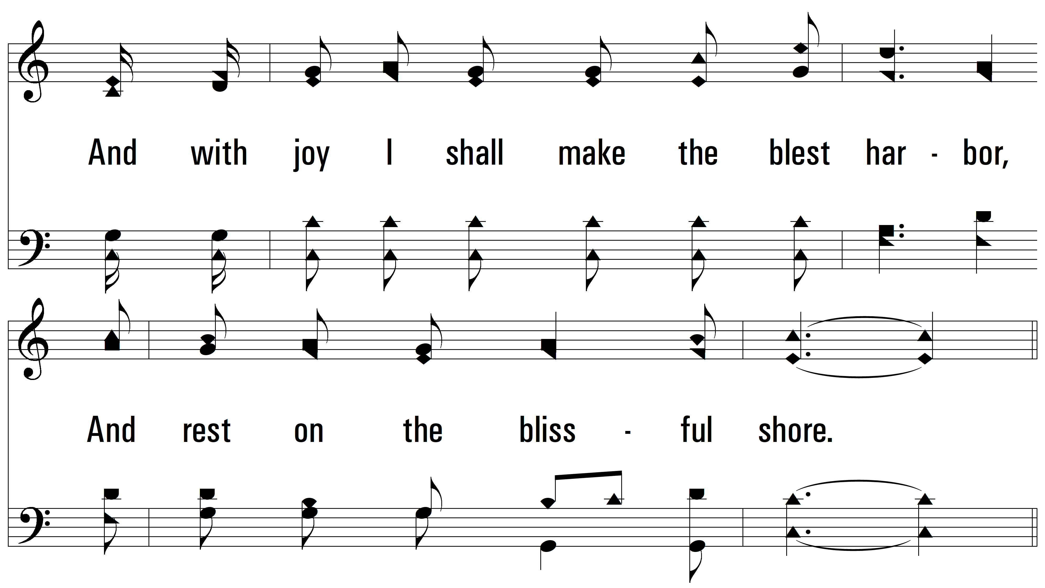
vs. 3

Slide 24
vs. 3

Slide 25
vs. 3

Slide 26
vs. 3

Slide 27
vs. 3

Slide 28
vs. 3
PDHymns.com
END

