Slide 1
Marvelous Things
Words: | Unknown
Music: | Unknown
3/4
A/A - DO
Verses: 1/Round
Lead - | DO
Alto - | SOL
Tenor - | MI
Bass - | DO
PDHymns.com

Slide 2
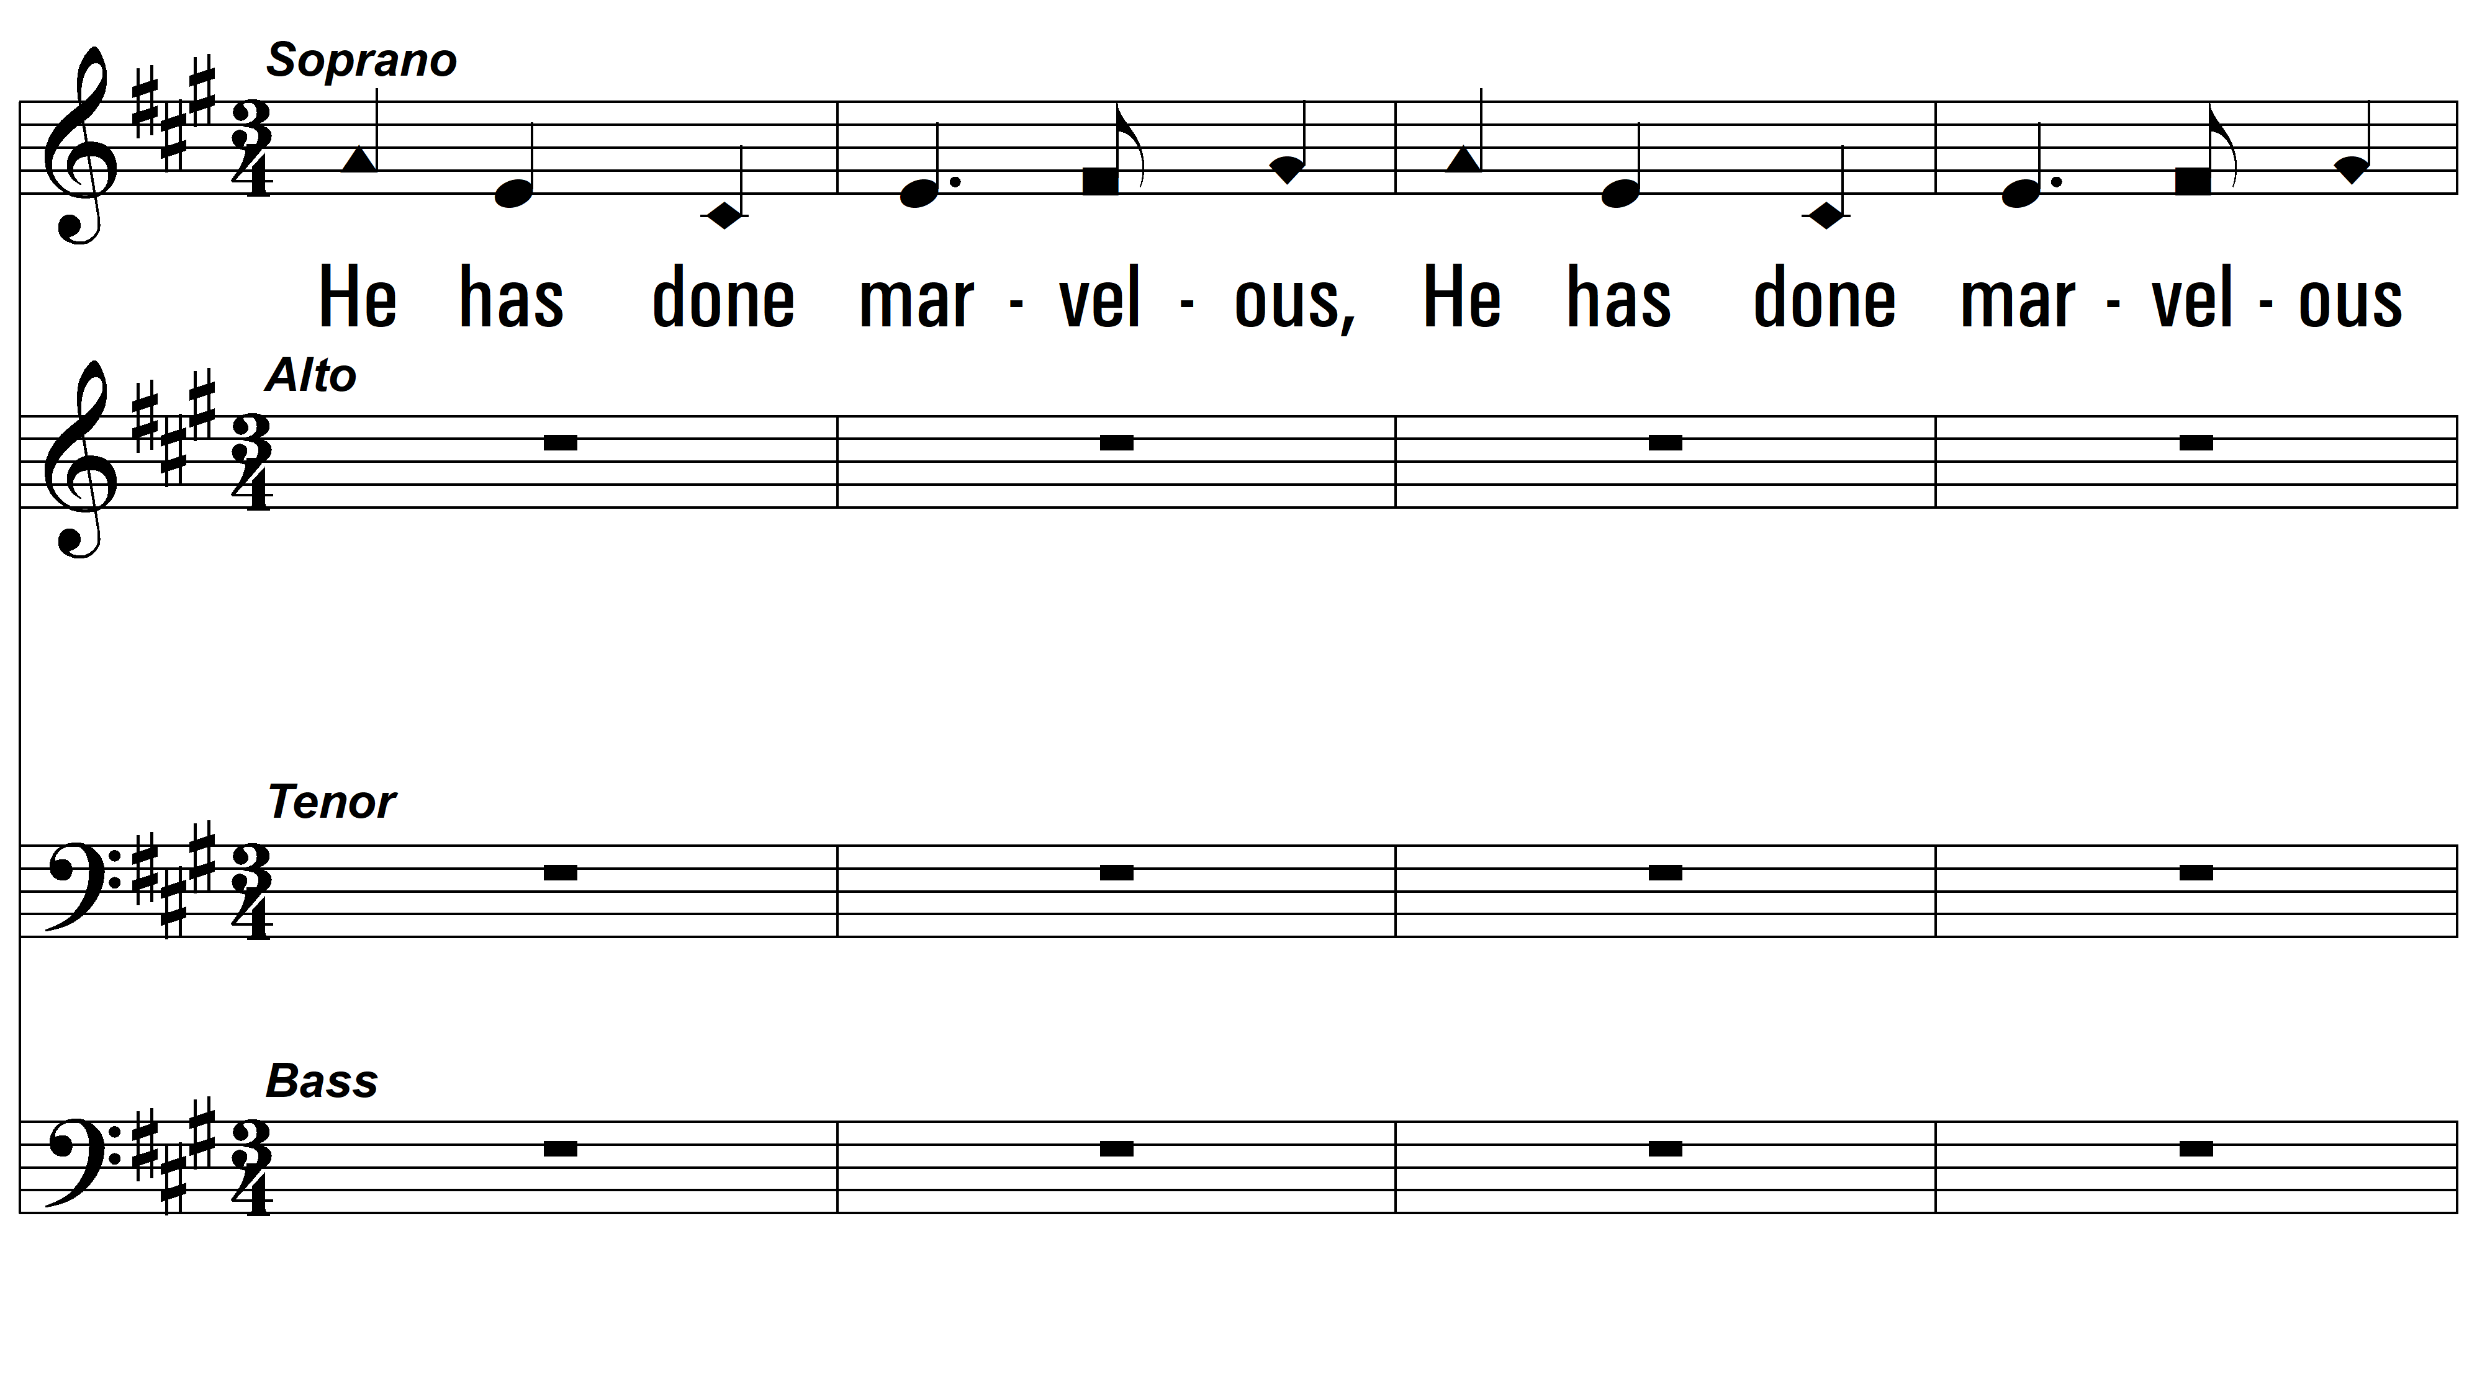
Round 1 ~ Marvelous Things

Slide 3
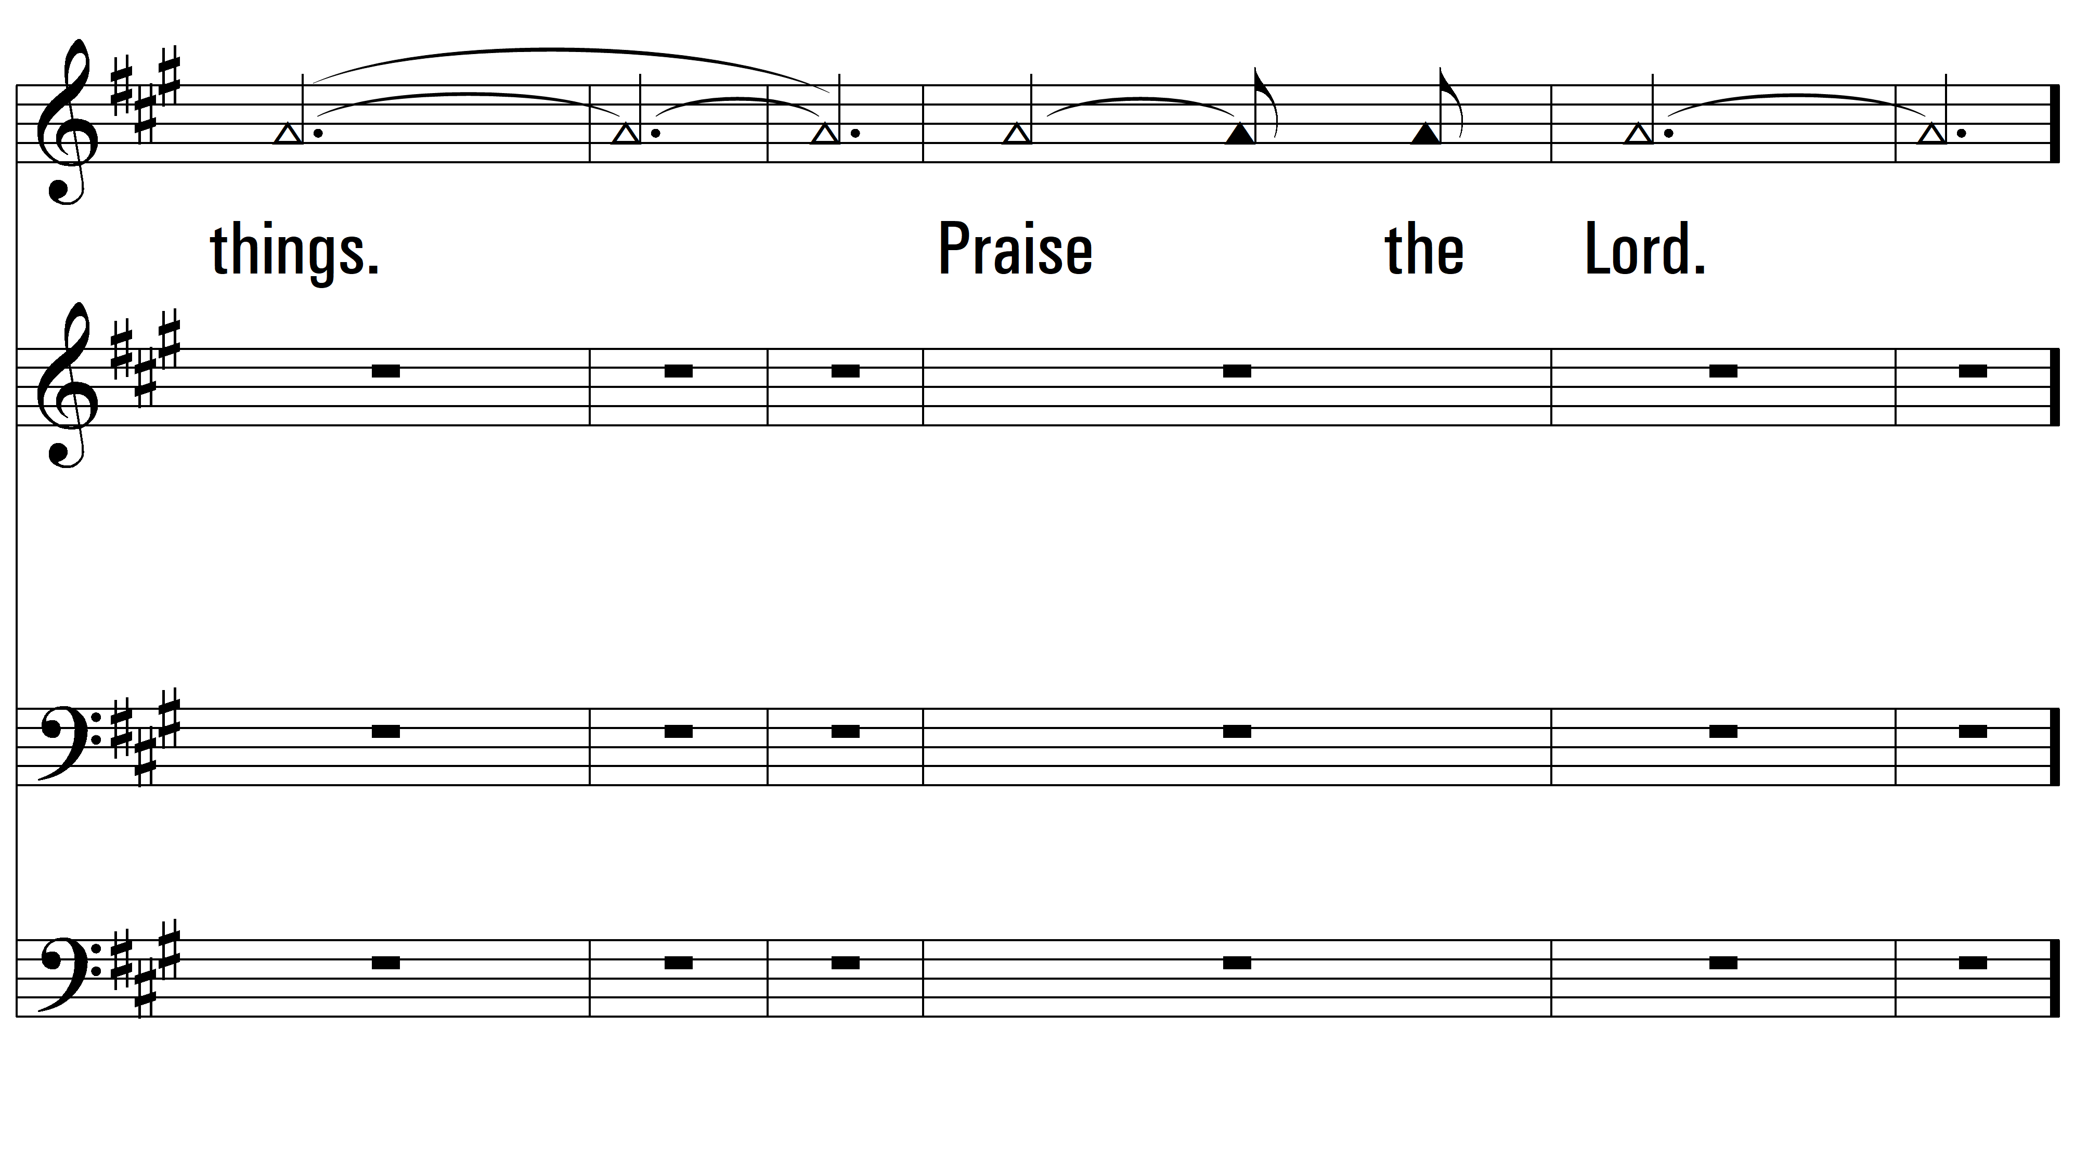
Round 1

Slide 4
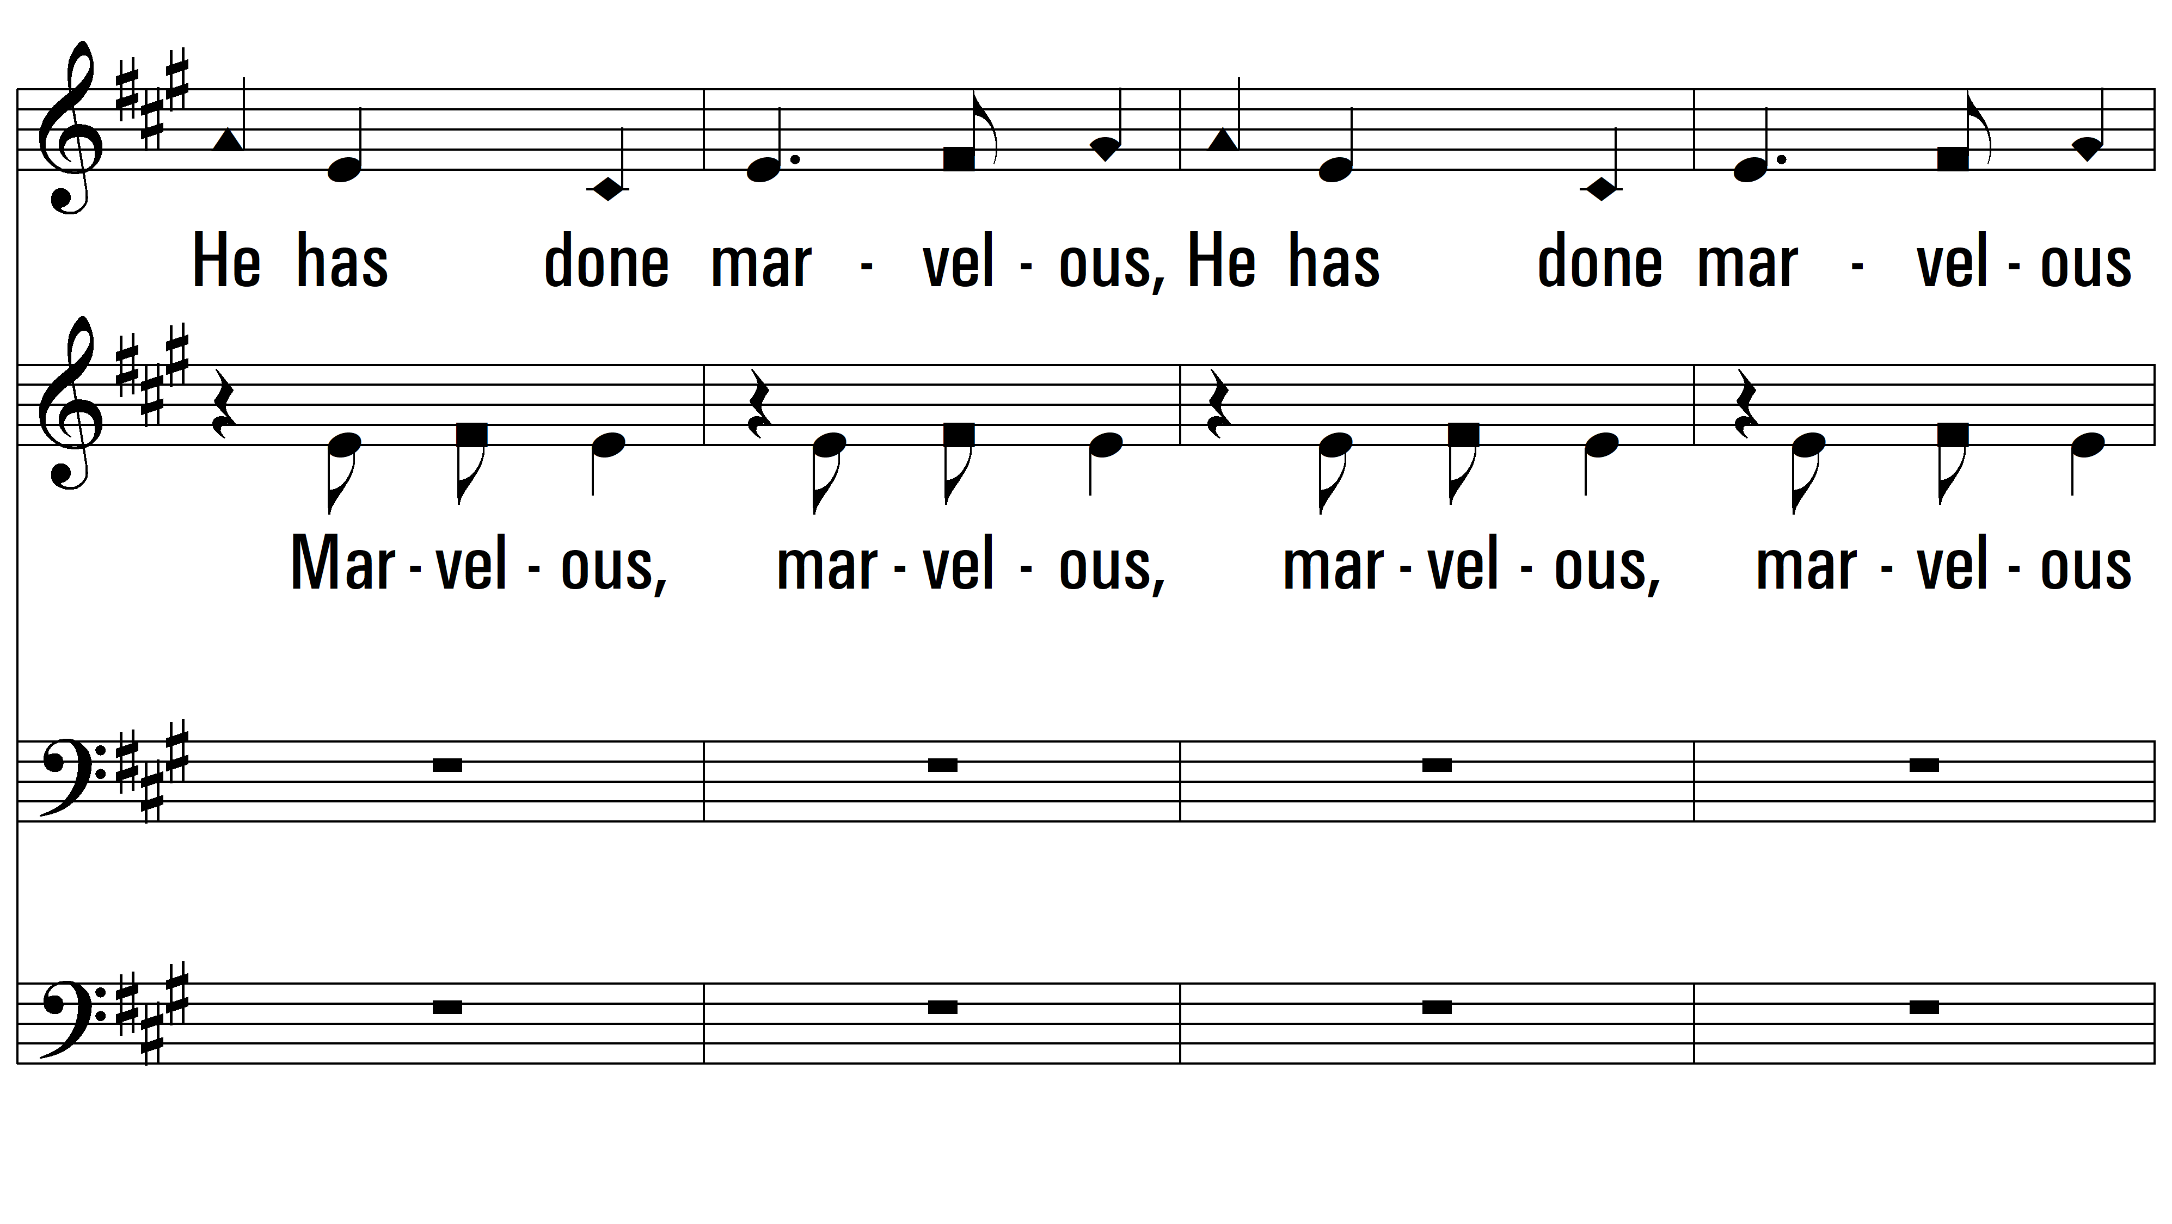
Round 2 ~ Marvelous Things

Slide 5
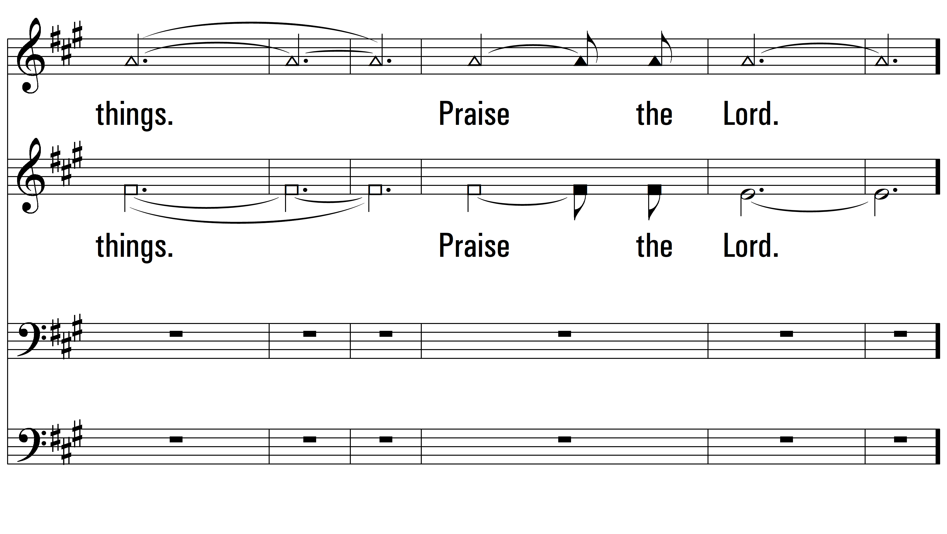
Round 2

Slide 6
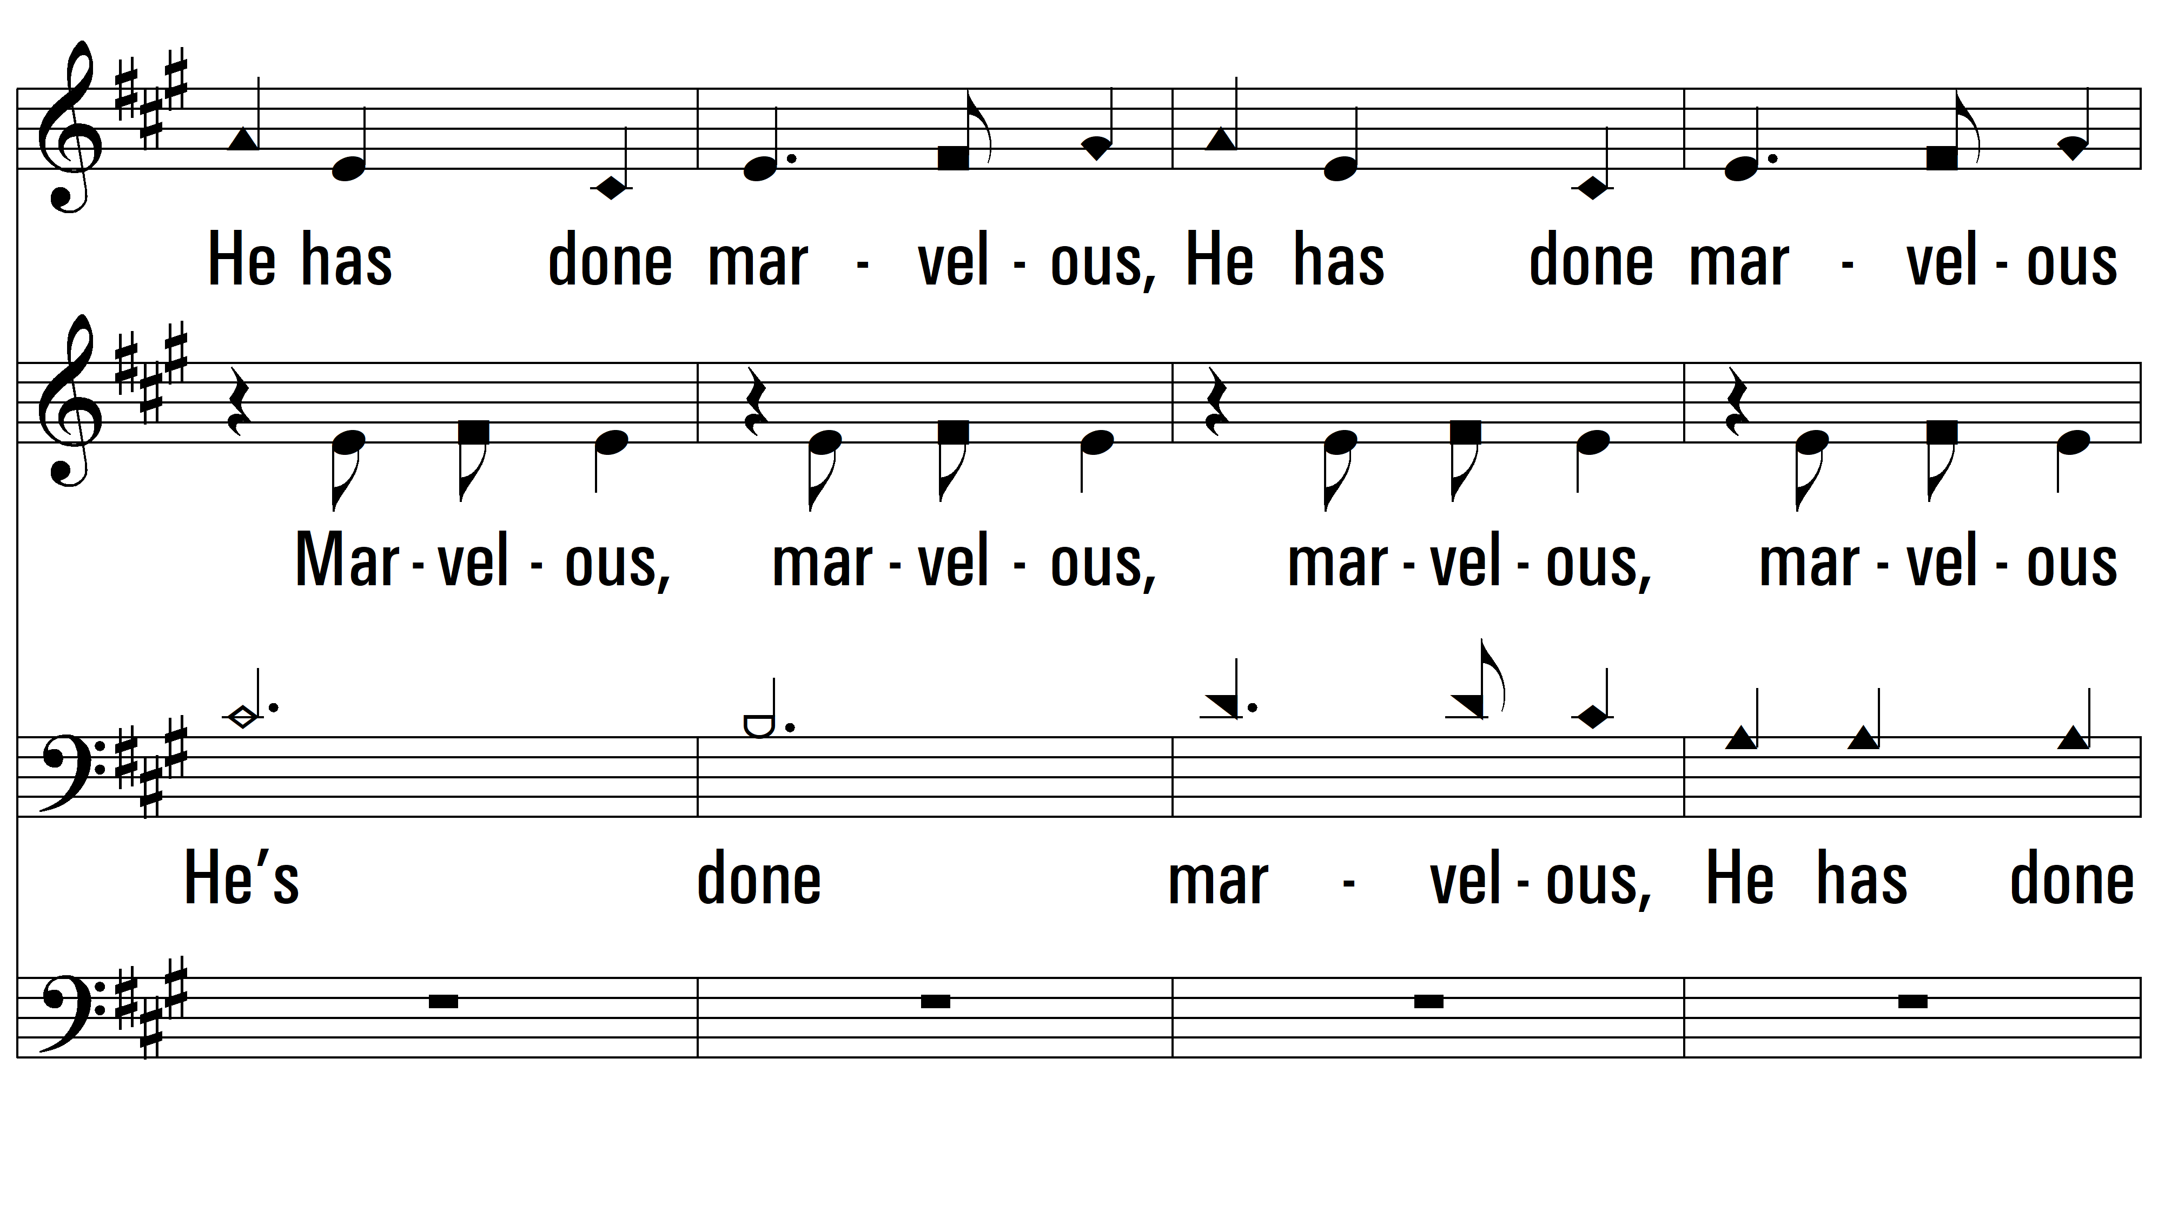
Round 3 ~ Marvelous Things

Slide 7
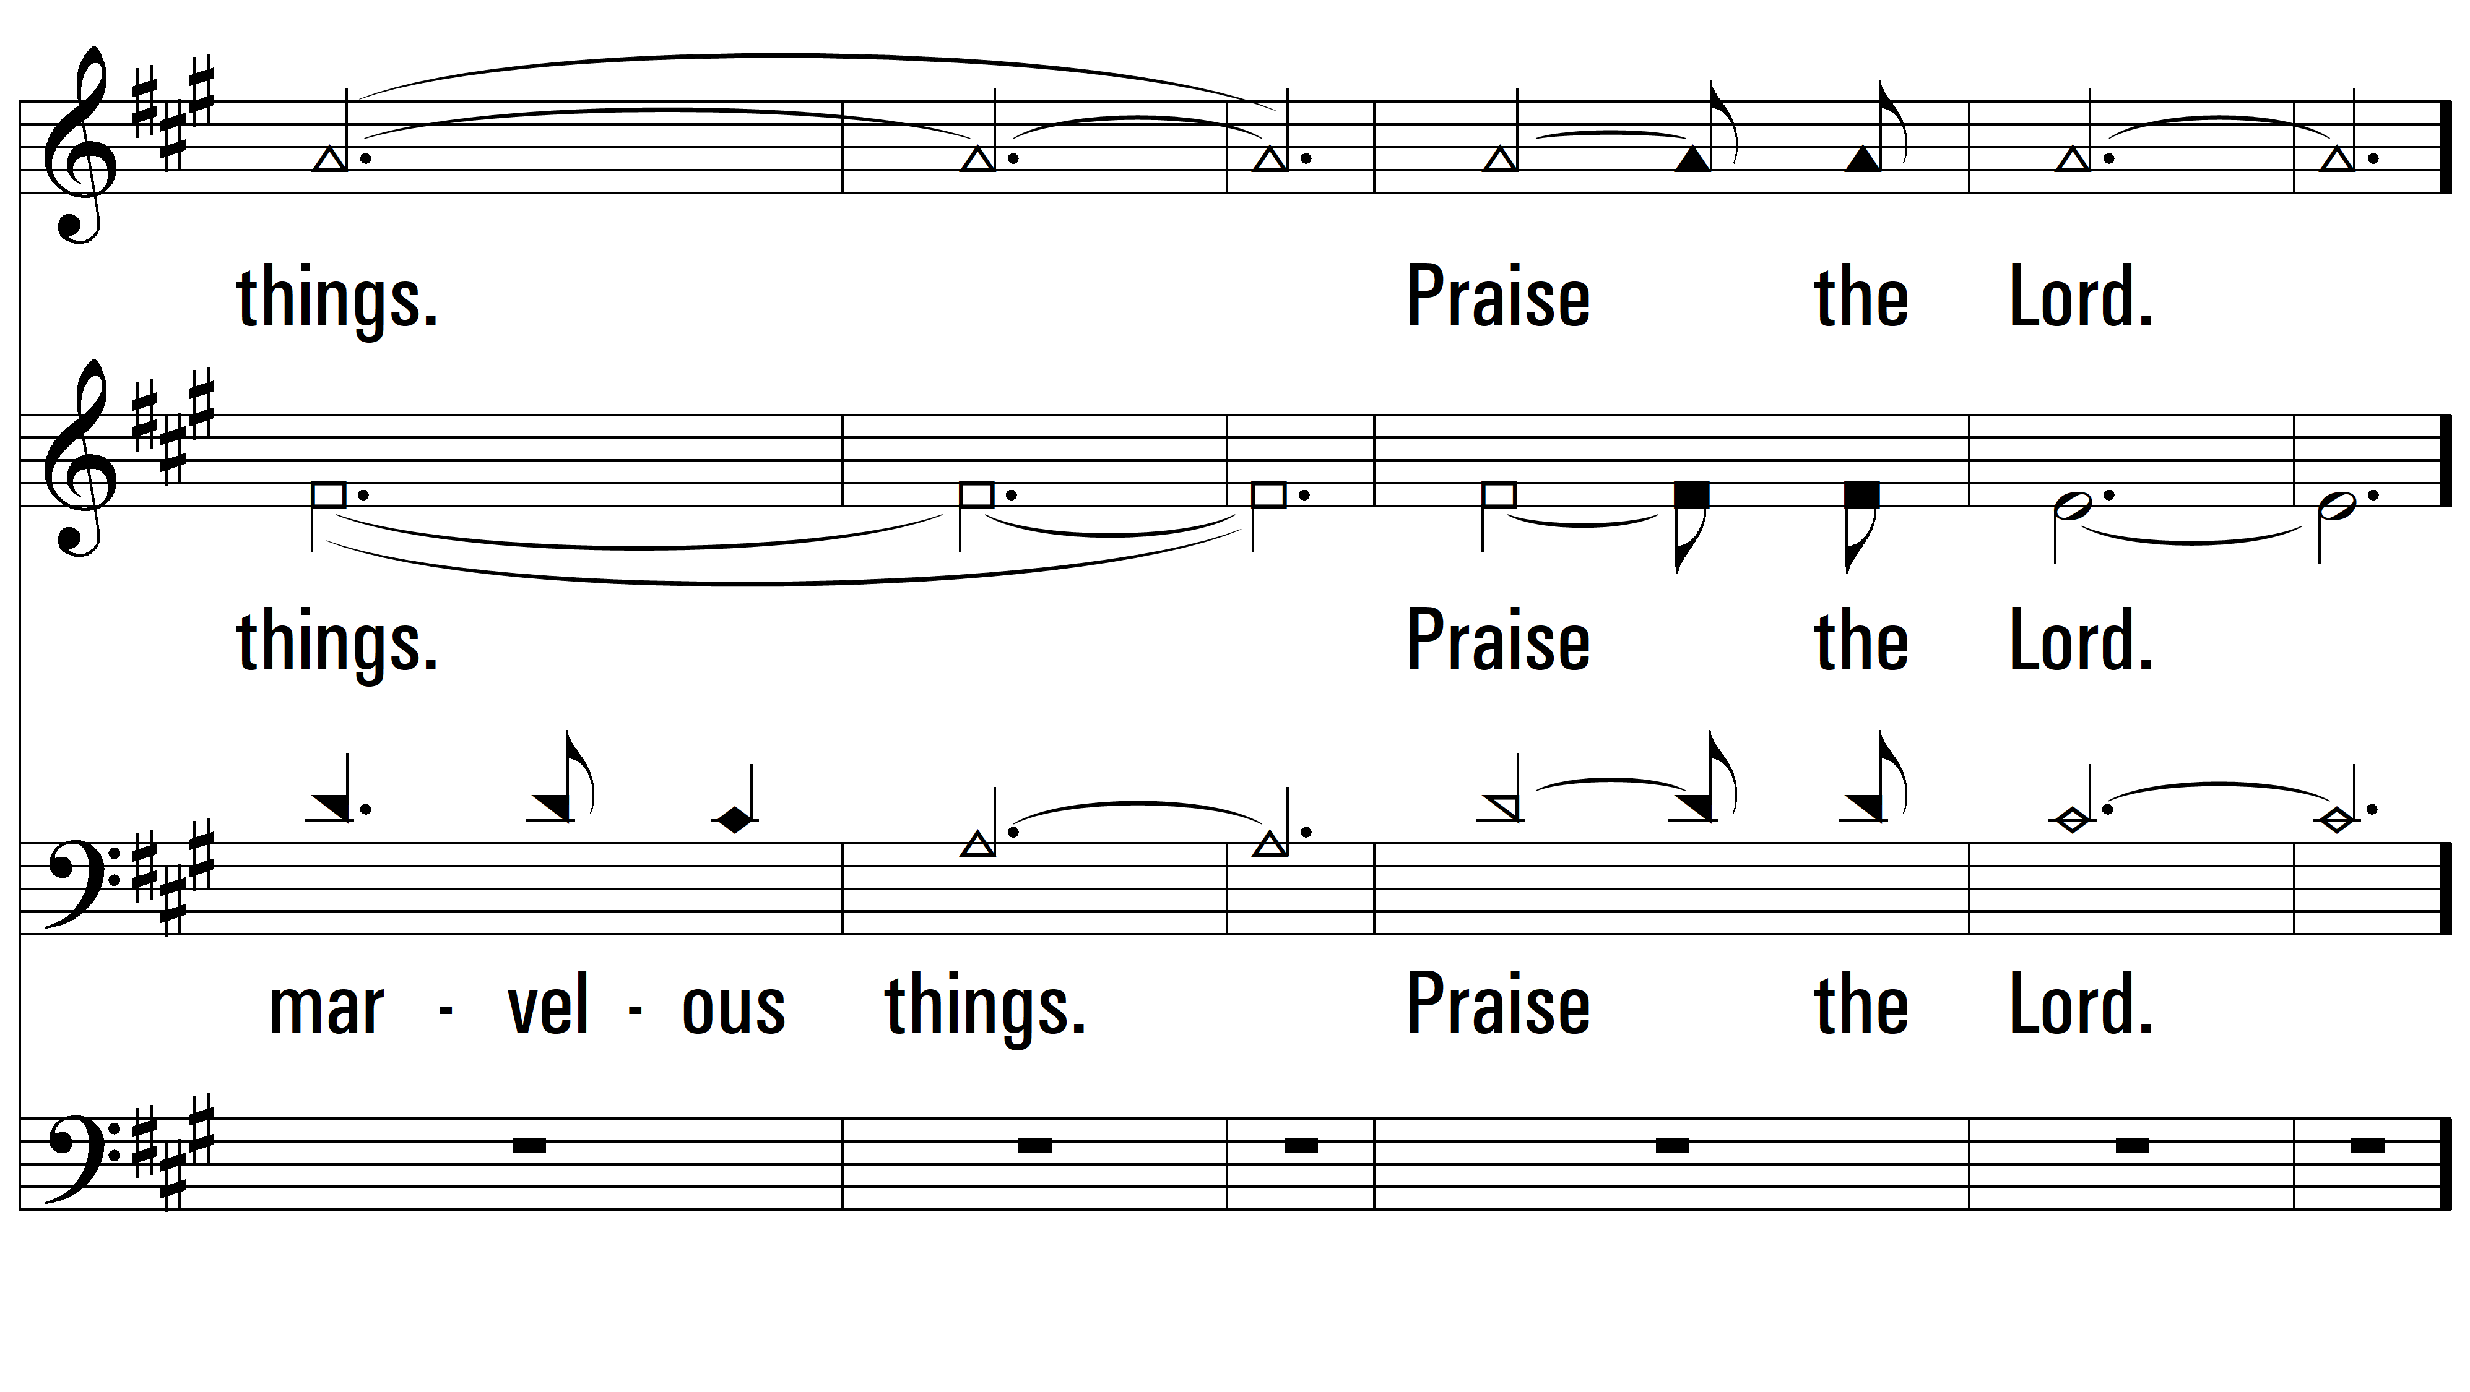
Round 3

Slide 8
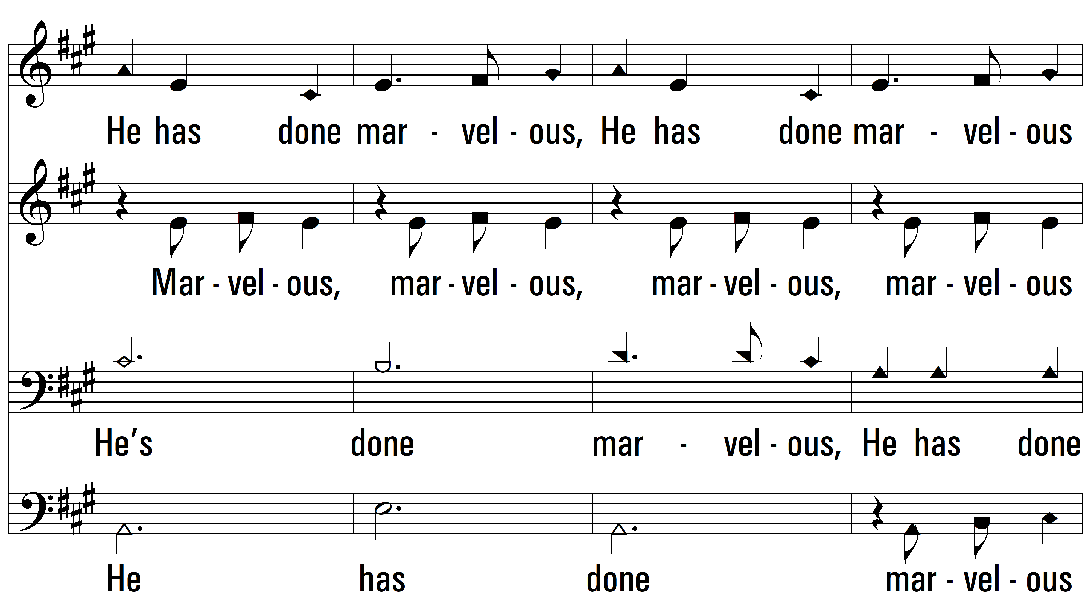
Round 4 ~ Marvelous Things

Slide 9
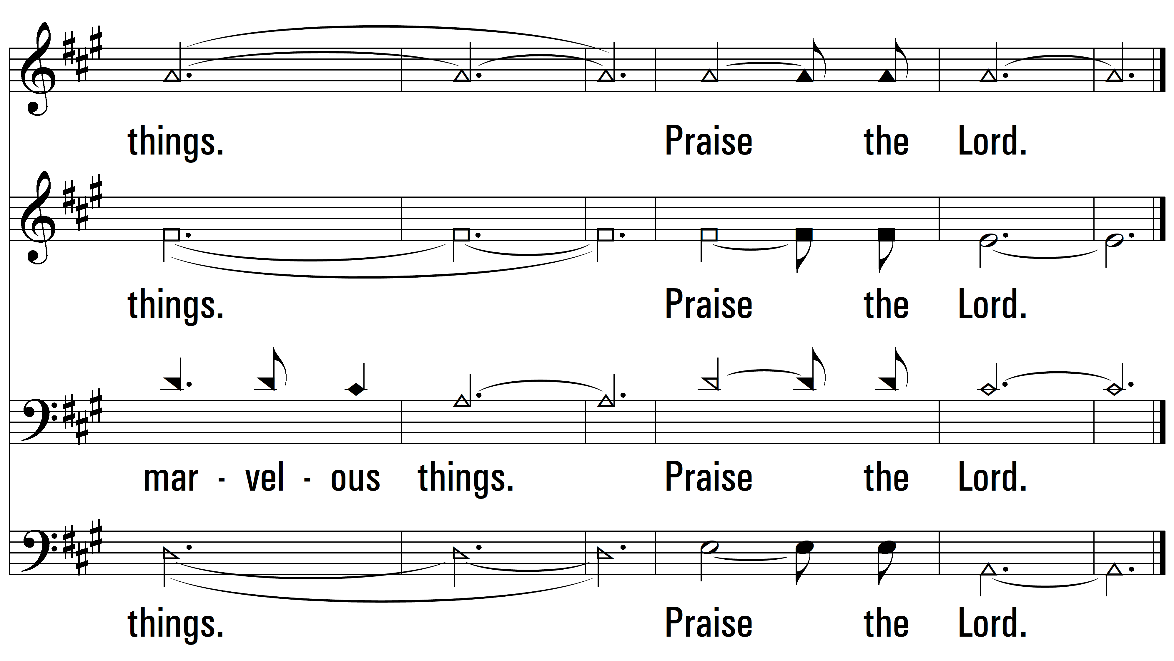
Round 4
PDHymns.com
END

