Slide 1
Love, Love
ROUND IN 3 PARTS
all groups are in unison
Words: | American Folk Hymn
Music: | English Folk Melody (c. 1600)
4/4
Gm(B^{b})/G - LA
Verses: 4 (Round)
Group 1 - | LA
Group 2 - | LA
Group 3 - | LA
PDHymns.com

Slide 2
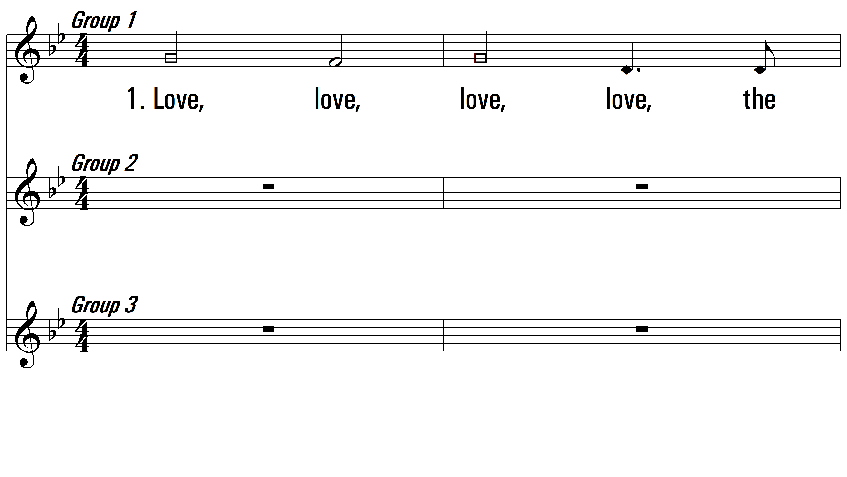
vs. 1 ~ Group 1 start

Slide 3
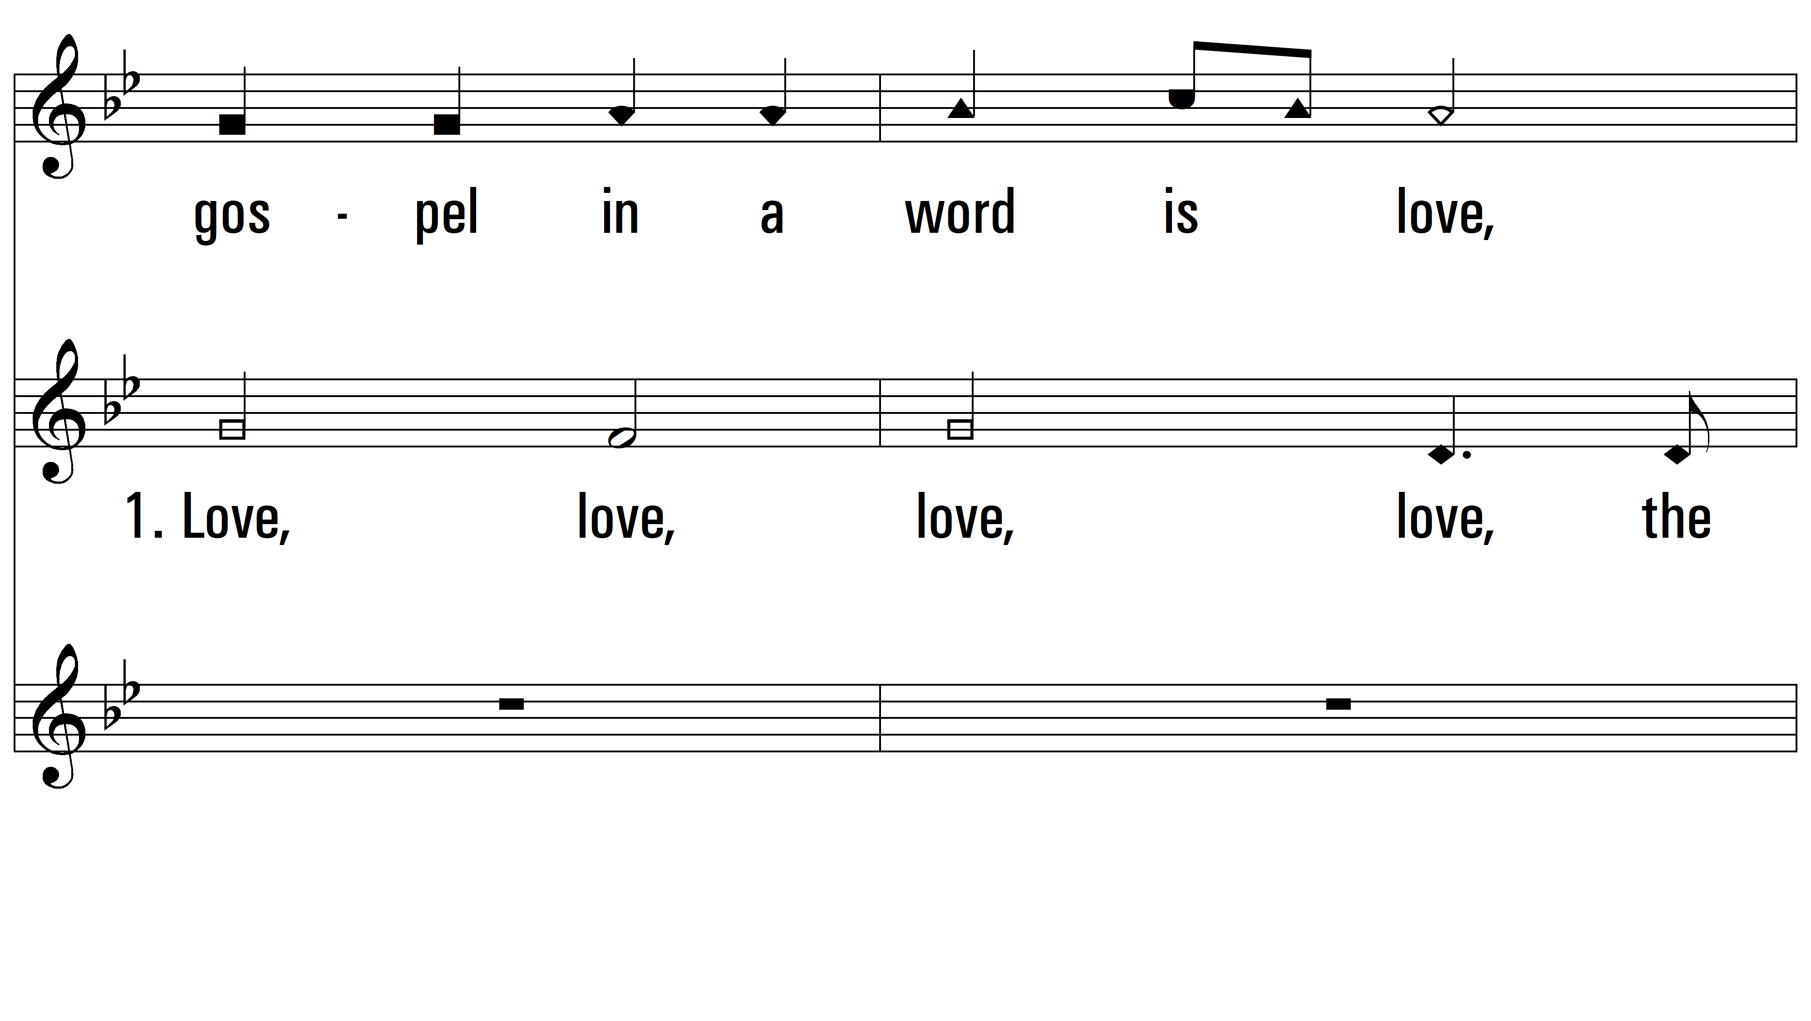
vs. 1 ~ Group 2 start

Slide 4
vs. 1 ~ Group 3 start

Slide 5
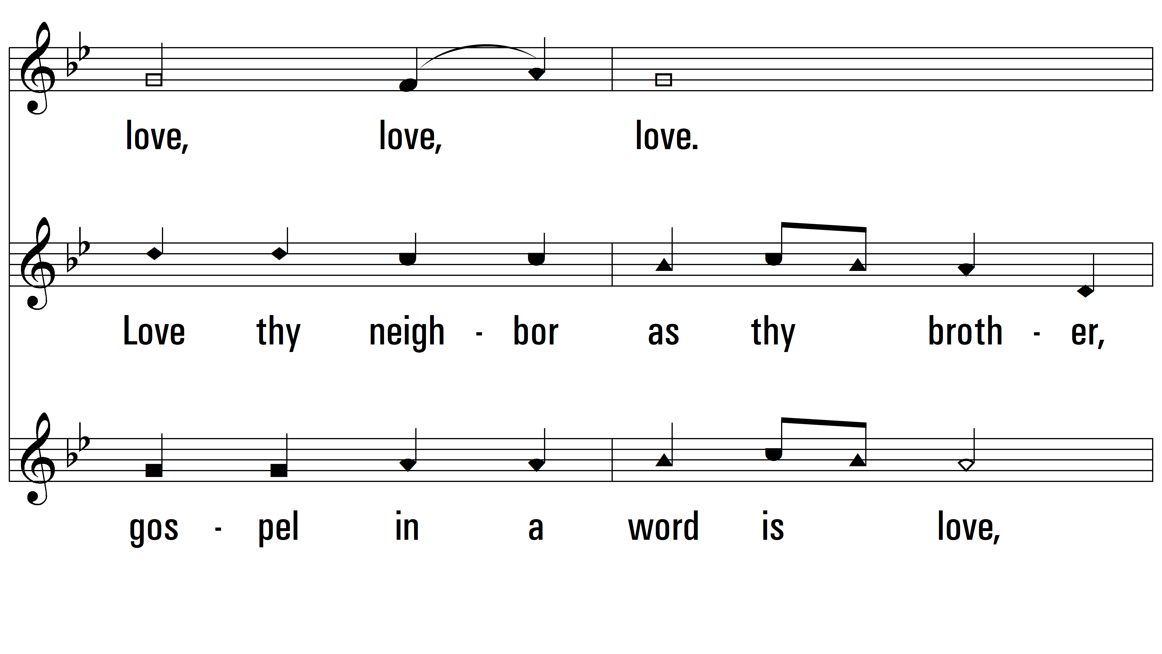
vs. 1

Slide 6
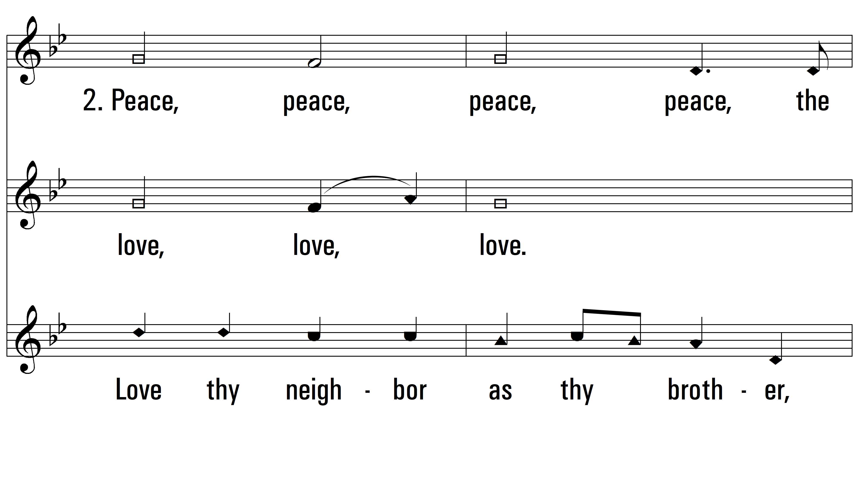
vs. 2 ~ Group 1 start

Slide 7
vs. 2 ~ Group 2 start

Slide 8
vs. 2 ~ Group 3 start

Slide 9
vs. 2

Slide 10
vs. 3 ~ Group 1 start

Slide 11
vs. 3 ~ Group 2 start

Slide 12
vs. 3 ~ Group 3 start

Slide 13
vs. 3

Slide 14
vs. 4 ~ Group 1 start

Slide 15
vs. 4 ~ Group 2 start

Slide 16
vs. 4 ~ Group 3 start

Slide 17
vs. 4

Slide 18
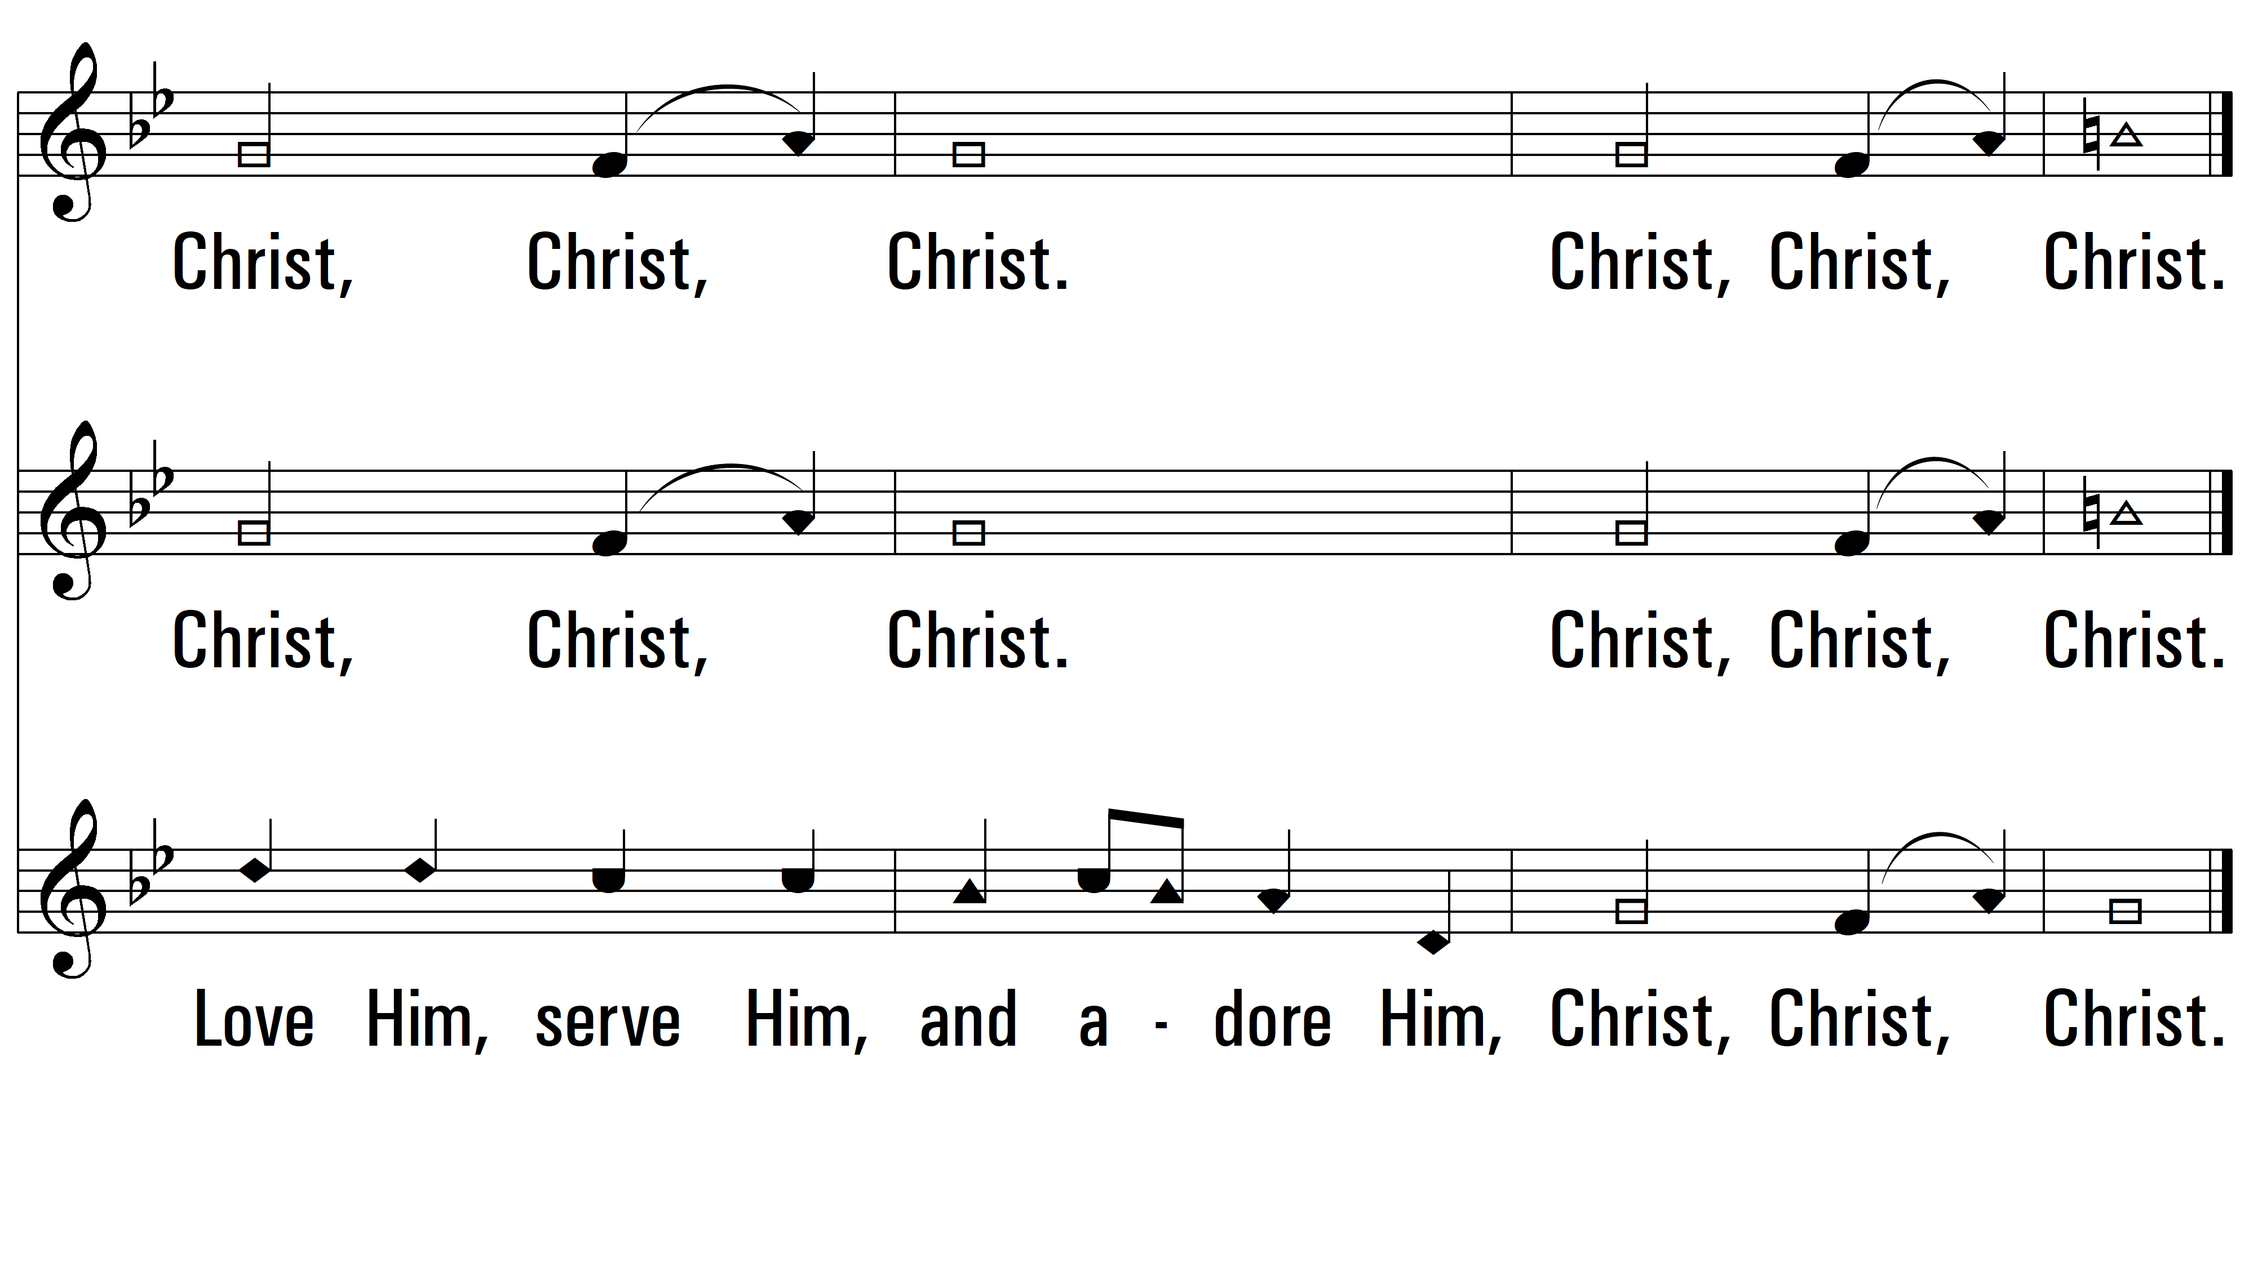
vs. 4
PDHymns.com
END

