Slide 1
Looking To Thee
Words: | James Rowe (1911)
Music: | H. M. Eagle (1911)
12/8
A/E - SOL
Verses: 3/Chorus
Lead - | SOL
Alto - | MI
Tenor - | DO
Bass - | DO
PDHymns.com

Slide 2
vs. 1 ~ Looking To Thee

Slide 3
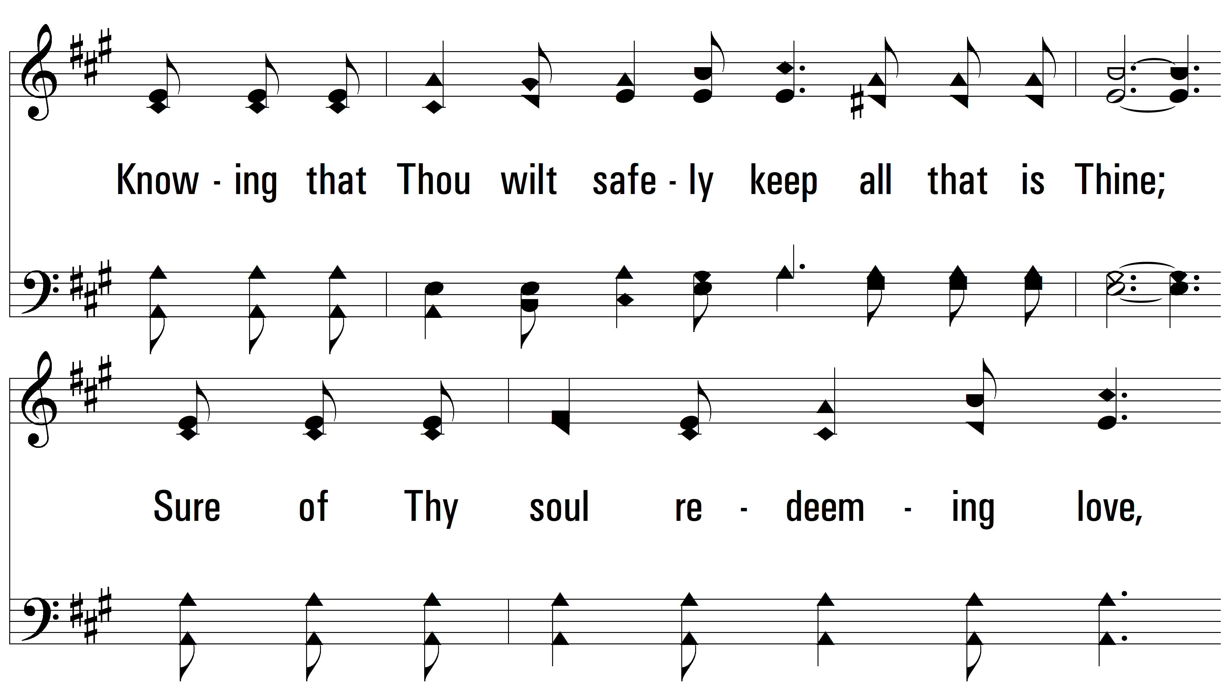
vs. 1

Slide 4
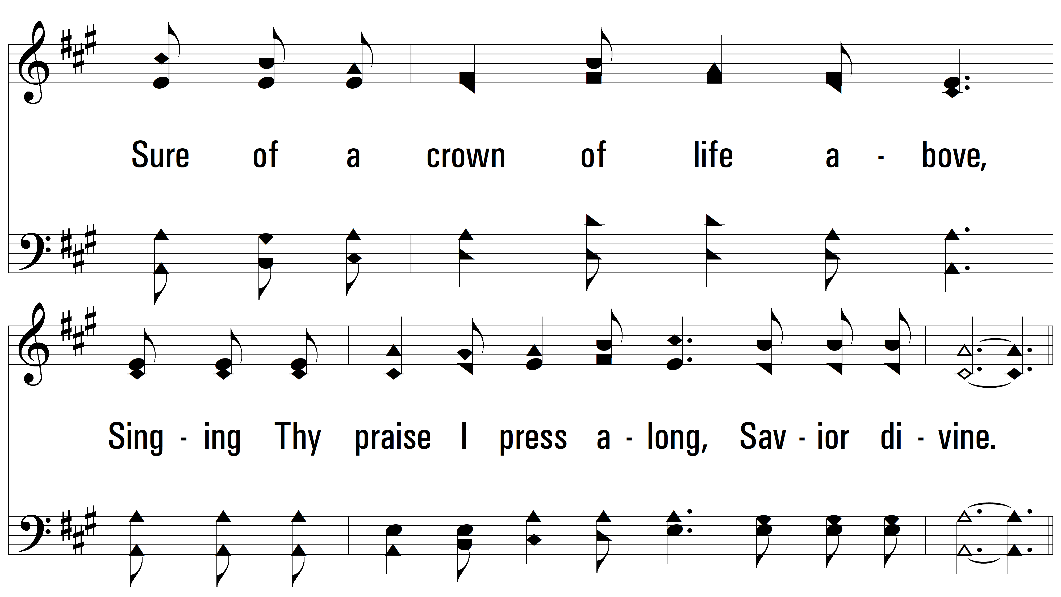
vs. 1

Slide 5
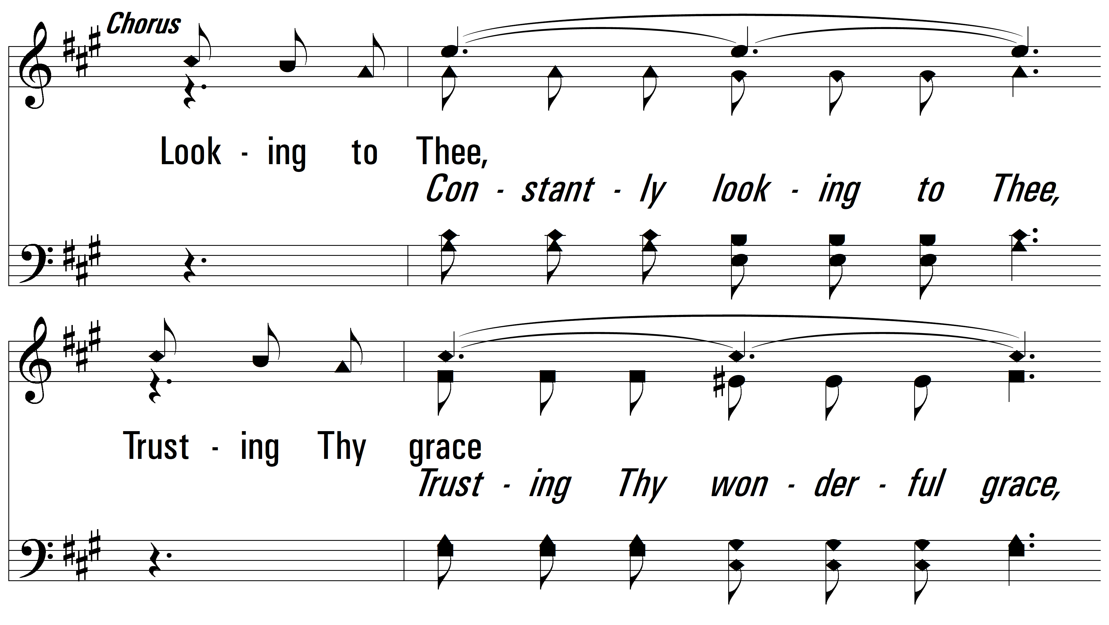
vs. 1

Slide 6
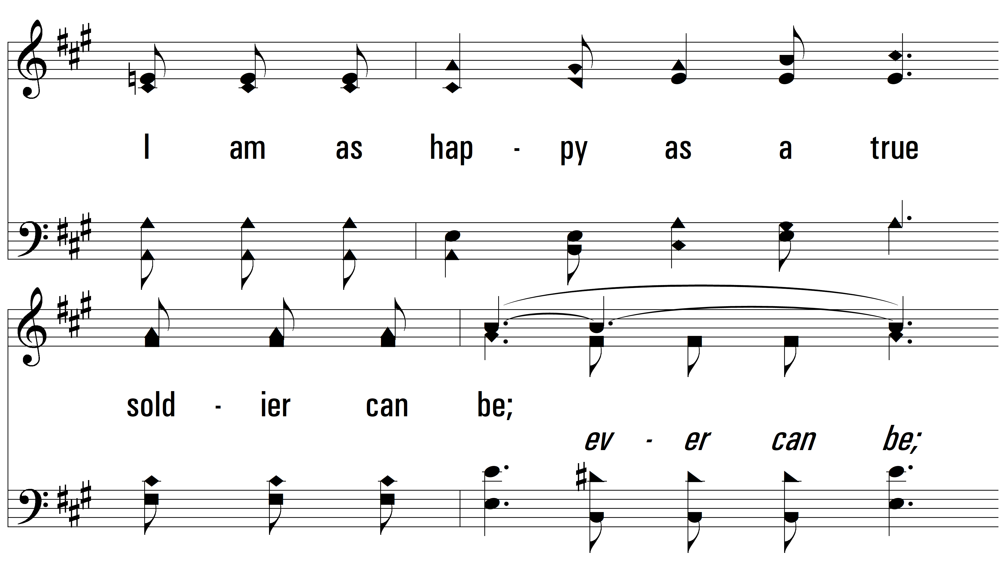
vs. 1

Slide 7
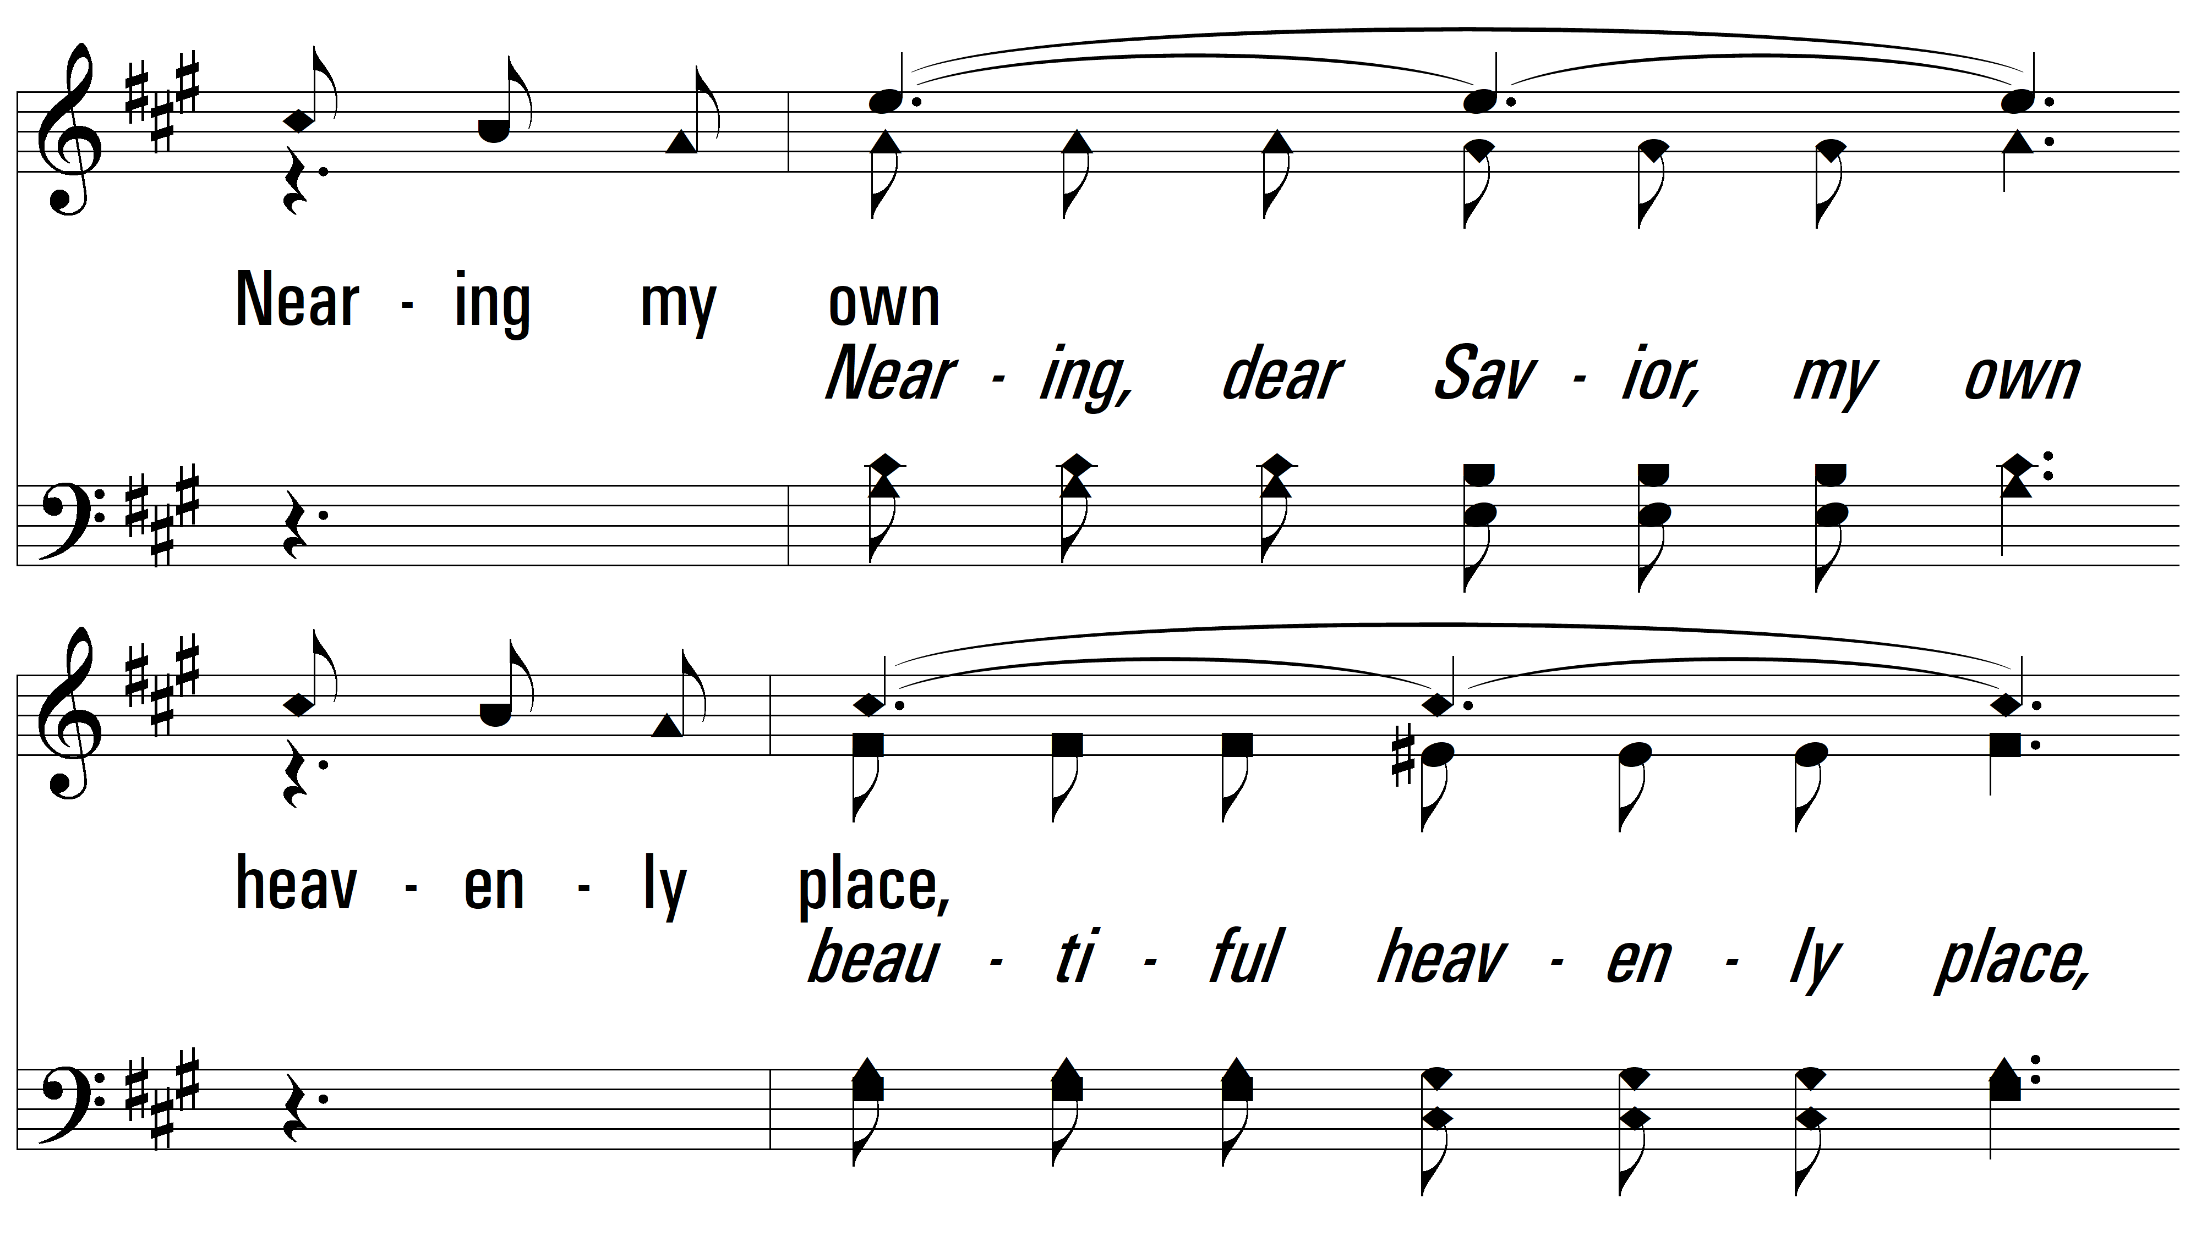
vs. 1

Slide 8
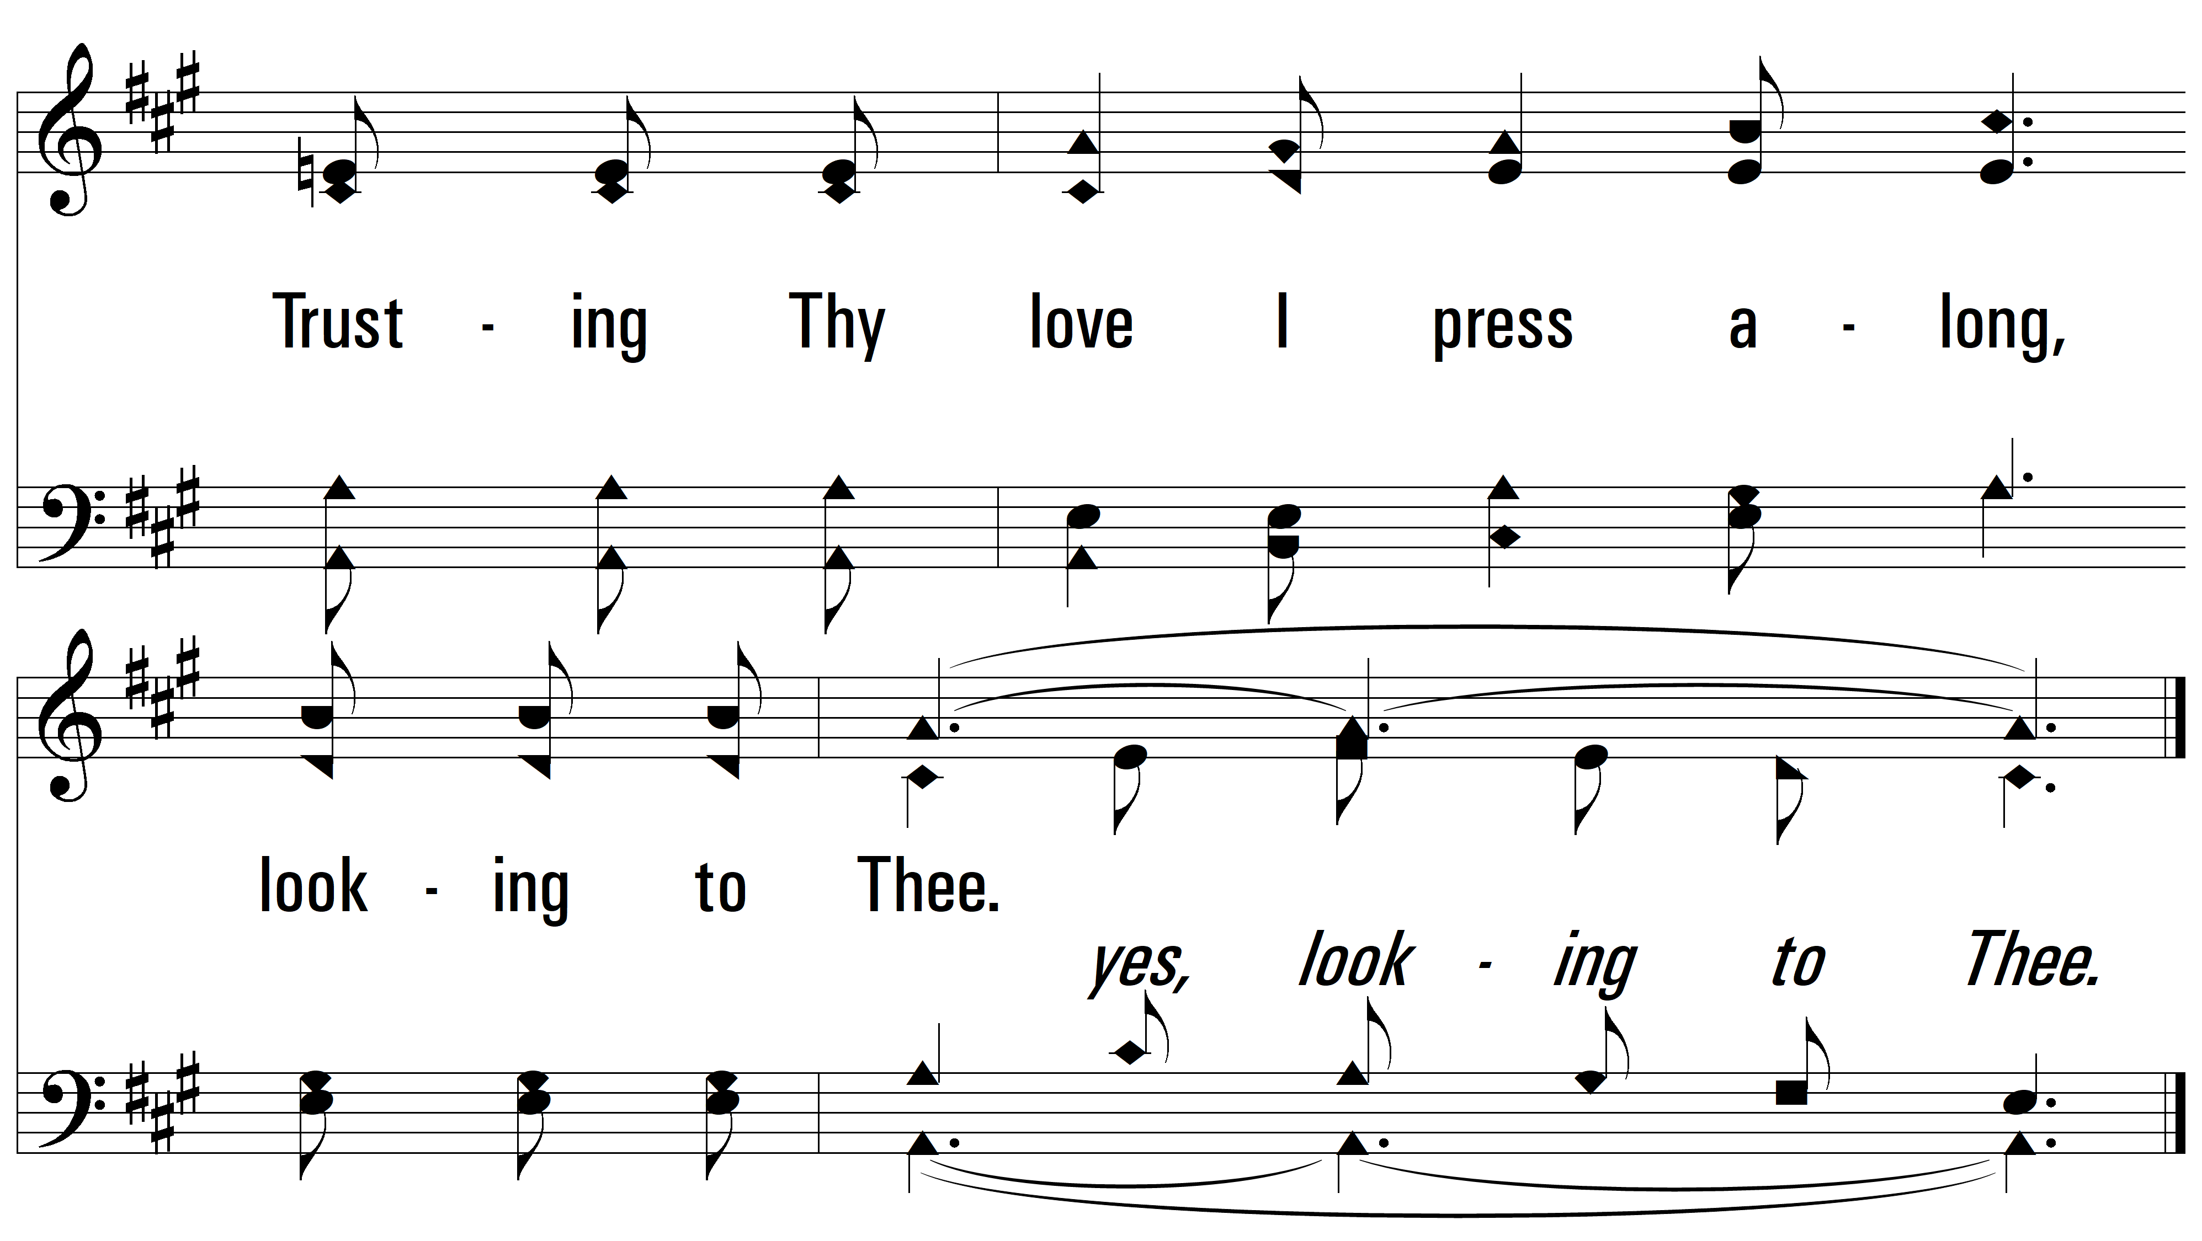
vs. 1

Slide 9
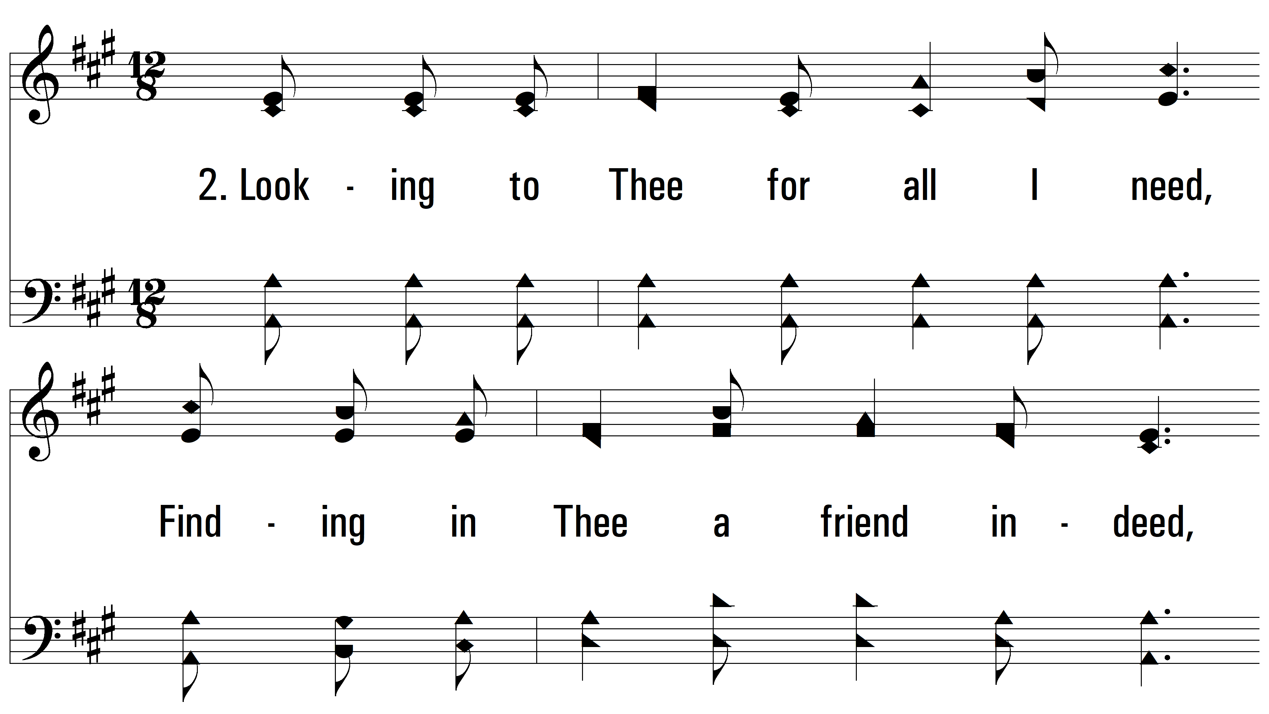
vs. 2 ~ Looking To Thee

Slide 10
vs. 2

Slide 11
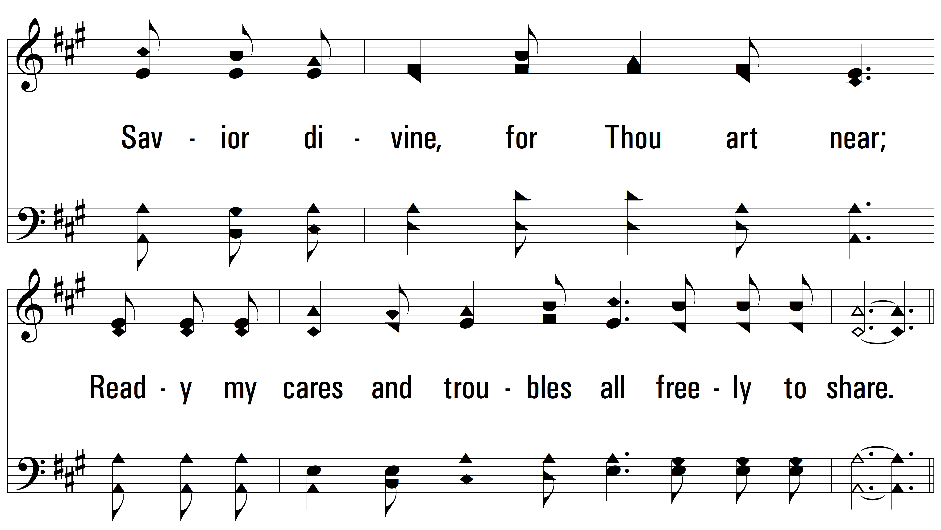
vs. 2

Slide 12
vs. 2

Slide 13
vs. 2

Slide 14
vs. 2

Slide 15
vs. 2

Slide 16
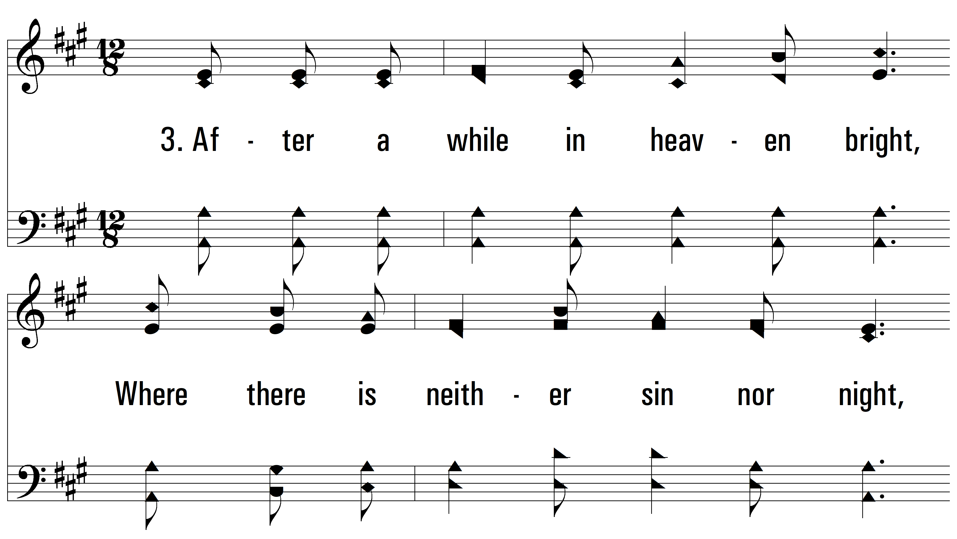
vs. 3 ~ Looking To Thee

Slide 17
vs. 3

Slide 18
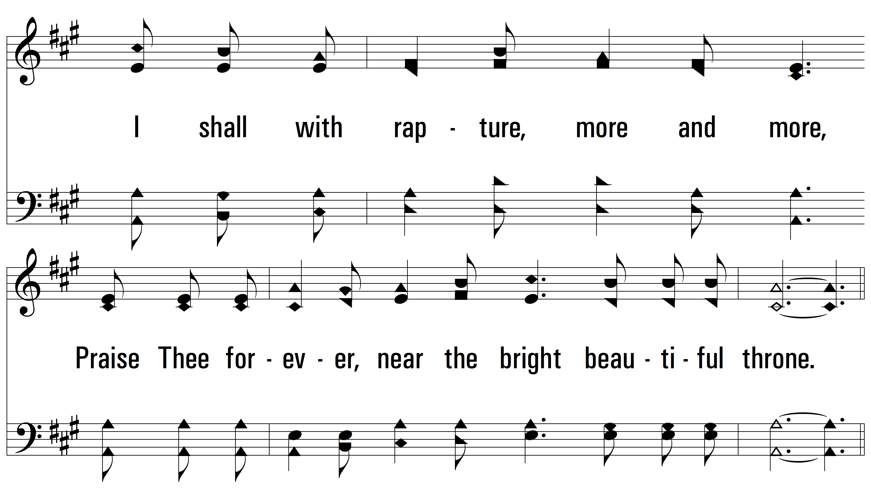
vs. 3

Slide 19
vs. 3

Slide 20
vs. 3

Slide 21
vs. 3

Slide 22
vs. 3
PDHymns.com
END

