Slide 1
Living For Jesus
Words: | T. O. Chisholm (1917)
Music: | C. Harold Lowden (1915)
4/4
F/A - MI
Verses: 3/Chorus
Lead - | MI
Alto - | DO
Tenor - | SOL
Bass - | DO
PDHymns.com

Slide 2
vs. 1 ~ Living For Jesus

Slide 3
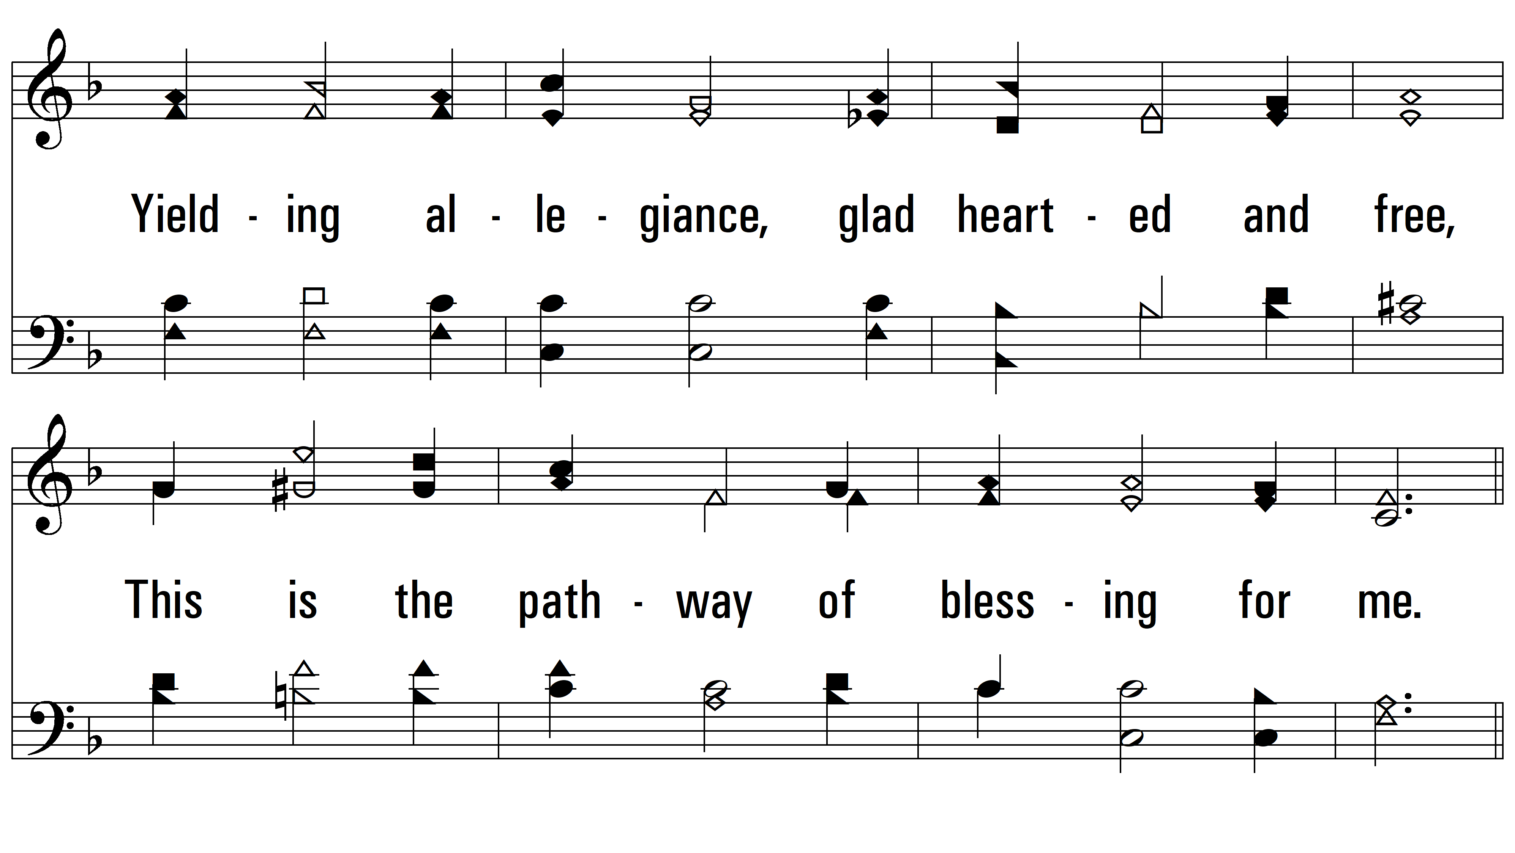
vs. 1

Slide 4
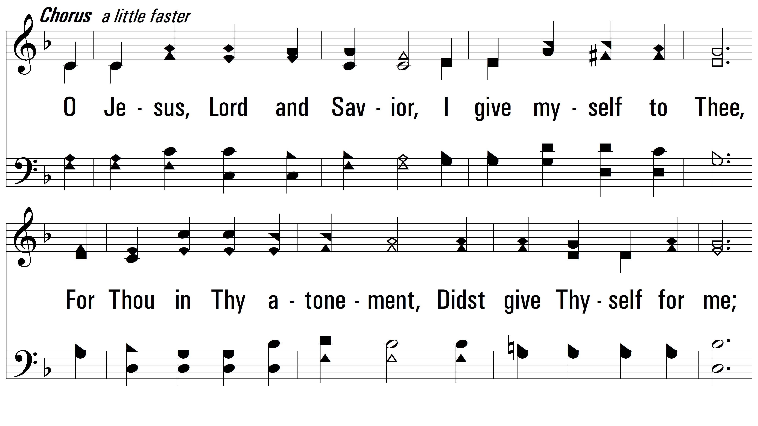
vs. 1

Slide 5
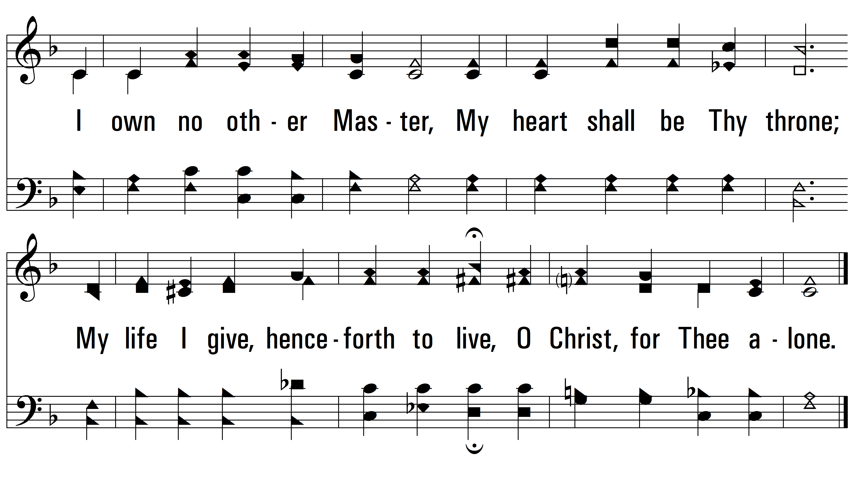
vs. 1

Slide 6
vs. 2 ~ Living For Jesus

Slide 7
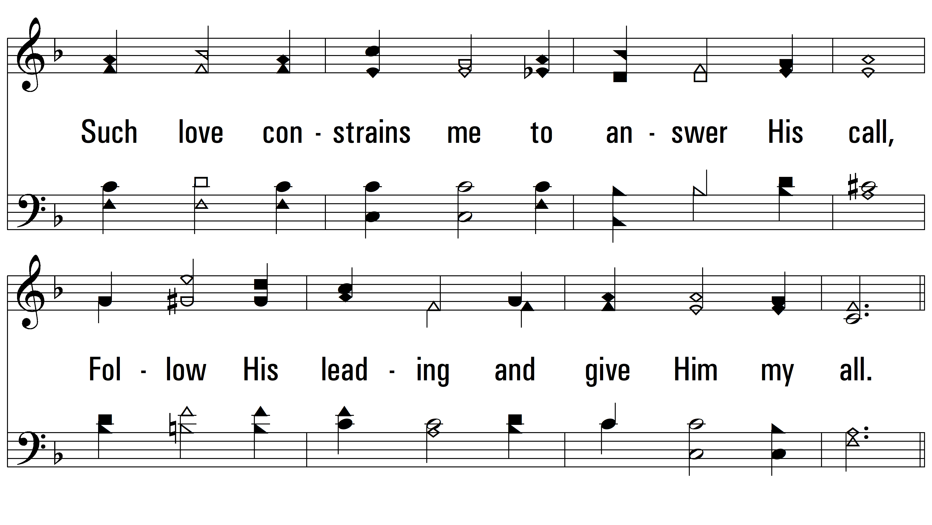
vs. 2

Slide 8
vs. 2

Slide 9
vs. 2

Slide 10
vs. 3 ~ Living For Jesus

Slide 11
vs. 3

Slide 12
vs. 3

Slide 13
vs. 3
PDHymns.com
END

