Slide 1
Living By Faith
Words: | James Wells (19118), vs.4 by R. E. W.
Music: | J. L. Heath (1918)
6/8+12/8
E^{b}/E^{b} - DO
Verses: 4/Chorus
Lead - | DO
Alto - | SOL
Tenor - | MI
Bass - | DO
PDHymns.com

Slide 2
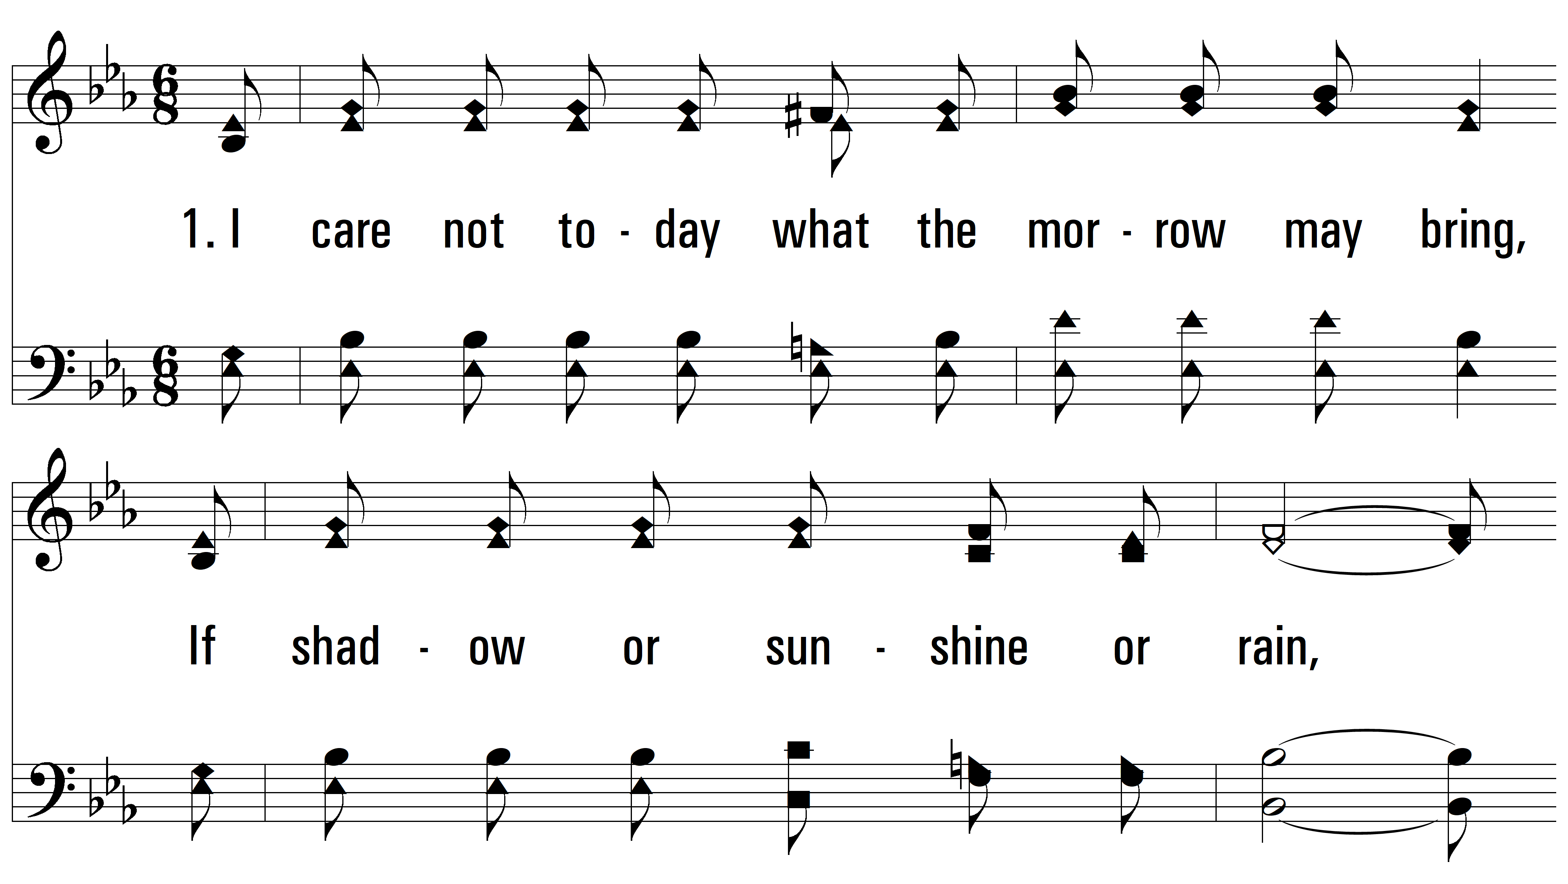
vs. 1 ~ Living By Faith

Slide 3
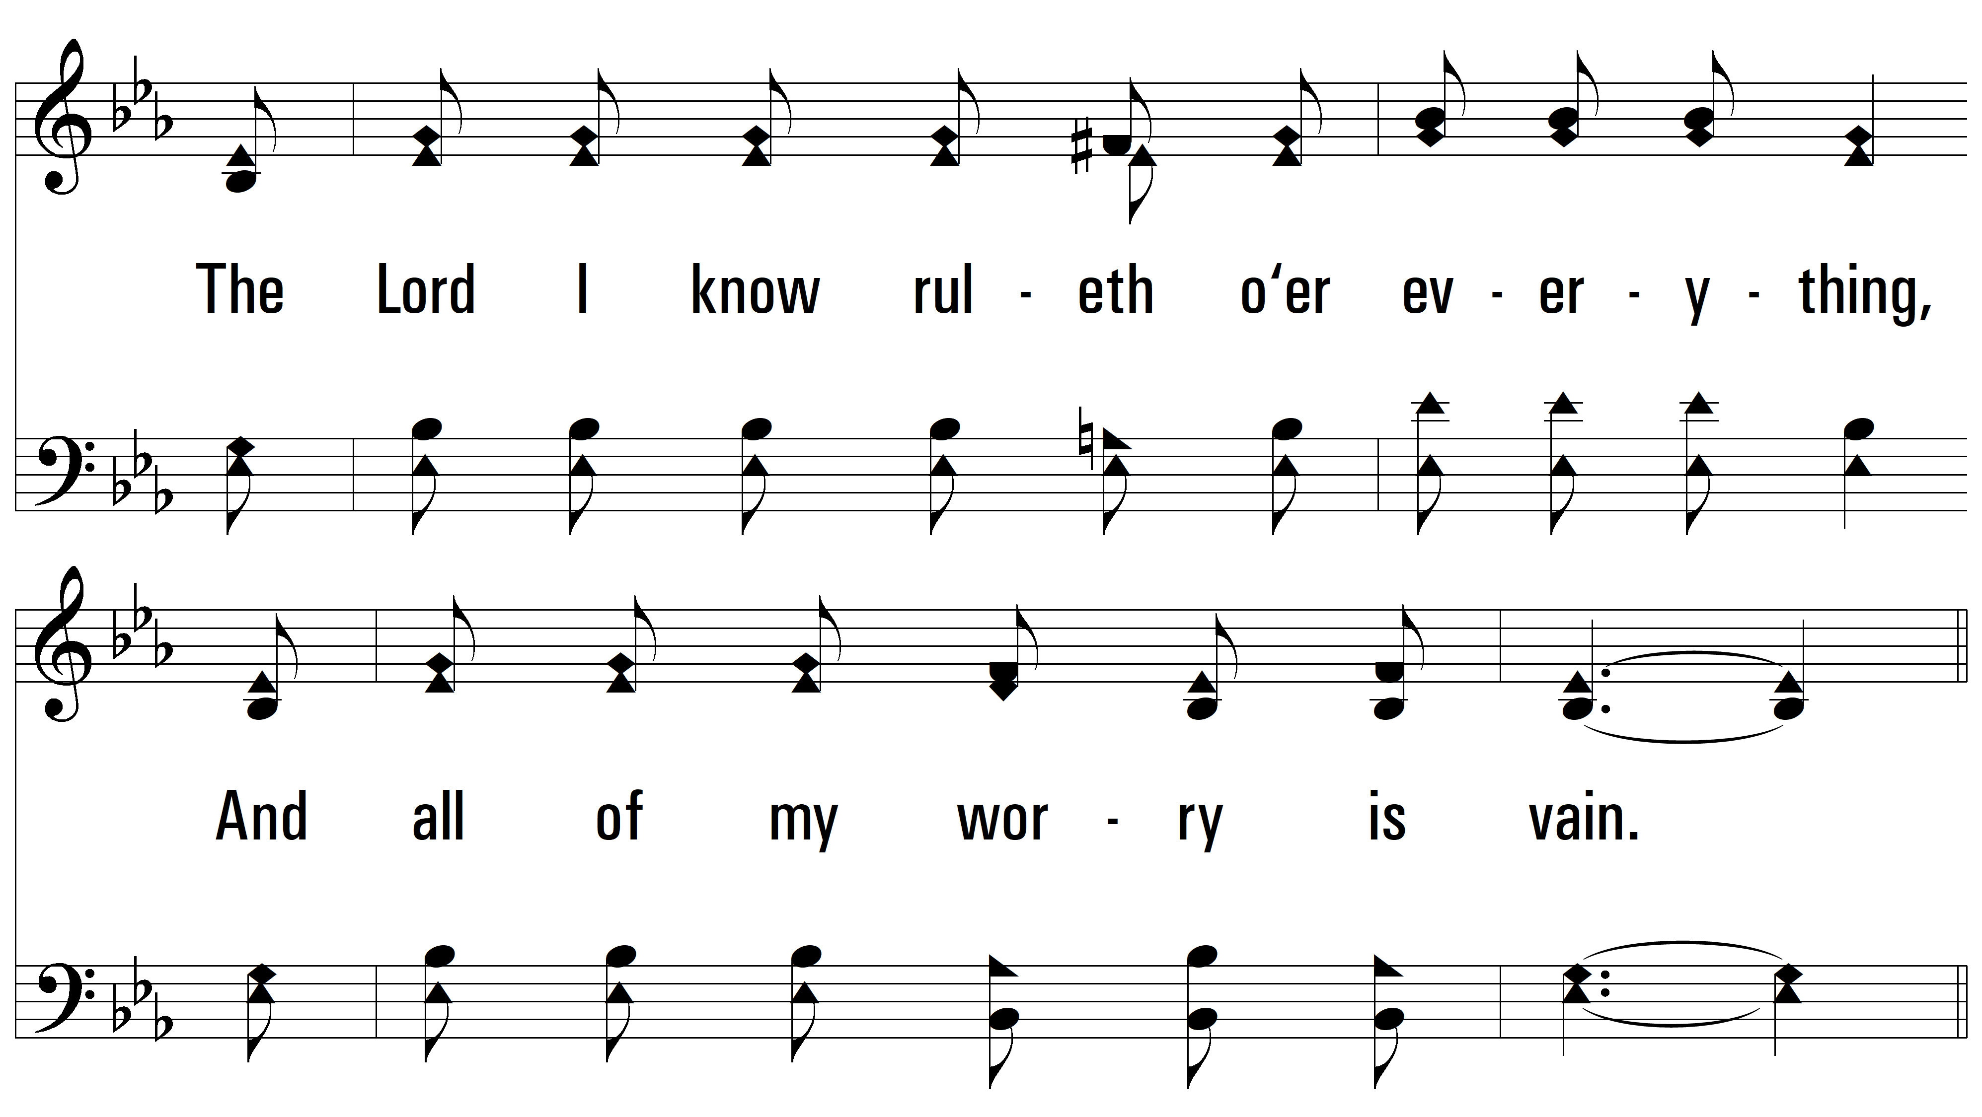
vs. 1

Slide 4
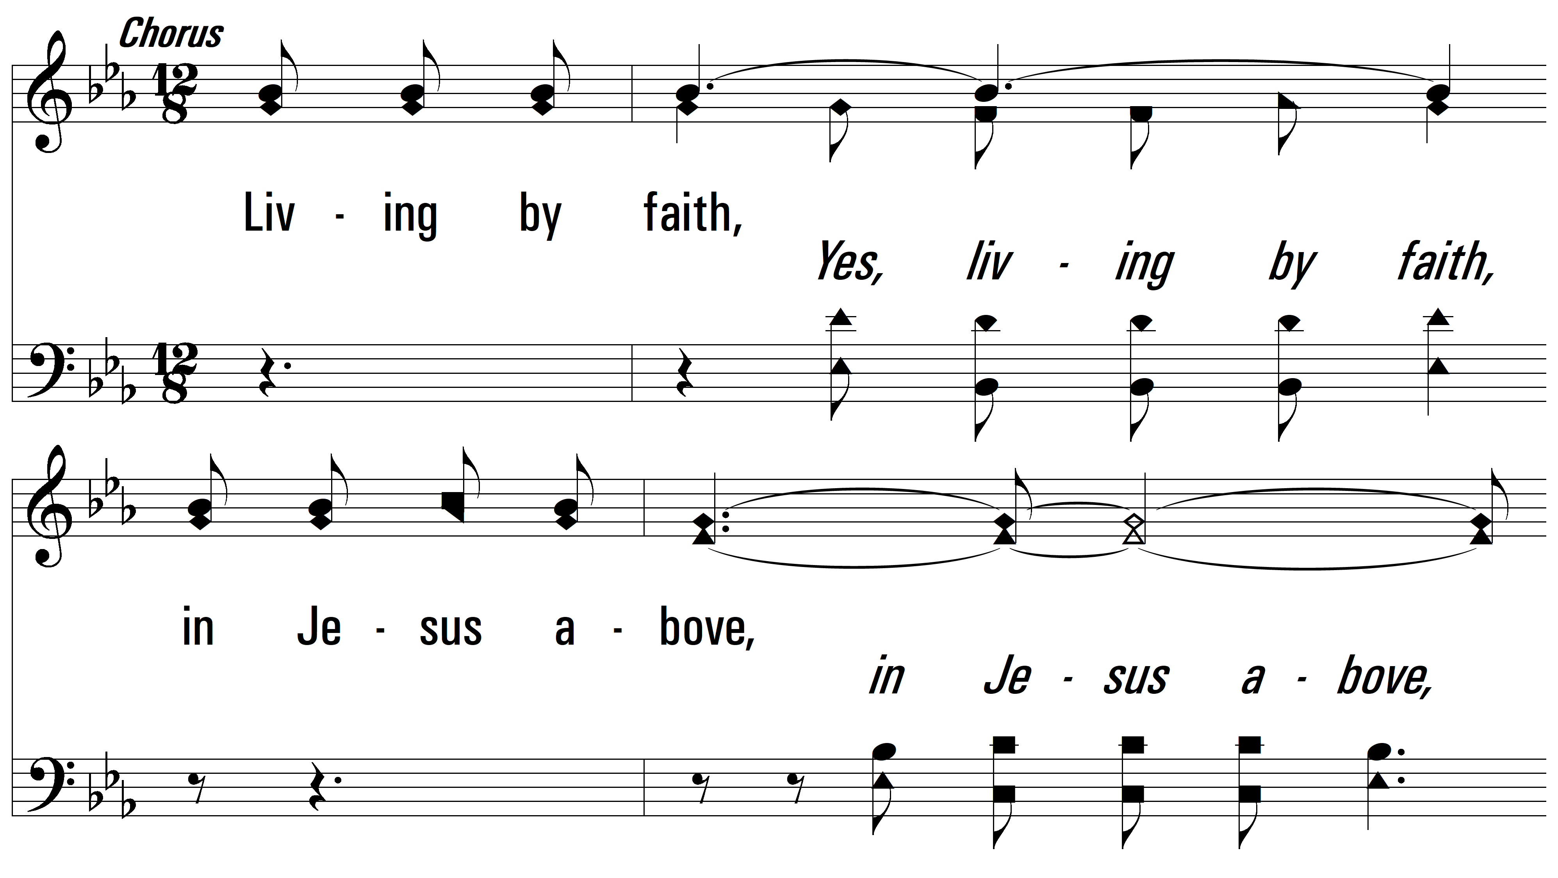
vs. 1

Slide 5
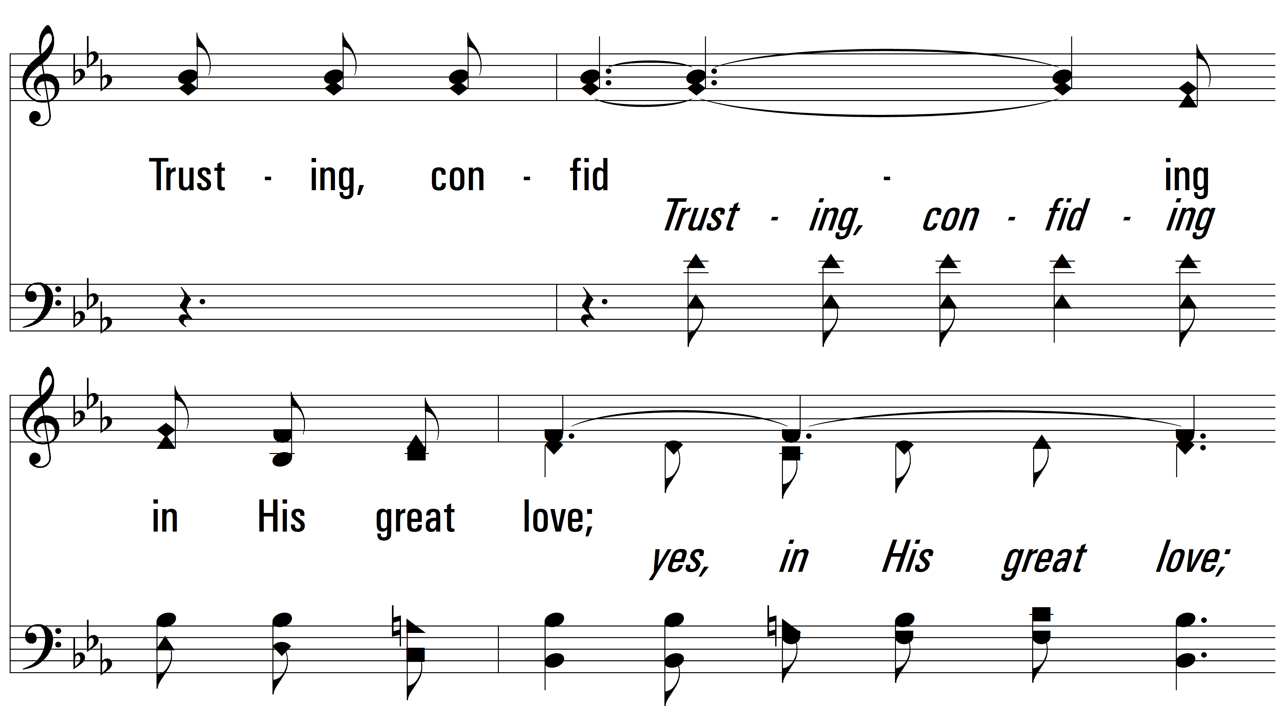
vs. 1

Slide 6
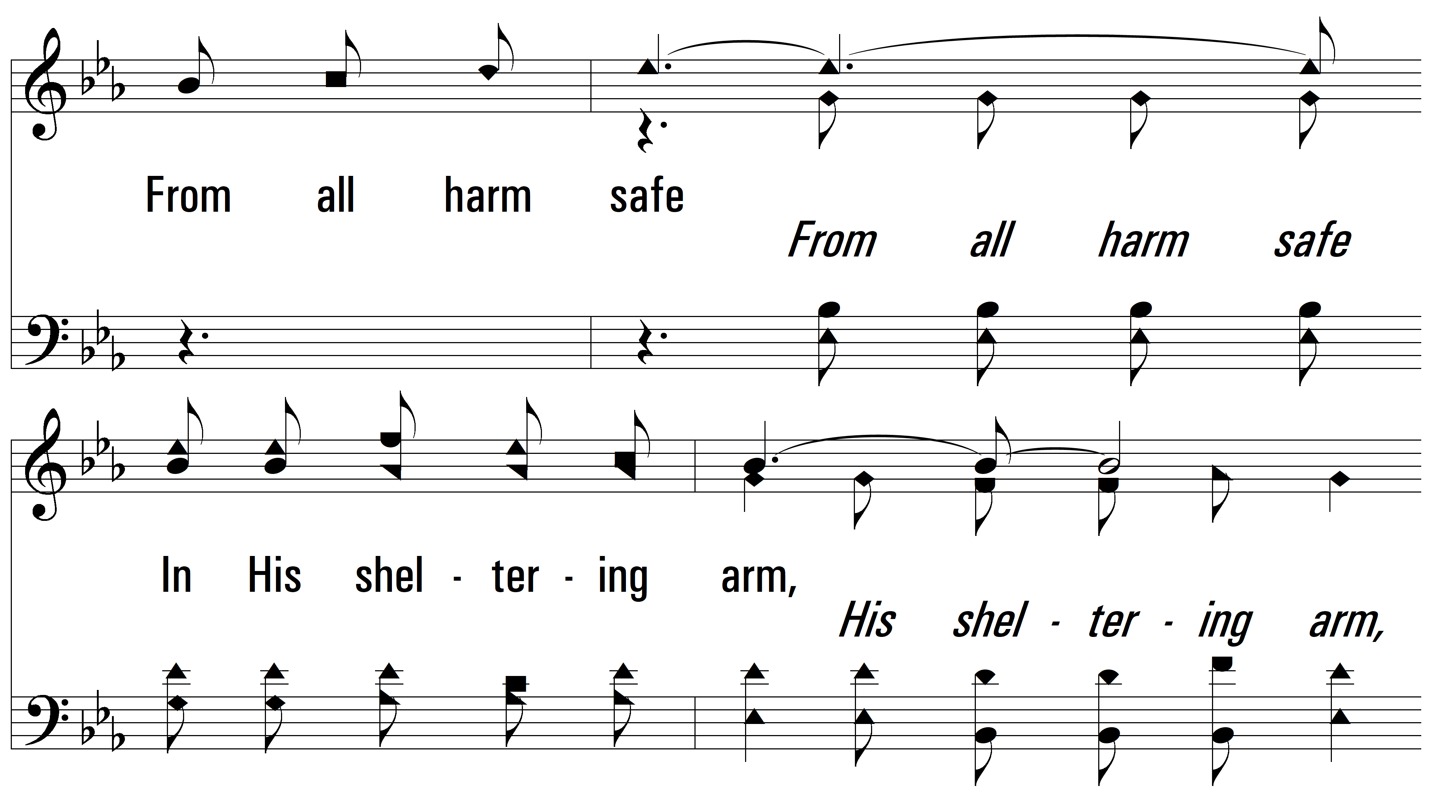
vs. 1

Slide 7
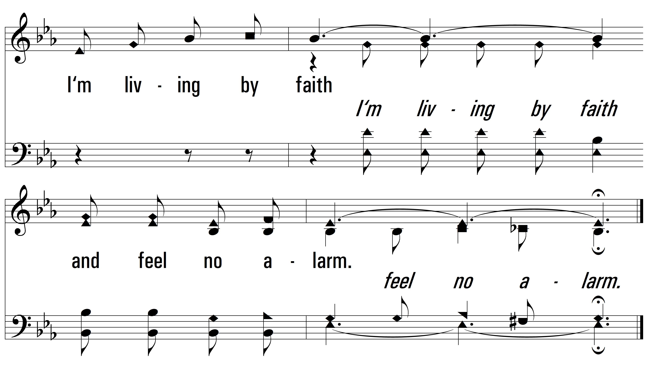
vs. 1

Slide 8
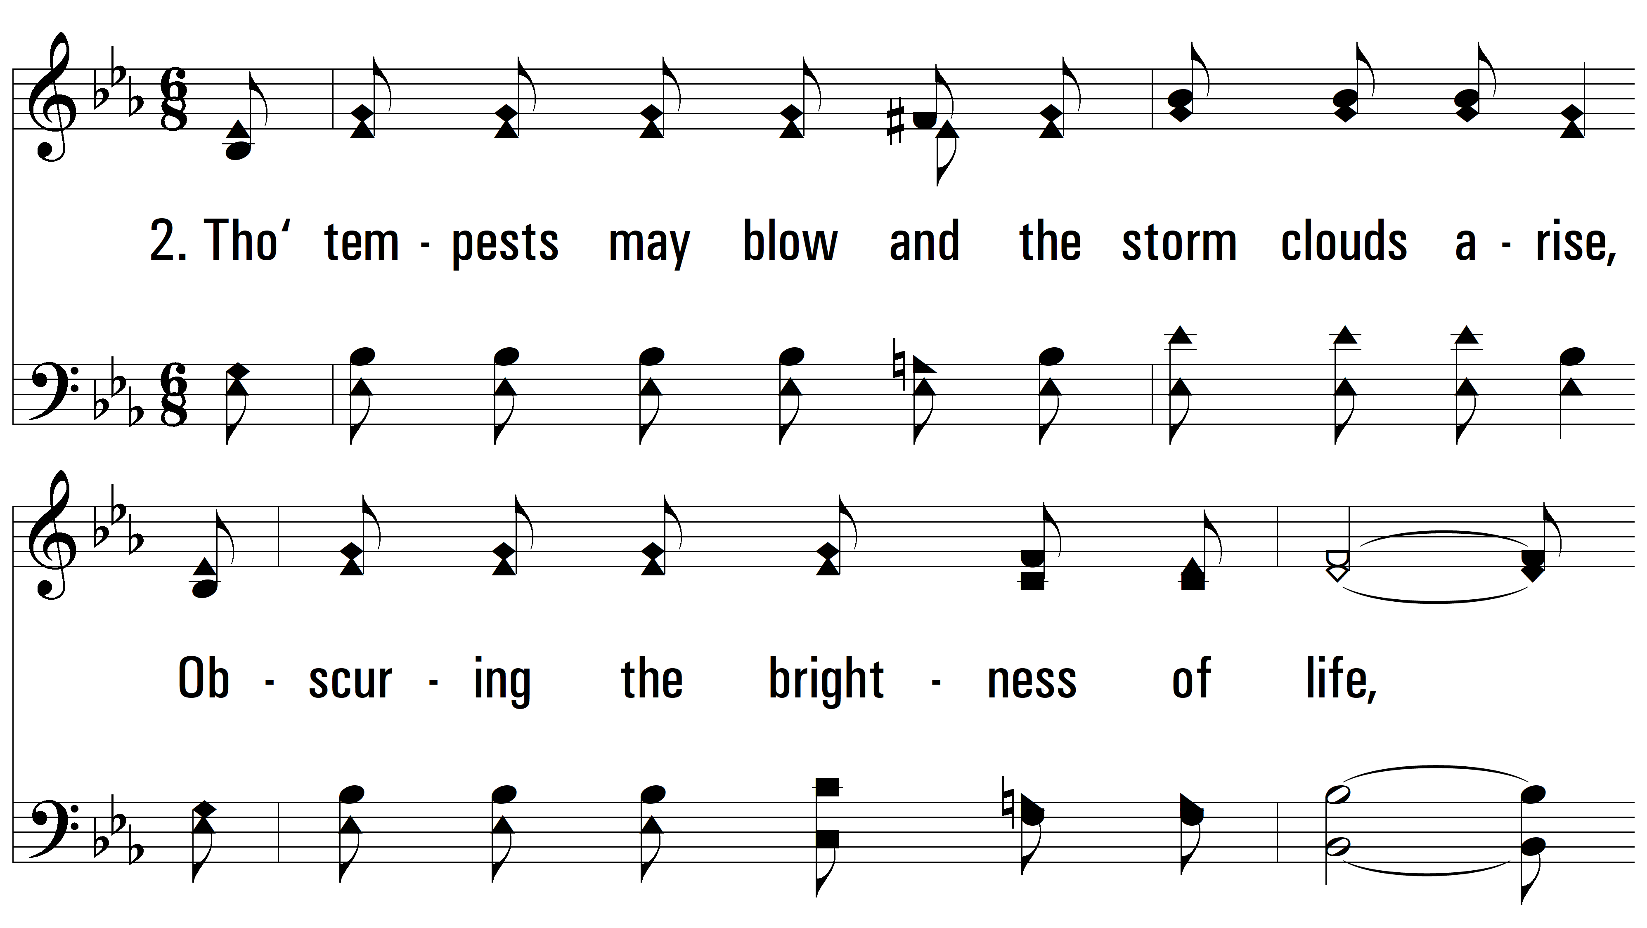
vs. 2 ~ Living By Faith

Slide 9
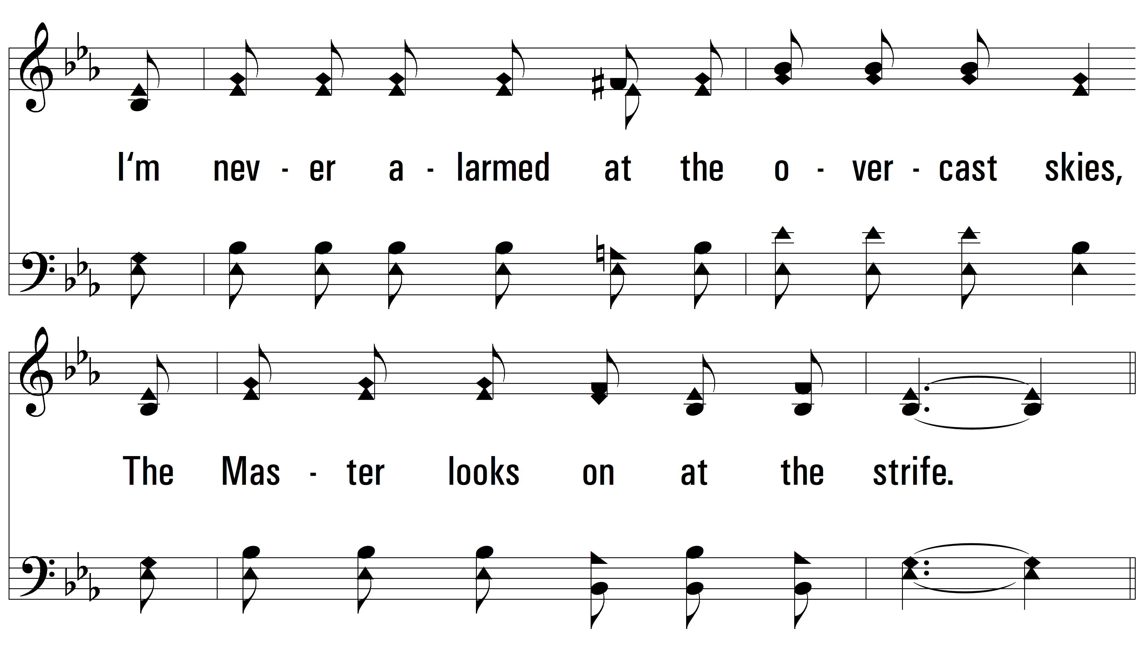
vs. 2

Slide 10
vs. 2

Slide 11
vs. 2

Slide 12
vs. 2

Slide 13
vs. 2

Slide 14
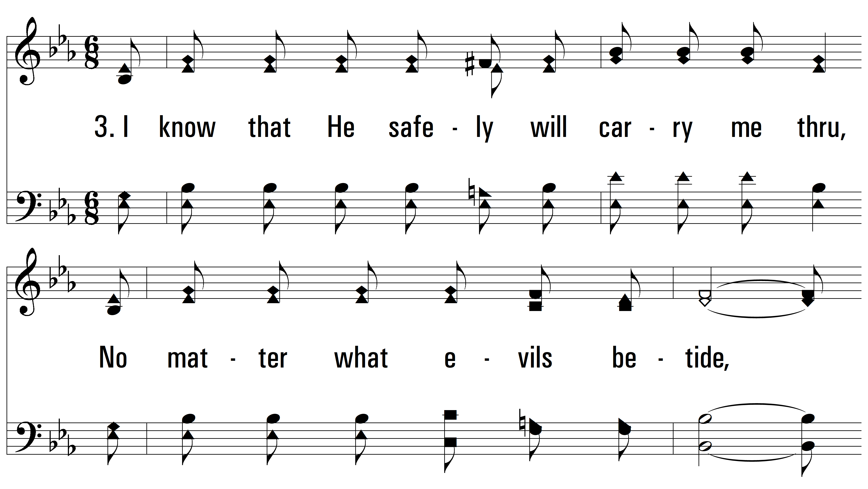
vs. 3 ~ Living By Faith

Slide 15
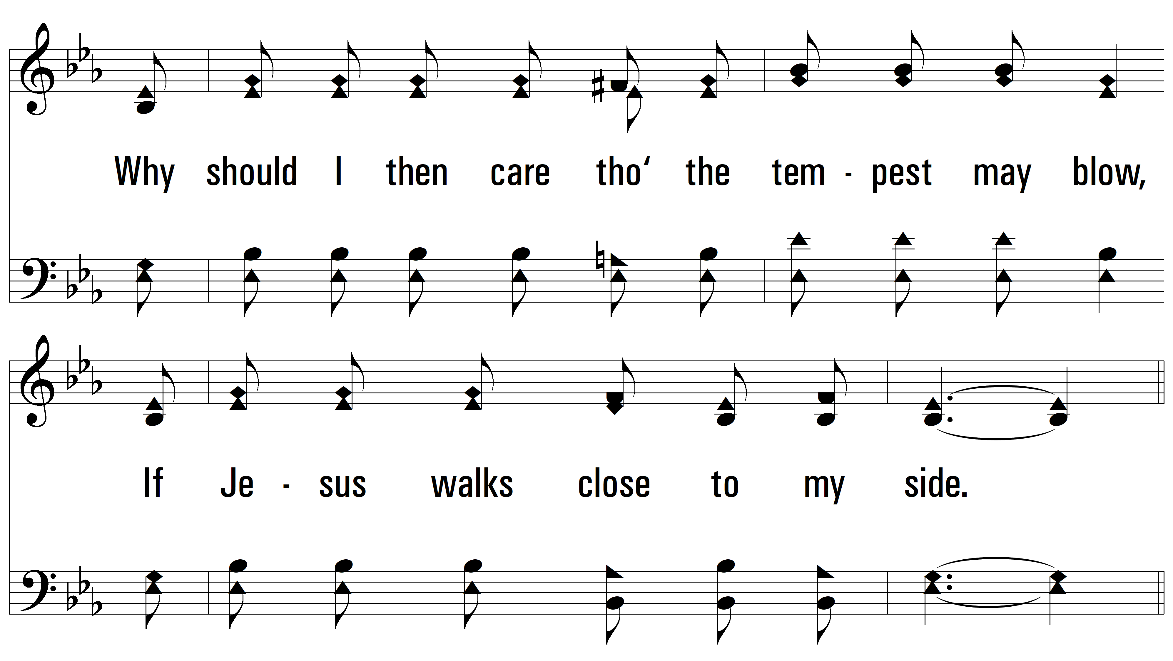
vs. 3

Slide 16
vs. 3

Slide 17
vs. 3

Slide 18
vs. 3

Slide 19
vs. 3

Slide 20
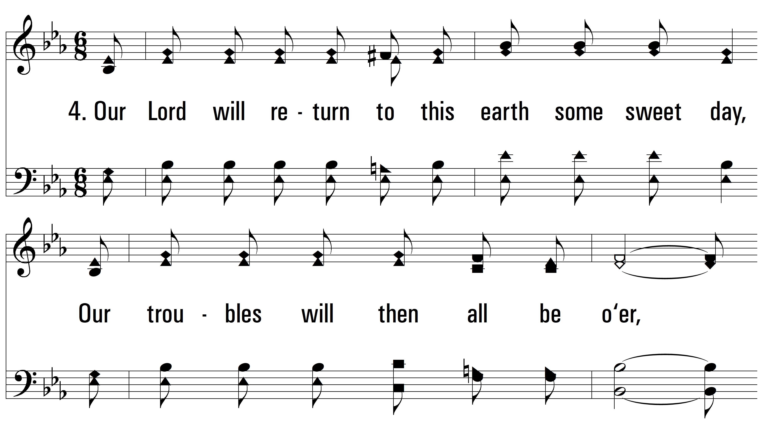
vs. 4 ~ Living By Faith

Slide 21
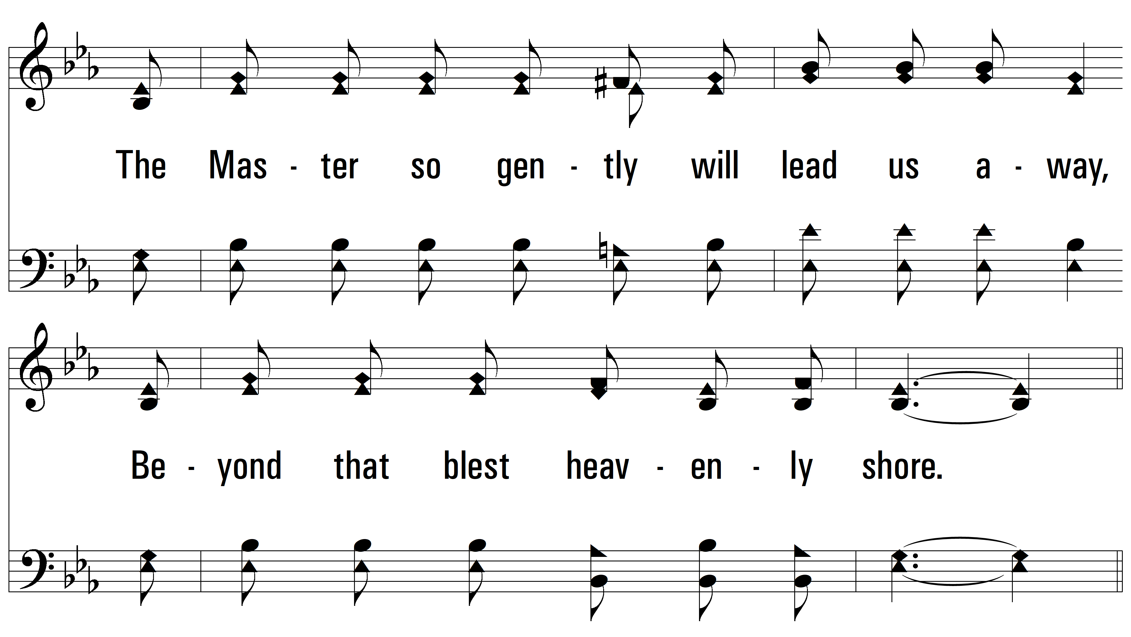
vs. 4

Slide 22
vs. 4

Slide 23
vs. 4

Slide 24
vs. 4

Slide 25
vs. 4
PDHymns.com
END

