Slide 1
Let The Whole Creation Cry
LLANFAIR
7.7.7.7
Words: | Stopford A. Brooke (1881)
Music: | Robert Williams (1817), Arr. John Roberts (1837)
4/4
F/F - DO
Verses: 4
Lead - | DO
Alto - | SOL
Tenor - | MI
Bass - | DO
PDHymns.com

Slide 2
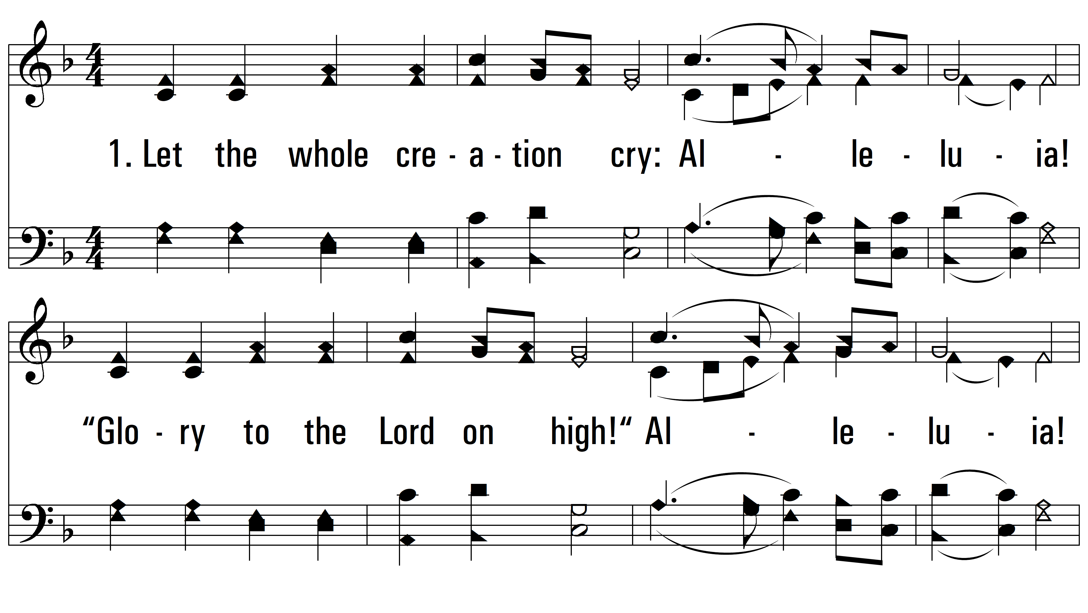
vs. 1 ~ Let The Whole Creation Cry

Slide 3
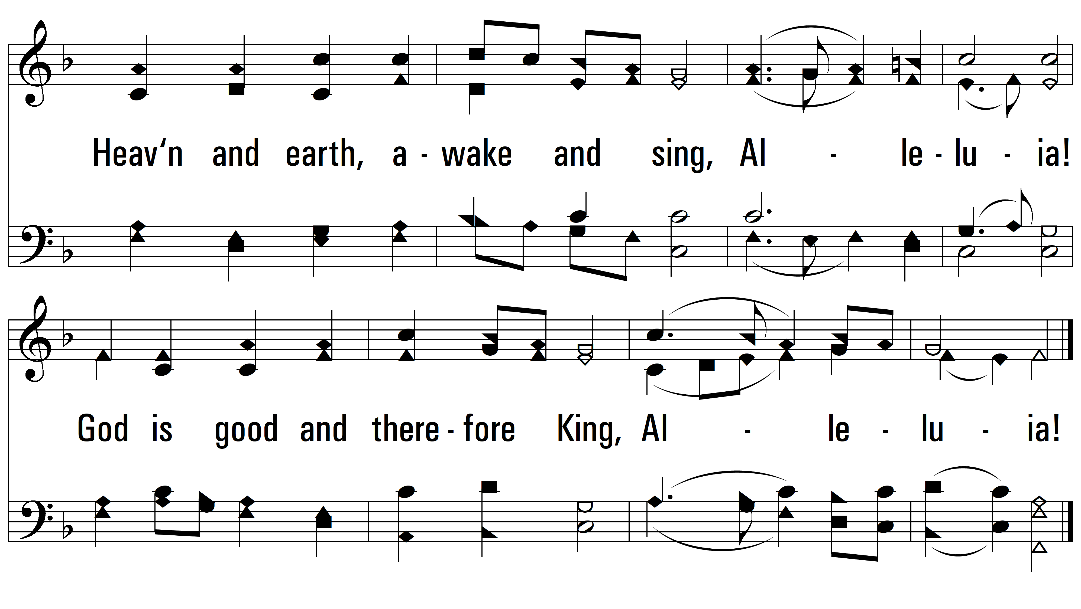
vs. 1

Slide 4
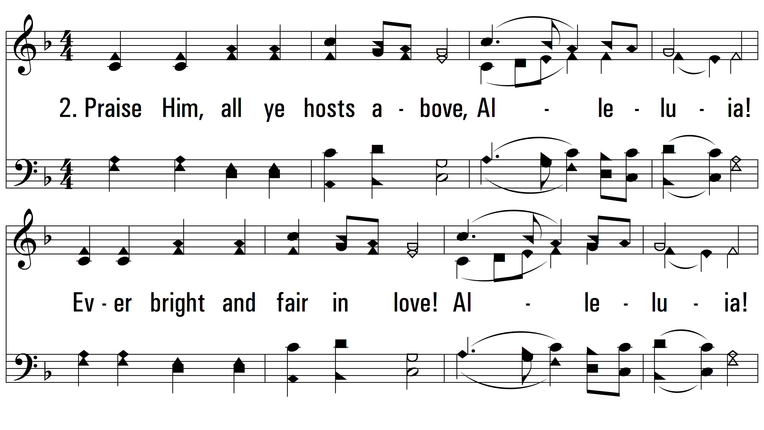
vs. 2 ~ Let The Whole Creation Cry

Slide 5
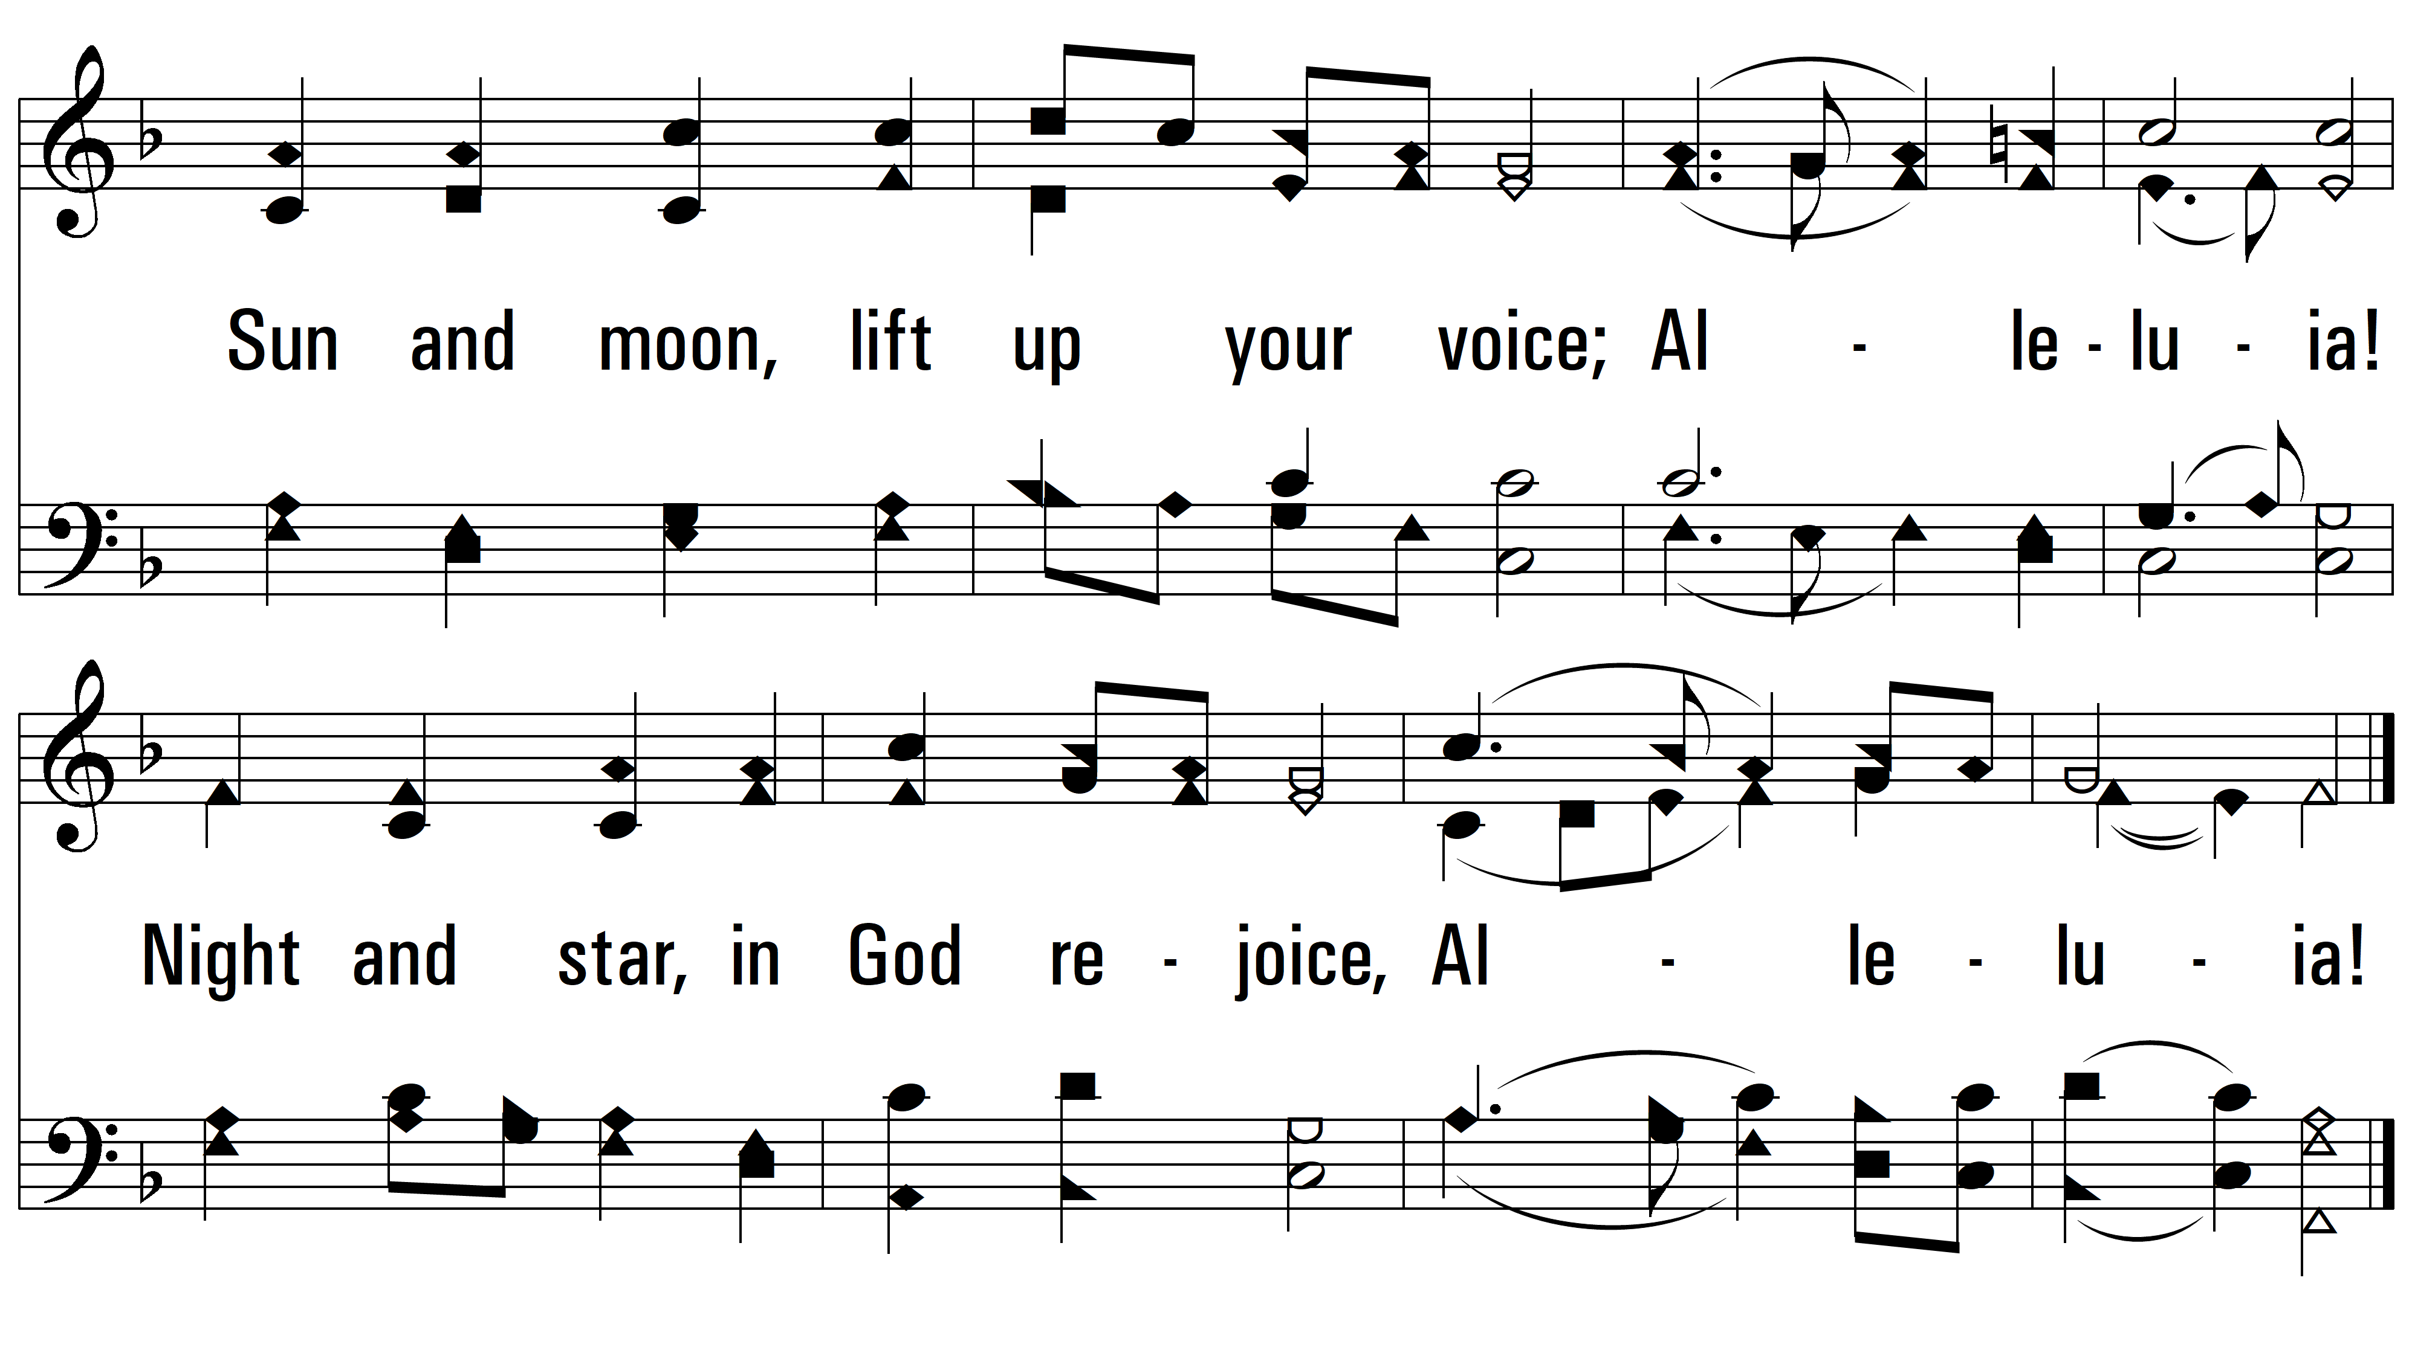
vs. 2

Slide 6
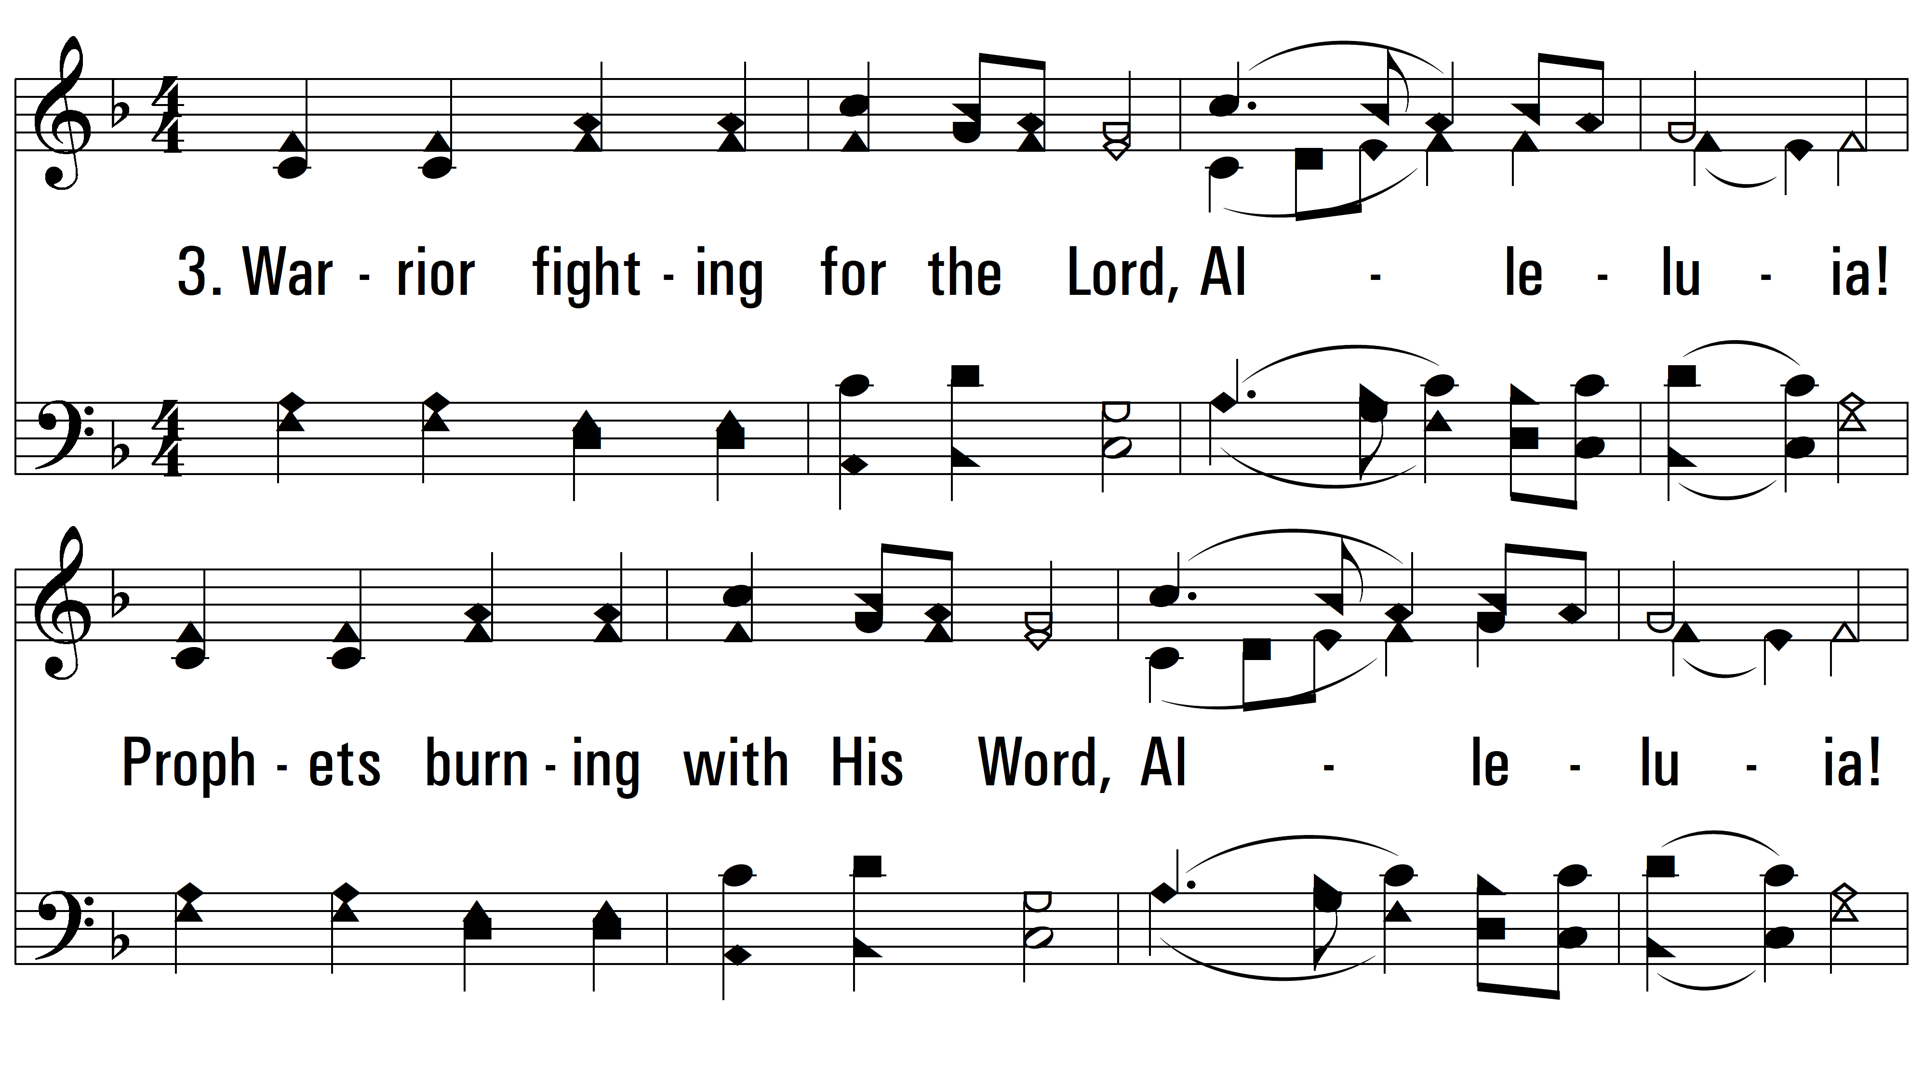
vs. 3 ~ Let The Whole Creation Cry

Slide 7
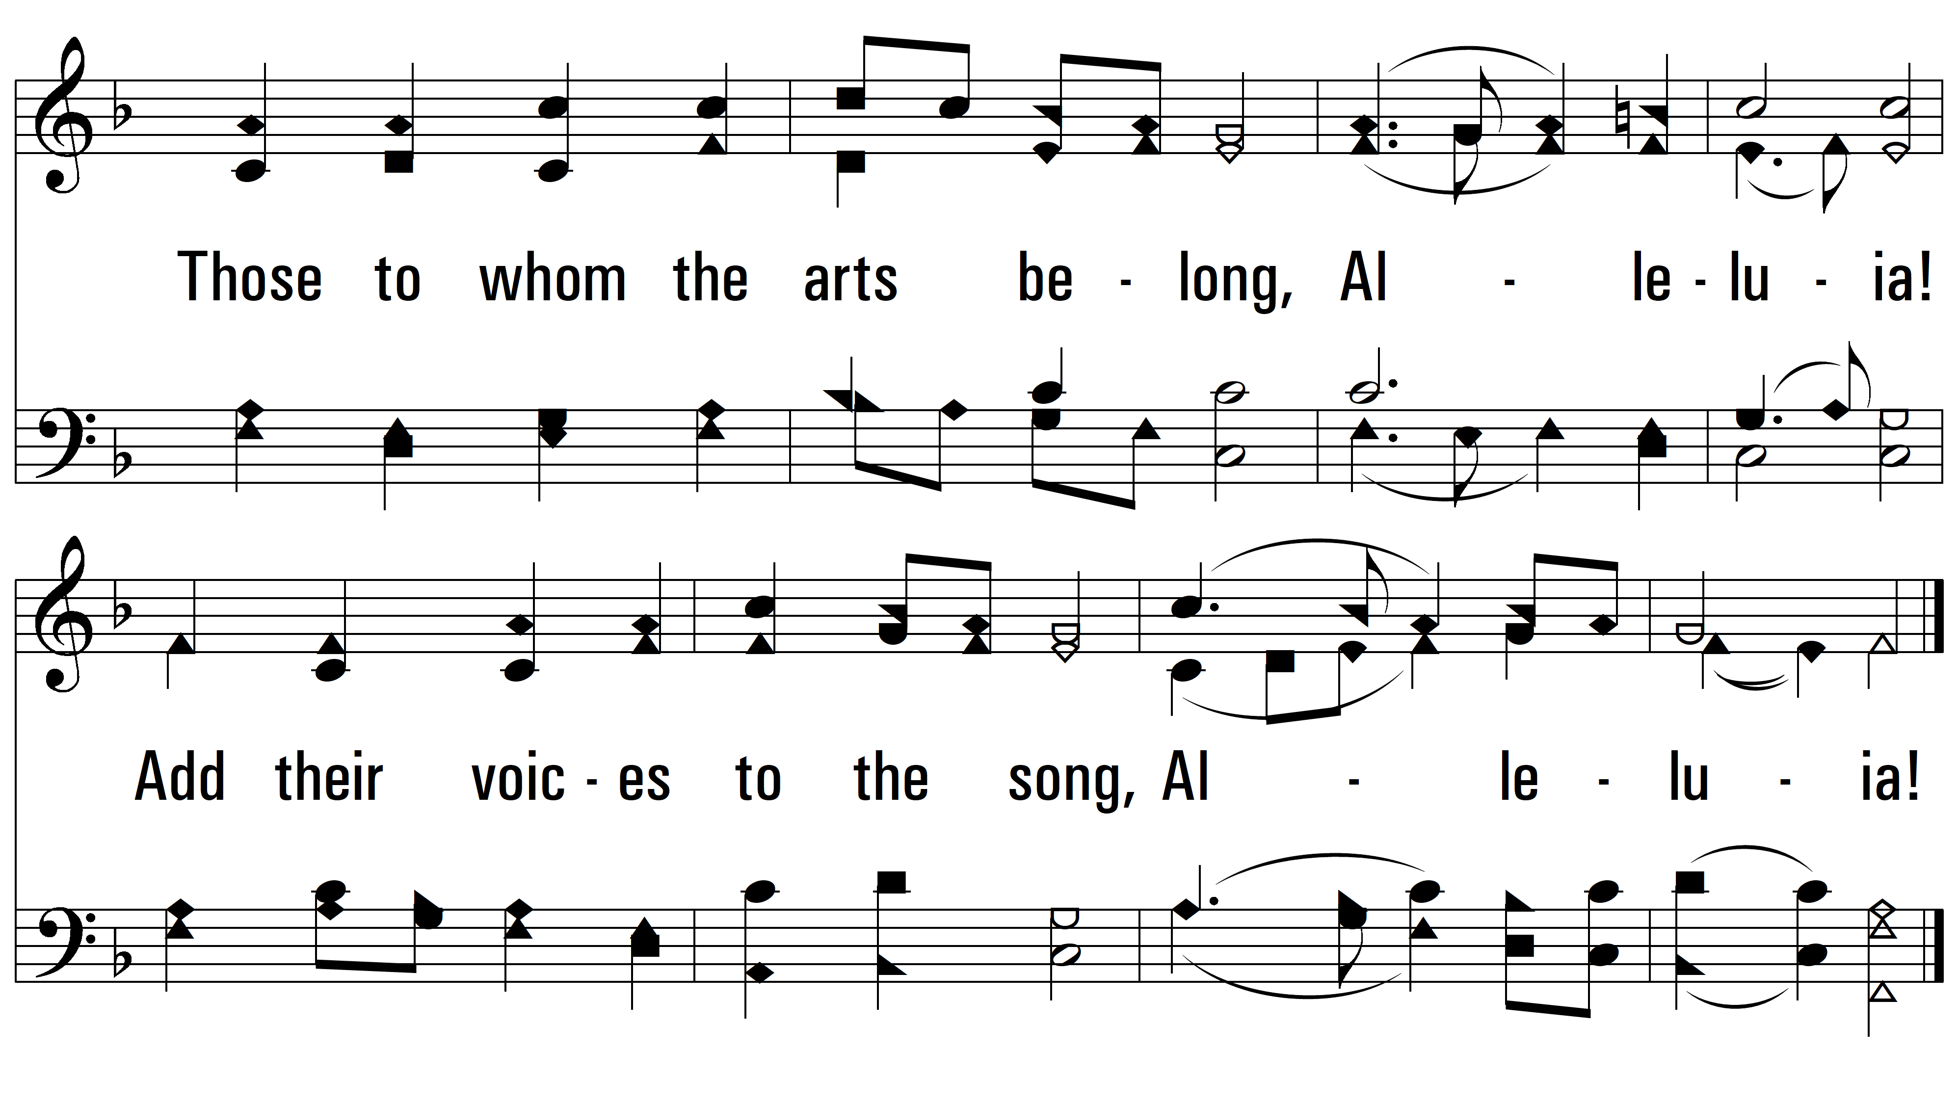
vs. 3

Slide 8
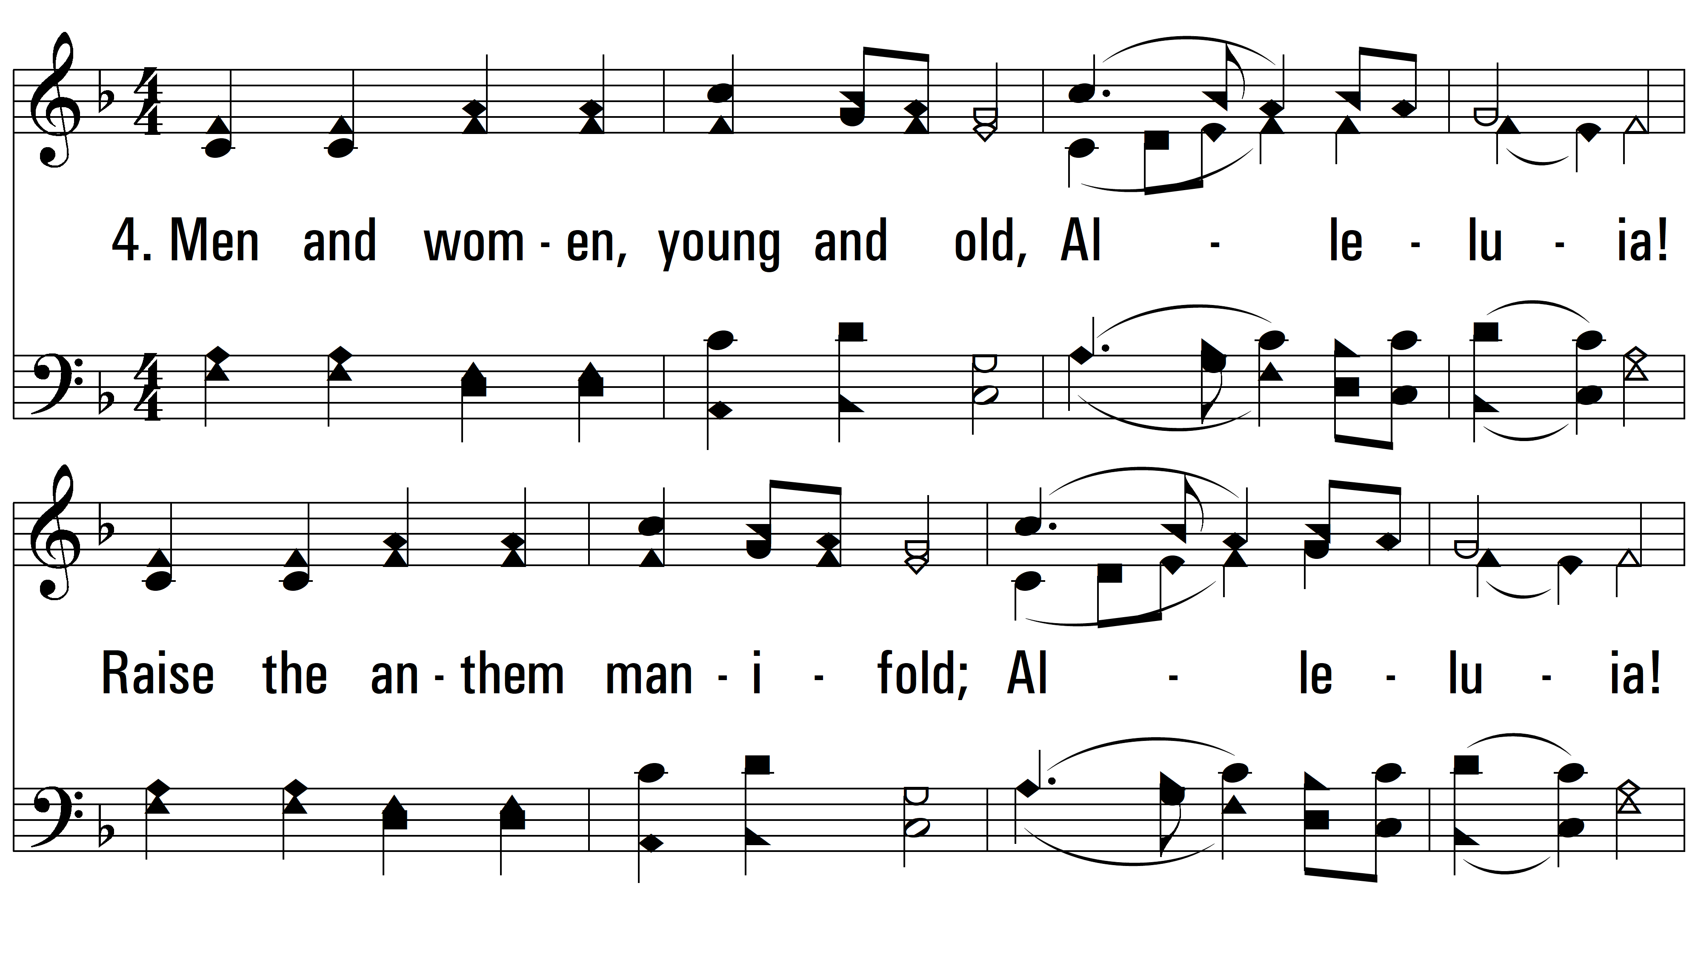
vs. 4 ~ Let The Whole Creation Cry

Slide 9
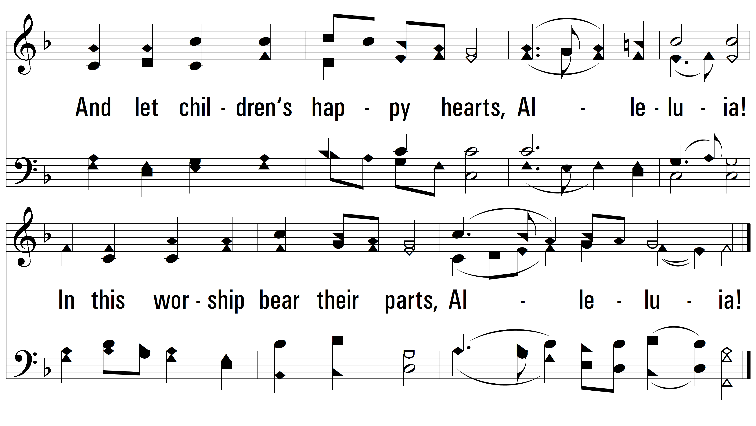
vs. 4
PDHymns.com
END

