Slide 1
Joyful, Joyful We Adore Thee
HYMN TO JOY
8.7.8.7.D
Words: | Henry van Dyke (1907)
Music: | Ludwig van Beethoven (1824), Arr. by Edward Hodges (1864)
4/4
G/B - MI
Verses: 4
Lead - | MI
Alto - | SOL
Tenor - | DO
Bass - | DO
PDHymns.com

Slide 2
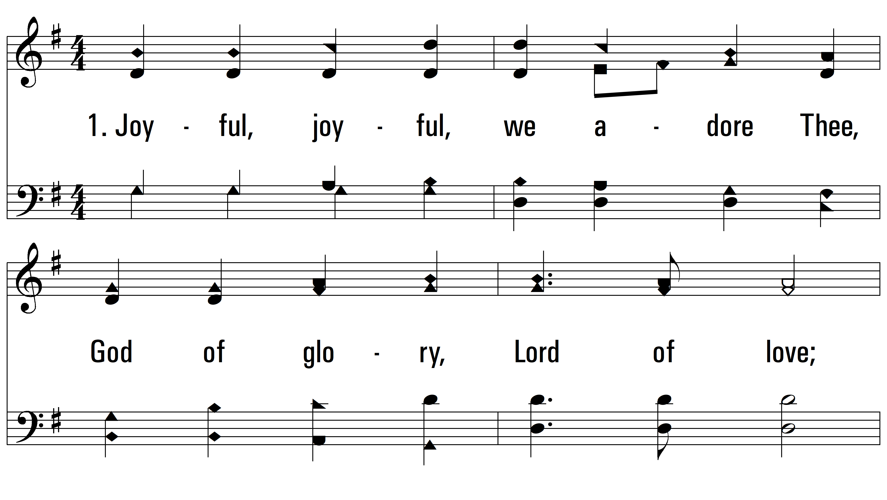
vs. 1 ~ Joyful, Joyful We Adore Thee

Slide 3
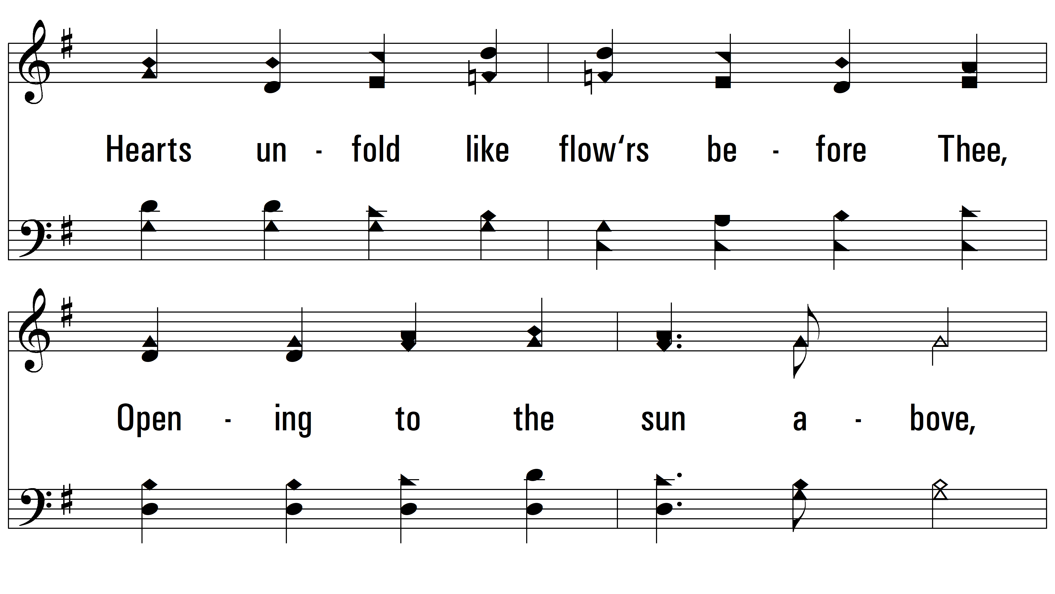
vs. 1

Slide 4
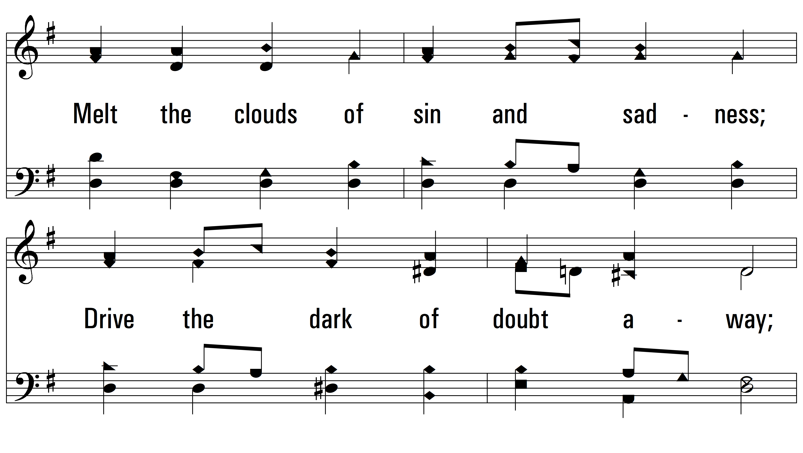
vs. 1

Slide 5
vs. 1

Slide 6
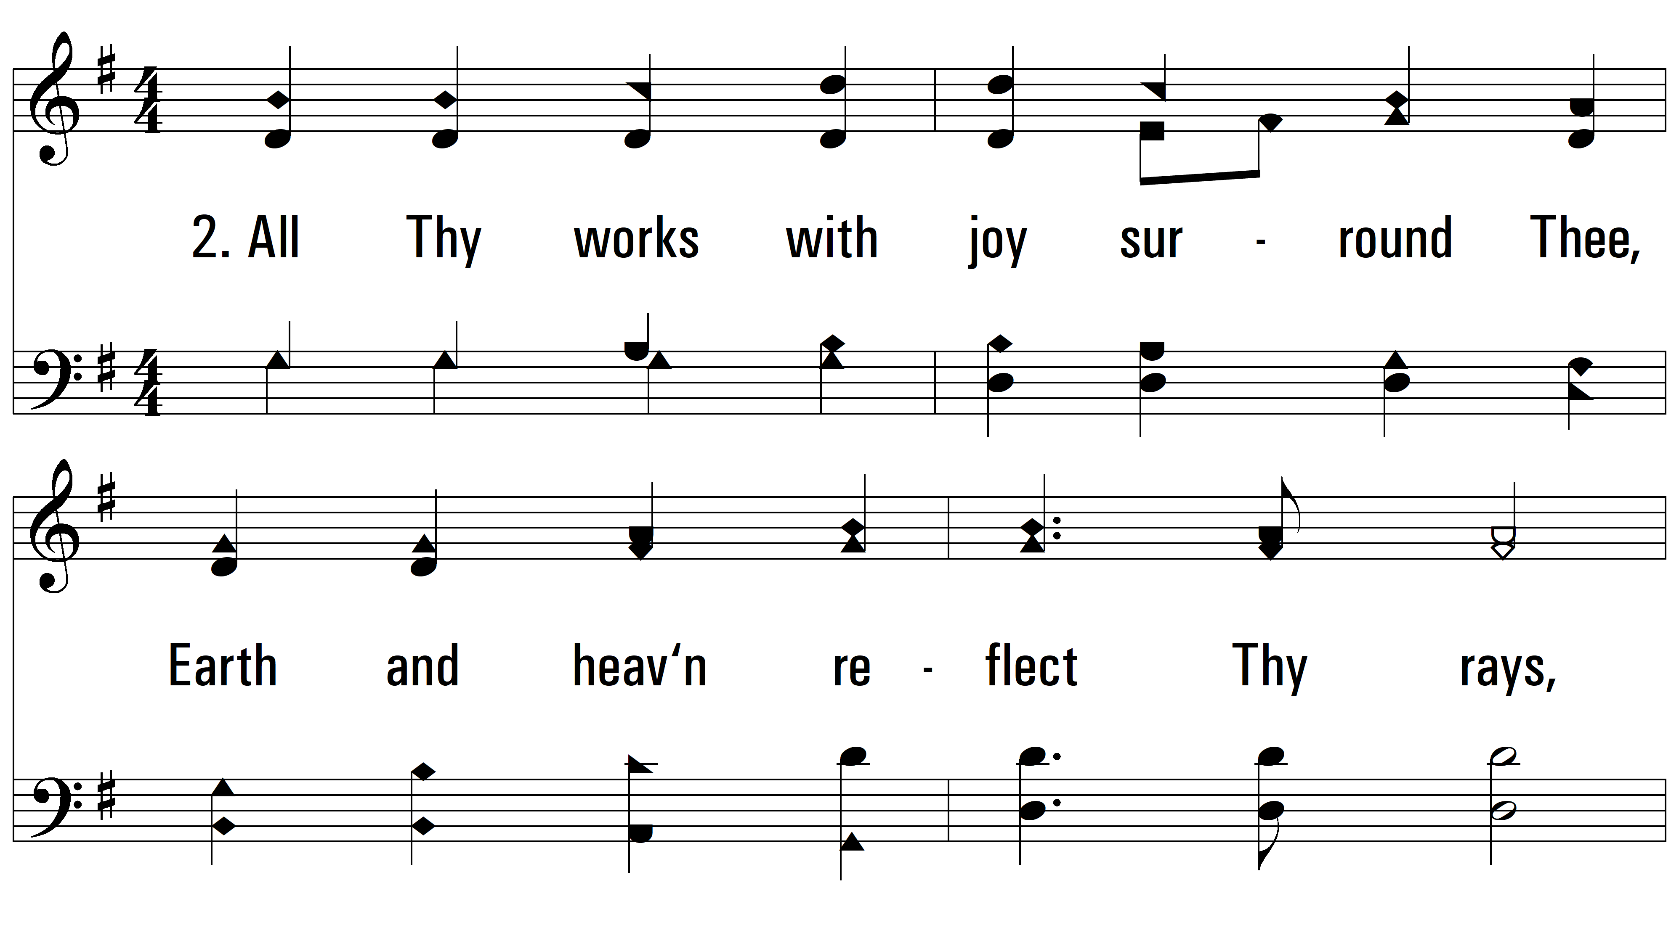
vs. 2 ~ Joyful, Joyful We Adore Thee

Slide 7
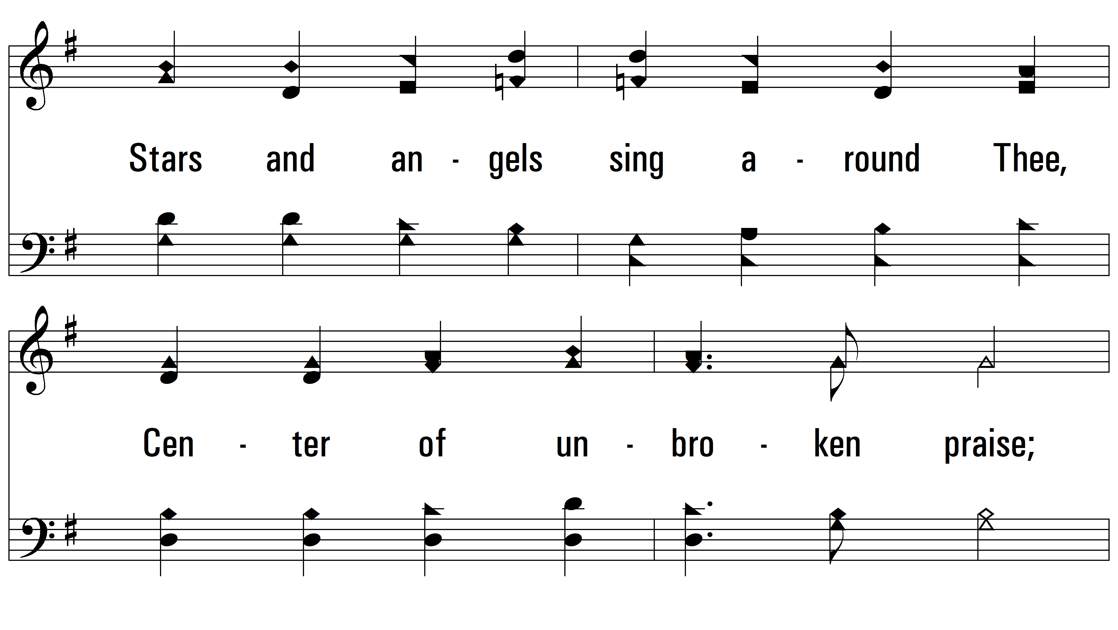
vs. 2

Slide 8
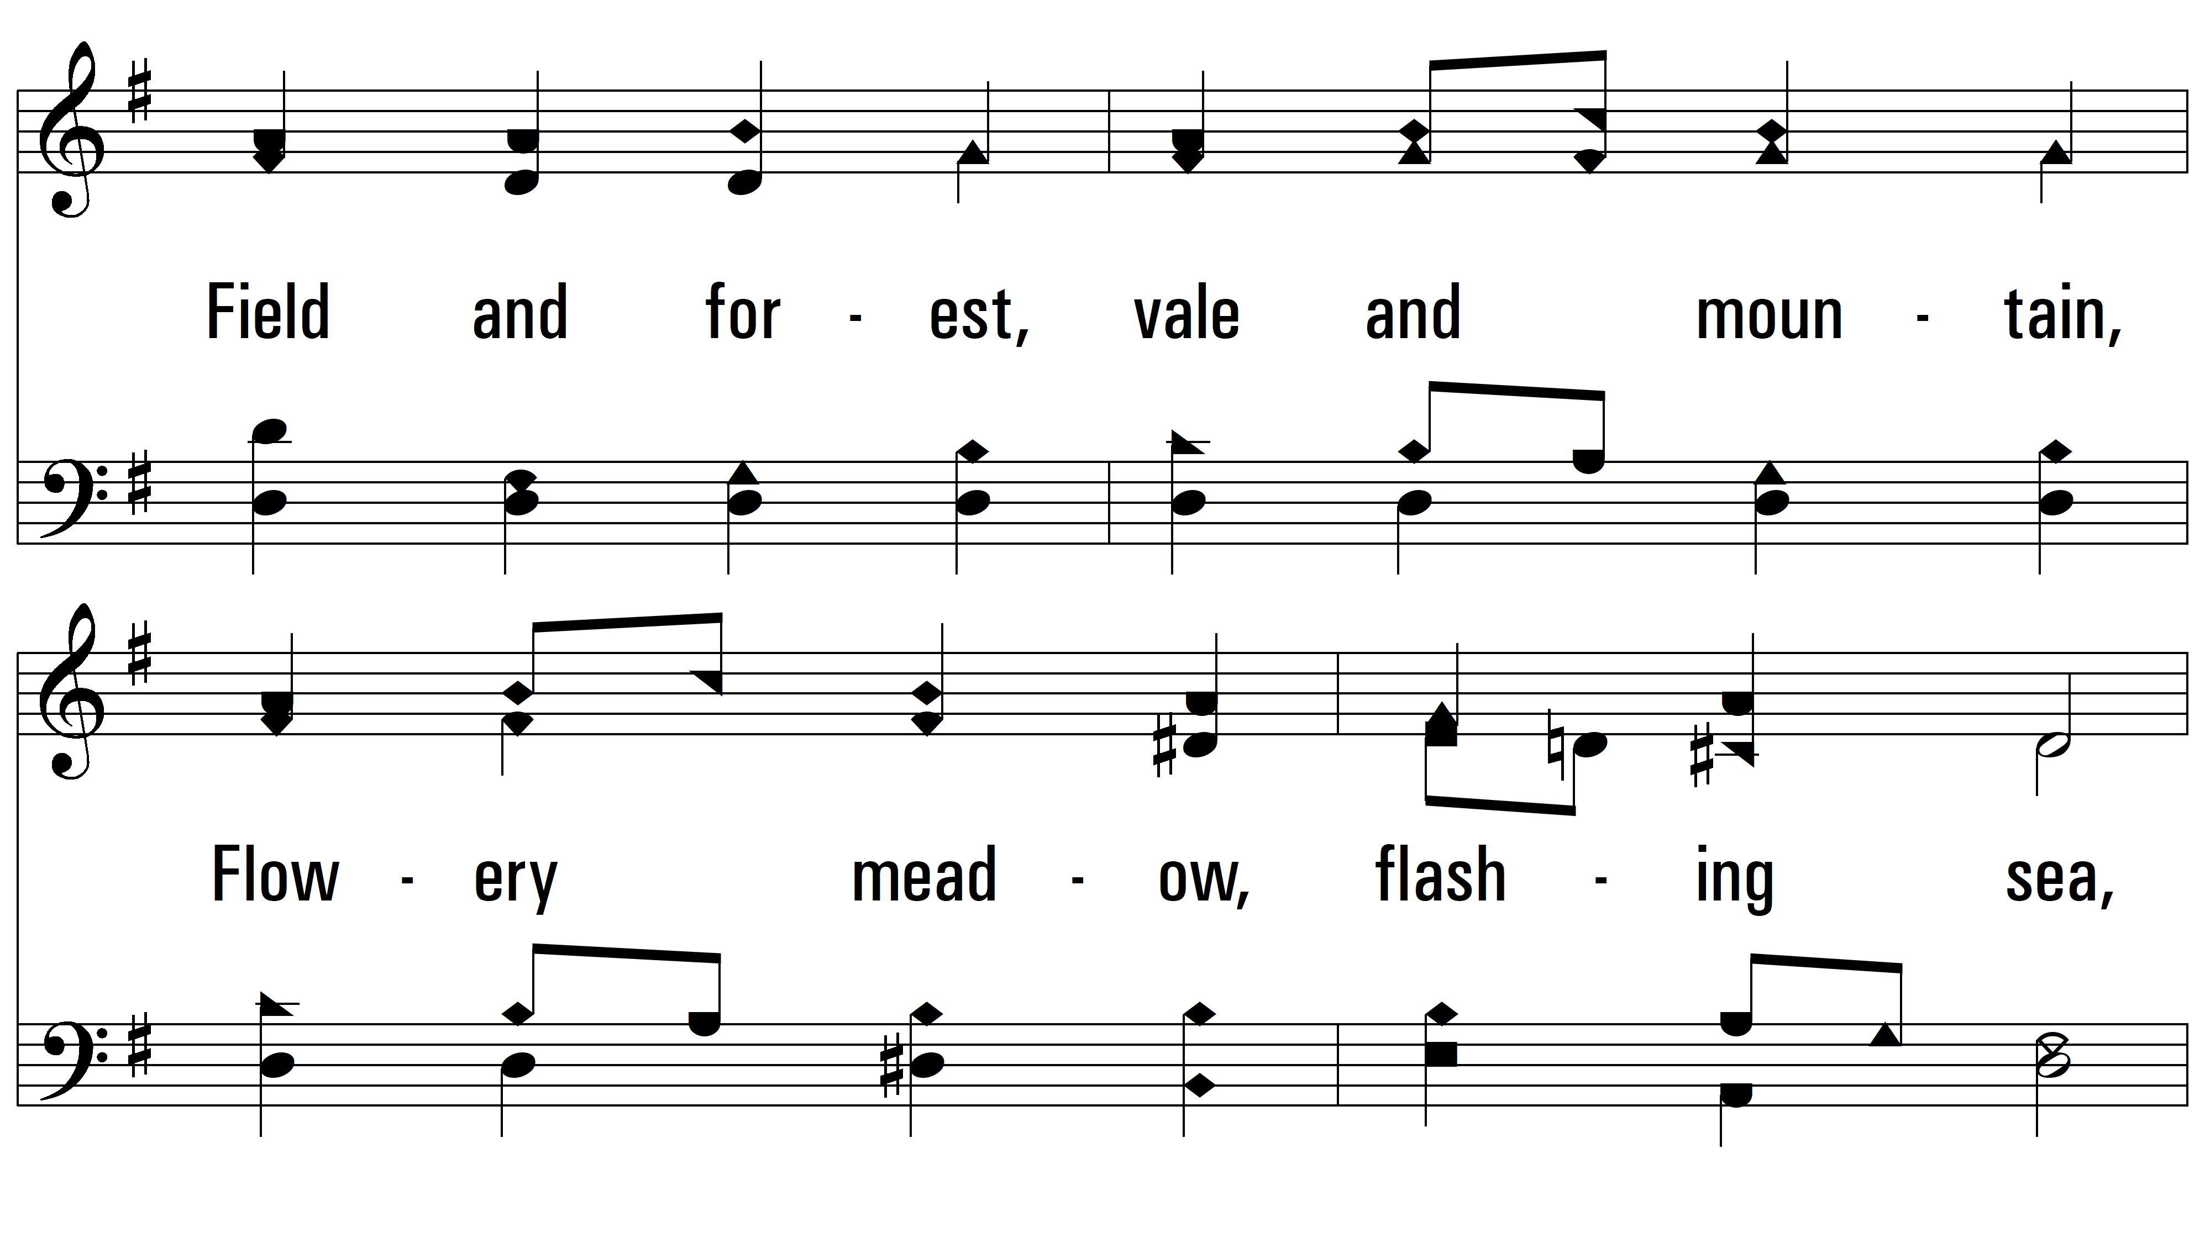
vs. 2

Slide 9
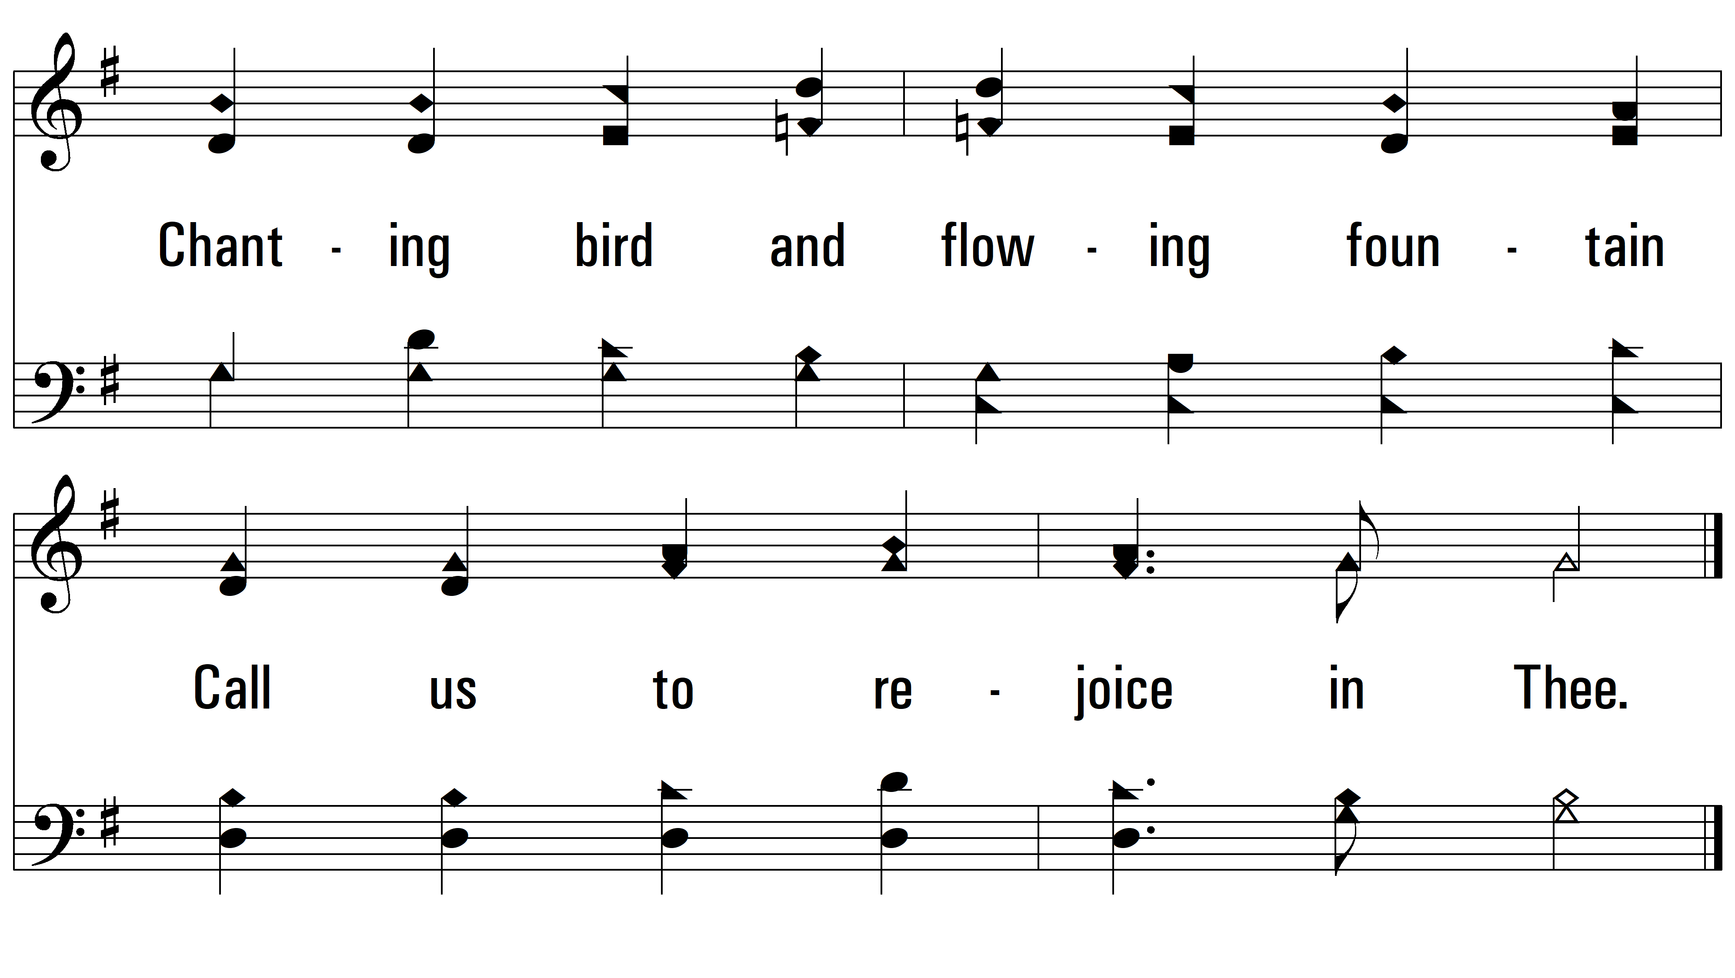
vs. 2

Slide 10
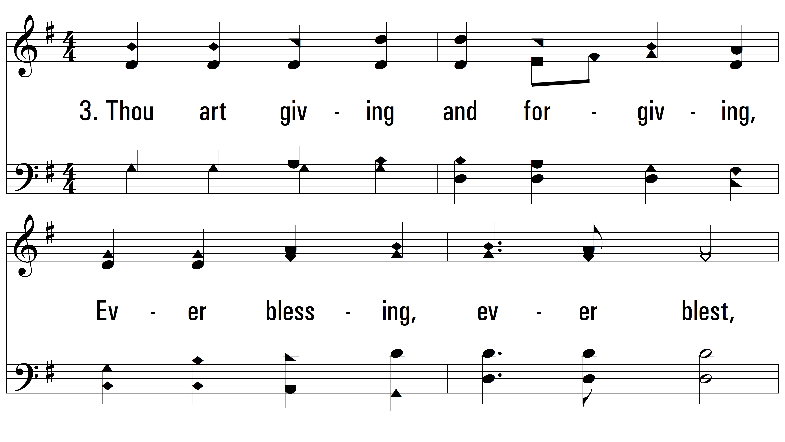
vs. 3 ~ Joyful, Joyful We Adore Thee

Slide 11
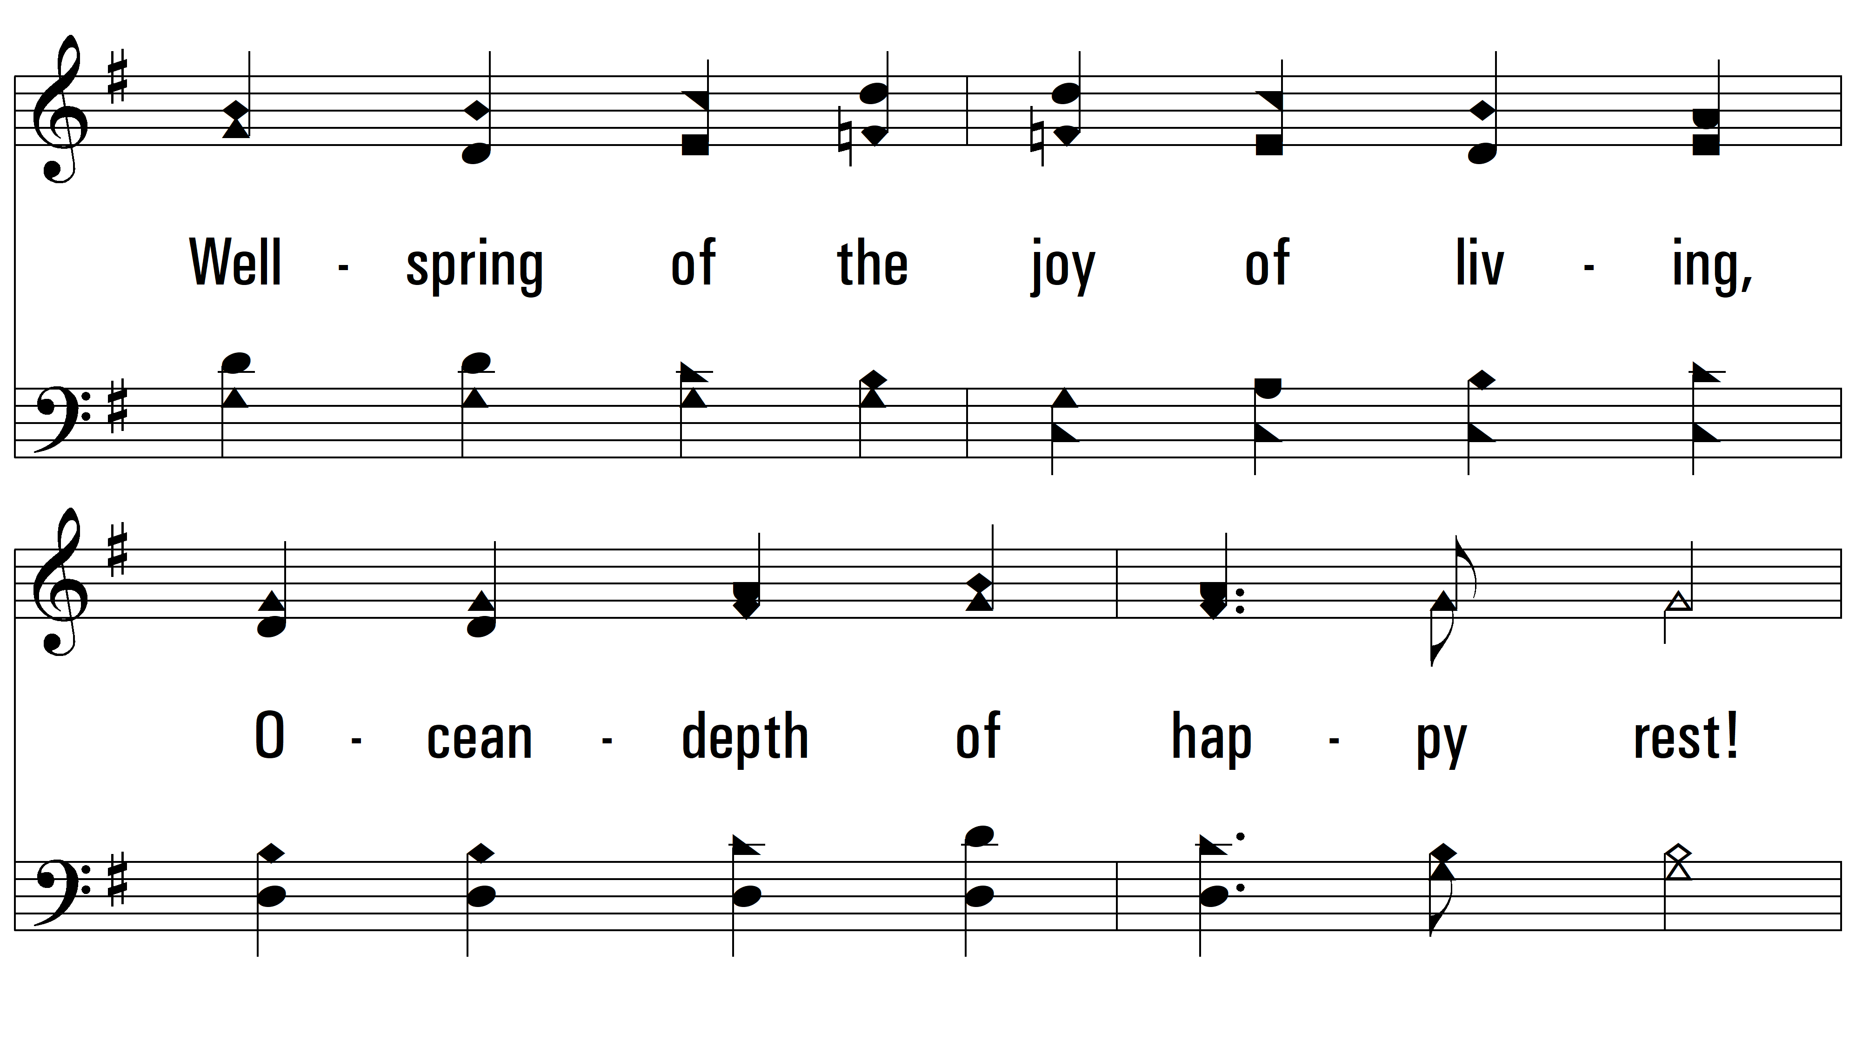
vs. 3

Slide 12
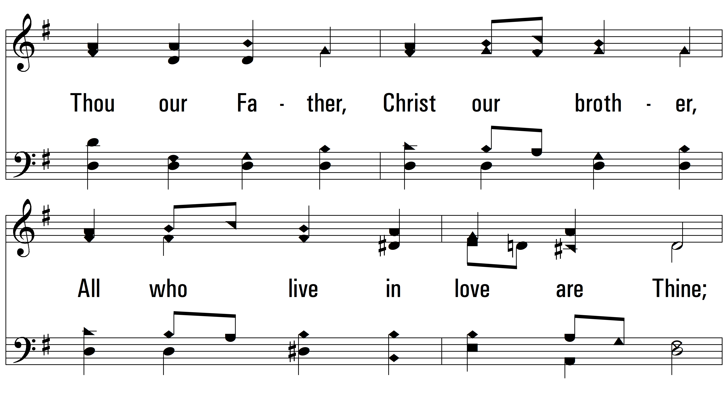
vs. 3

Slide 13
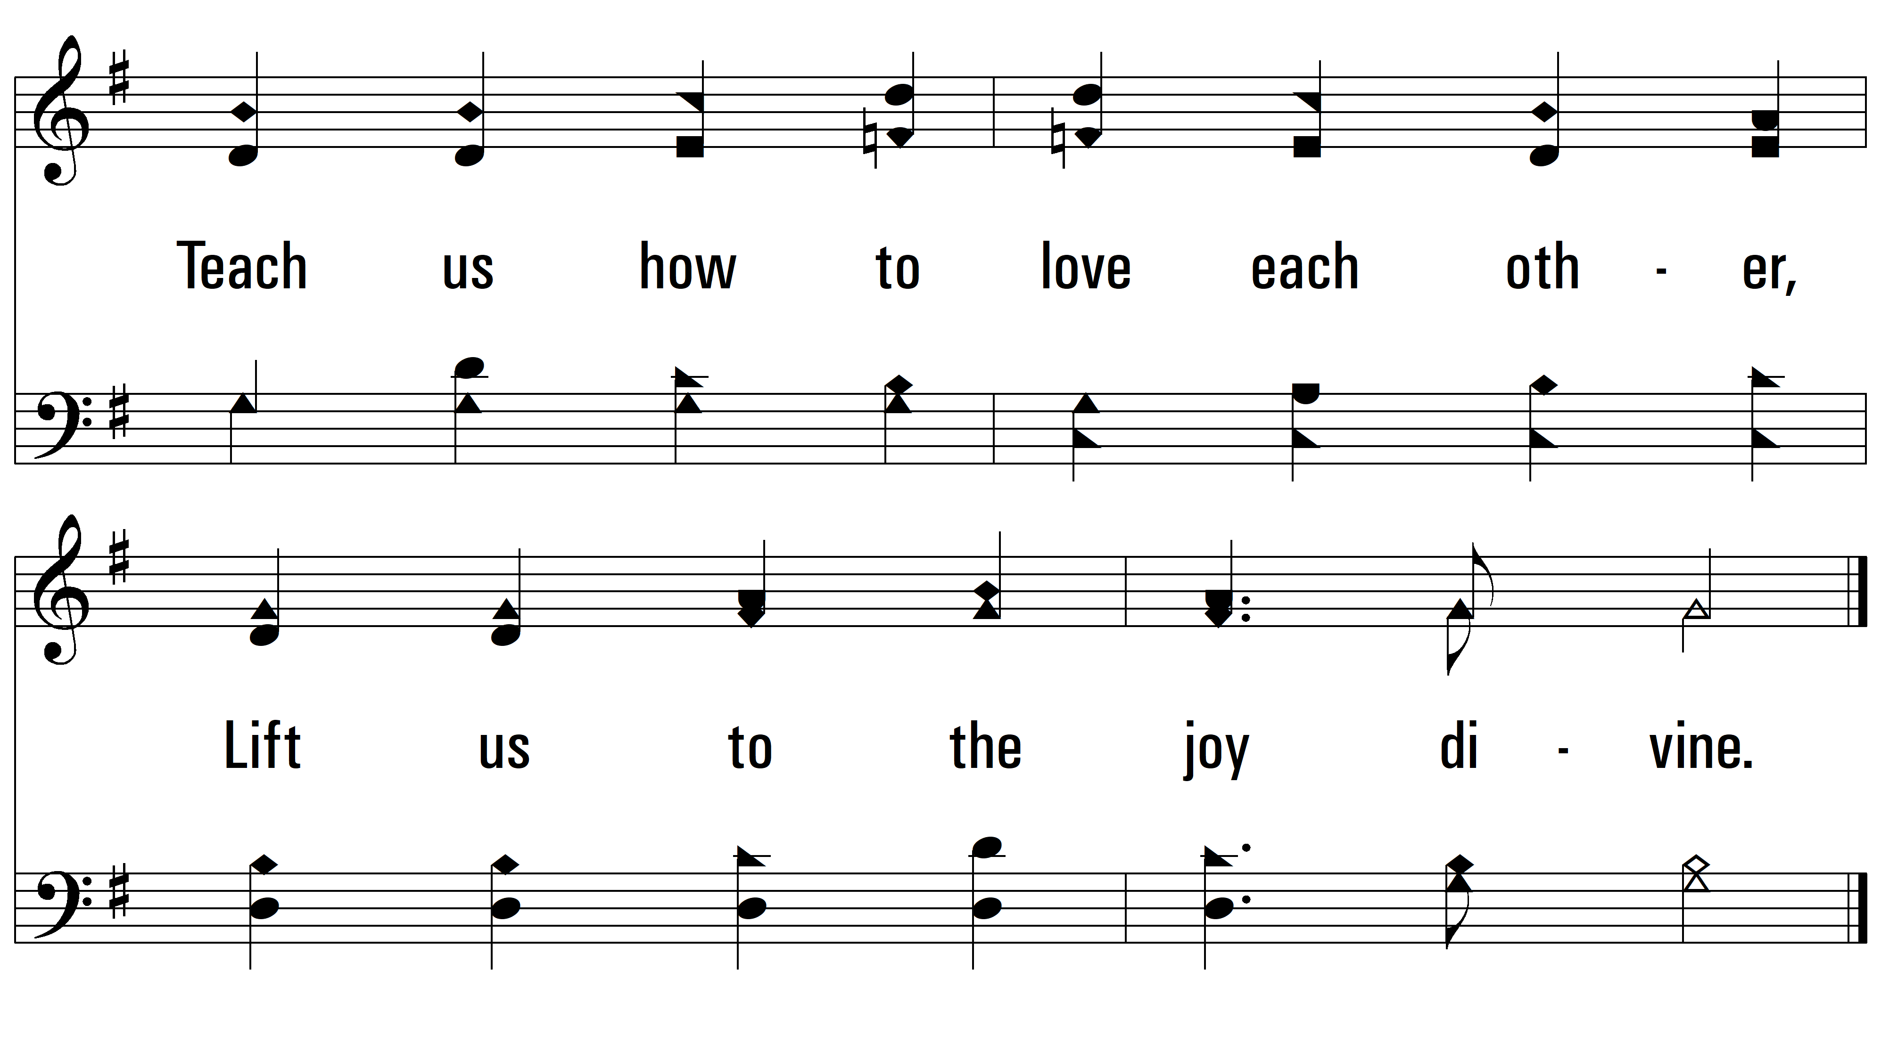
vs. 3

Slide 14
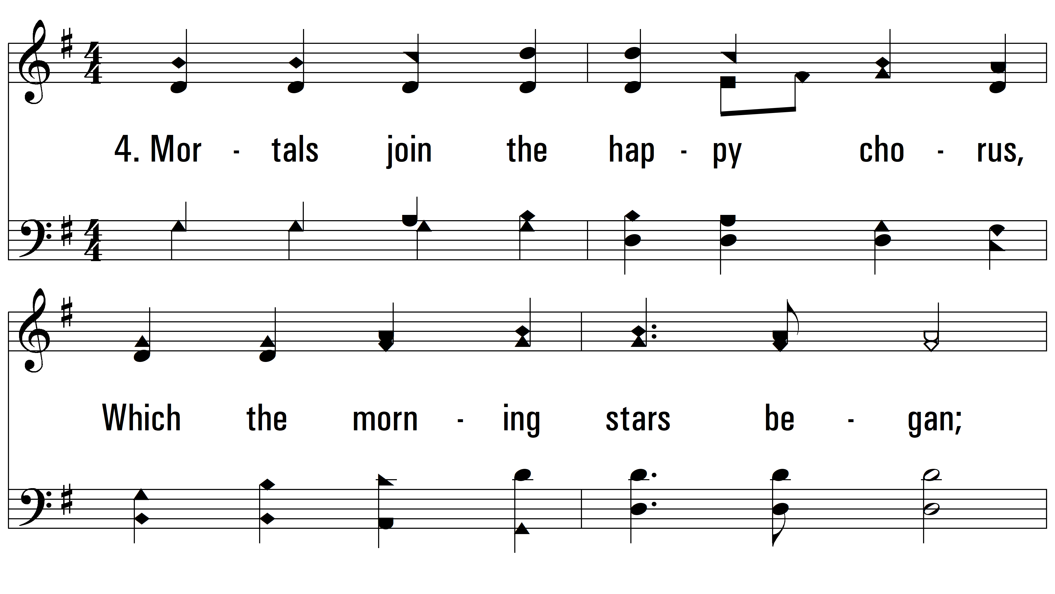
vs. 4 ~ Joyful, Joyful We Adore Thee

Slide 15
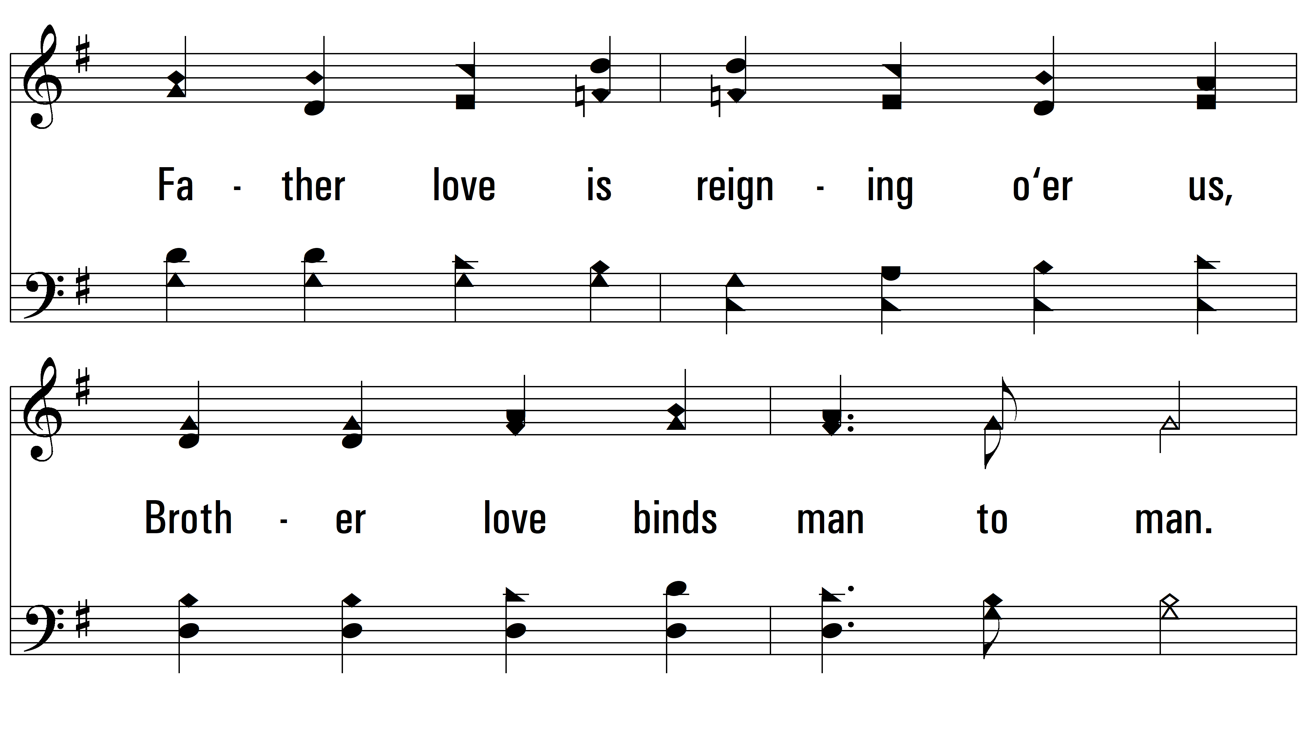
vs. 4

Slide 16
vs. 4

Slide 17
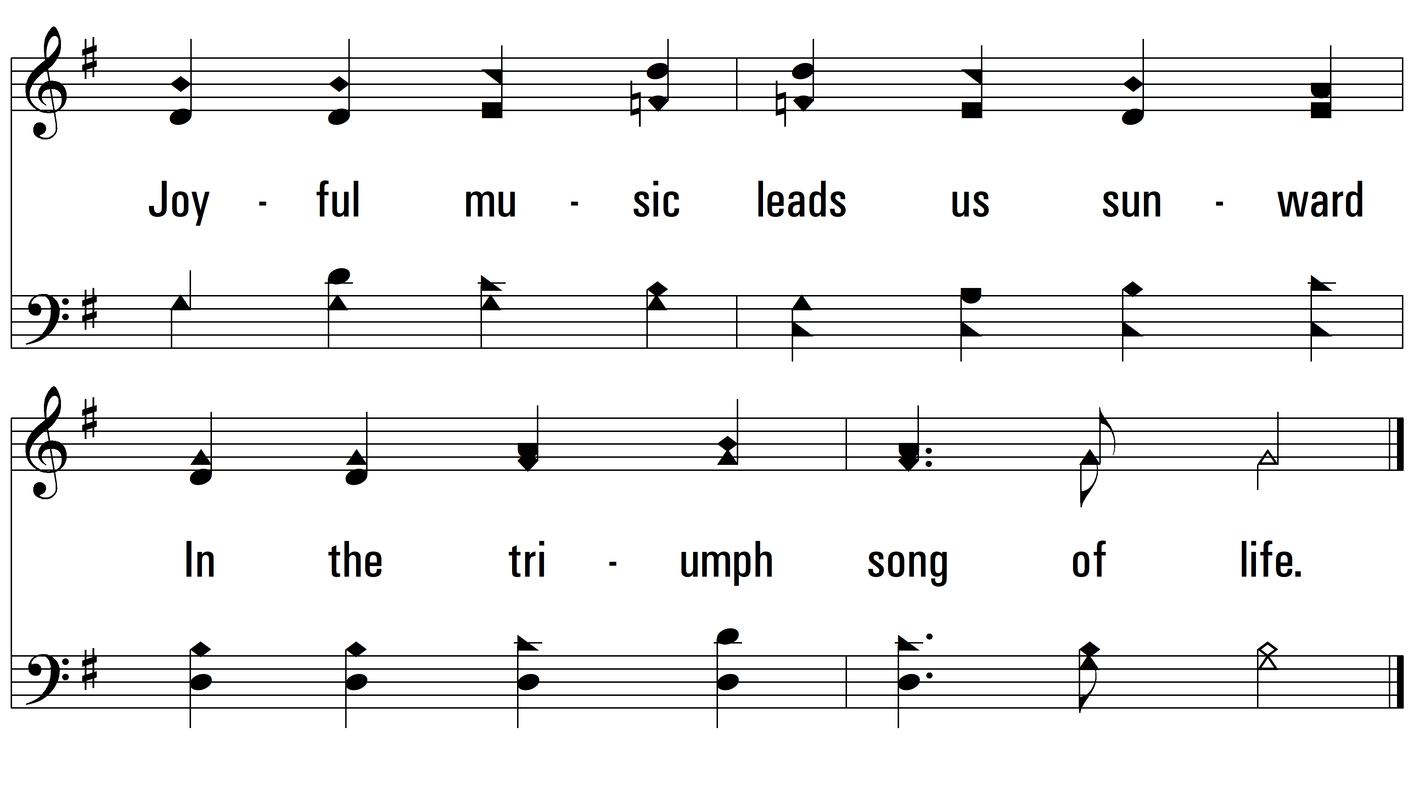
vs. 4
PDHymns.com
END

