Slide 1
Jesus Paid It All
(All To Christ I Owe)
Words: | Elvina M. Hall (1865)
Music: | John T. Grape (1868)
3/4
E^{b}/E^{b} - DO
Verses: 3
Lead - | DO
Alto - | DO
Tenor - | MI
Bass - | DO
PDHymns.com

Slide 2
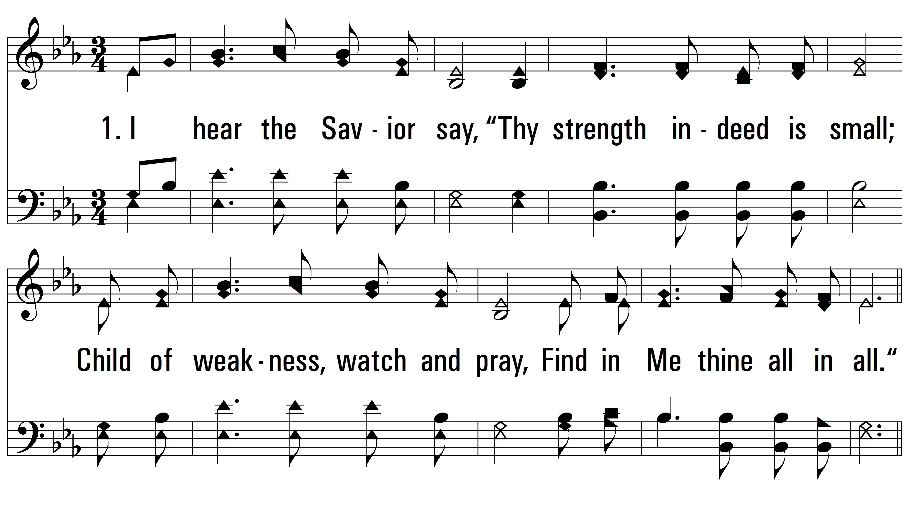
vs. 1 ~ Jesus Paid It All

Slide 3
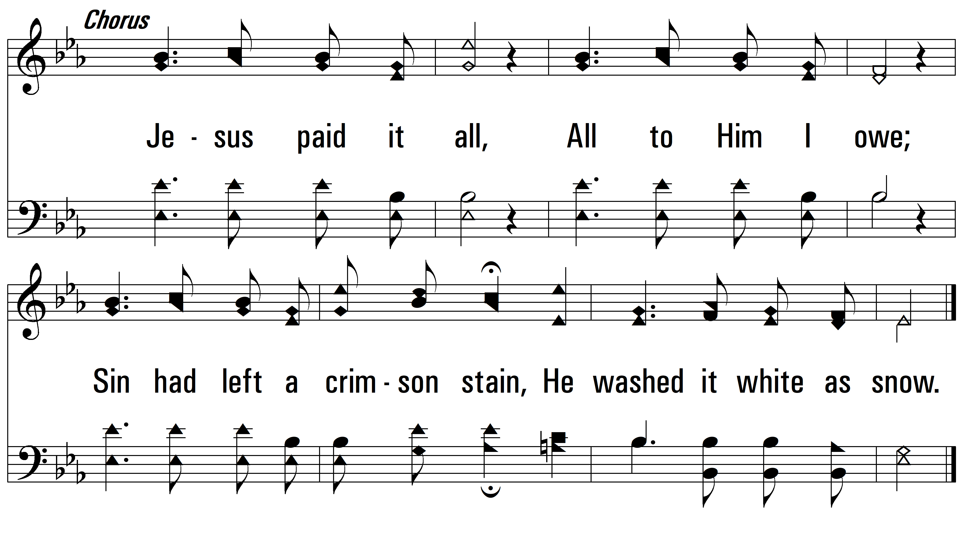
vs. 1

Slide 4
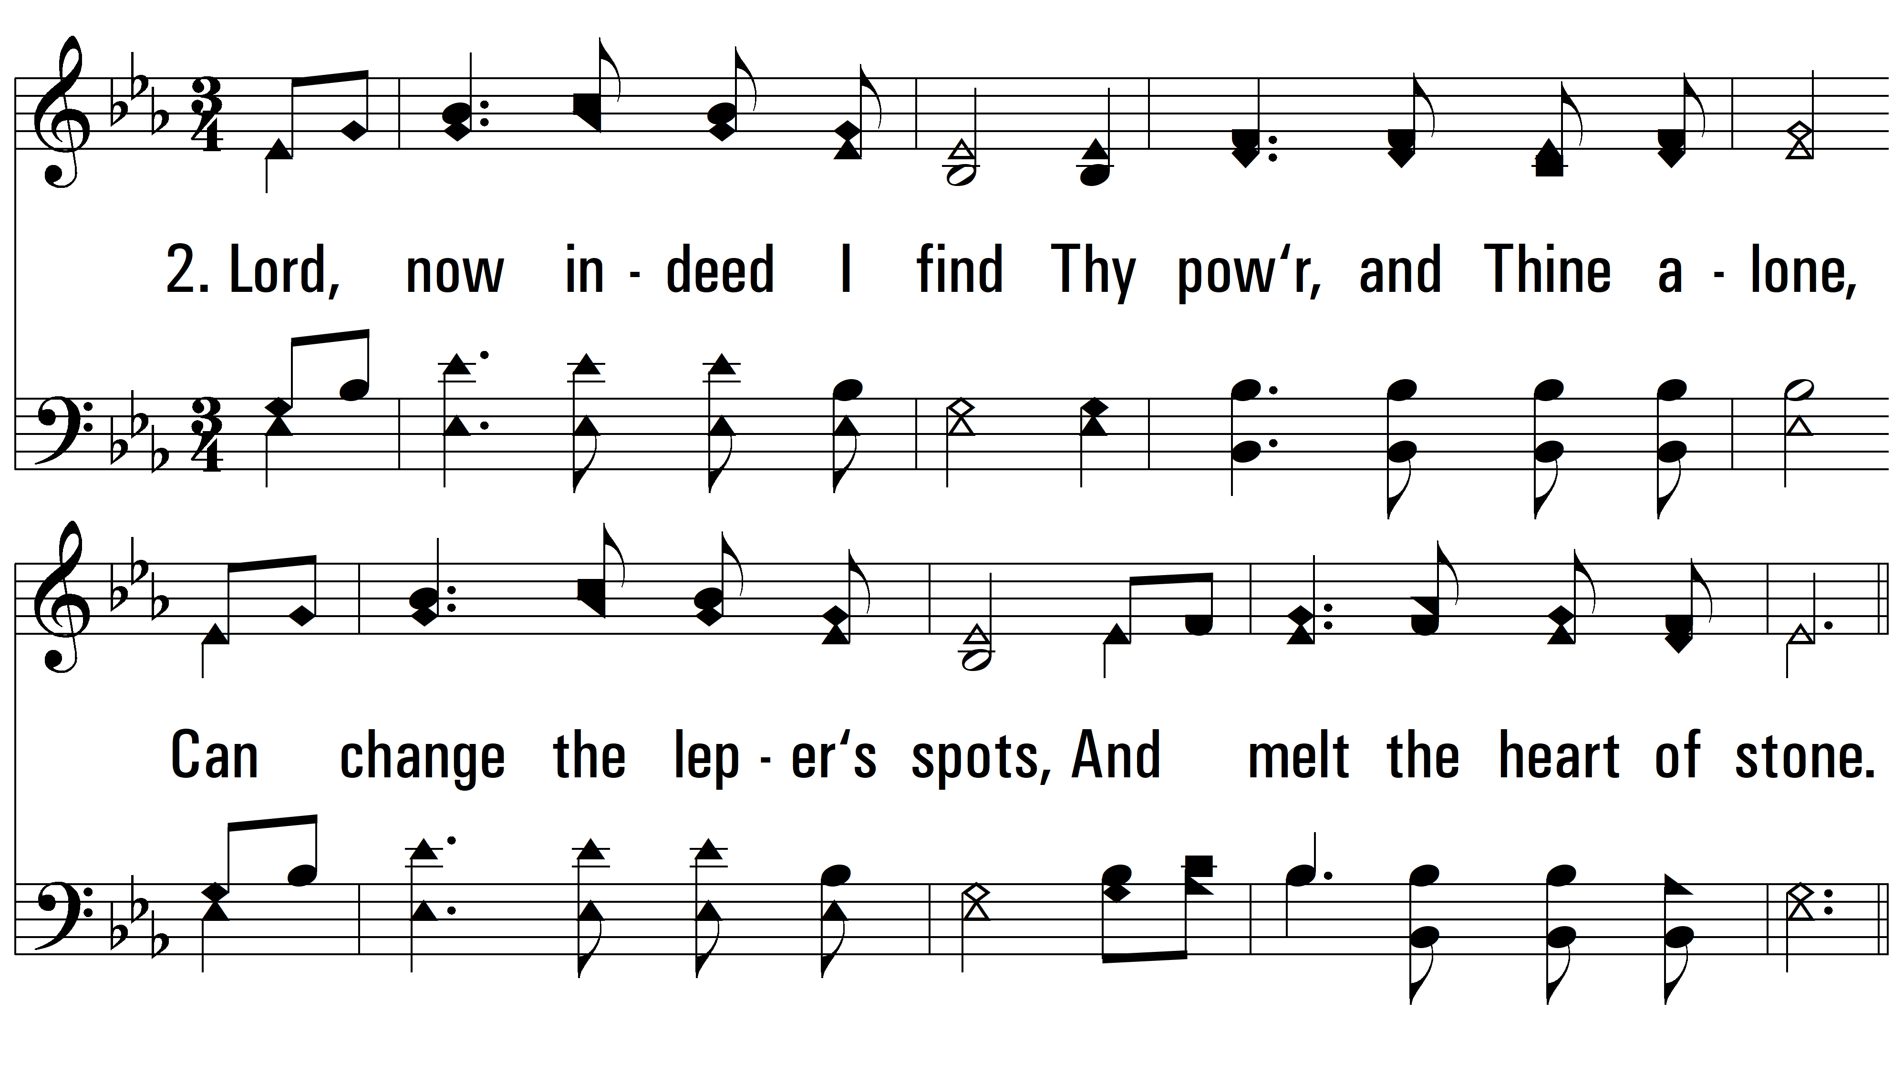
vs. 2 ~ Jesus Paid It All

Slide 5
vs. 2

Slide 6
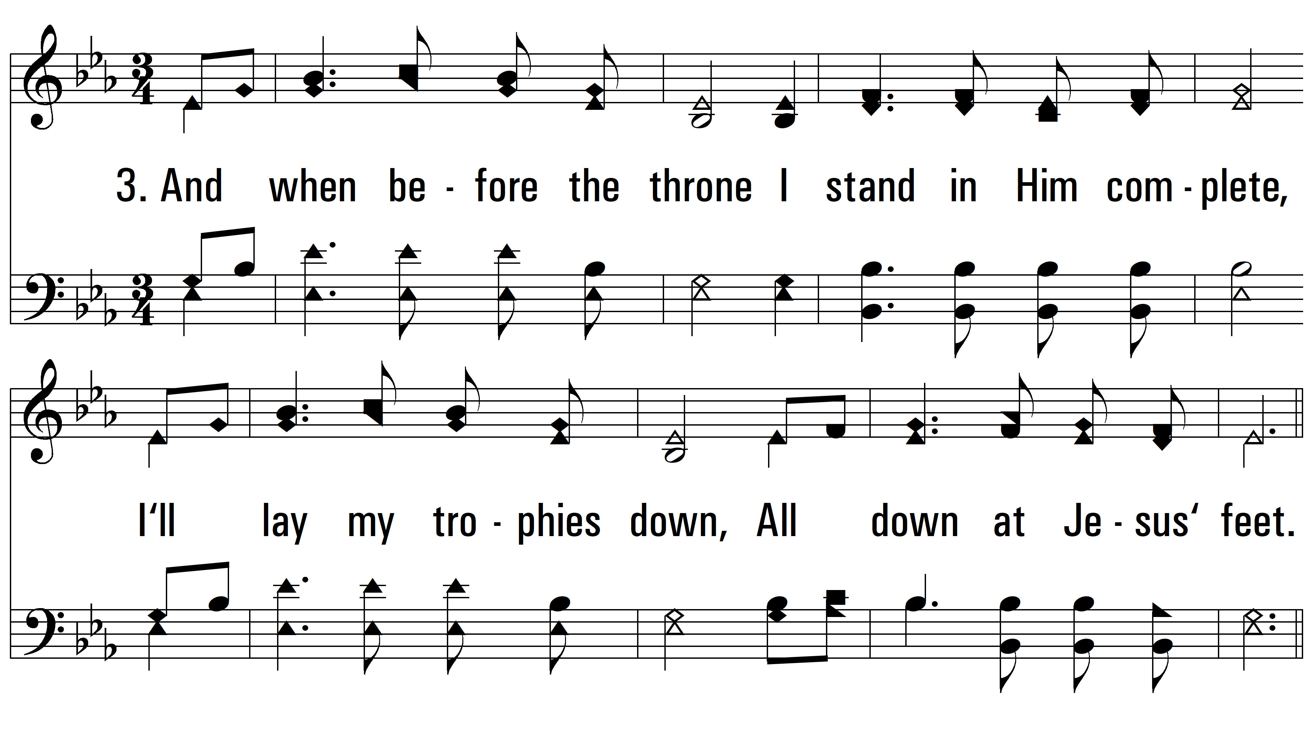
vs. 3 ~ Jesus Paid It All

Slide 7
vs. 3
PDHymns.com
END

