Slide 1
Jesus, Meek And Gentle
DOWSTON CASTLE
6.5.6.5
Words: | George R. Prynne (1856)
Music: | Clarence Hudson (1891)
6/4
E^{b}/B^{b} - SOL
Verses: 3
Lead - | SOL
Alto - | MI
Tenor - | SOL
Bass - | DO
PDHymns.com

Slide 2
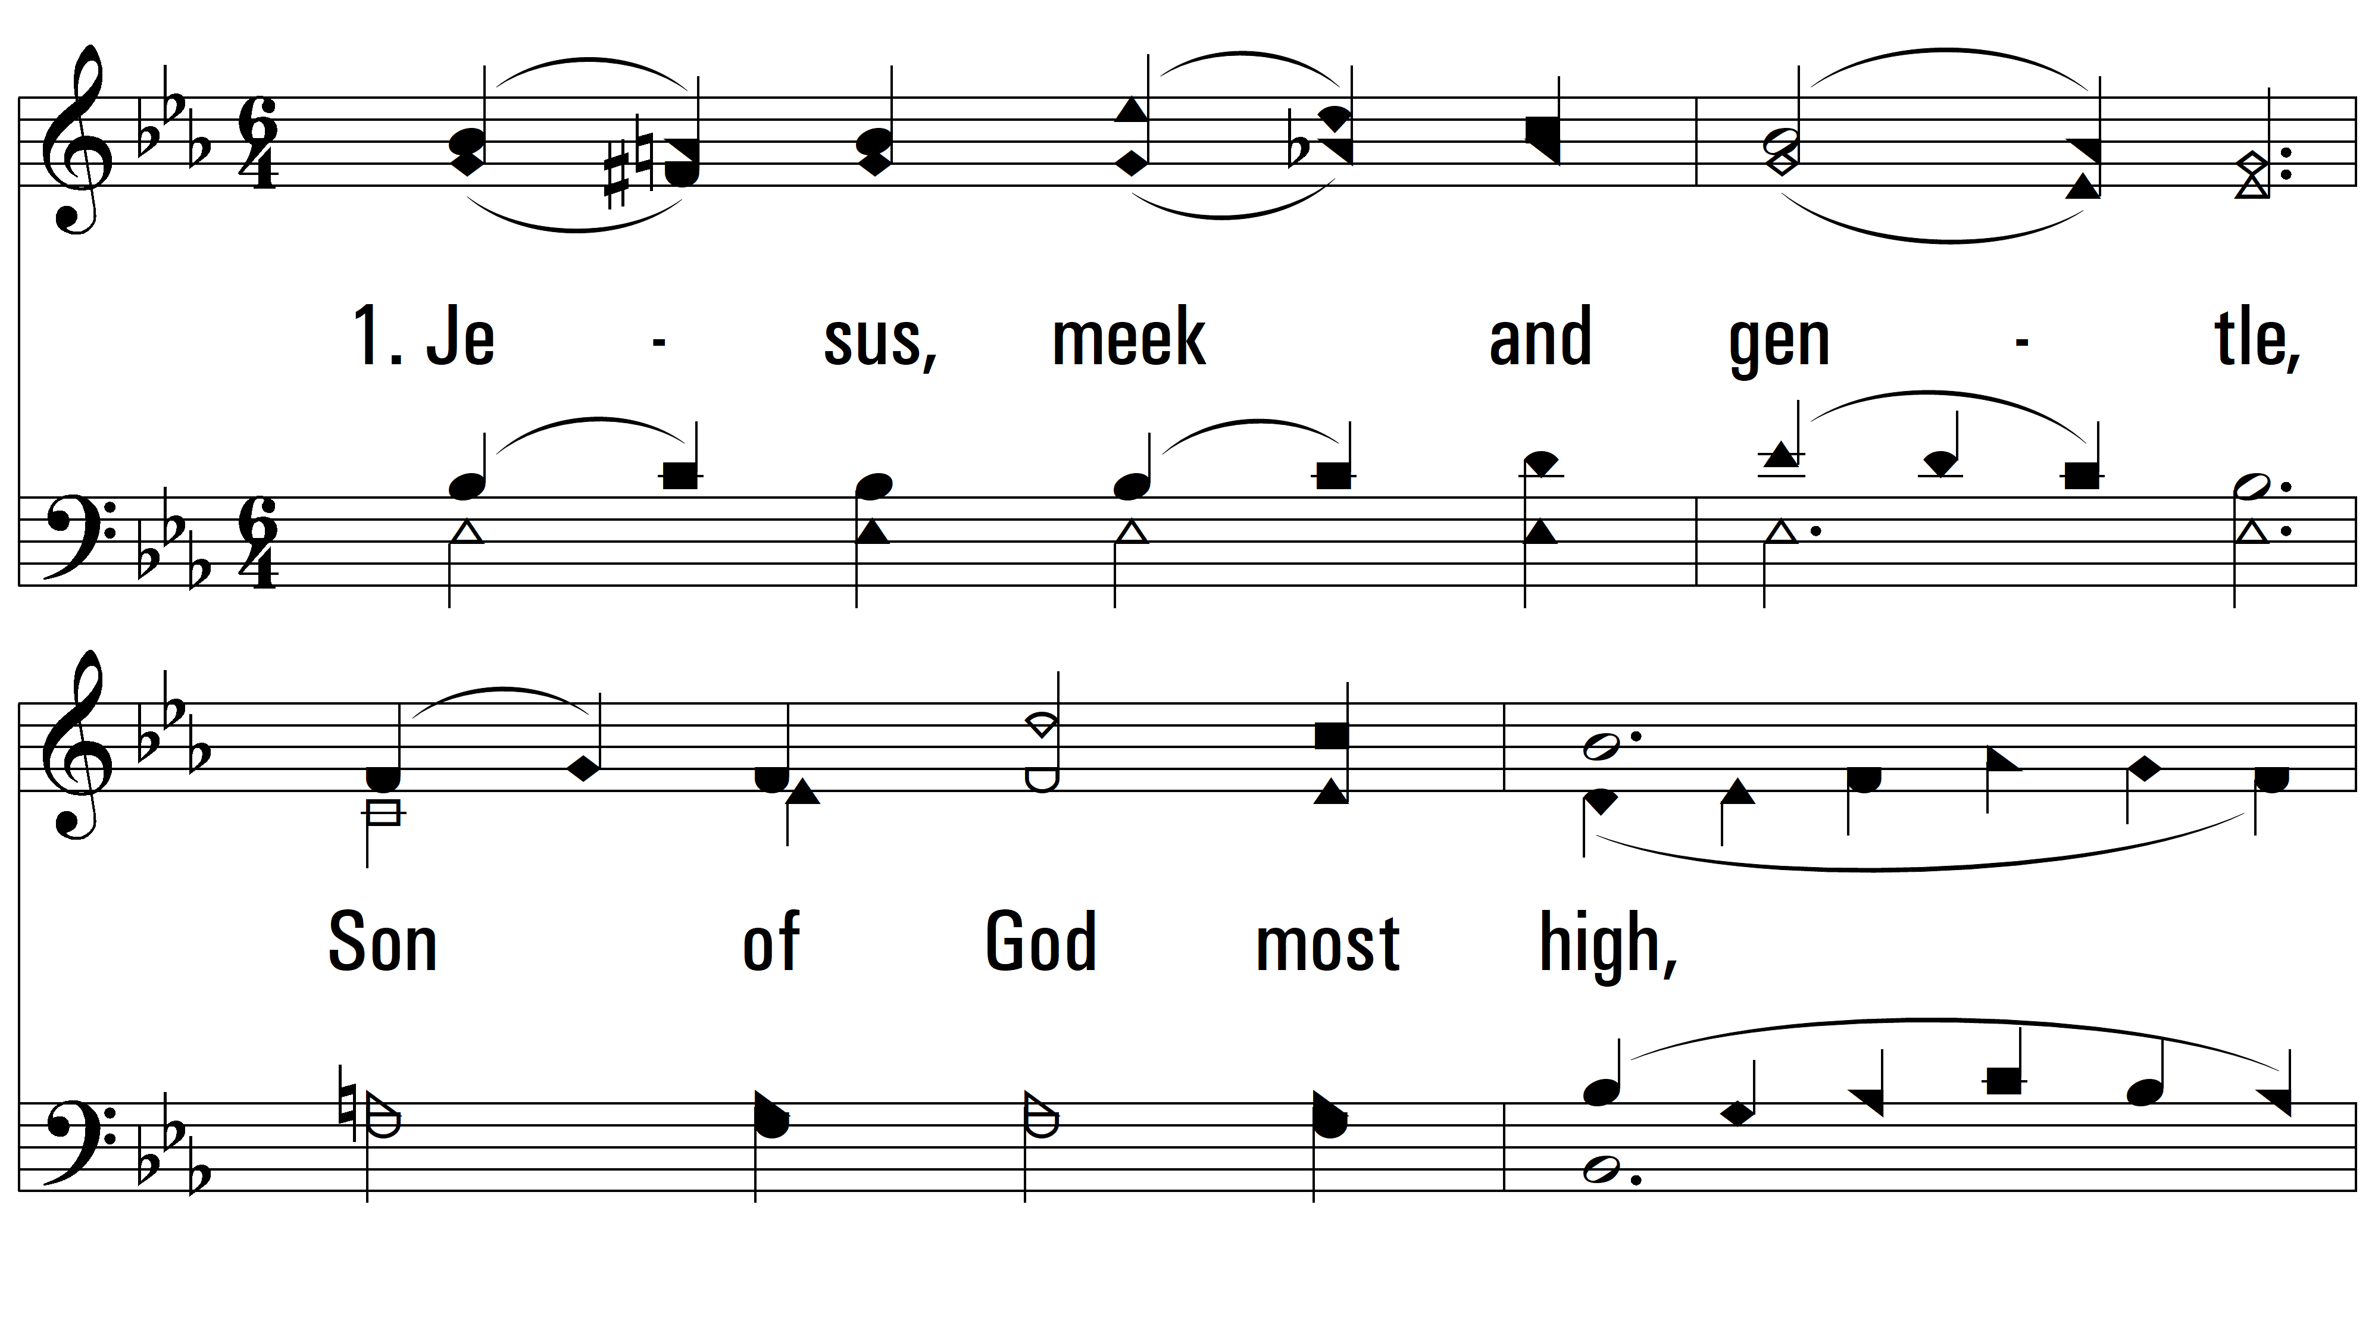
vs. 1 ~ Jesus, Meek And Gentle

Slide 3
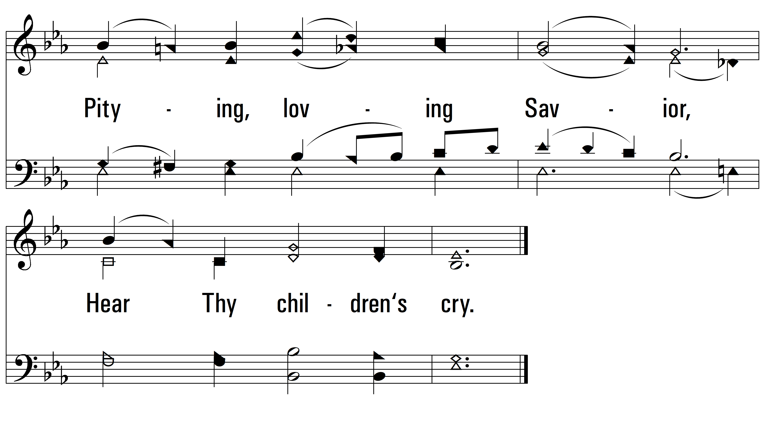
vs. 1

Slide 4
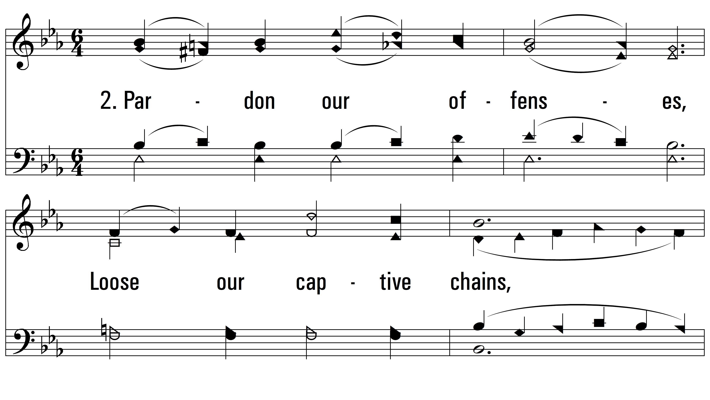
vs. 2 ~ Jesus, Meek And Gentle

Slide 5
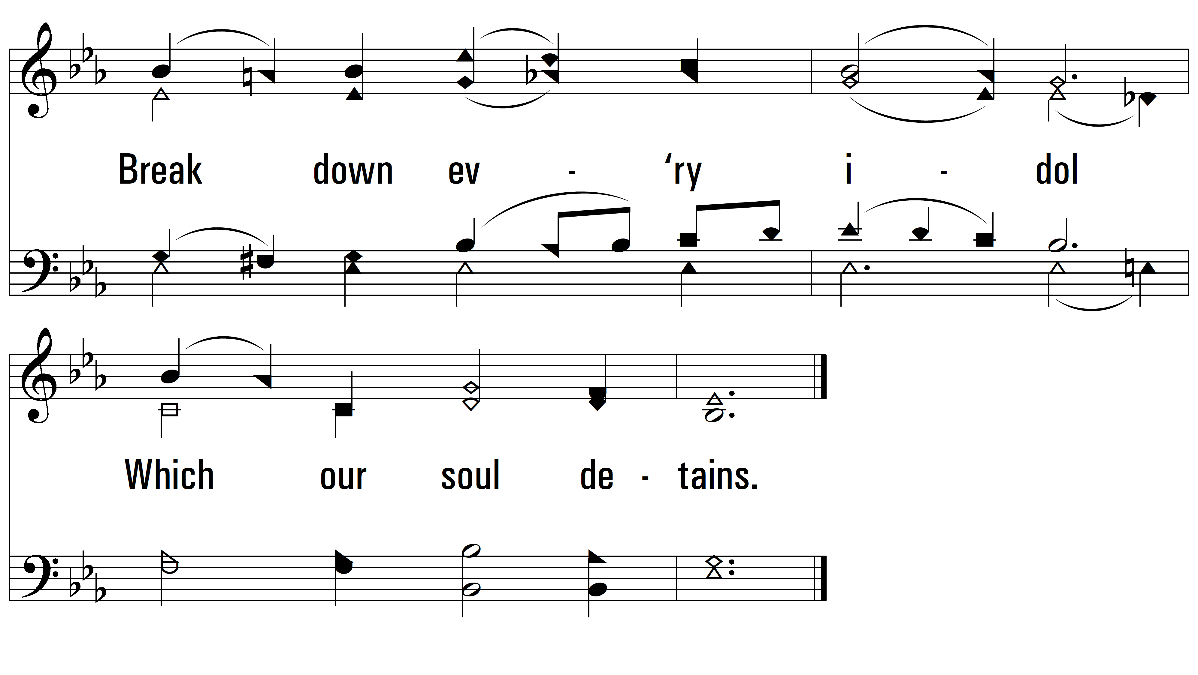
vs. 2

Slide 6
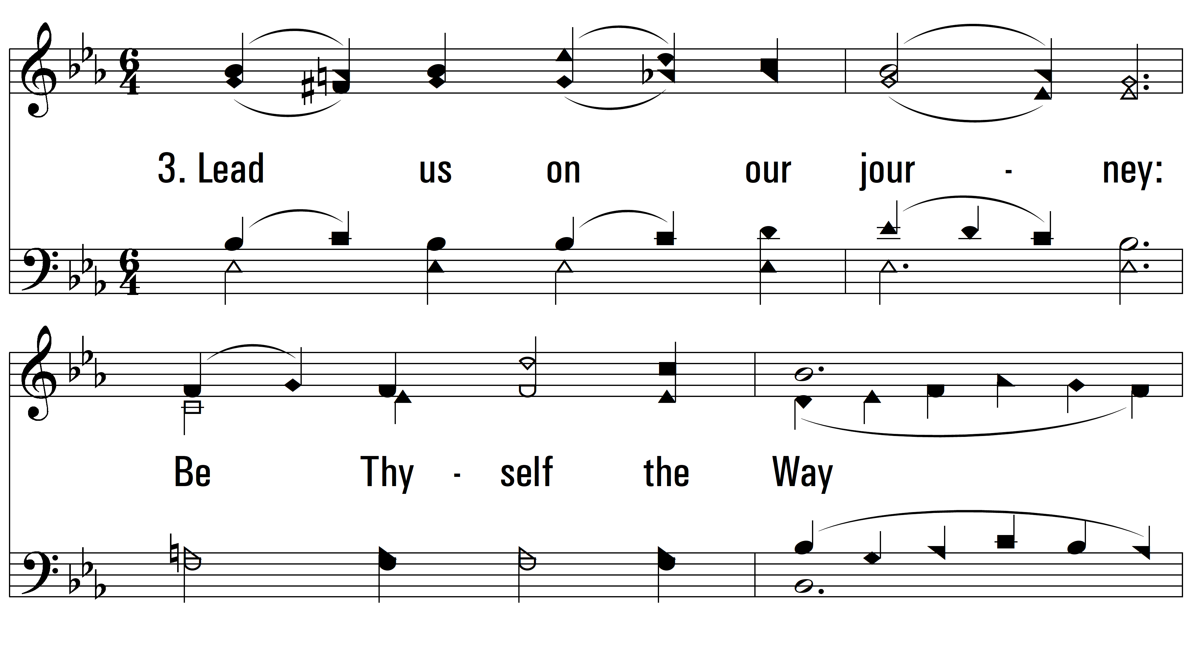
vs. 3 ~ Jesus, Meek And Gentle

Slide 7
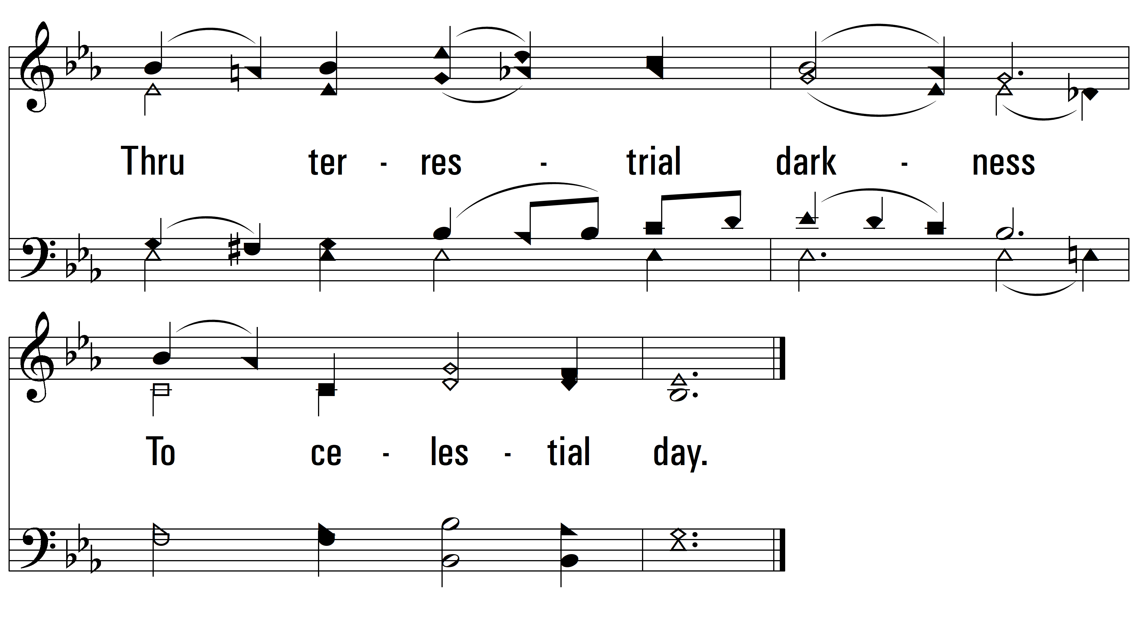
vs. 3
PDHymns.com
END

