Slide 1
Jesus Loves Me
Words: | Anna B. Warner (1860)
Music: | William B. Bradbury (1862)
2/4
E^{b}/B^{b} - SOL
Verses: 4/Chorus
Lead - | SOL
Alto - | MI
Tenor - | SOL
Bass - | DO
PDHymns.com

Slide 2
vs. 1 ~ Jesus Loves Me

Slide 3
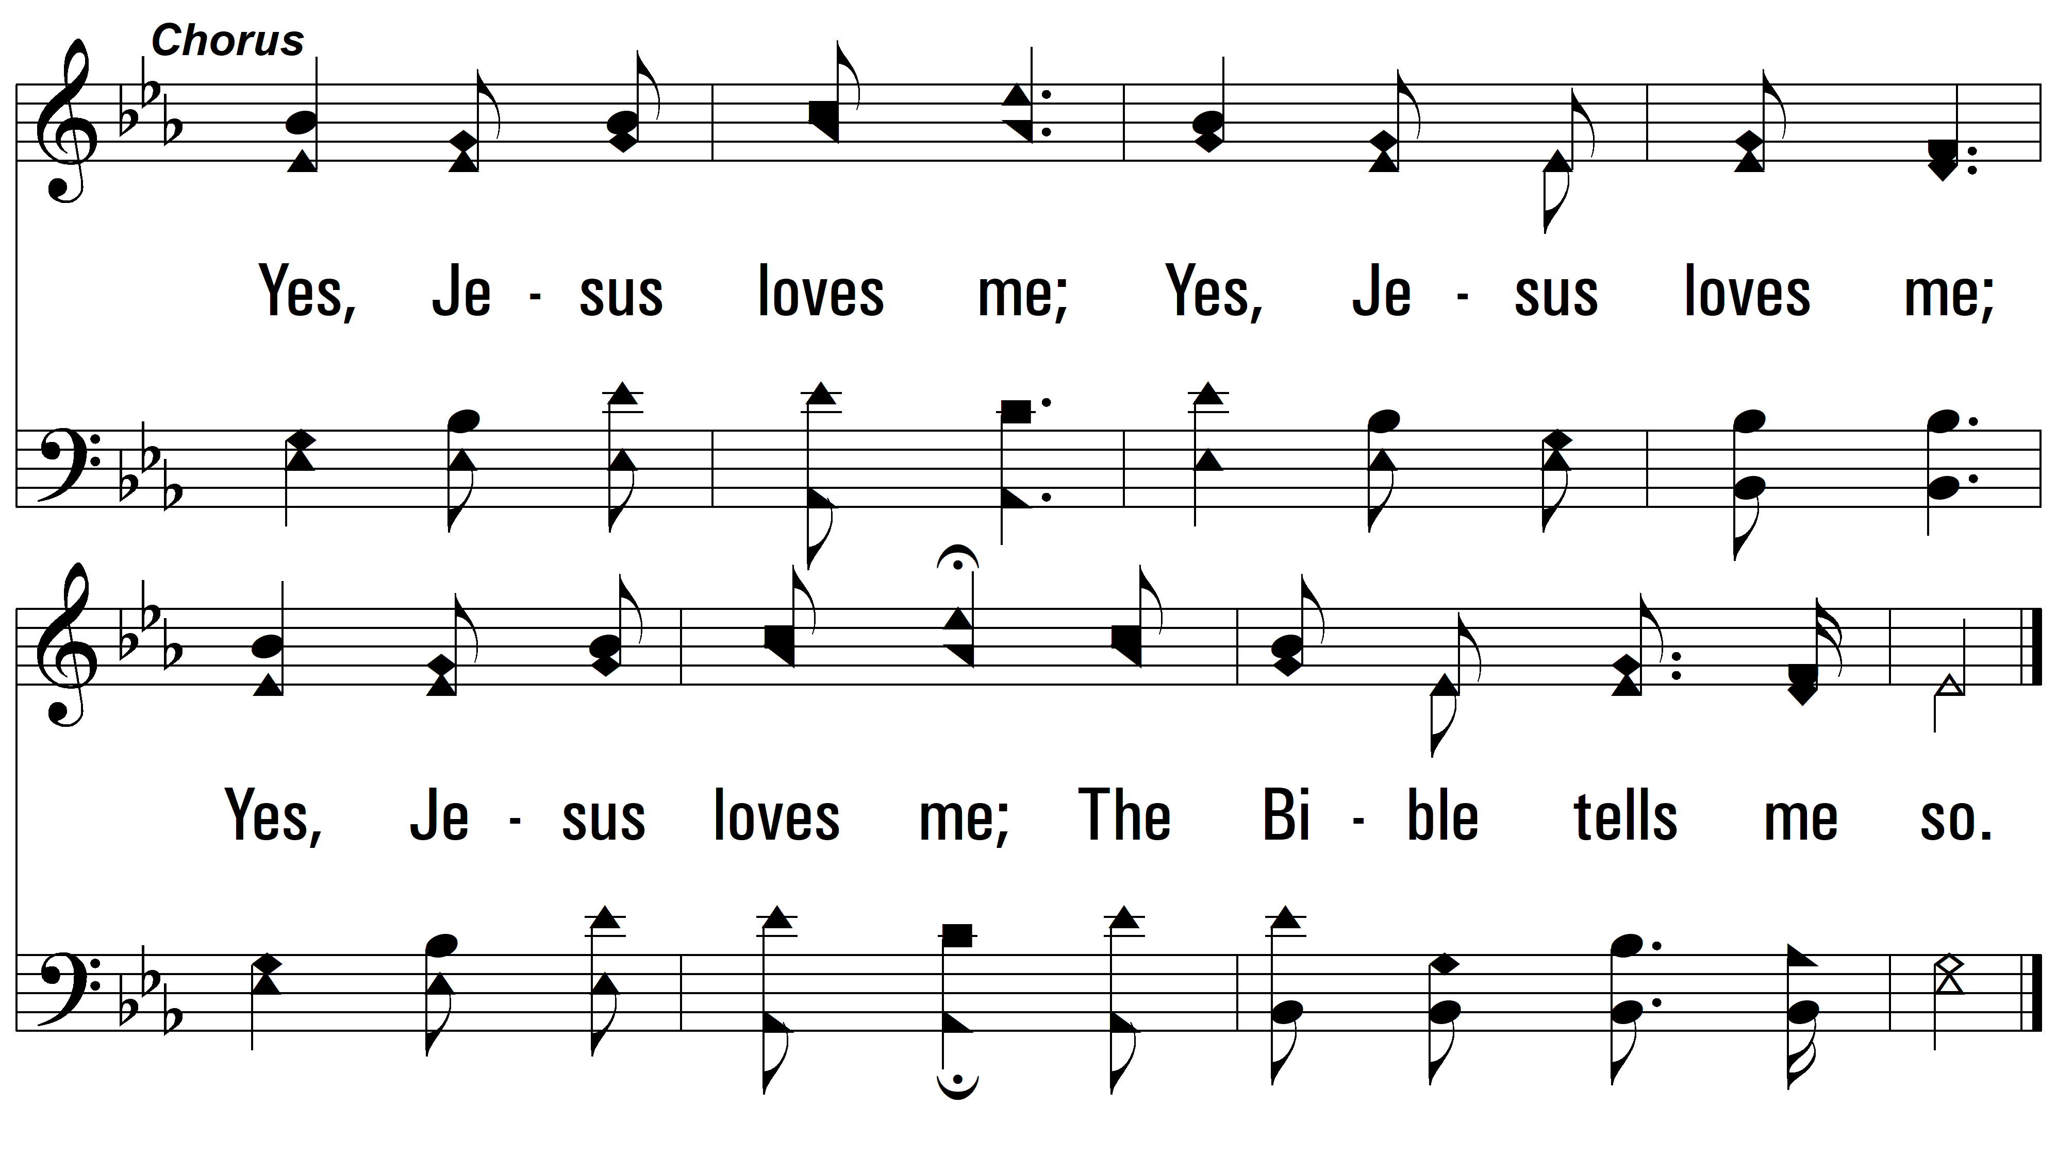
vs. 1

Slide 4
vs. 2 ~ Jesus Loves Me

Slide 5
vs. 2

Slide 6
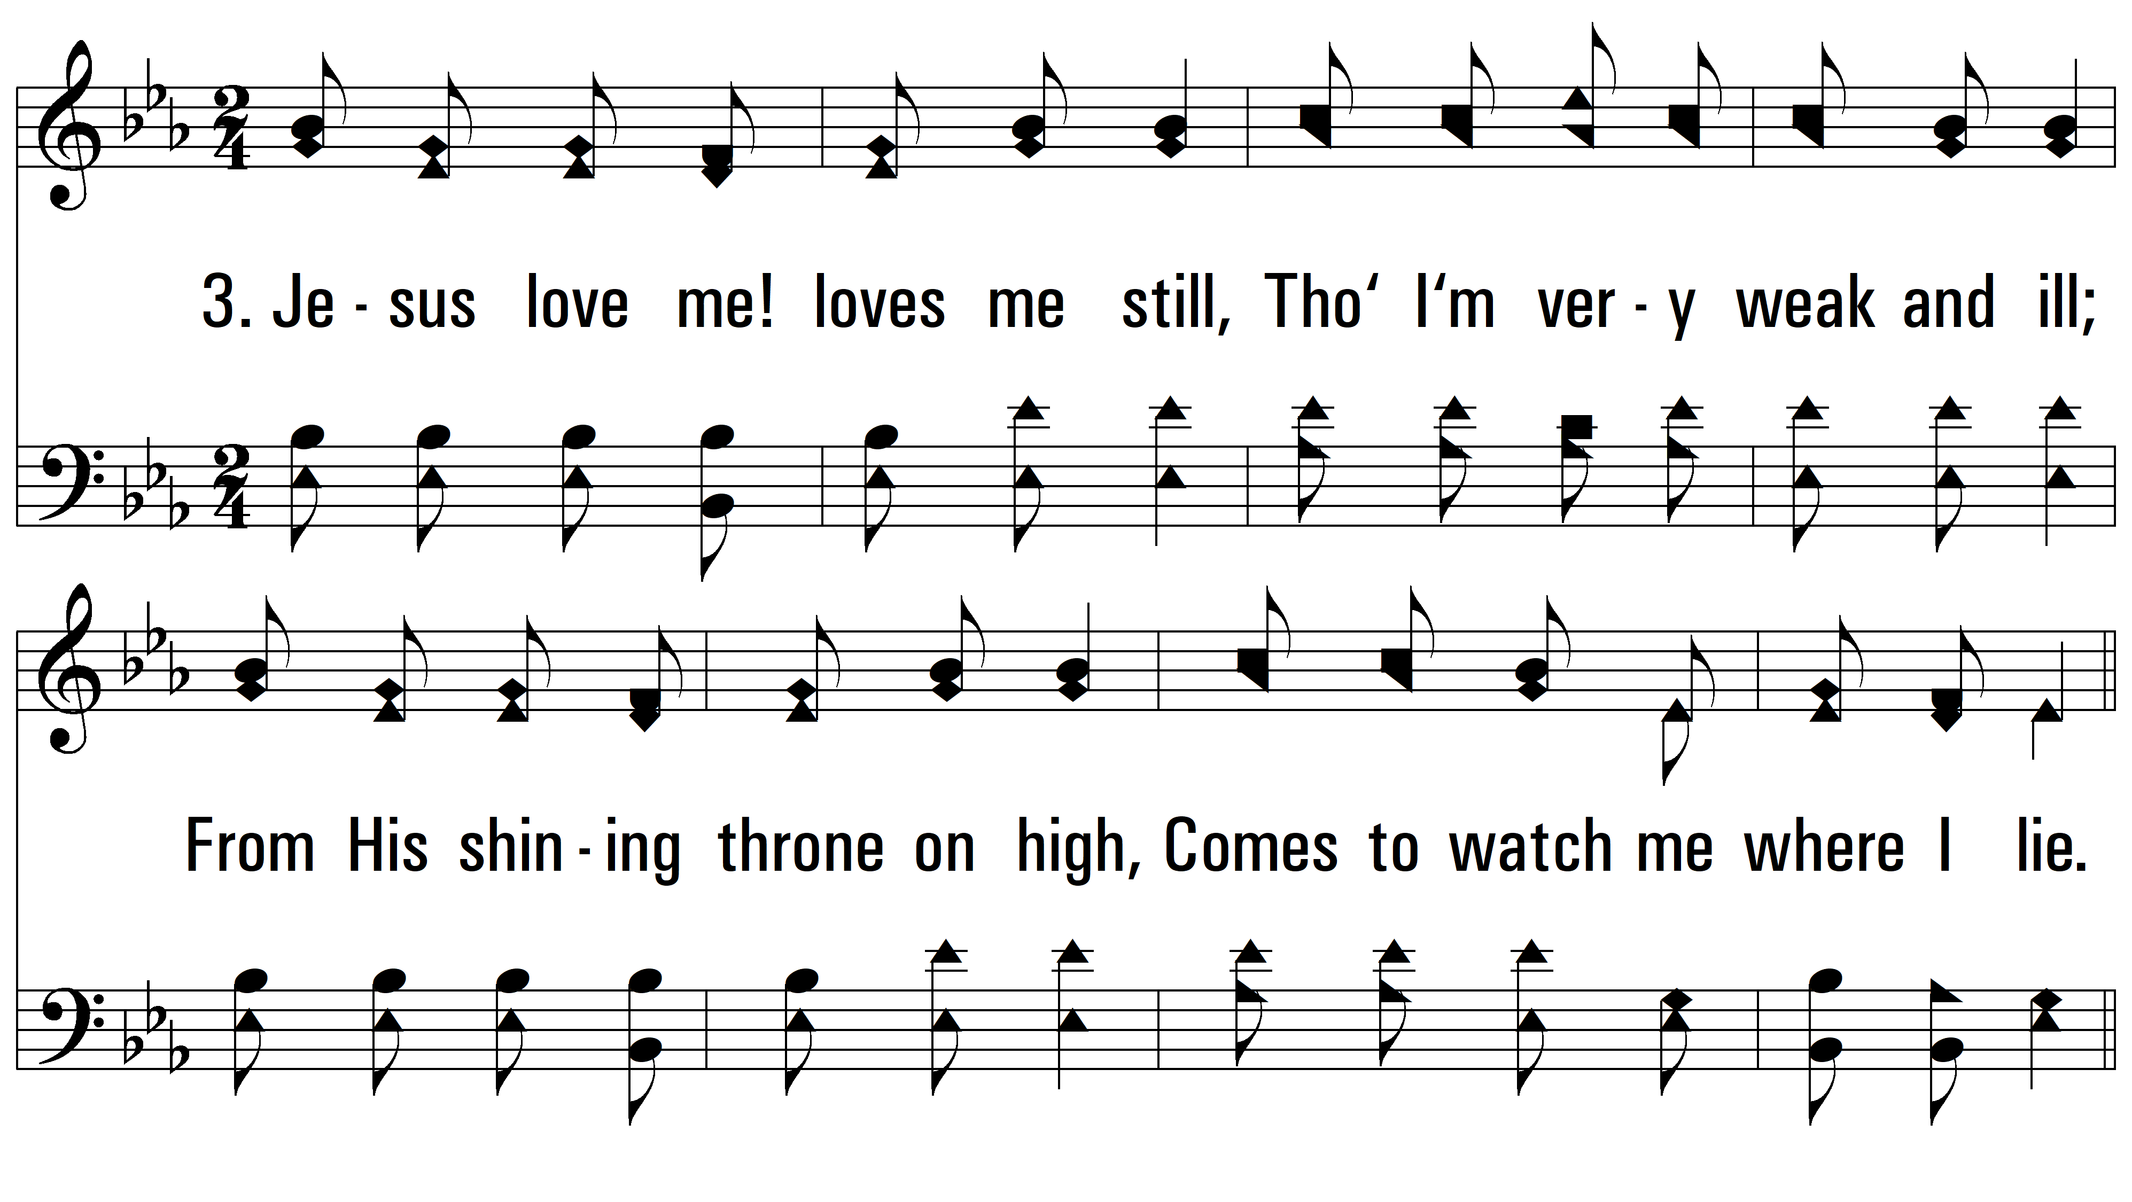
vs. 3 ~ Jesus Loves Me

Slide 7
vs. 3

Slide 8
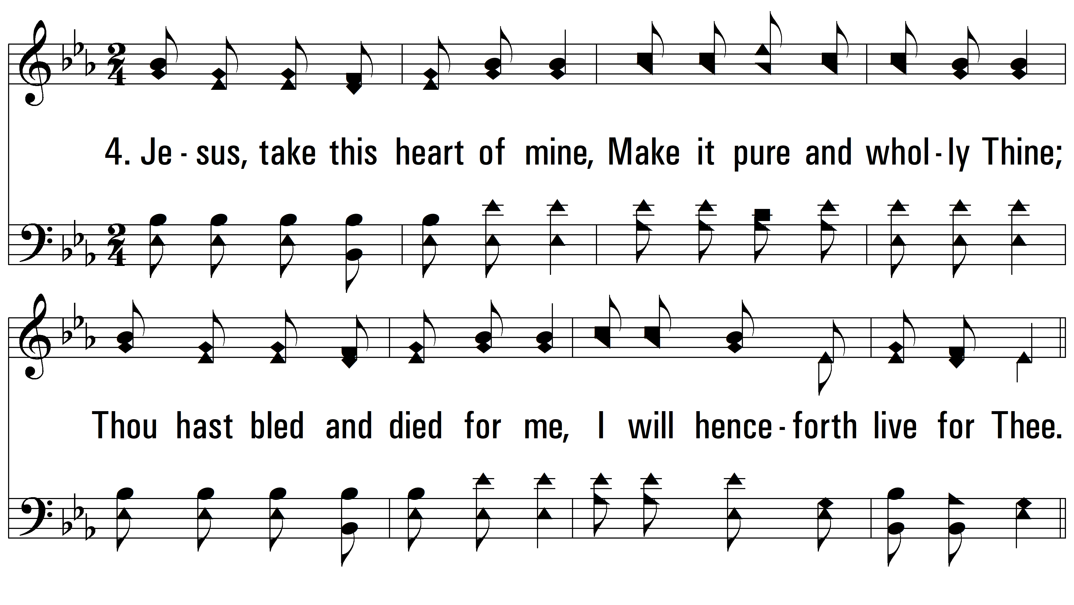
vs. 4 ~ Jesus Loves Me

Slide 9
vs. 4
PDHymns.com
END

