Slide 1
Jesus Calls Us
GALILEE
8.7.8.7
Words: | Cecil F. Alexander (1852)
Music: | William H. Jude (1887)
3/4
B^{b}/D - MI
Verses: 5
Lead - | MI
Alto - | MI
Tenor - | DO
Bass - | DO
PDHymns.com

Slide 2
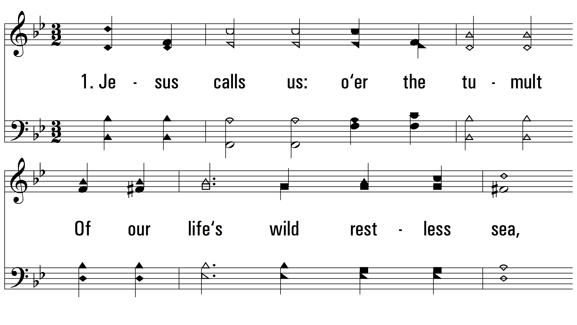
vs. 1 ~ Jesus Calls Us

Slide 3
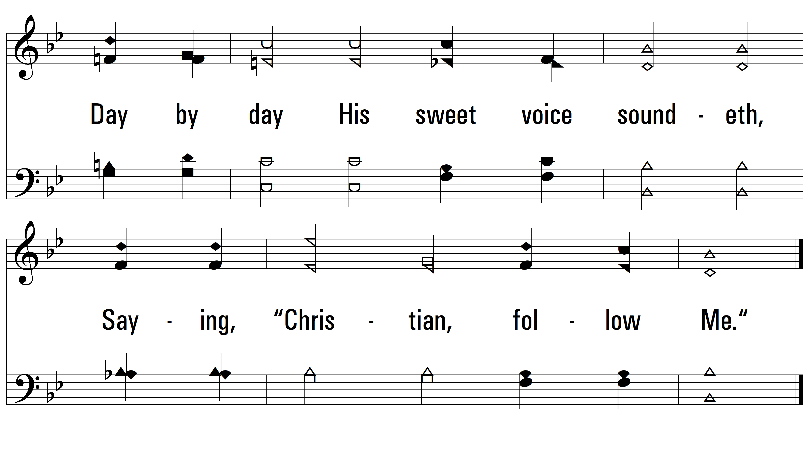
vs. 1

Slide 4
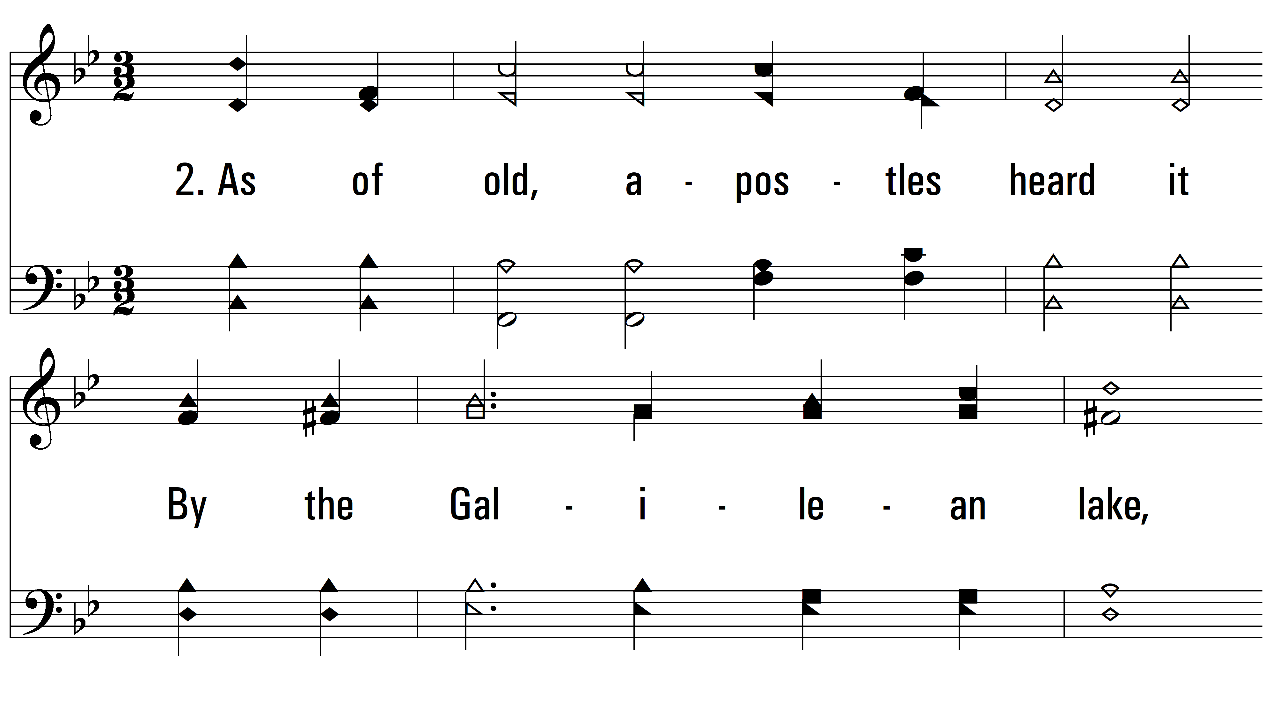
vs. 2 ~ Jesus Calls Us

Slide 5
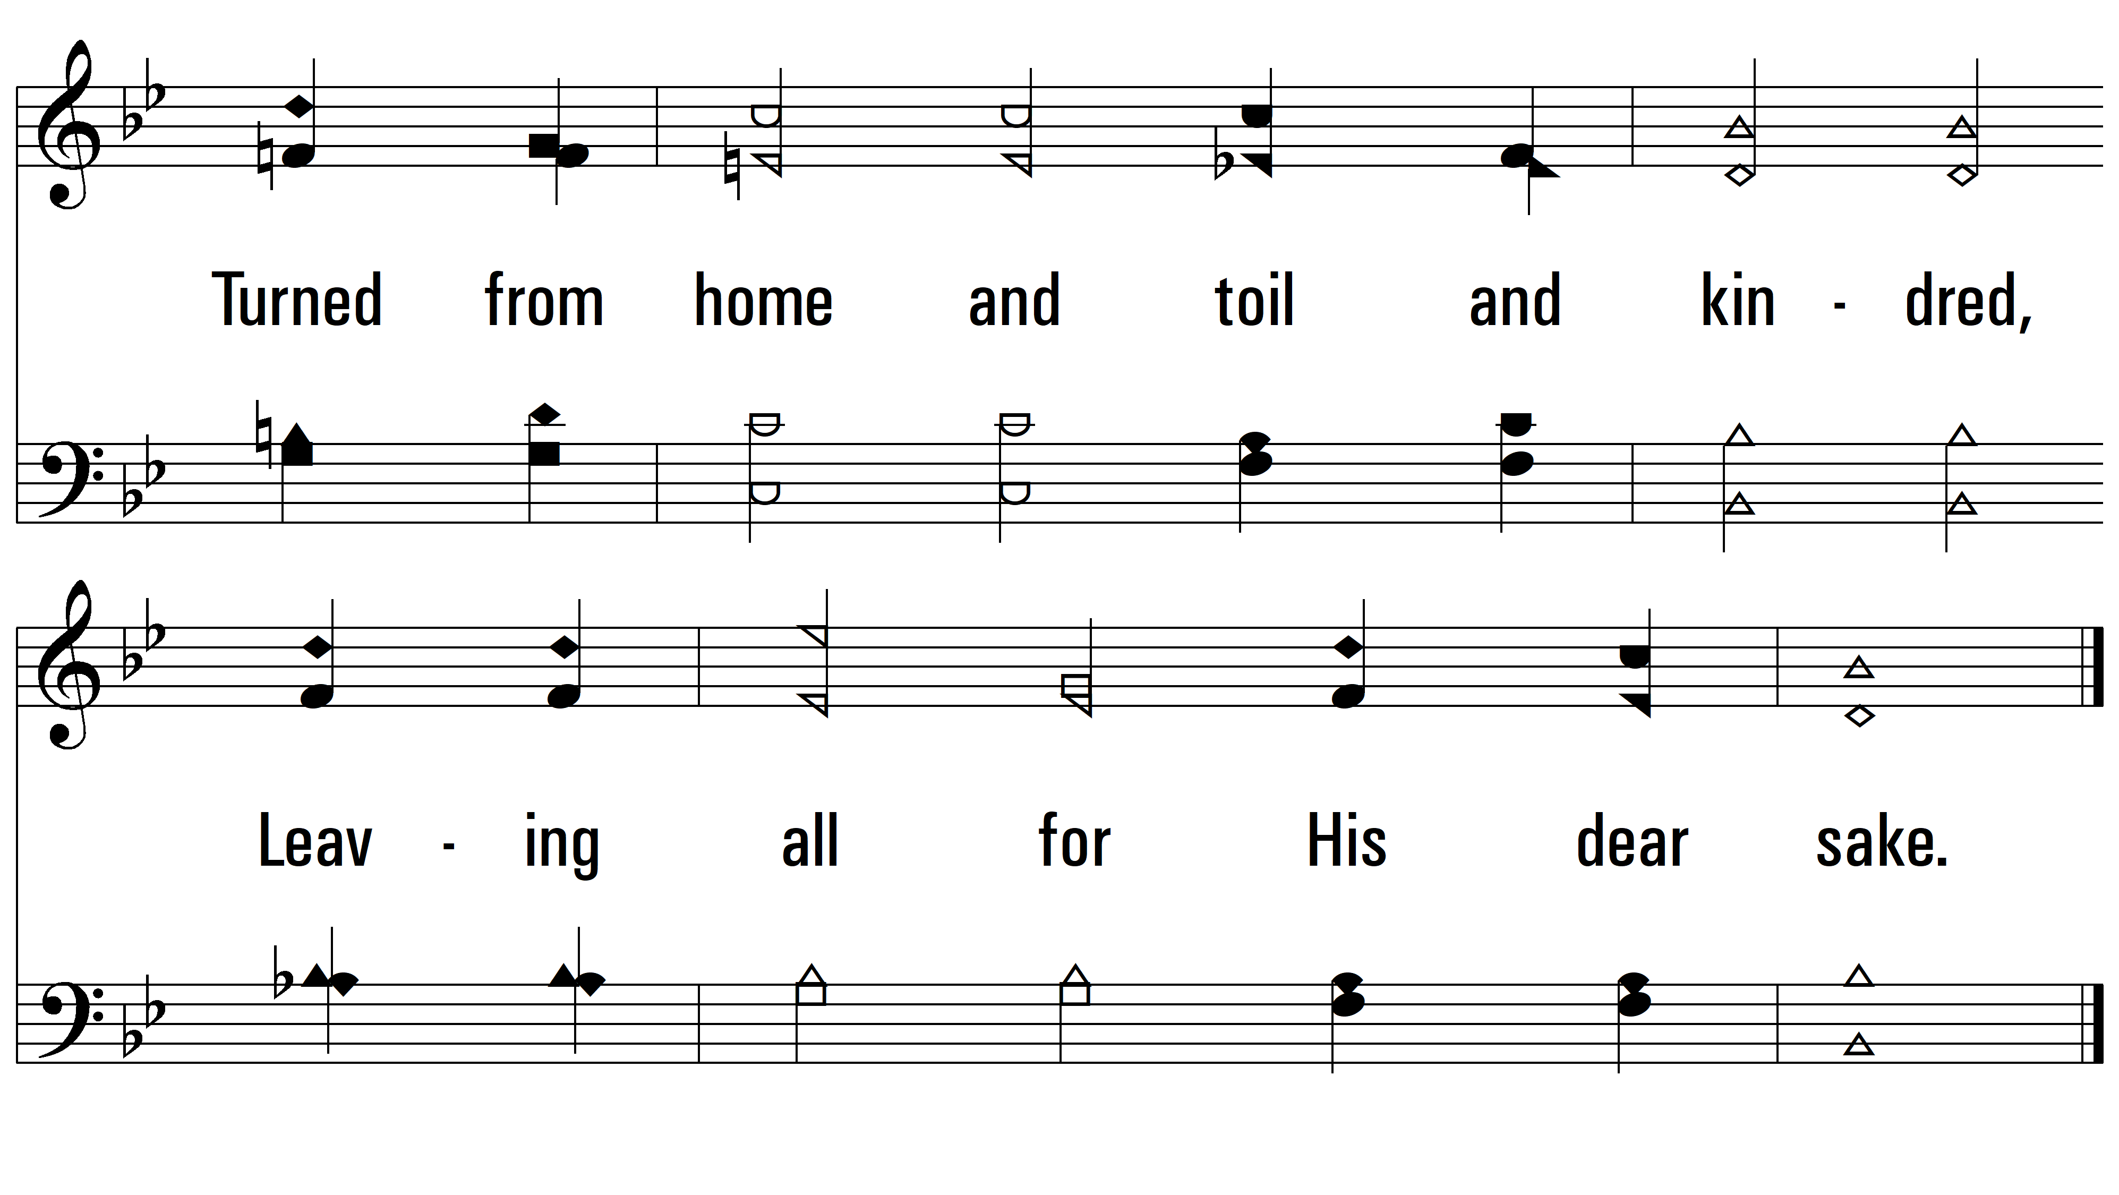
vs. 2

Slide 6
vs. 3 ~ Jesus Calls Us

Slide 7
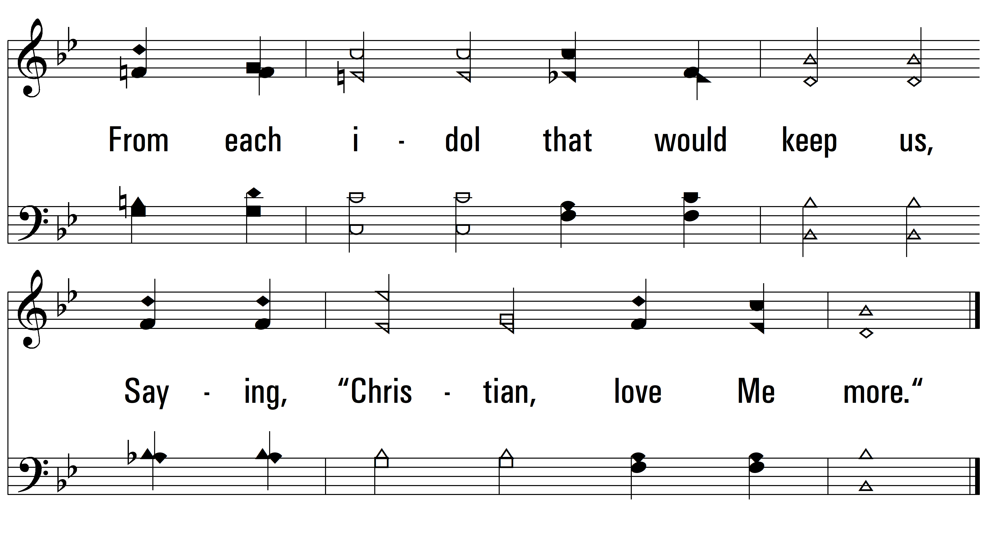
vs. 3

Slide 8
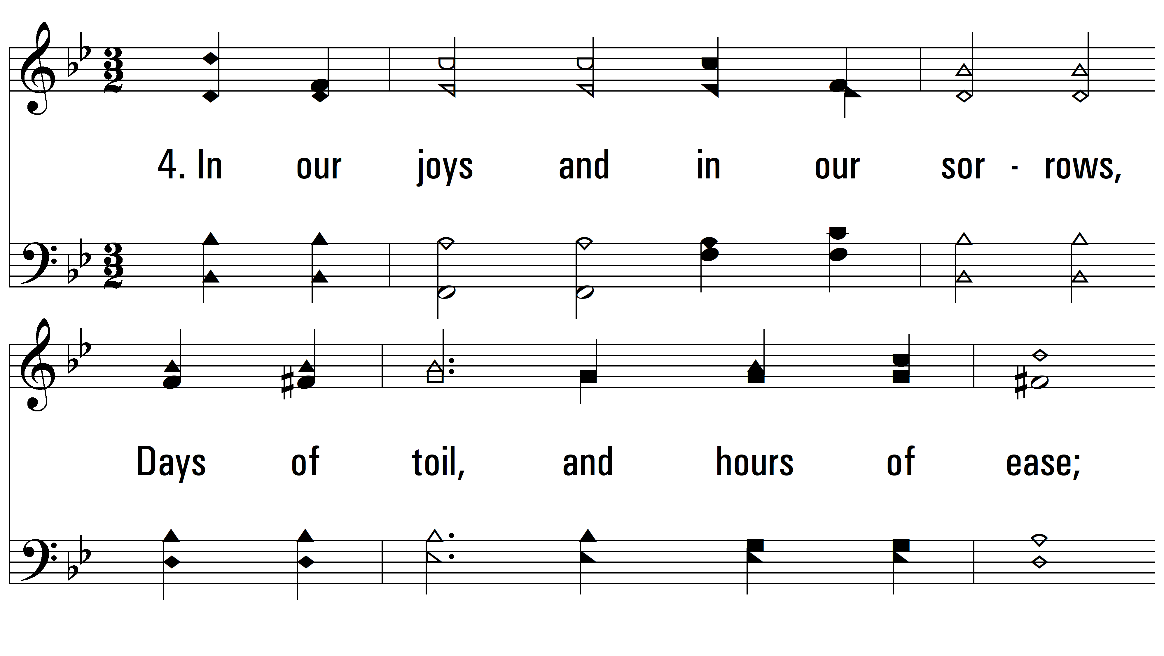
vs. 4 ~ Jesus Calls Us

Slide 9
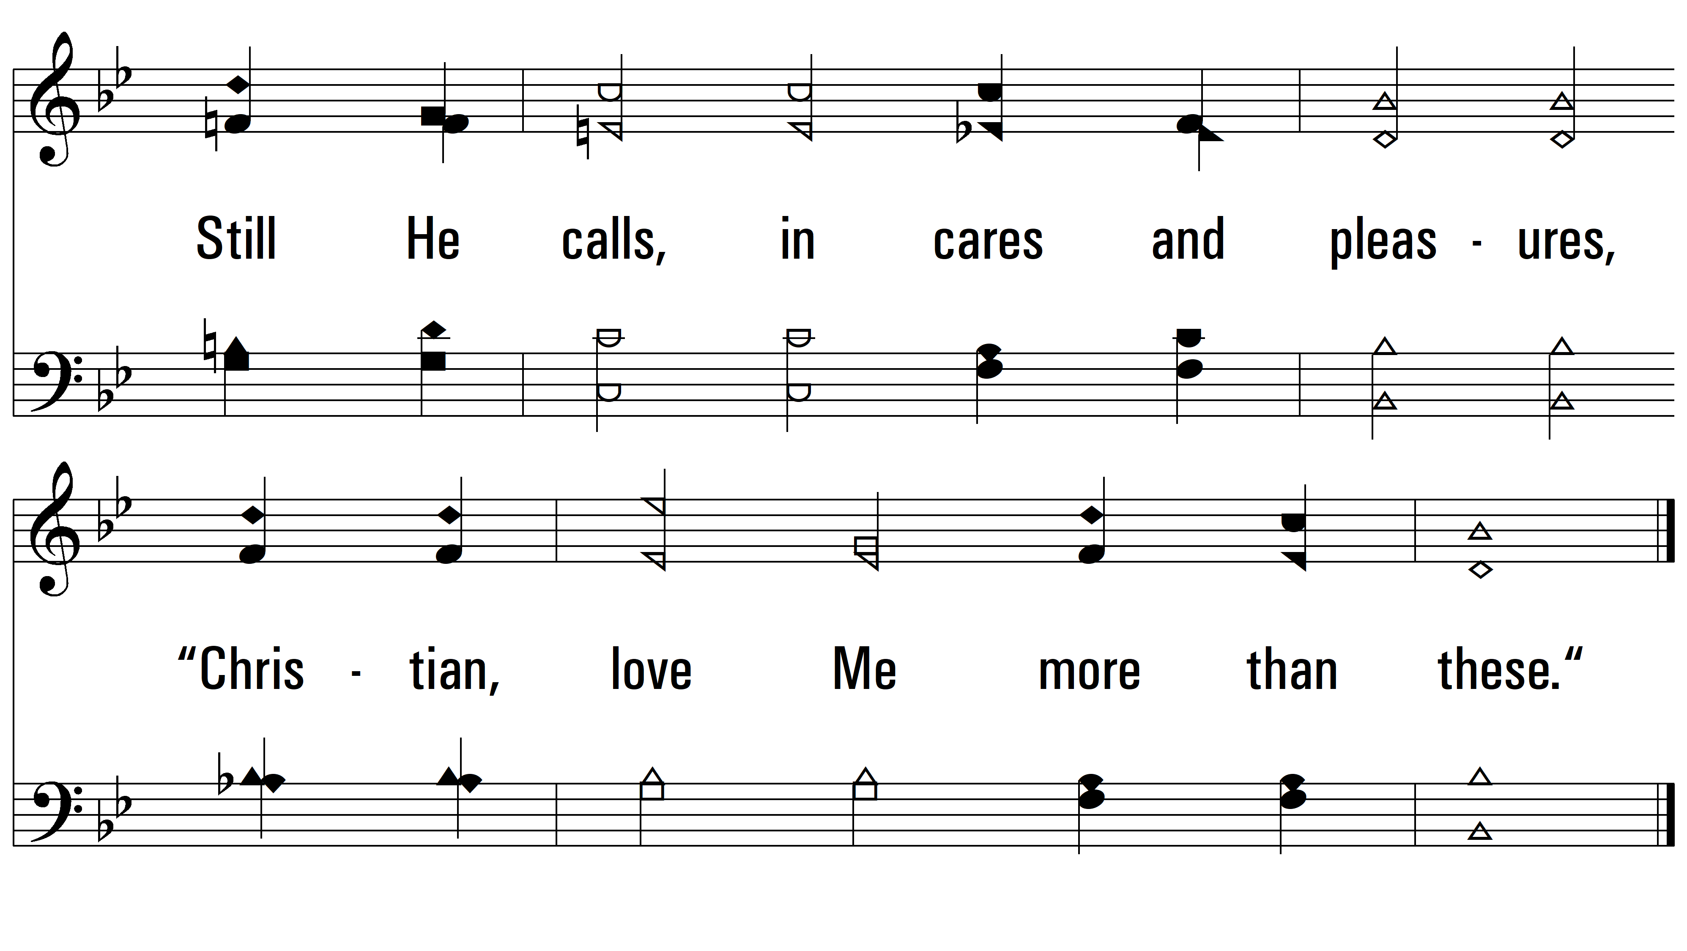
vs. 4

Slide 10
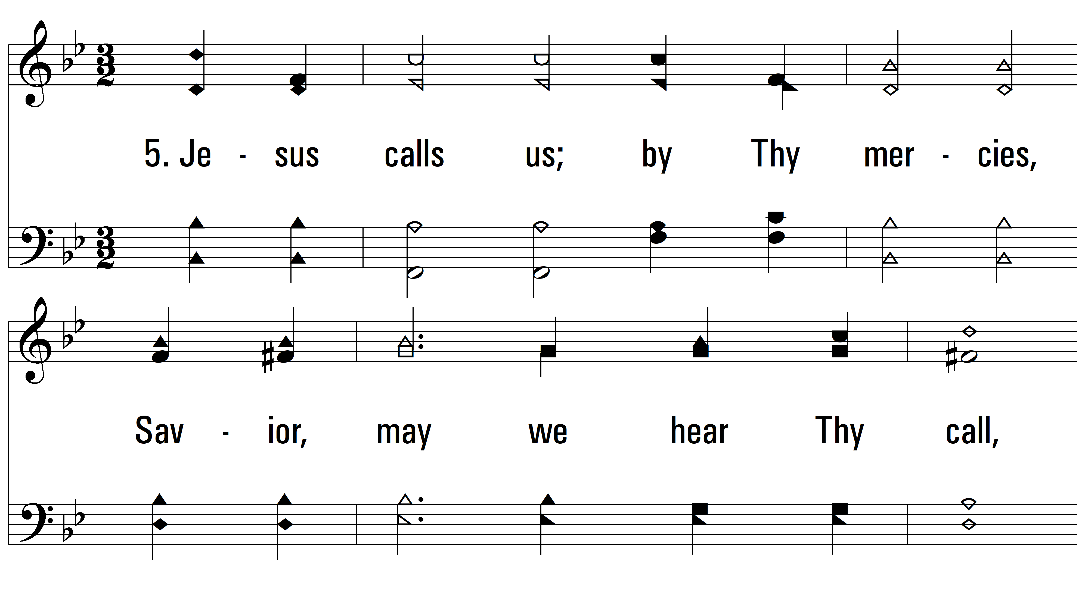
vs. 5 ~ Jesus Calls Us

Slide 11
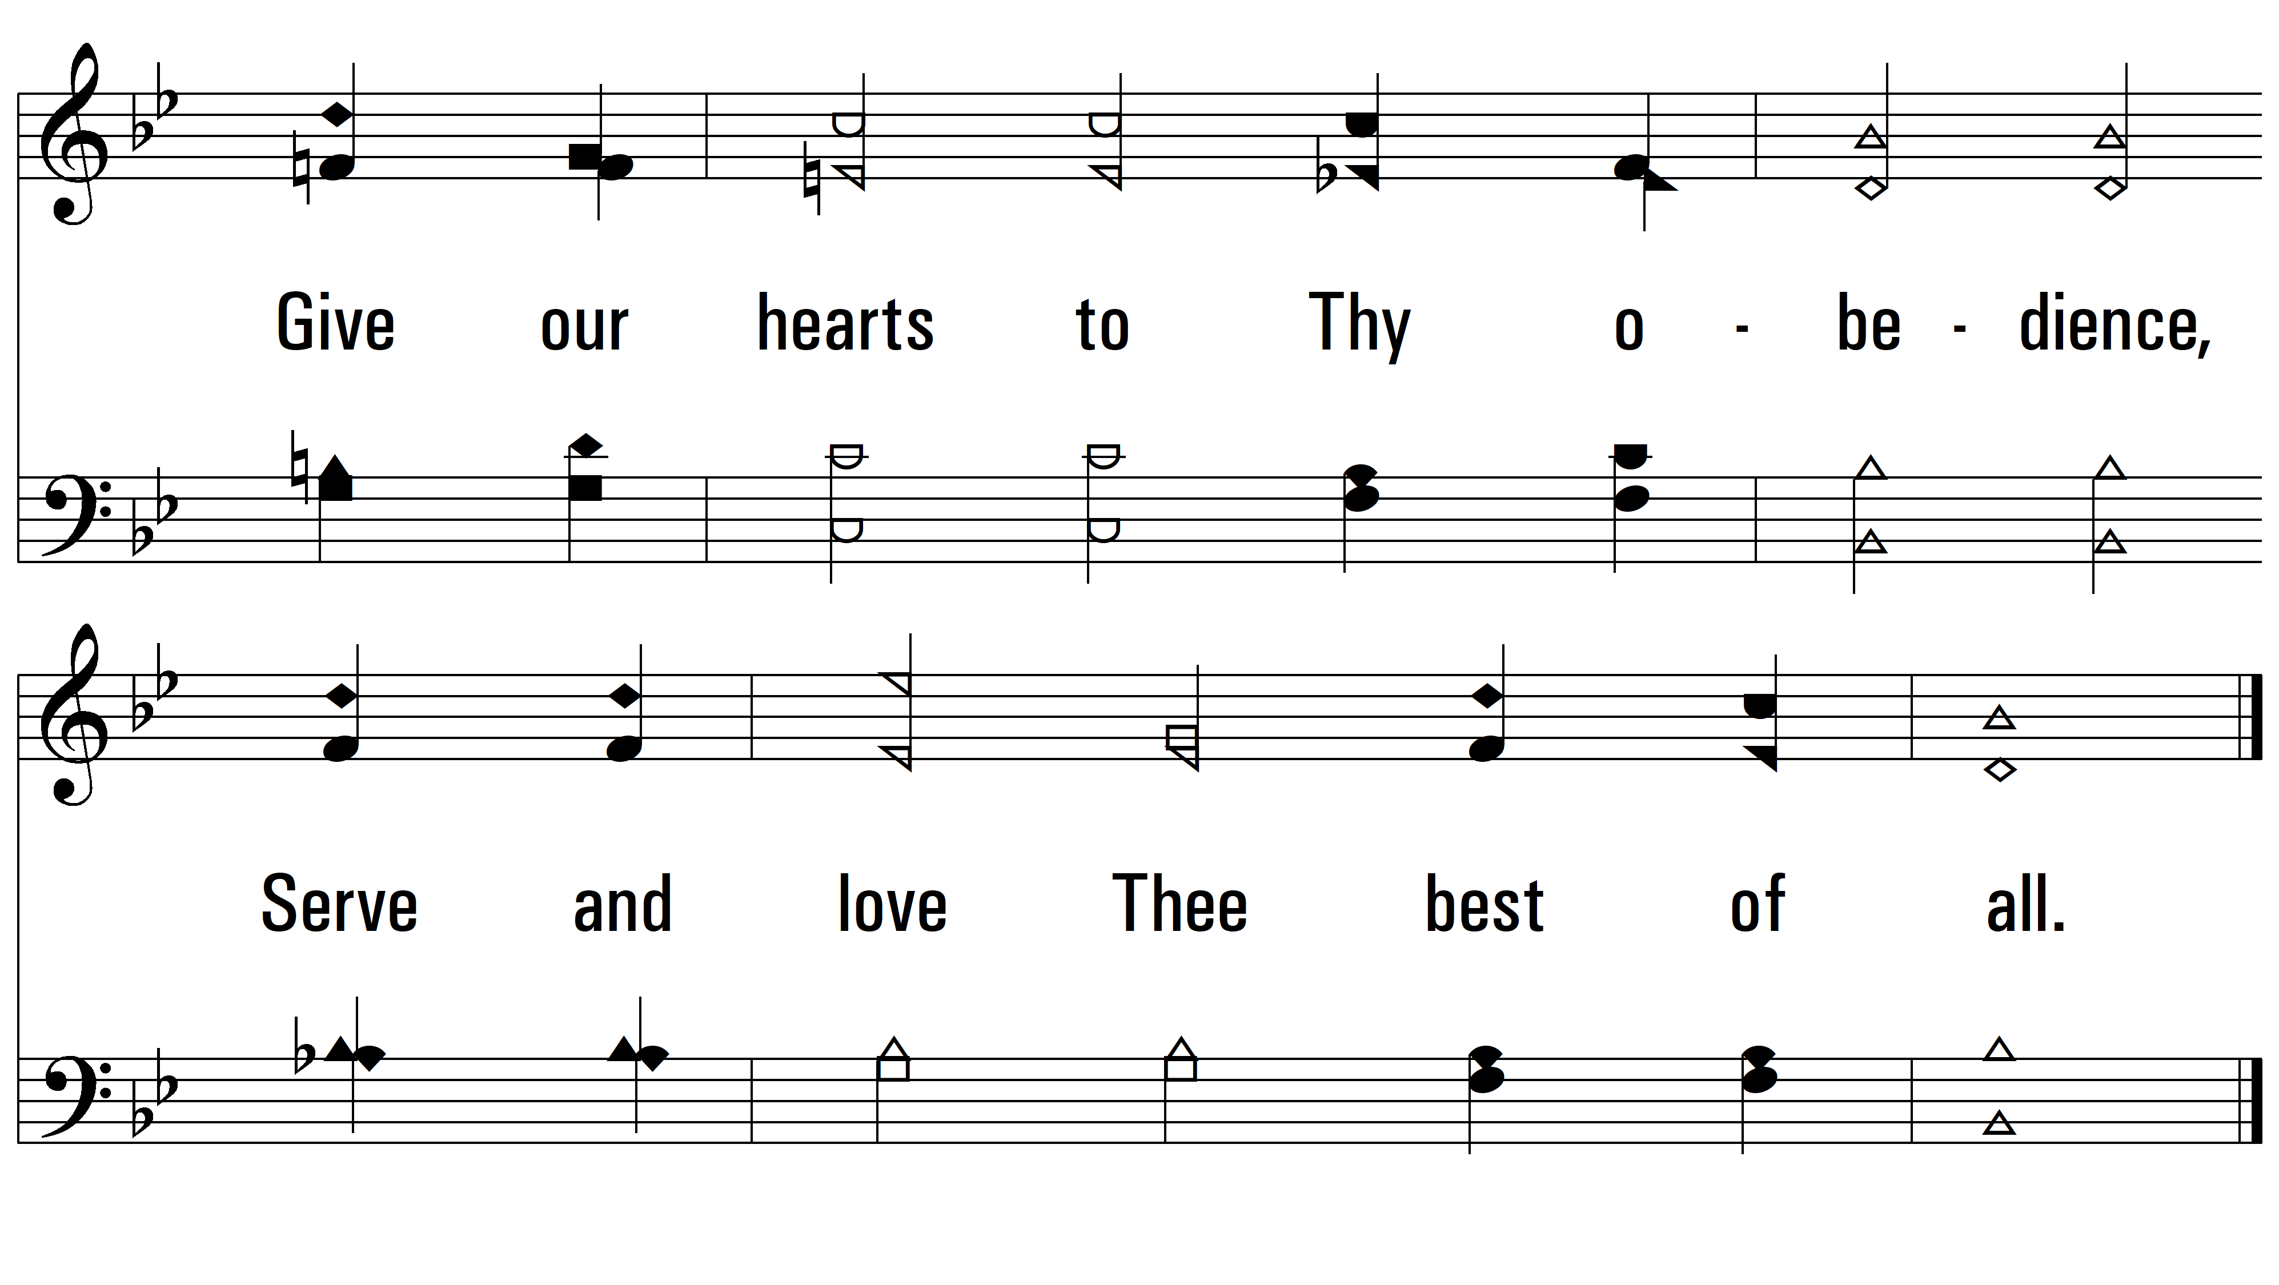
vs. 5
PDHymns.com
END

