Slide 1
I’ve Got Peace Like A River
Words: | American Spiritual
Music: | American Spiritual
4/4
G/D - SOL
Verses: 4
Lead - | SOL
Alto - | MI
Tenor - | DO
Bass - | DO
PDHymns.com

Slide 2
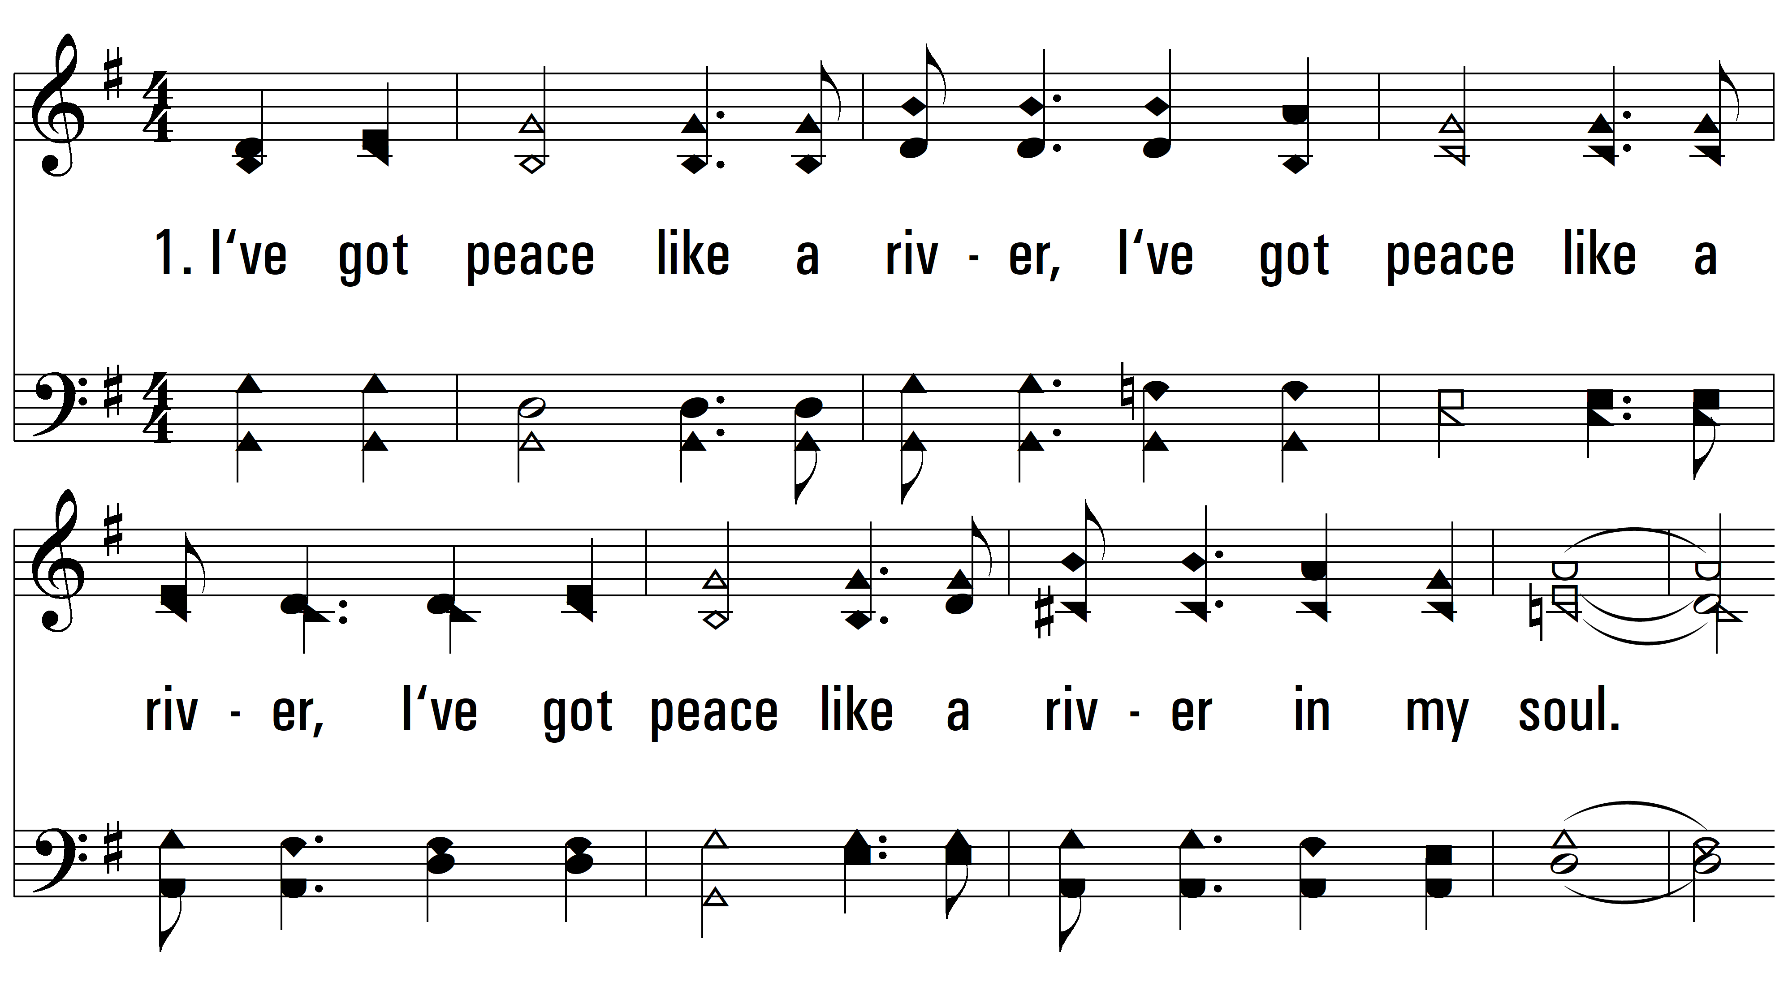
vs. 1 ~ I’ve Got Peace Like A River

Slide 3
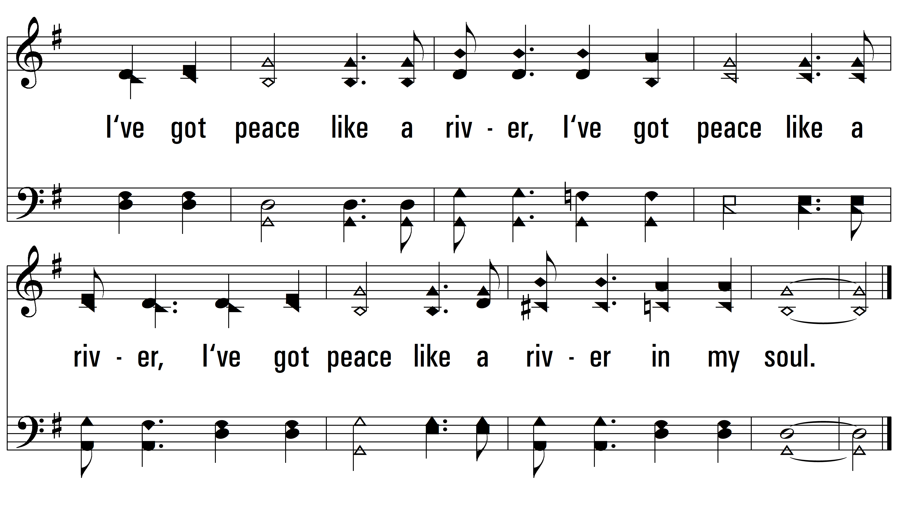
vs. 1

Slide 4
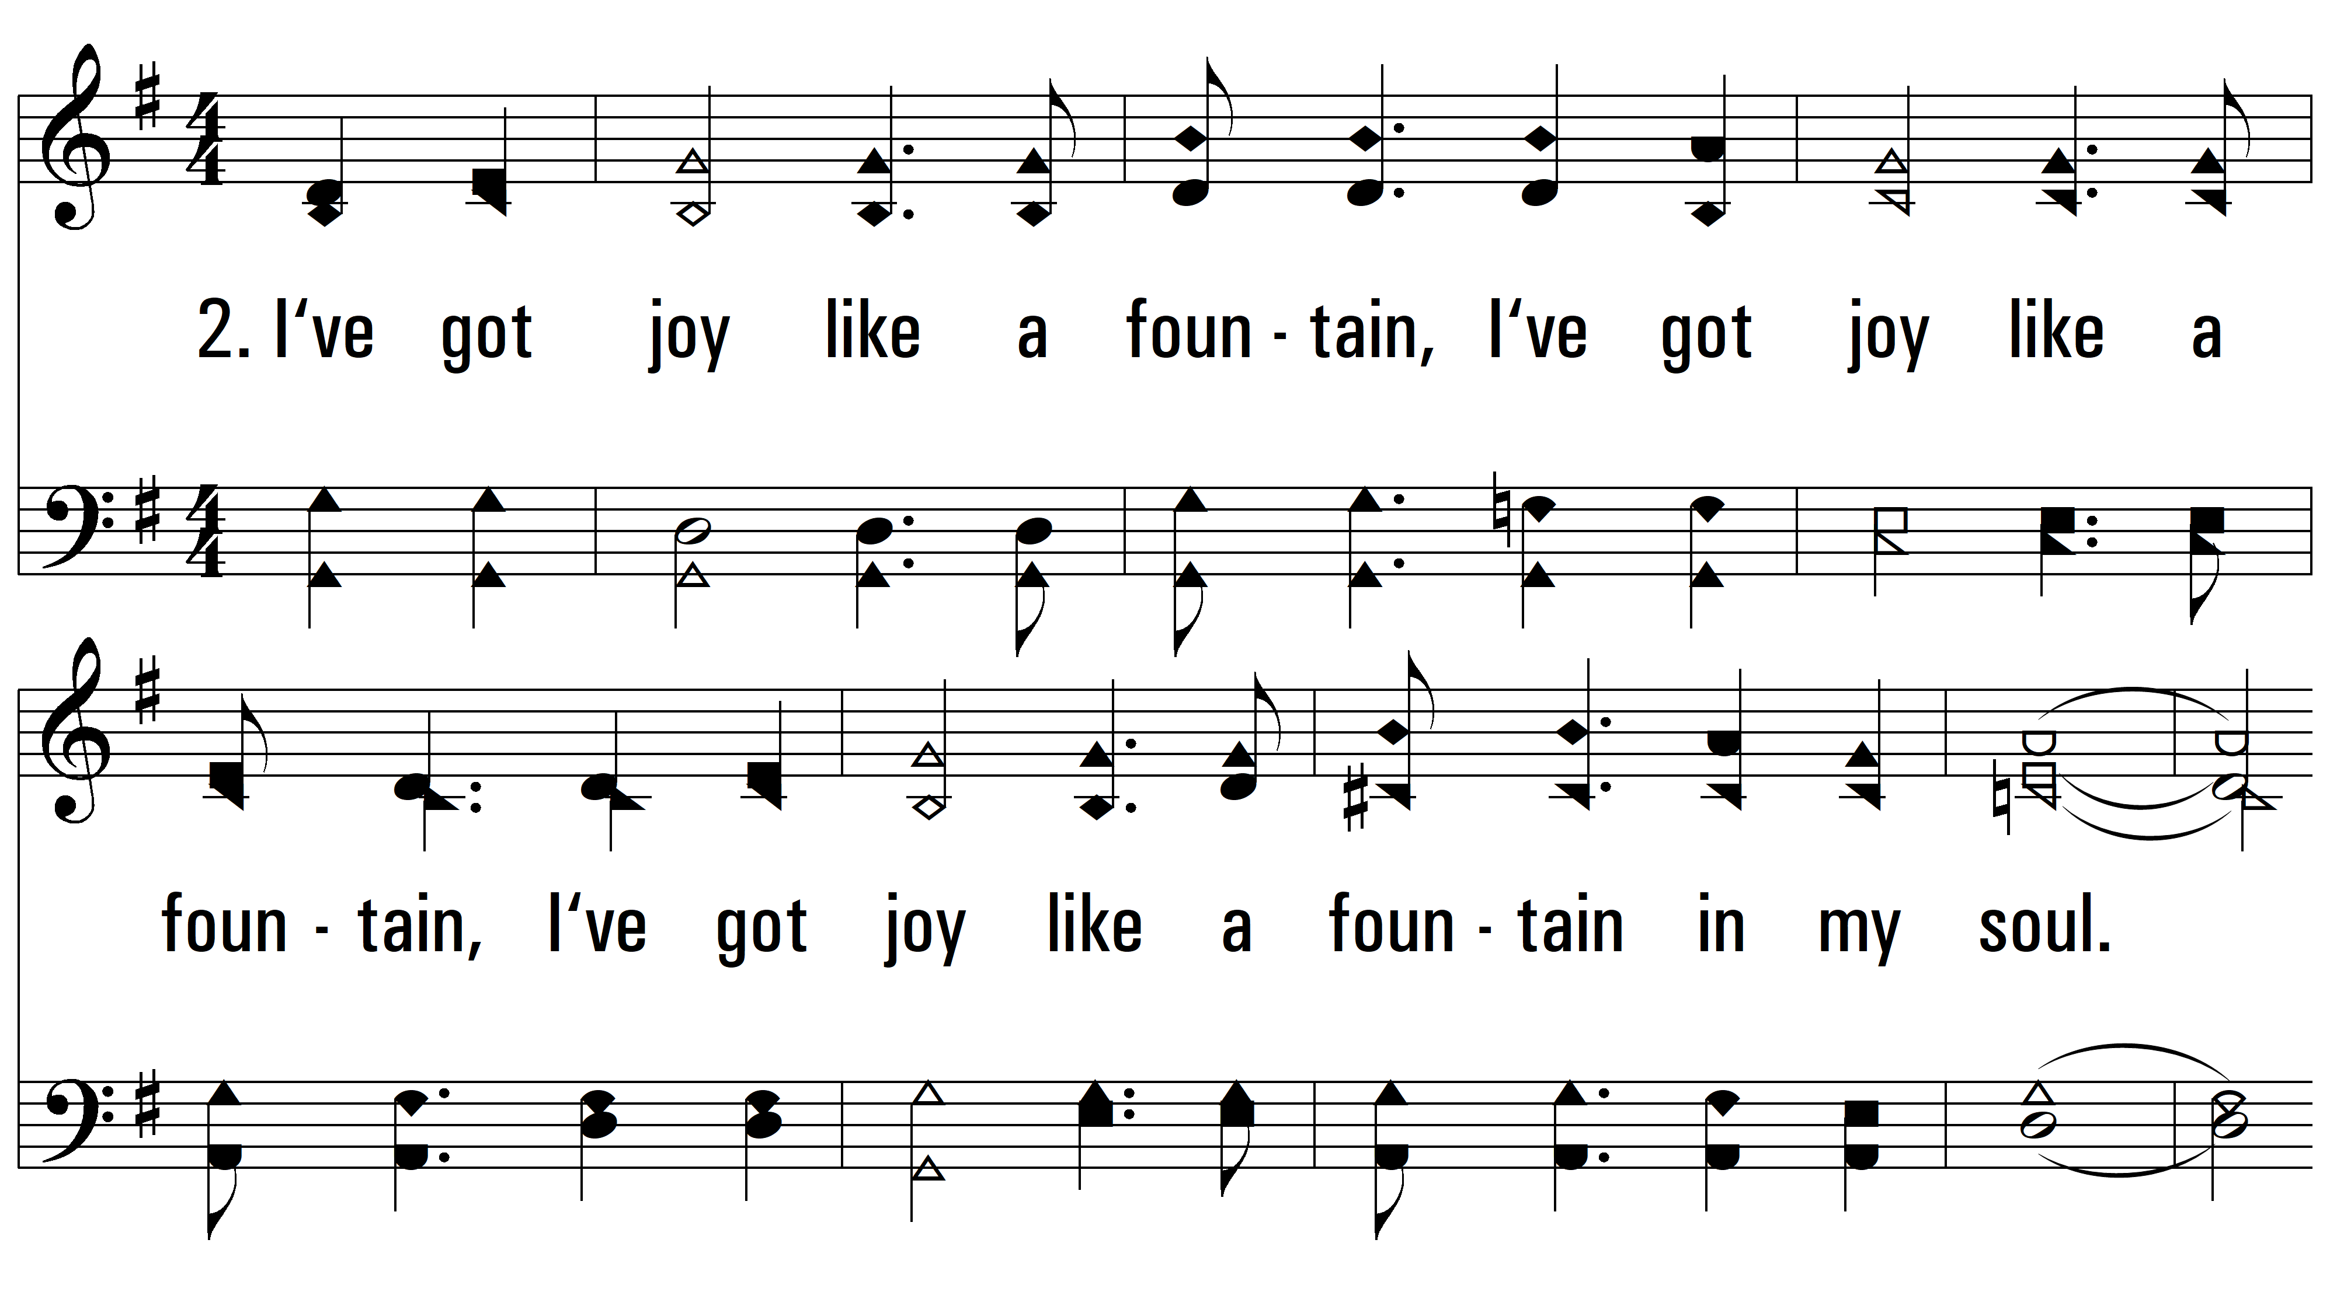
vs. 2 ~ I’ve Got Peace Like A River

Slide 5
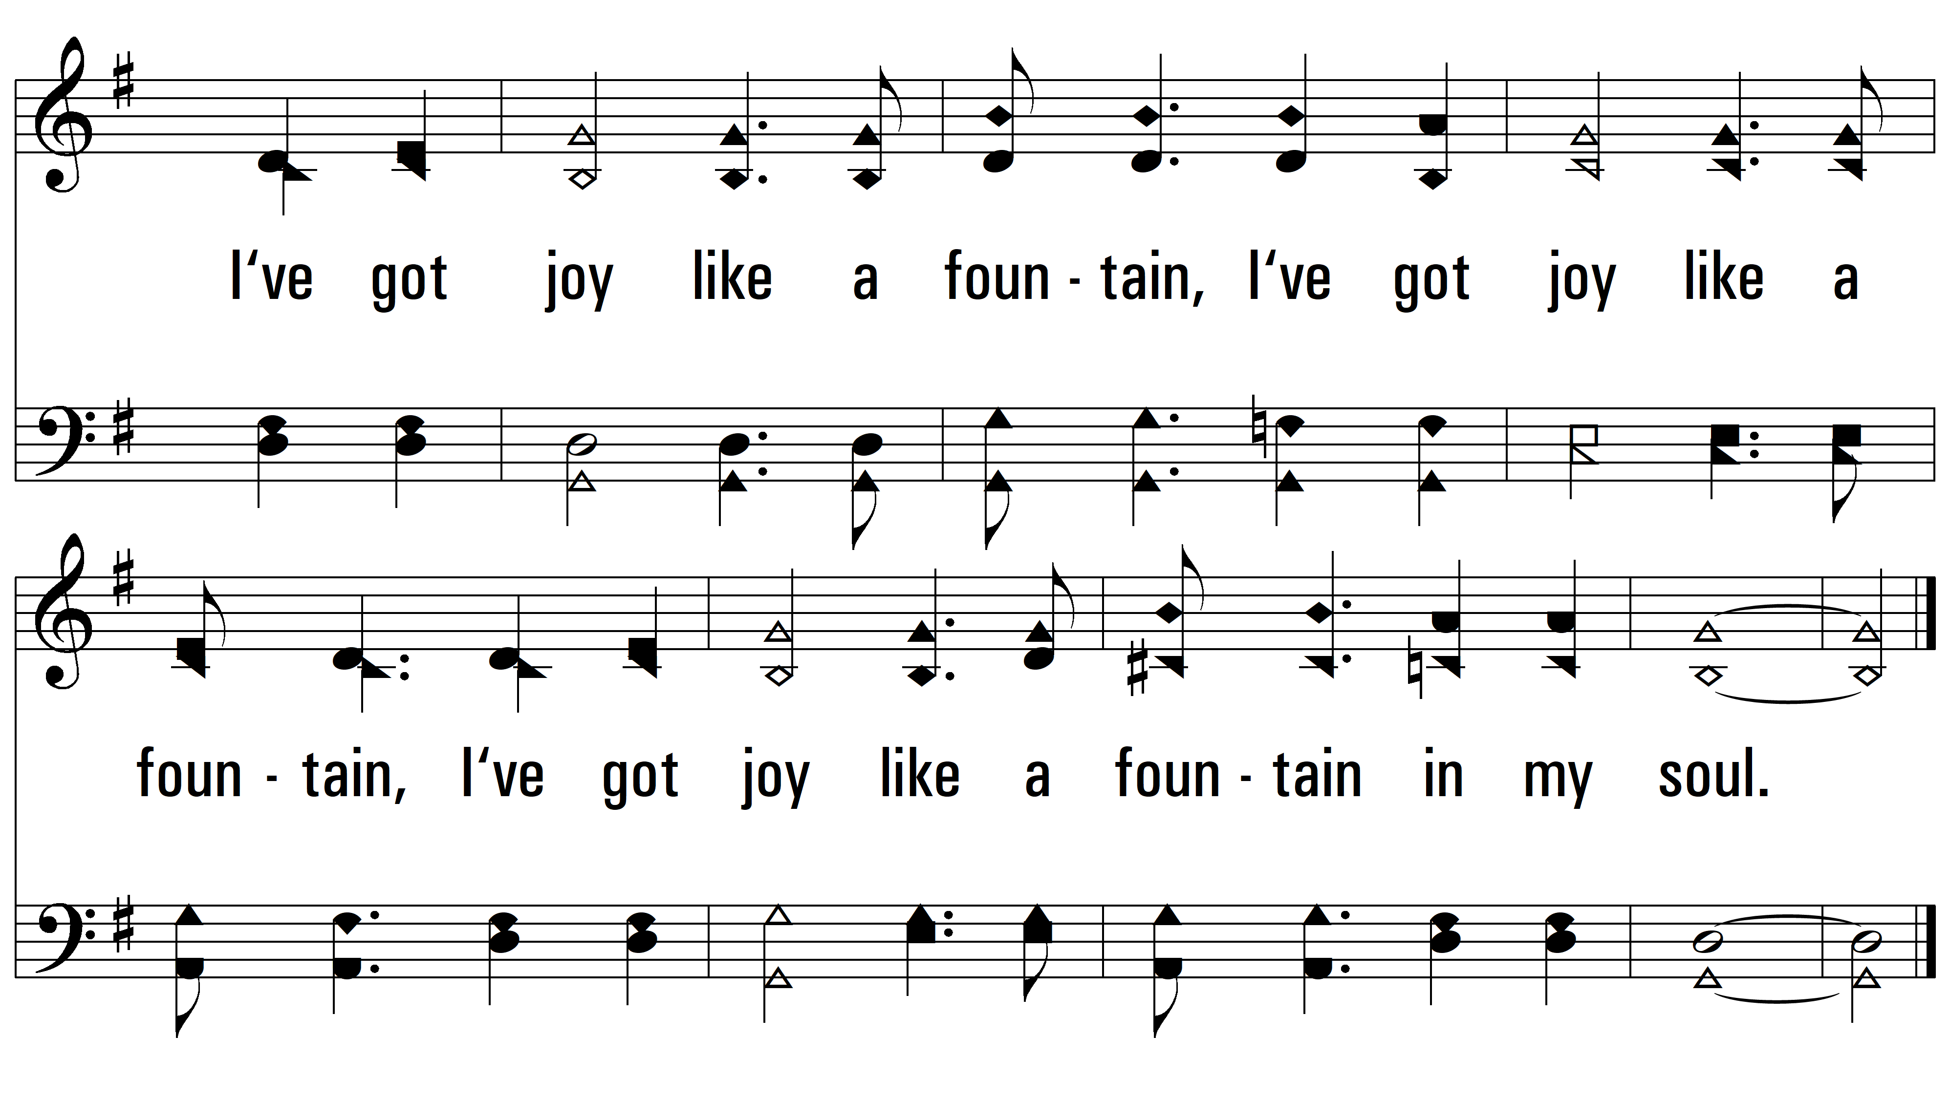
vs. 2

Slide 6
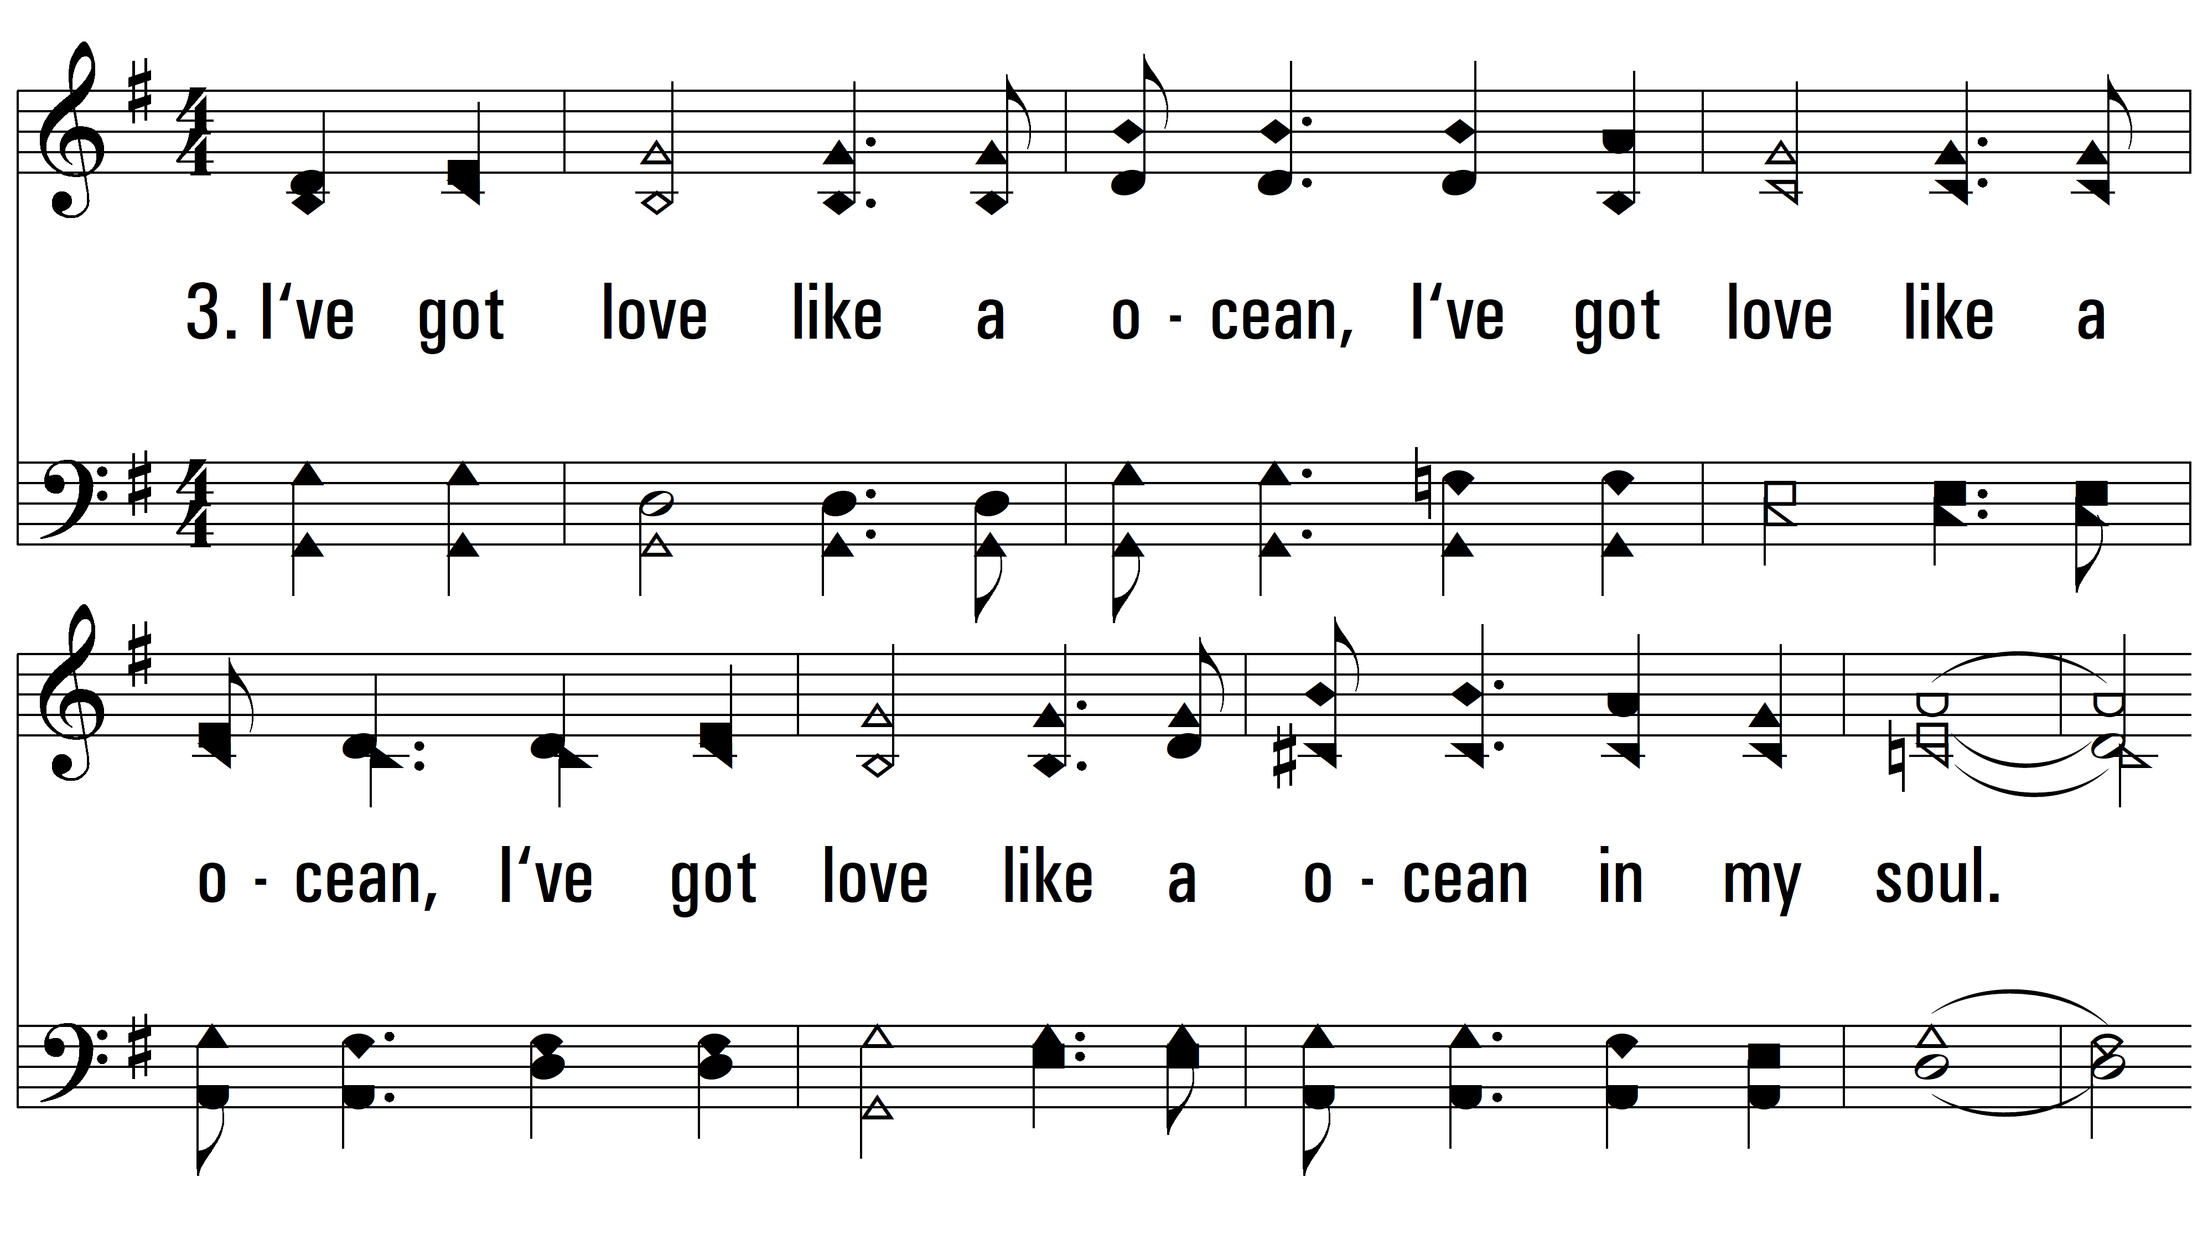
vs. 3 ~ I’ve Got Peace Like A River

Slide 7
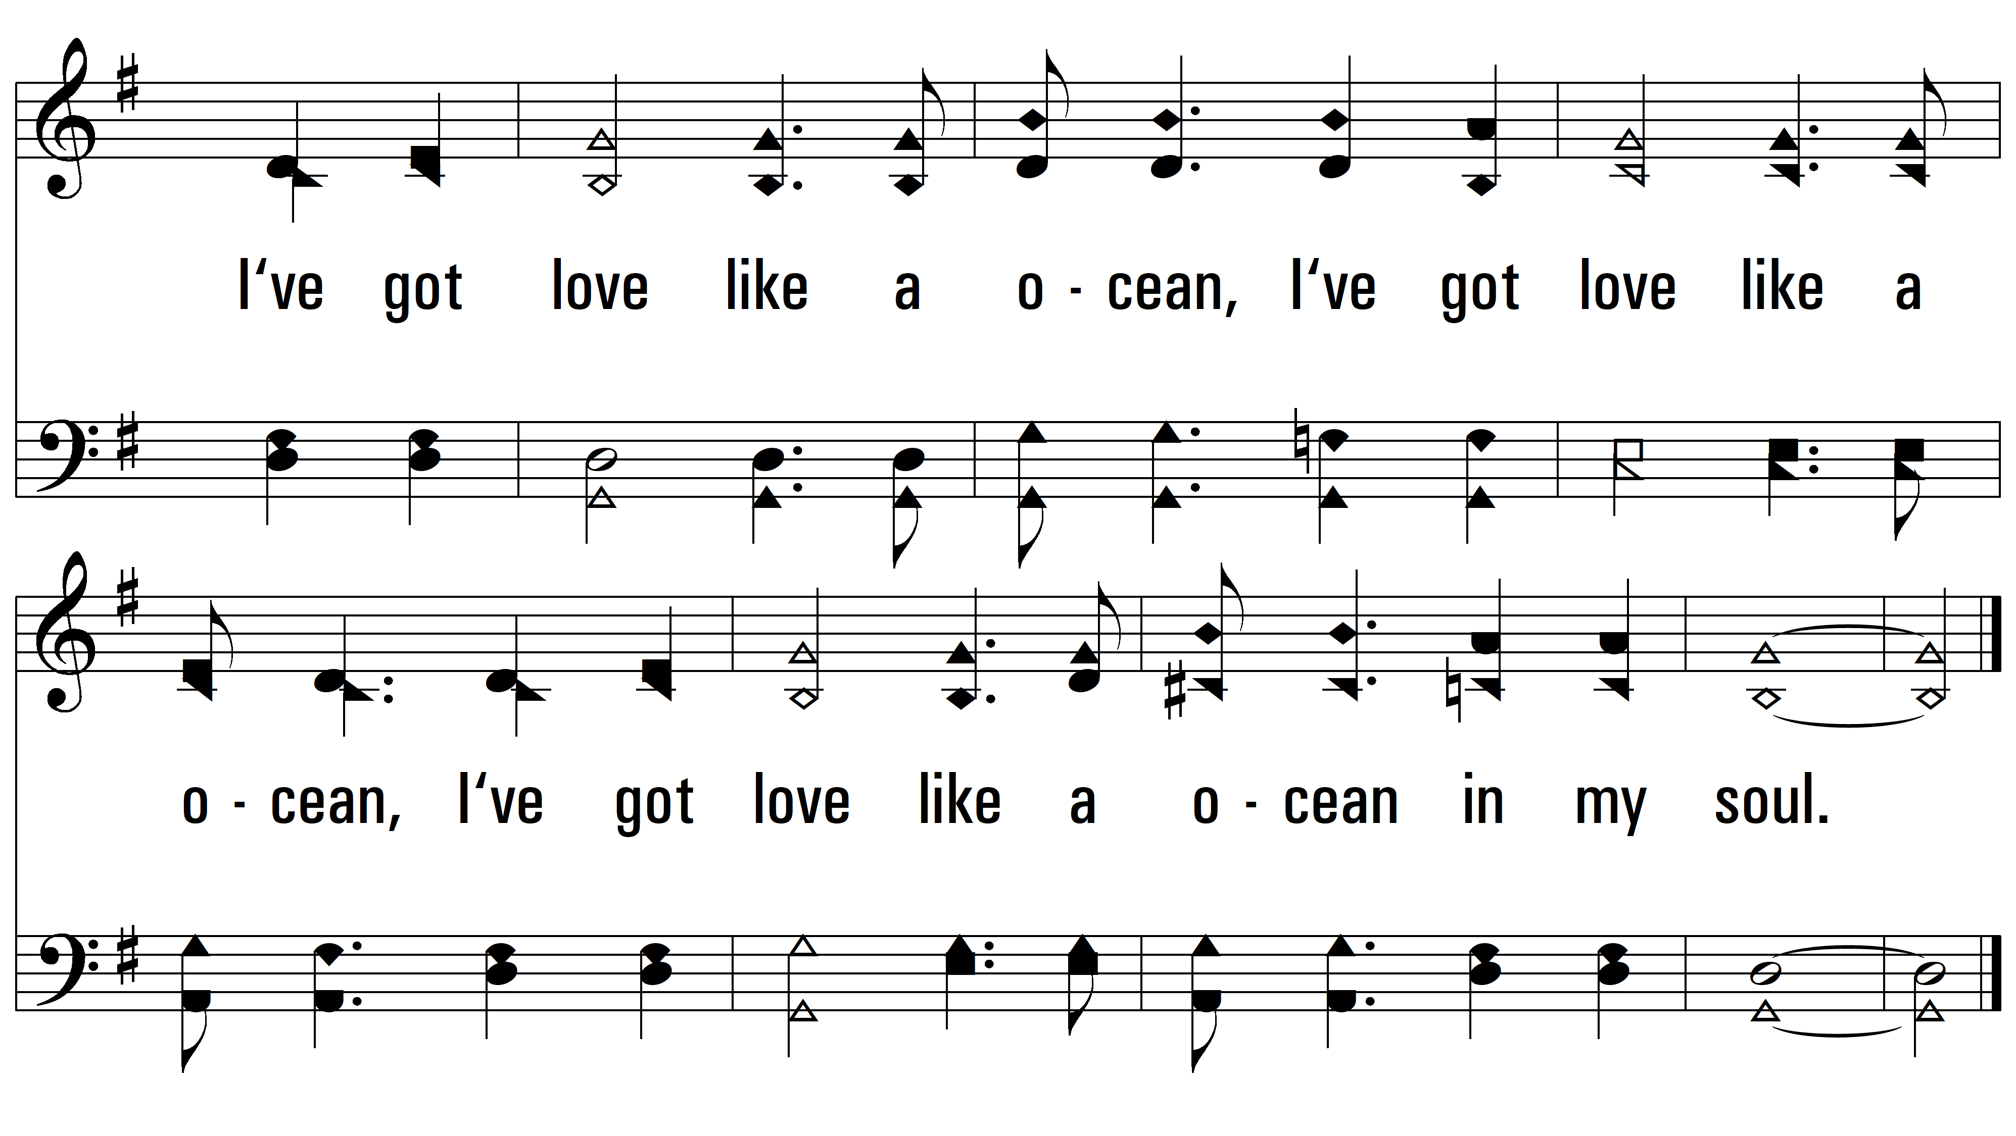
vs. 3

Slide 8
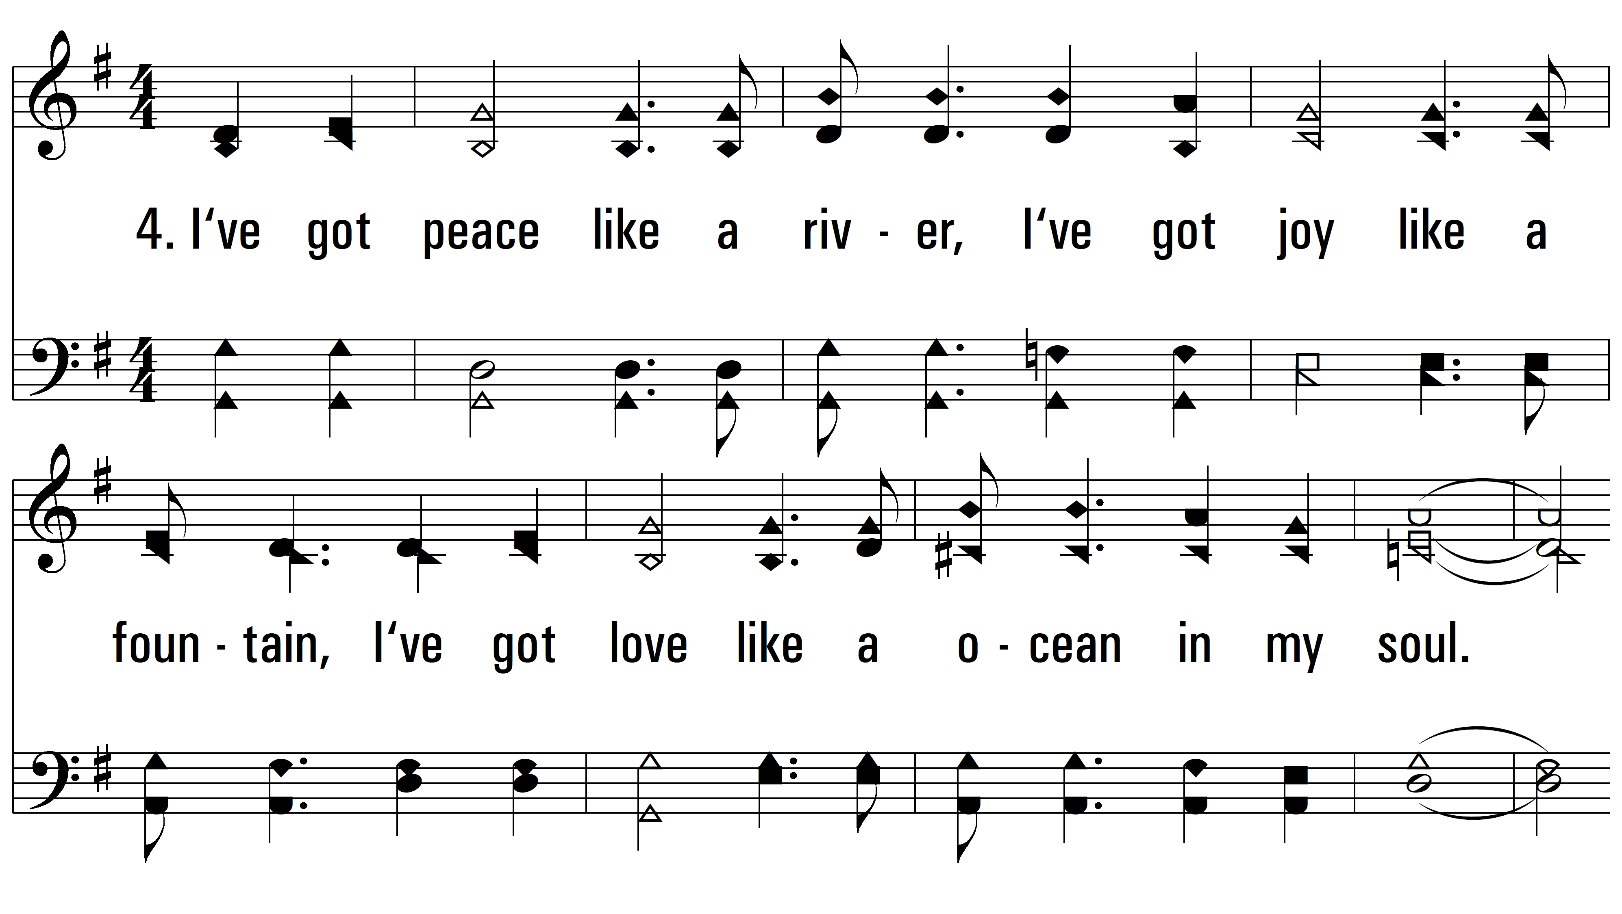
vs. 4 ~ I’ve Got Peace Like A River

Slide 9
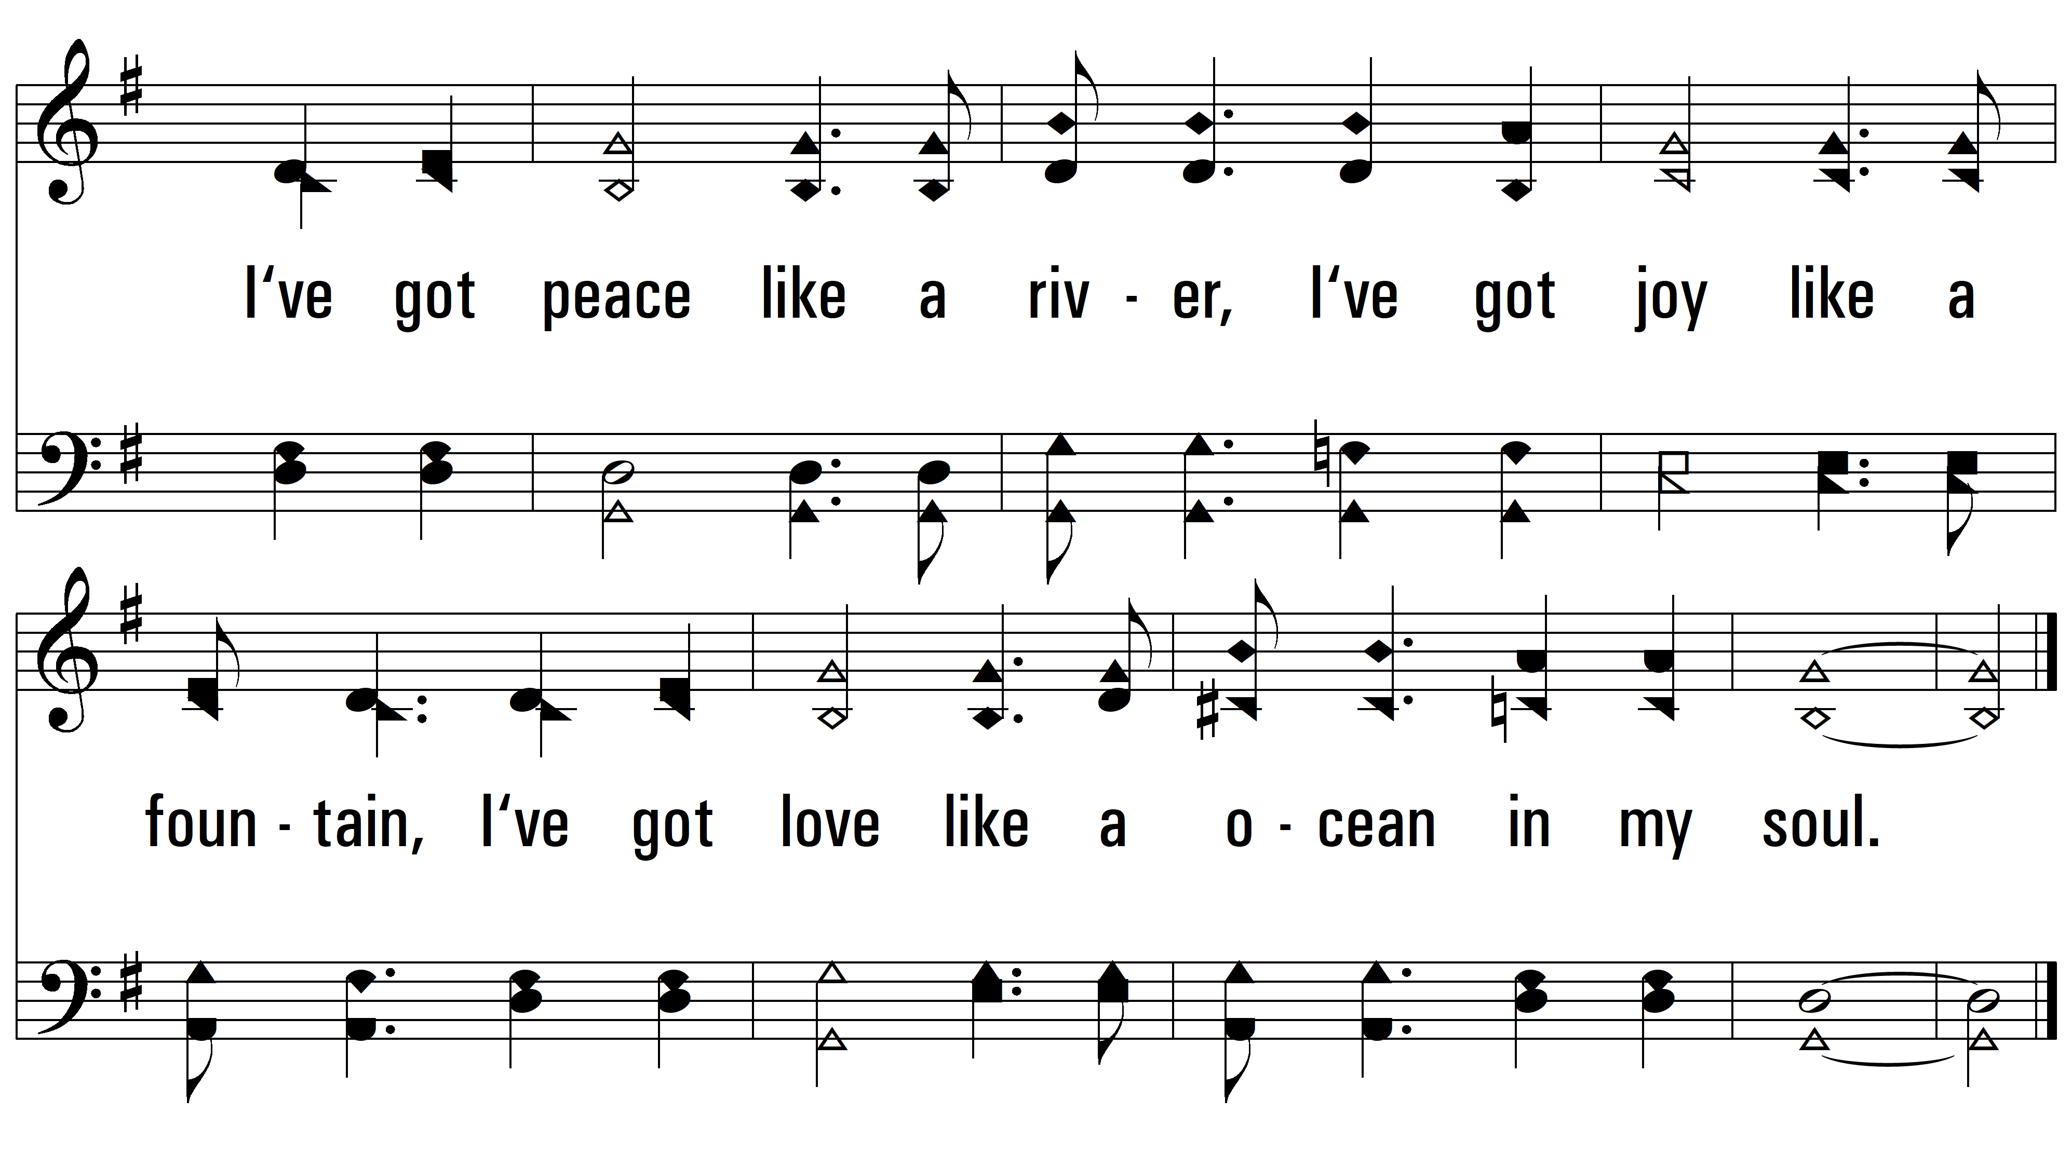
vs. 4
PDHymns.com
END

