Slide 1
It Pays To Serve Jesus
Words: | Frank C. Huston (1909)
Music: | Frank C. Huston (1909)
3/4
E^{b}/B^{b} - SOL
Verses: 3/Chorus
Lead - | MI
Alto - | DO
Tenor - | MI
Bass - | DO
PDHymns.com

Slide 2
vs. 1 ~ It Pays To Serve Jesus

Slide 3
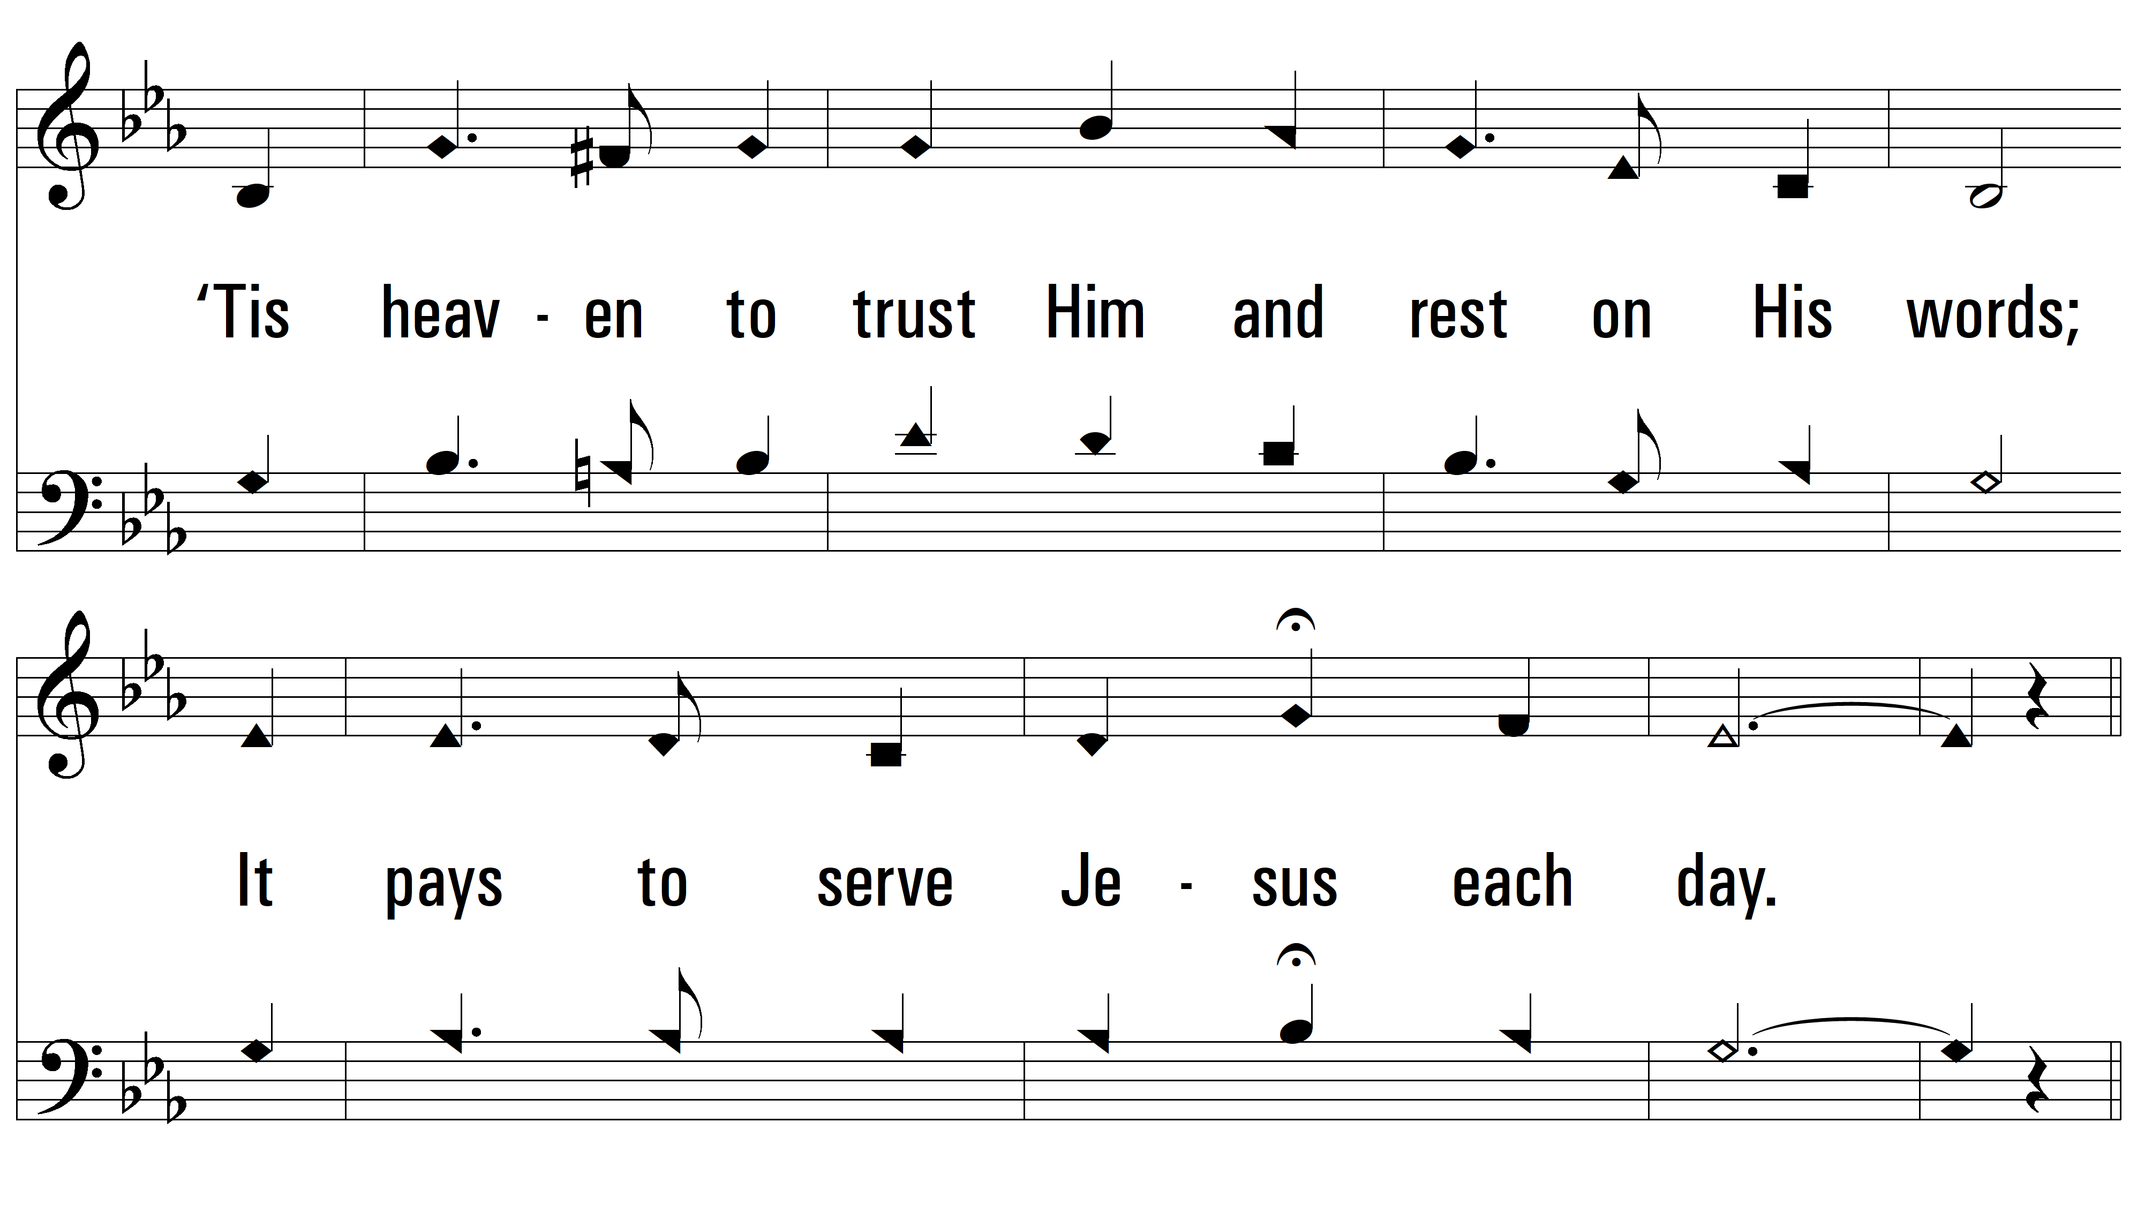
vs. 1

Slide 4
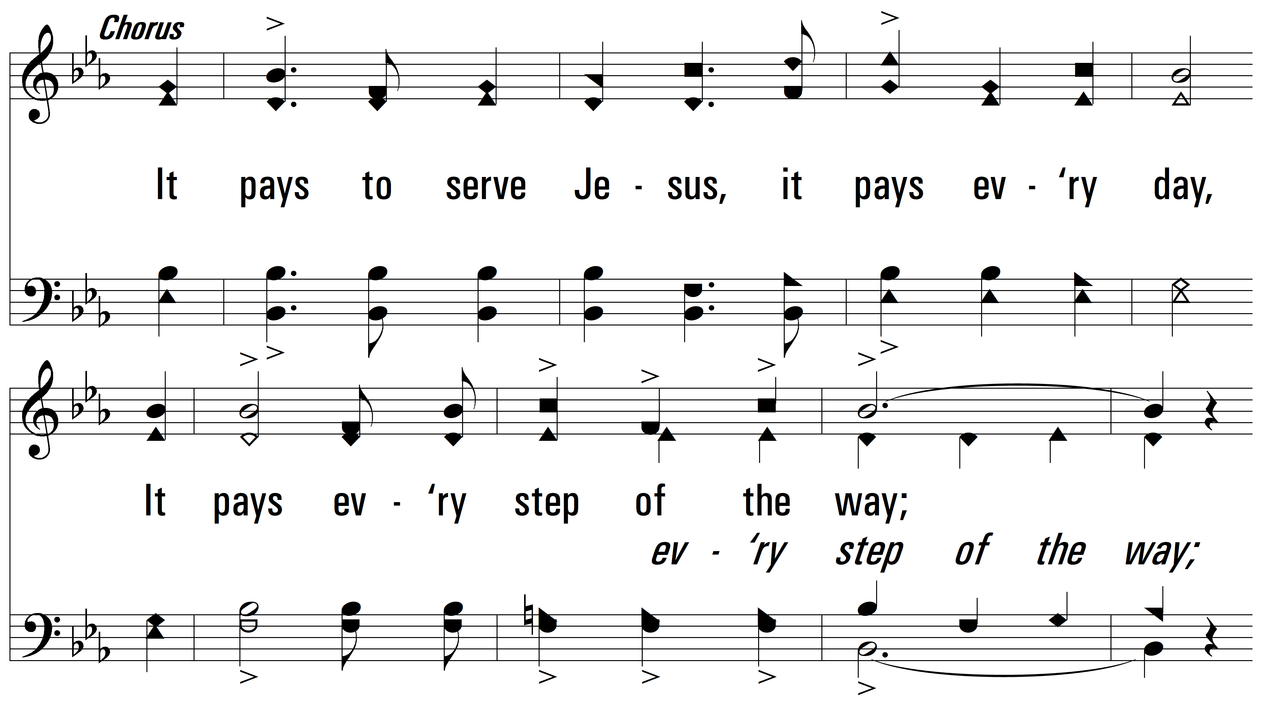
vs. 1

Slide 5
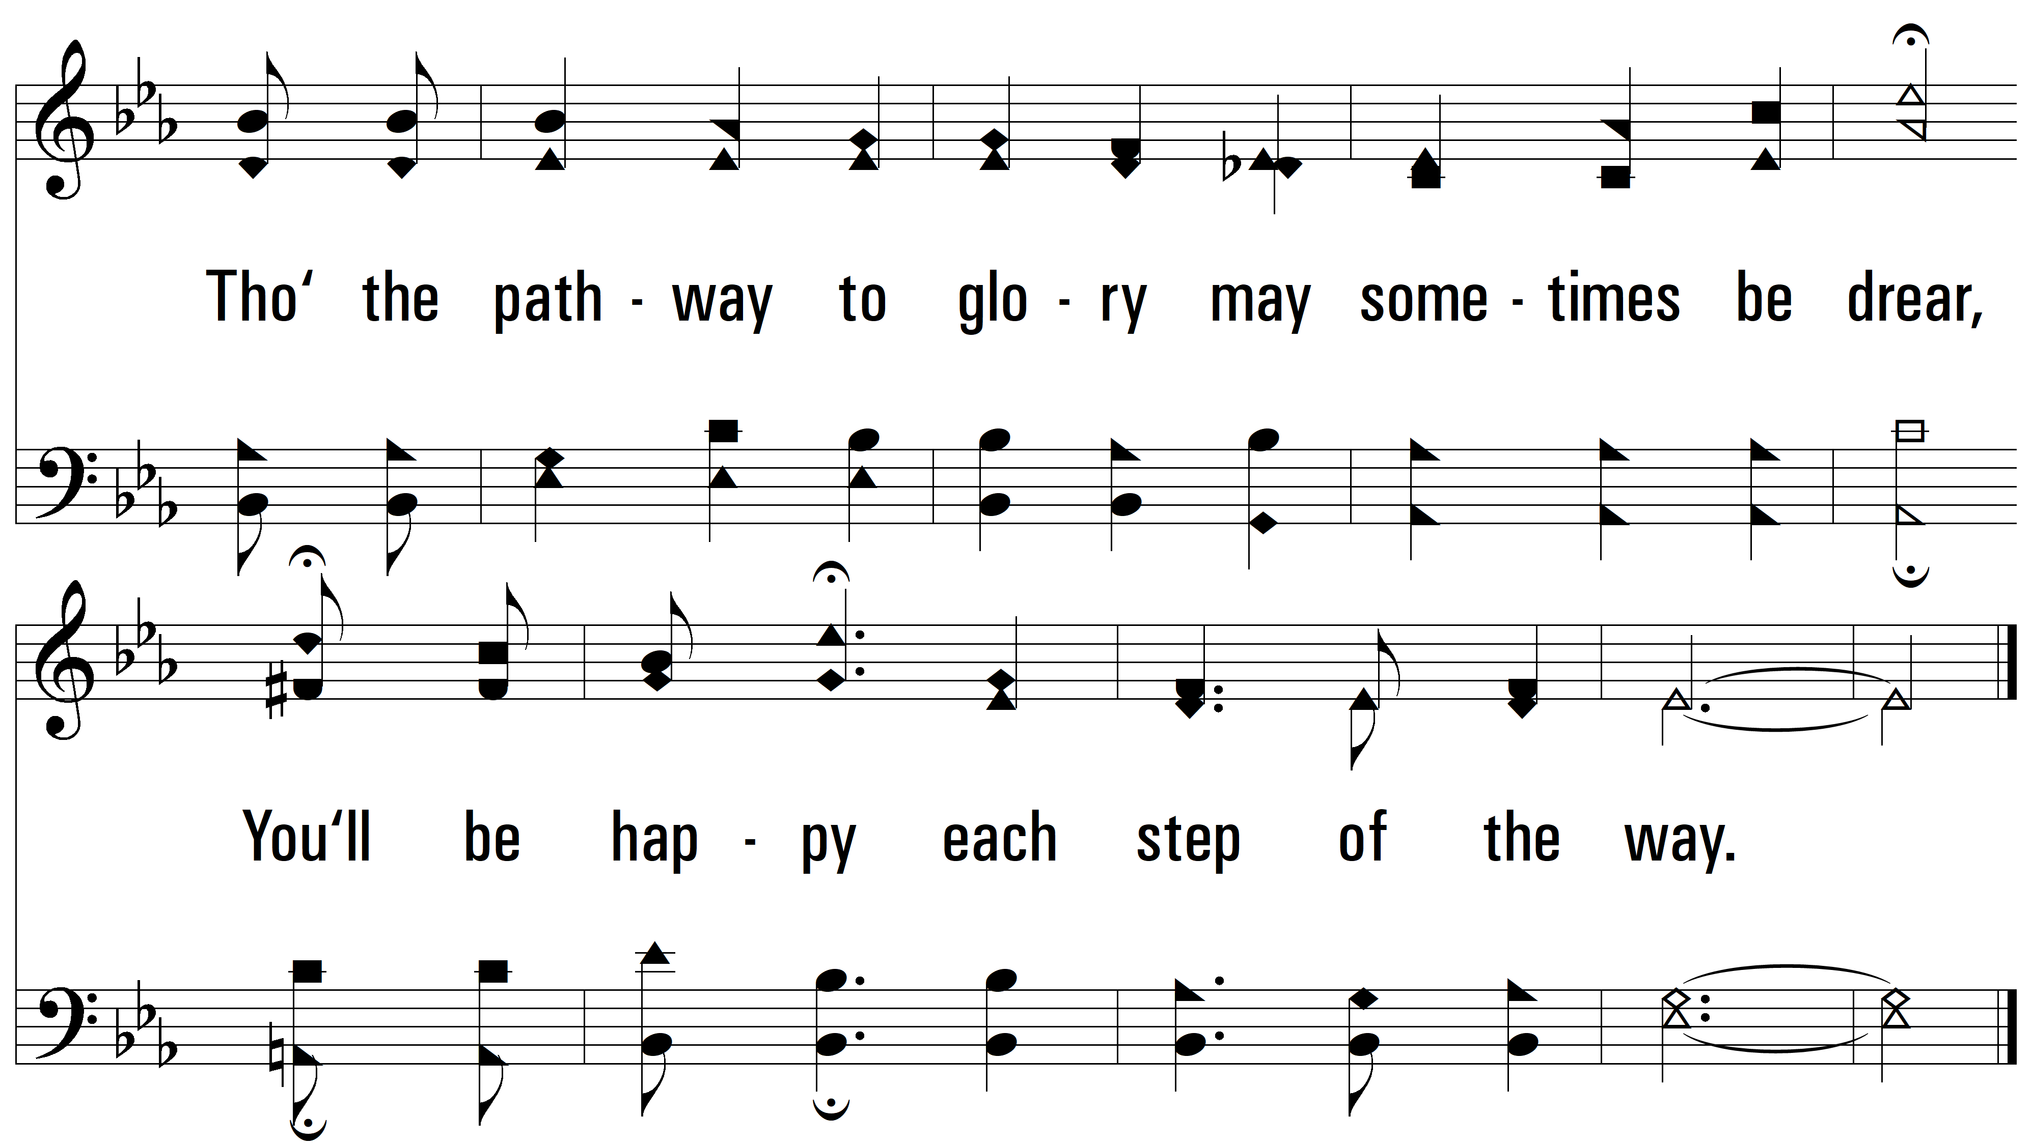
vs. 1

Slide 6
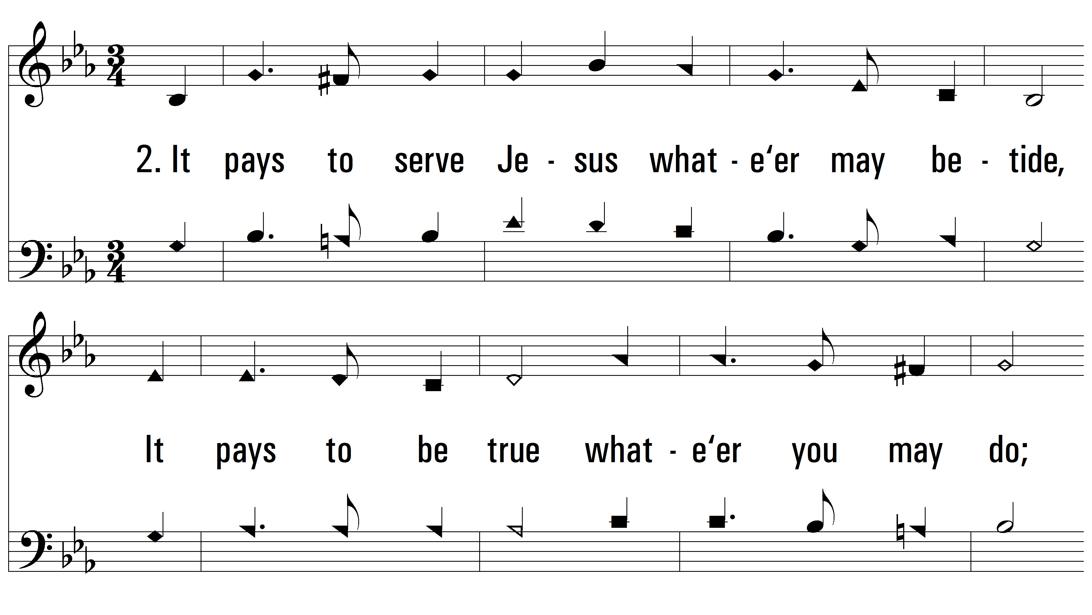
vs. 2 ~ It Pays To Serve Jesus

Slide 7
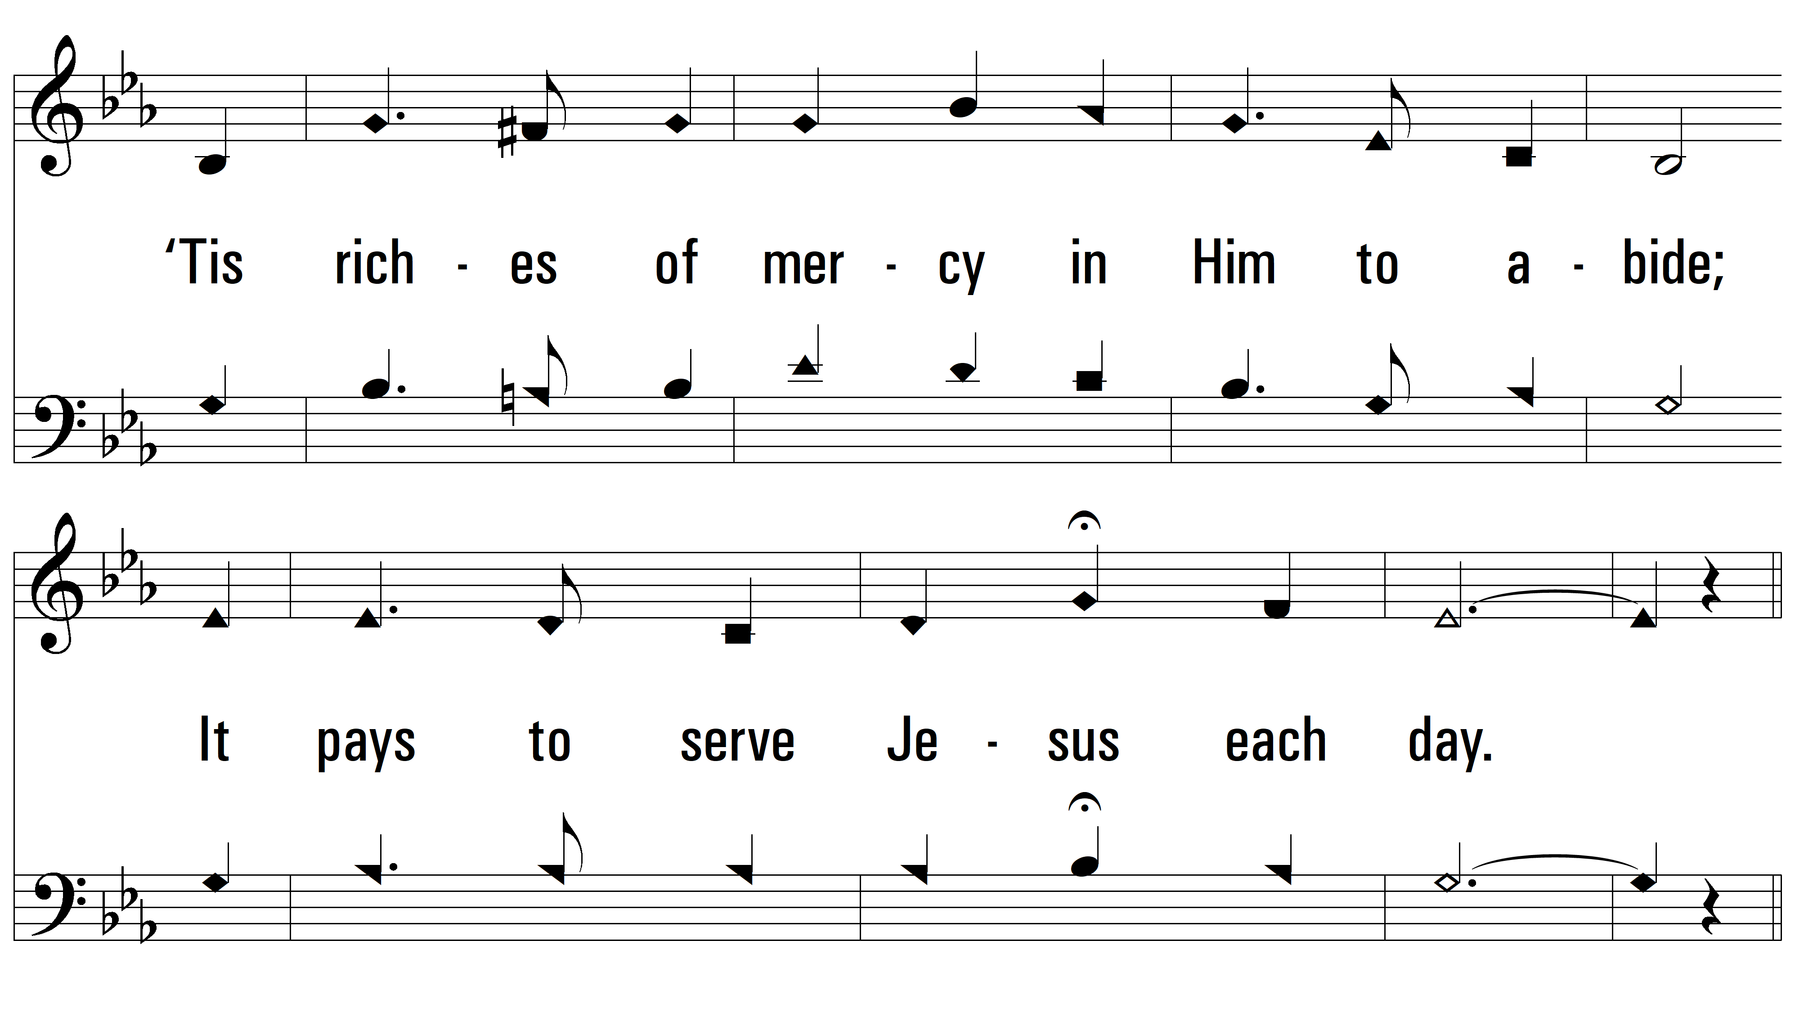
vs. 2

Slide 8
vs. 2

Slide 9
vs. 2

Slide 10
vs. 3 ~ It Pays To Serve Jesus

Slide 11
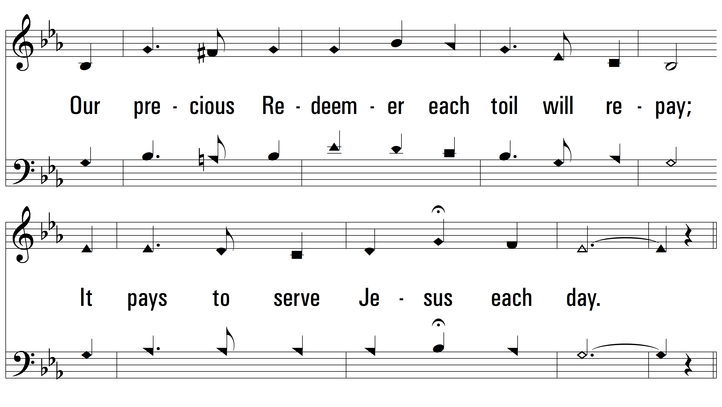
vs. 3

Slide 12
vs. 3

Slide 13
vs. 3
PDHymns.com
END

