Slide 1
It Is Good To Sing Your Praises
BLAENWERN
8.7.8.7.D
Words: | Psalm 92, Arr. McNaughter’s Psalter
Music: | William P. Rowlands (1905)
3/4
G/D - SOL
Verses: 3/Chorus
Lead - | SOL
Alto - | MI
Tenor - | DO
Bass - | DO
PDHymns.com

Slide 2
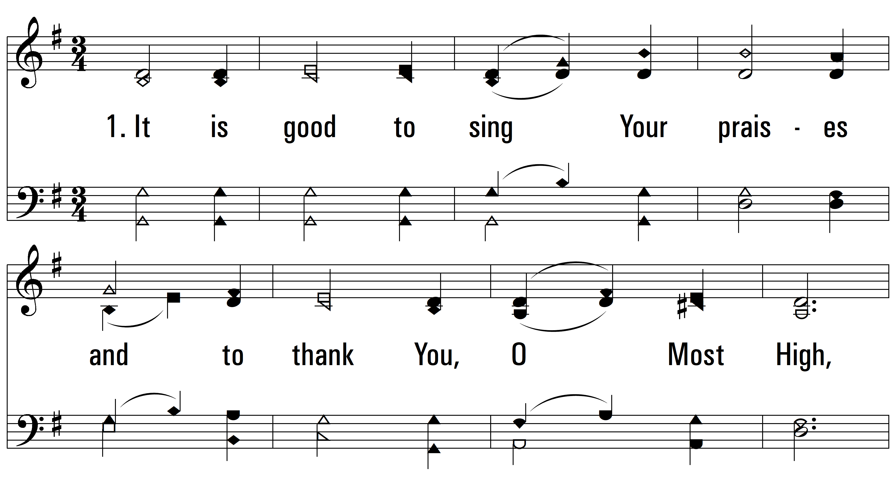
vs. 1 ~ It Is Good To Sing Your Praises

Slide 3
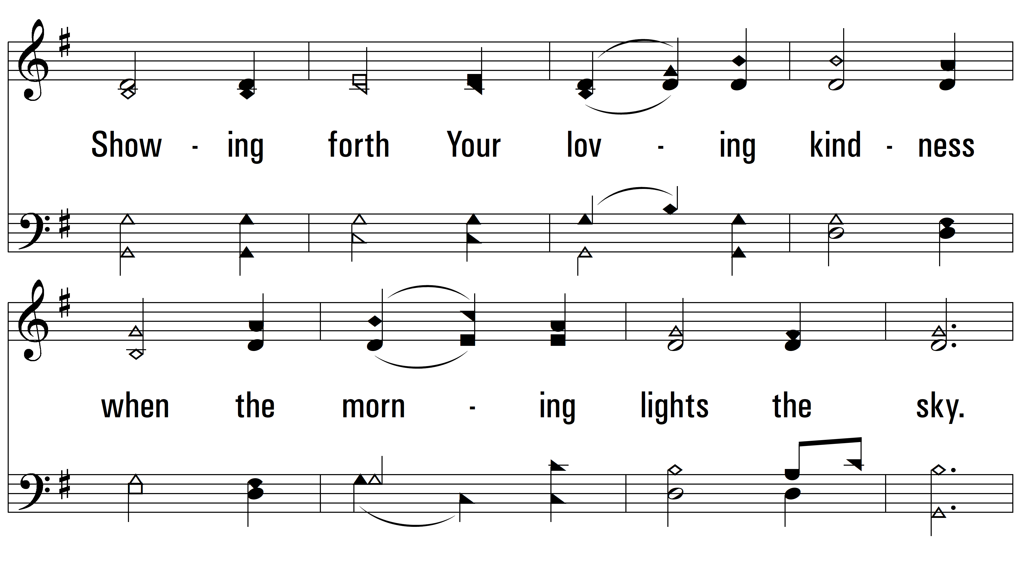
vs. 1

Slide 4
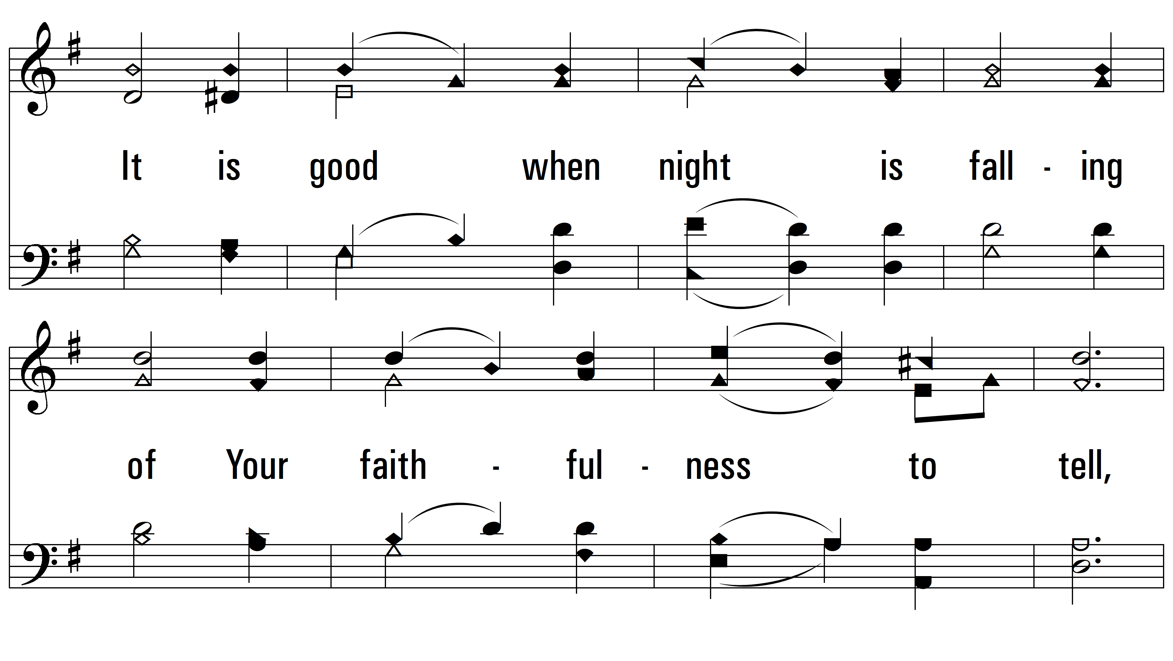
vs. 1

Slide 5
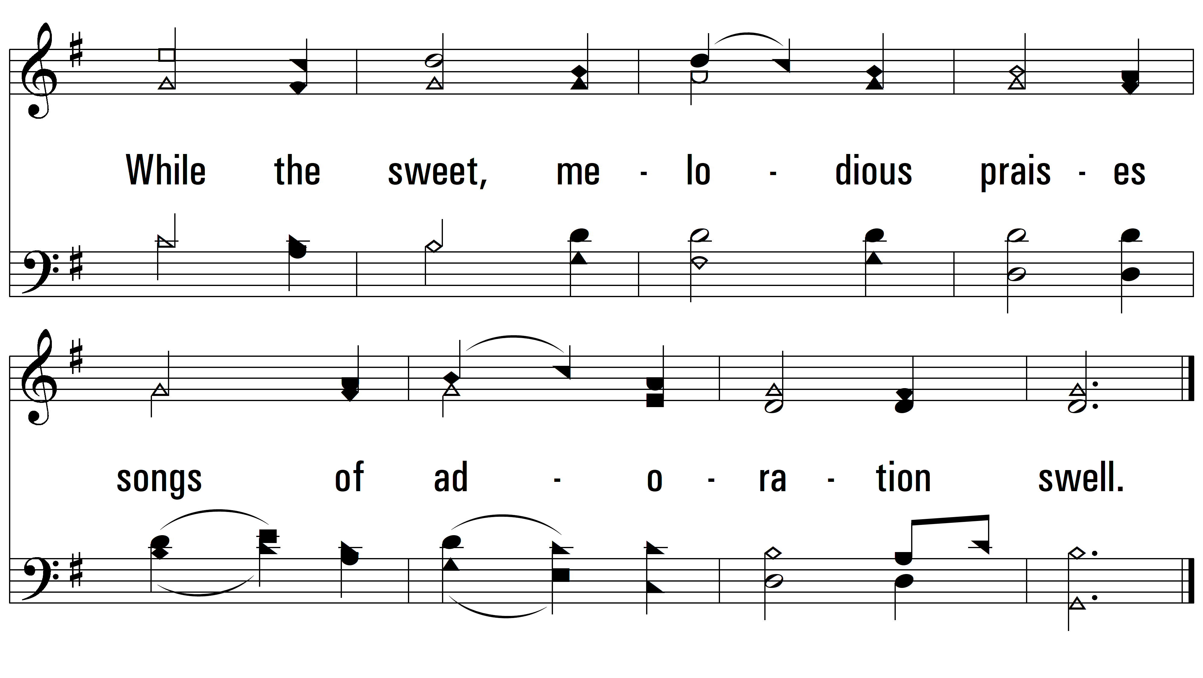
vs. 1

Slide 6
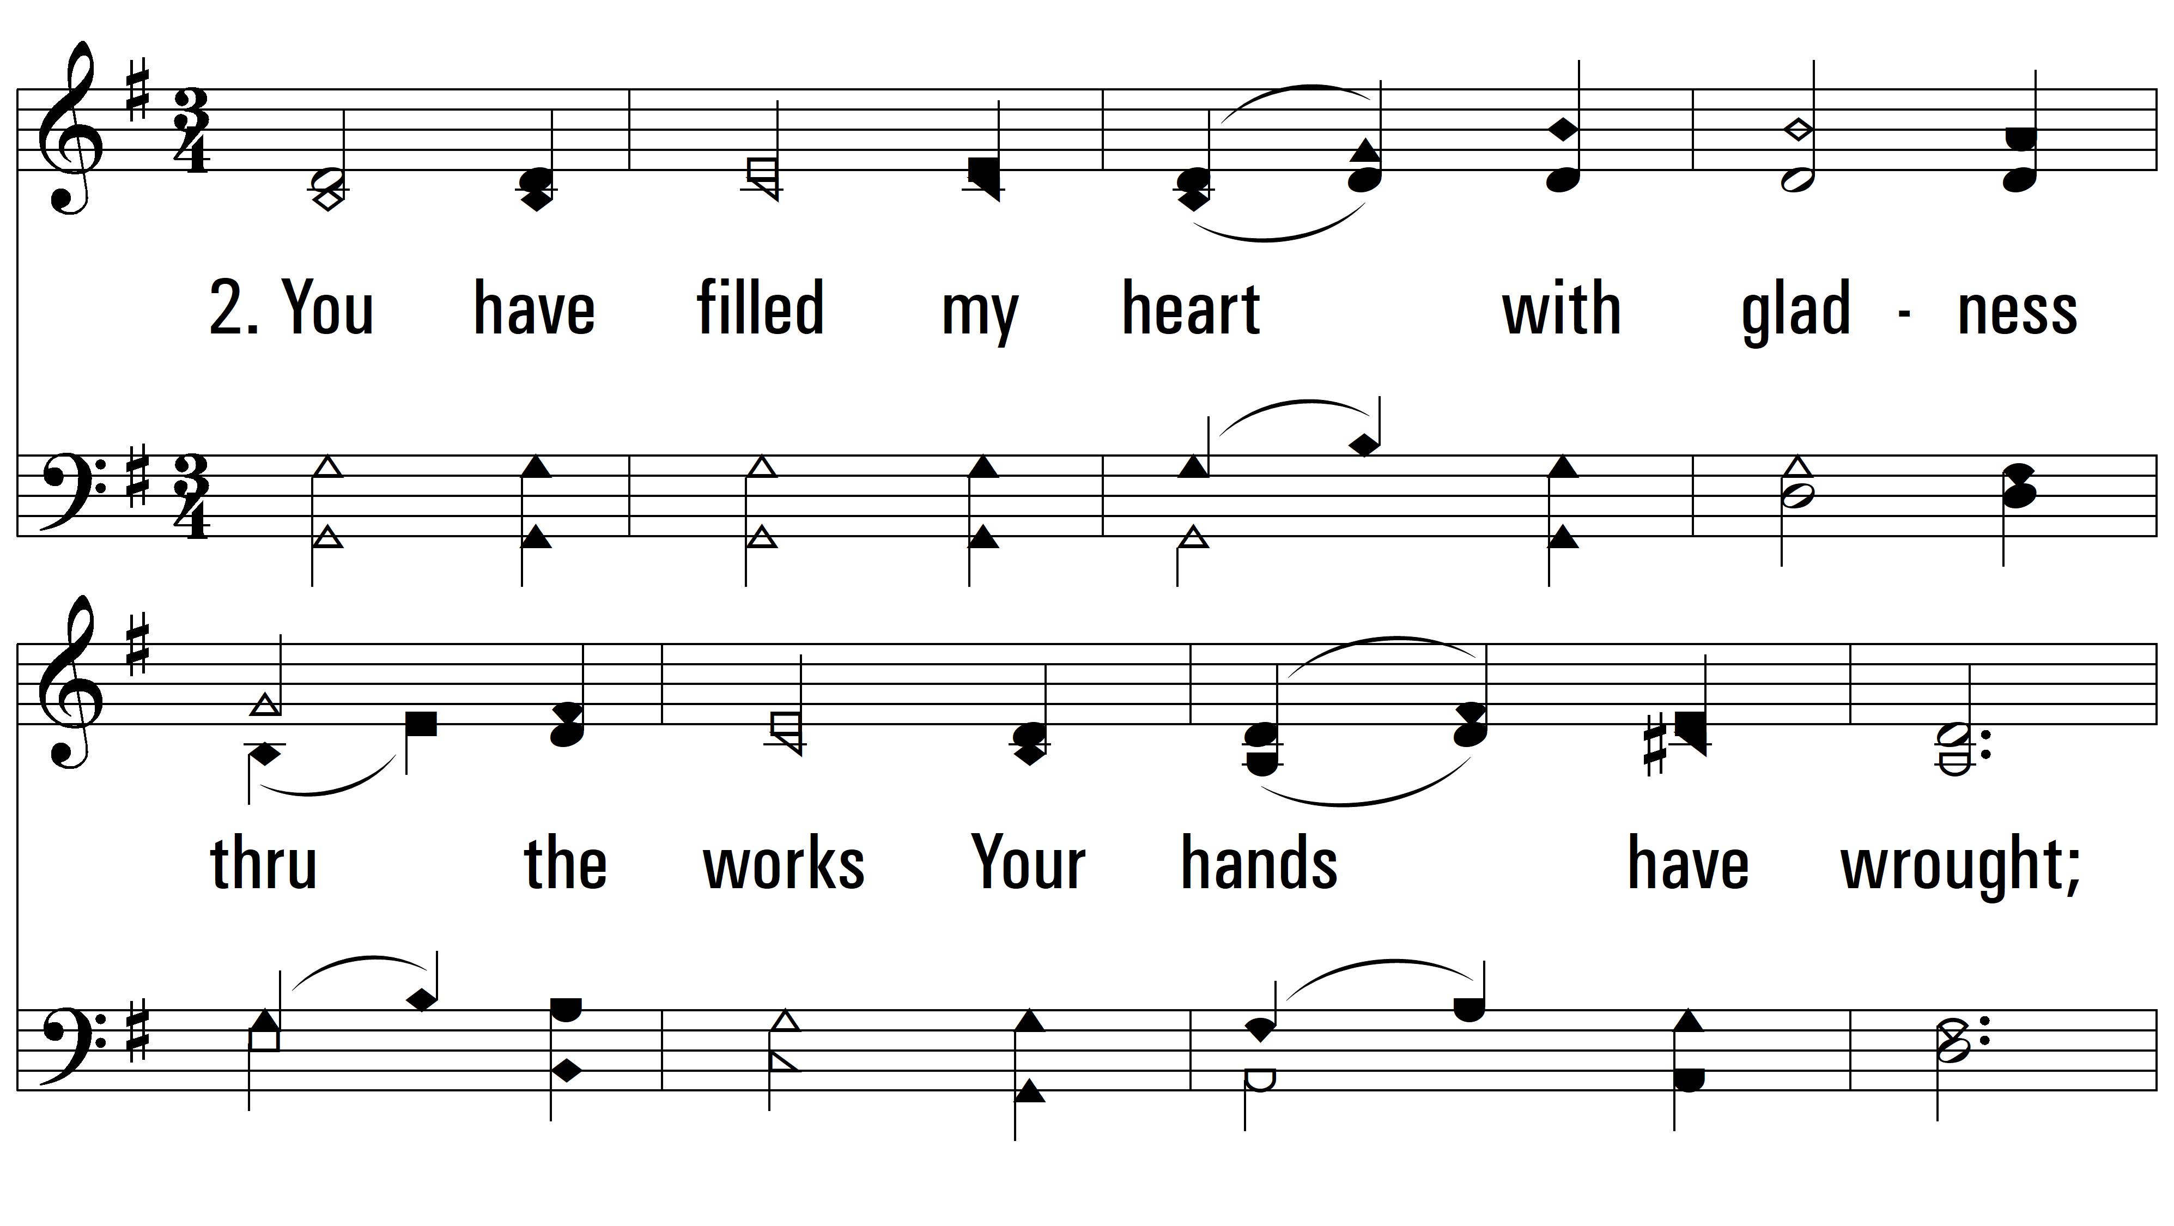
vs. 2 ~ It Is Good To Sing Your Praises

Slide 7
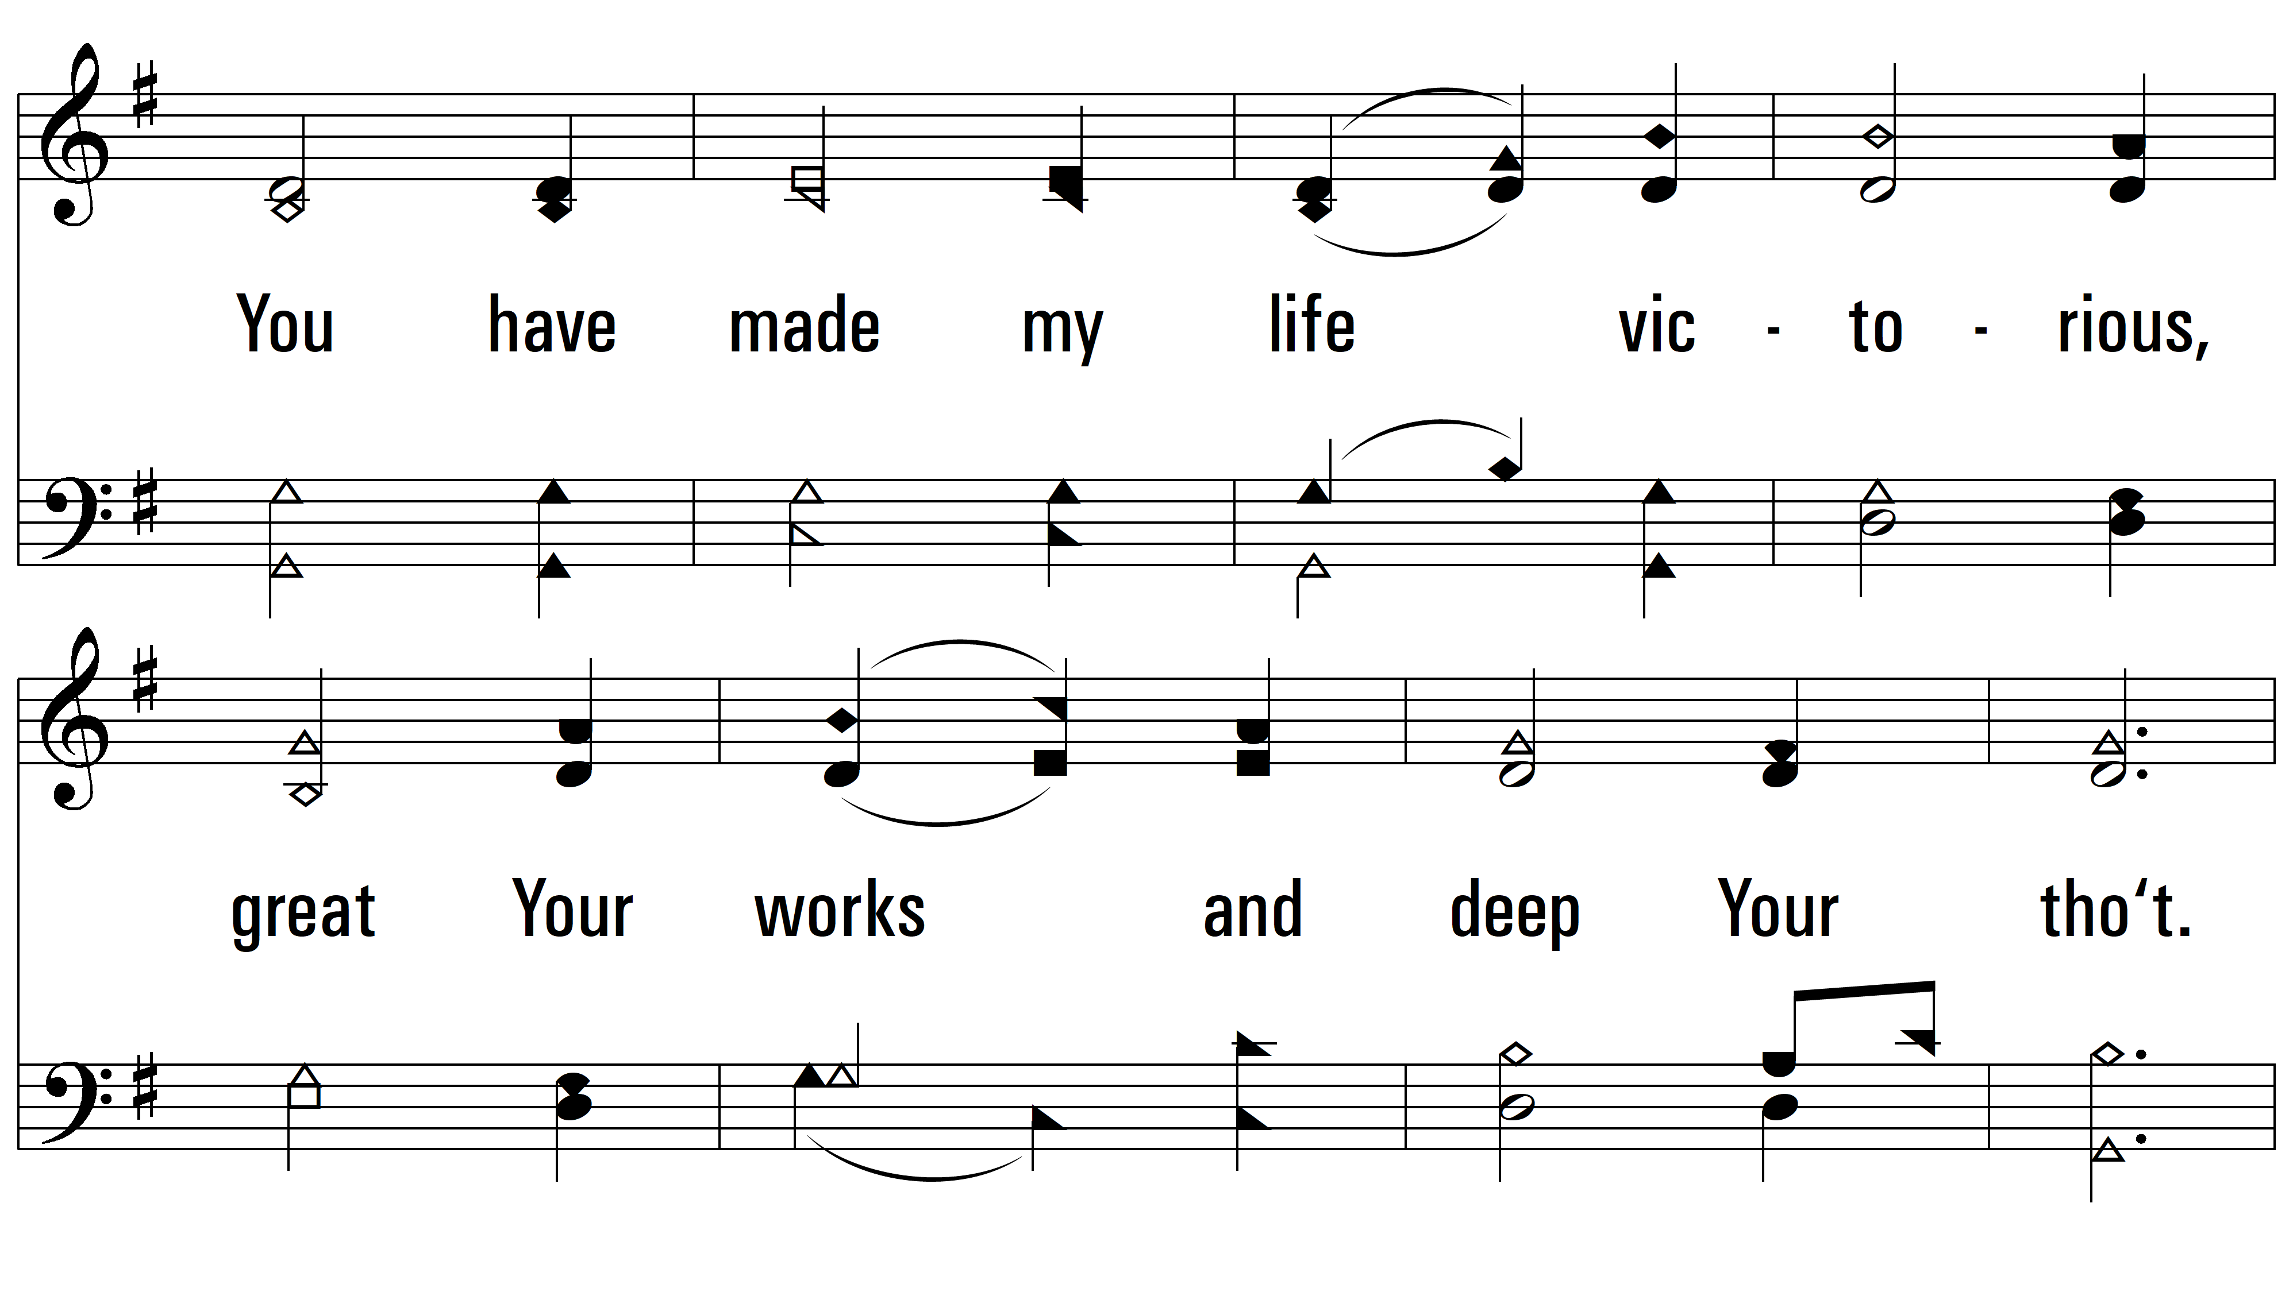
vs. 2

Slide 8
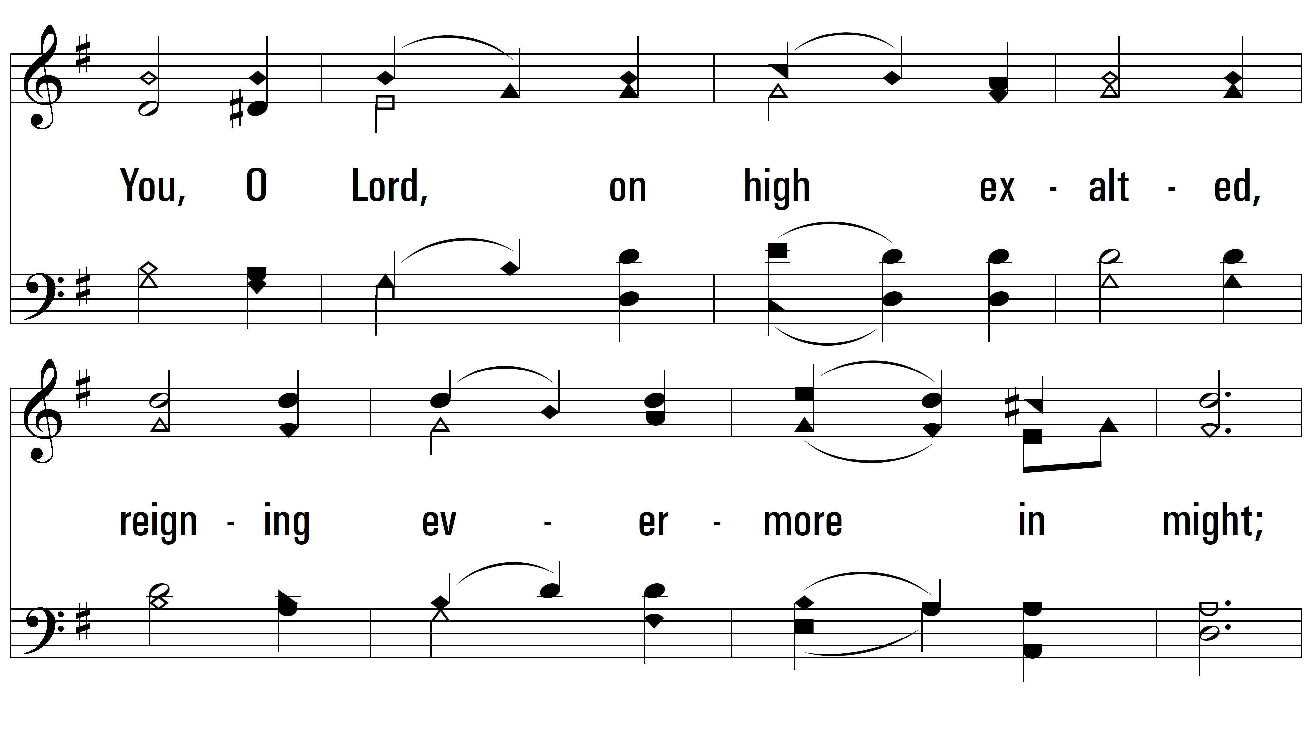
vs. 2

Slide 9
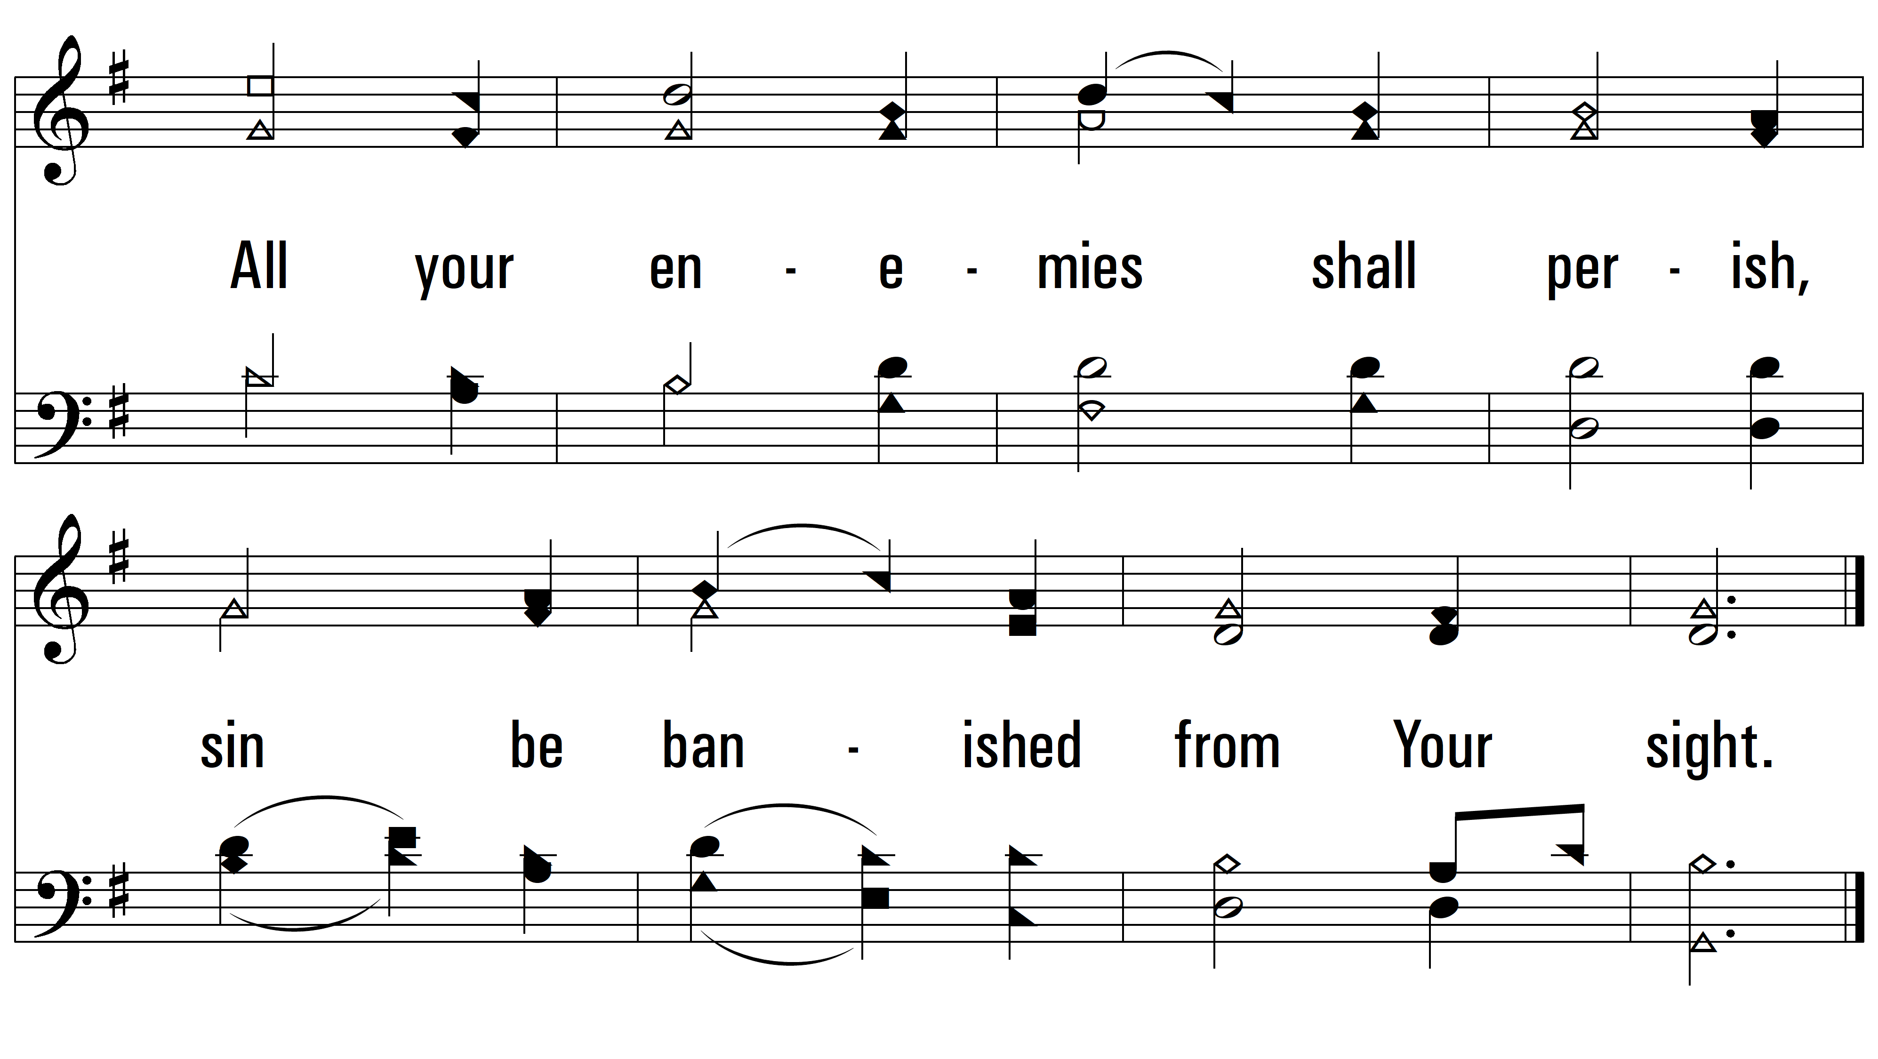
vs. 2

Slide 10
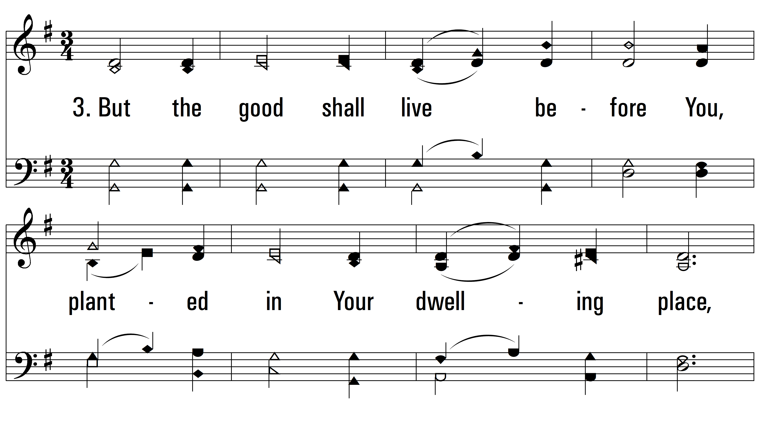
vs. 3 ~ It Is Good To Sing Your Praises

Slide 11
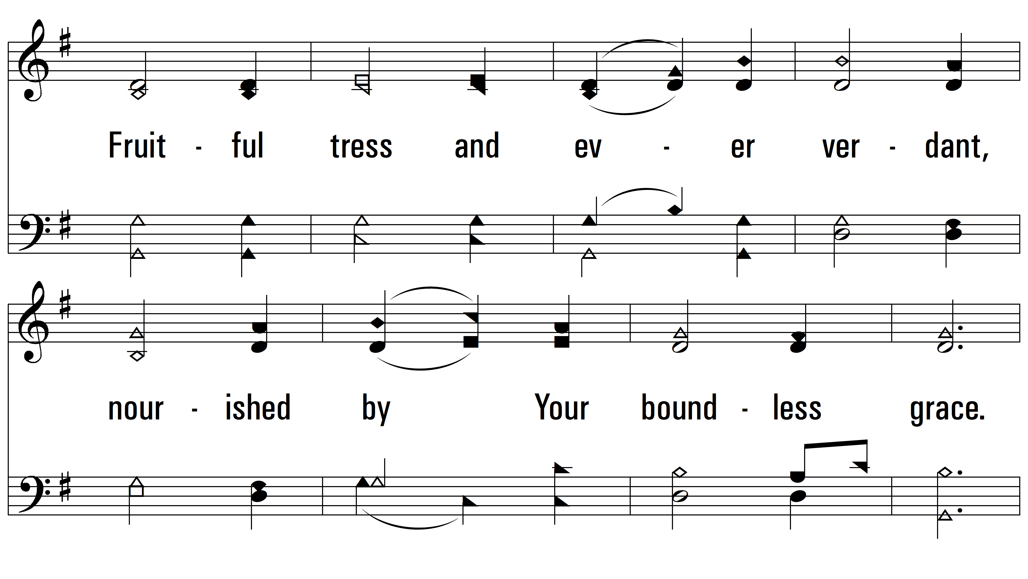
vs. 3

Slide 12
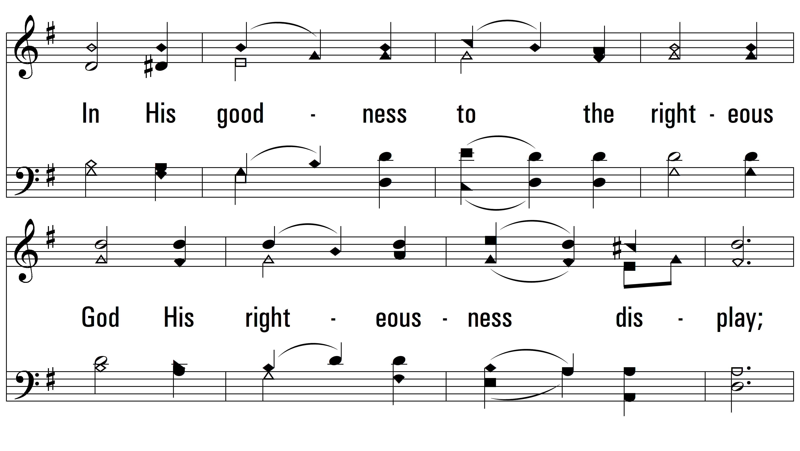
vs. 3

Slide 13
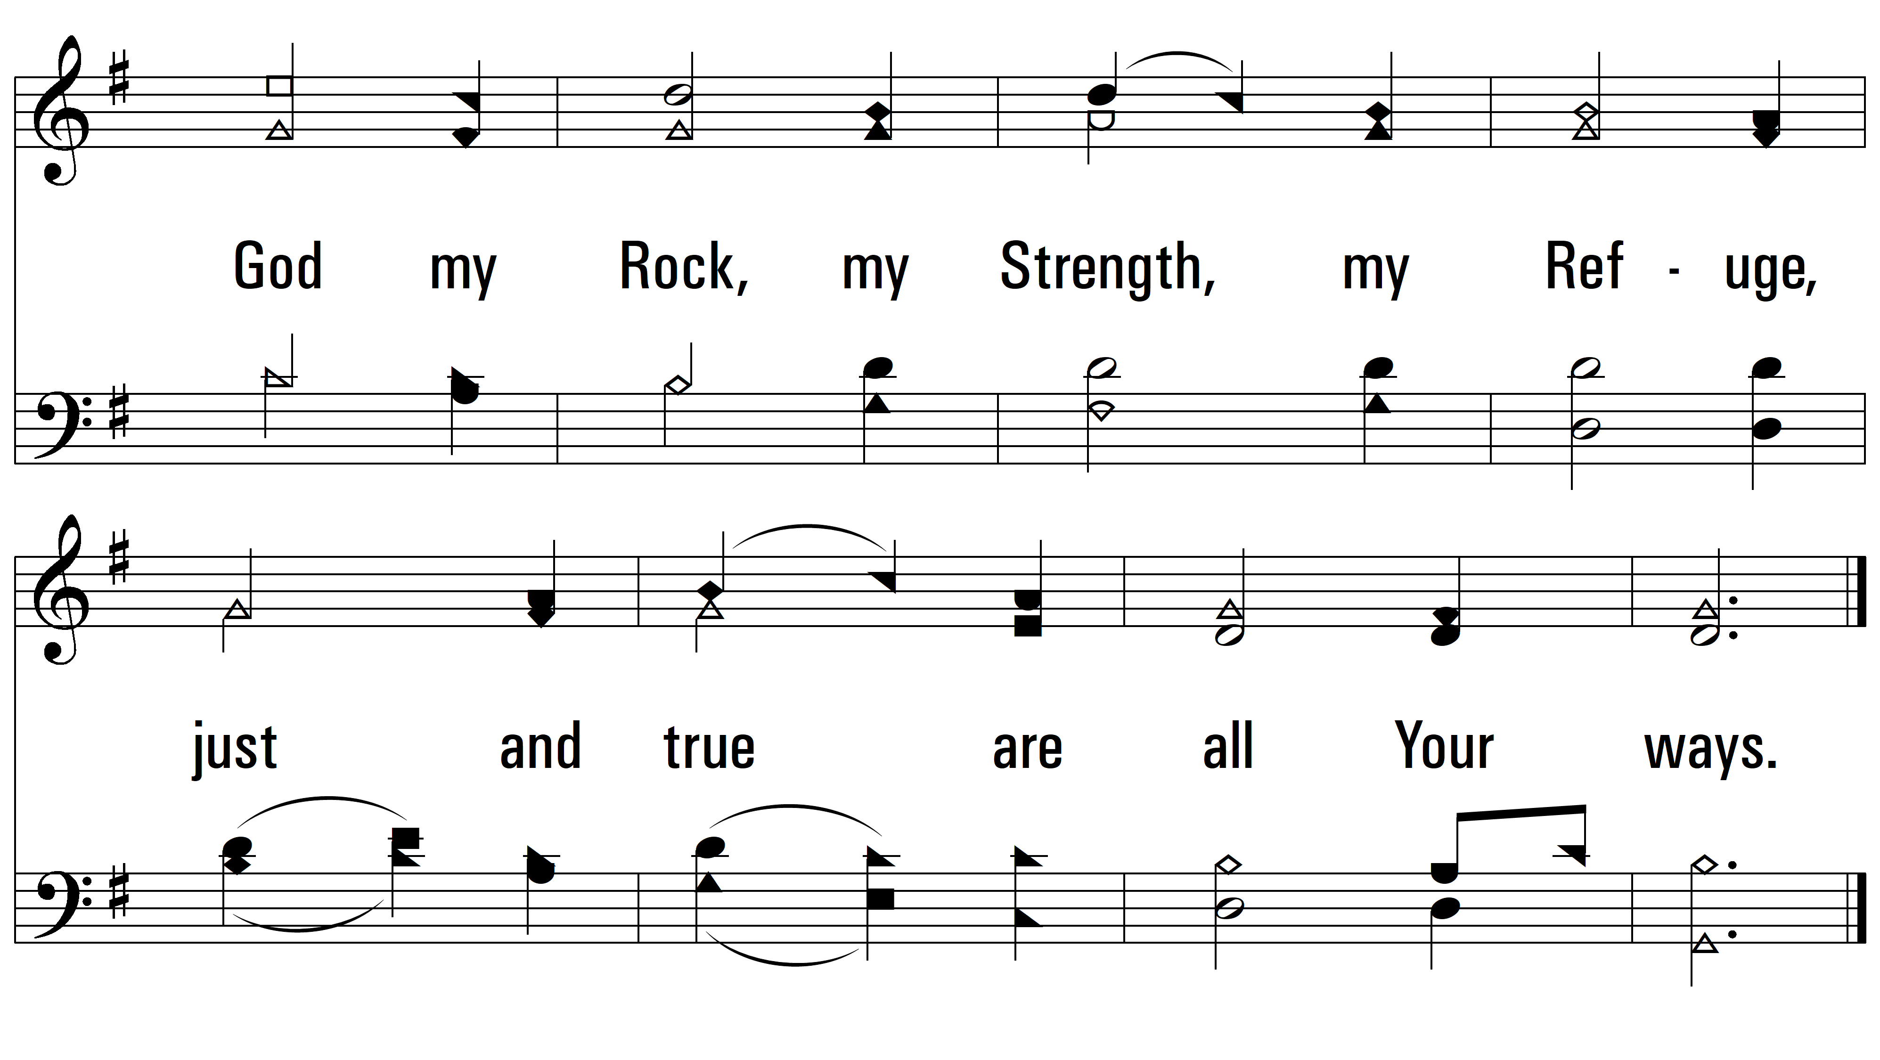
vs. 3
PDHymns.com
END

