Slide 1
Is My Name Written There
(Lord, I Care Not For Riches)
Words: | Mrs. Mary A. Kidder (1878)
Music: | Frank M. Davis (1878)
3/4
A^{b}/E^{b} - SOL
Verses: 3/Chorus
Lead - | SOL
Alto - | MI
Tenor - | DO
Bass - | DO
PDHymns.com

Slide 2
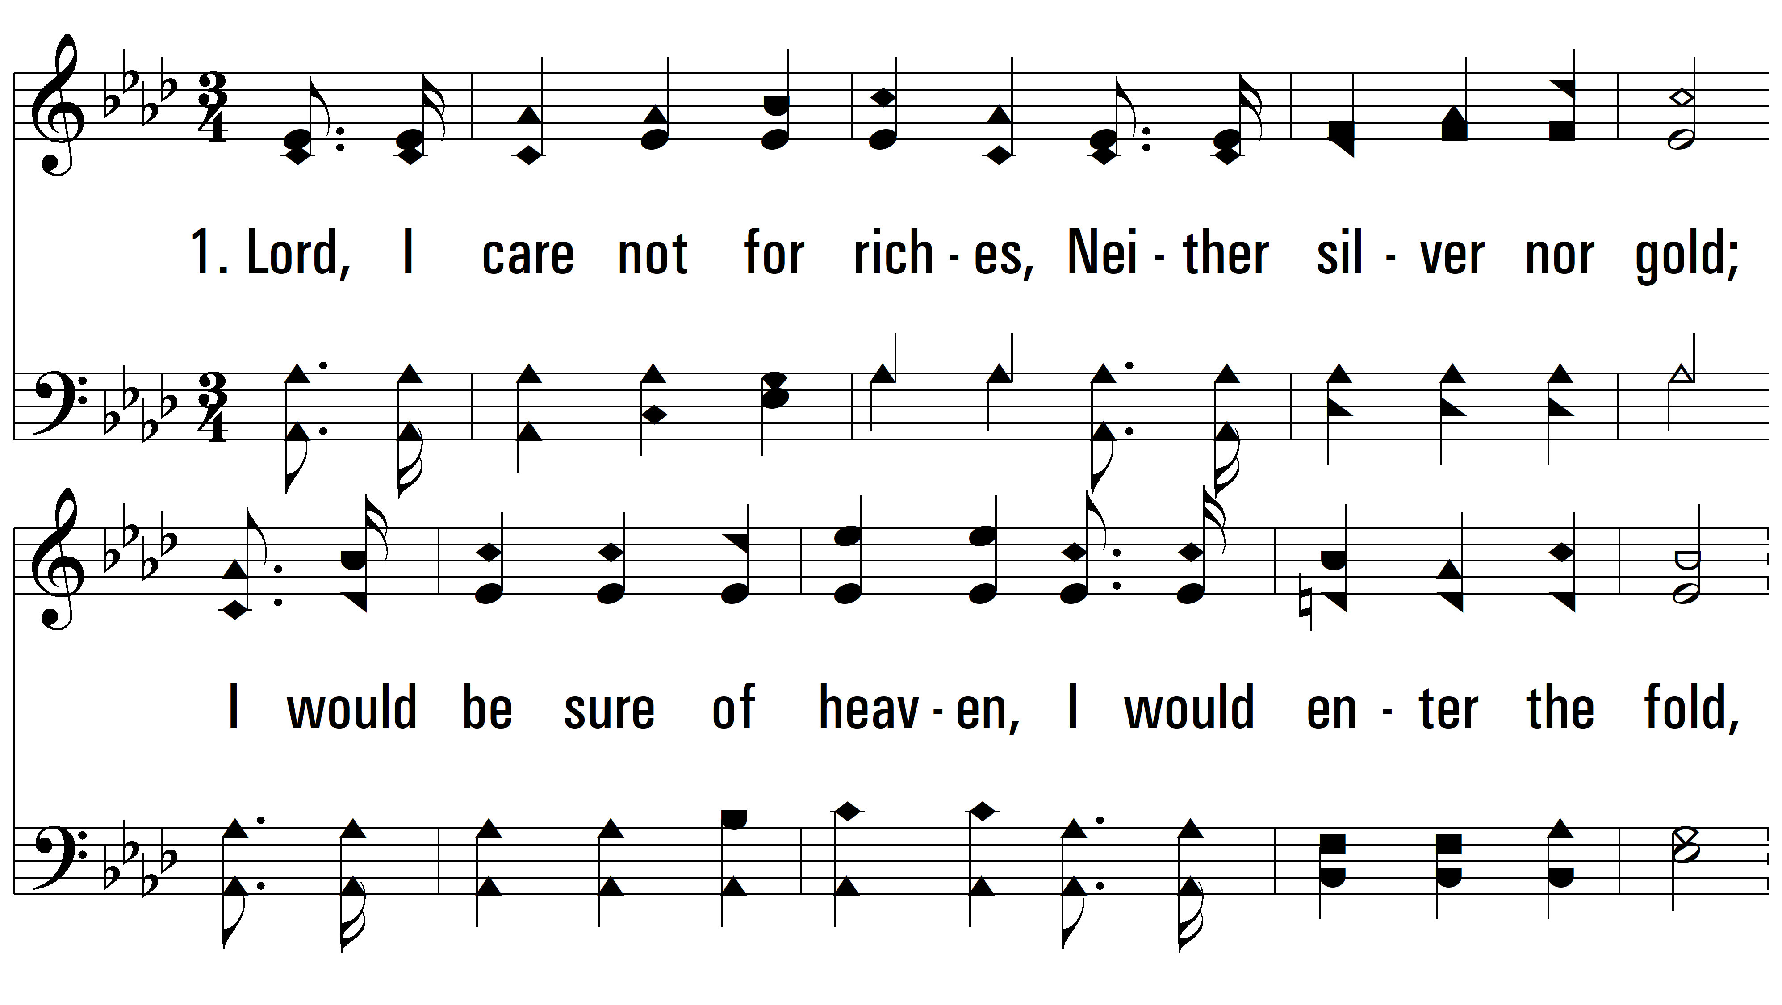
vs. 1 ~ Is My Name Written There

Slide 3
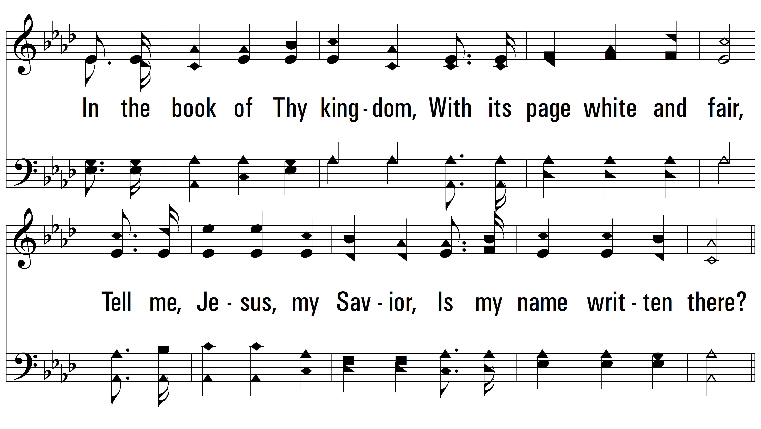
vs. 1

Slide 4
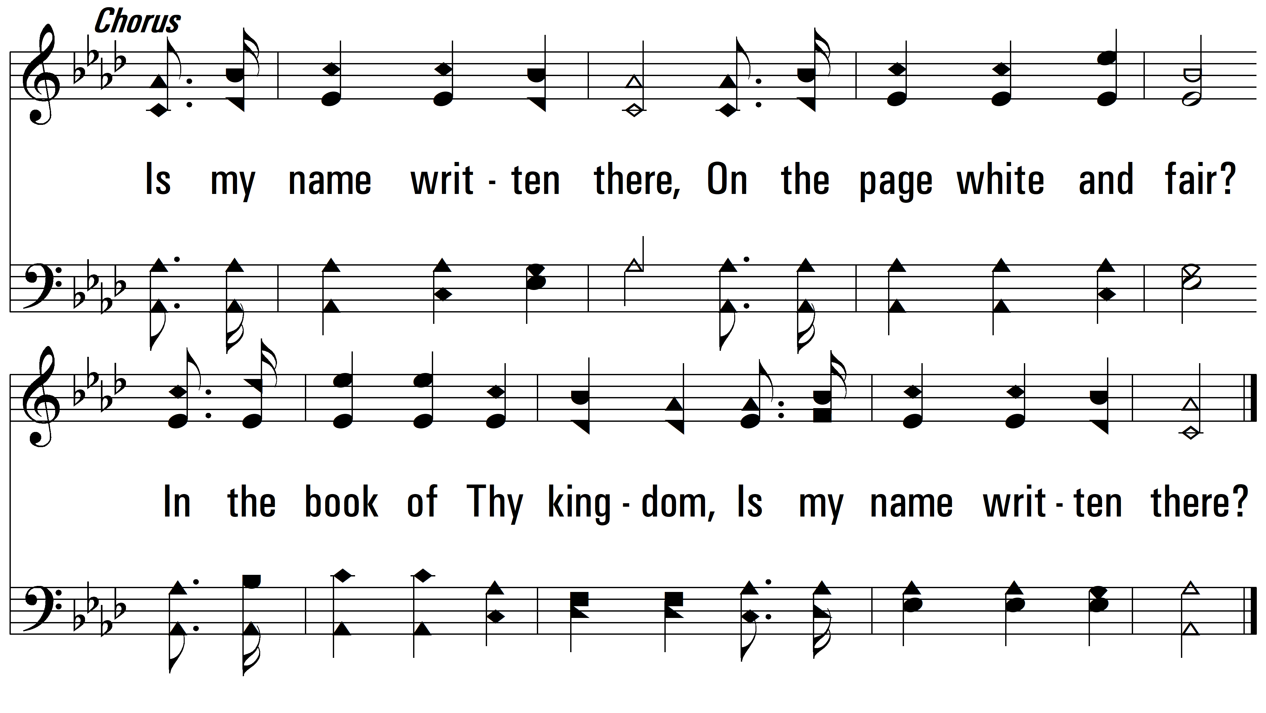
vs. 1

Slide 5
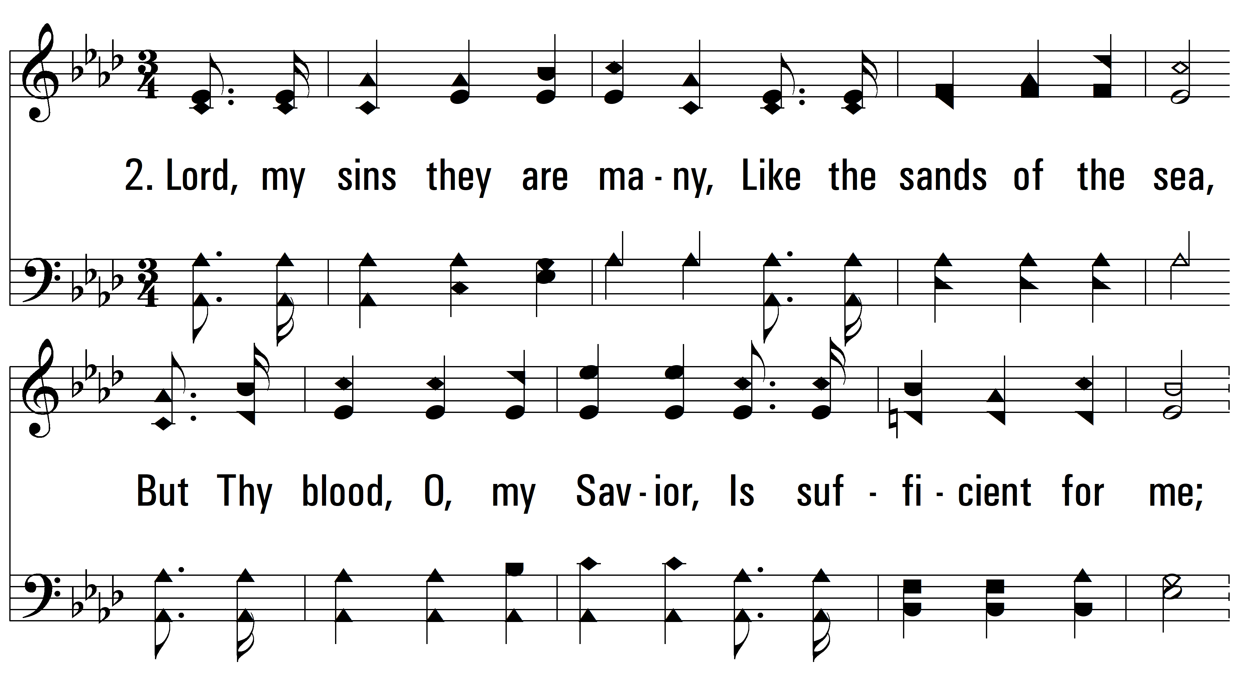
vs. 2 ~ Is My Name Written There

Slide 6
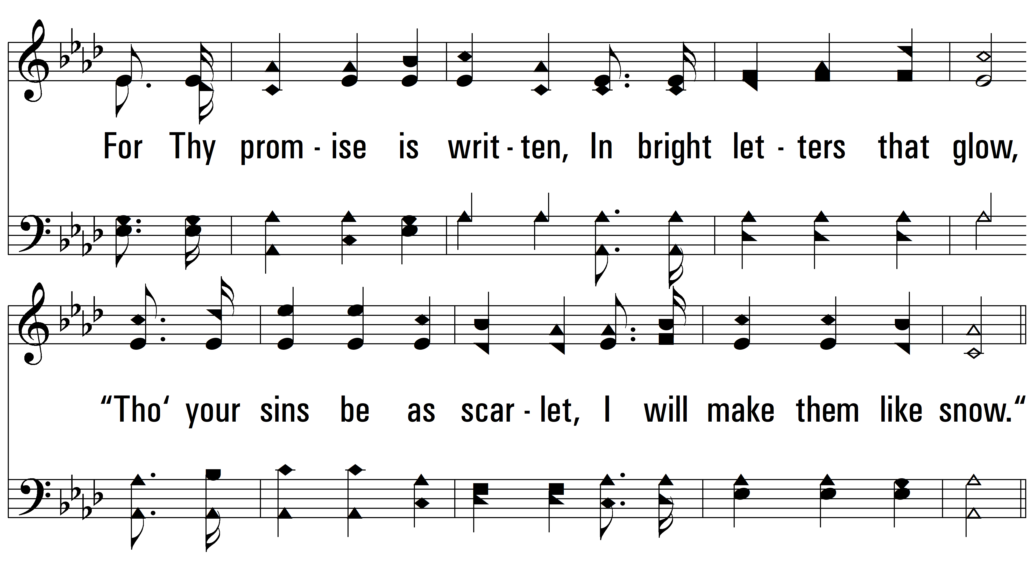
vs. 2

Slide 7
vs. 2

Slide 8
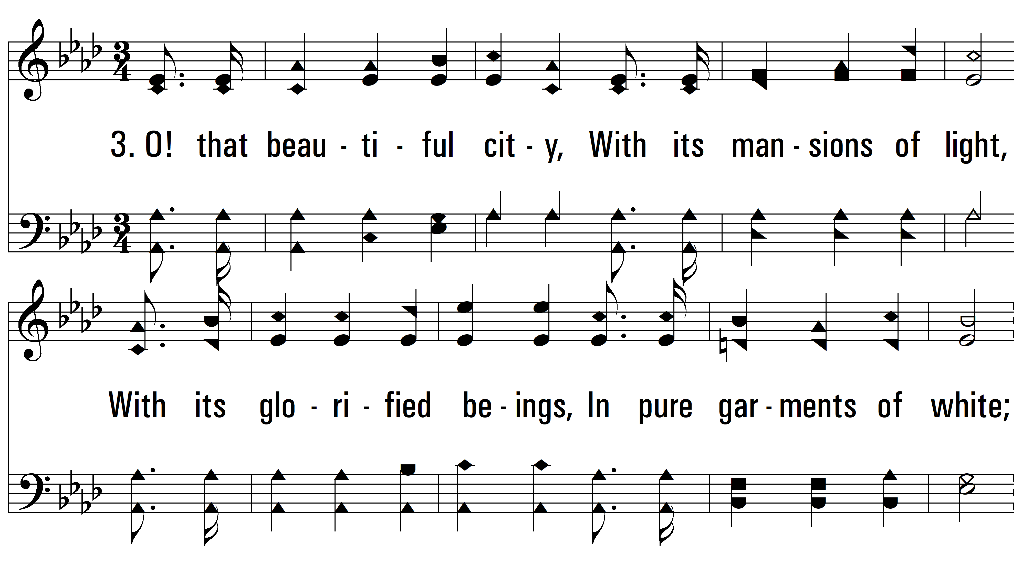
vs. 3 ~ Is My Name Written There

Slide 9
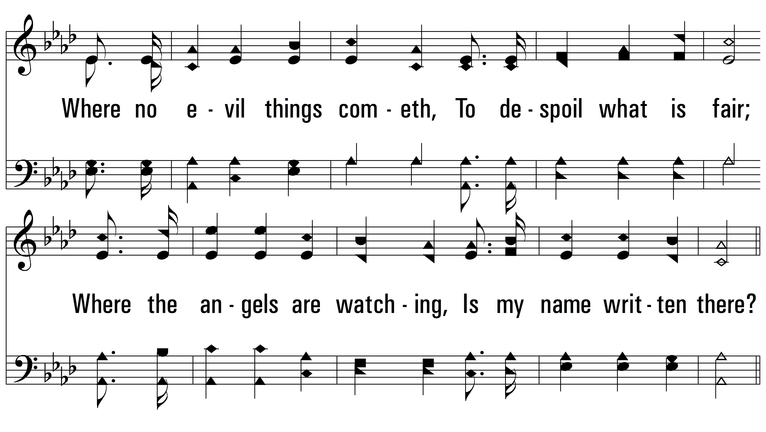
vs. 3

Slide 10
vs. 3
PDHymns.com
END

