Slide 1
In The Kingdom Of The Lord
Words: | Palmer Hartsough (1916)
Music: | F. Clark Perry (1916)
3/4 - 4/4
E/B - SOL
Verses: 3/Chorus
Lead - | SOL
Alto - | SOL
Tenor - | MI
Bass - | DO
PDHymns.com

Slide 2
vs. 1 ~ In The Kingdom Of The Lord

Slide 3
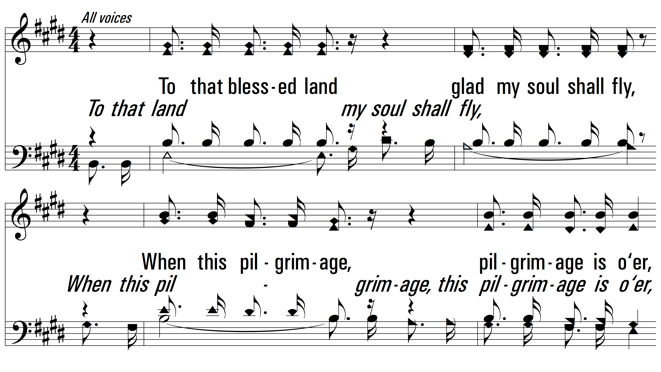
vs. 1

Slide 4
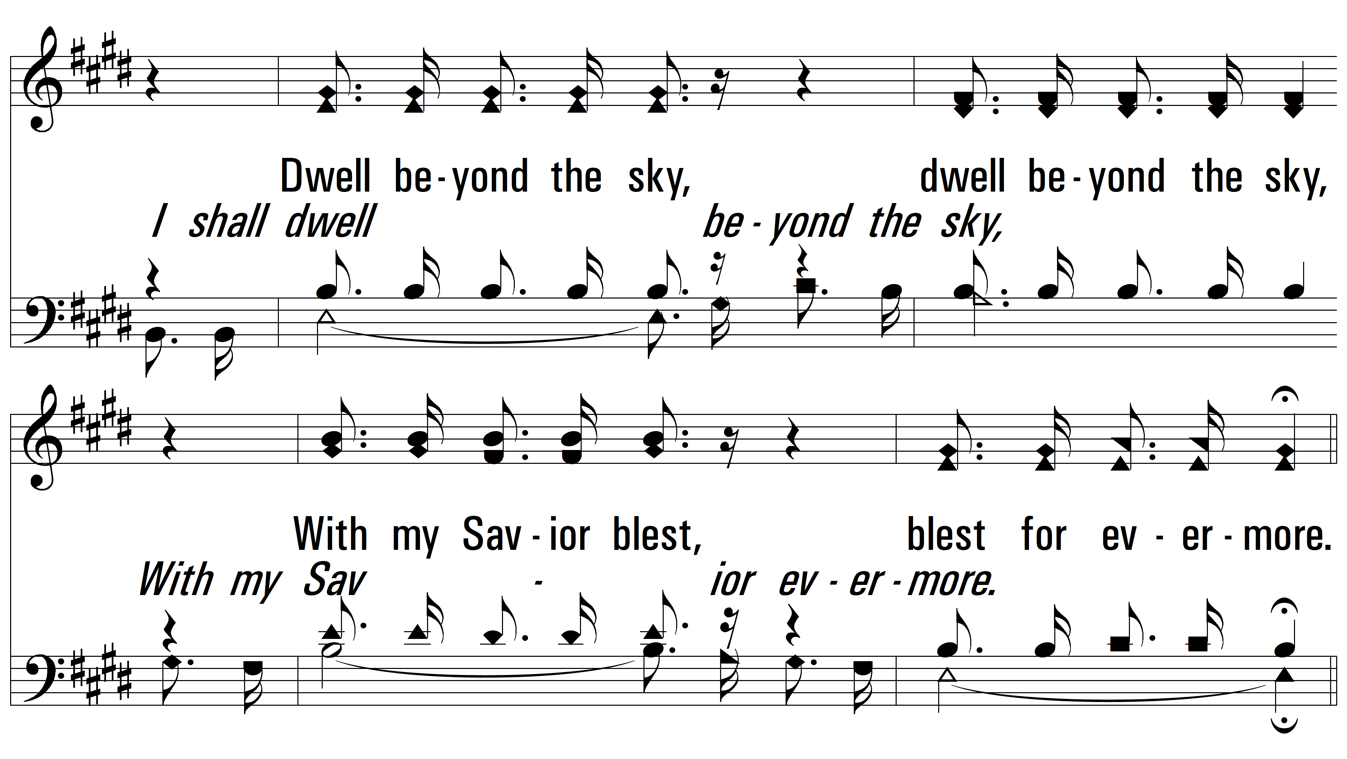
vs. 1

Slide 5
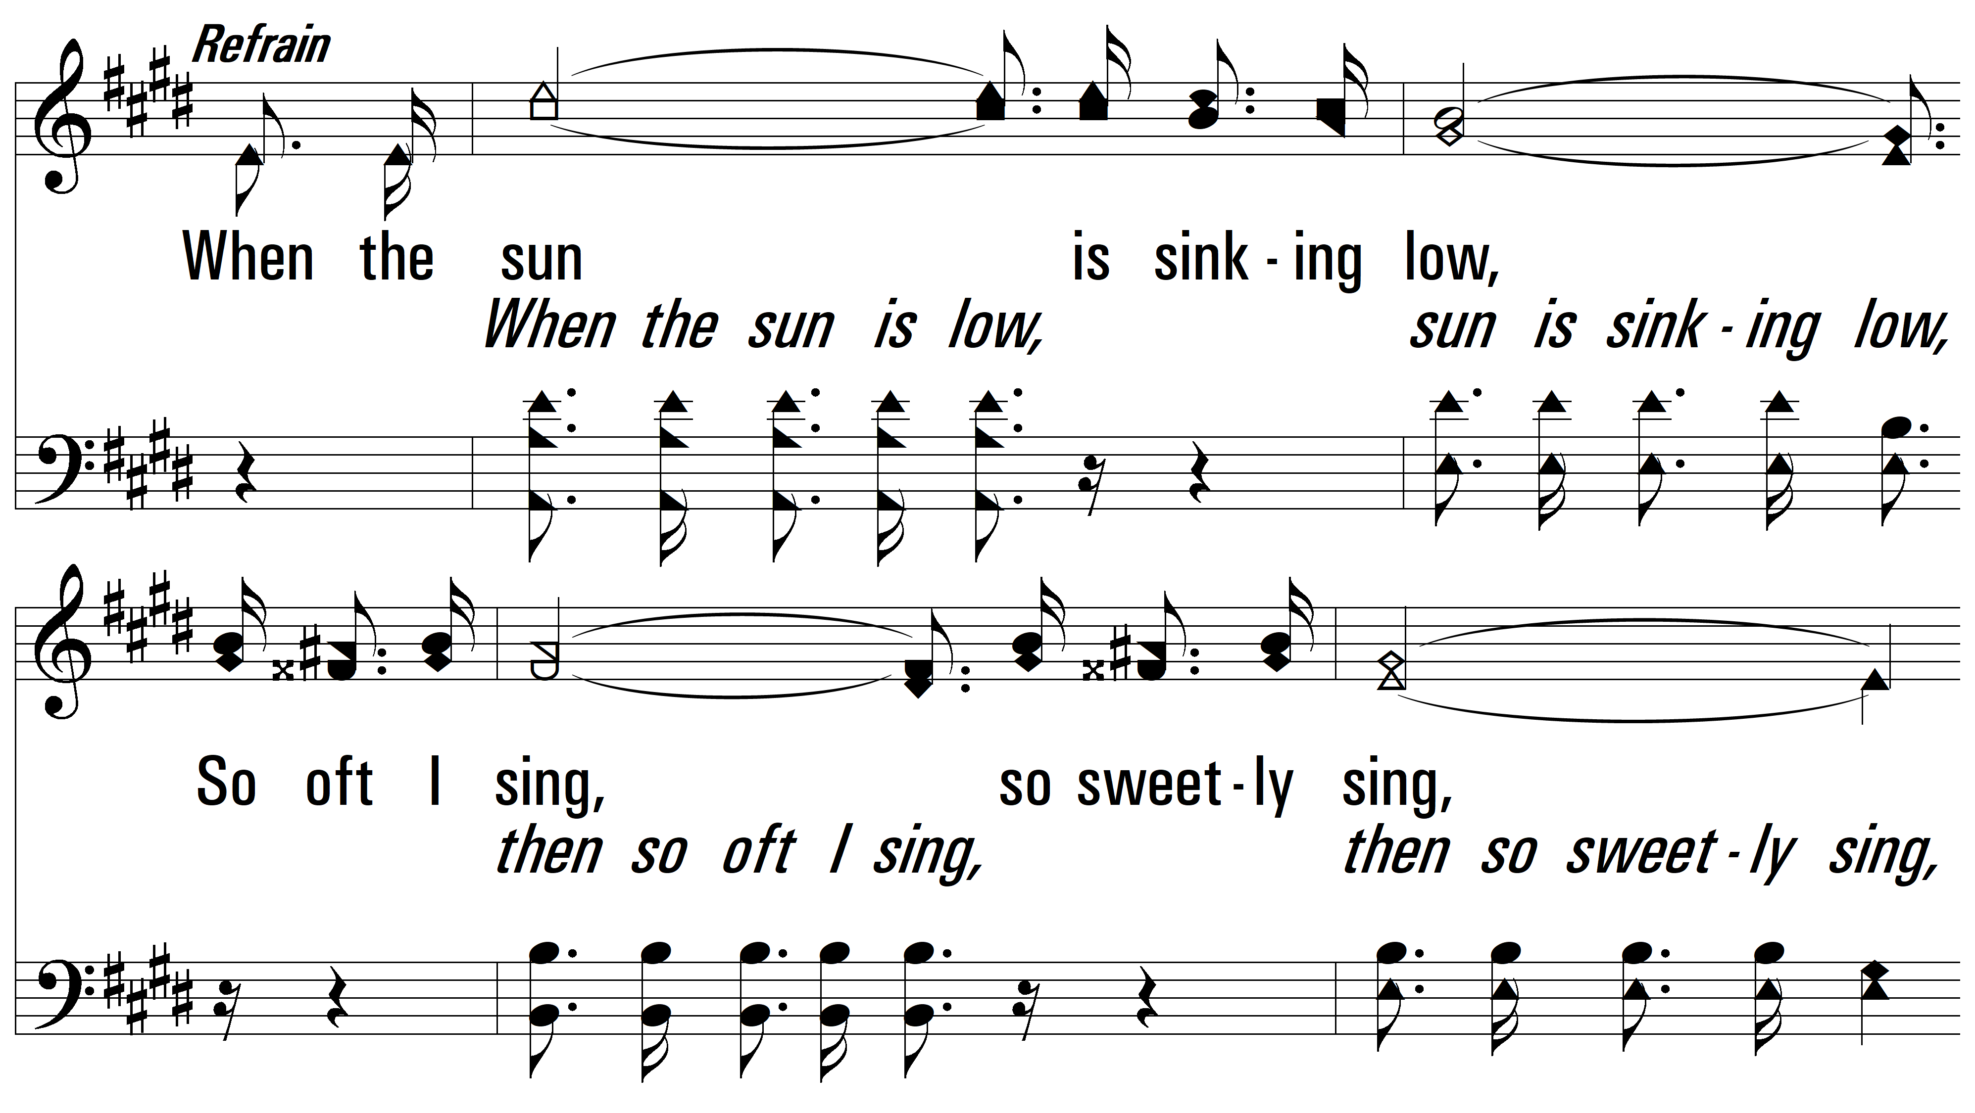
vs. 1

Slide 6
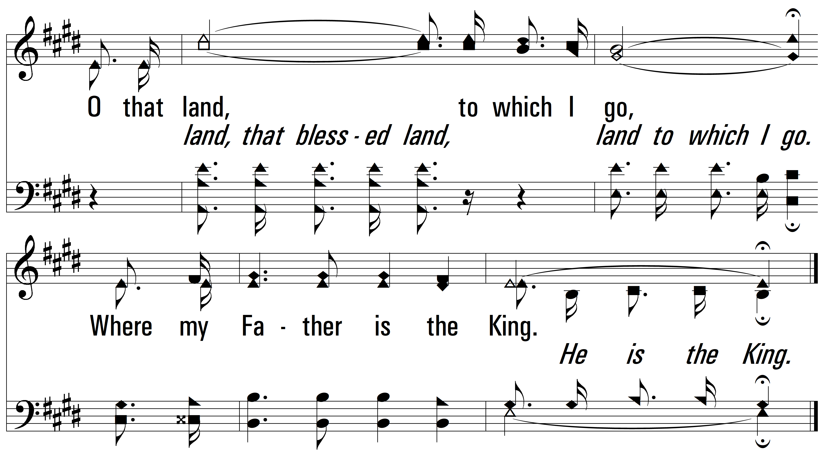
vs. 1

Slide 7
vs. 2 ~ In The Kingdom Of The Lord

Slide 8
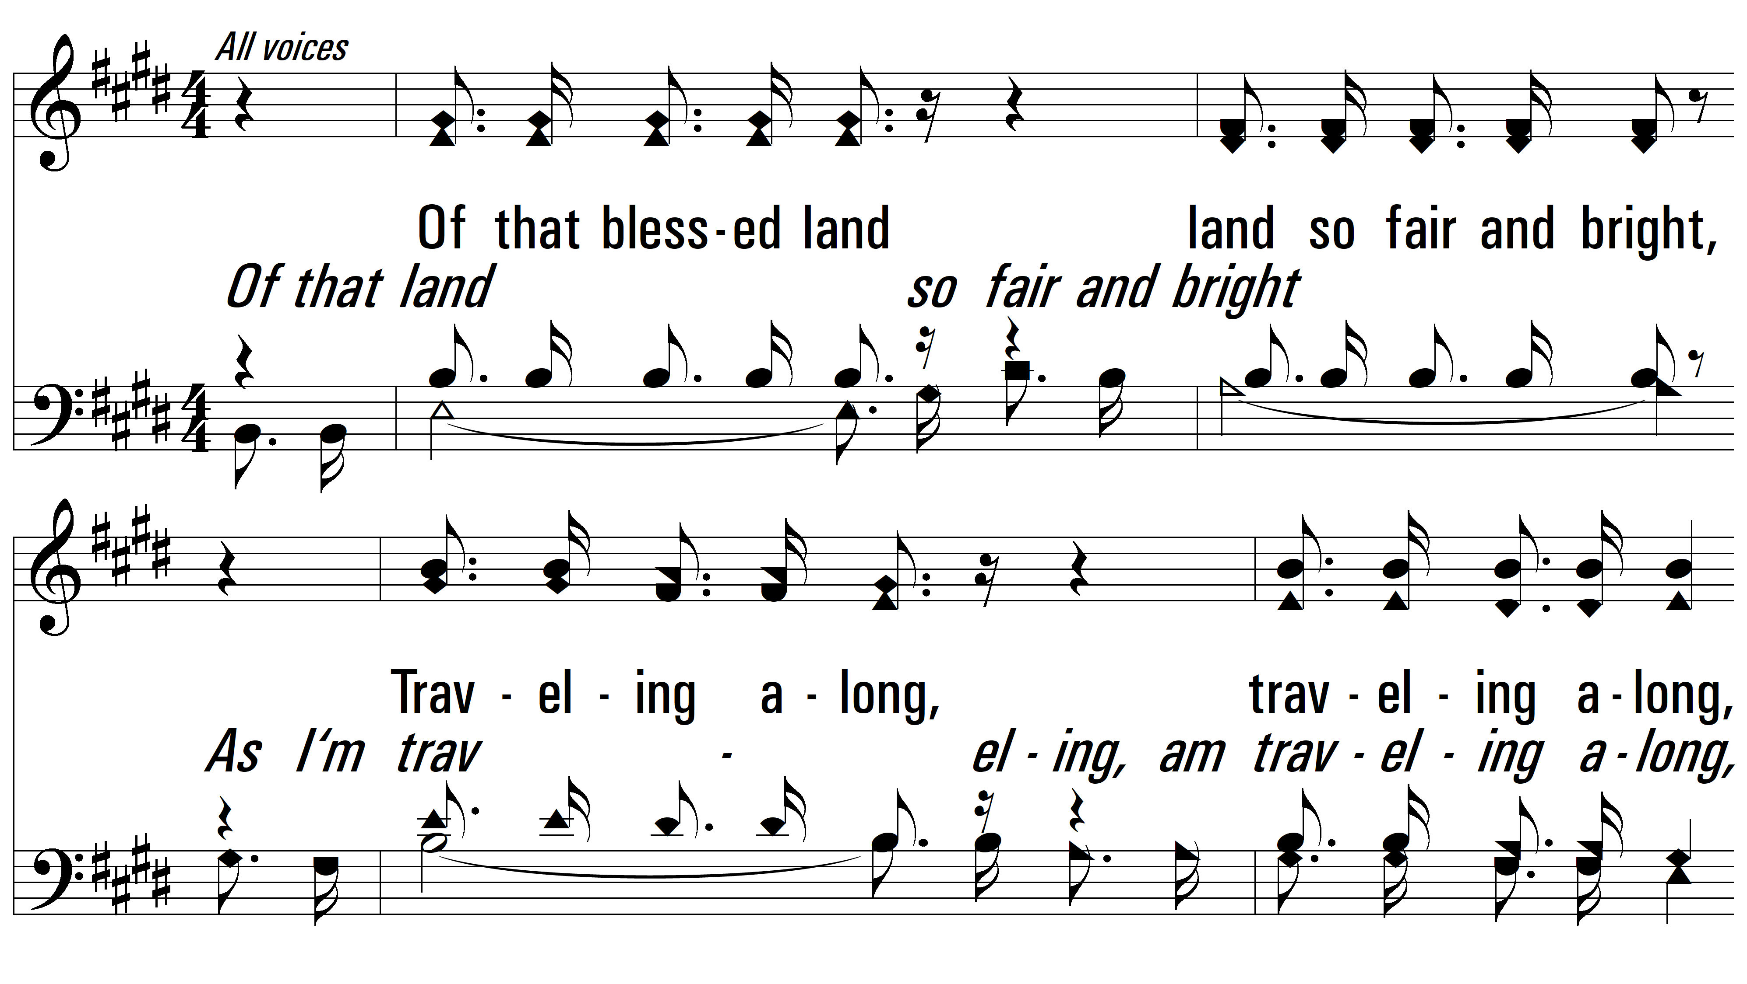
vs. 2

Slide 9
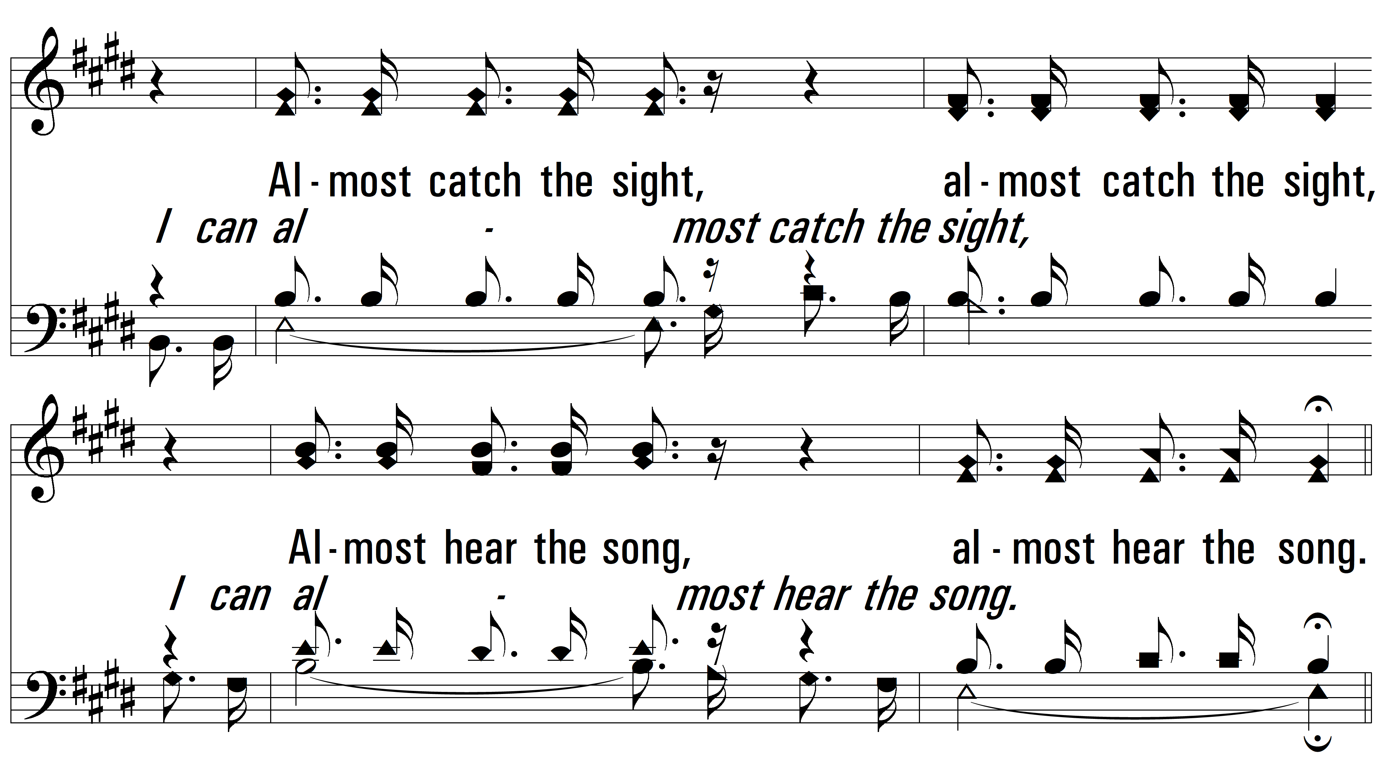
vs. 2

Slide 10
vs. 2

Slide 11
vs. 2

Slide 12
vs. 3 ~ In The Kingdom Of The Lord

Slide 13
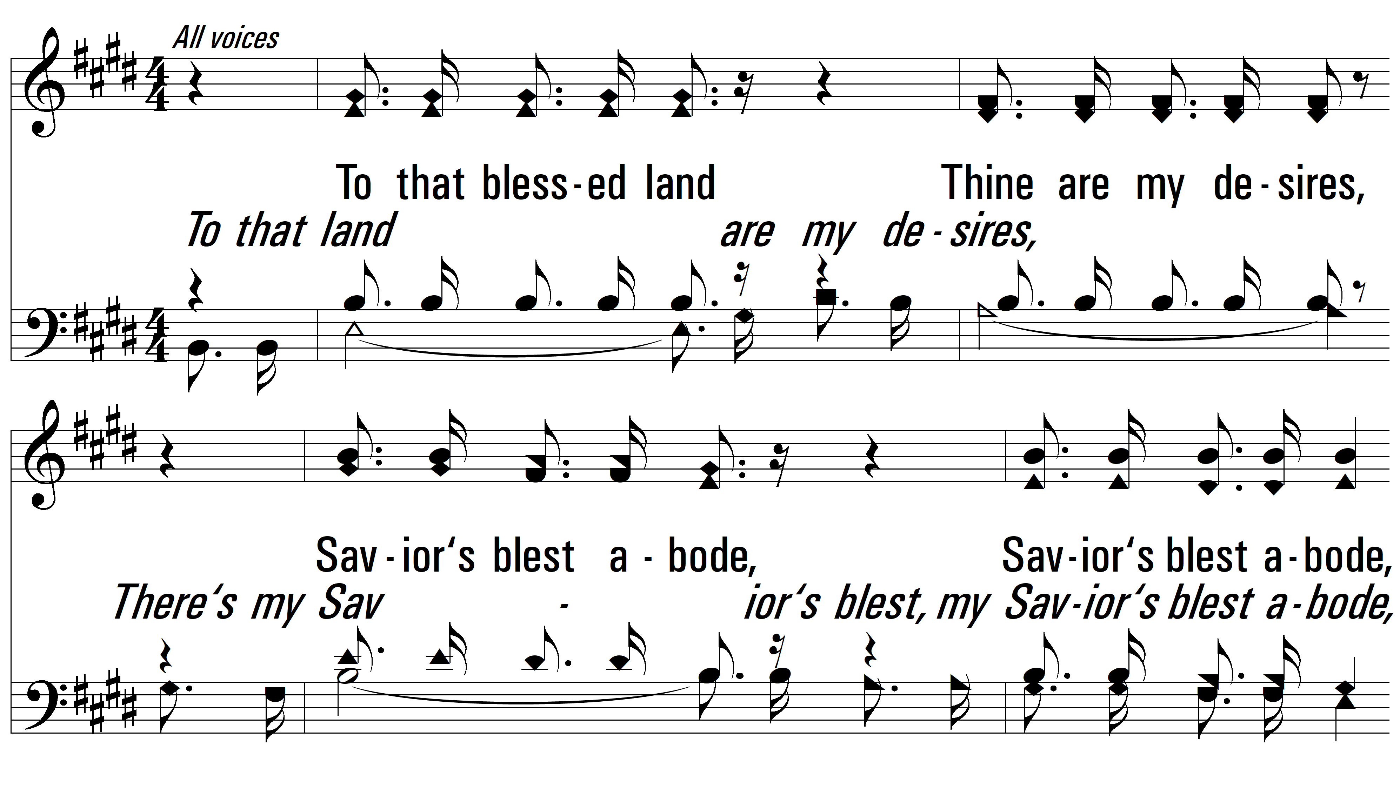
vs. 3

Slide 14
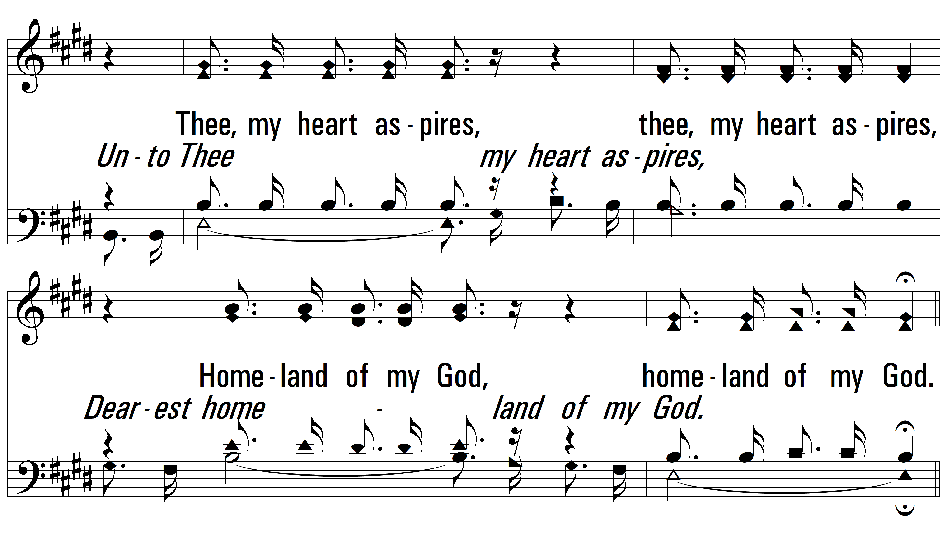
vs. 3

Slide 15
vs. 3

Slide 16
vs. 3
PDHymns.com
END

