Slide 1
I'm Happy Today
Words: | American Folk Hymn
Music: | American Folk Melody, Arr. Ellis J. Crum
4/4
E^{b}/B^{b} - SOL
Verses: 5
Lead - | SOL
Alto - | MI
Tenor - | SOL
Bass - | DO
PDHymns.com

Slide 2
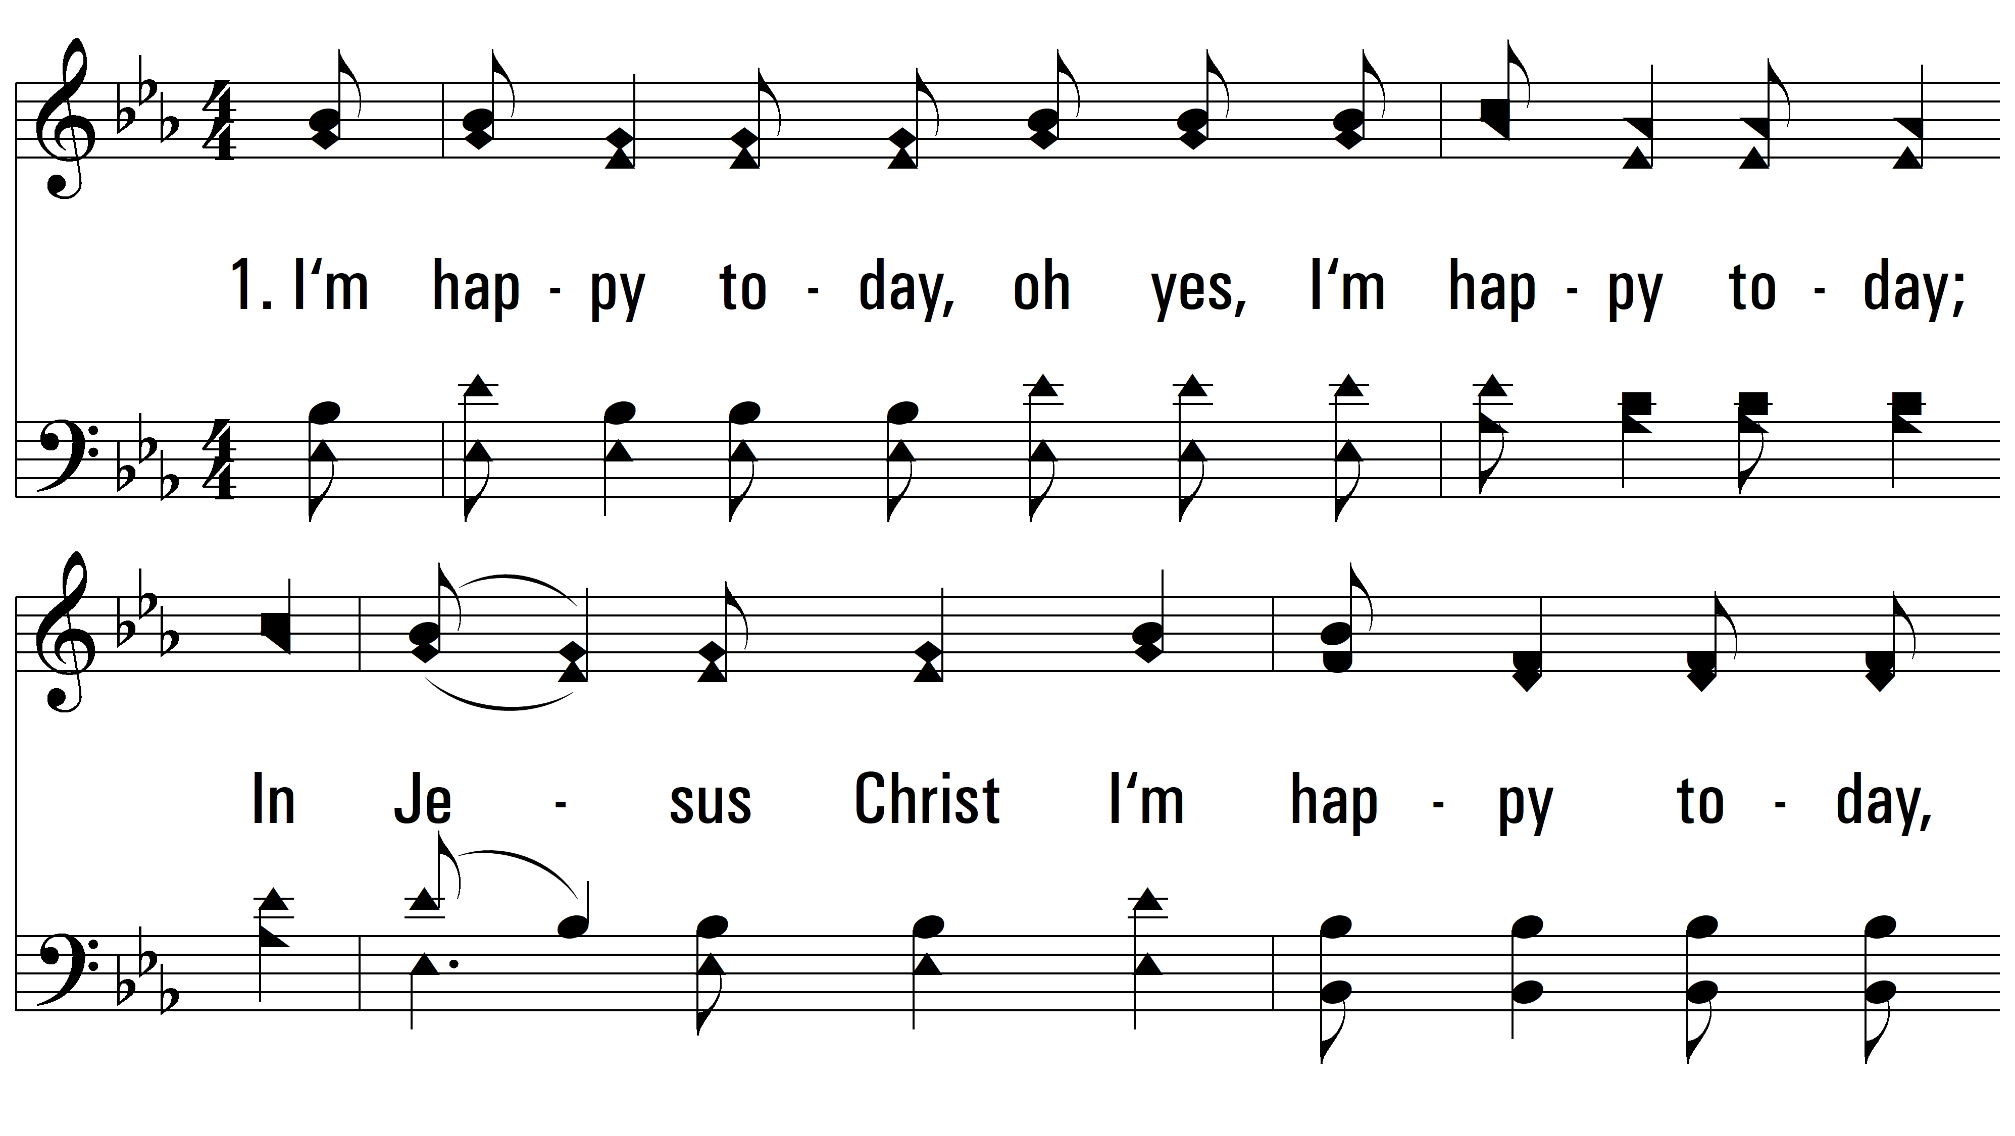
vs. 1 ~ I'm Happy Today

Slide 3
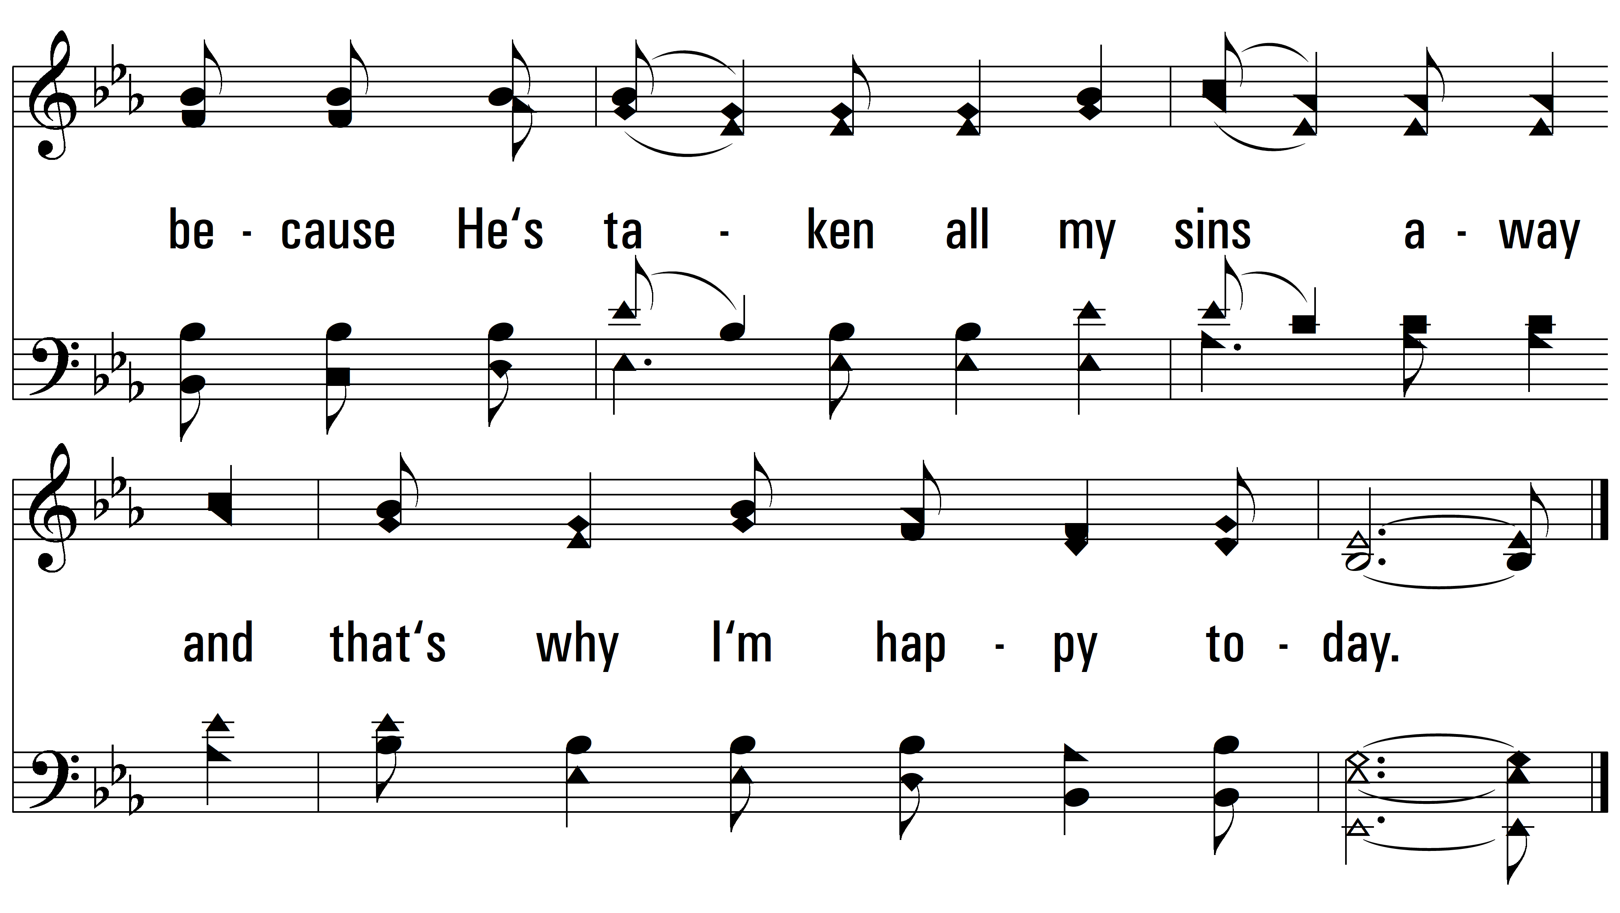
vs. 1

Slide 4
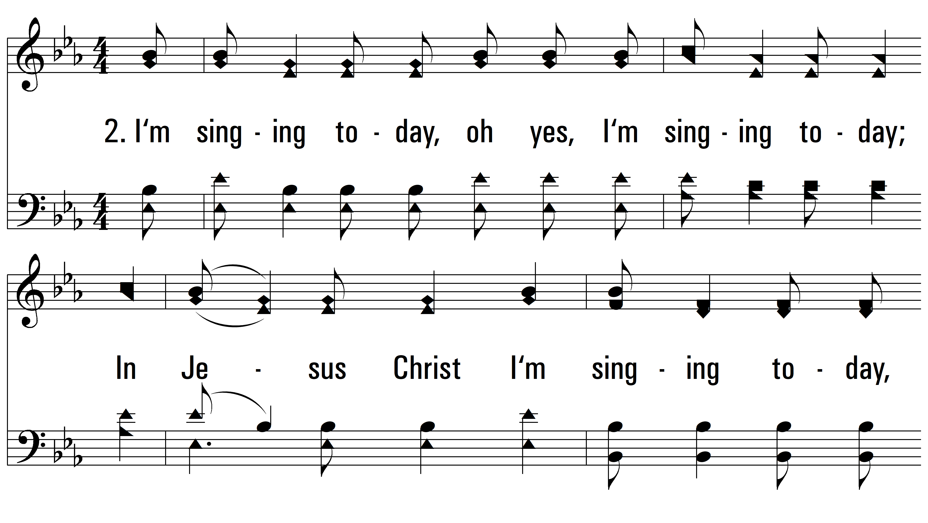
vs. 2 ~ I'm Happy Today

Slide 5
vs. 2

Slide 6
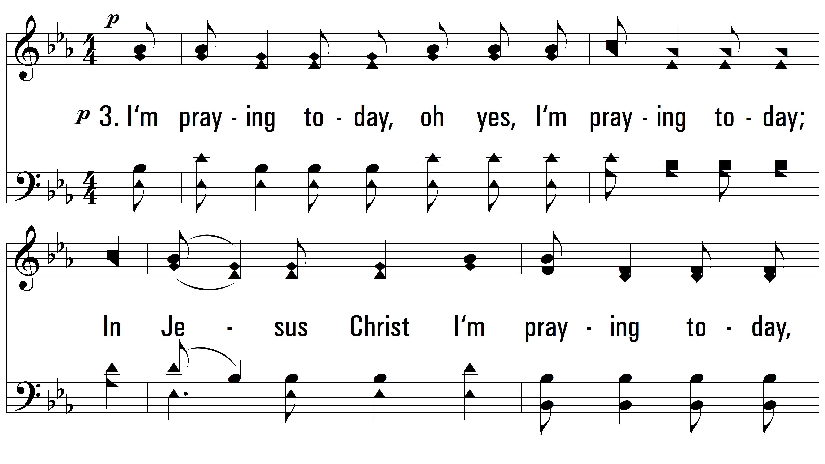
vs. 3 ~ I'm Happy Today

Slide 7
vs. 3

Slide 8
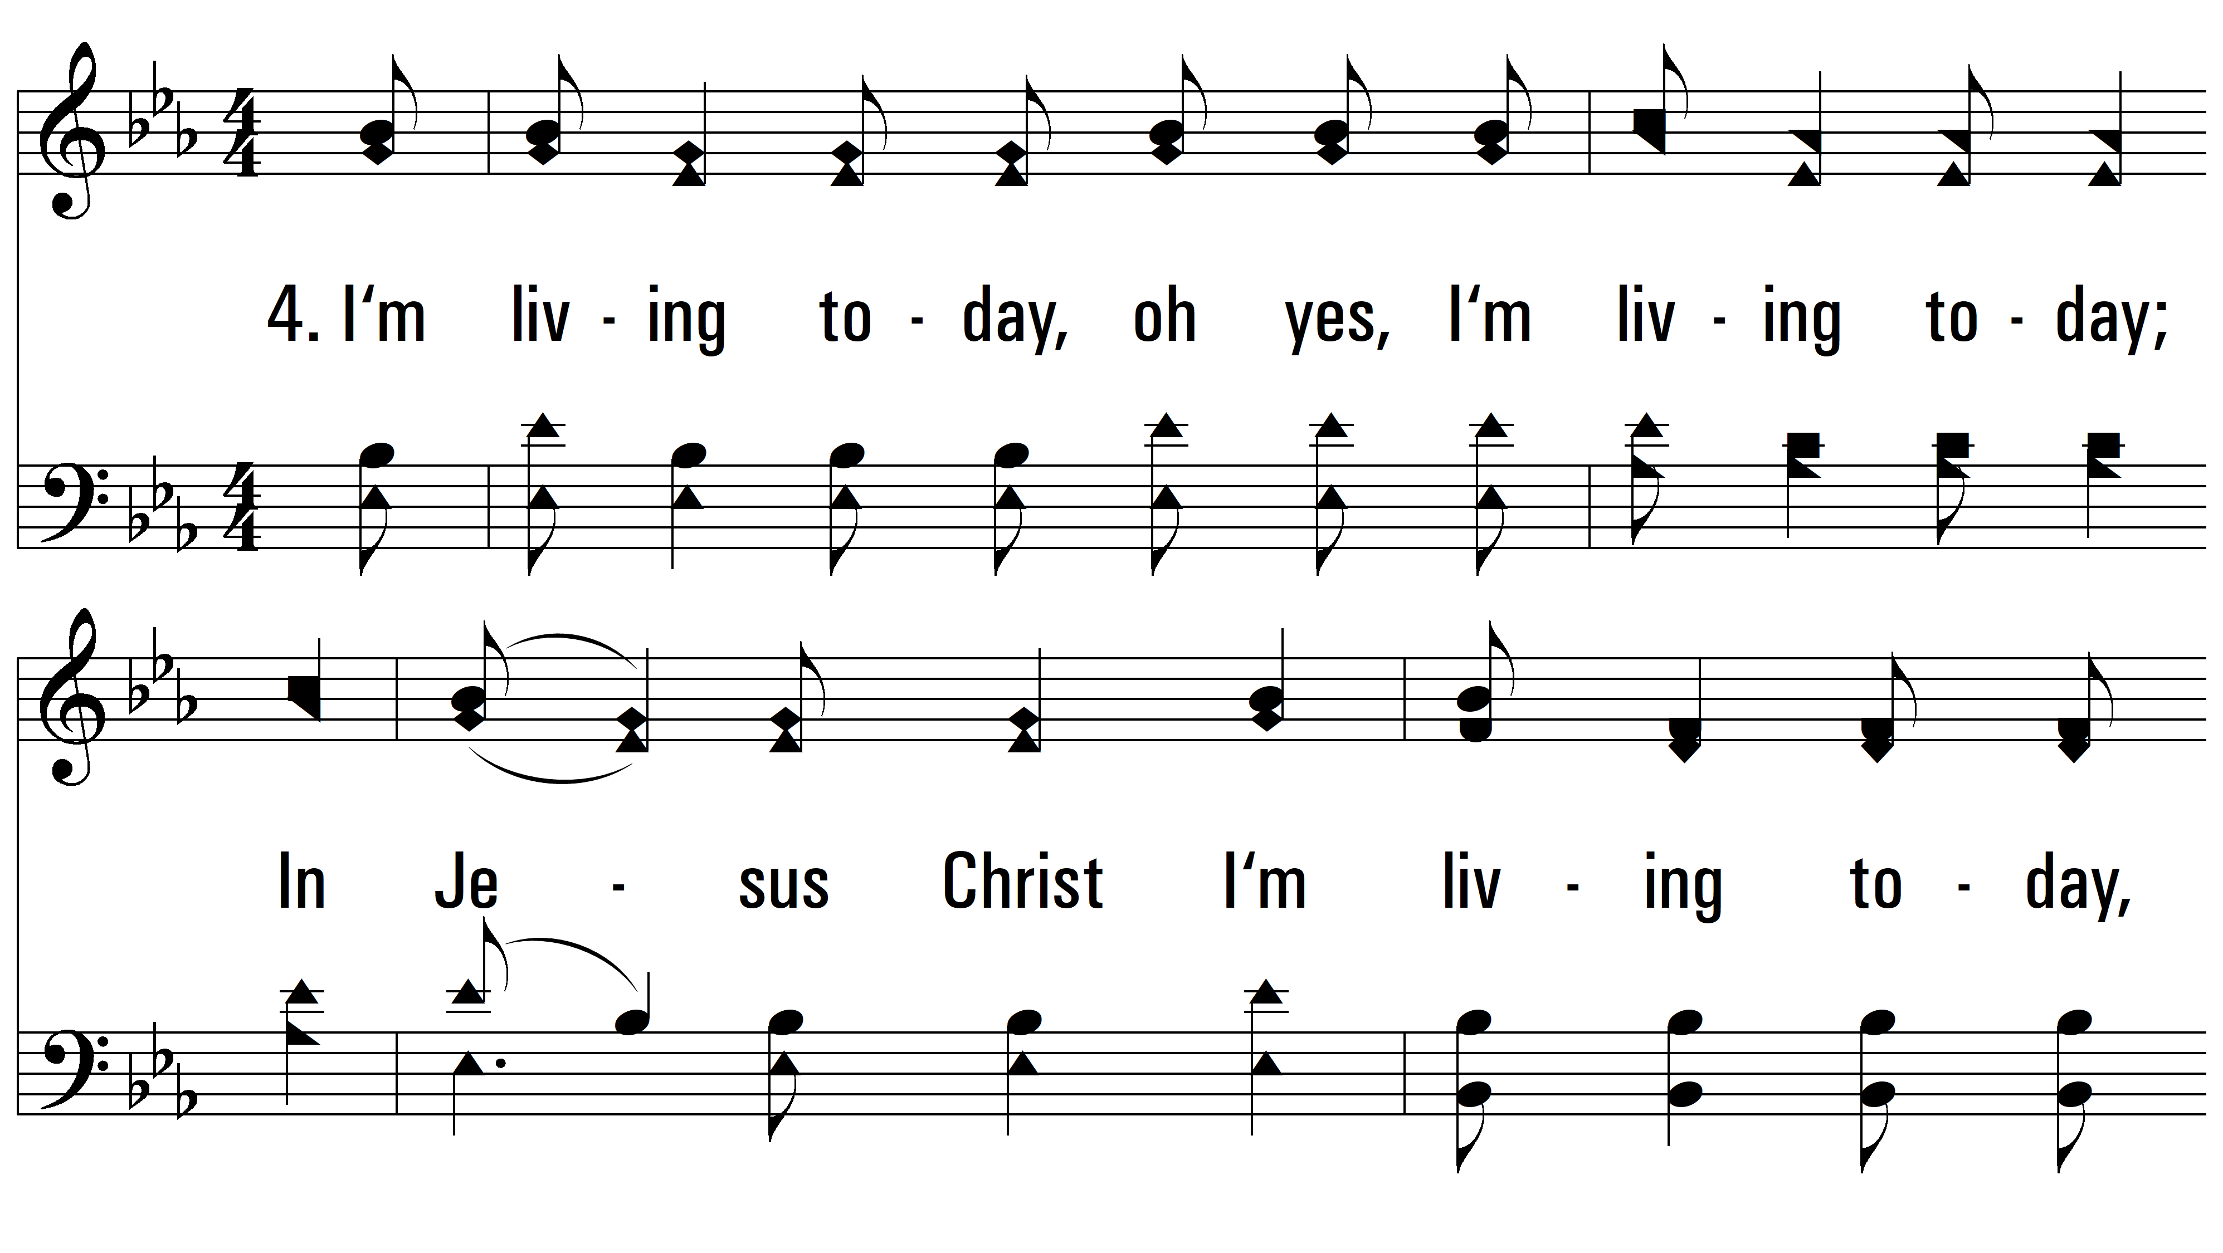
vs. 4 ~ I'm Happy Today

Slide 9
vs. 4

Slide 10
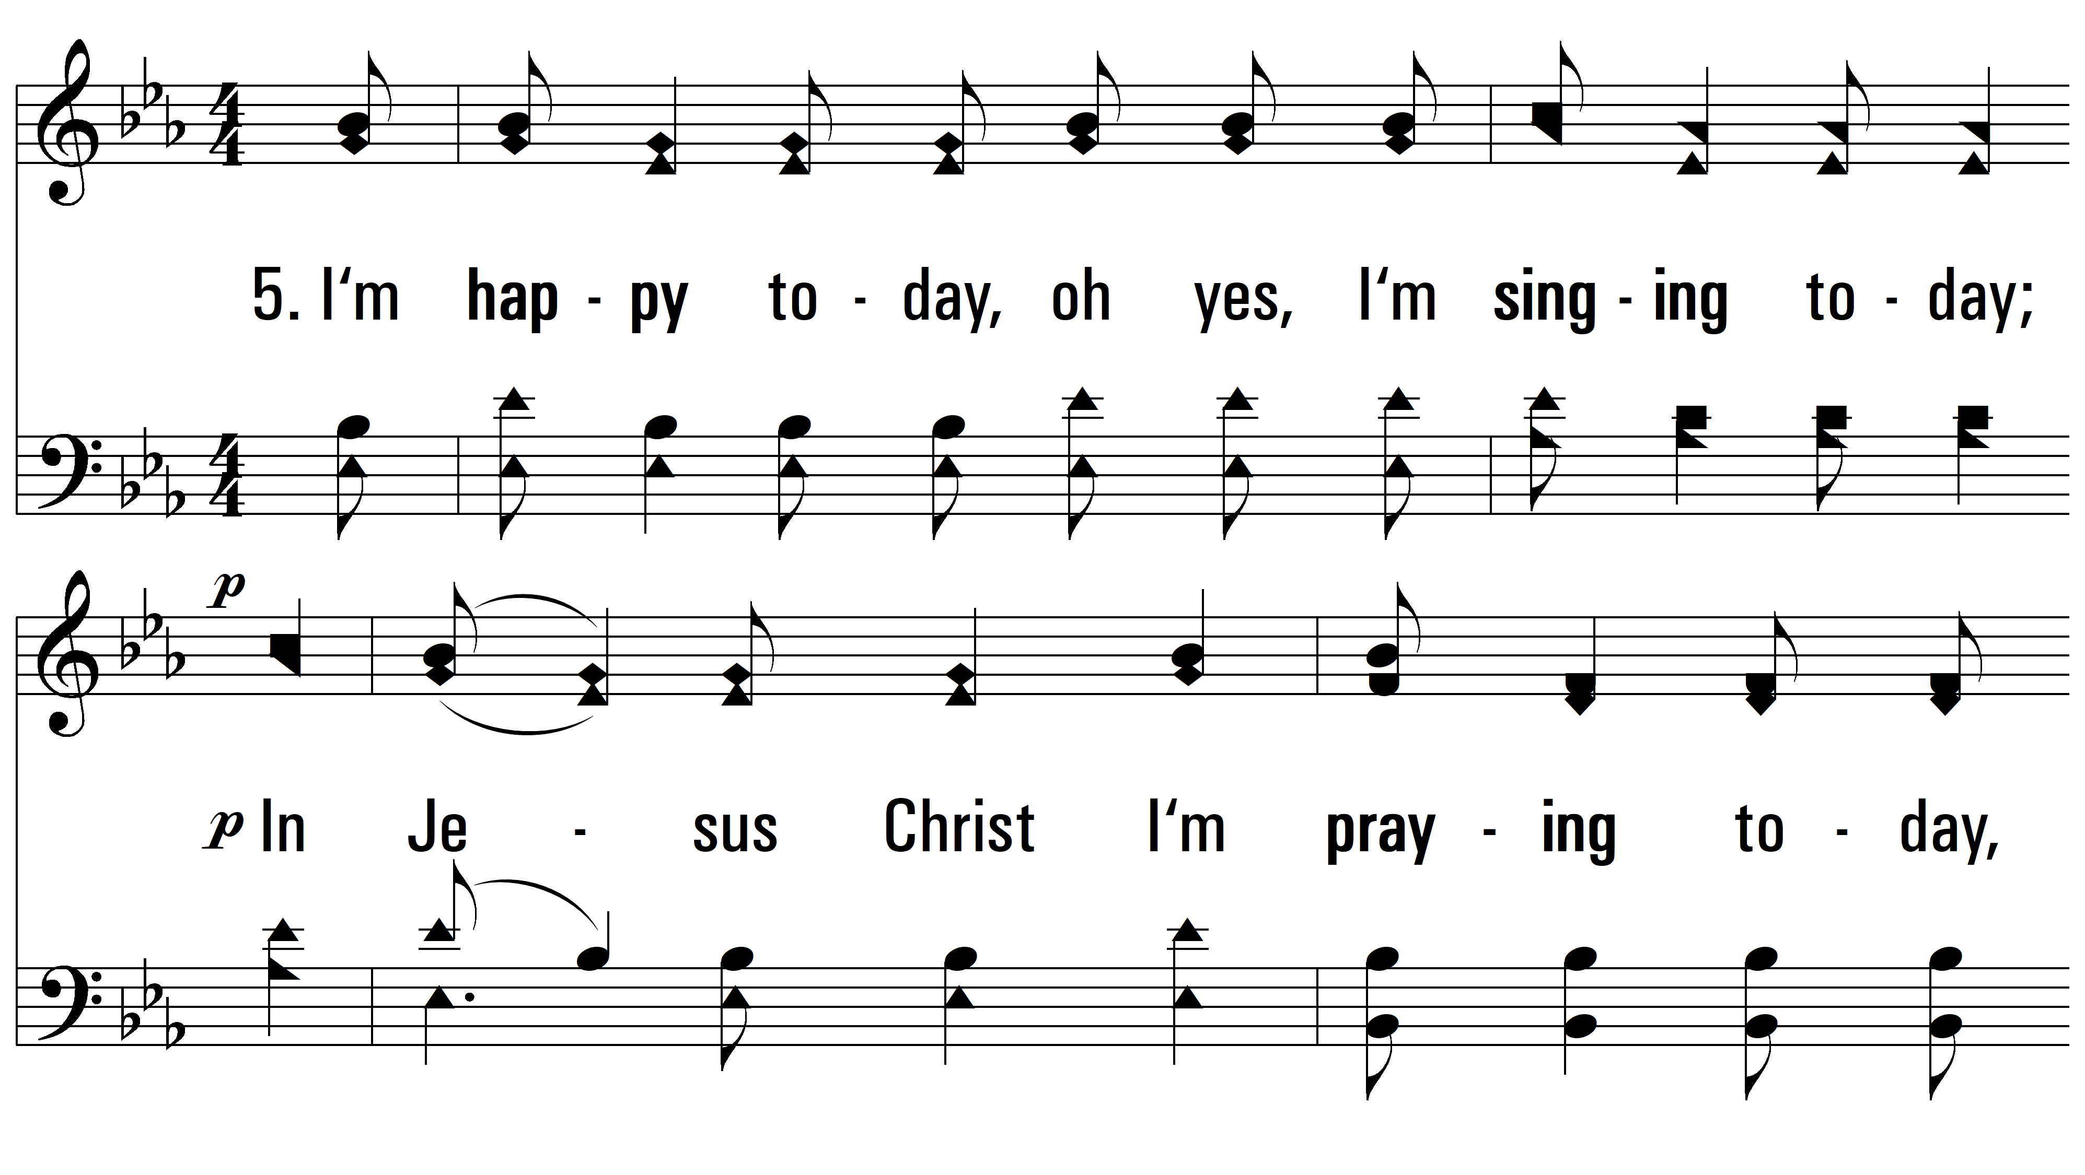
vs. 5 ~ I'm Happy Today

Slide 11
vs. 5
PDHymns.com
END

