Slide 1
I'll Be List'ning
Words: | American Spiritual - Traditional
Music: | American Spiritual - Traditional, Arr. V. O. Stamps
4/4
G/G - DO
Verses: 3/Chorus
Lead - | DO
Alto - | SOL
Tenor - | MI
Bass - | DO
PDHymns.com

Slide 2
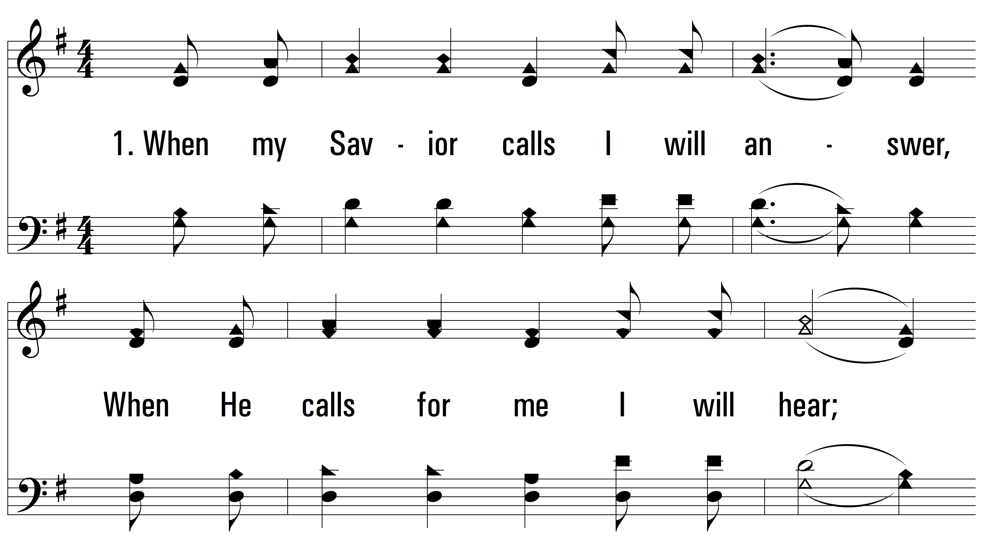
vs. 1 ~ I'll Be List'ning

Slide 3
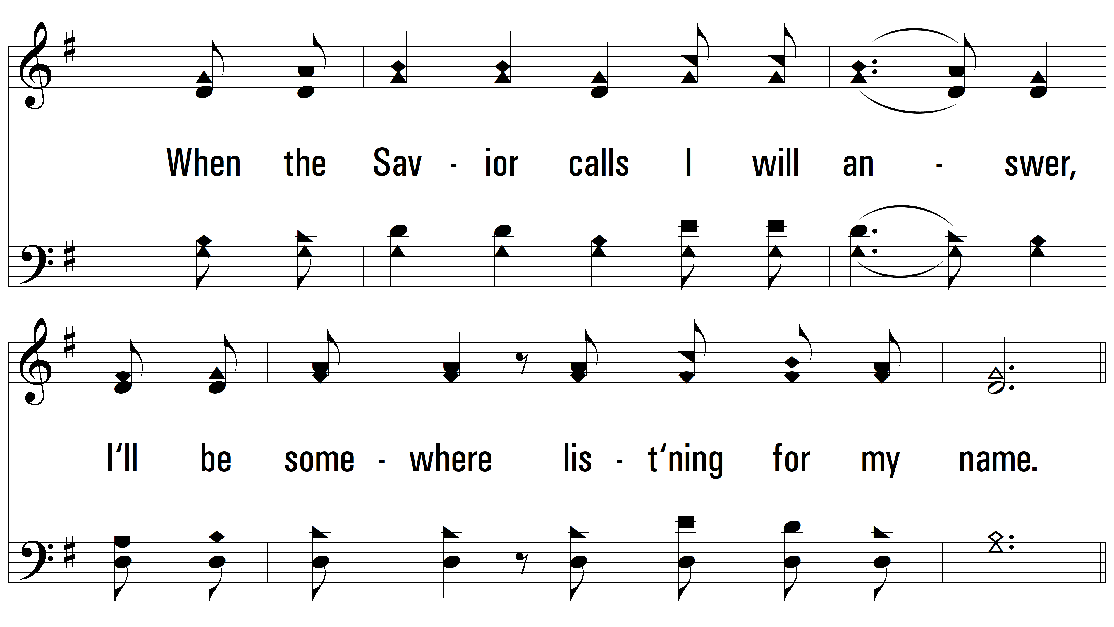
vs. 1

Slide 4
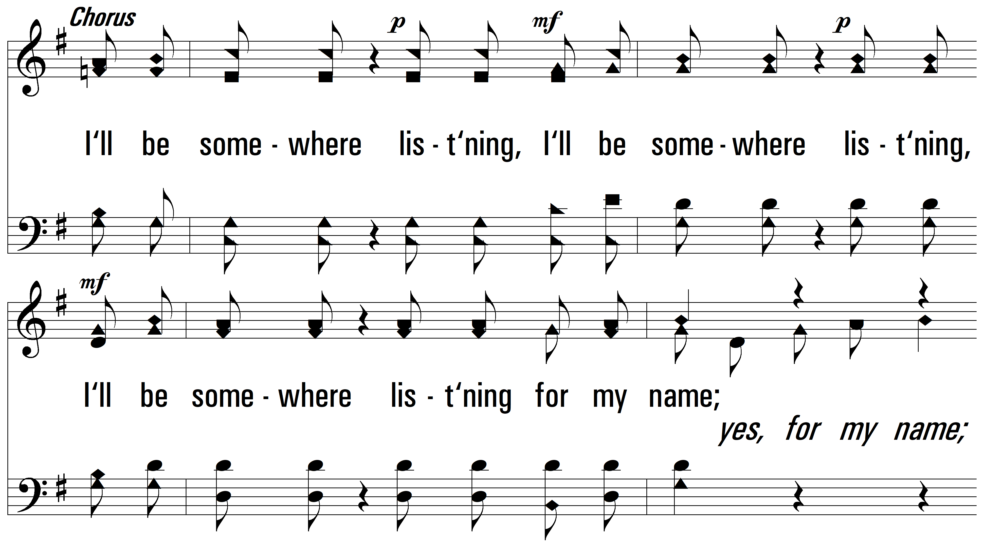
vs. 1

Slide 5
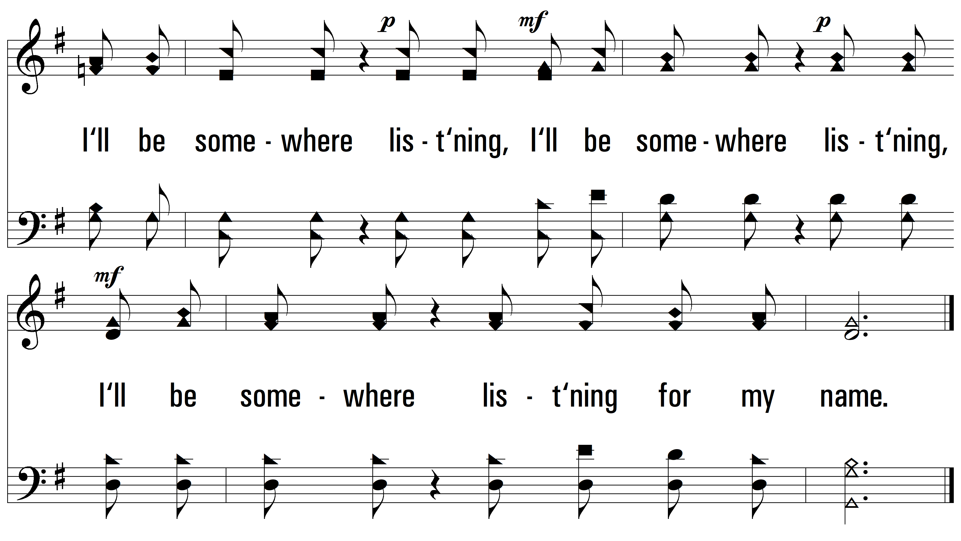
vs. 1

Slide 6
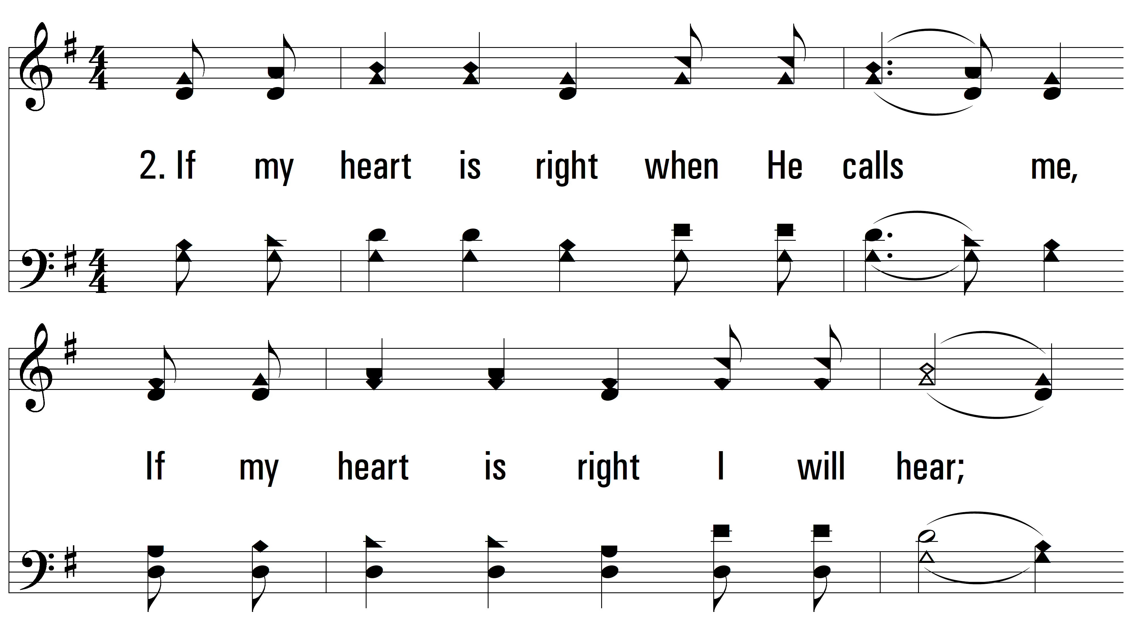
vs. 1 ~ I'll Be List'ning

Slide 7
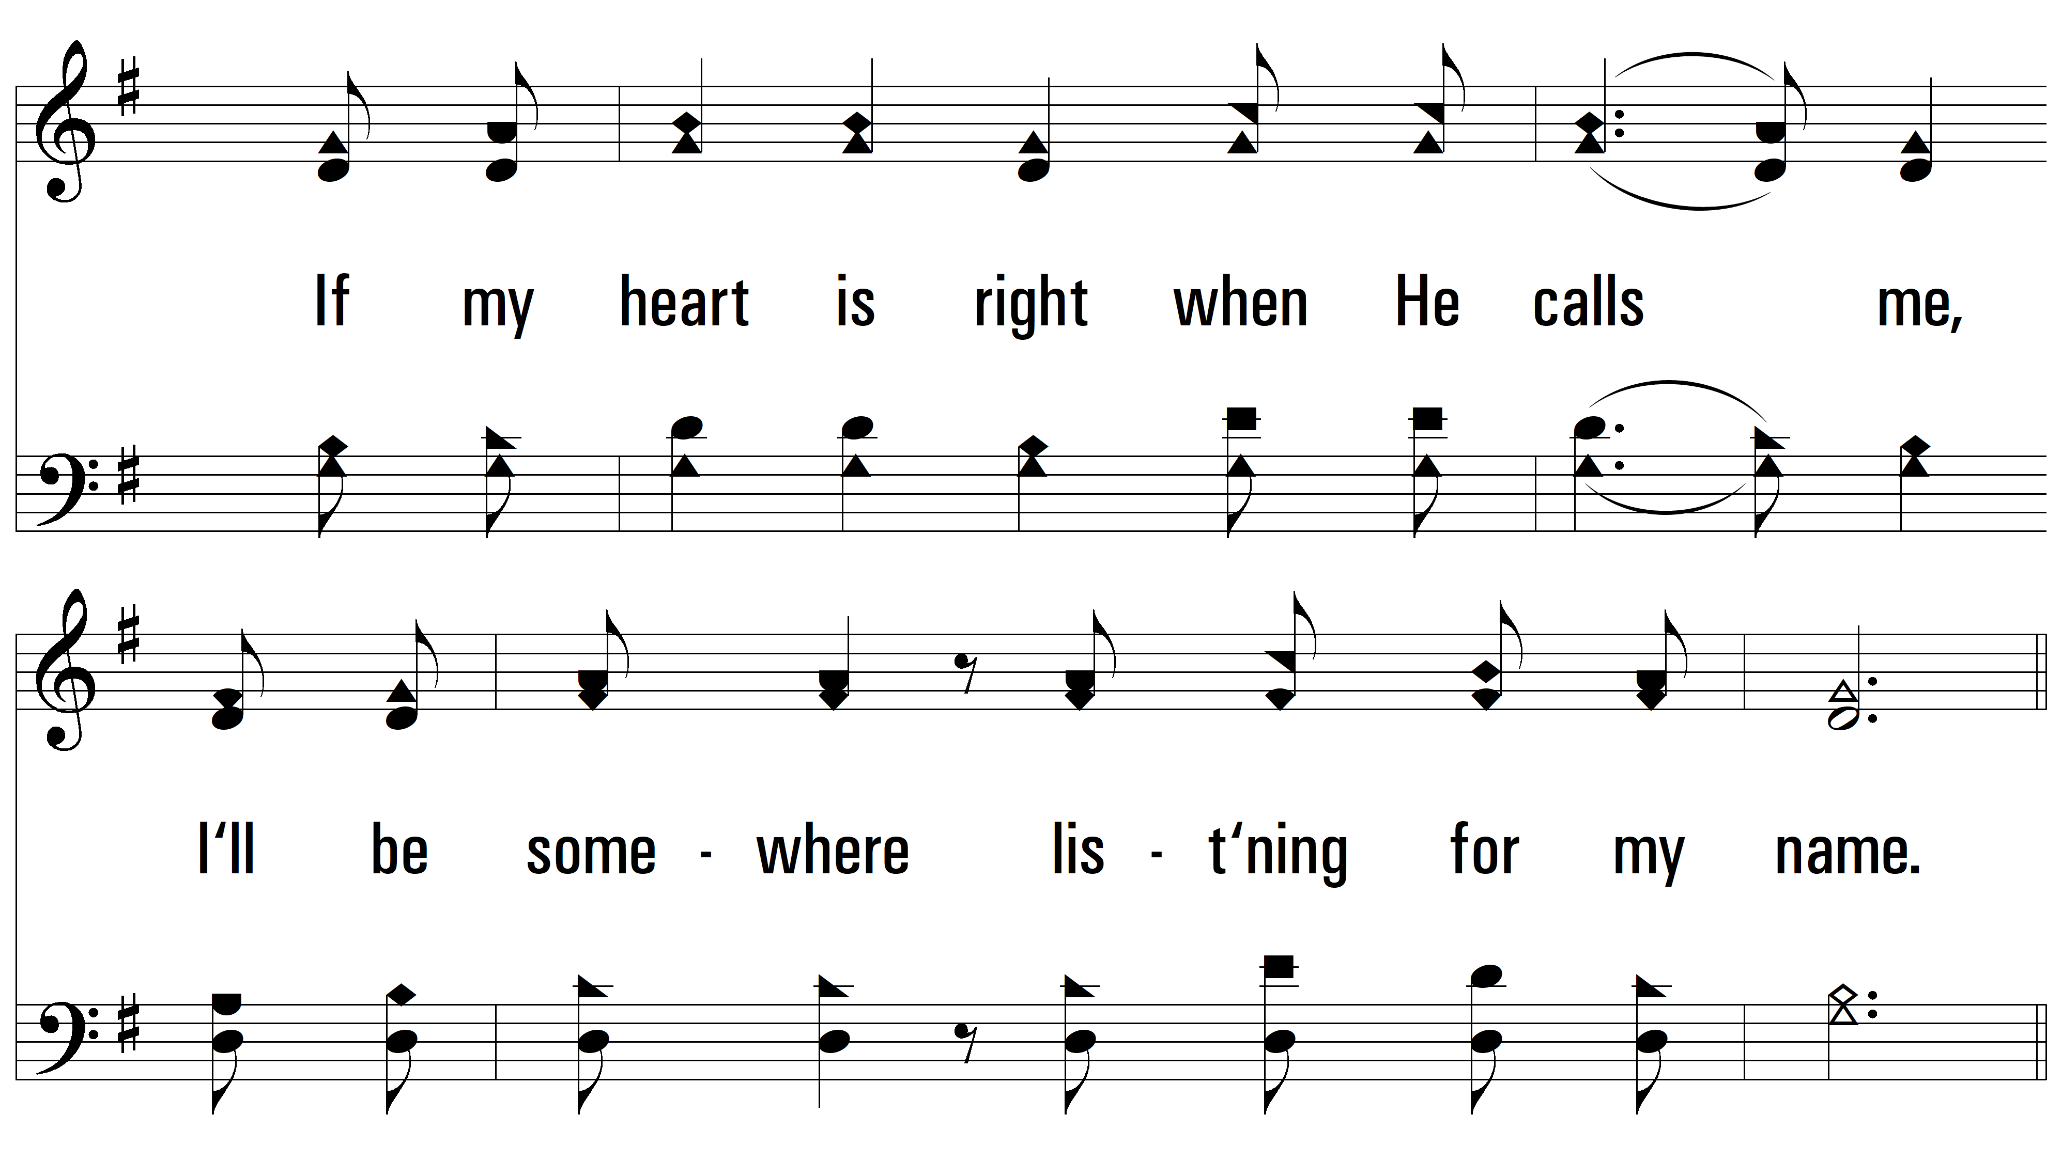
vs. 2

Slide 8
vs. 2

Slide 9
vs. 2

Slide 10
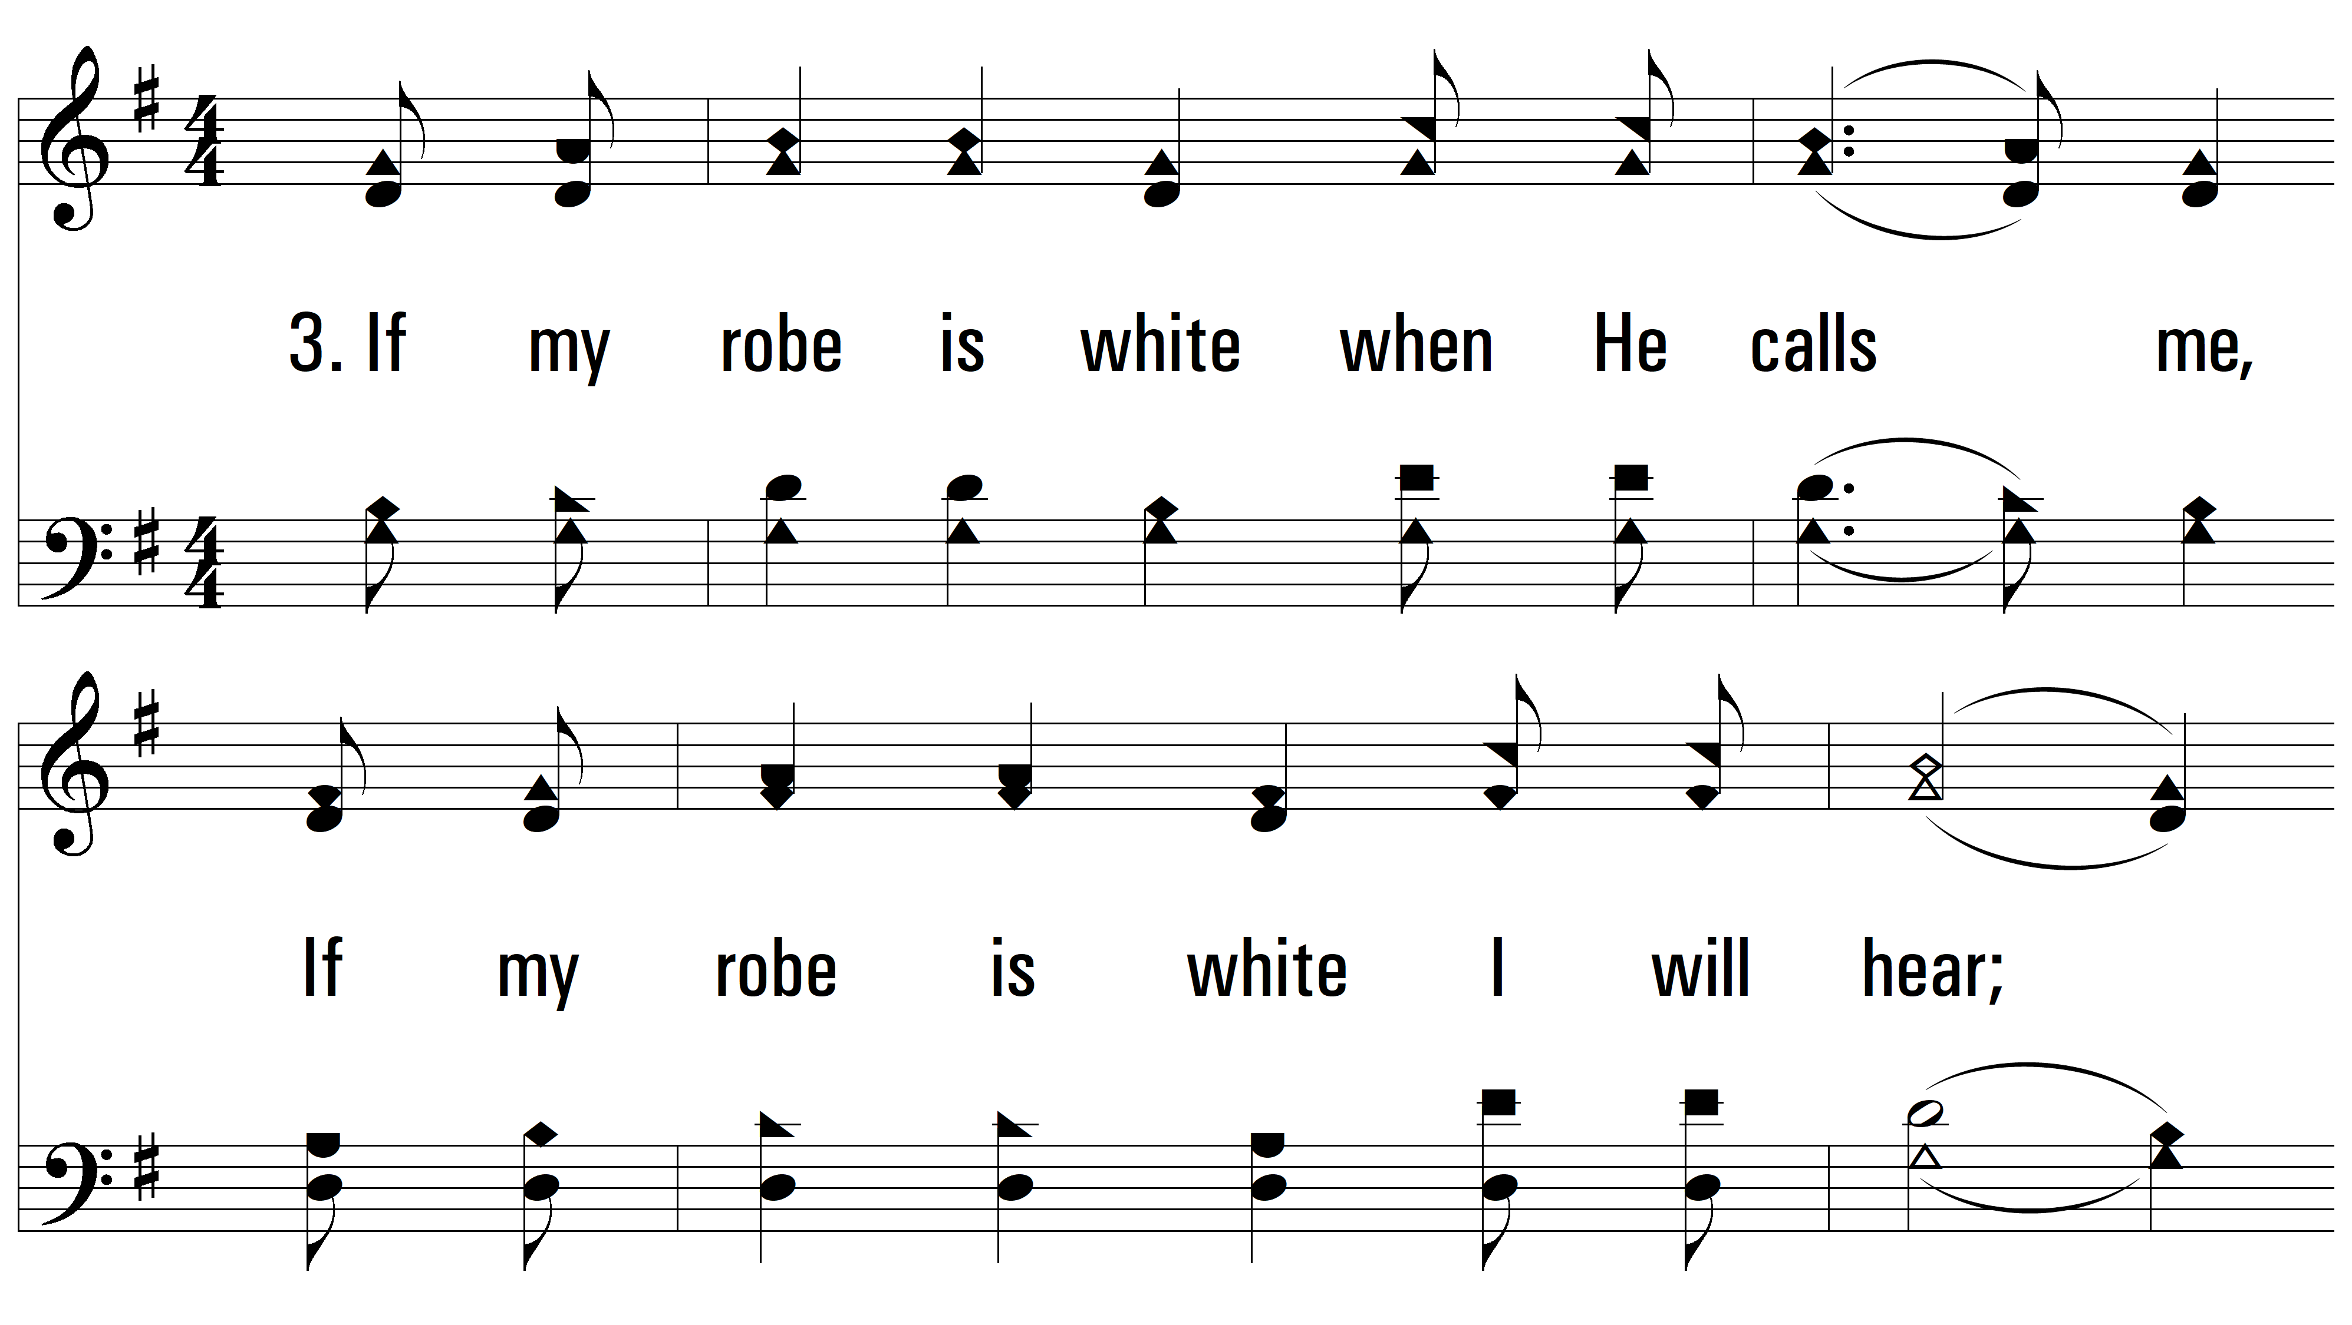
vs. 3 ~ I'll Be List'ning

Slide 11
vs. 3

Slide 12
vs. 3

Slide 13
vs. 3
PDHymns.com
END

