Slide 1
I Sing The Mighty Power Of God
ELLACOMBE
CMD
Words: | Isaac Watts (1715)
Music: | Gesangbuch der Herogl, Württemberg (1784), Har. by William H. Monk (1868)
4/4
B^{b}/F - SOL
Verses: 3
Lead - | SOL
Alto - | SOL
Tenor - | SOL
Bass - | SOL
PDHymns.com

Slide 2
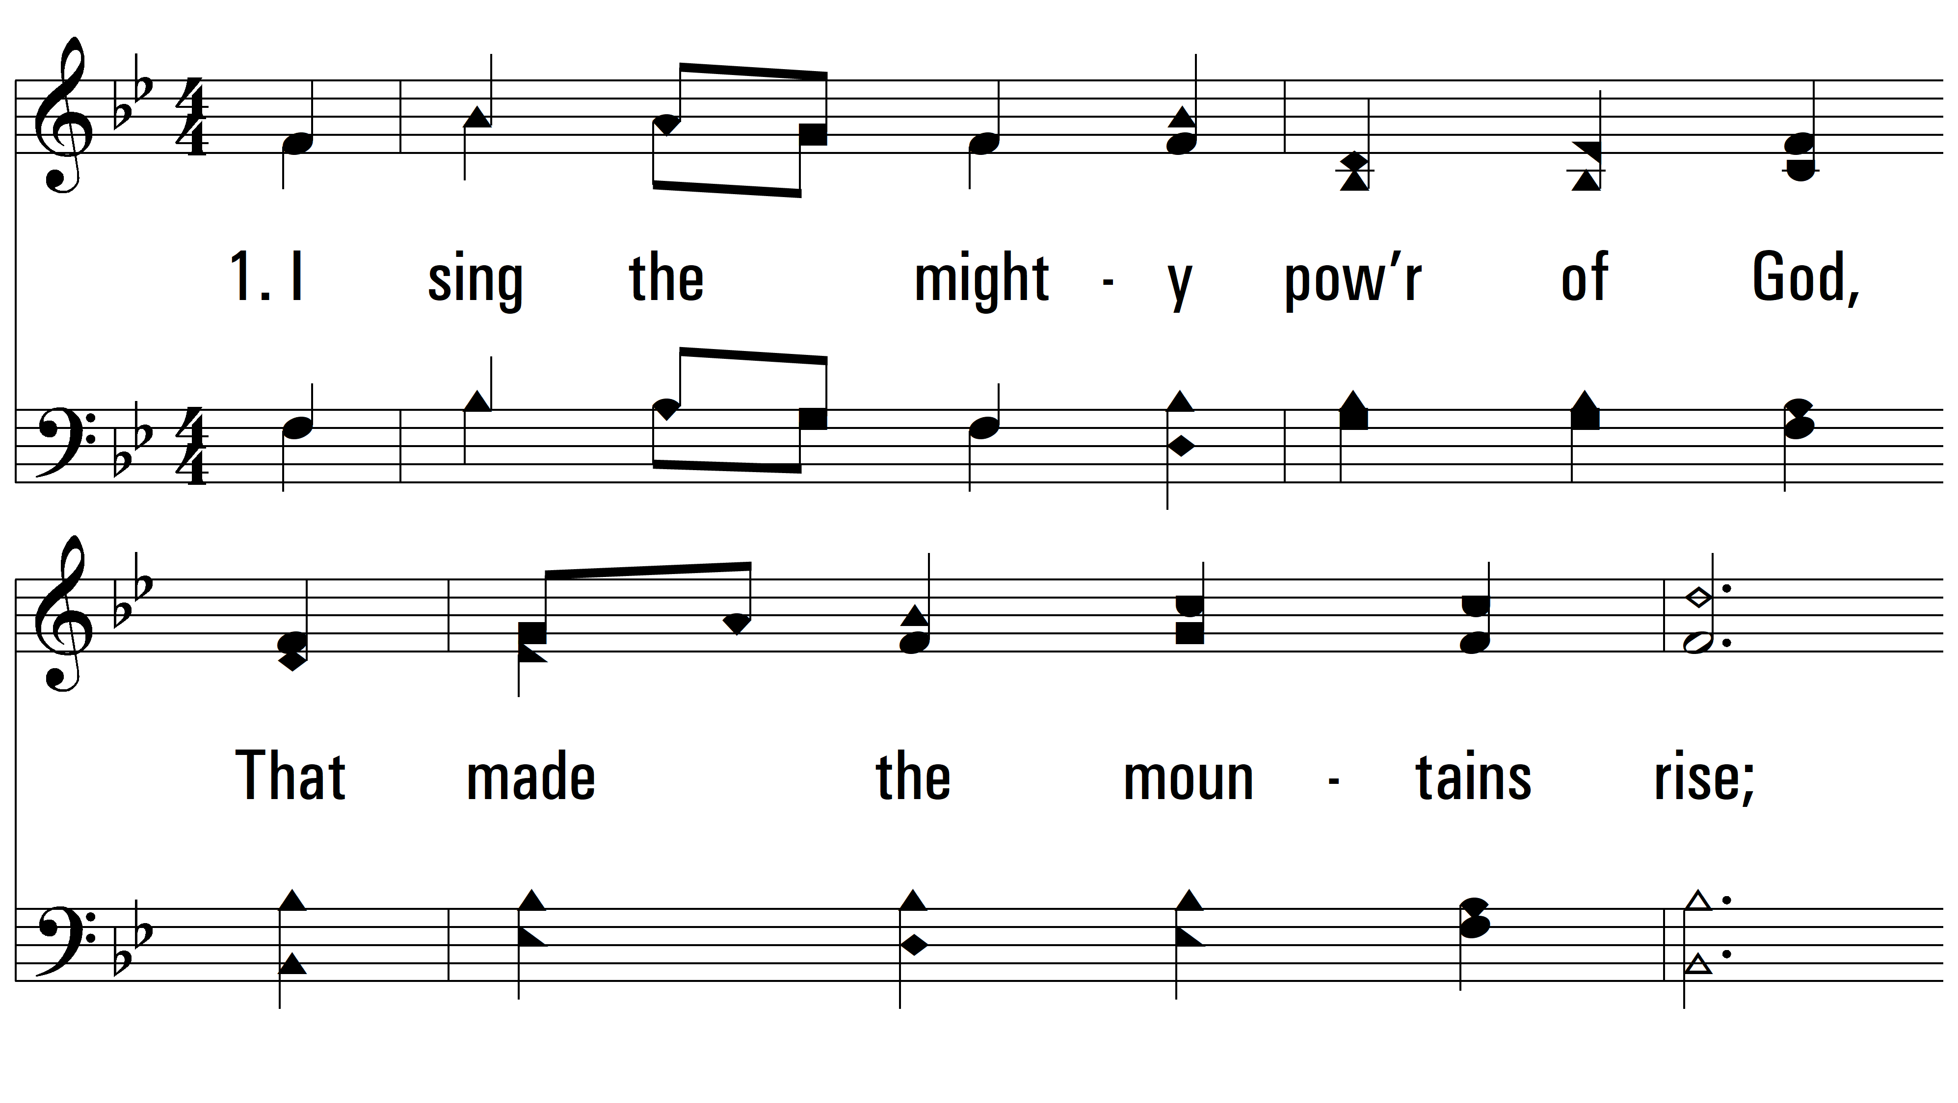
vs. 1 ~ I Sing The Mighty Power Of God

Slide 3
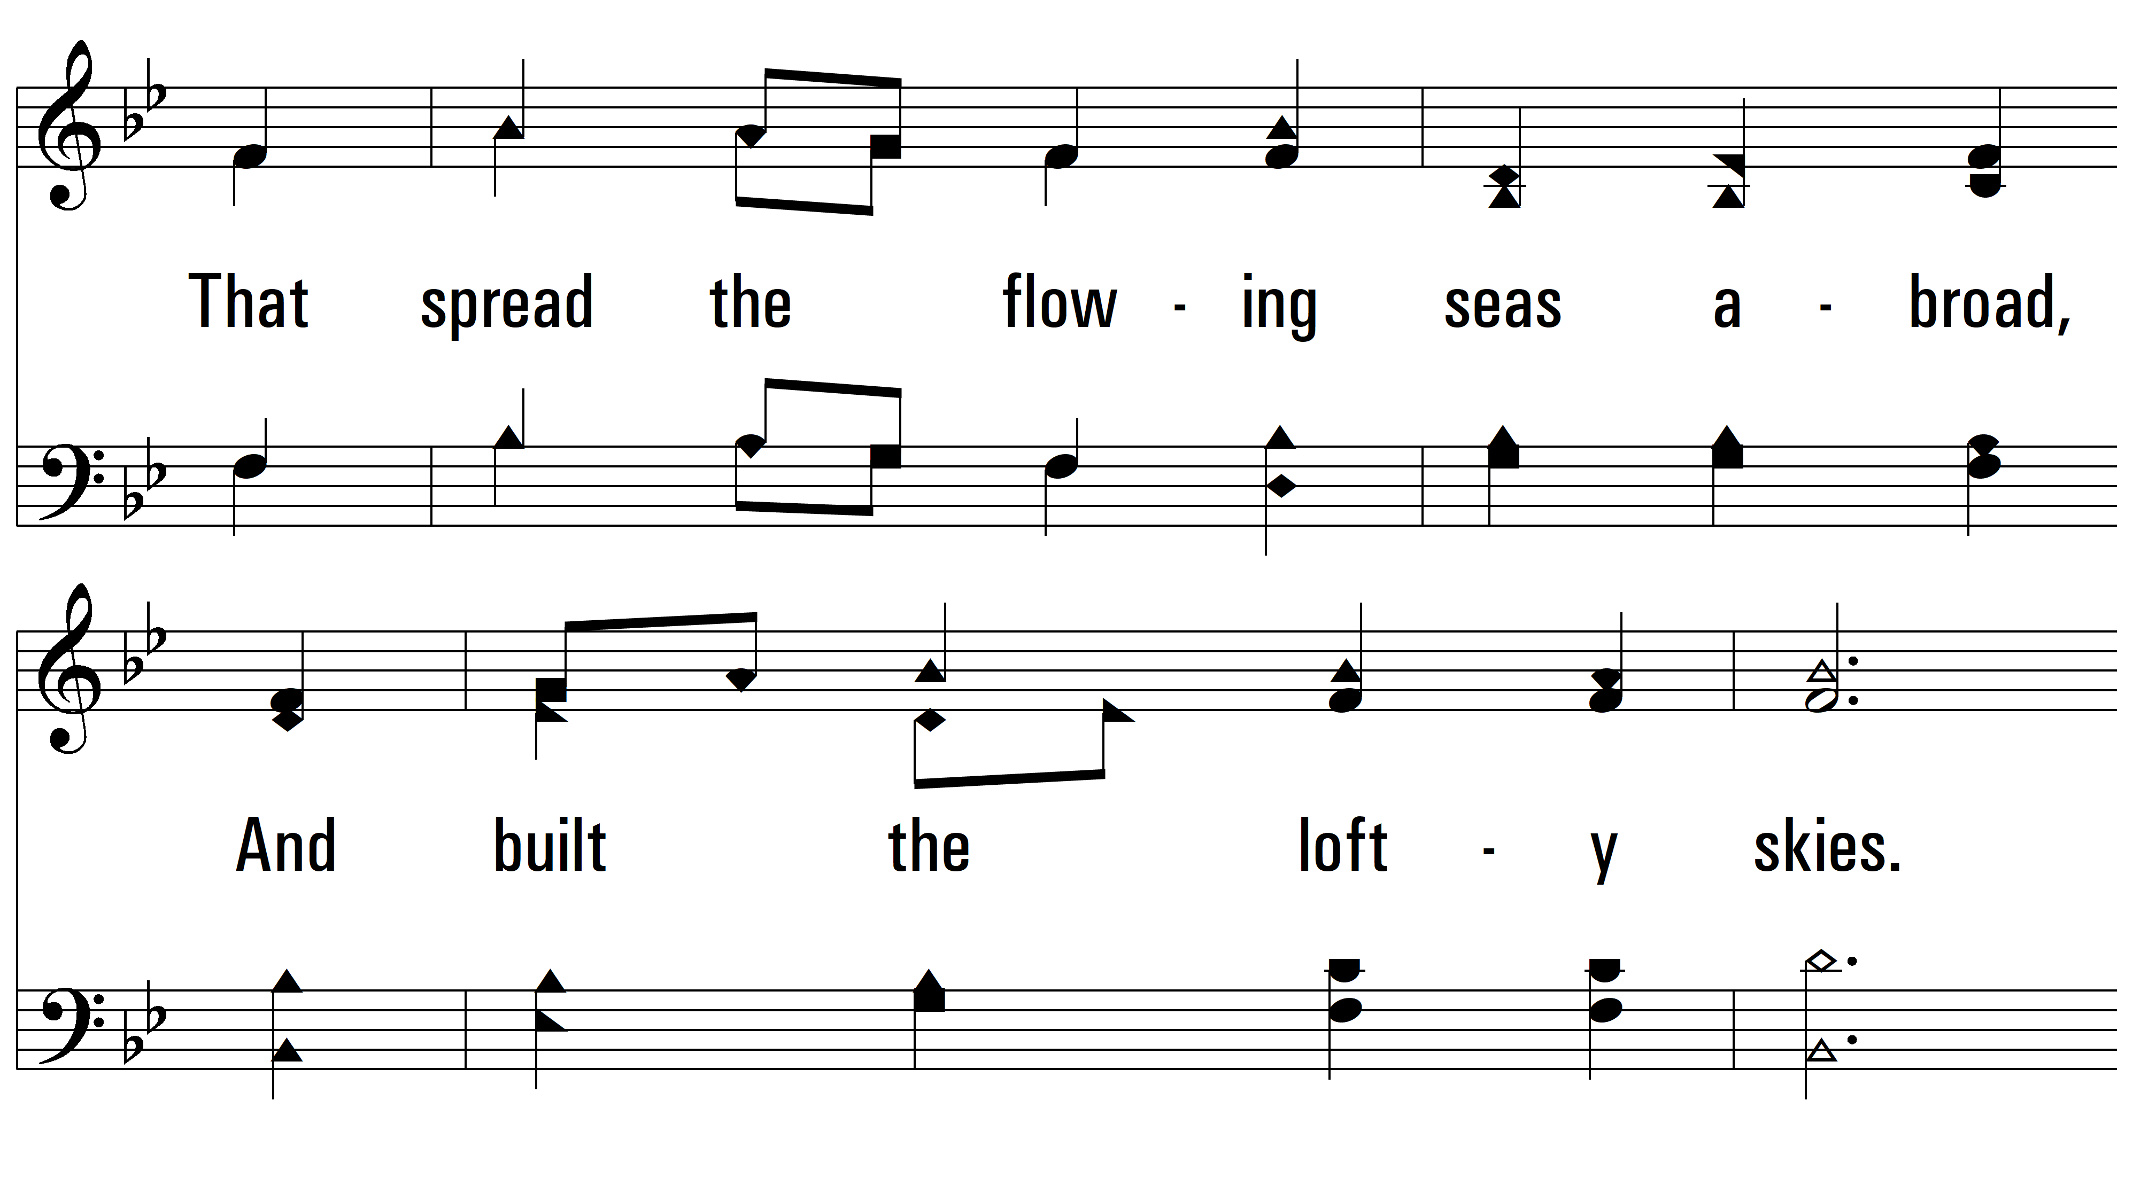
vs. 1

Slide 4
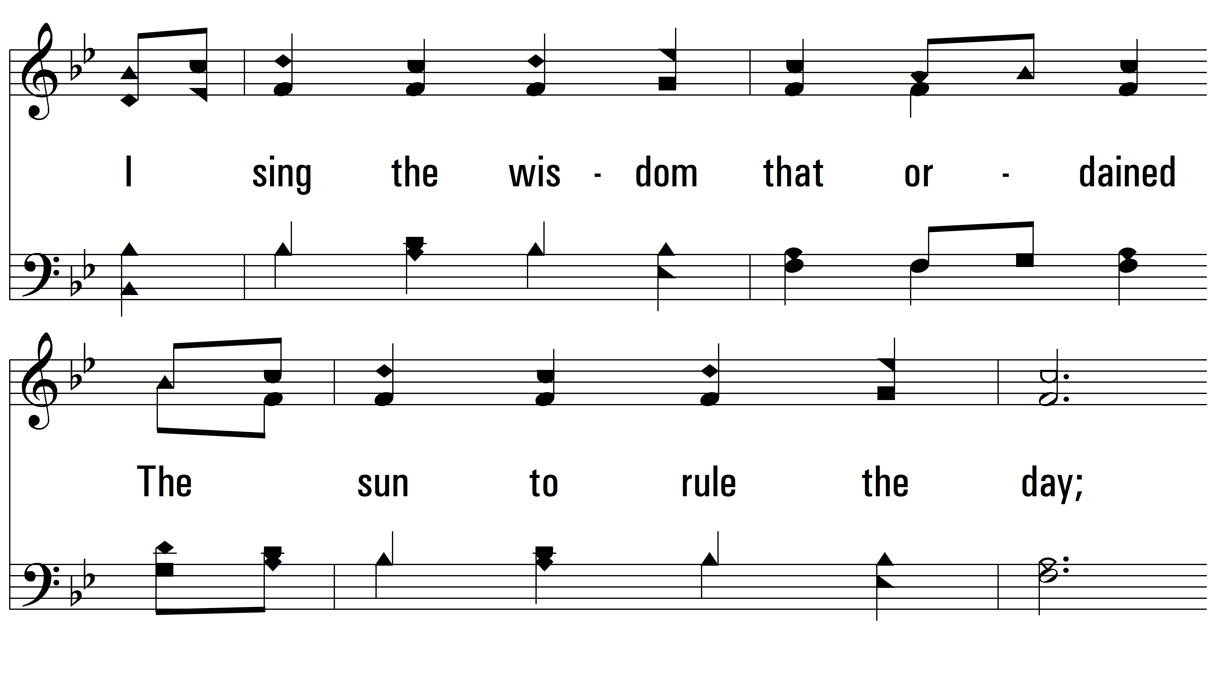
vs. 1

Slide 5
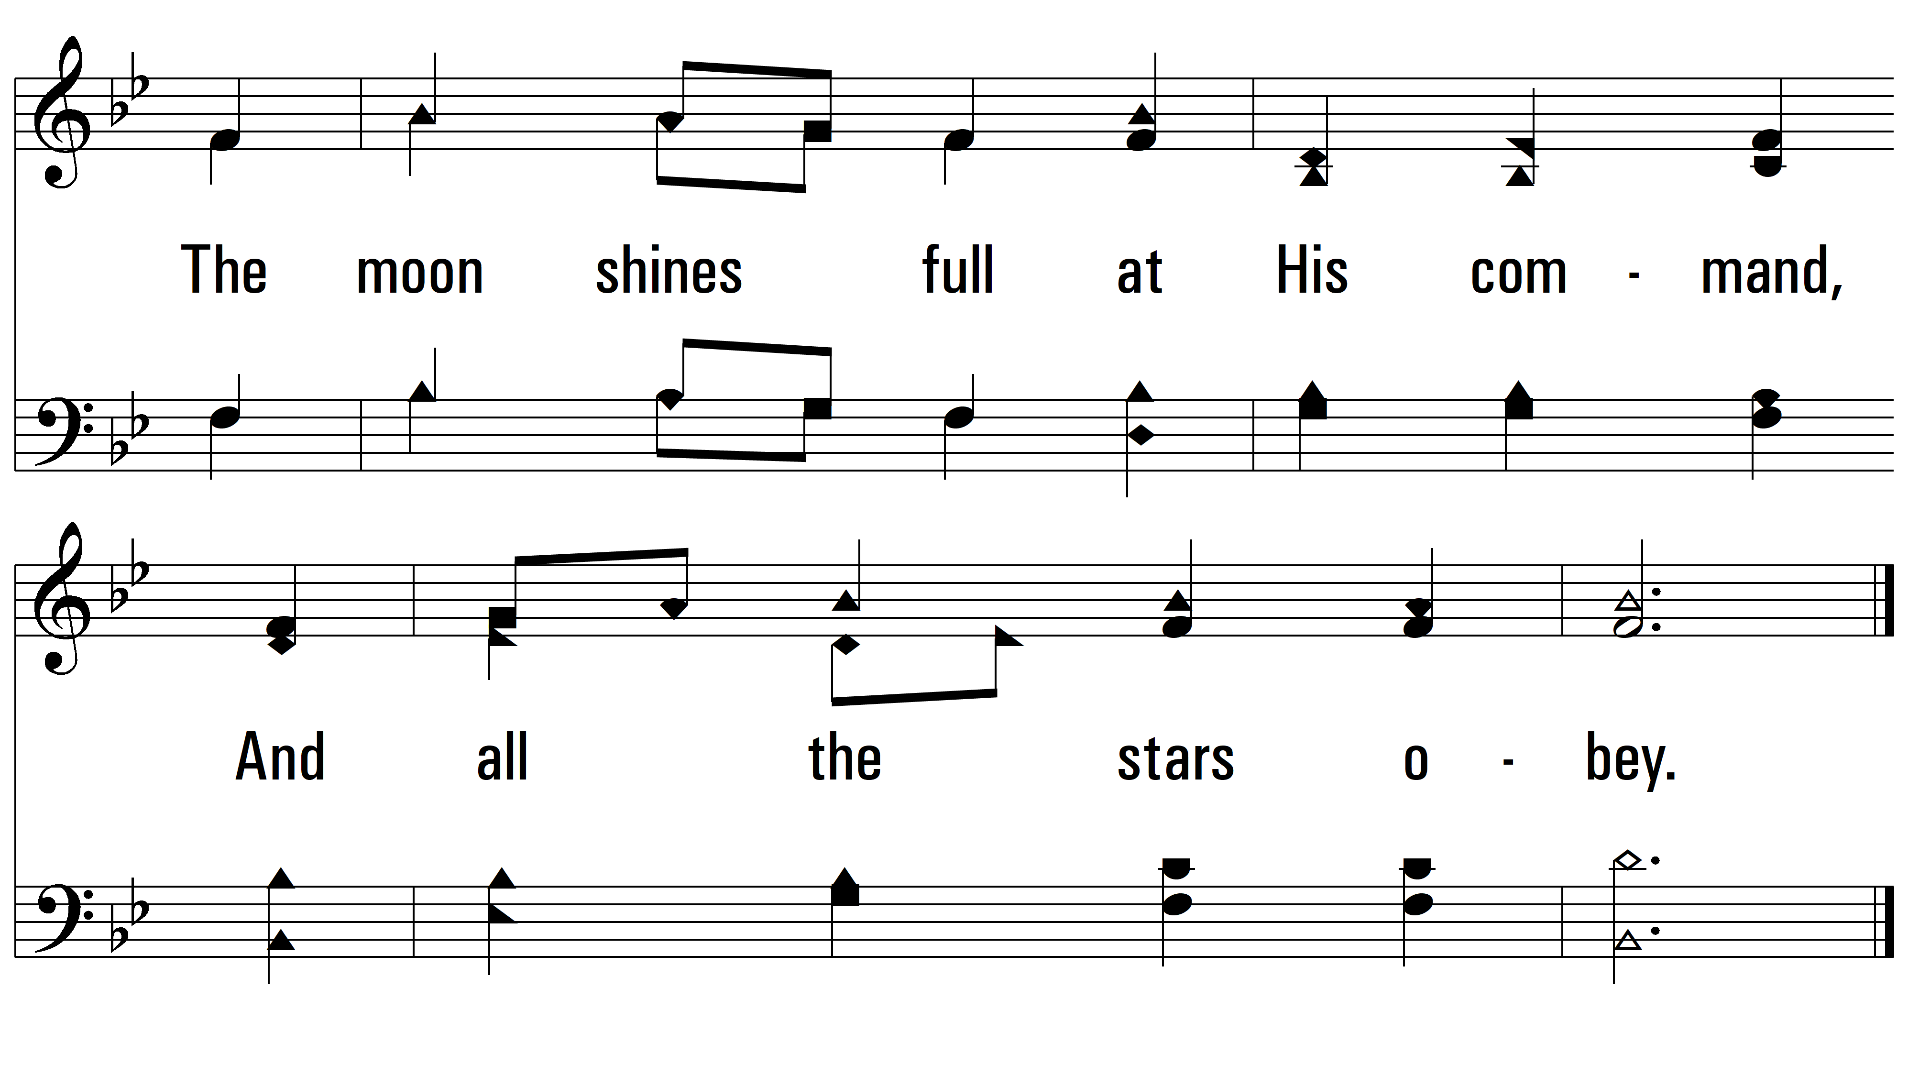
vs. 1

Slide 6
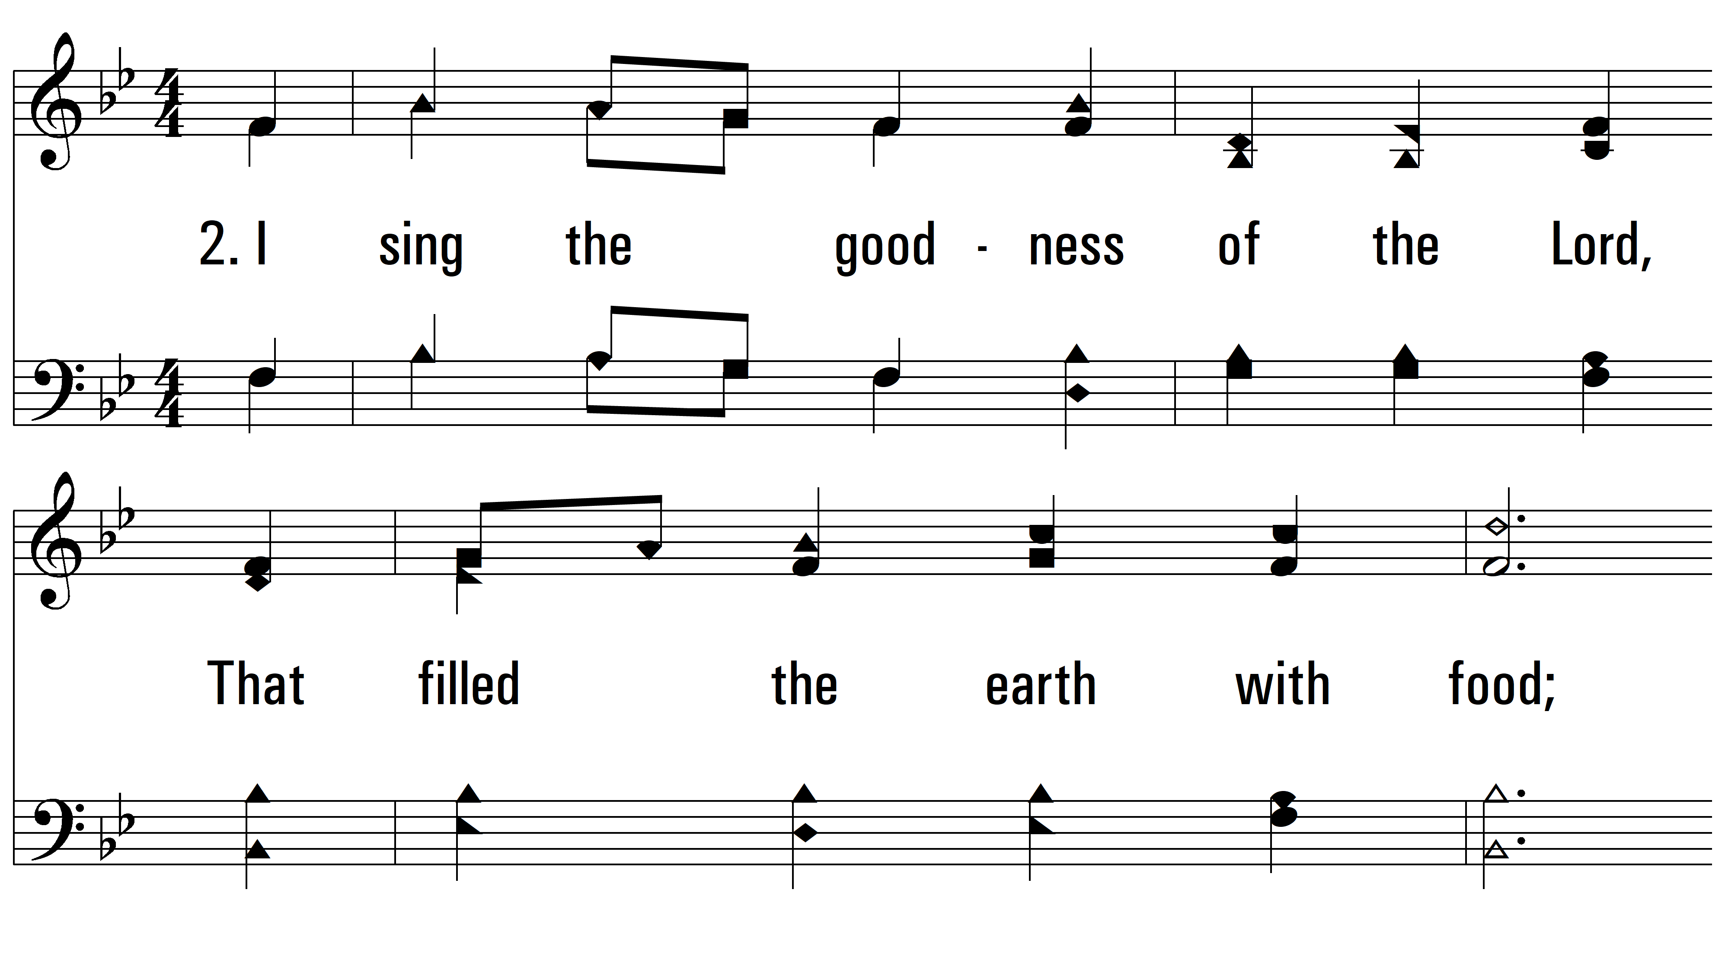
vs. 2 ~ I Sing The Mighty Power Of God

Slide 7
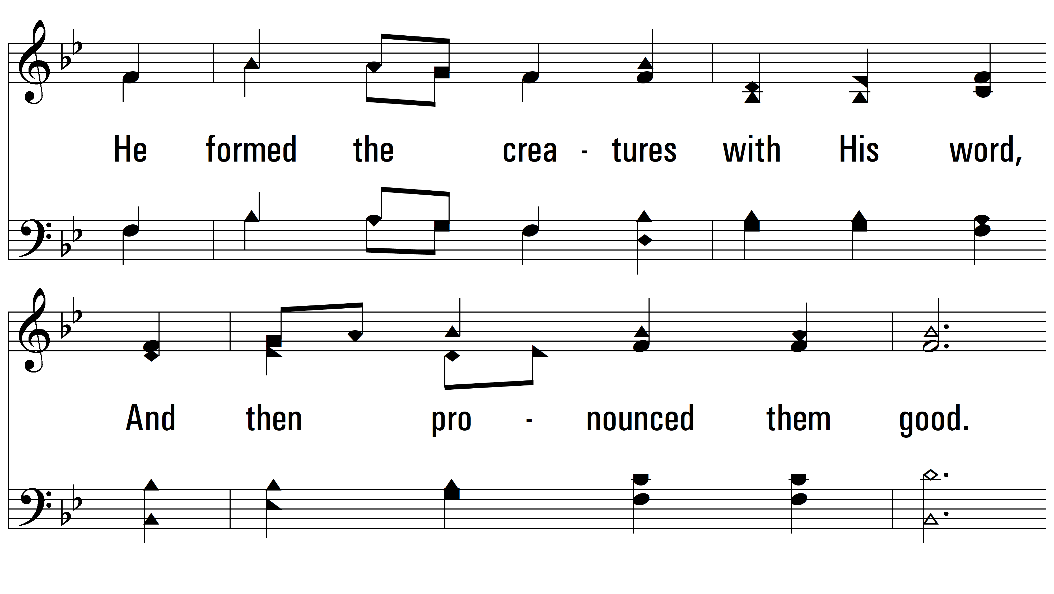
vs. 2

Slide 8
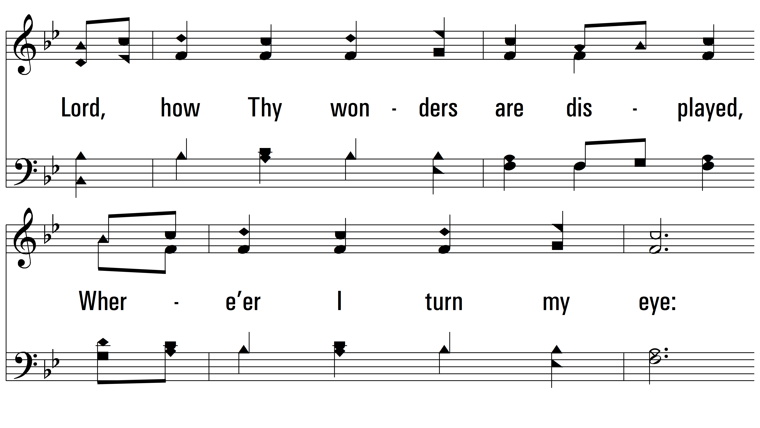
vs. 2

Slide 9
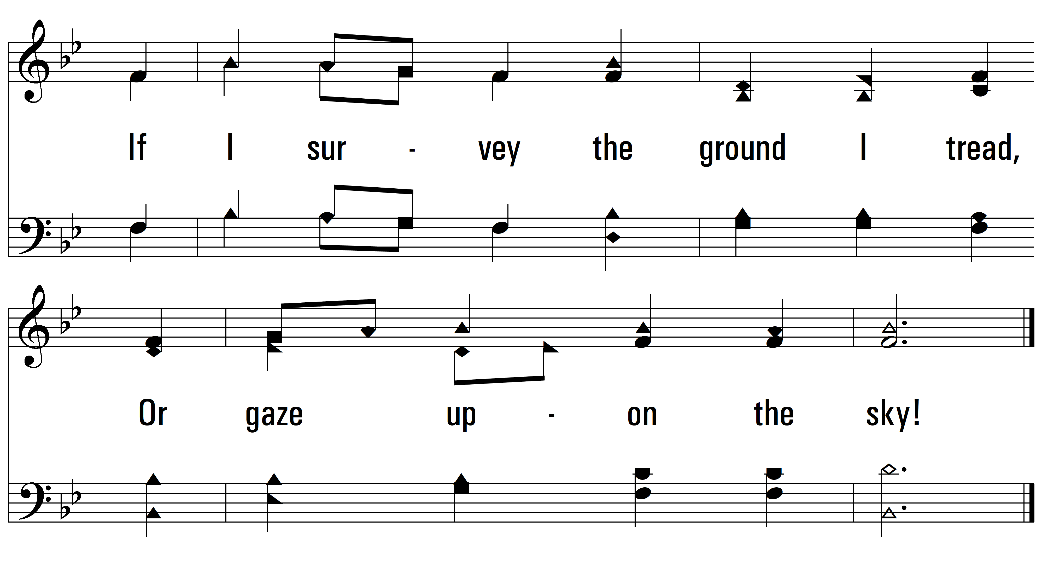
vs. 2

Slide 10
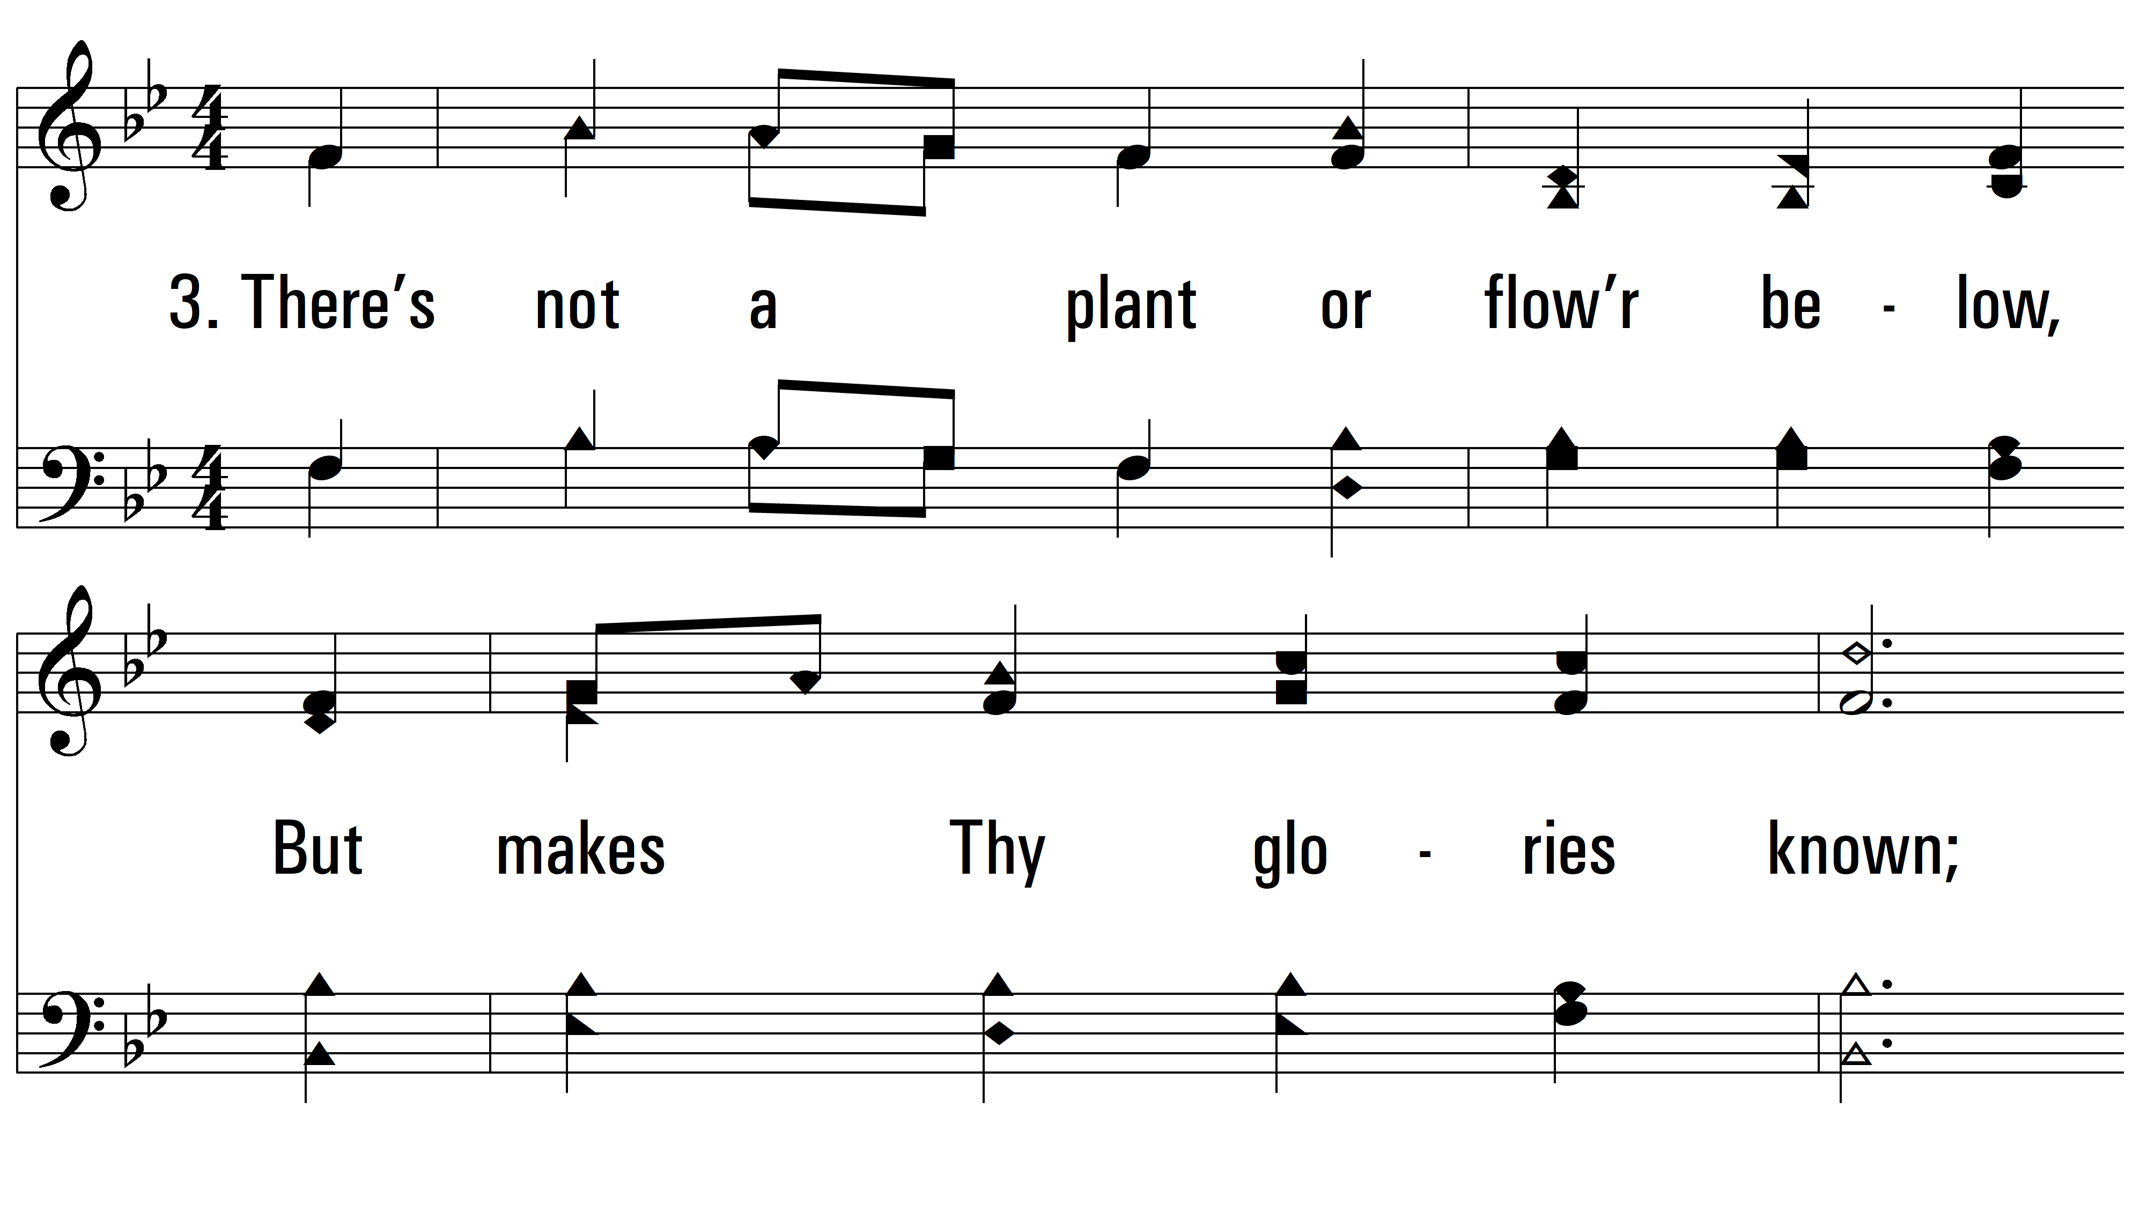
vs. 3 ~ I Sing The Mighty Power Of God

Slide 11
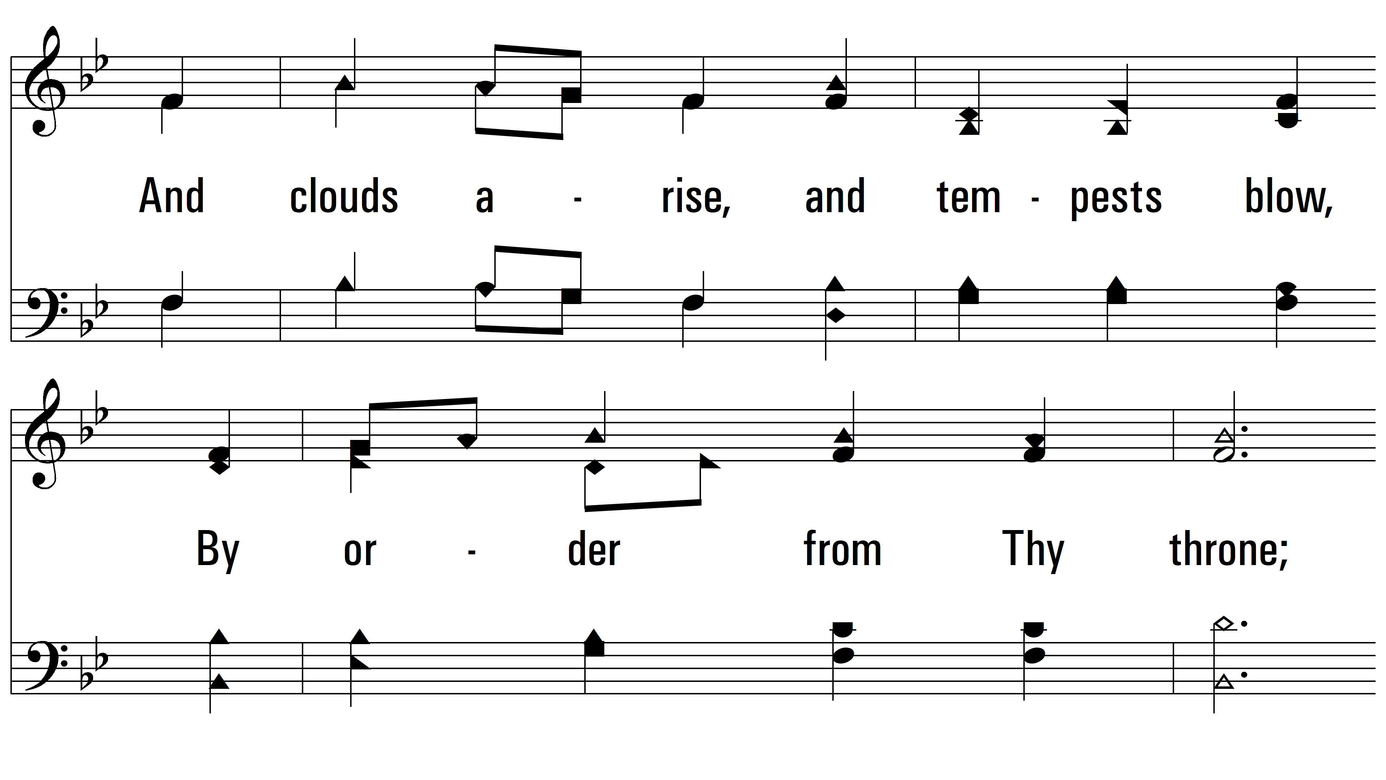
vs. 3

Slide 12
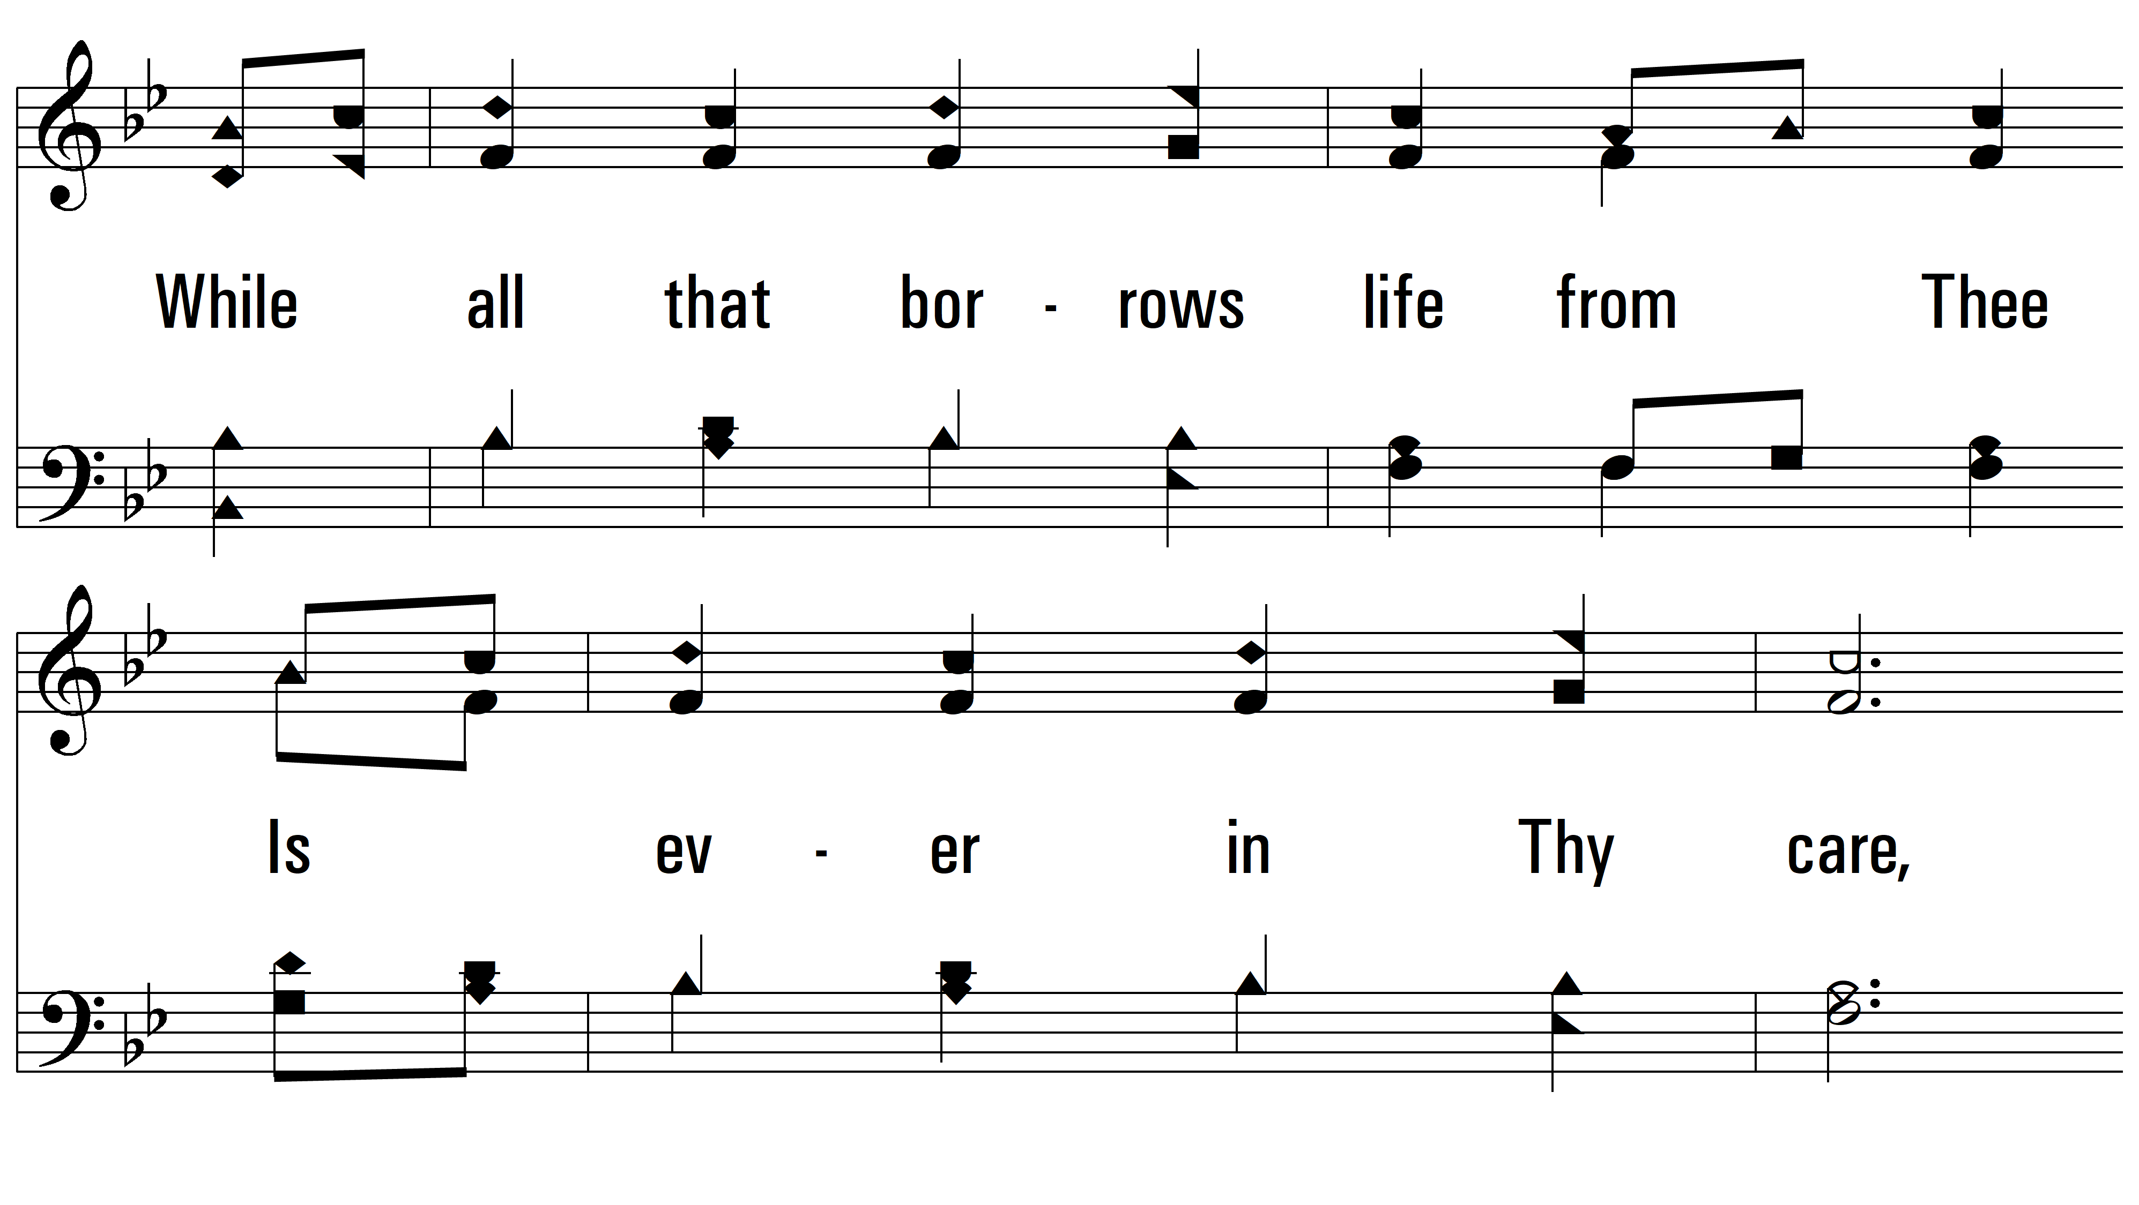
vs. 3

Slide 13
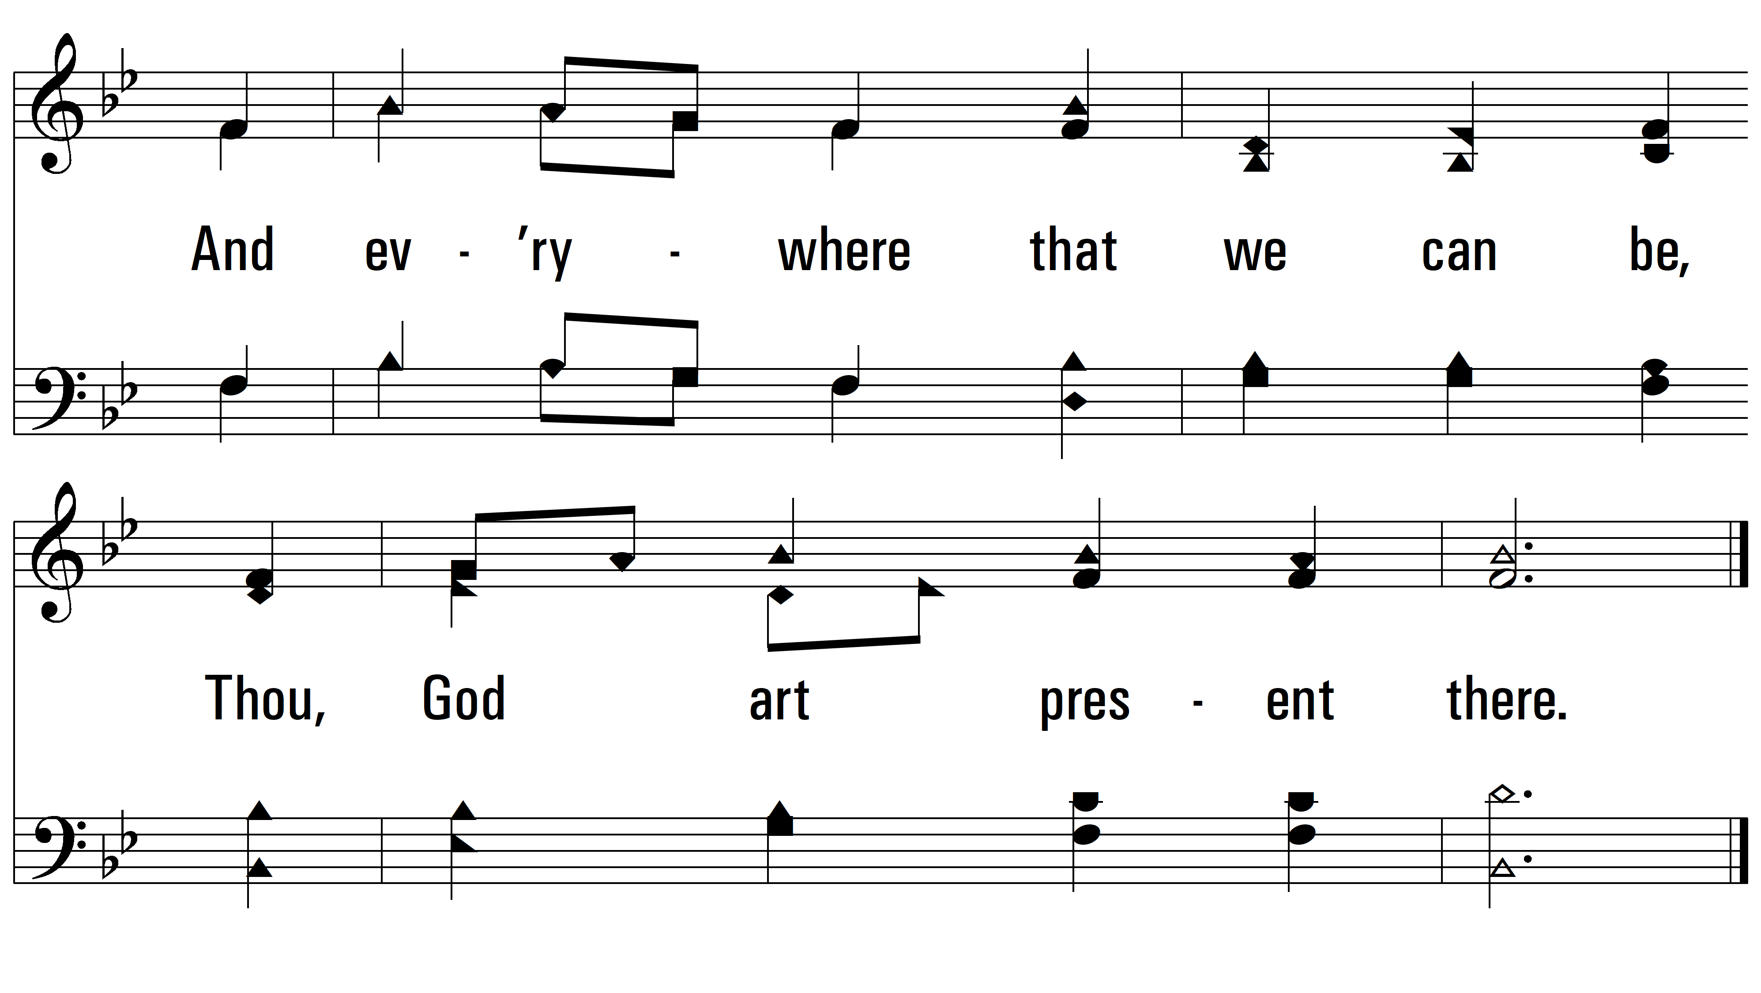
vs. 3
PDHymns.com
END

