Slide 1
I Am Coming To The Cross
Words: | William McDonald (1872)
Music: | William G. Fischer (1869)
3/4
G/D - SOL
Verses: 3/Chorus
Lead - | SOL
Alto - | SOL
Tenor - | MI
Bass - | DO
PDHymns.com

Slide 2
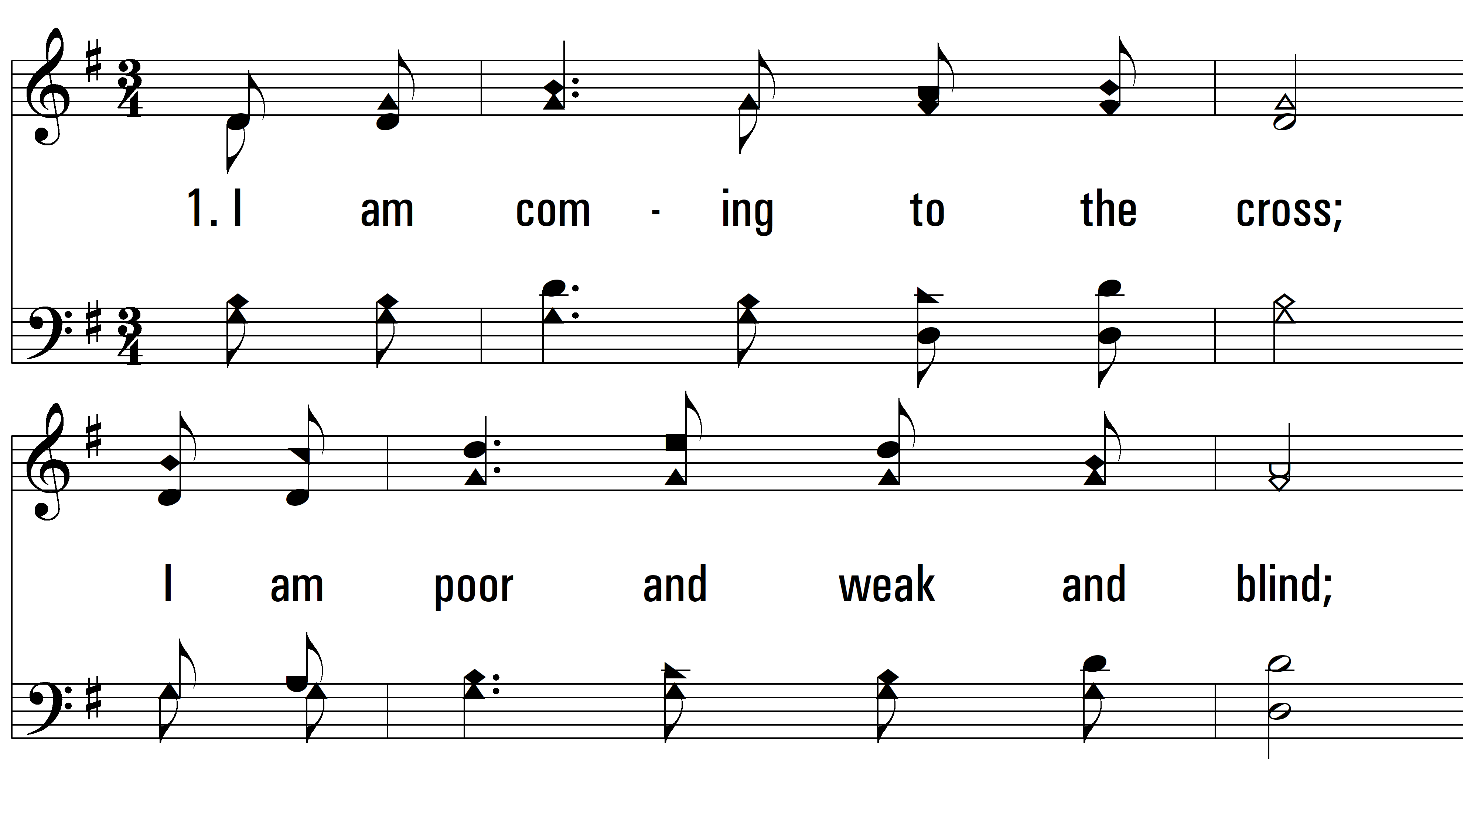
vs. 1 ~ I Am Coming To The Cross

Slide 3
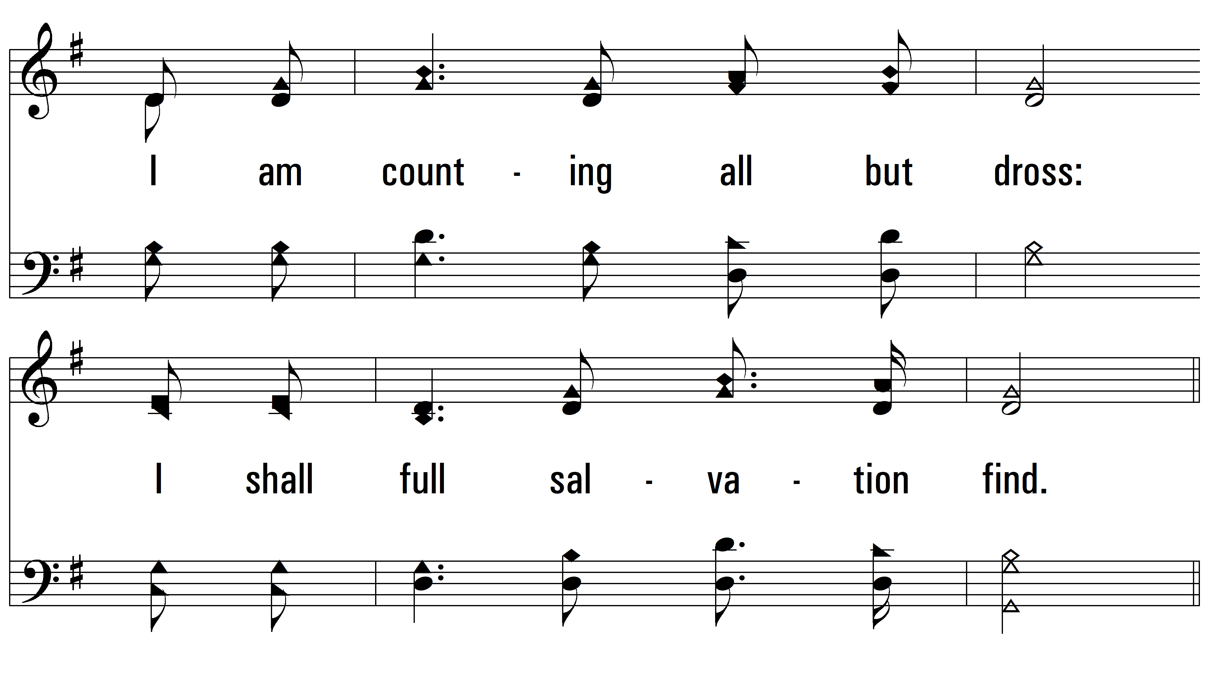
vs. 1

Slide 4
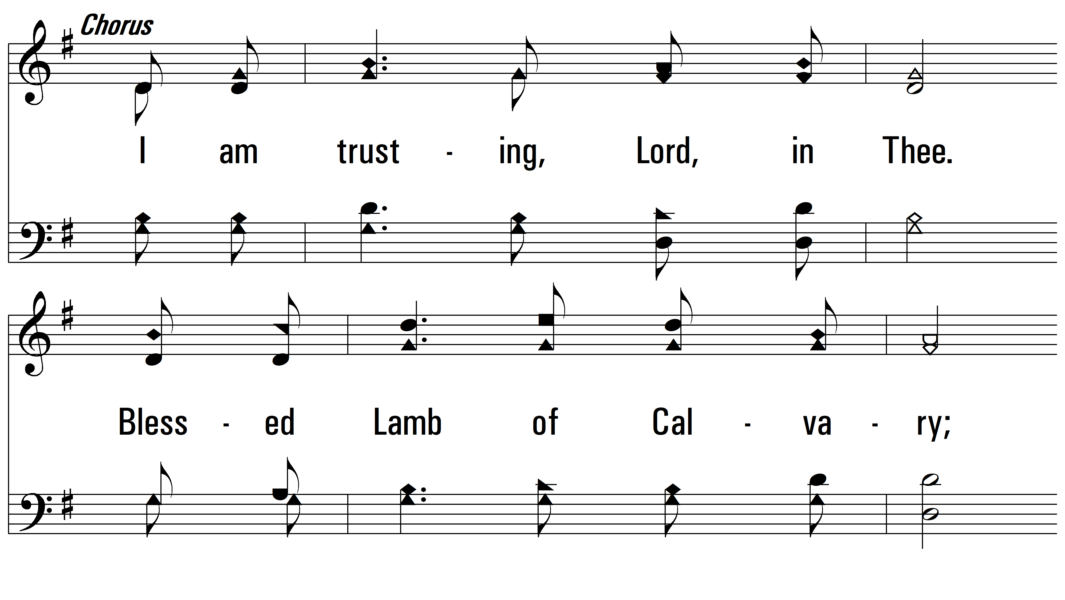
vs. 1

Slide 5
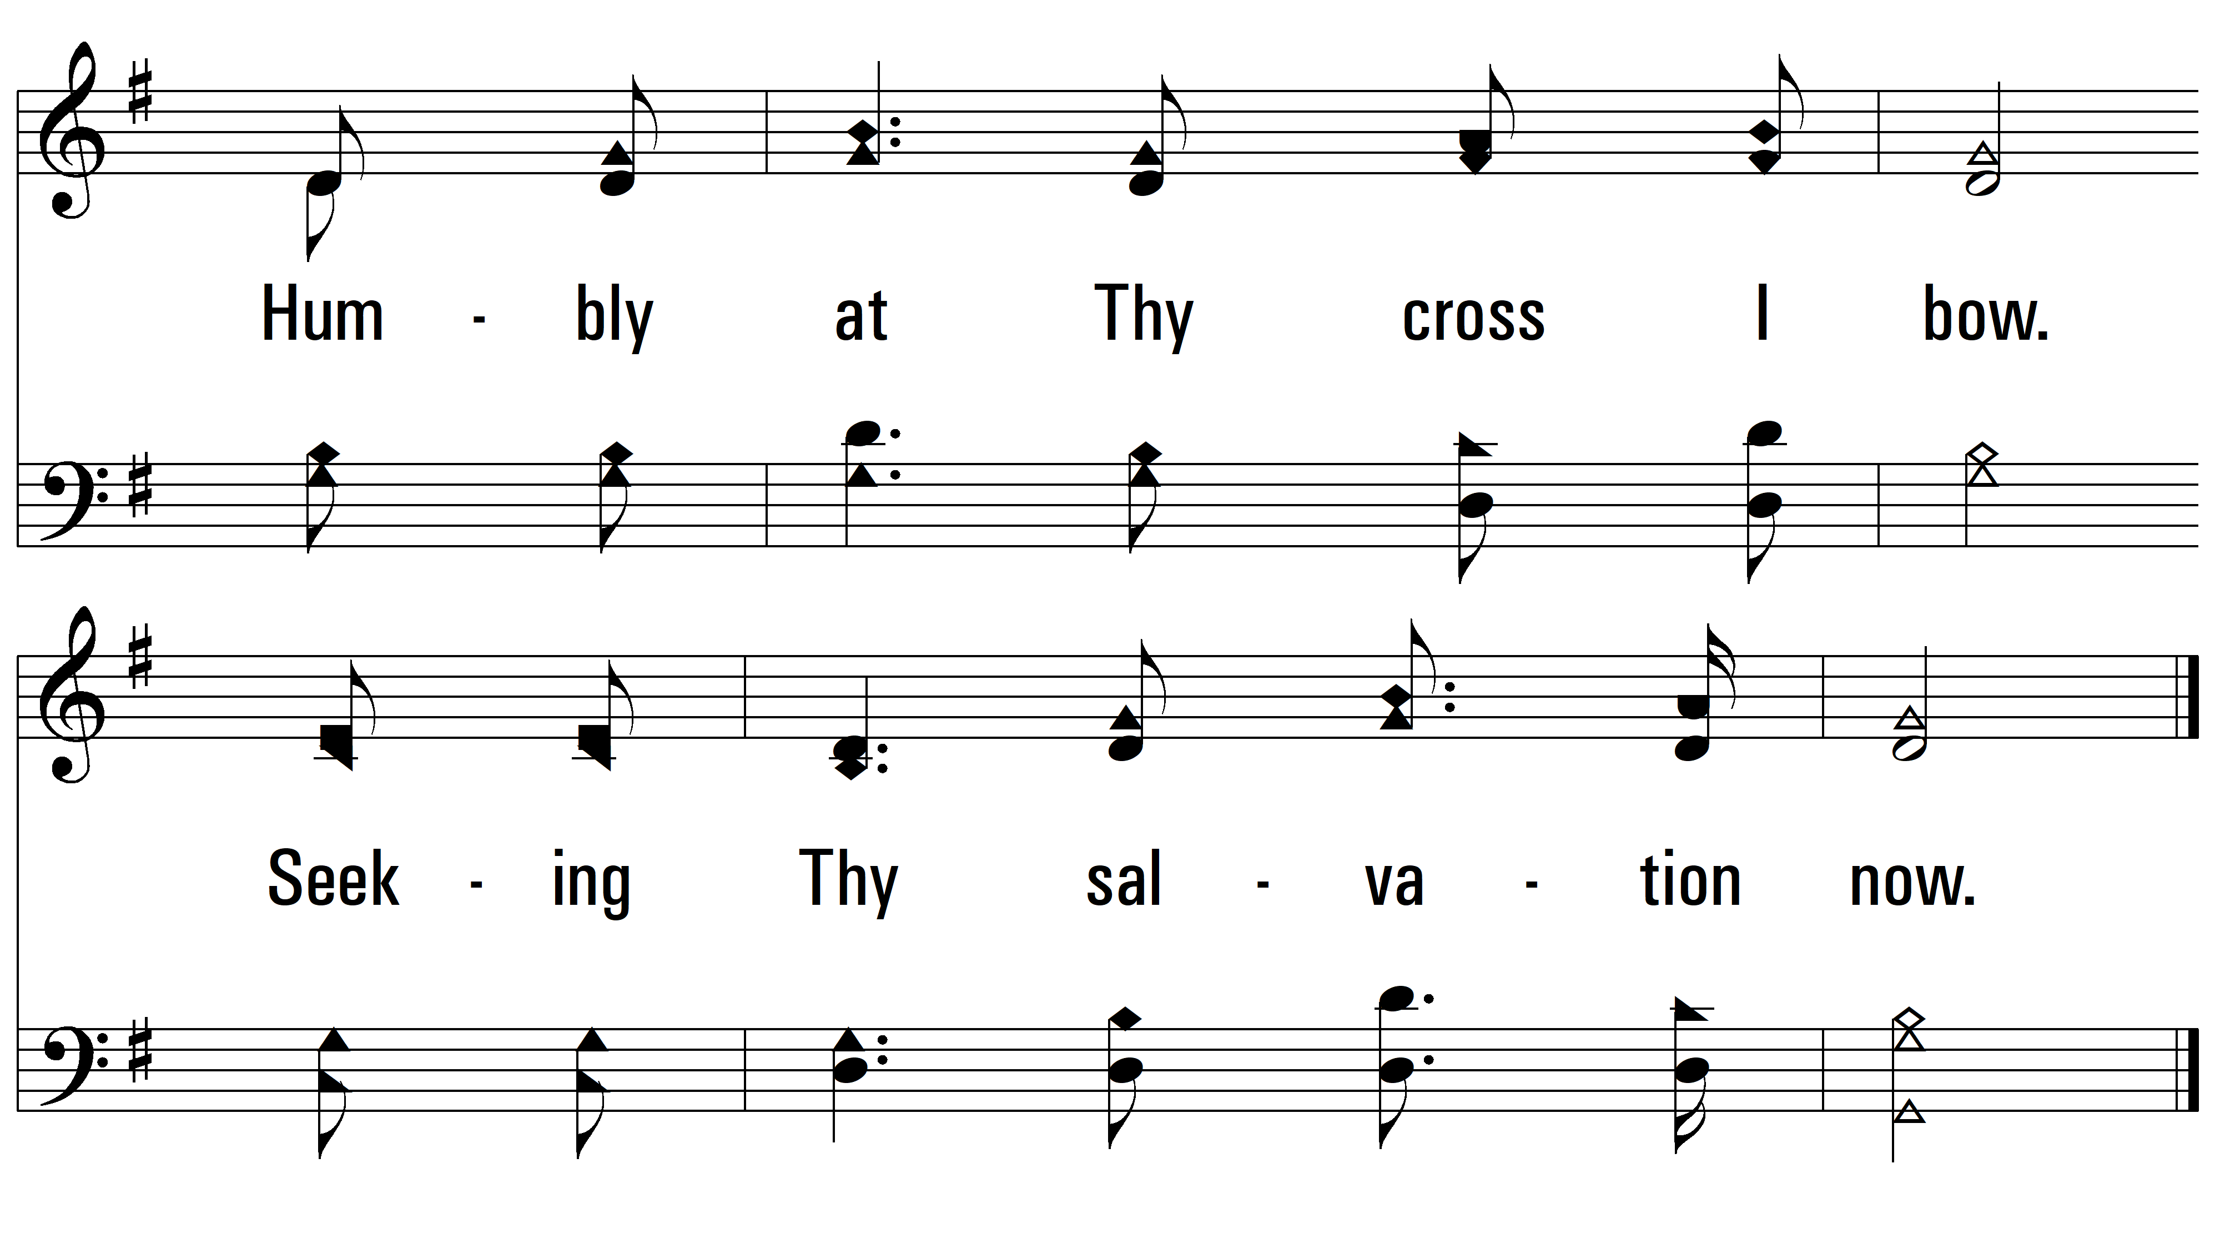
vs. 1

Slide 6
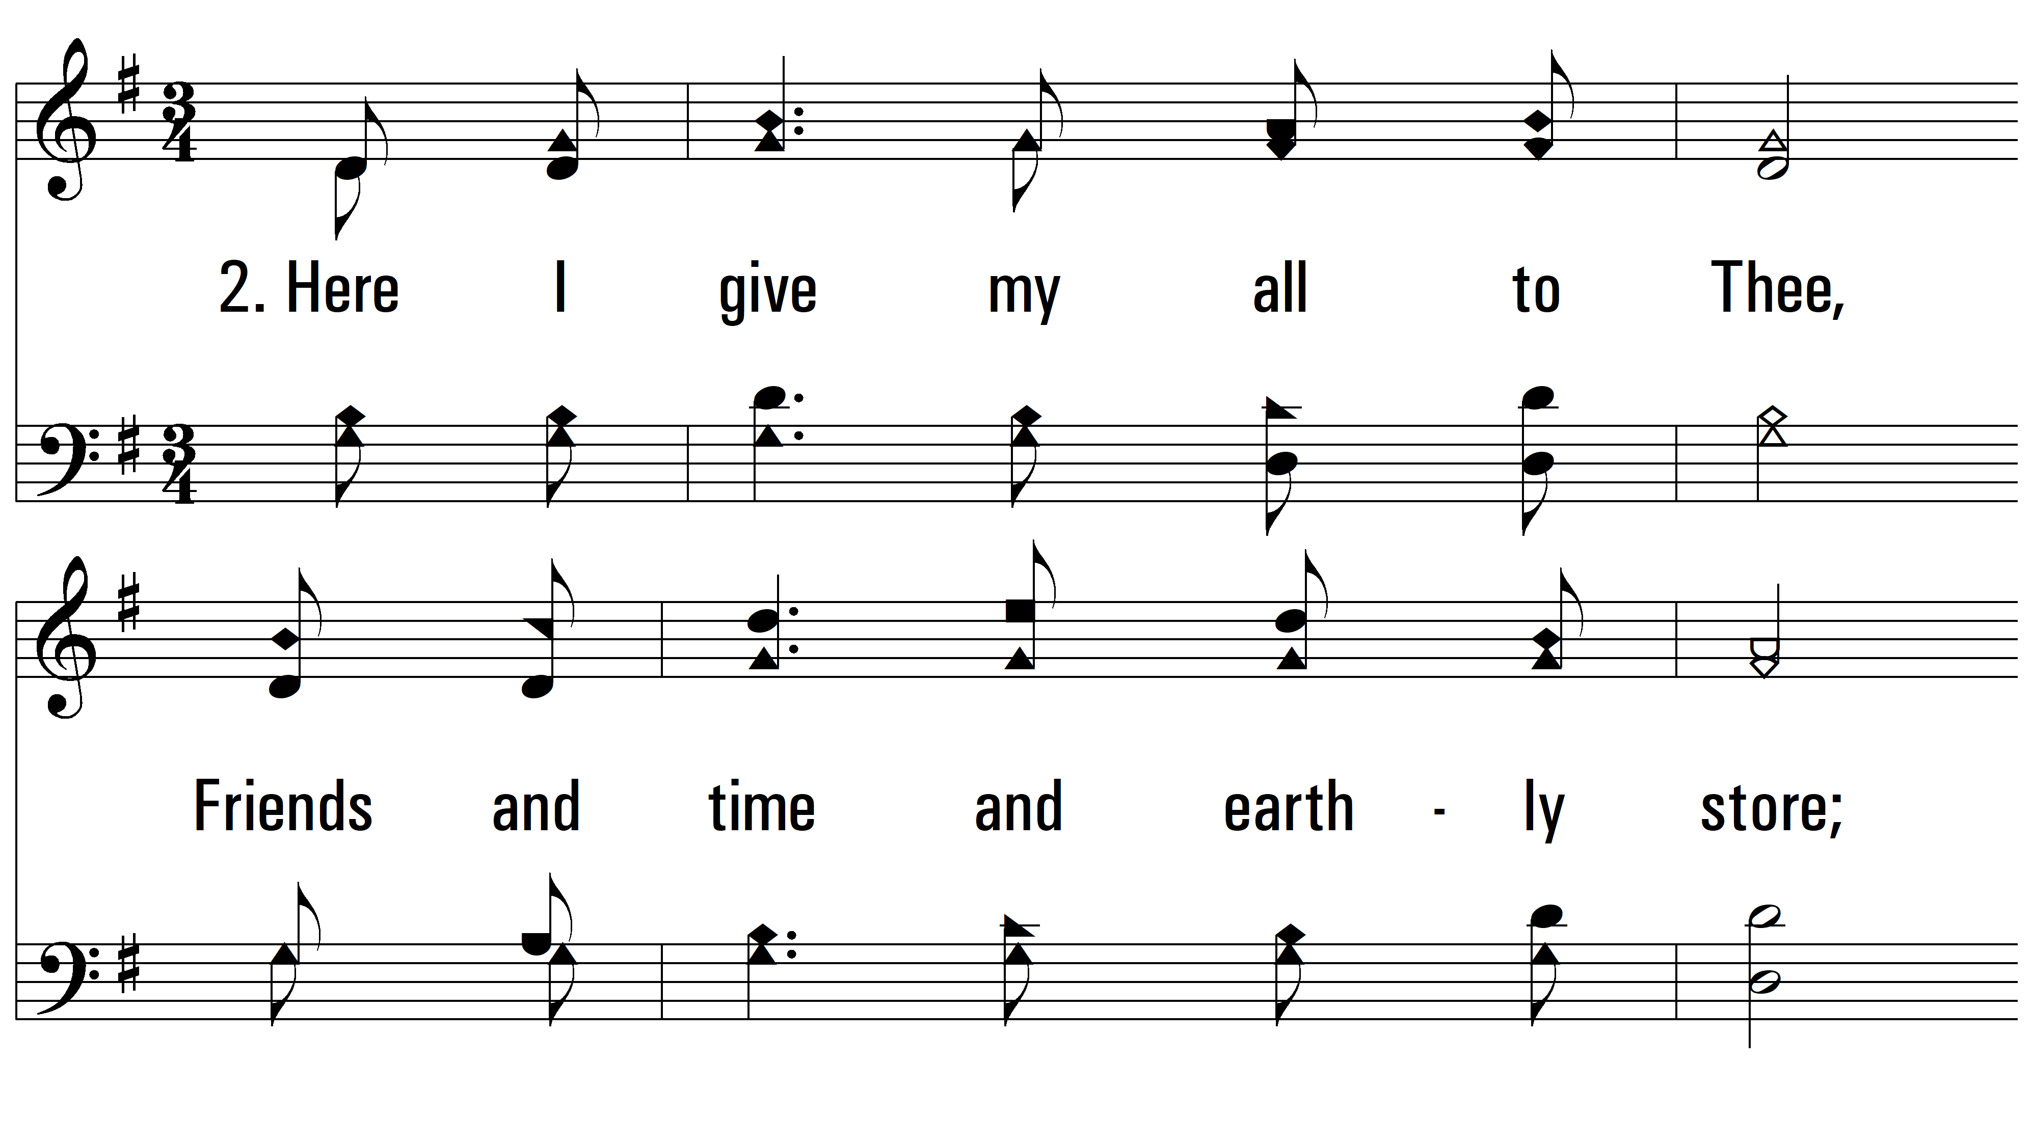
vs. 1 ~ I Am Coming To The Cross

Slide 7
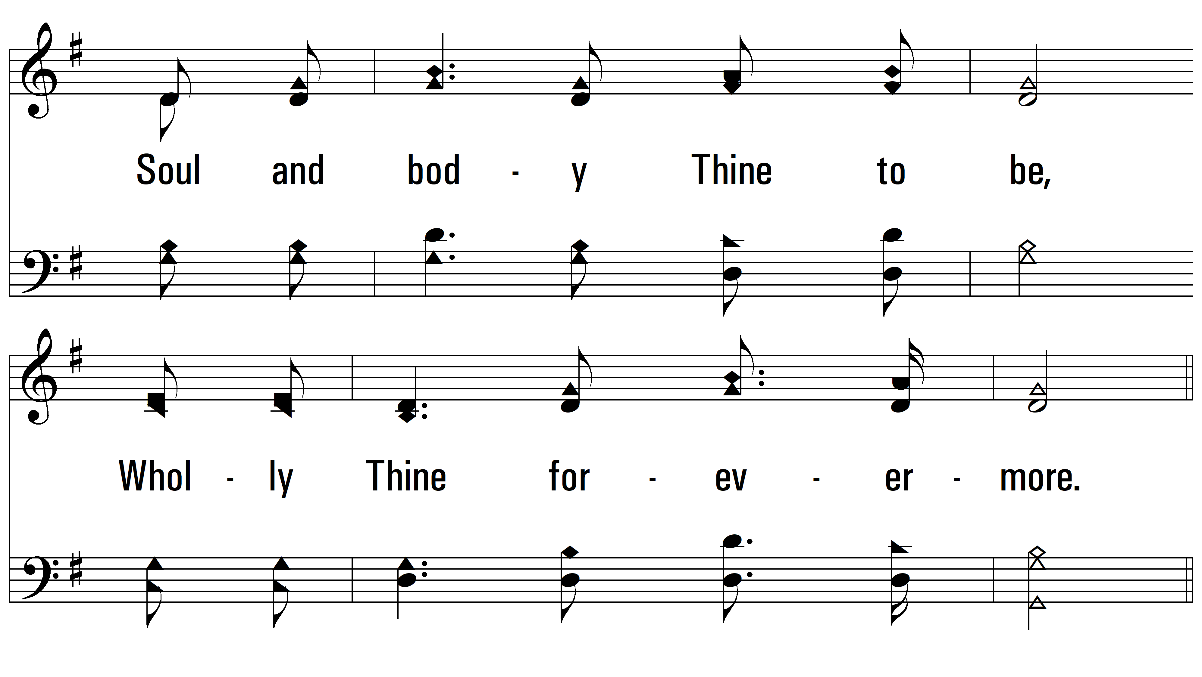
vs. 2

Slide 8
vs. 2

Slide 9
vs. 2

Slide 10
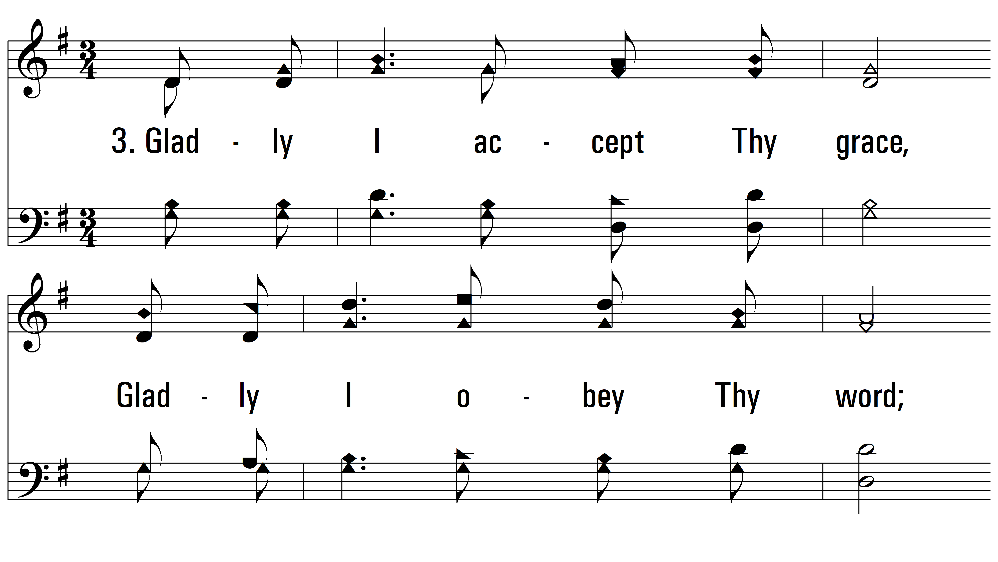
vs. 3 ~ I Am Coming To The Cross

Slide 11
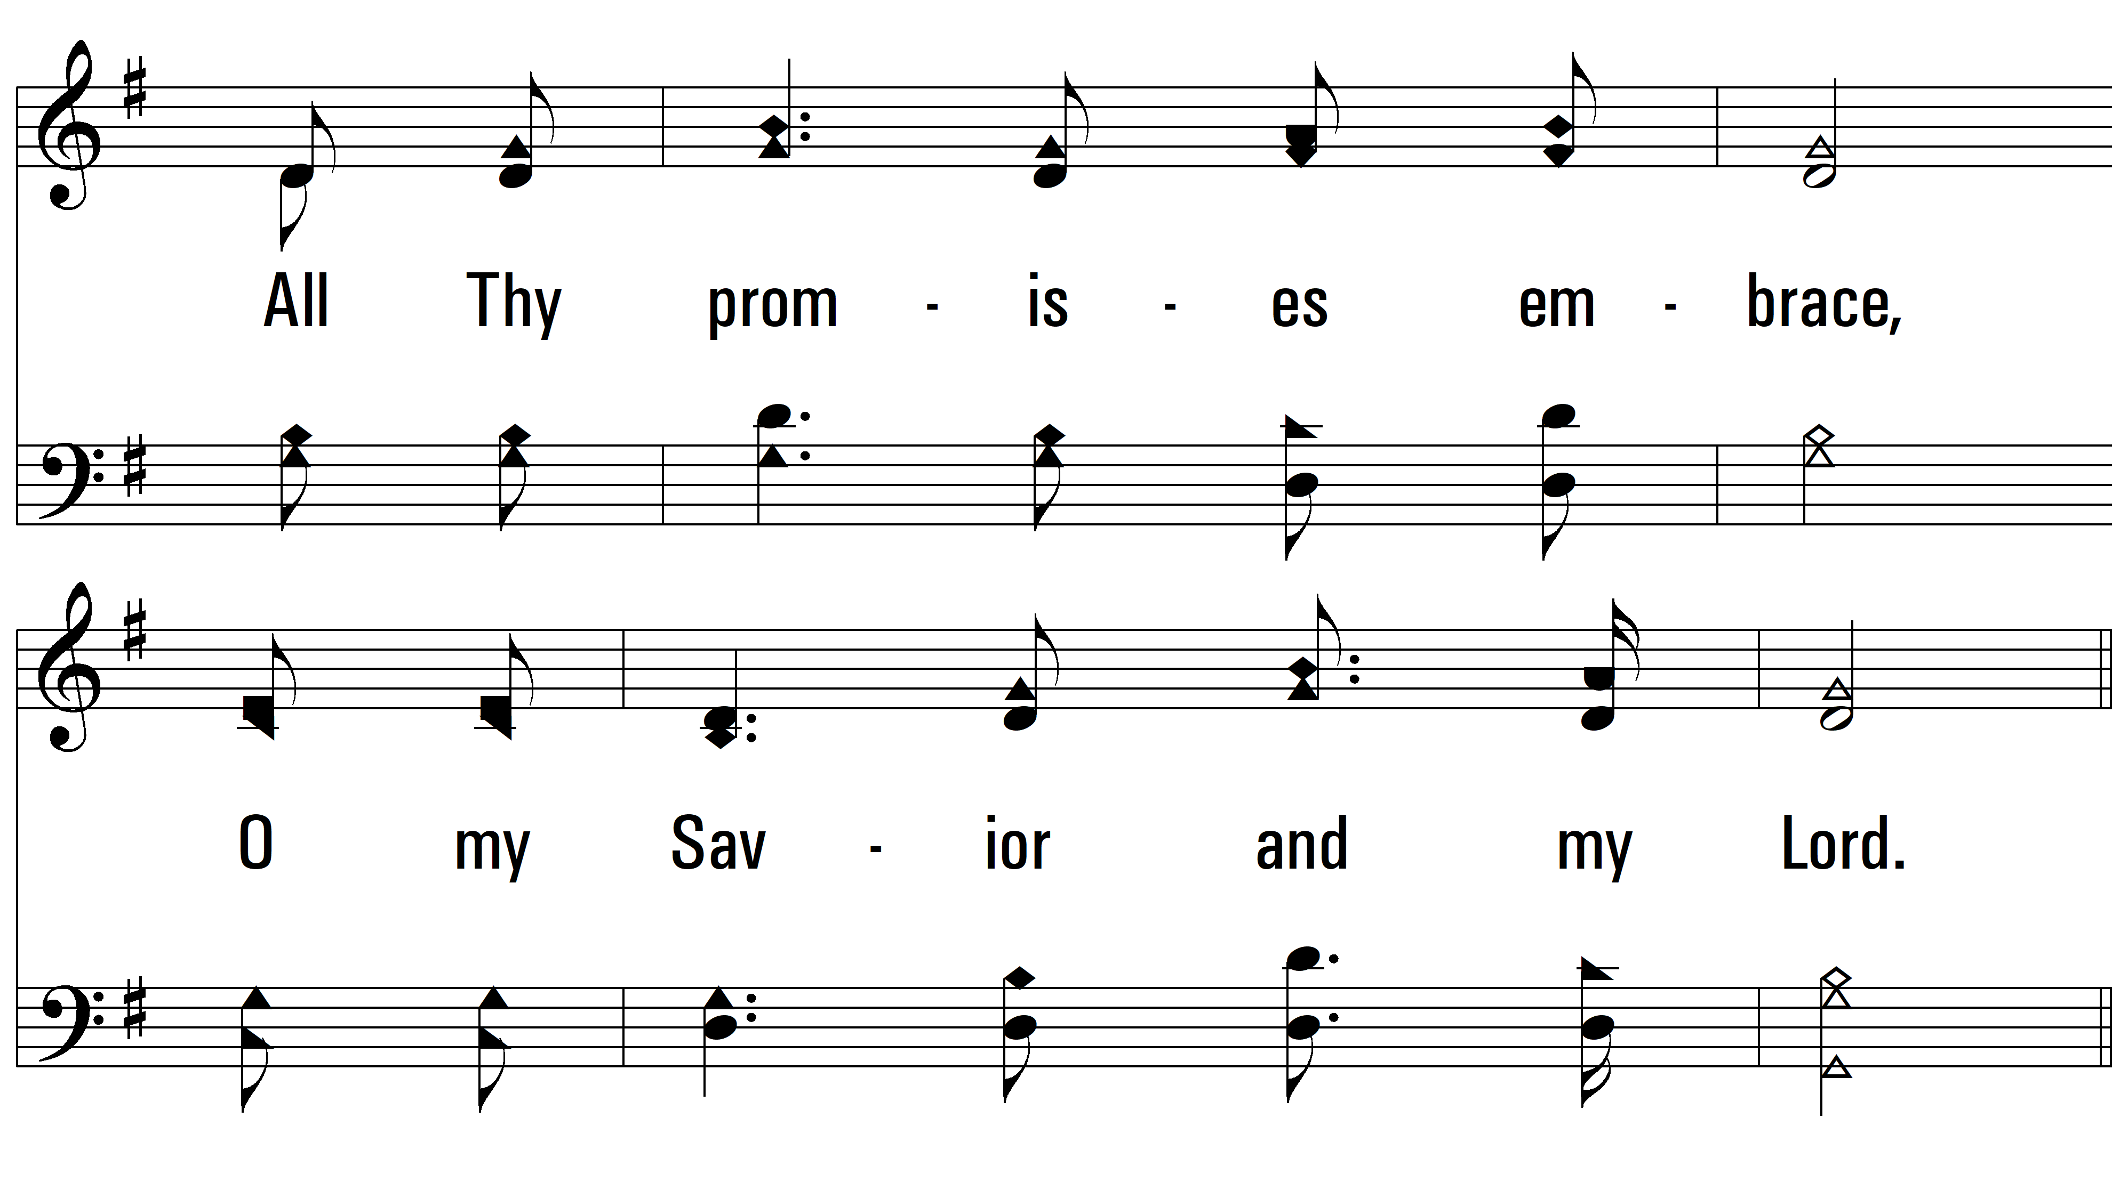
vs. 3

Slide 12
vs. 3

Slide 13
vs. 3
PDHymns.com
END

