Slide 1
I Am A Stranger Here
(The King’s Business)
Words: | Dr. E. T. Cassel (1902)
Music: | Dr. E. T. Cassel (1902)
4/4
E/B - SOL
Verses: 3/Chorus
Lead - | SOL
Alto - | SOL
Tenor - | MI
Bass - | DO
PDHymns.com

Slide 2
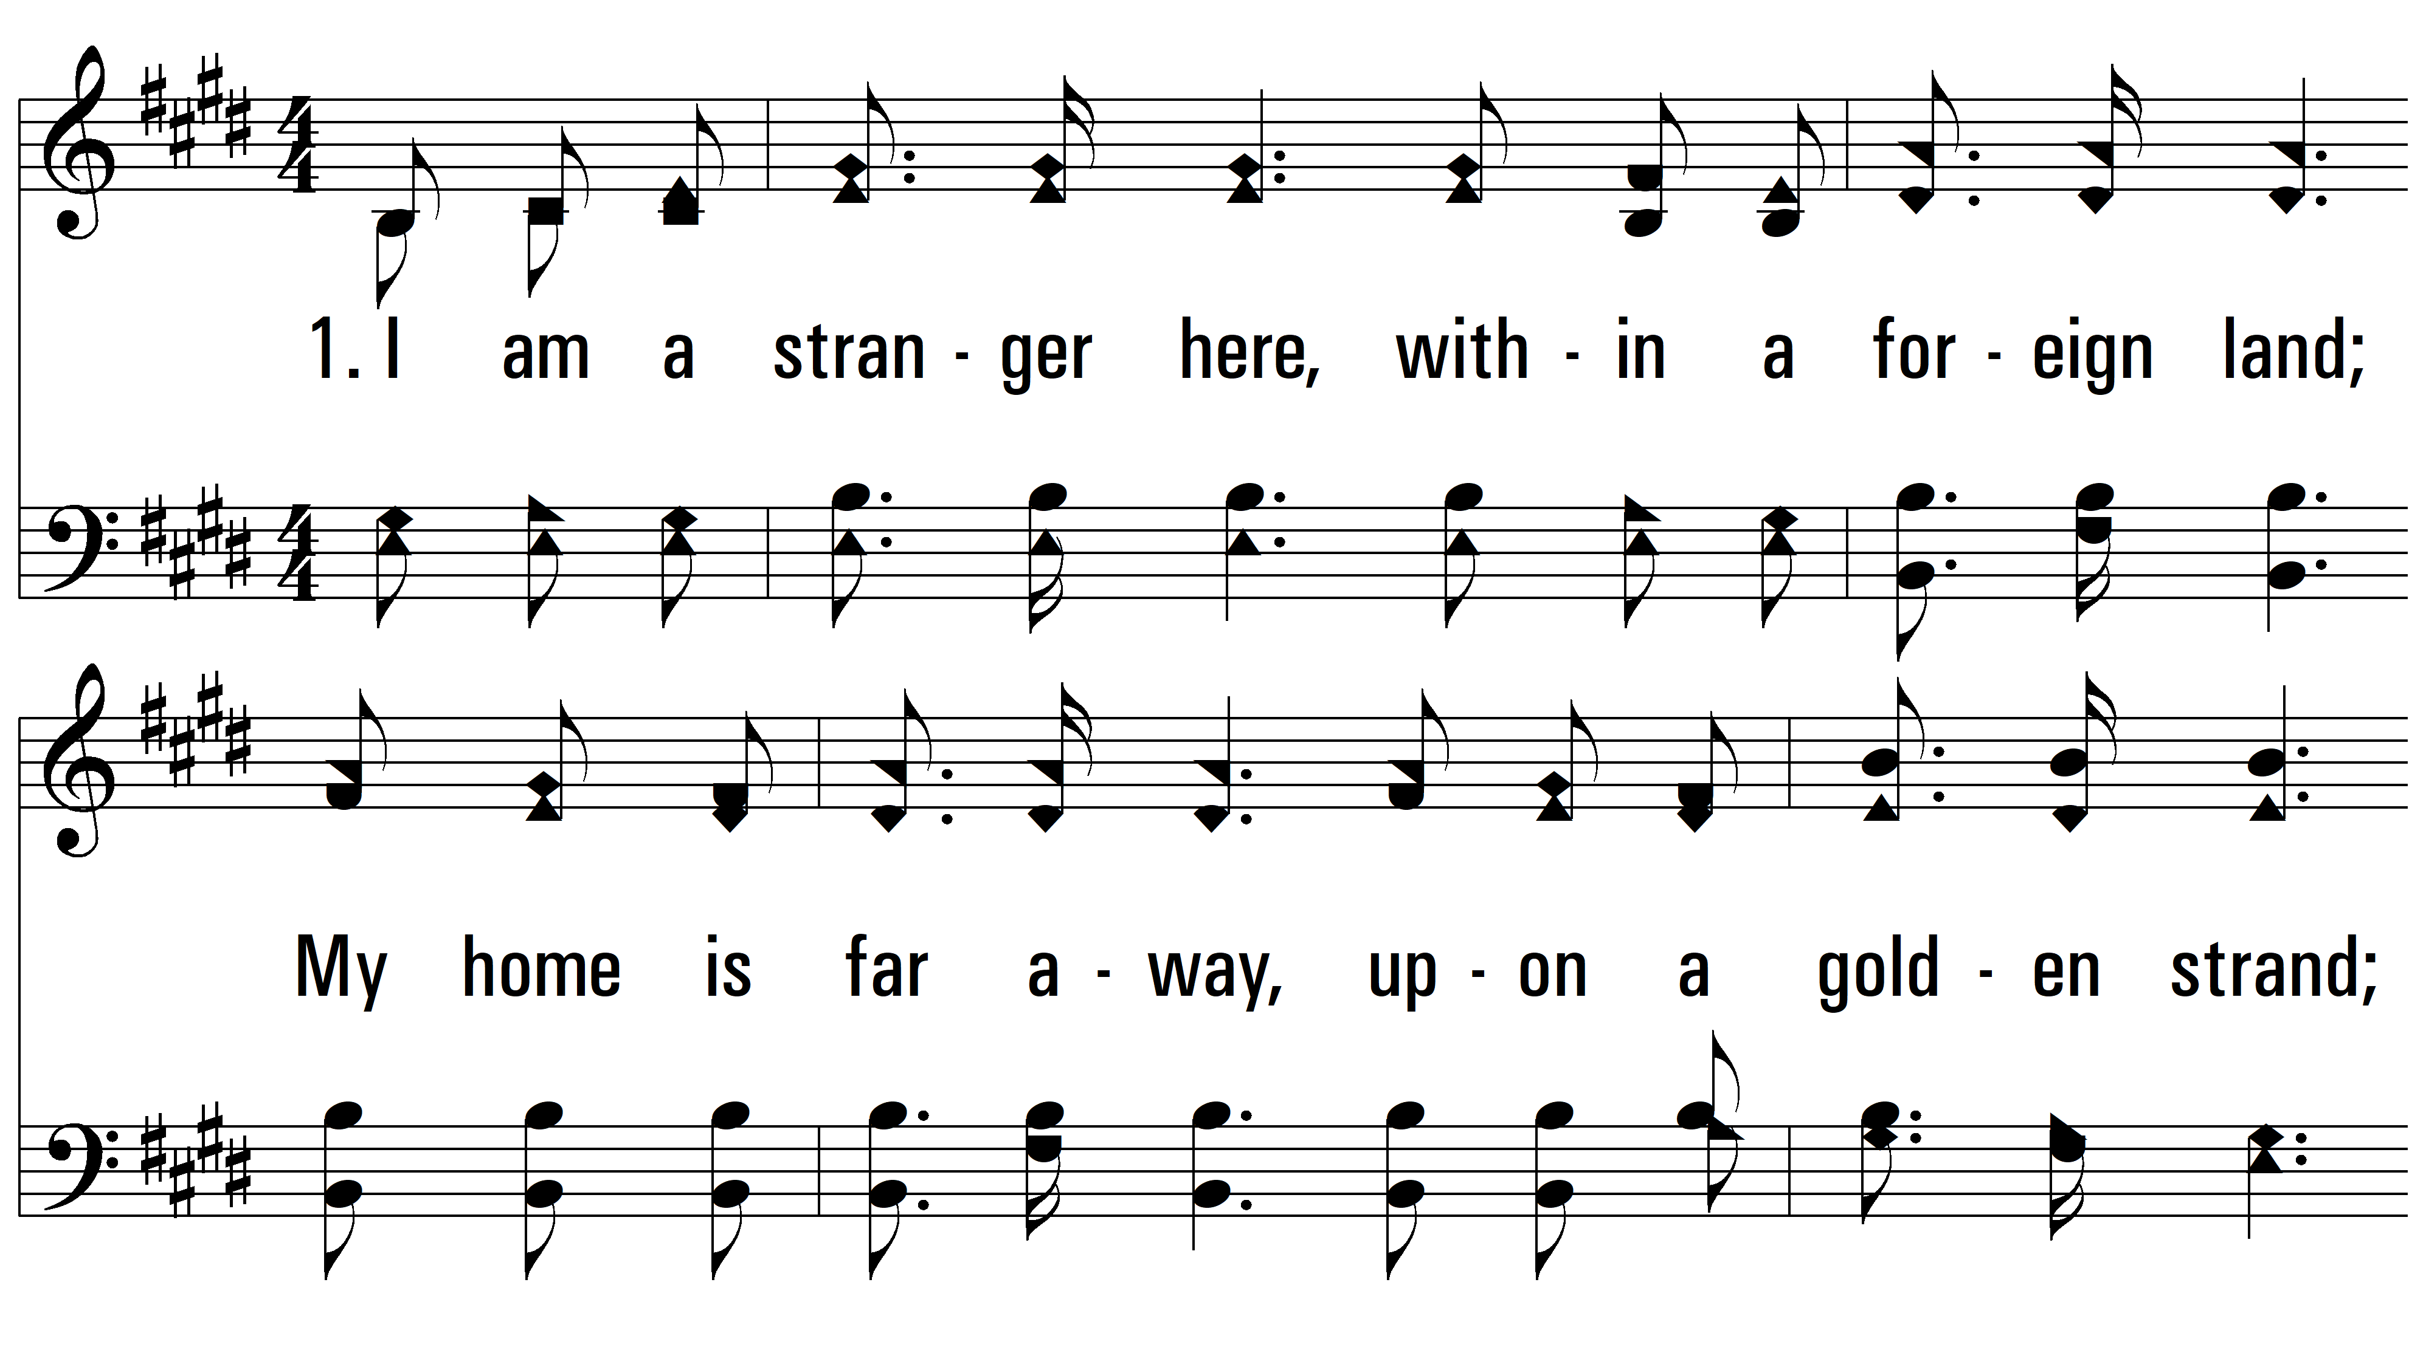
vs. 1 ~ I Am A Stranger Here

Slide 3
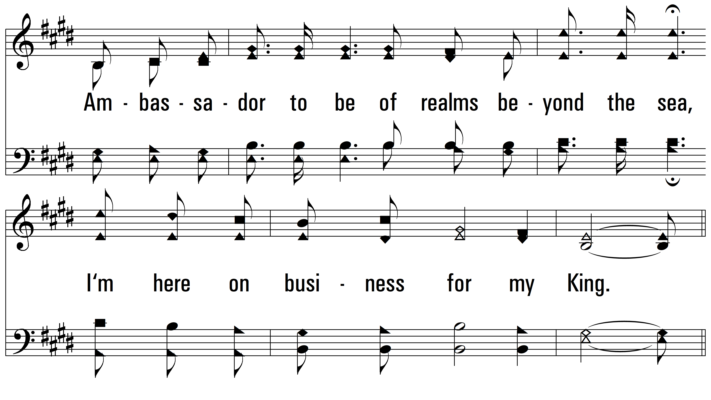
vs. 1

Slide 4
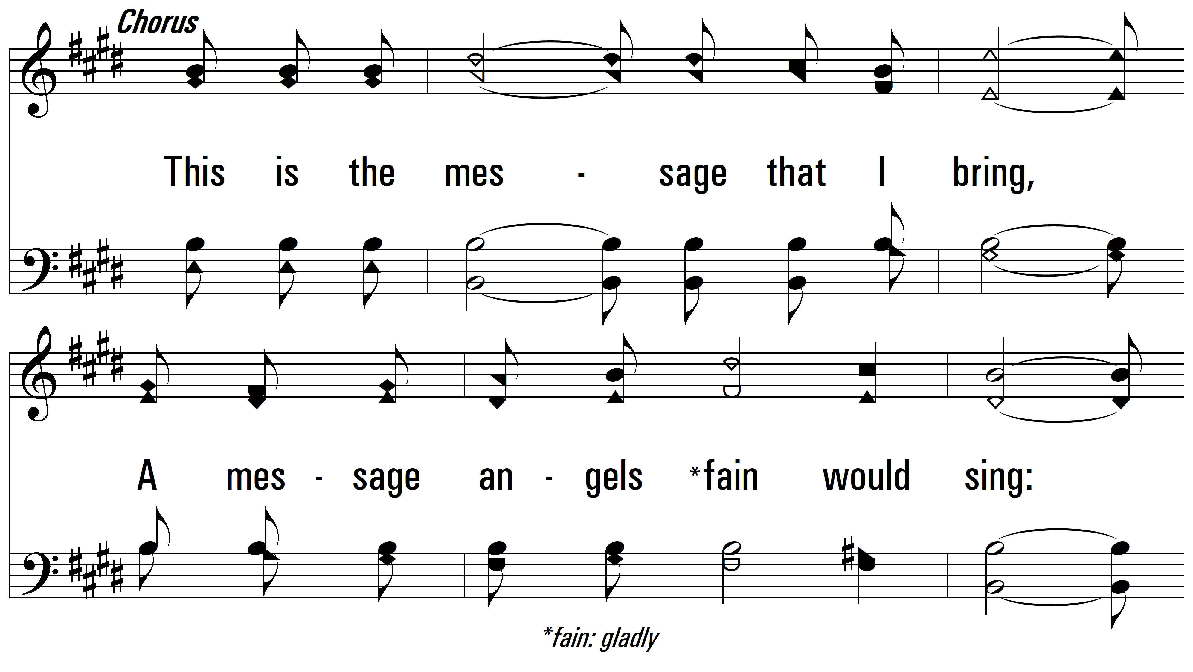
vs. 1

Slide 5
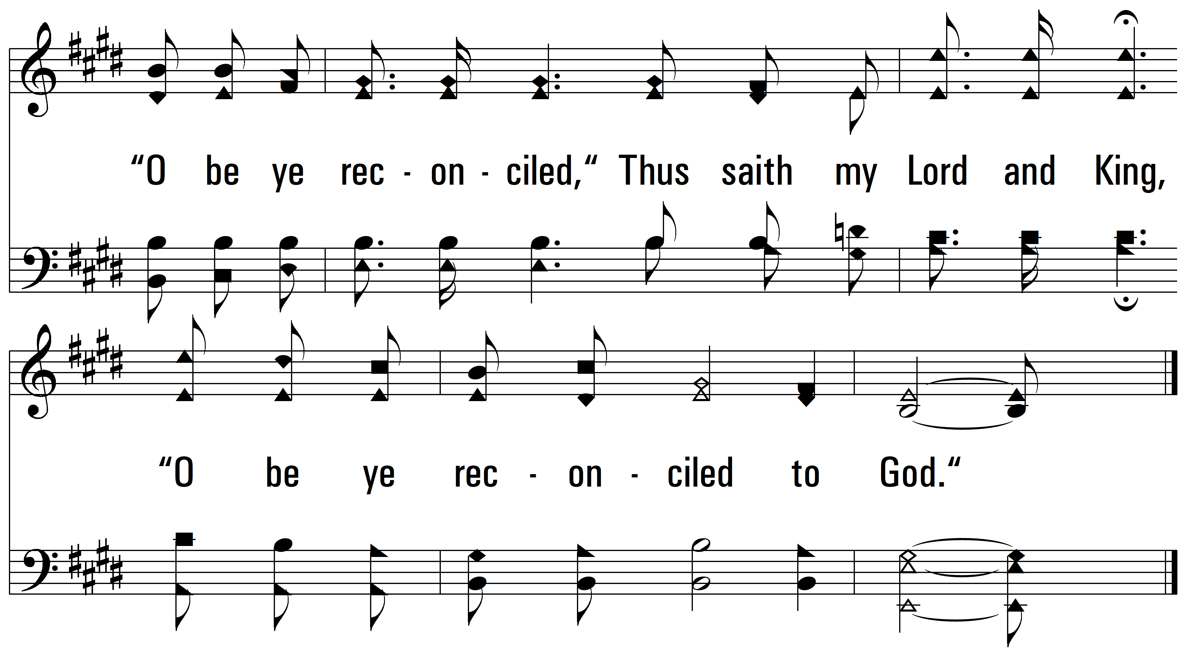
vs. 1

Slide 6
vs. 2 ~ I Am A Stranger Here

Slide 7
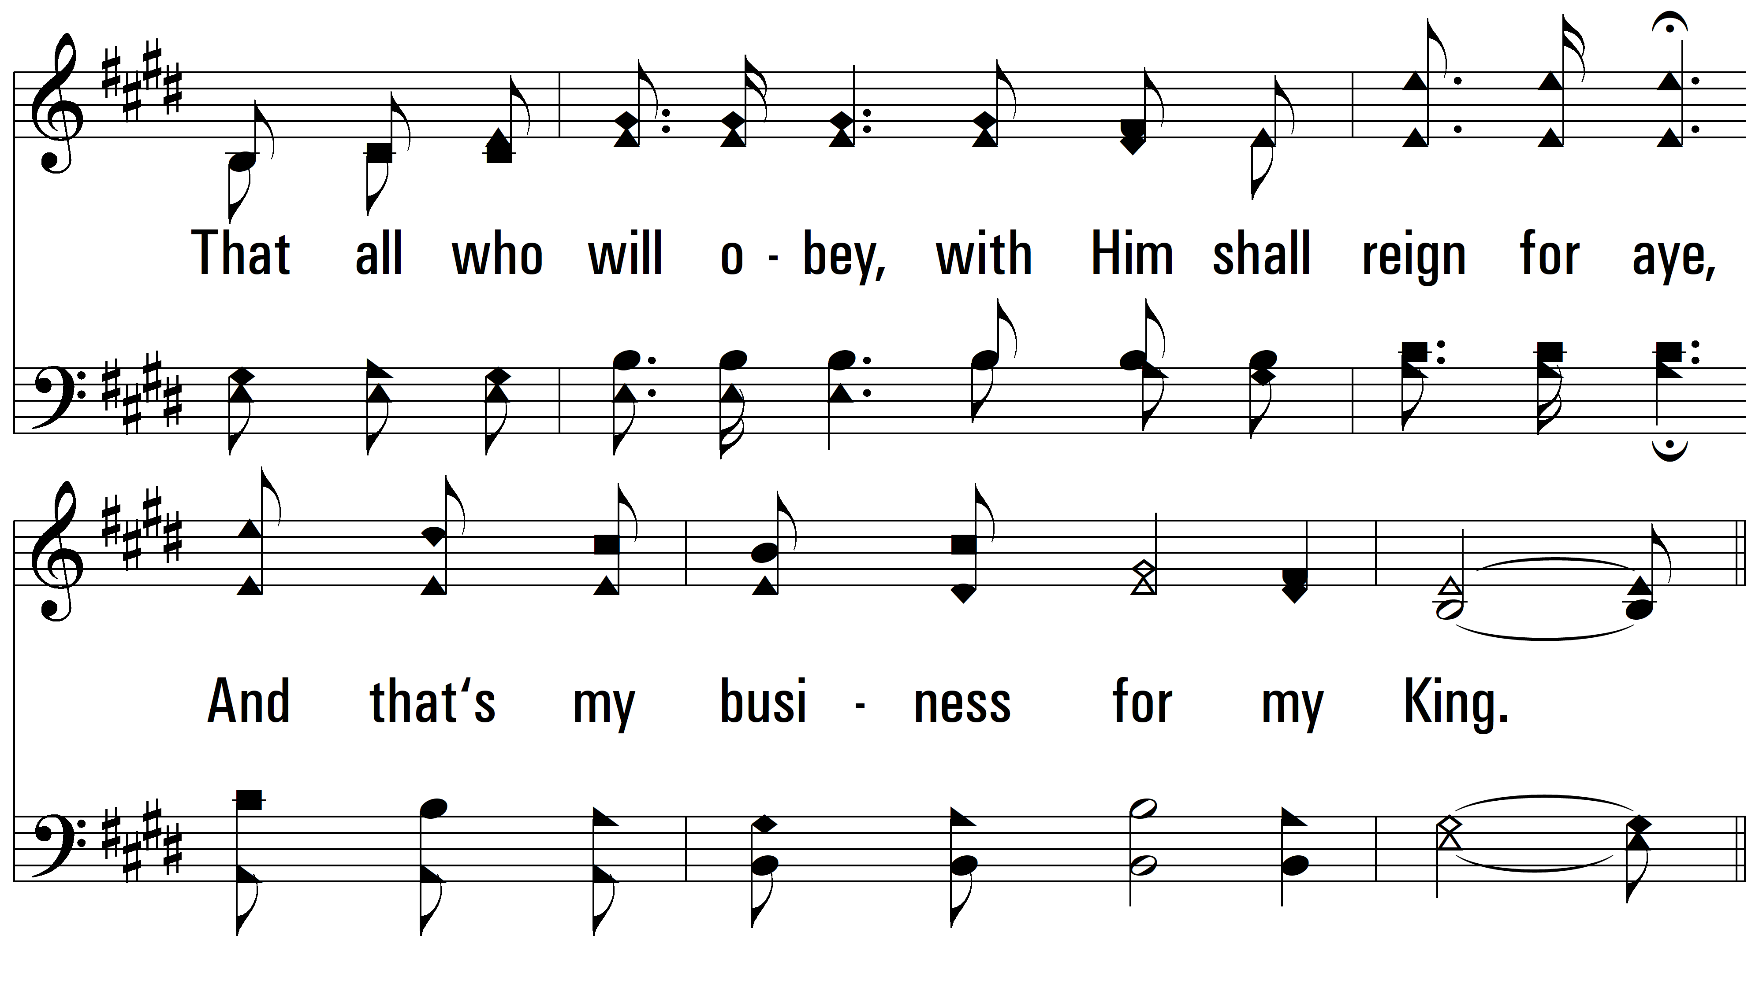
vs. 2

Slide 8
vs. 2

Slide 9
vs. 2

Slide 10
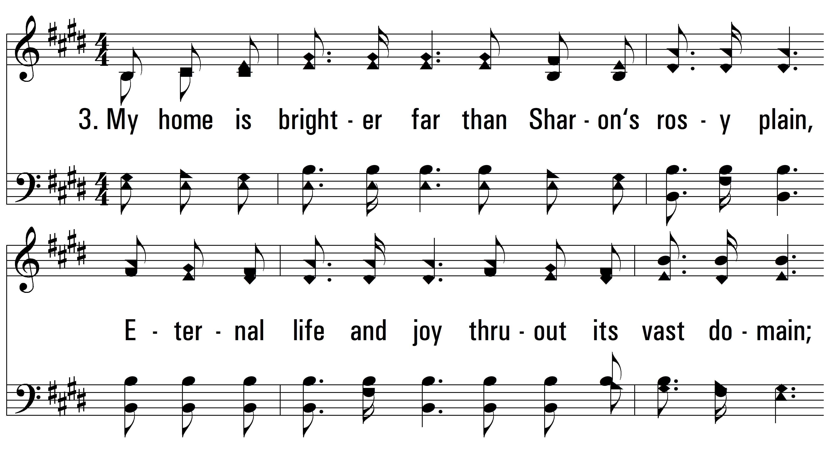
vs. 3 ~ I Am A Stranger Here

Slide 11
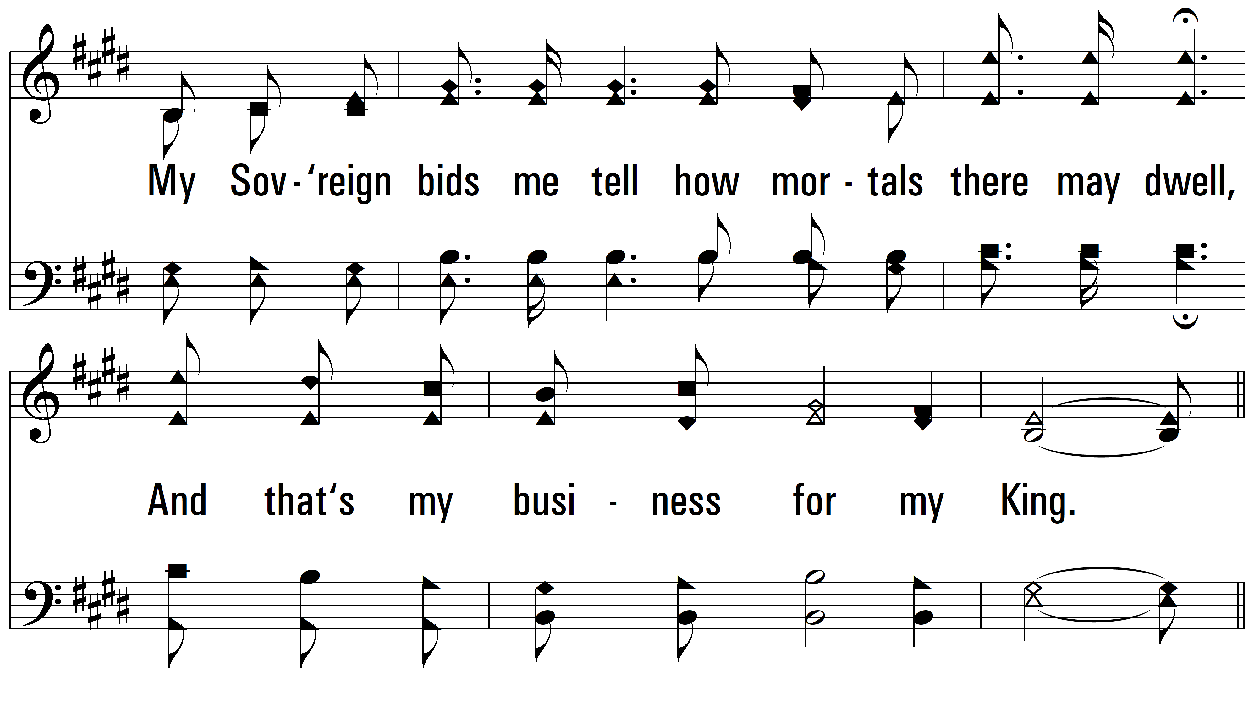
vs. 3

Slide 12
vs. 3

Slide 13
vs. 3
PDHymns.com
END

