Slide 1
How Firm A Foundation
FOUNDATION
11.11.11.11
Words: | George Keith (1787)
Music: | from Funks Genuine Church Music (1832)
2/2
A/E - SOL
Verses: 6
Lead - | SOL
Alto - | SOL
Tenor - | SOL
Bass - | SOL
PDHymns.com

Slide 2
vs. 1 ~ How Firm A Foundation

Slide 3
vs. 1

Slide 4
vs. 2 ~ How Firm A Foundation

Slide 5
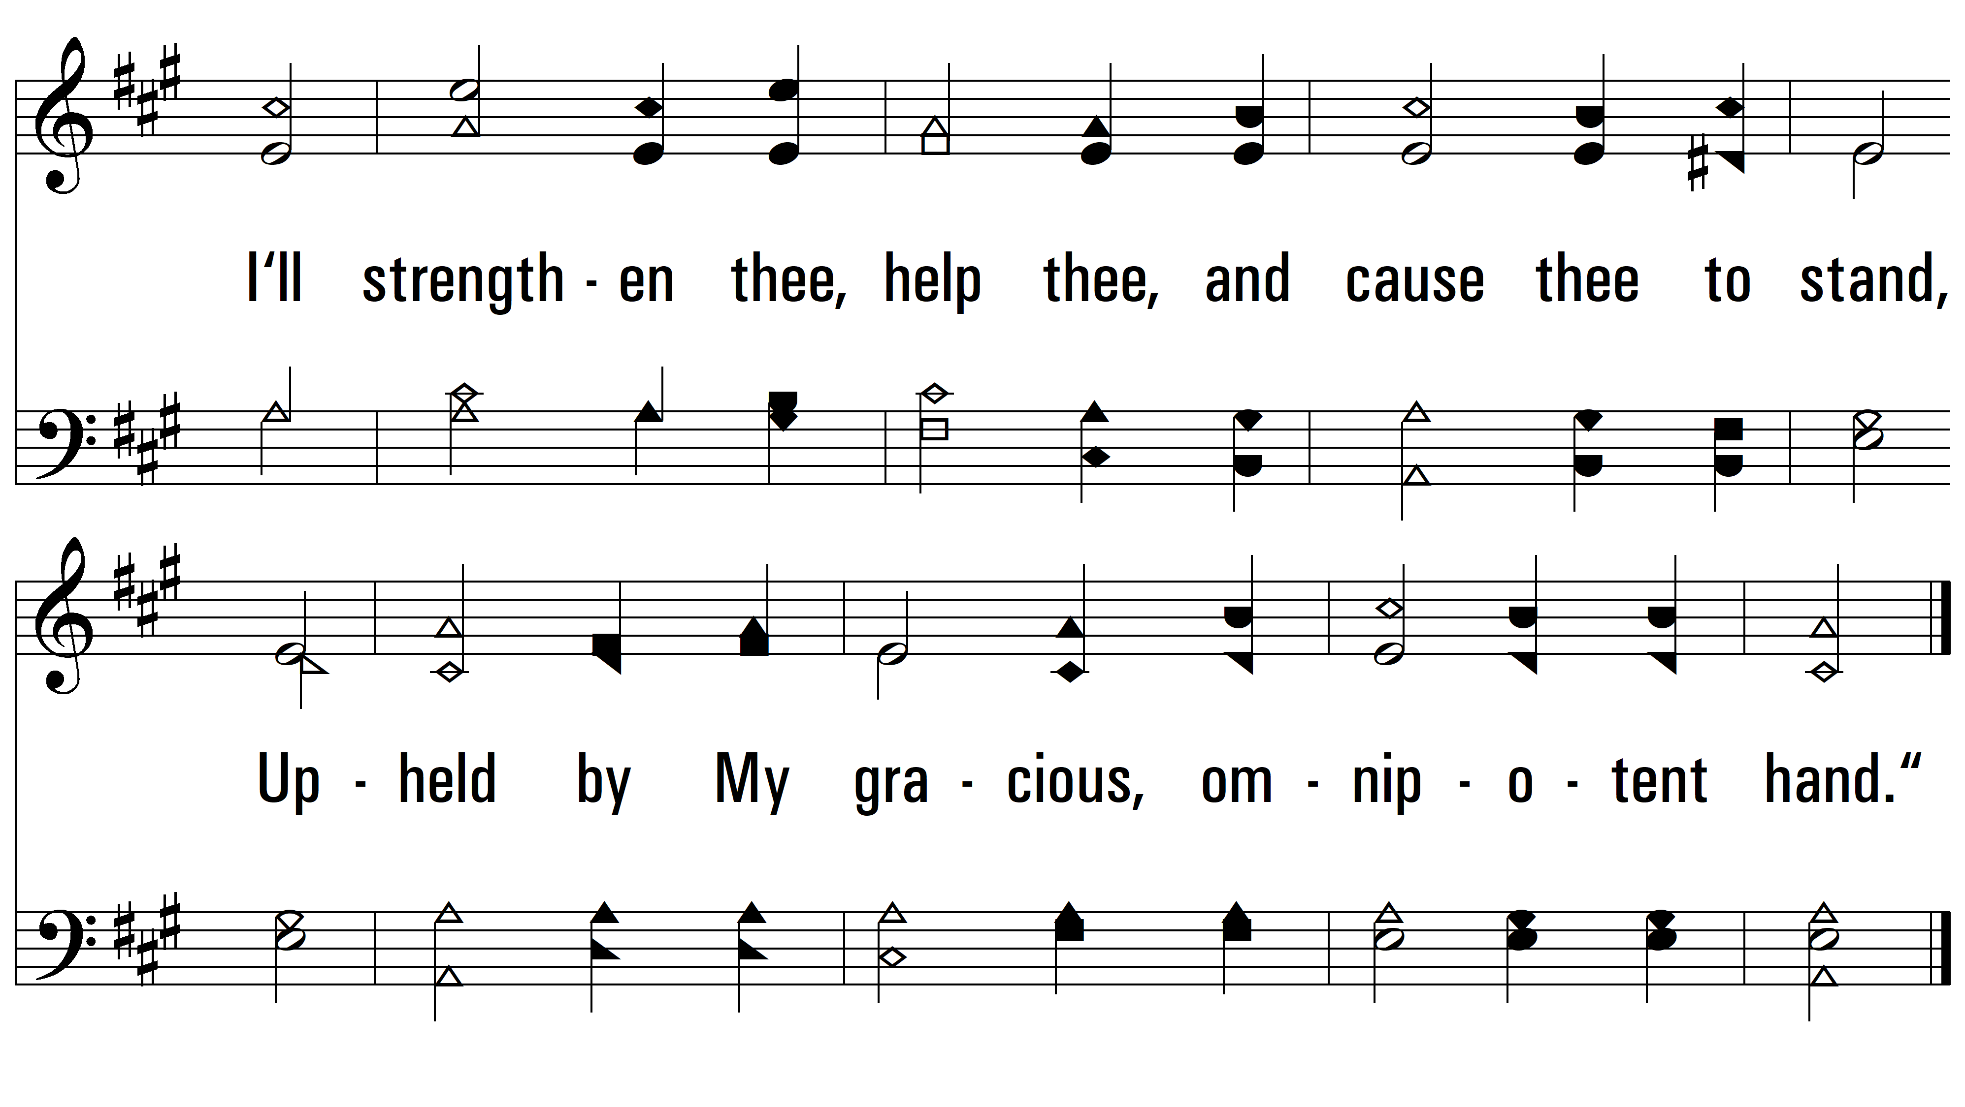
vs. 2

Slide 6
vs. 3 ~ How Firm A Foundation

Slide 7
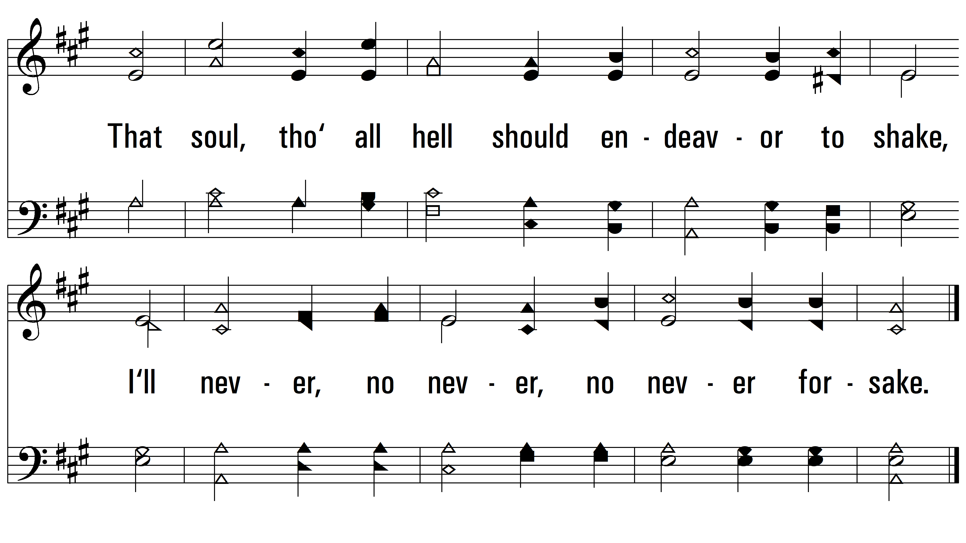
vs. 3
PDHymns.com
END

