Slide 1
Home of the Soul
Words: | Mrs. Ellen N. Gates (1865)
Music: | Philip Phillips (1853)
3/4
E^{b}/E^{b} - DO
Verses: 3
Lead - | DO
Alto - | DO
Tenor - | MI
Bass - | DO
PDHymns.com

Slide 2
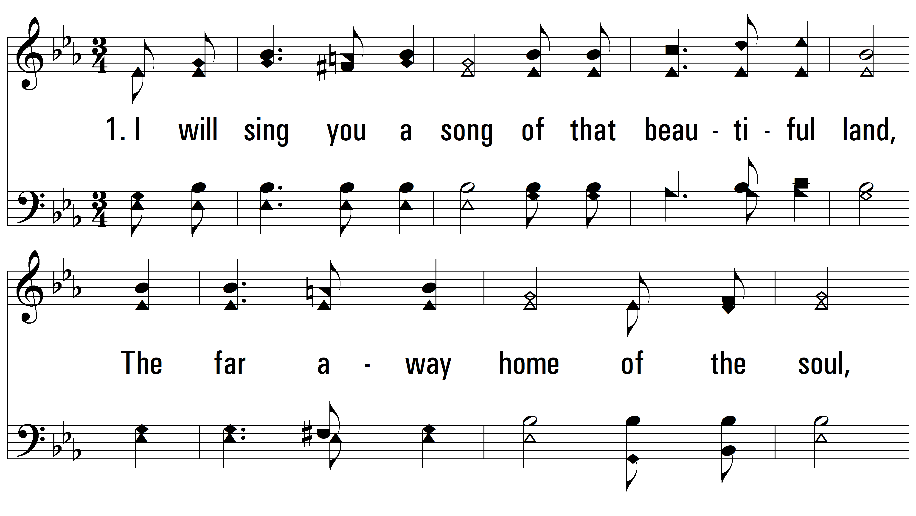
vs. 1 ~ Home of the Soul

Slide 3
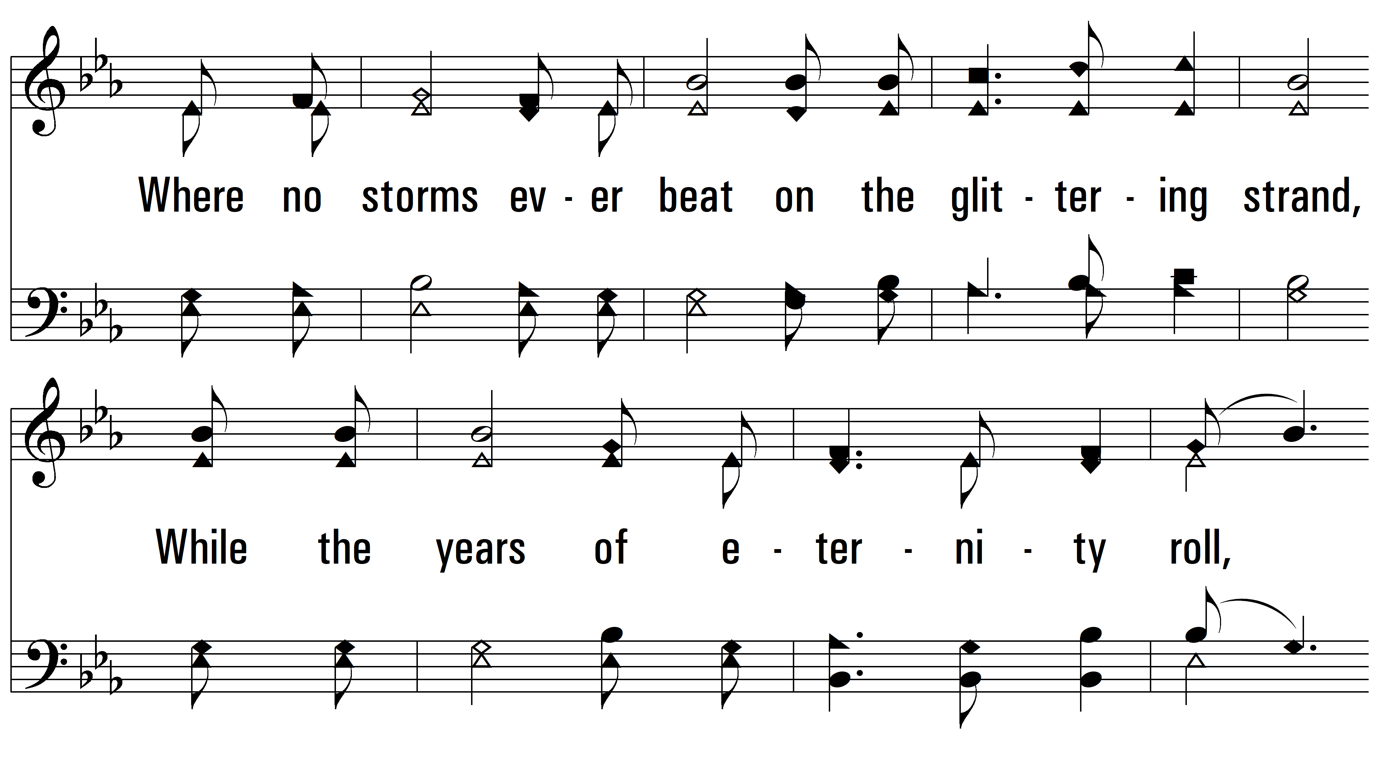
vs. 1

Slide 4
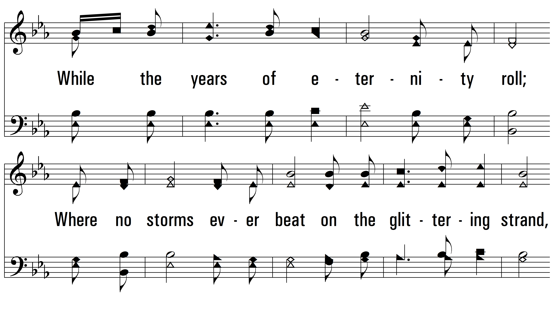
vs. 1

Slide 5
vs. 1

Slide 6
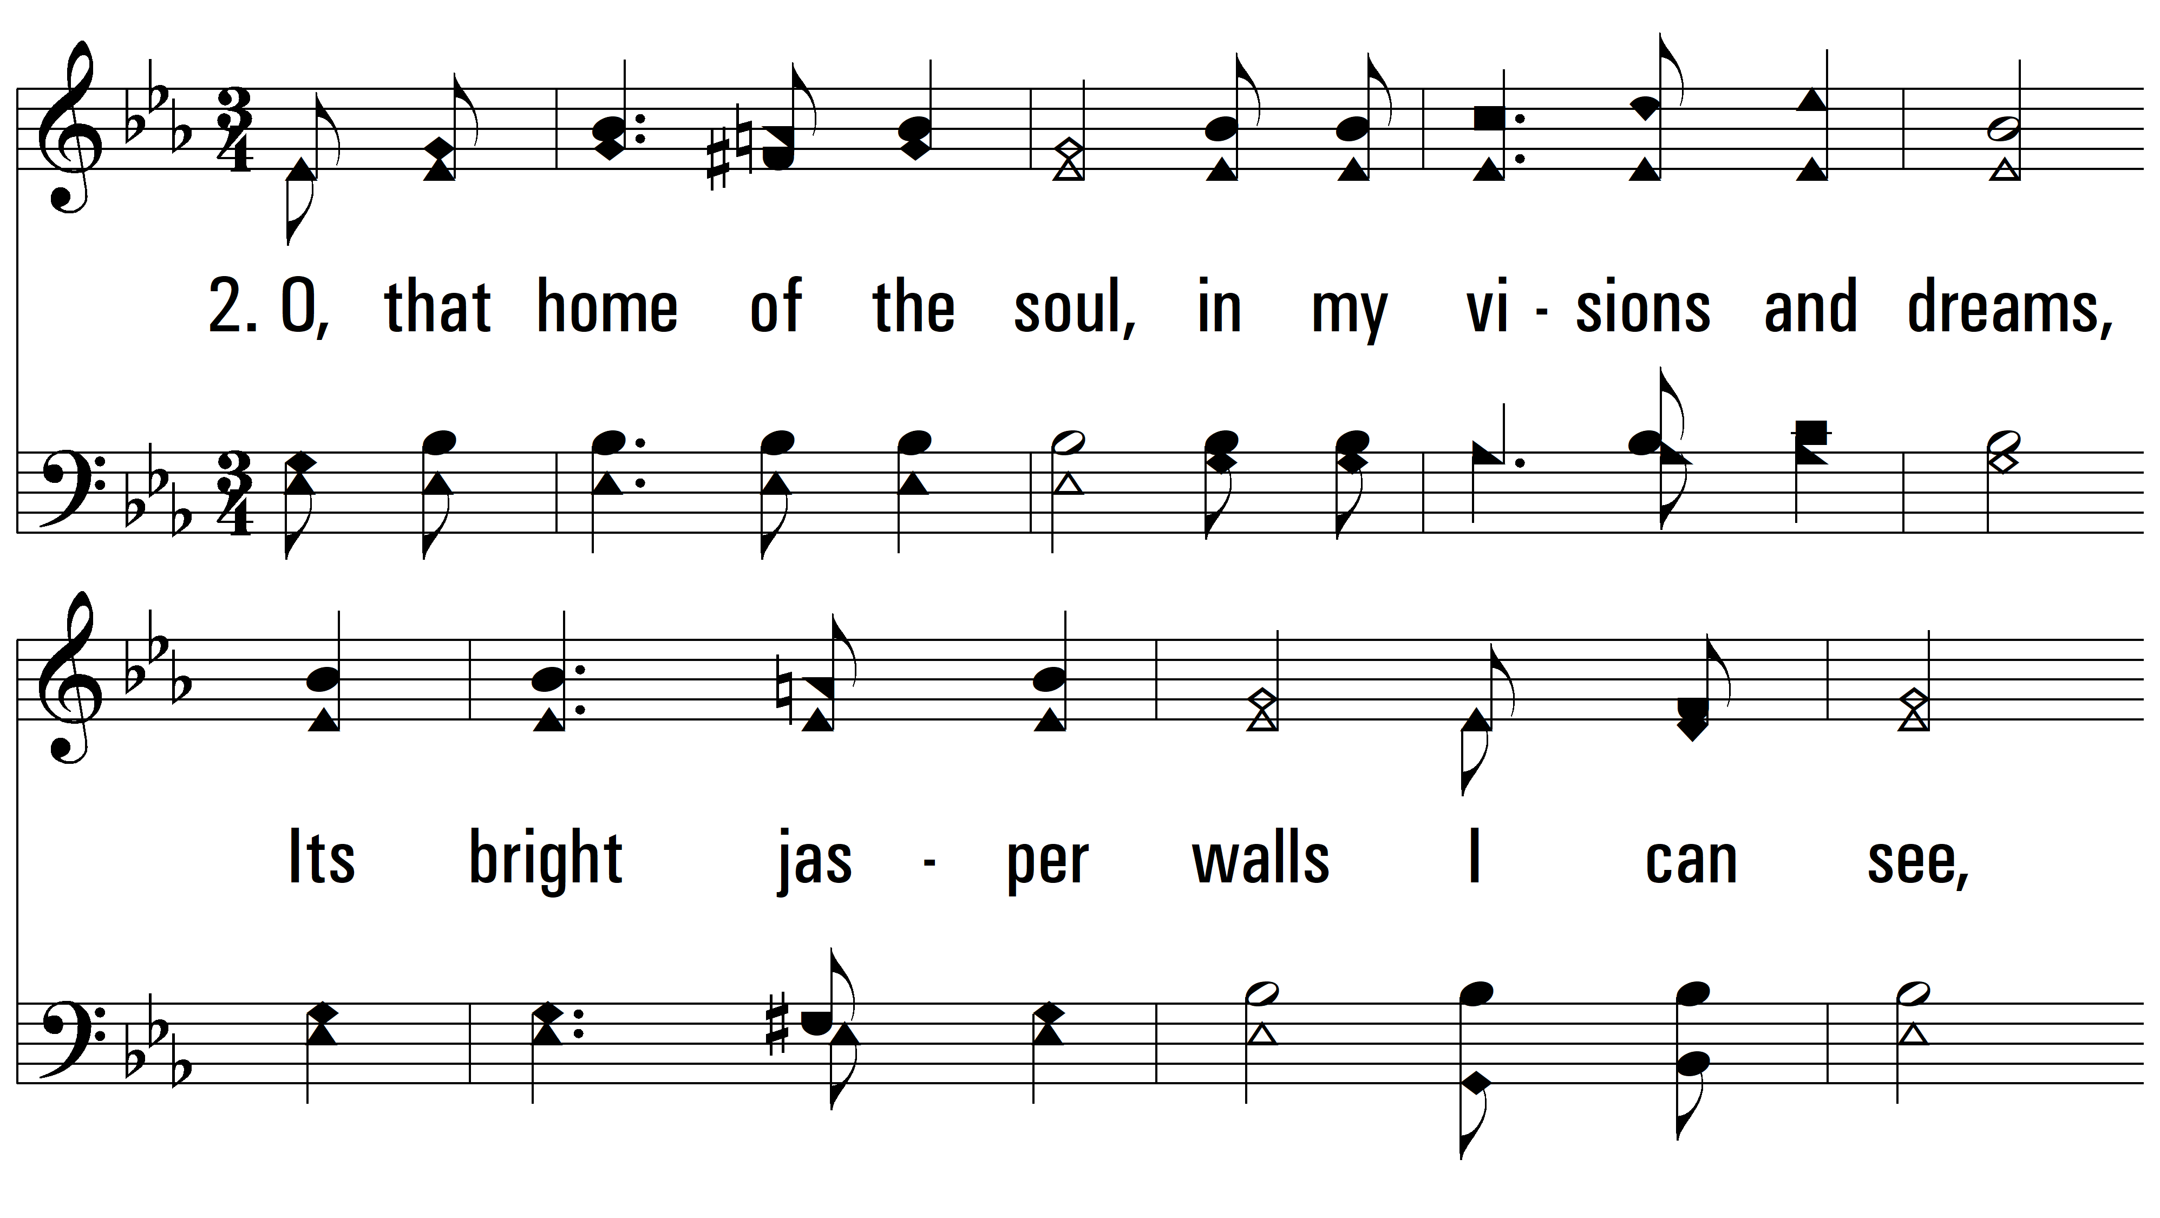
vs. 2 ~ Home of the Soul

Slide 7
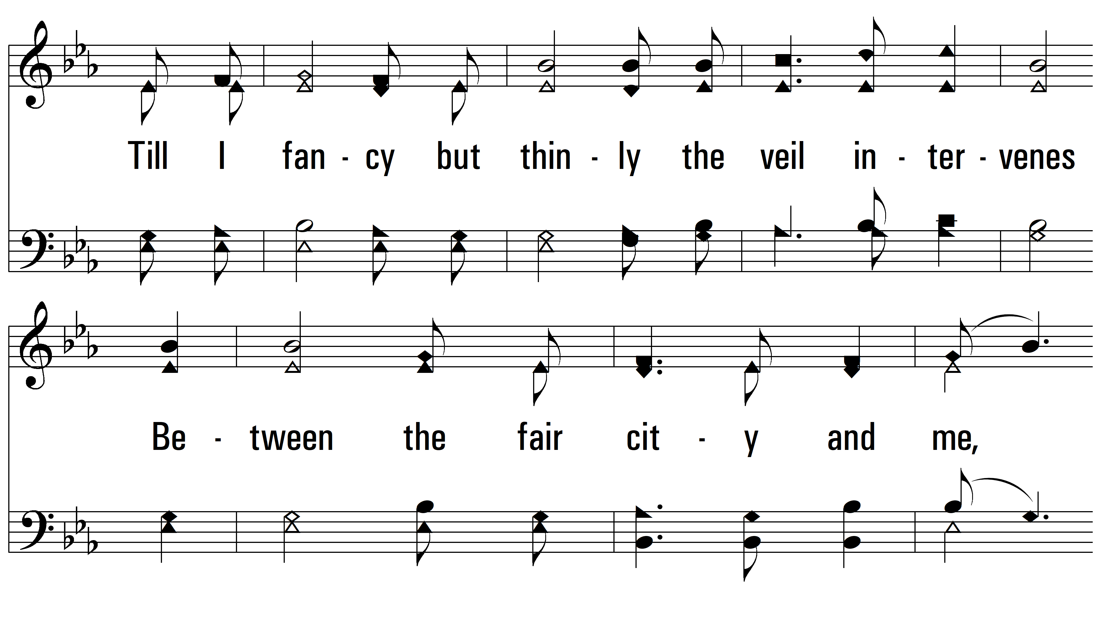
vs. 2

Slide 8
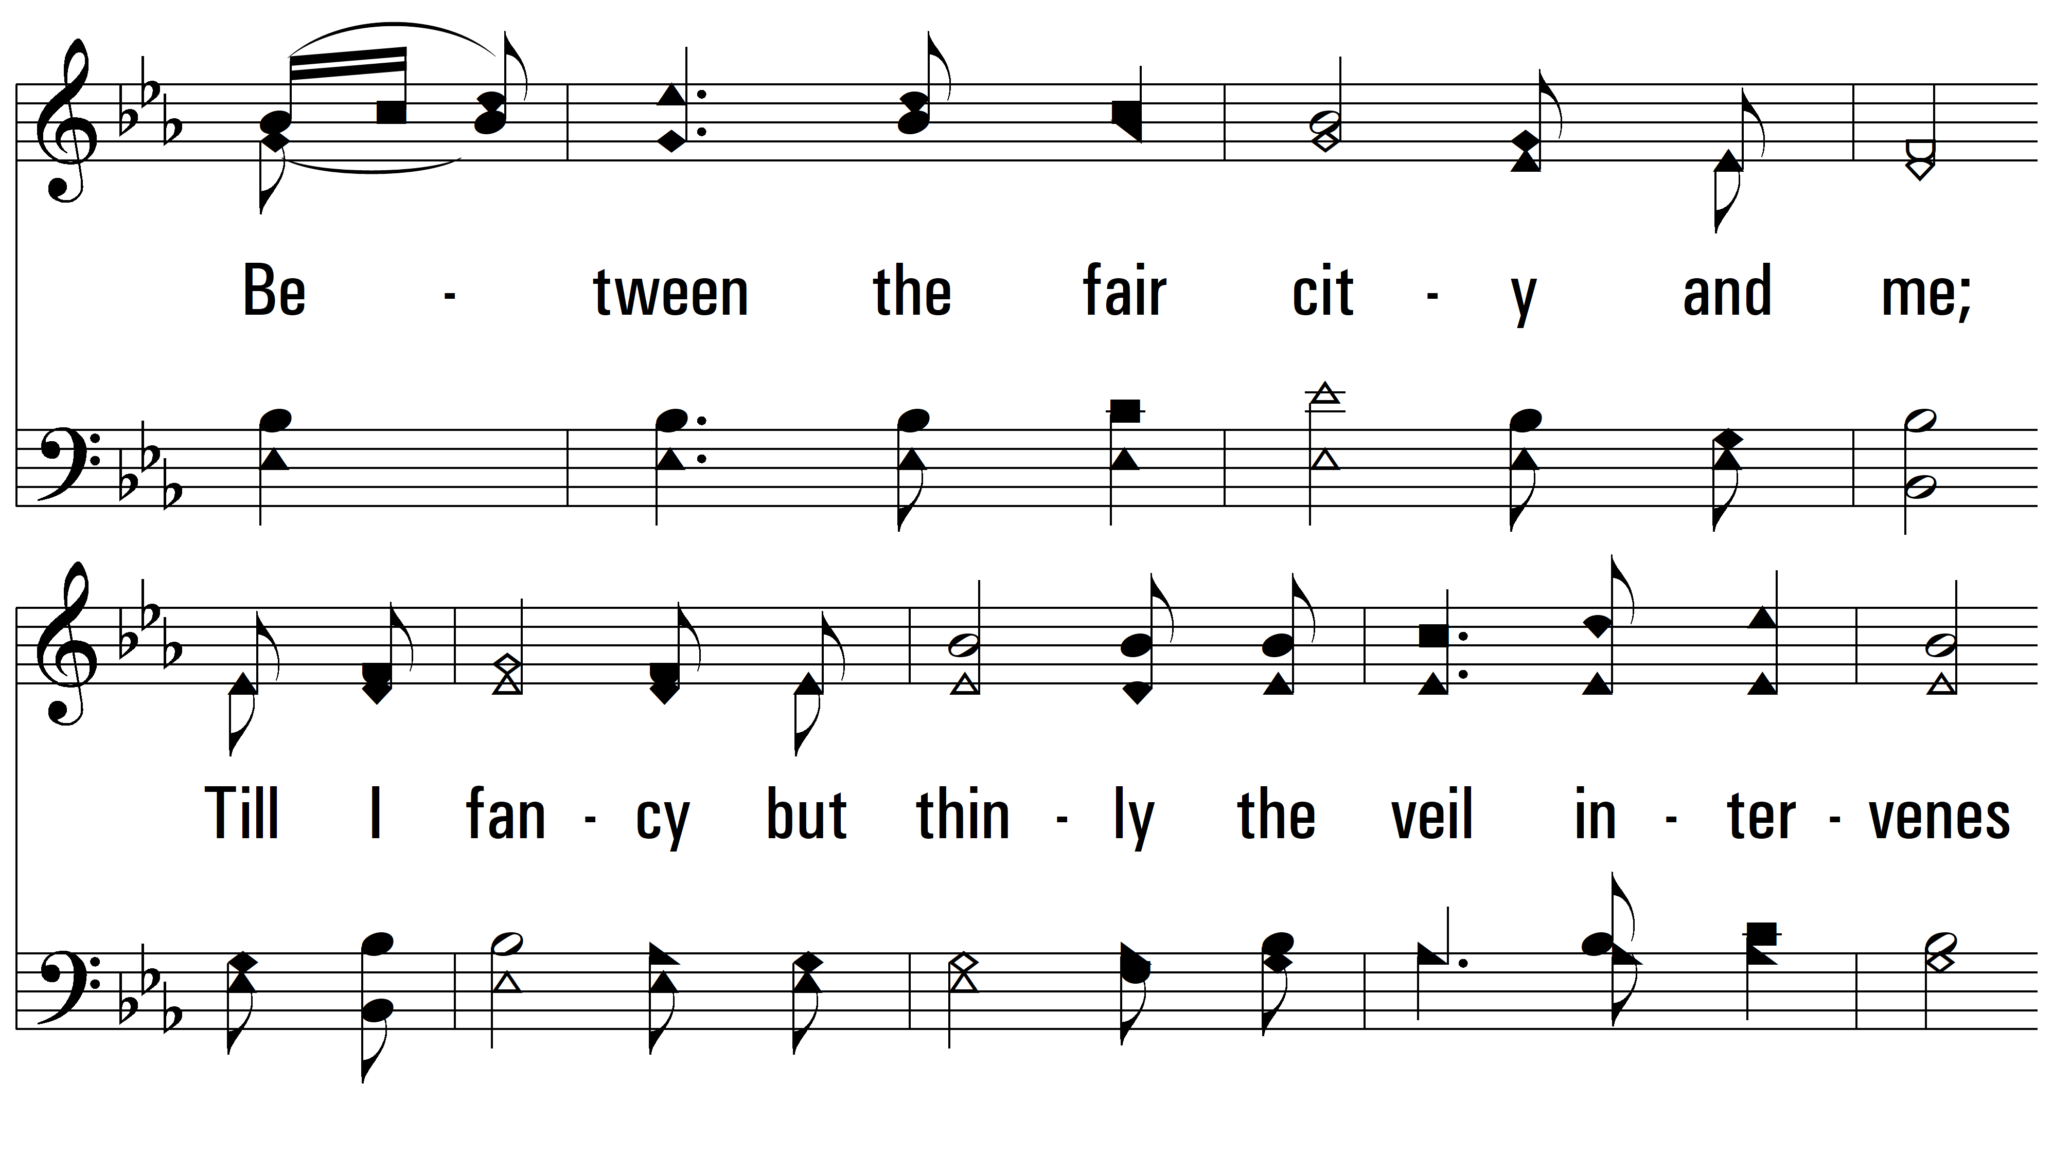
vs. 2

Slide 9
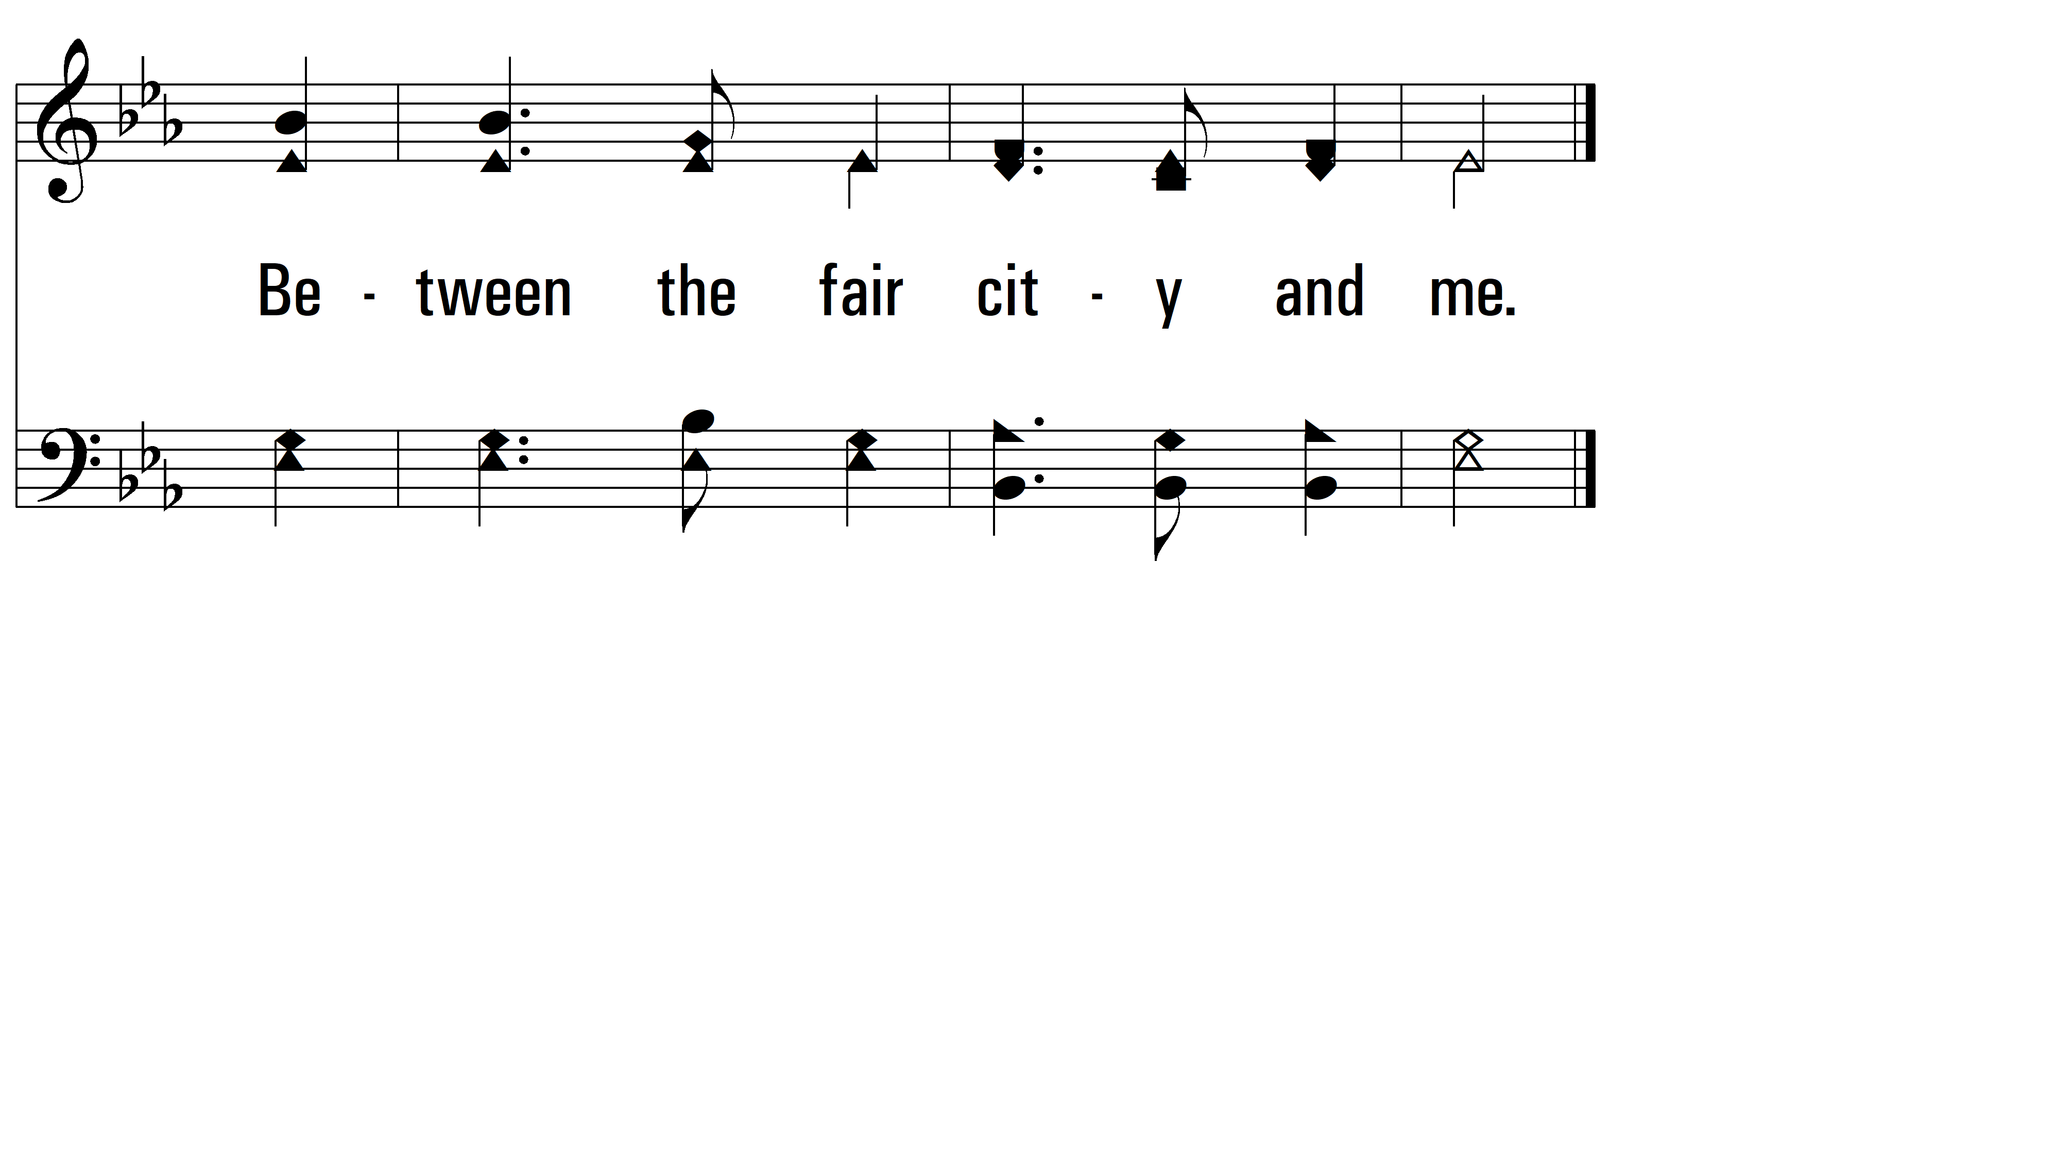
vs. 2

Slide 10
vs. 3 ~ Home of the Soul

Slide 11
vs. 3

Slide 12
vs. 3

Slide 13
vs. 3
PDHymns.com
END

