Slide 1
Holy, Holy, Holy
NICAEA
12.12.12.10
Words: | Reginald Heber (1826)
Music: | John B. Dykes (1861)
4/4
E^{b}/E^{b} - DO
Verses: 4
Lead - | DO
Alto - | SOL
Tenor - | MI
Bass - | DO
PDHymns.com

Slide 2
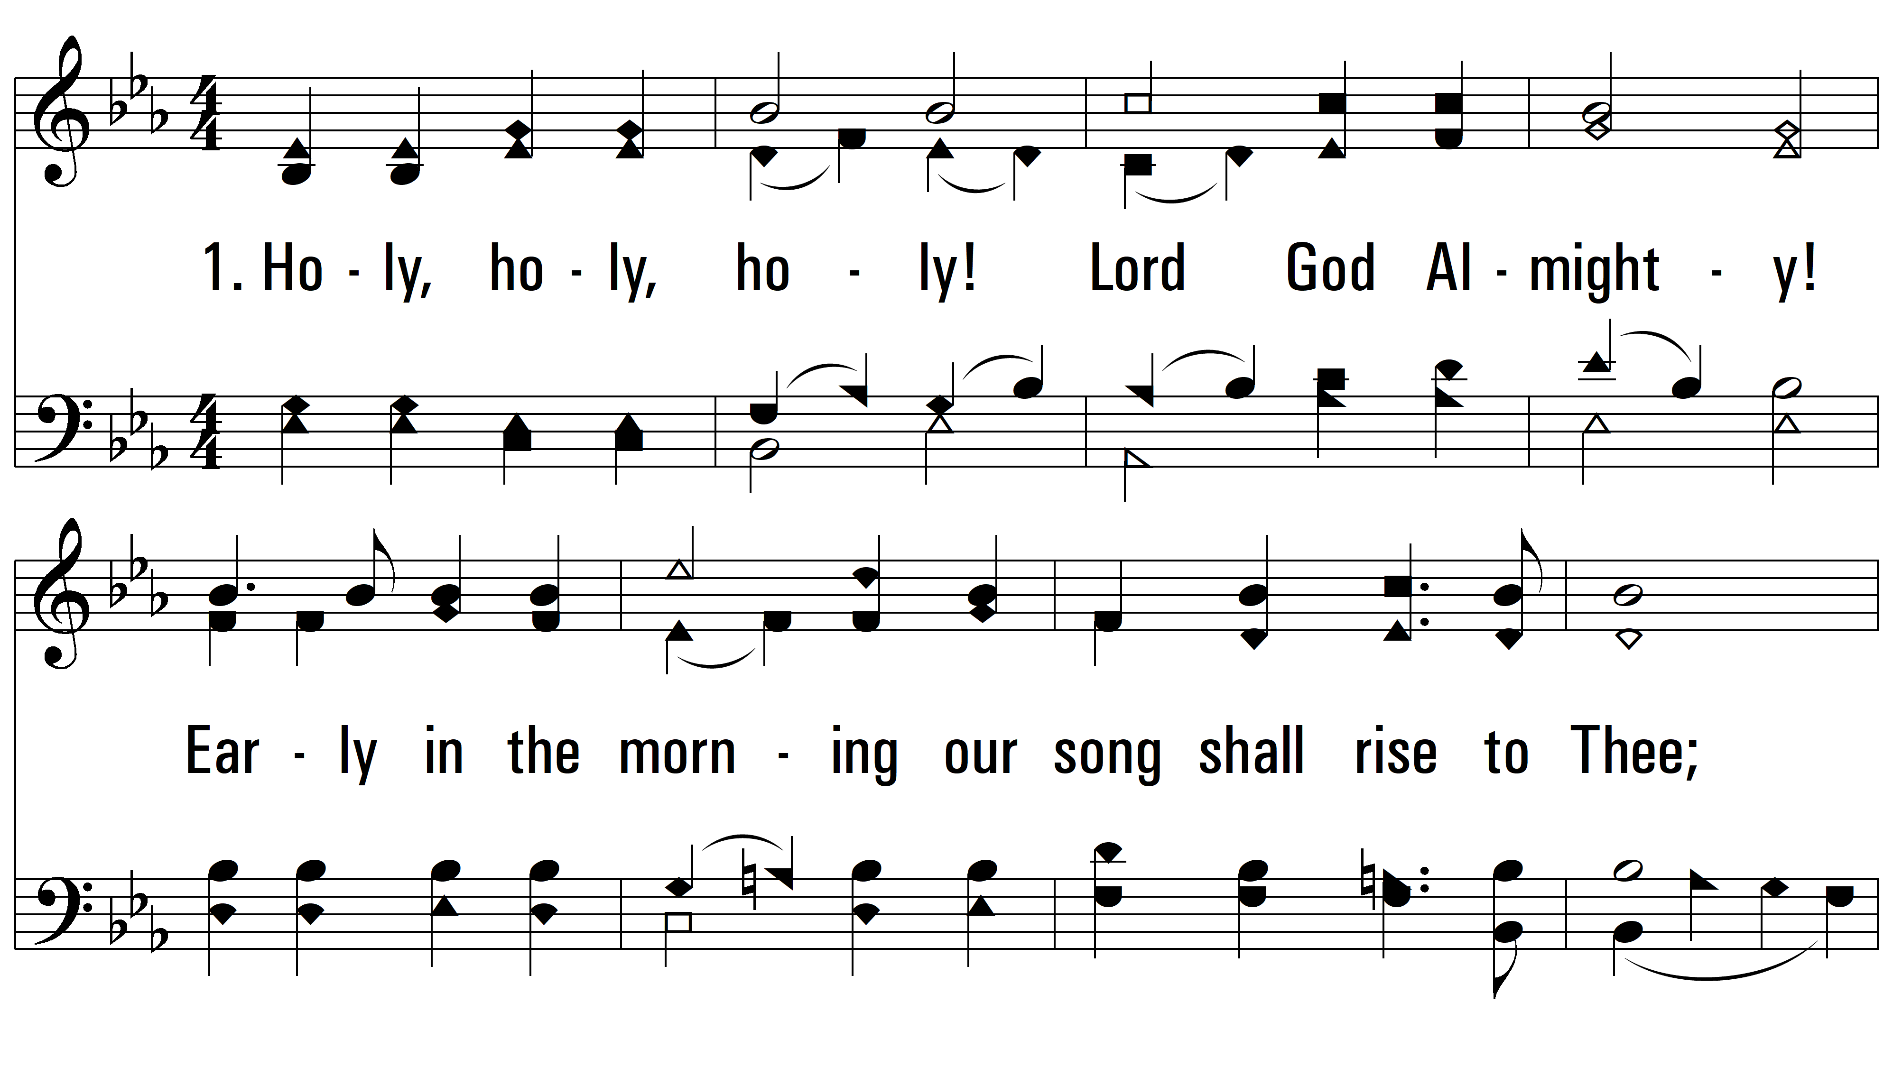
vs. 1 ~ Holy, Holy, Holy

Slide 3
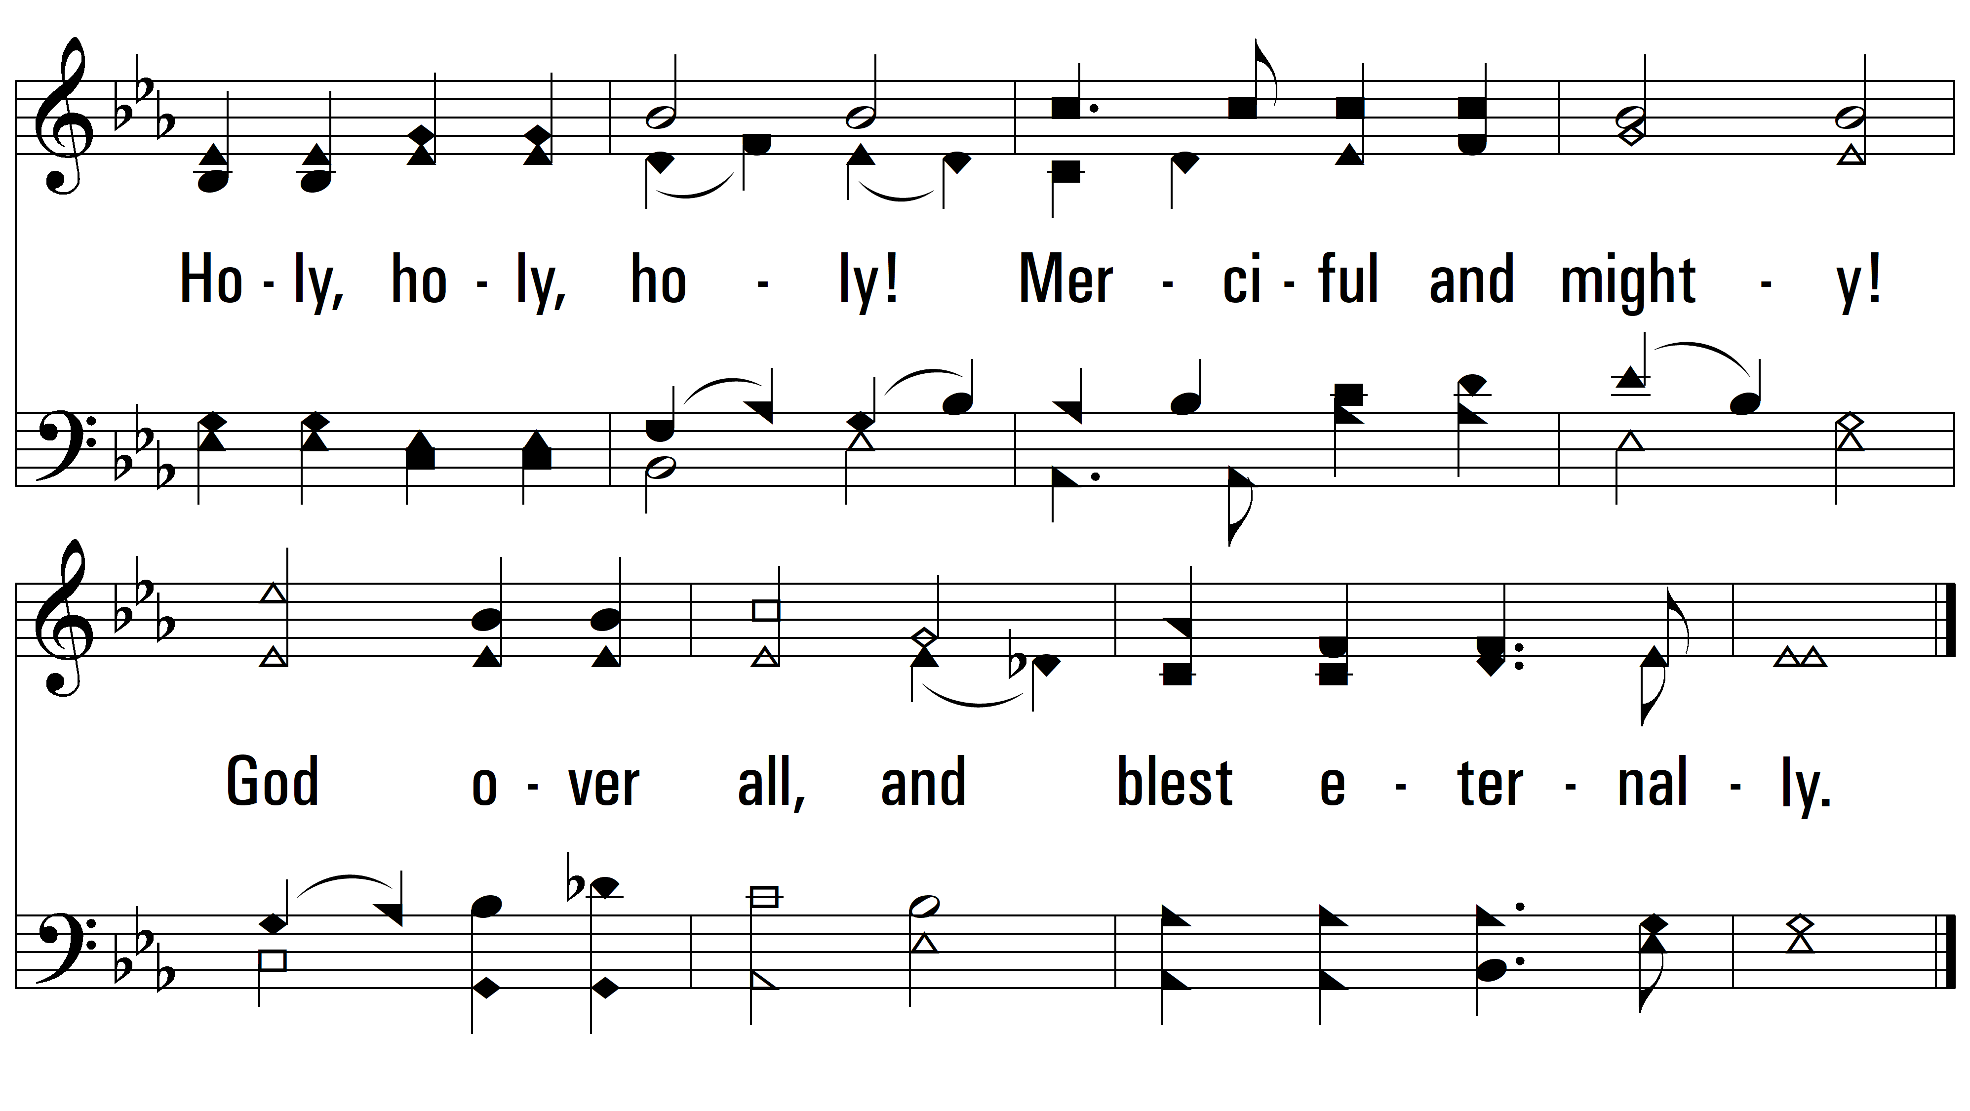
vs. 1

Slide 4
vs. 2 ~ Holy, Holy, Holy

Slide 5
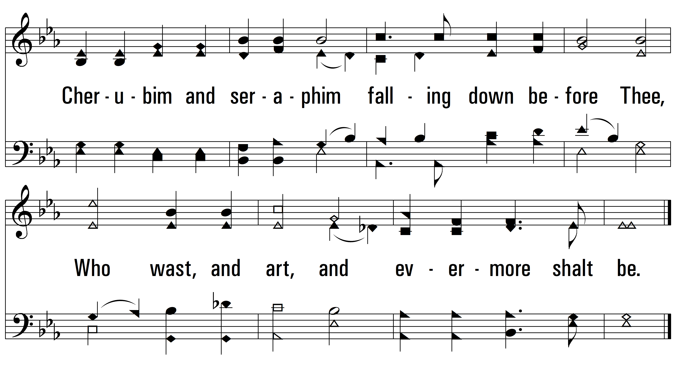
vs. 2

Slide 6
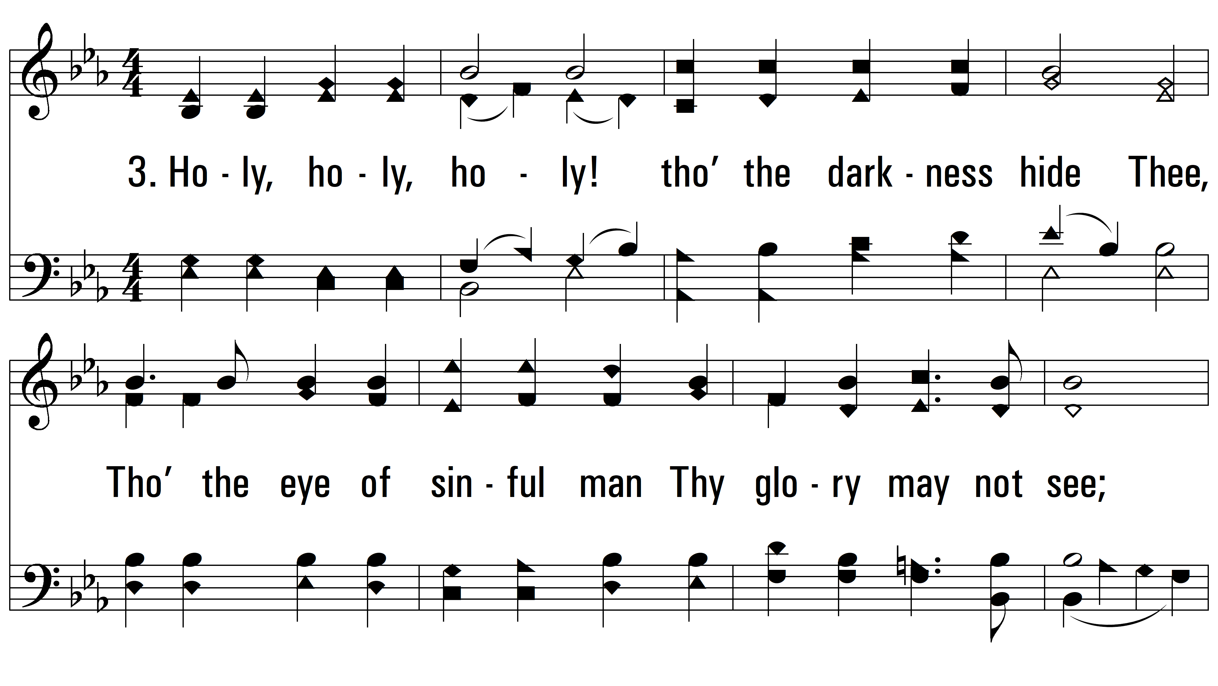
vs. 3 ~ Holy, Holy, Holy

Slide 7
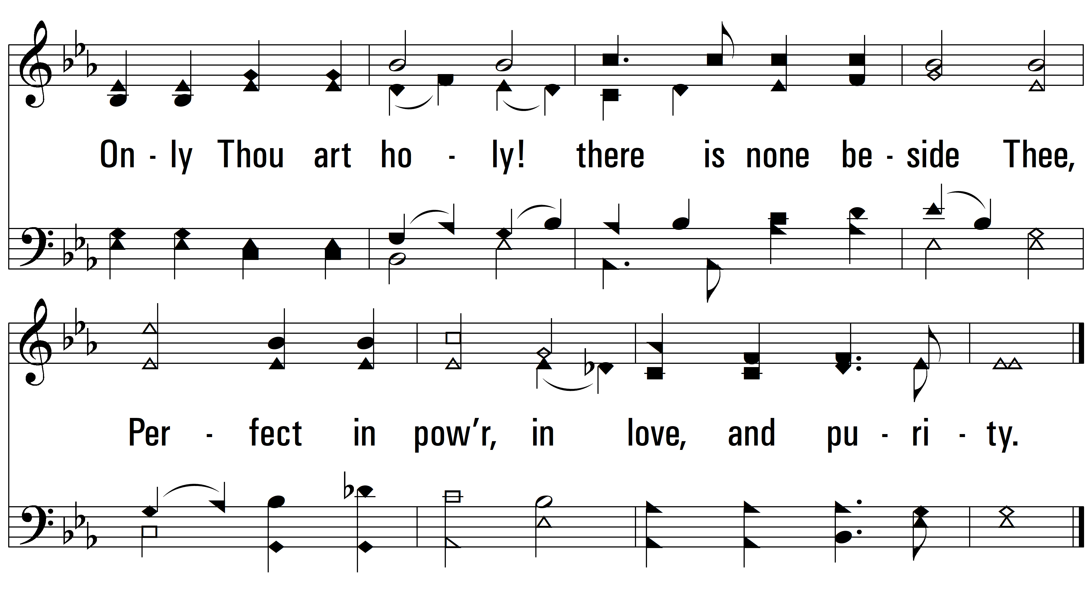
vs. 3

Slide 8
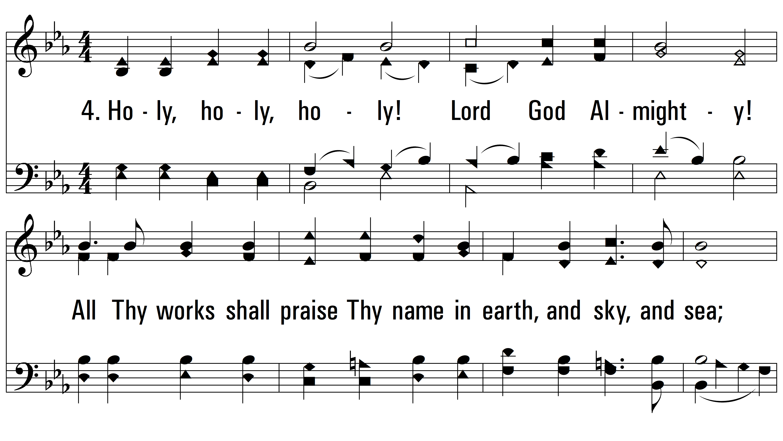
vs. 4 ~ Holy, Holy, Holy

Slide 9
vs. 4
PDHymns.com
END

