Slide 1
His Eye Is On The Sparrow
Words: | Mrs. C. D. Martin (1906)
Music: | Charles H. Gabriel (1906)
6/8
D^{b}/A^{b} - SOL
Verses: 3/Chorus
Lead - | SOL
Alto - | MI
Tenor - | DO
Bass - | DO
PDHymns.com

Slide 2
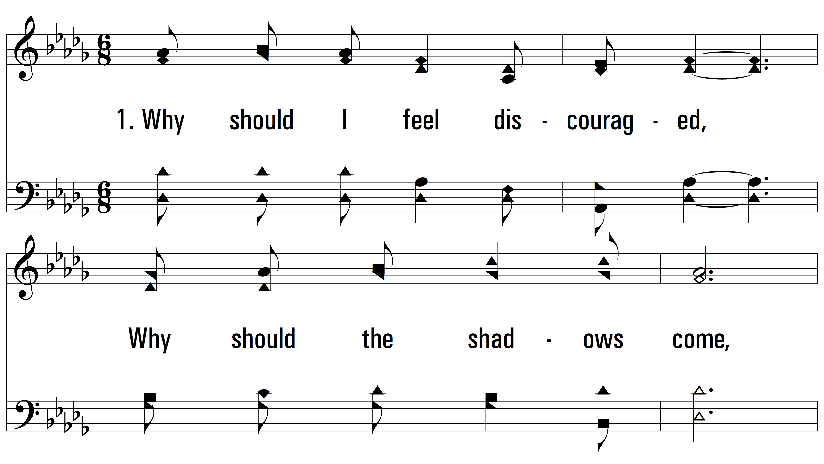
vs. 1 ~ His Eye Is On The Sparrow

Slide 3
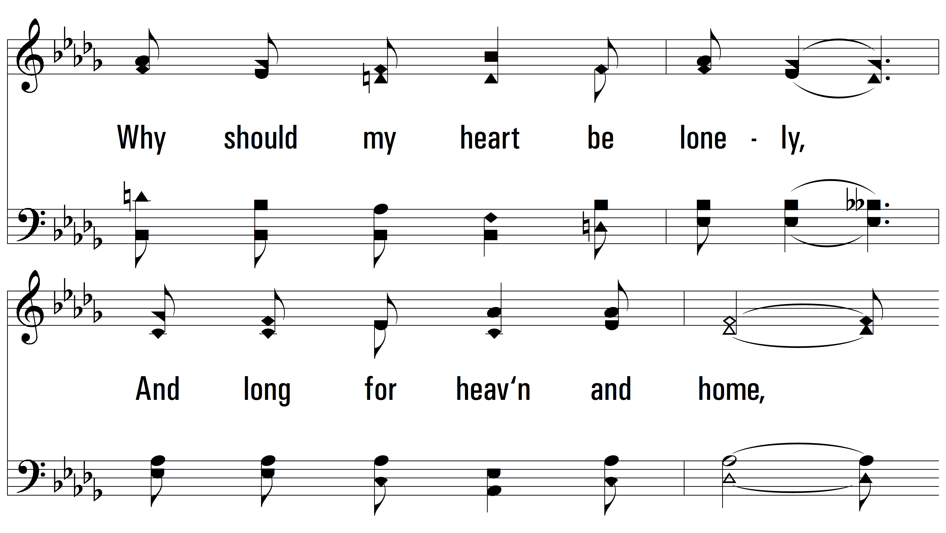
vs. 1

Slide 4
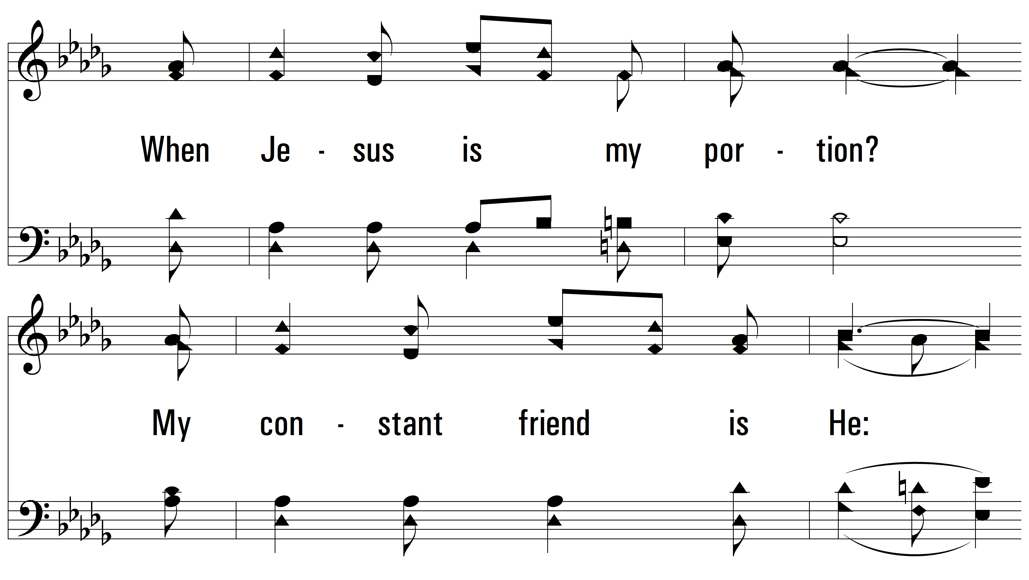
vs. 1

Slide 5
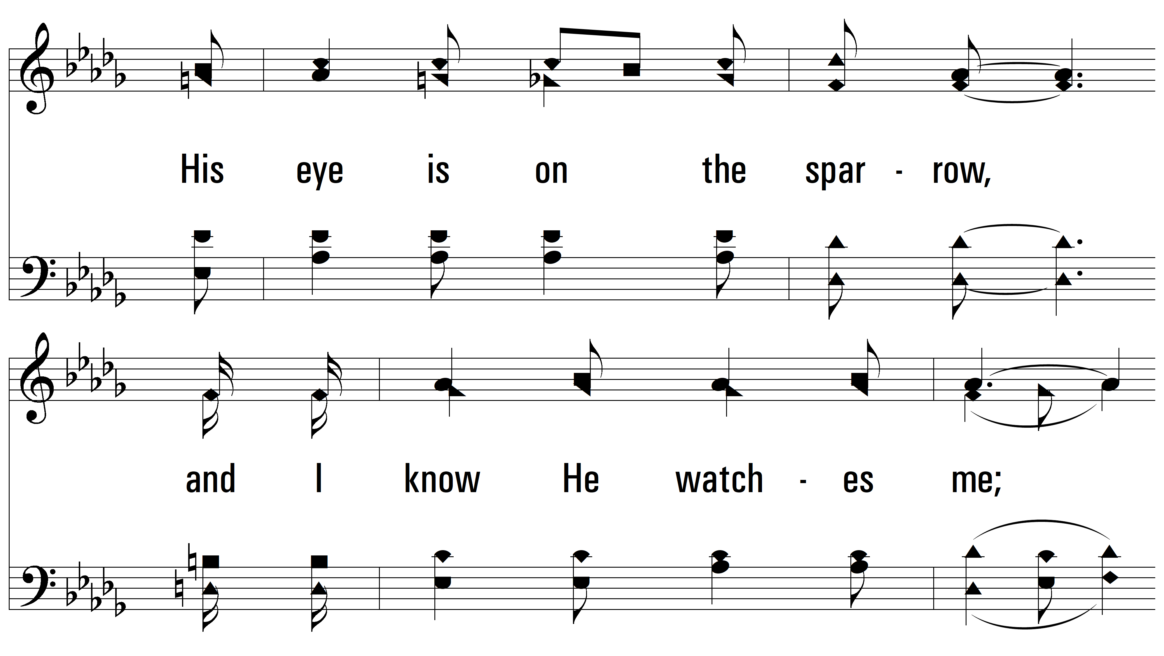
vs. 1

Slide 6
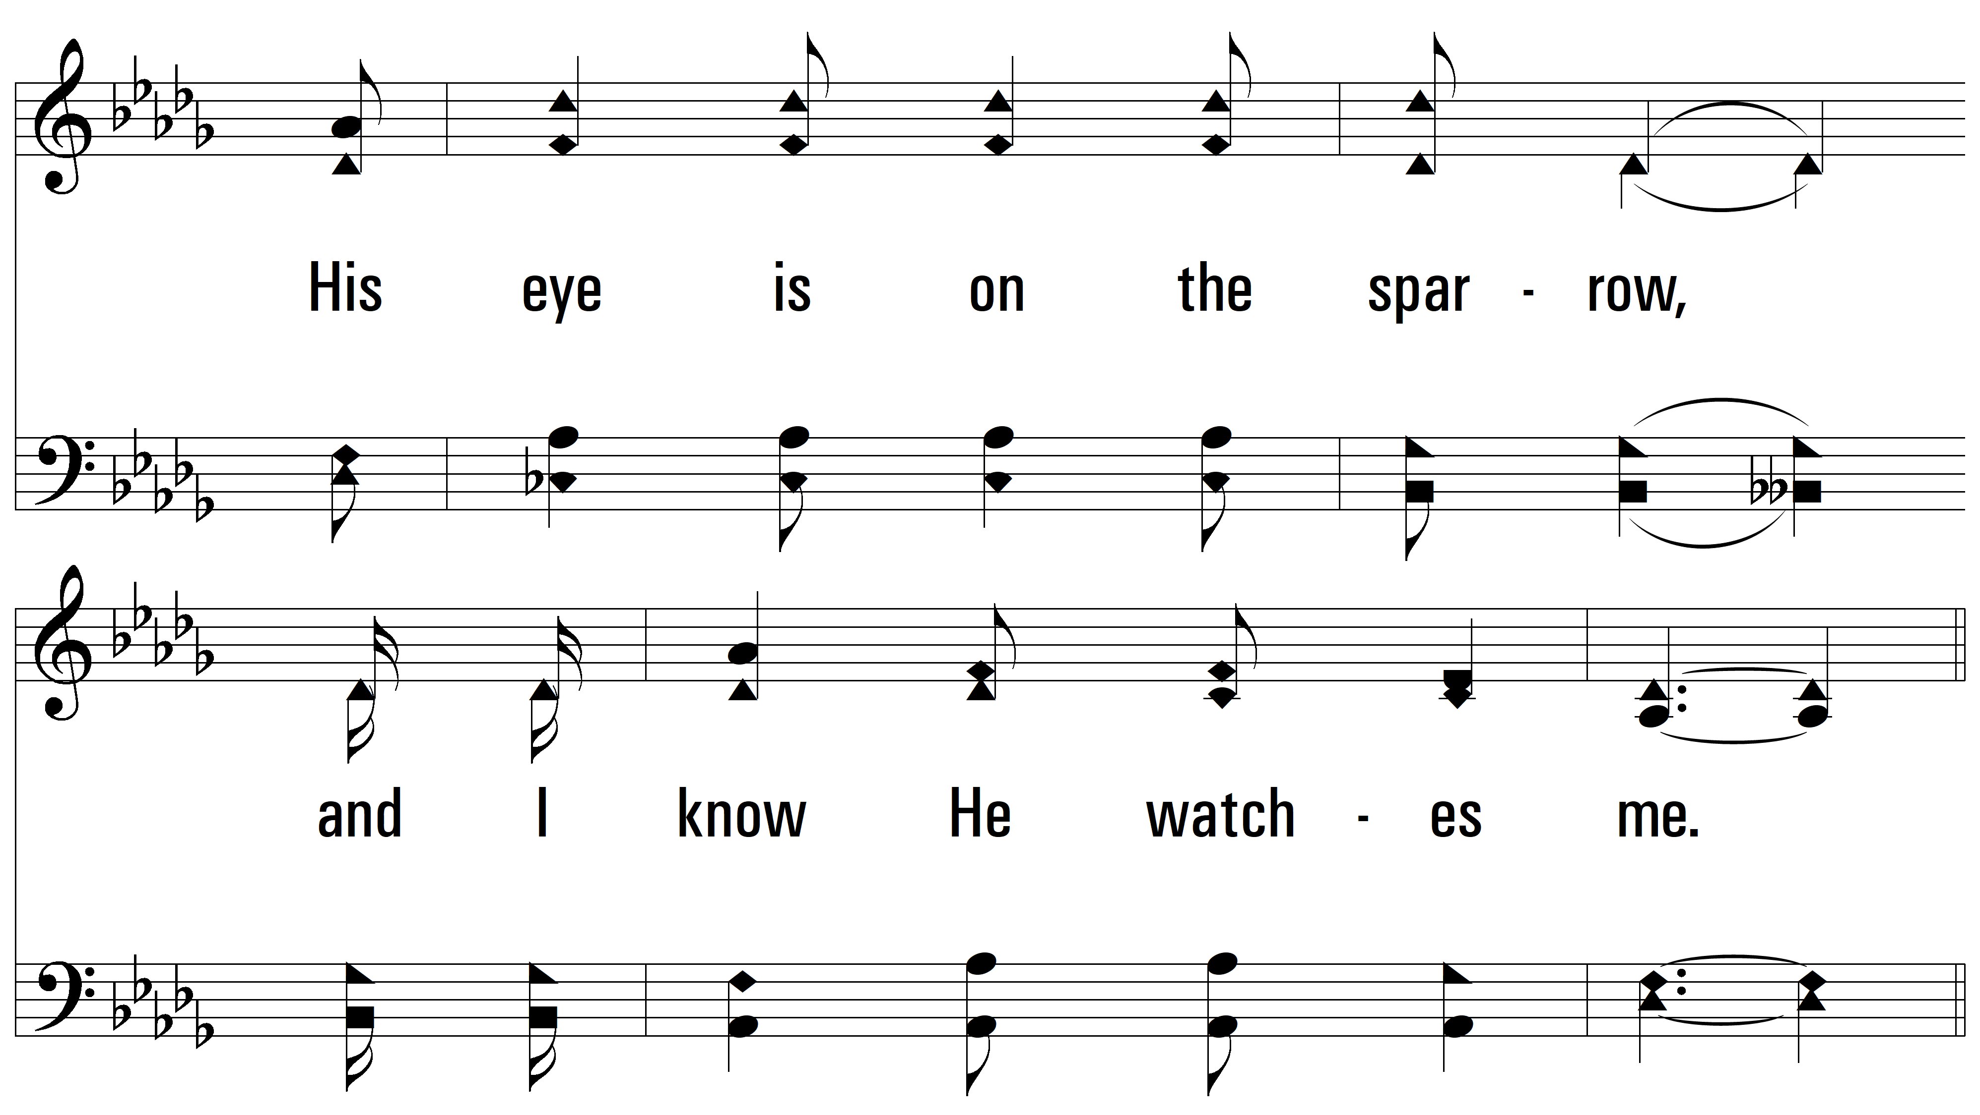
vs. 1

Slide 7
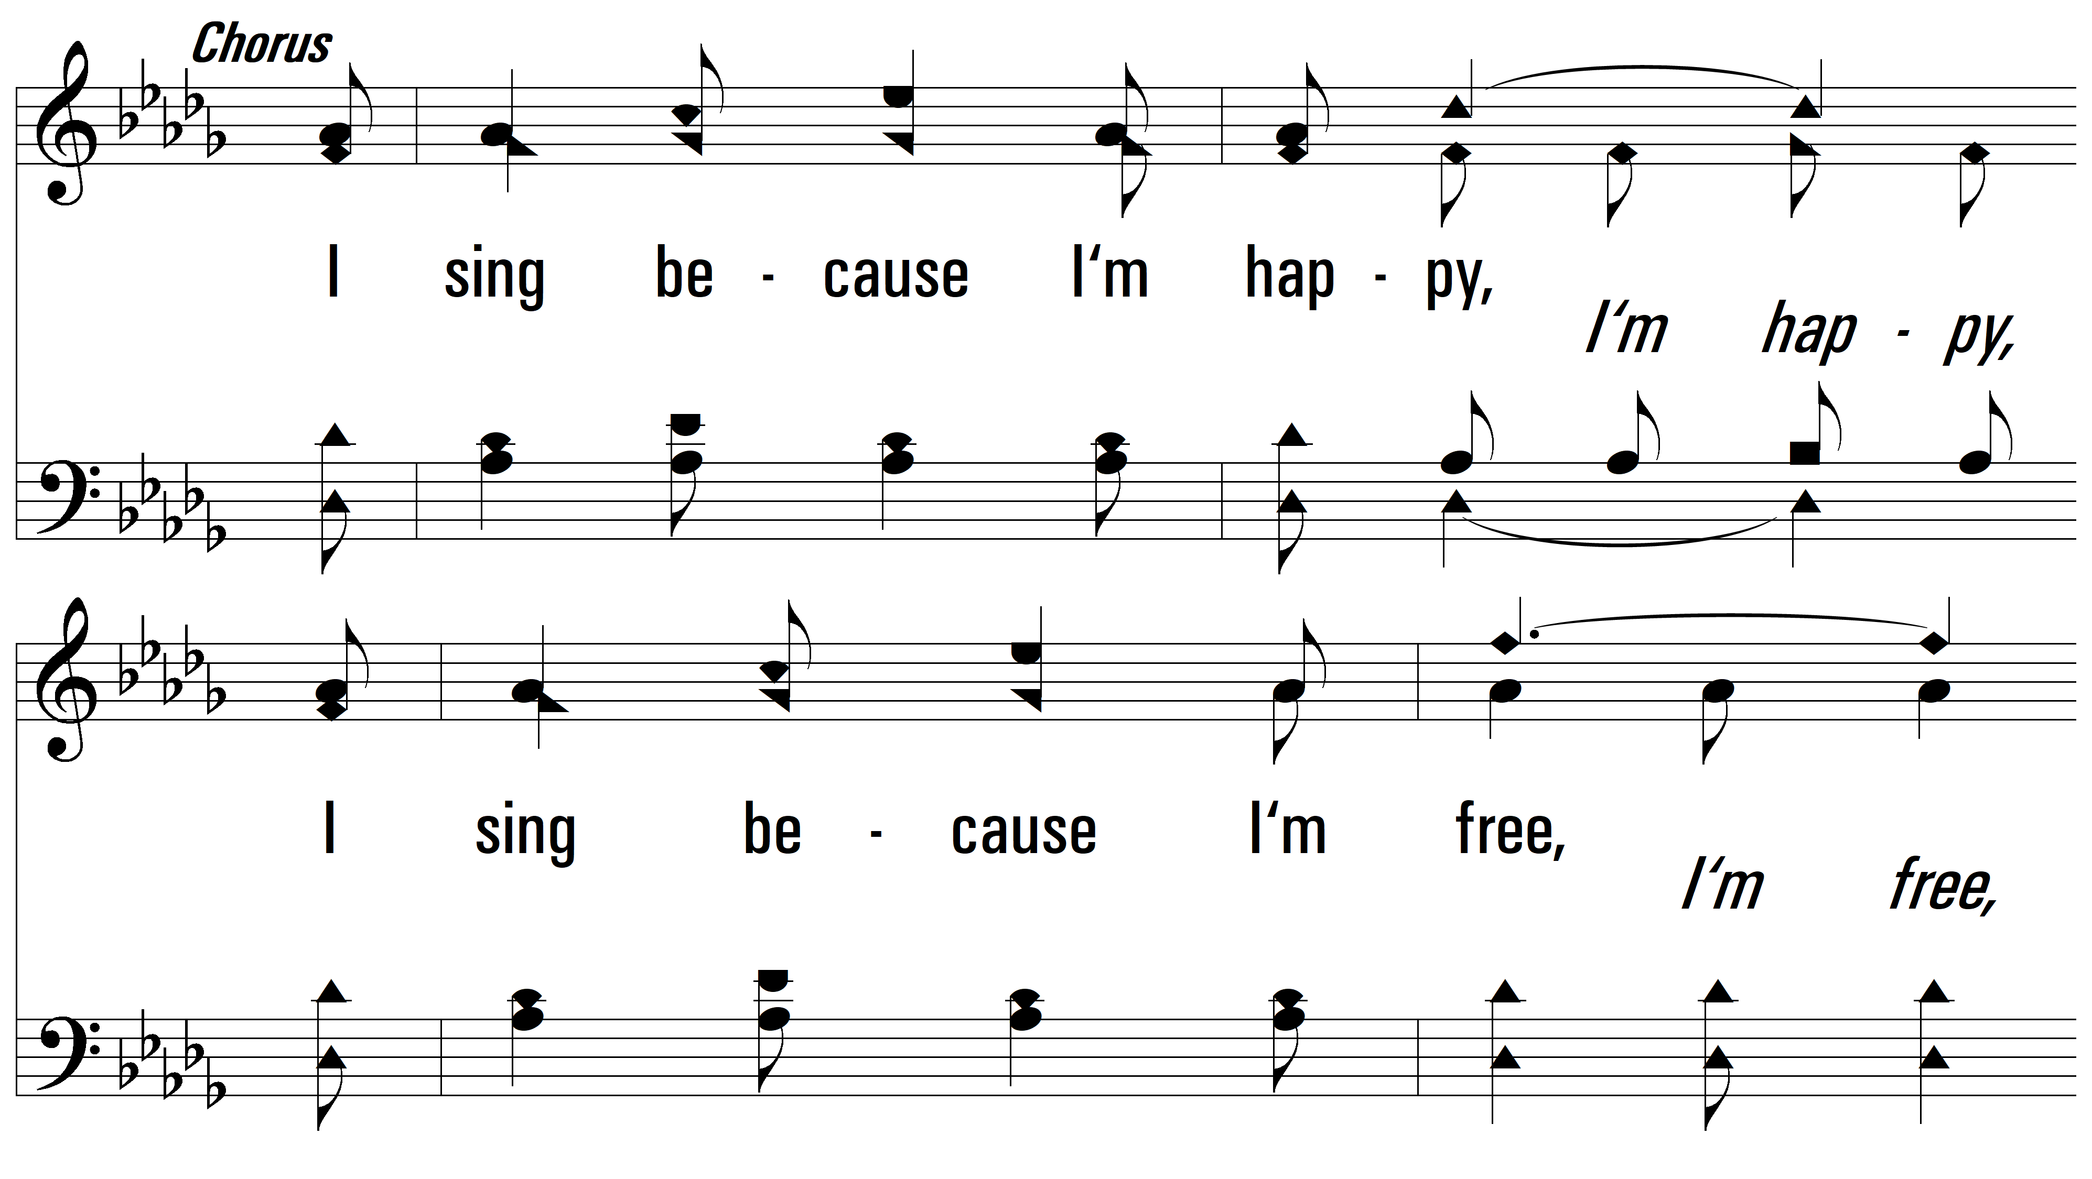
vs. 1

Slide 8
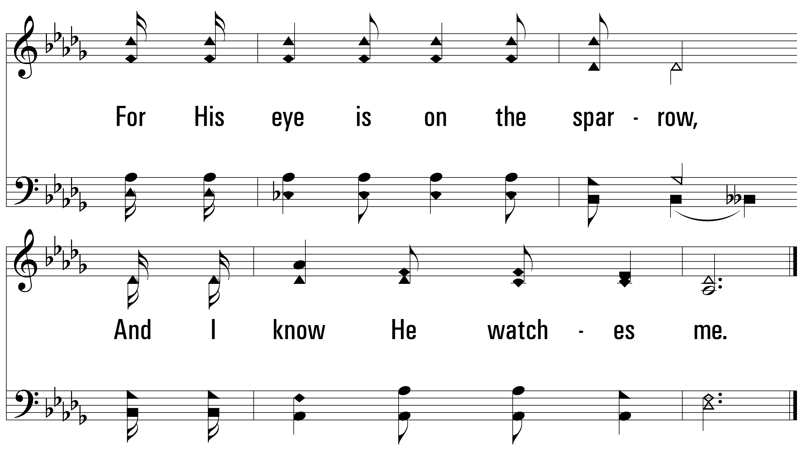
vs. 1

Slide 9
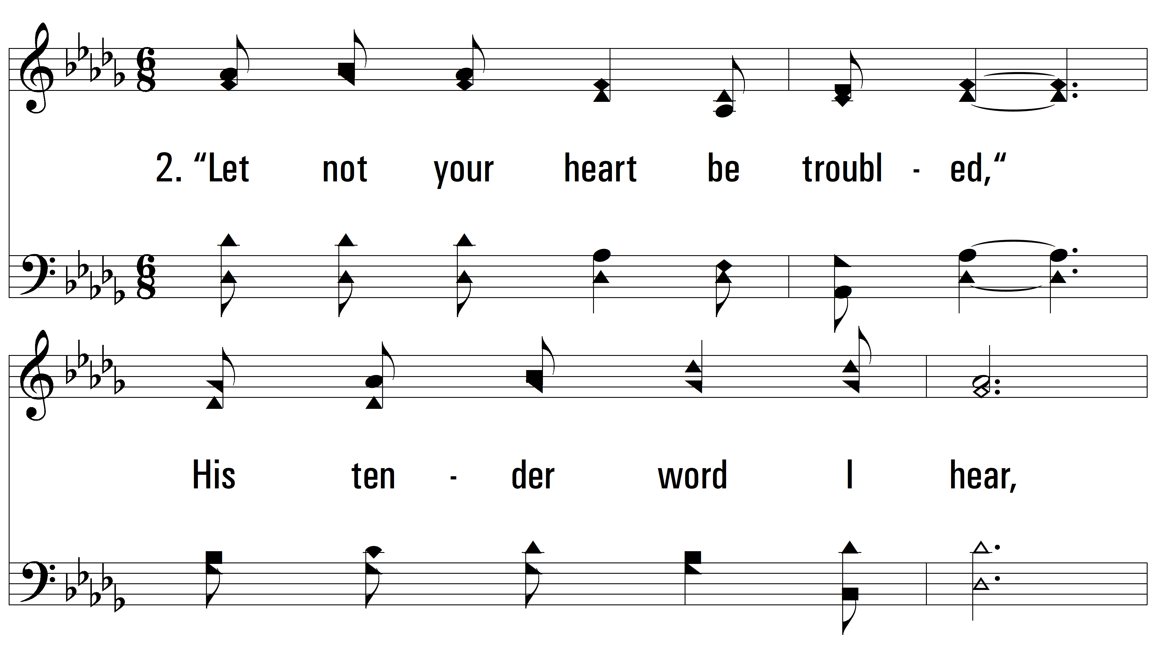
vs. 2 ~ His Eye Is On The Sparrow

Slide 10
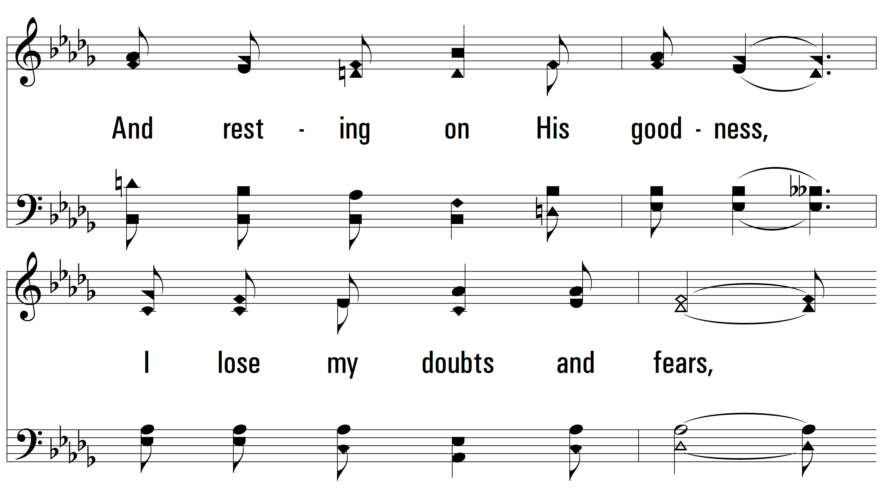
vs. 2

Slide 11
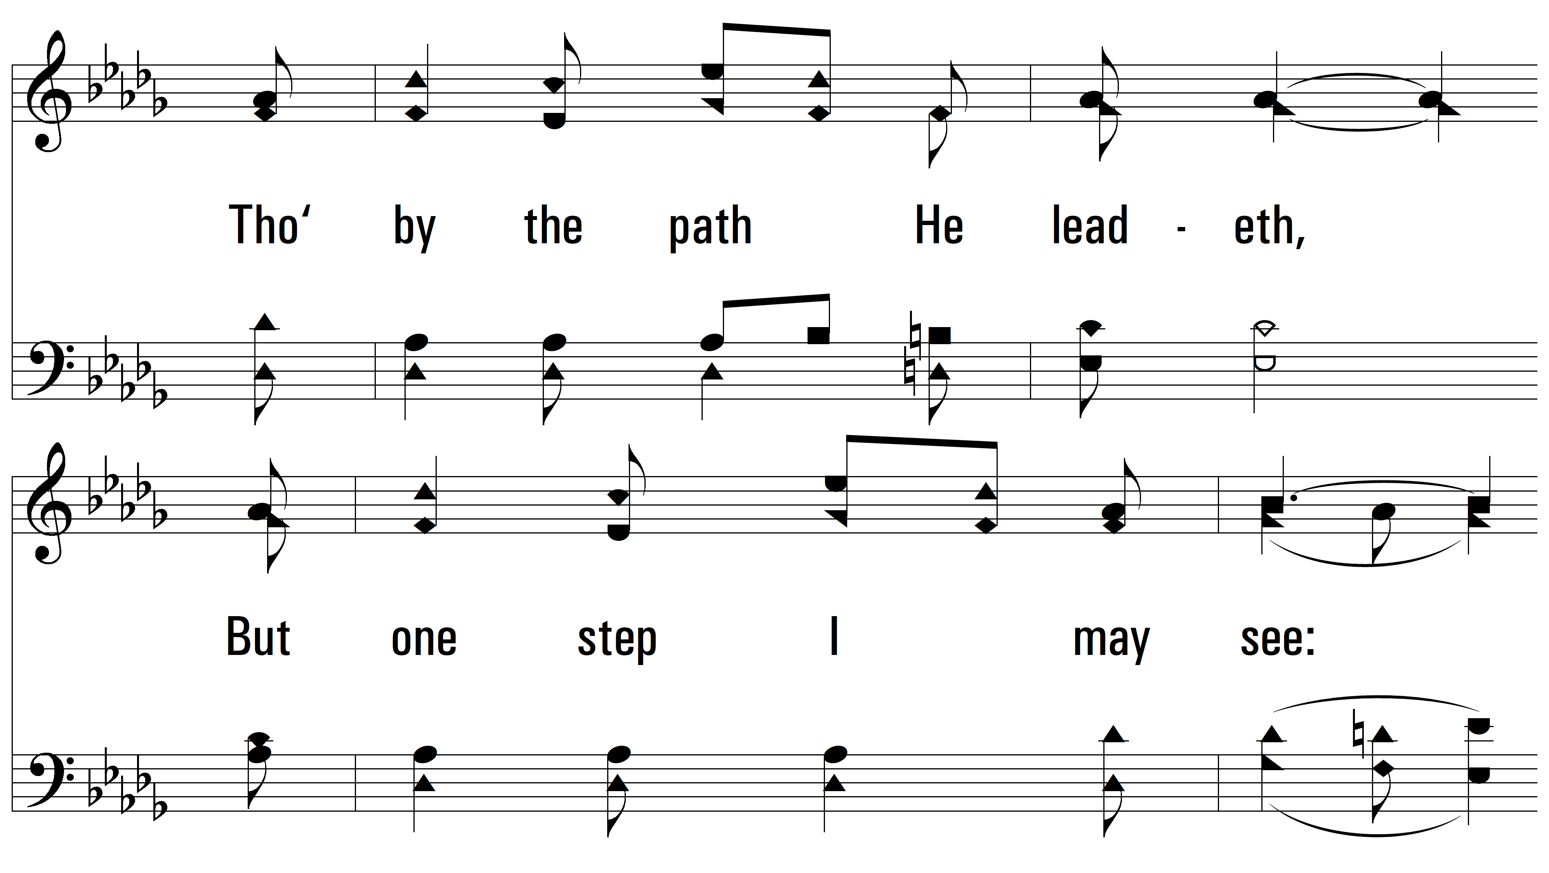
vs. 2

Slide 12
vs. 2

Slide 13
vs. 2

Slide 14
vs. 2

Slide 15
vs. 2

Slide 16
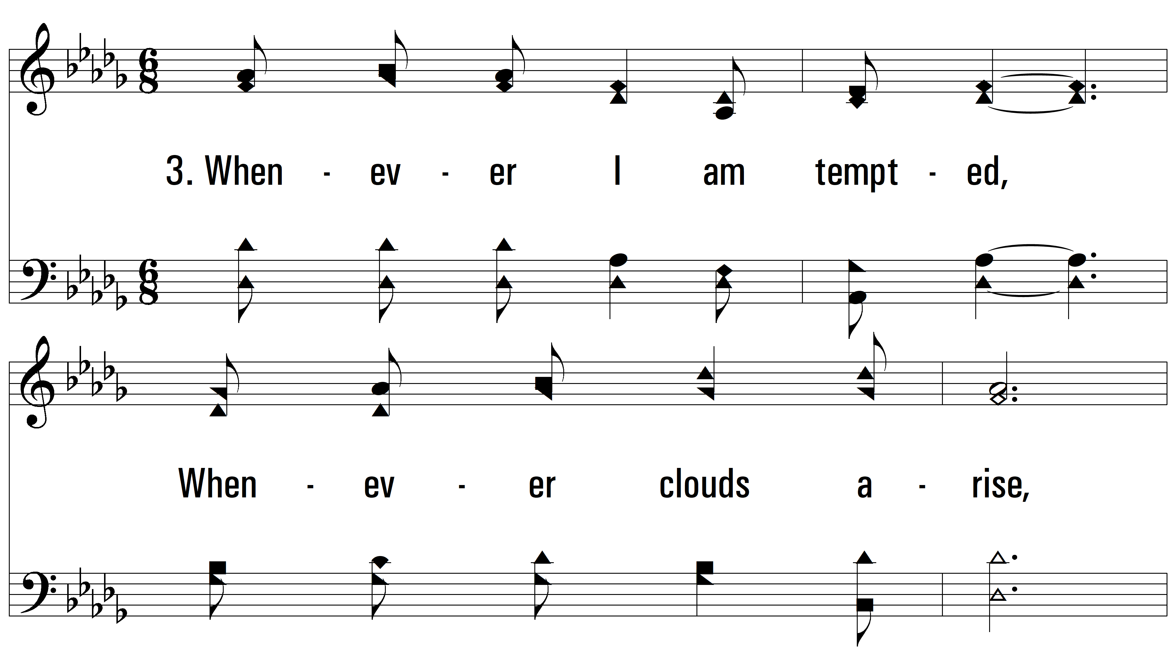
vs. 3 ~ His Eye Is On The Sparrow

Slide 17
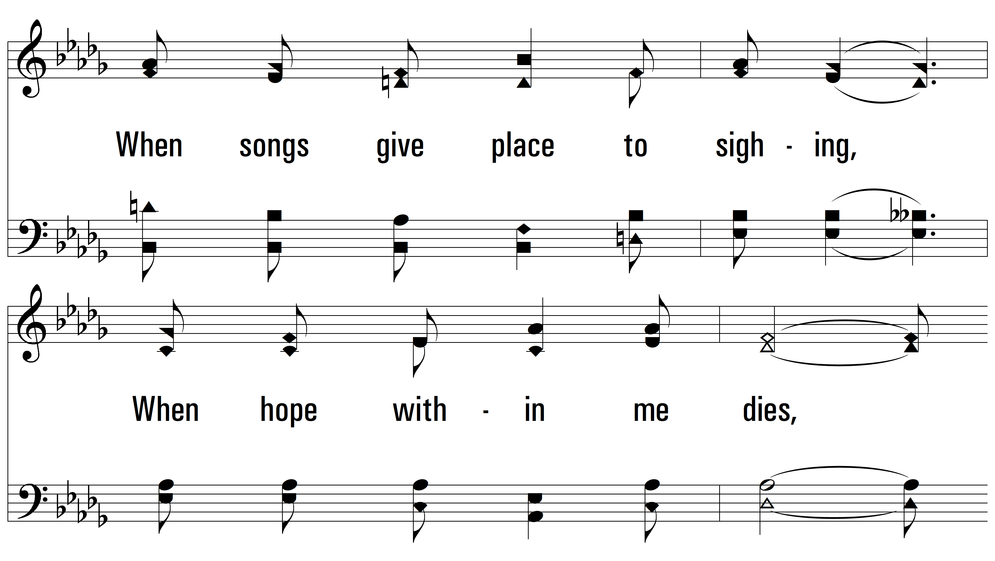
vs. 3

Slide 18
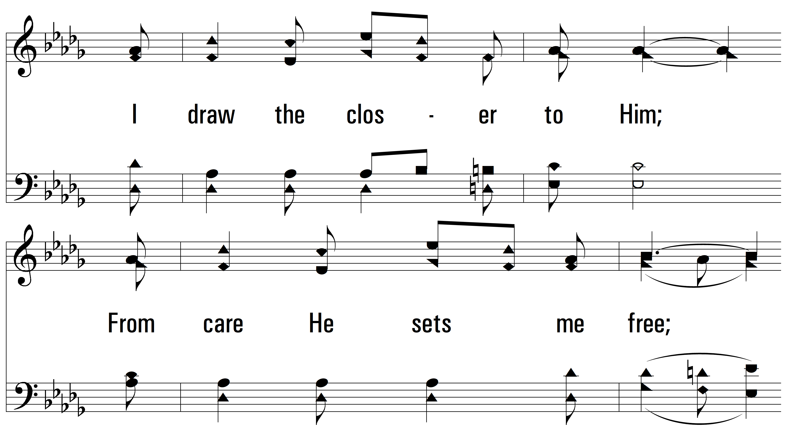
vs. 3

Slide 19
vs. 3

Slide 20
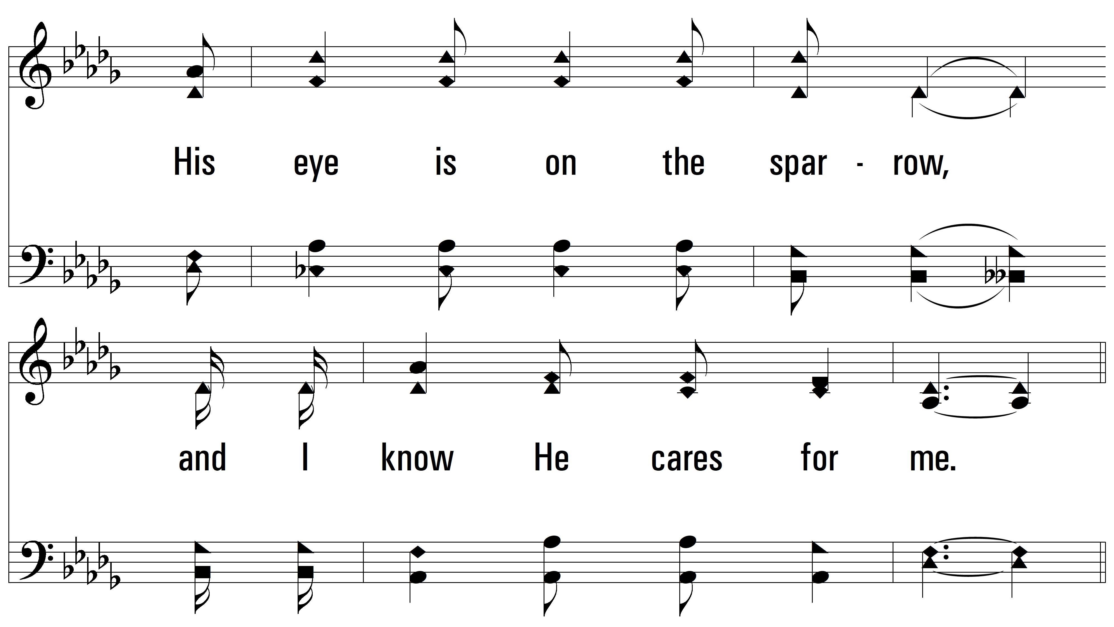
vs. 3

Slide 21
vs. 3

Slide 22
vs. 3
PDHymns.com
END

