Slide 1
Hide Me, O My Savior
Words: | Fanny J. Crosby (1886)
Music: | W. H. Doane (1886)
4/4
A^{b}/C - MI
Verses: 3/Chorus
Lead - | MI
Alto - | SOL
Tenor - | DO
Bass - | DO
PDHymns.com

Slide 2
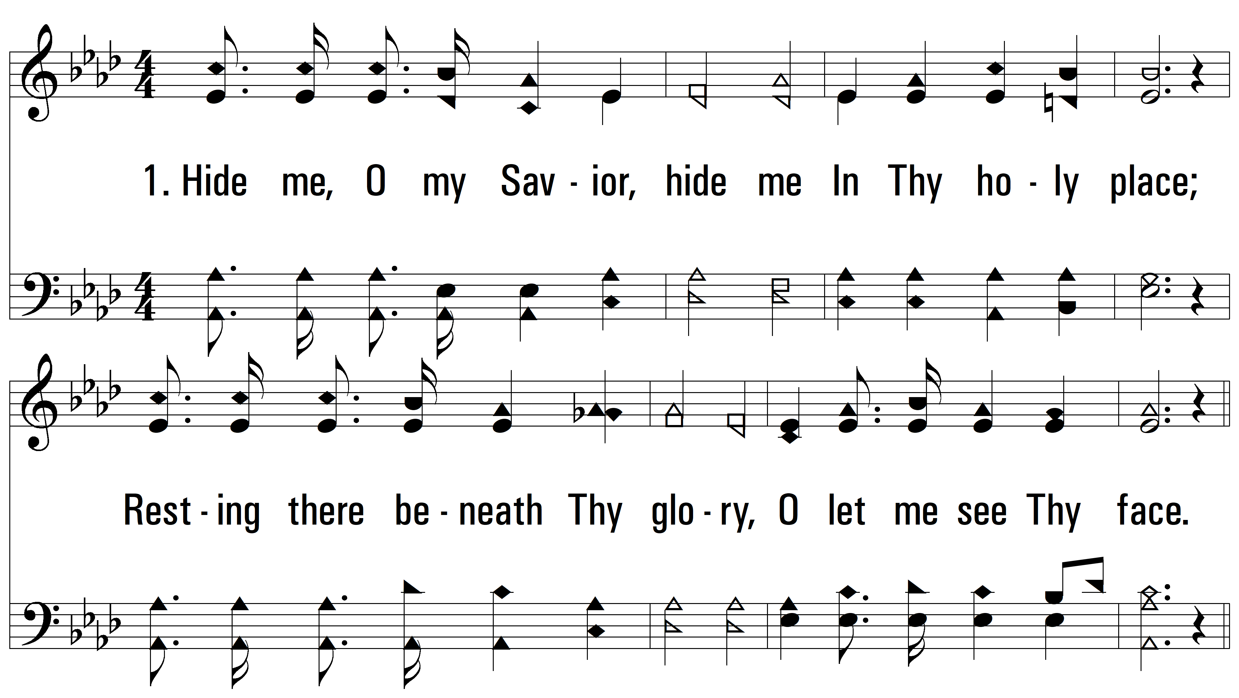
vs. 1 ~ Hide Me, O My Savior

Slide 3
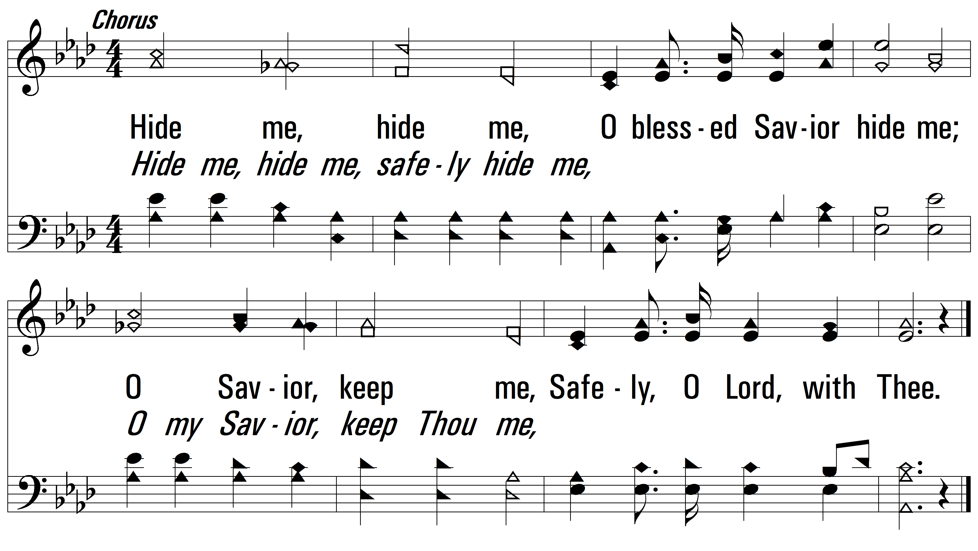
vs. 1

Slide 4
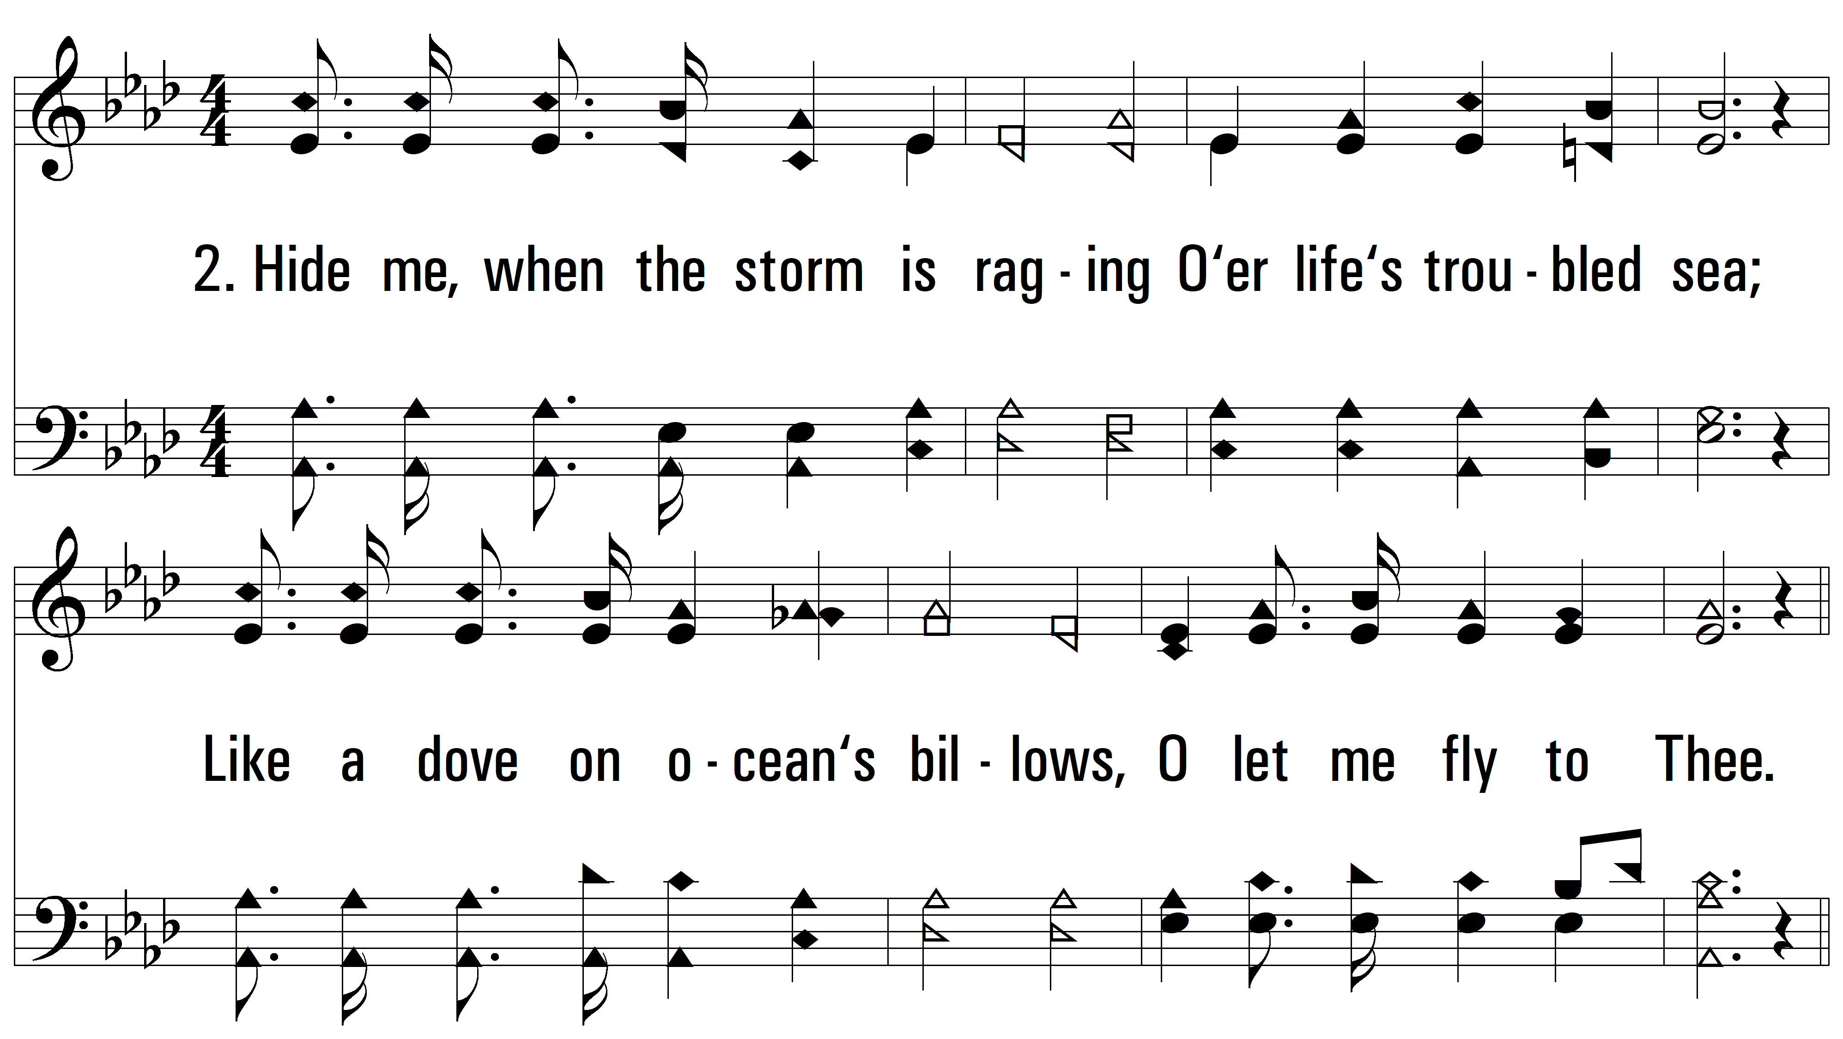
vs. 2 ~ Hide Me, O My Savior

Slide 5
vs. 2

Slide 6
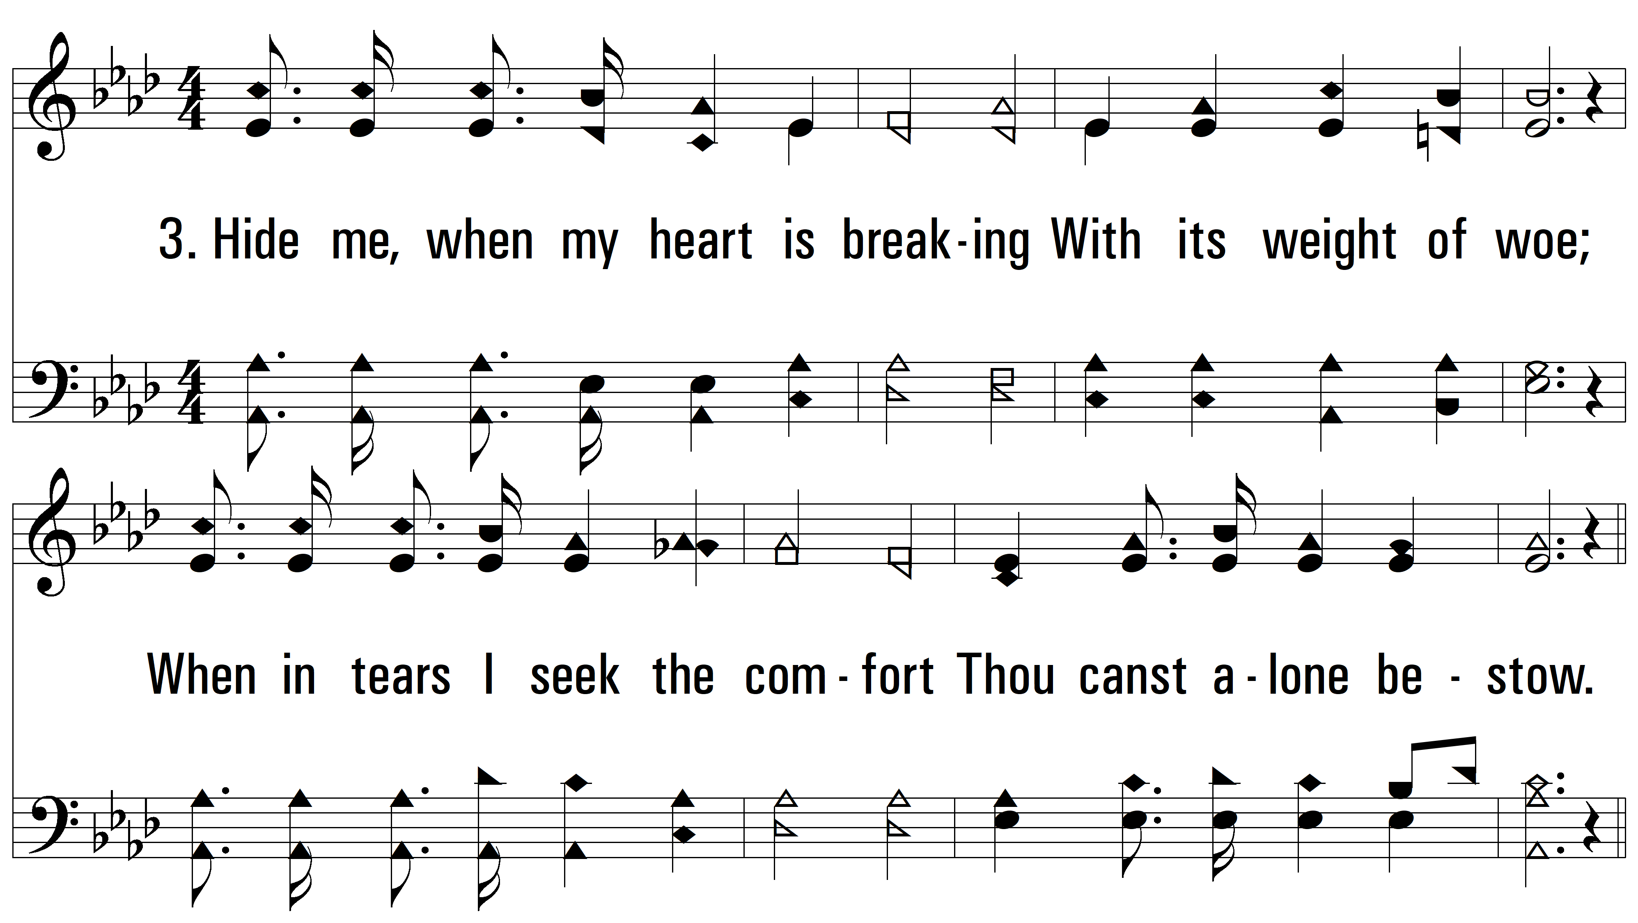
vs. 3 ~ Hide Me, O My Savior

Slide 7
vs. 3
PDHymns.com
END

