Slide 1
Heavenly Sunlight
(Walking In Sunlight)
Words: | H. J. Zelley (1899)
Music: | G. H. Cook (1899)
9/8
G/D - SOL
Verses: 3/Chorus
Lead - | SOL
Alto - | SOL
Tenor - | SOL
Bass - | SOL
PDHymns.com

Slide 2
vs. 1 ~ Heavenly Sunlight

Slide 3
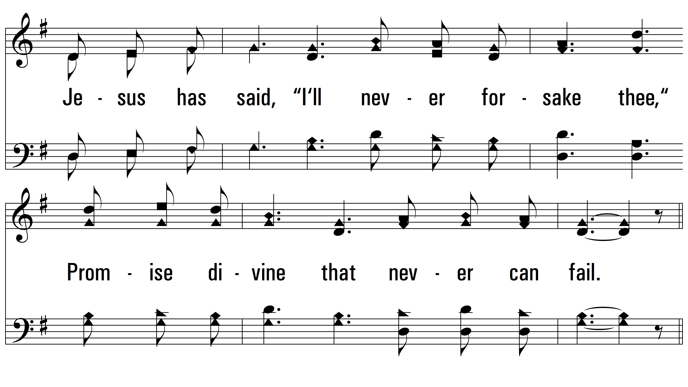
vs. 1

Slide 4
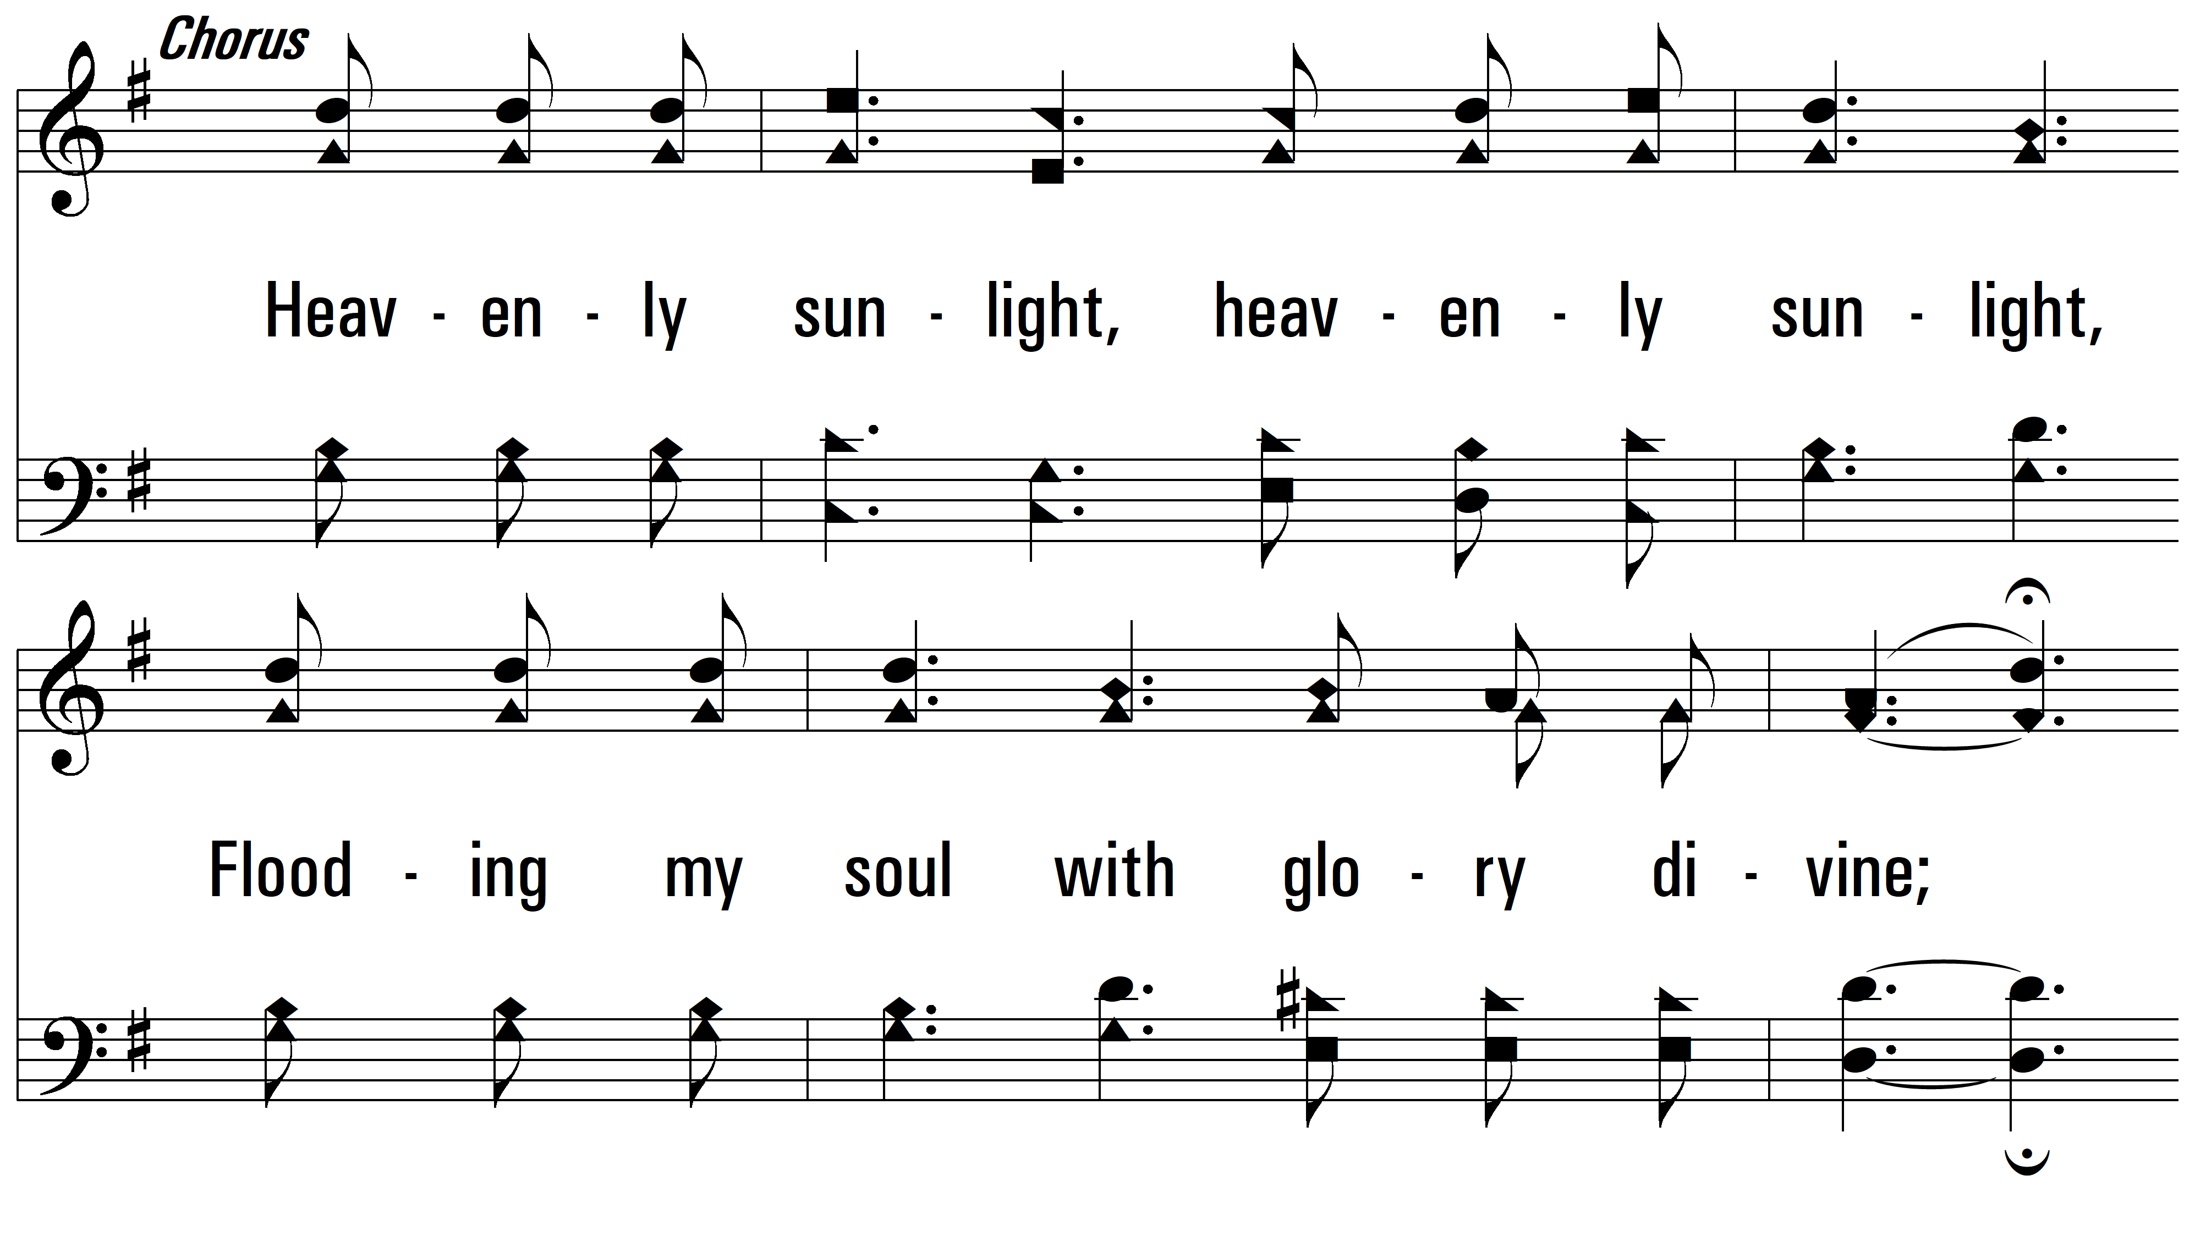
vs. 1

Slide 5
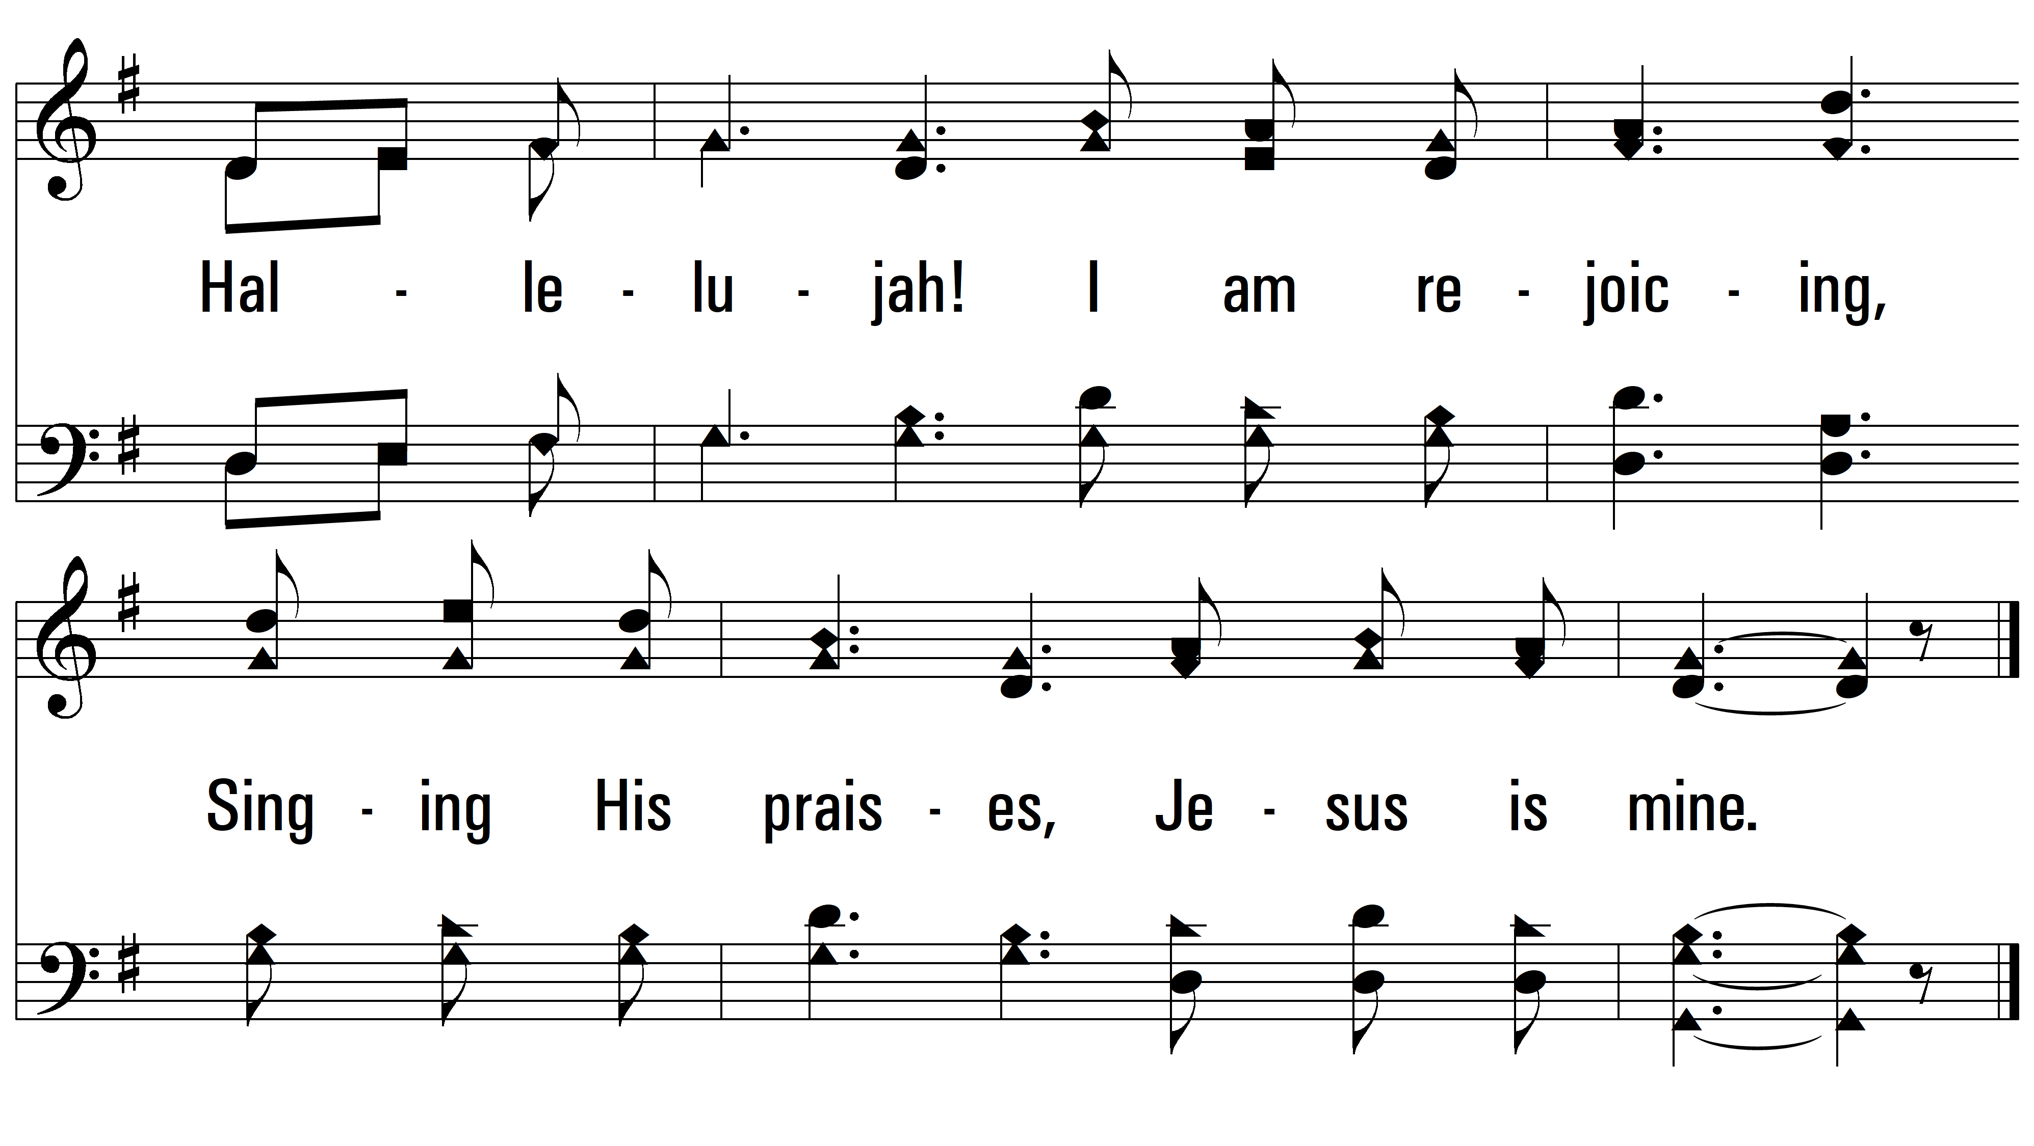
vs. 1

Slide 6
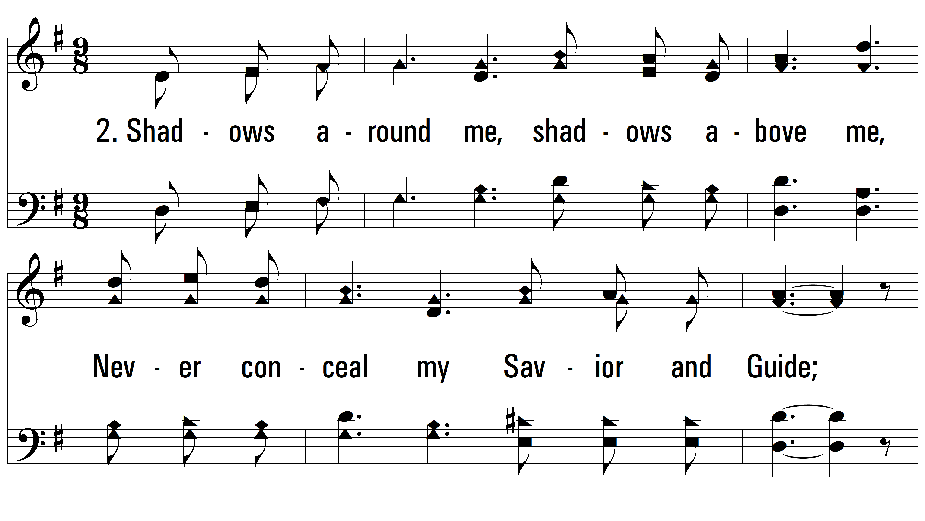
vs. 2 ~ Heavenly Sunlight

Slide 7
vs. 2

Slide 8
vs. 2

Slide 9
vs. 2

Slide 10
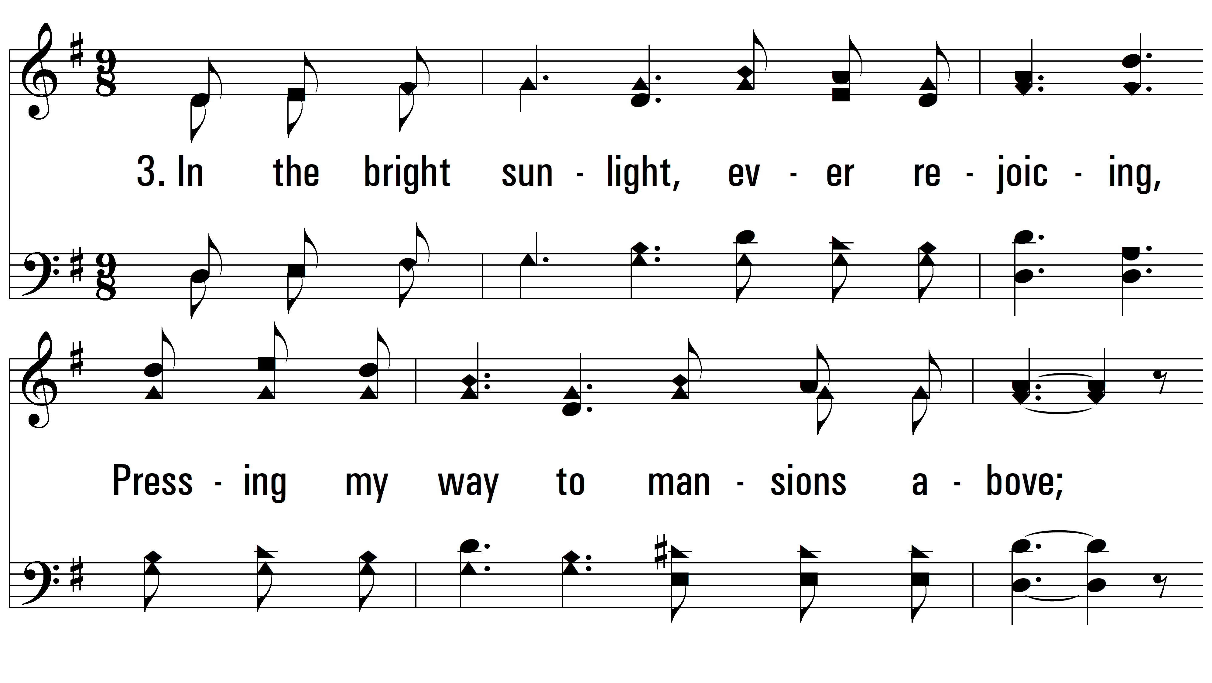
vs. 3 ~ Heavenly Sunlight

Slide 11
vs. 3

Slide 12
vs. 3

Slide 13
vs. 3
PDHymns.com
END

