Slide 1
Hear, O Israel
Words: | Traditional, adapted from Deuteronomy 6:4-5
Music: | Traditional, Arr. by David Sexton
2/2
E^{b}/E^{b} - DO
Verses: 2
Lead - | DO
Alto - | LA
Tenor - | MI
Bass - | LA
PDHymns.com

Slide 2
vs. 1 ~ Hear, O Israel

Slide 3
vs. 1

Slide 4
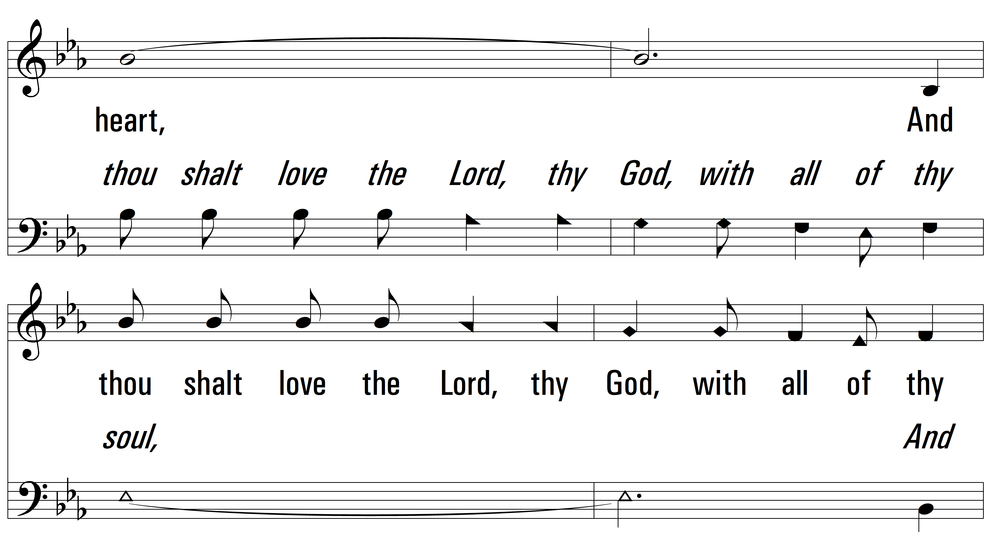
vs. 1

Slide 5
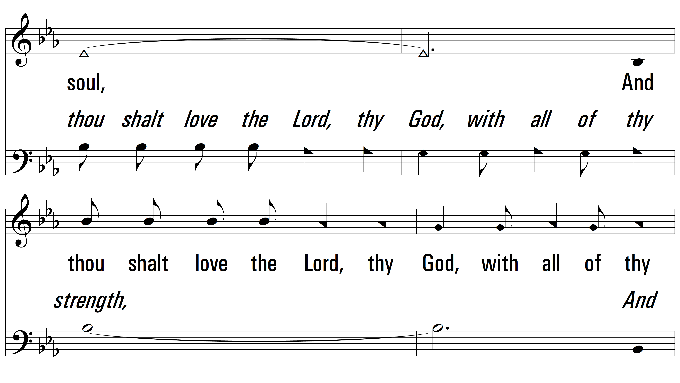
vs. 1

Slide 6
vs. 1

Slide 7
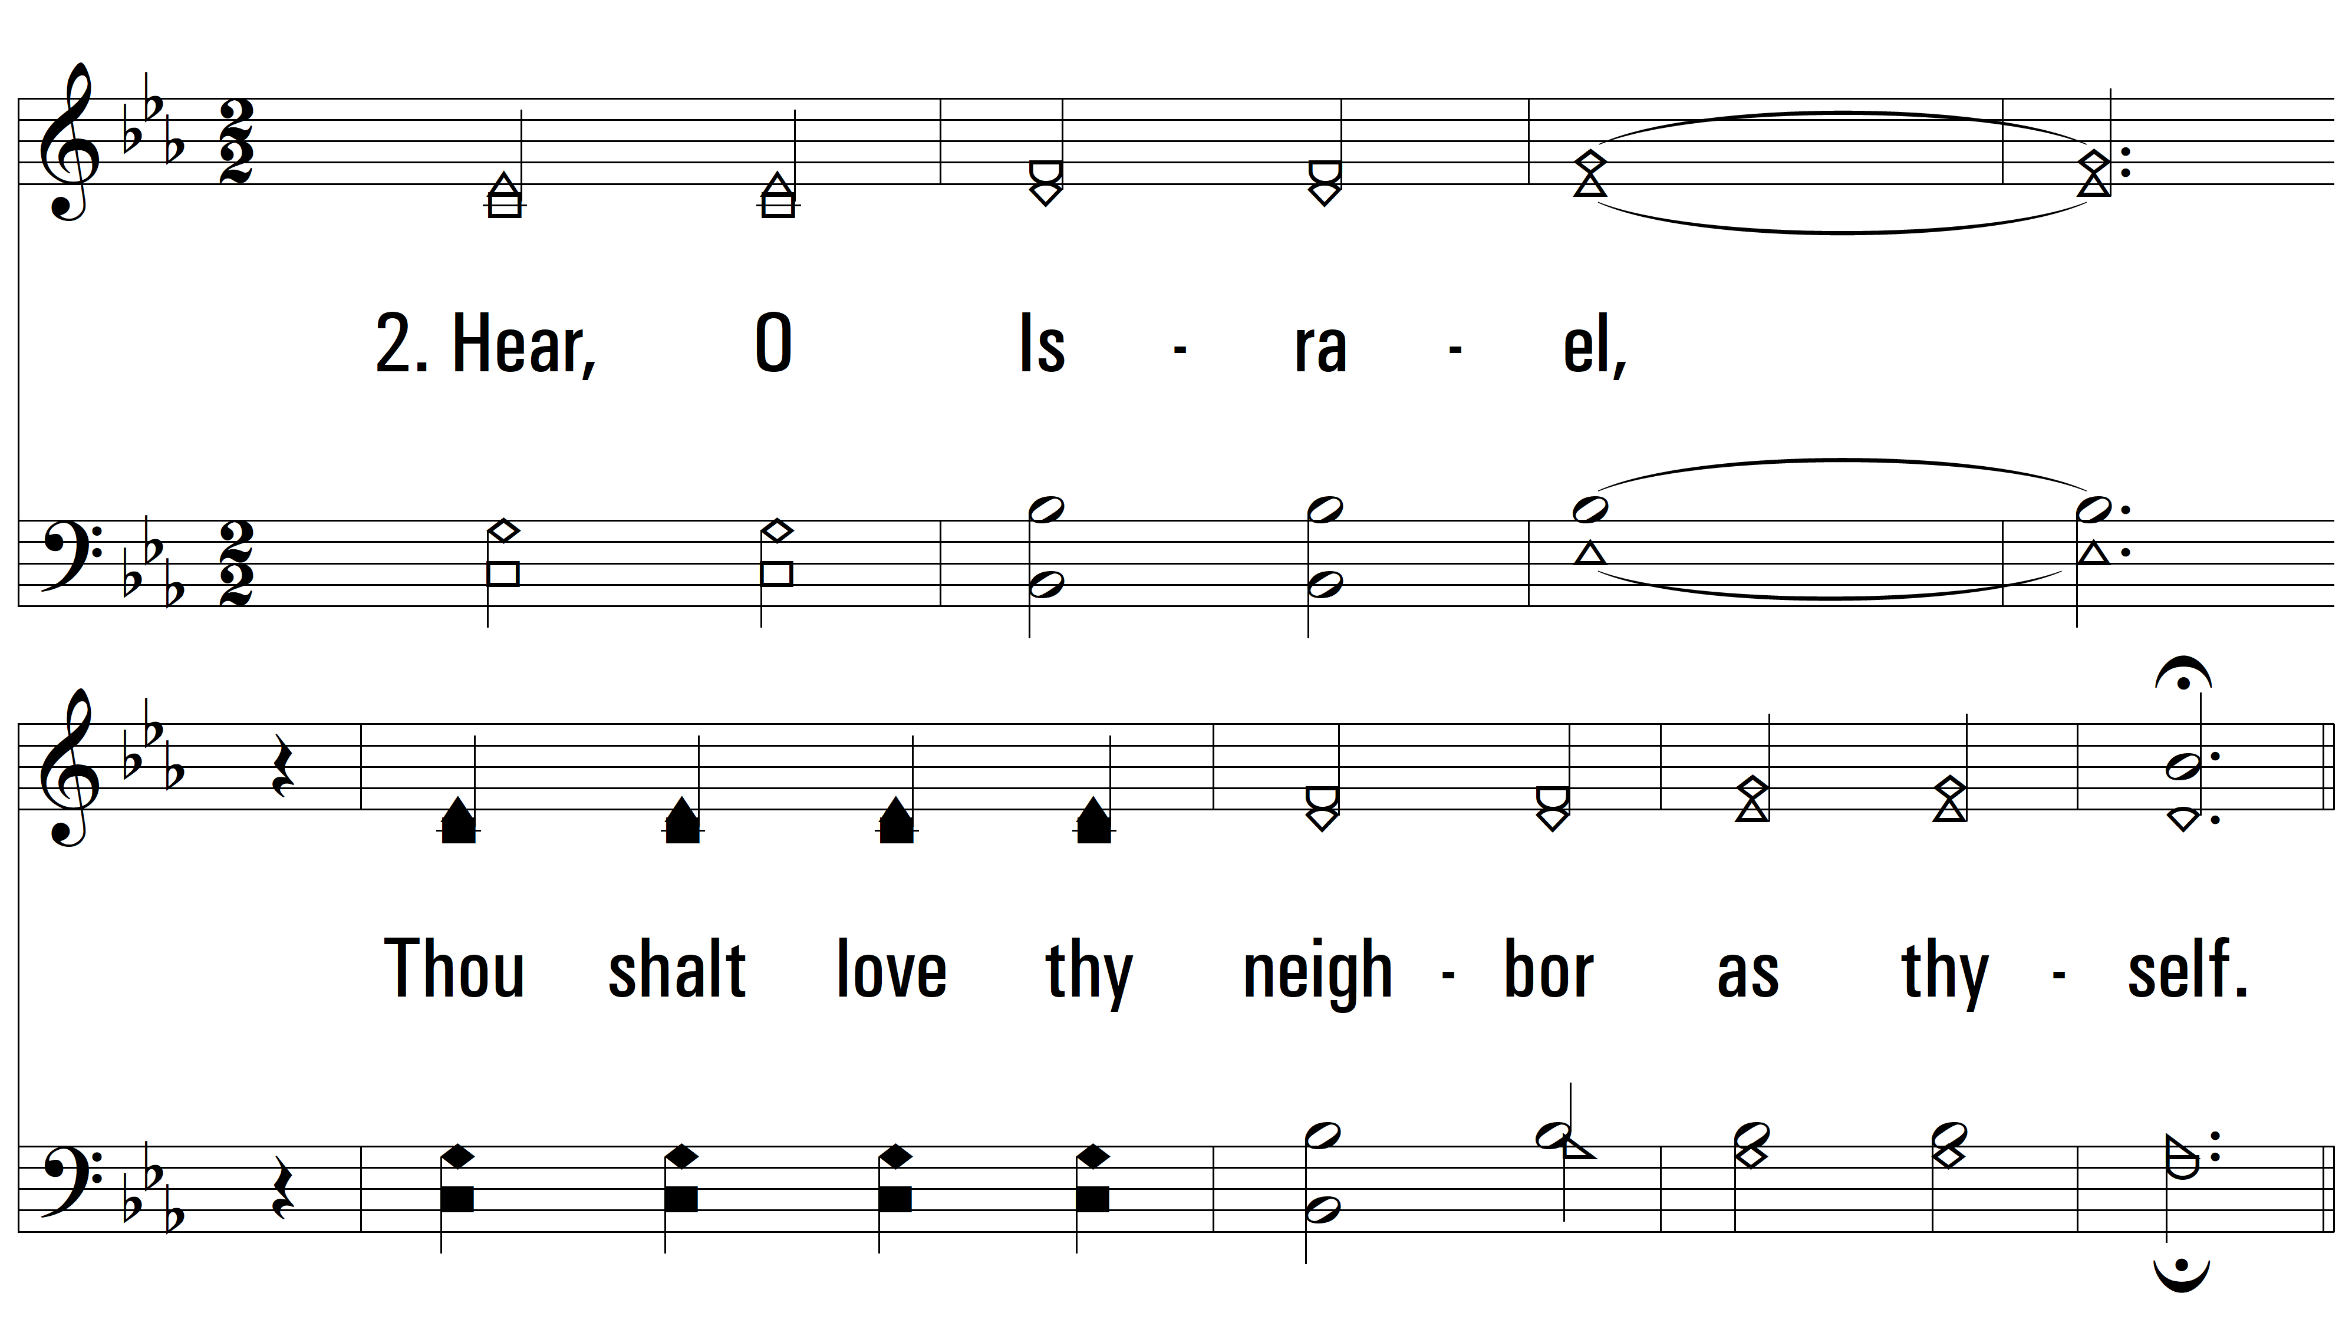
vs. 2 ~ Hear, O Israel

Slide 8
vs. 2

Slide 9
vs. 2

Slide 10
vs. 2

Slide 11
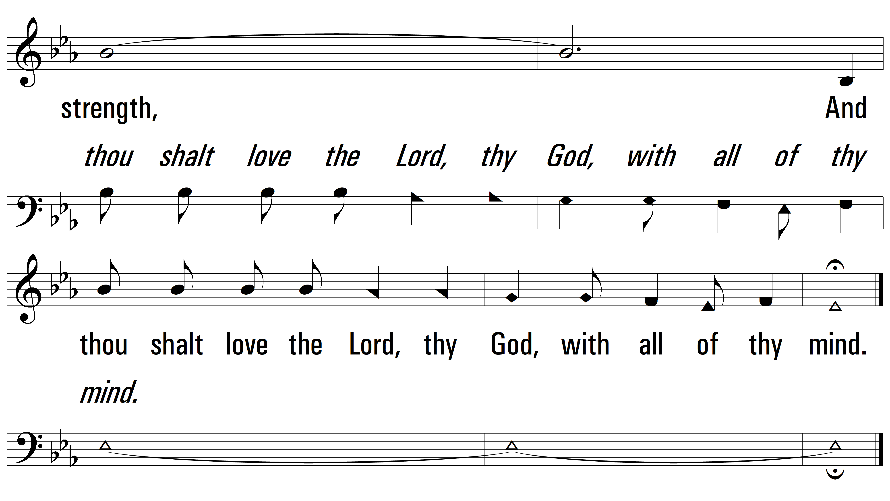
vs. 2

Slide 12
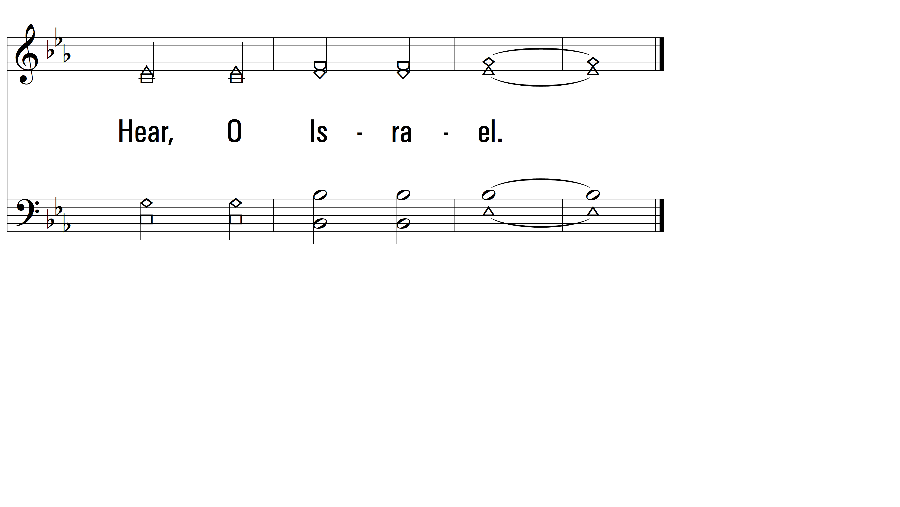
vs. 2
PDHymns.com
END

