Slide 1
Hear Me Now
PASS ME NOT
8.5.8.5 w/ Chorus
Words: | Fanny J. Crosby (1868), Arranged by Eillis J. Crum
Music: | William H. Doane (1870)
4/4
A^{b}/C - MI
Verses: 4/Chorus
Lead - | MI
Alto - | SOL
Tenor - | DO
Bass - | DO
PDHymns.com

Slide 2
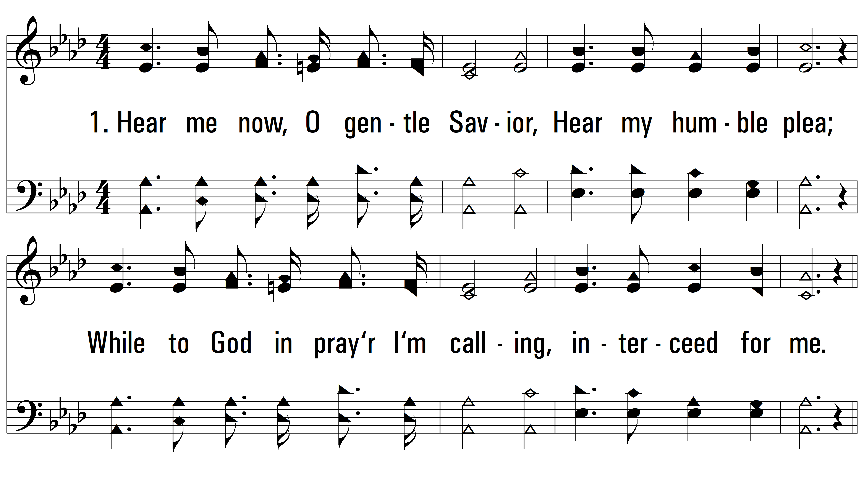
vs. 1 ~ Hear Me Now

Slide 3
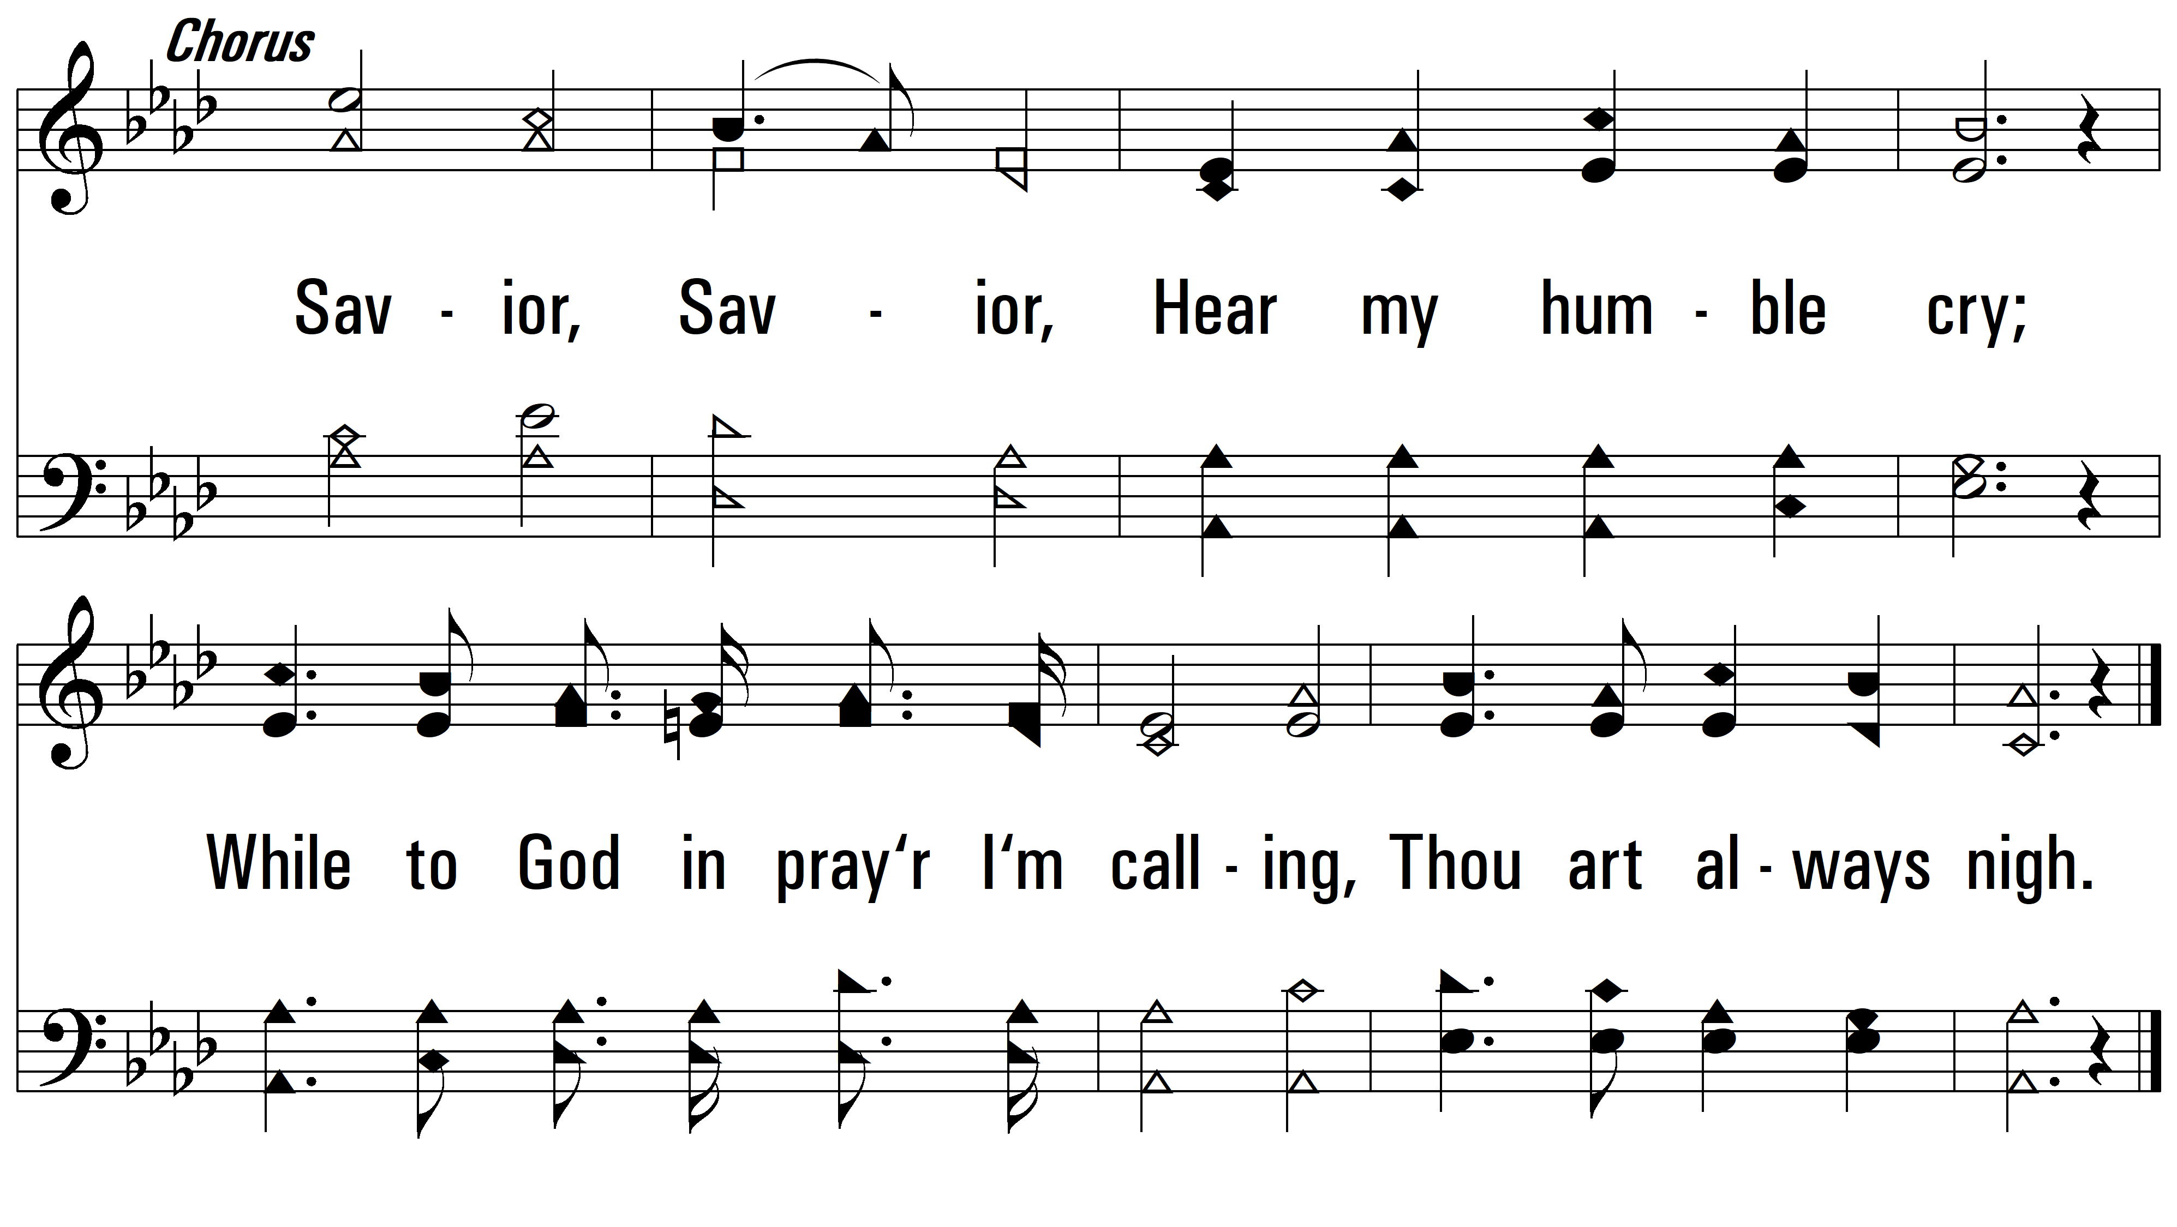
vs. 1

Slide 4
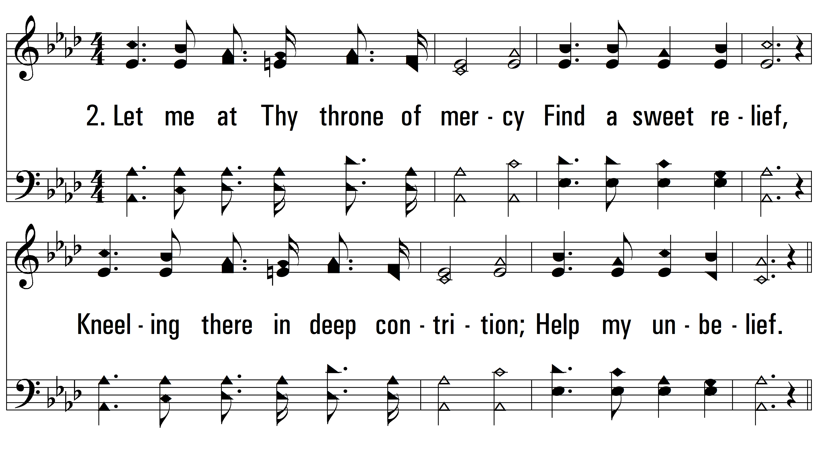
vs. 2 ~ Hear Me Now

Slide 5
vs. 2

Slide 6
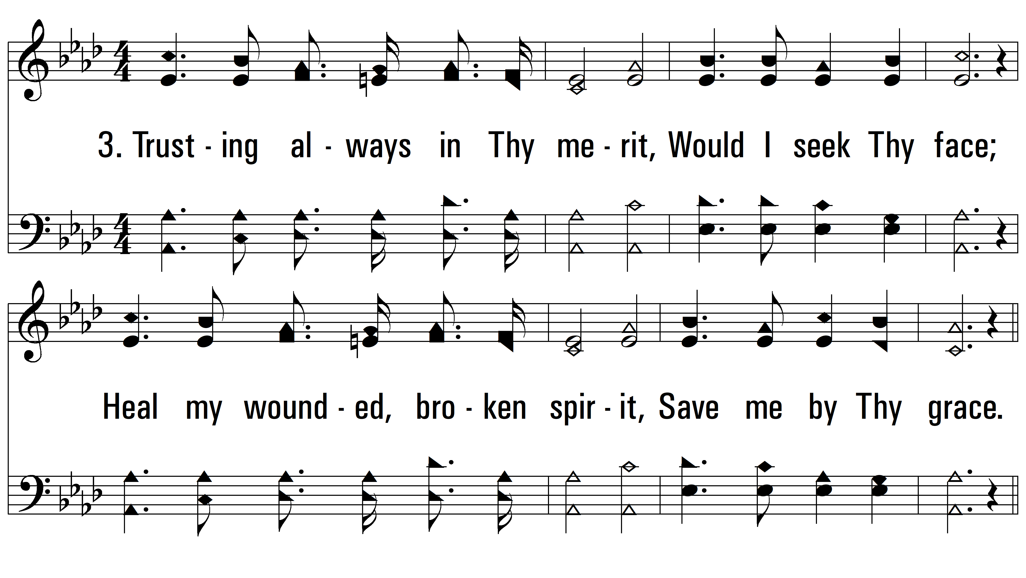
vs. 3 ~ Hear Me Now

Slide 7
vs. 3

Slide 8
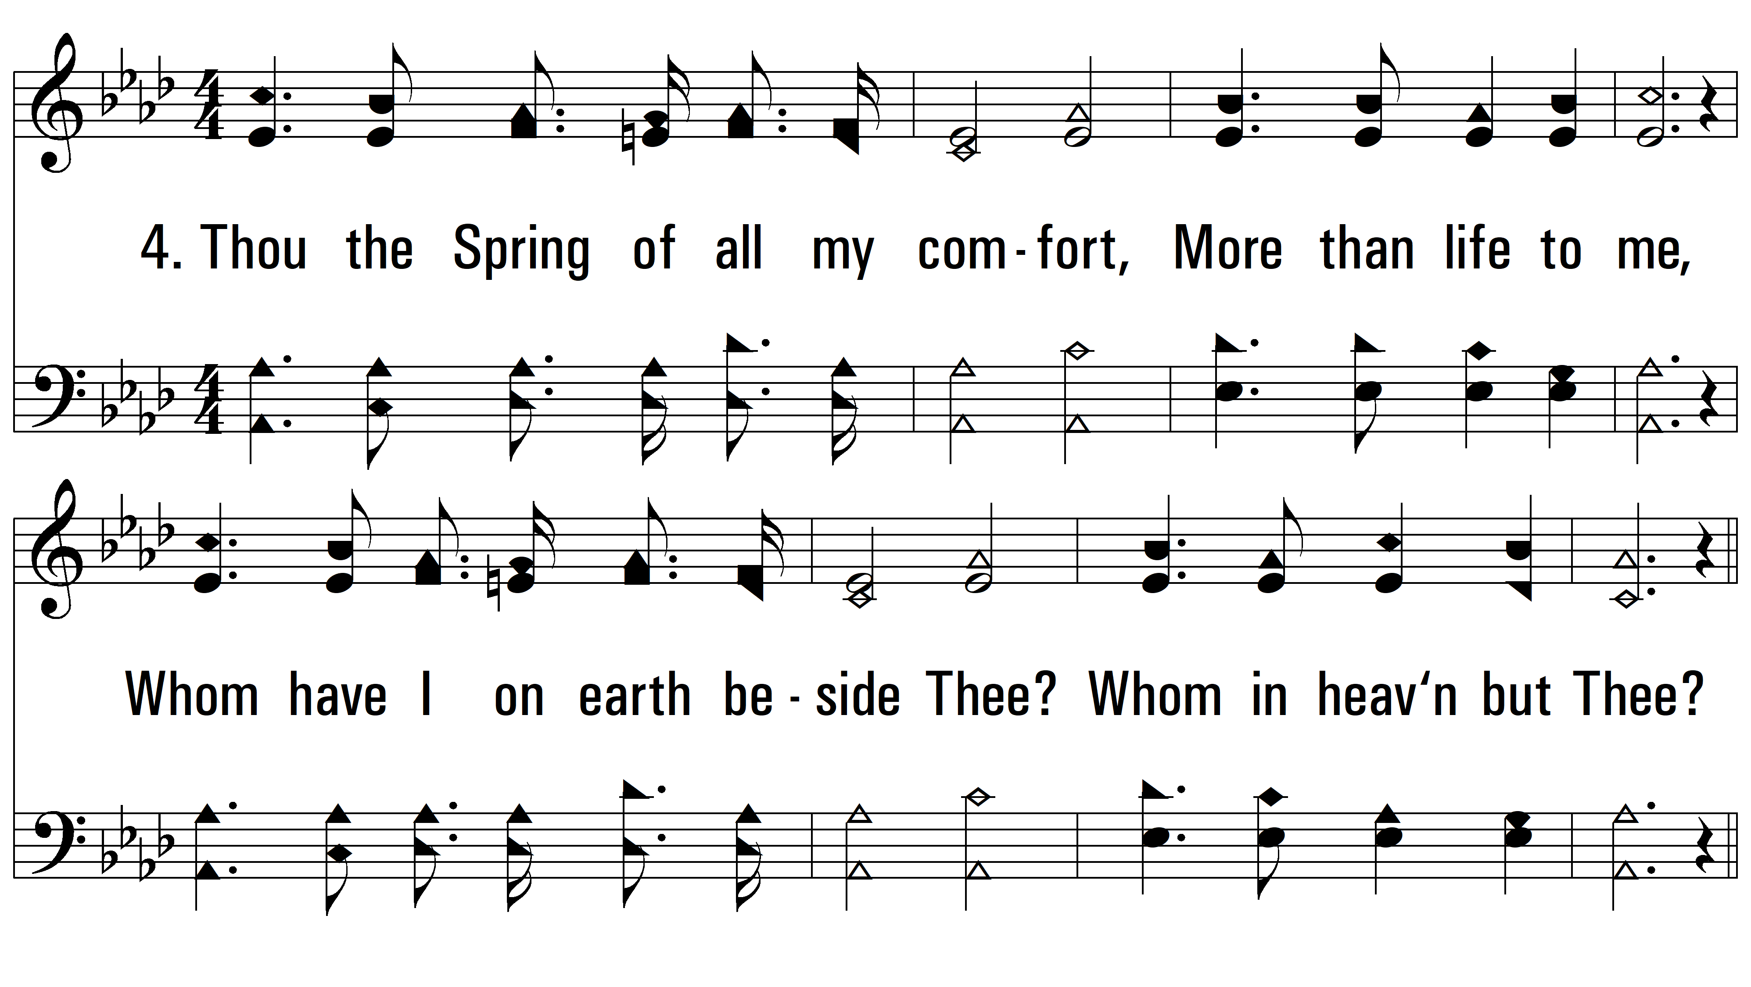
vs. 4 ~ Hear Me Now

Slide 9
vs. 4
PDHymns.com
END

