Slide 1
Hark! The Gentle Voice
Words: | Mrs. M. B. C. Slade (1873)
Music: | A. B. Everett (1873)
4/4
D/F# - MI
Verses: 3/Chorus
Lead - | MI
Alto - | DO
Tenor - | SOL
Bass - | DO
PDHymns.com

Slide 2
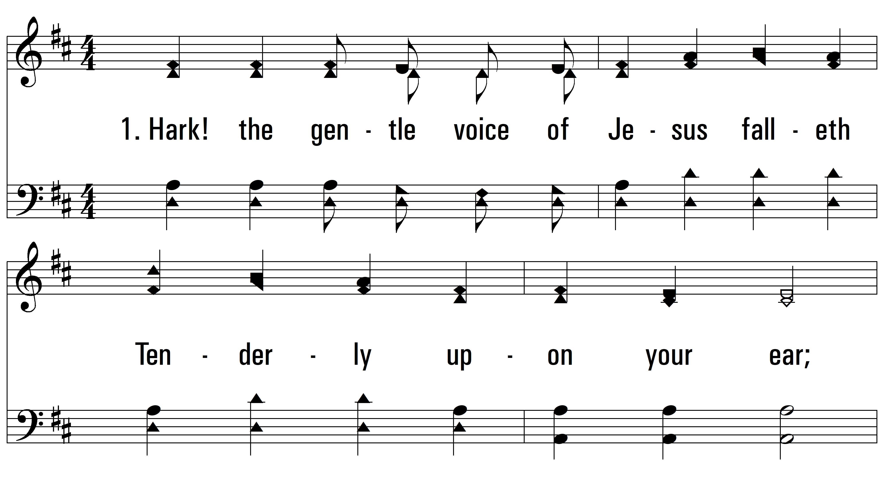
vs. 1 ~ Hark! The Gentle Voice

Slide 3
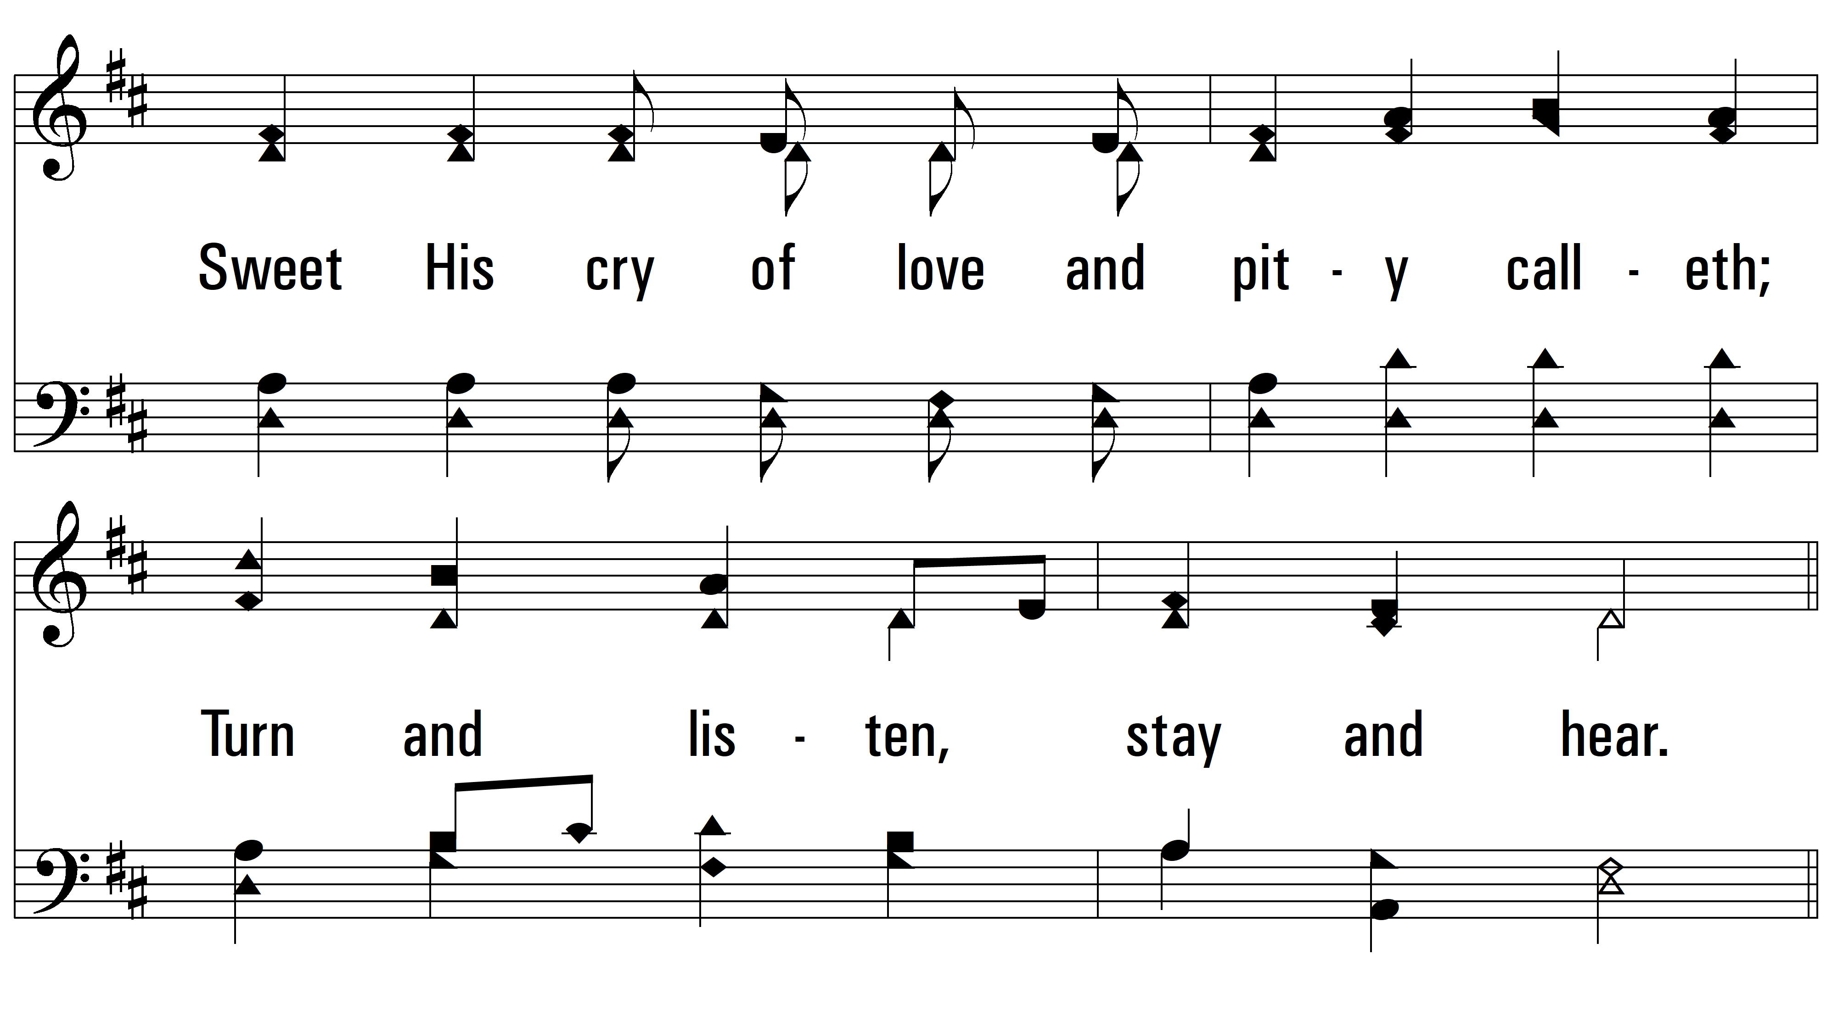
vs. 1

Slide 4
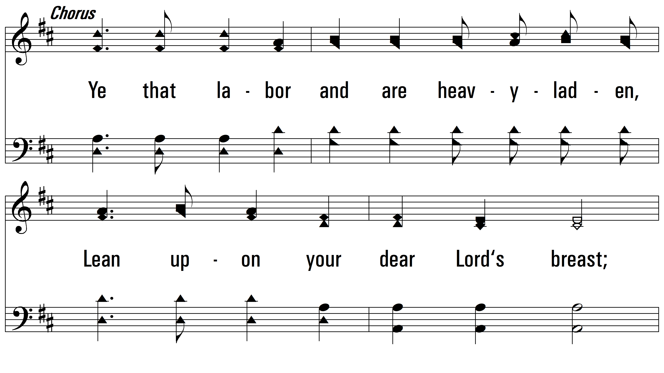
vs. 1

Slide 5
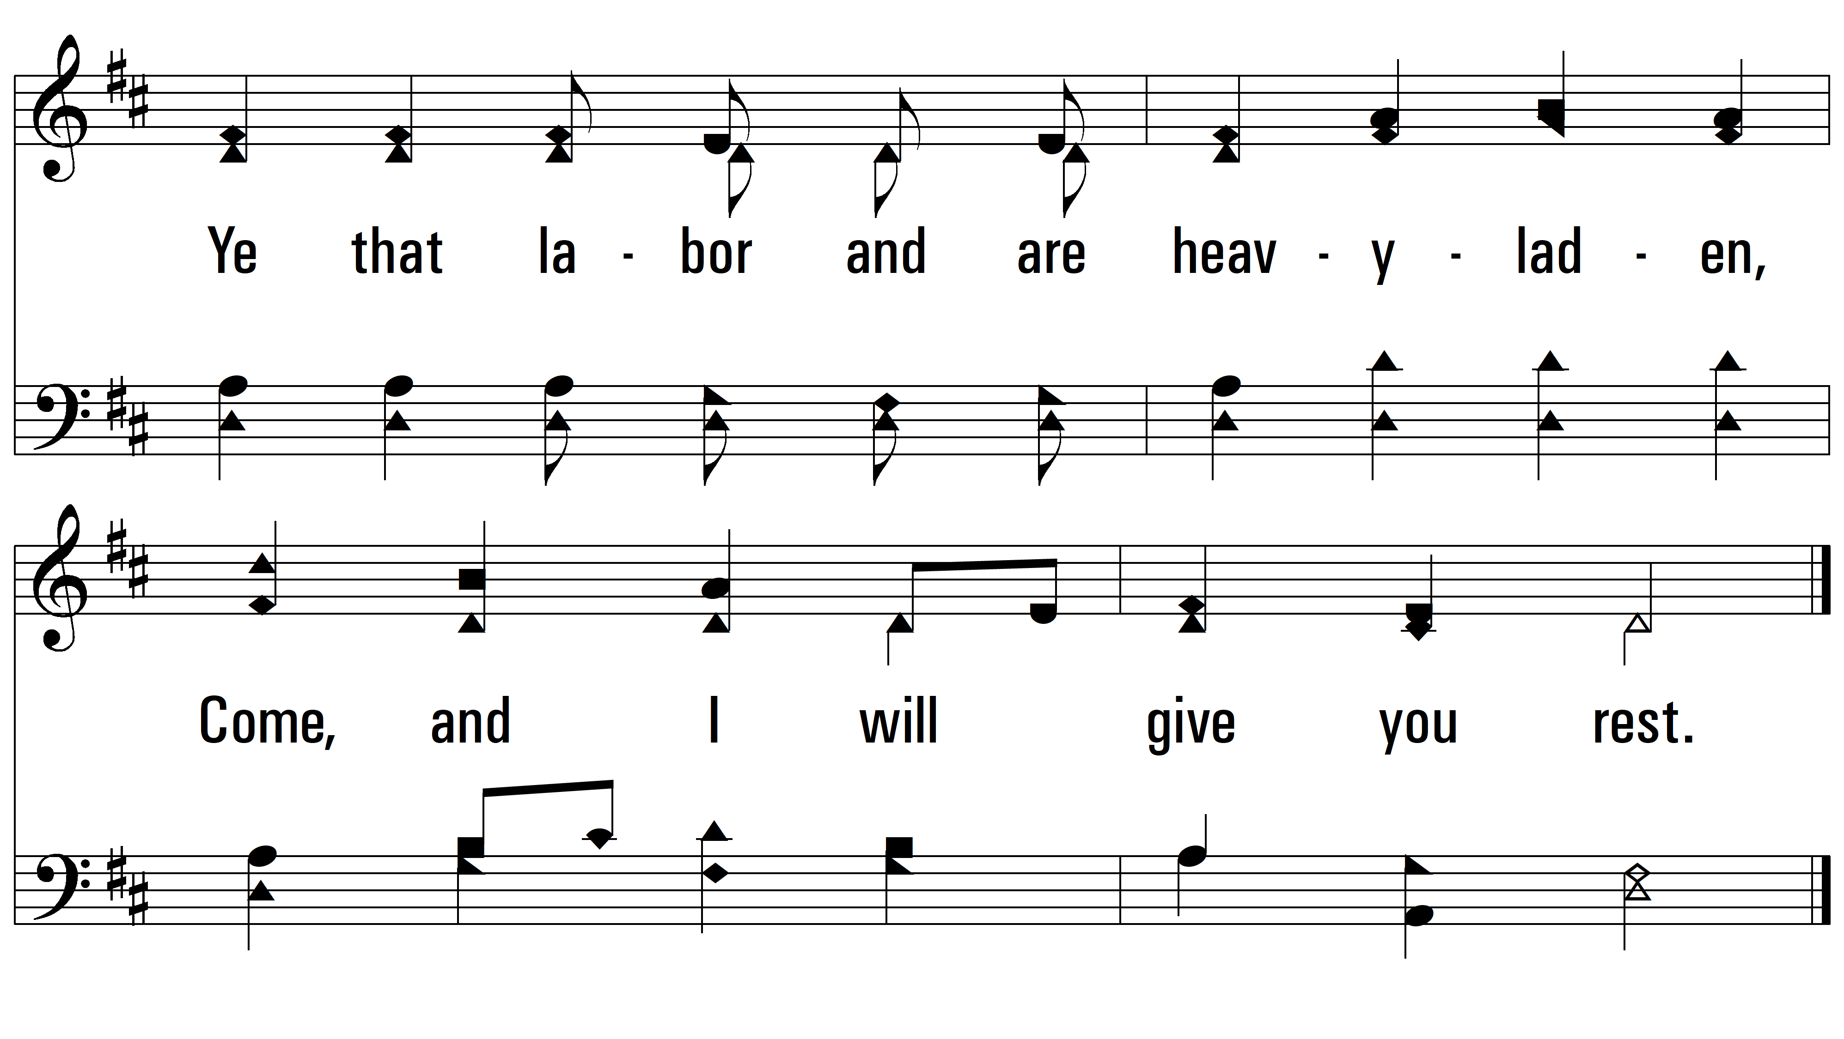
vs. 1

Slide 6
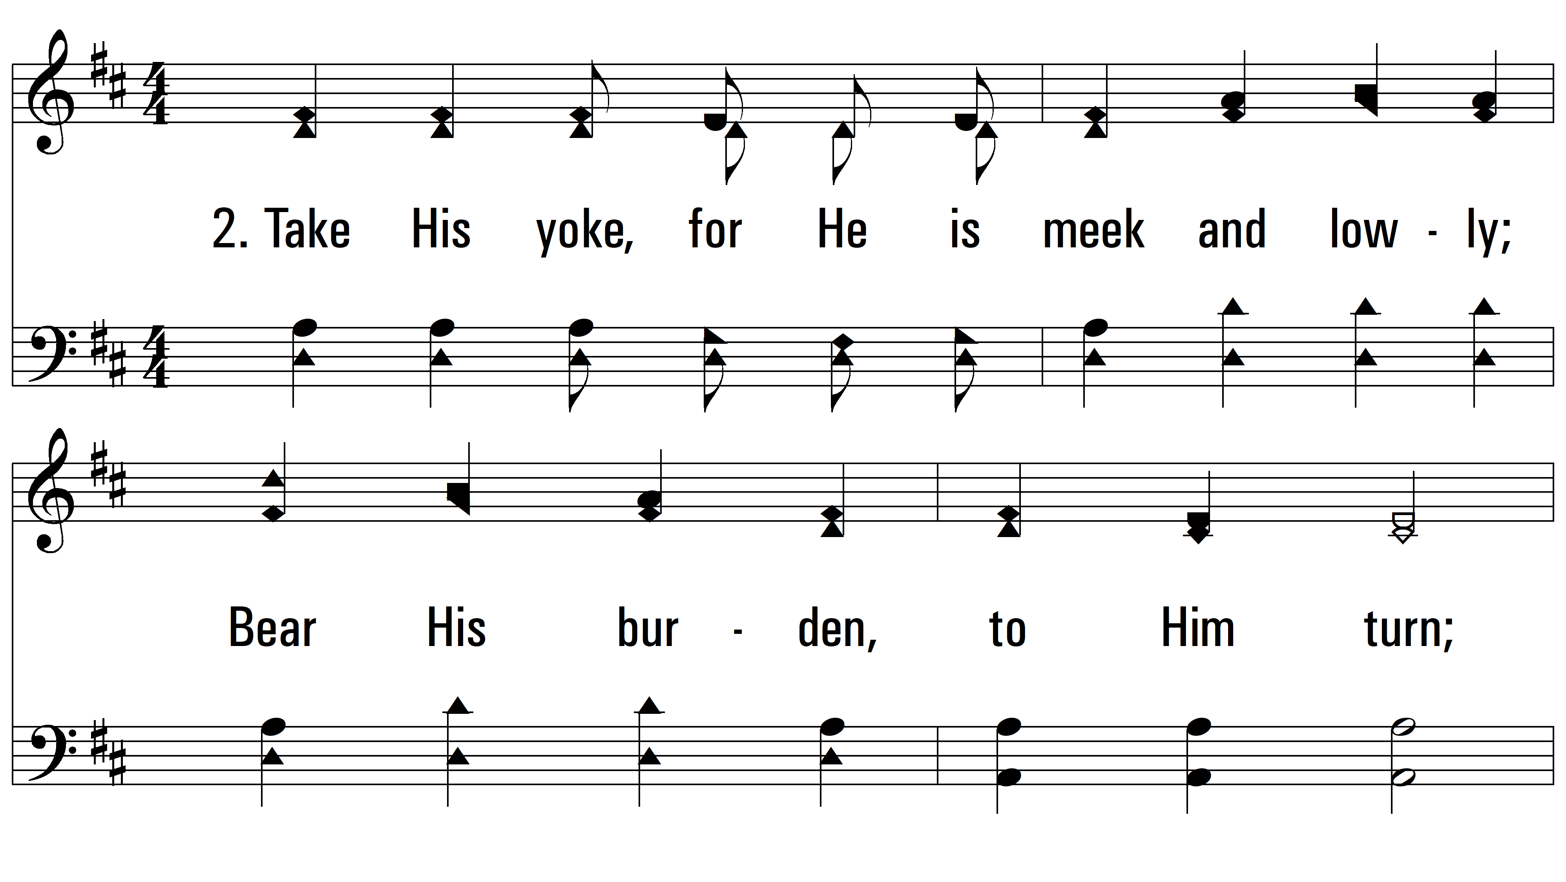
vs. 2 ~ Hark! The Gentle Voice

Slide 7
vs. 2

Slide 8
vs. 2

Slide 9
vs. 2

Slide 10
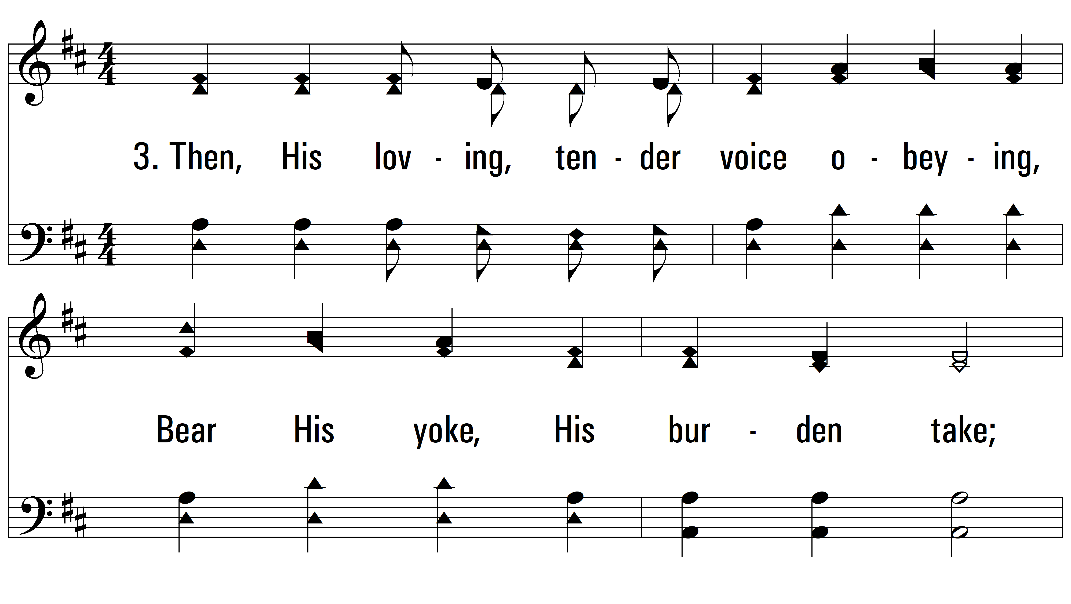
vs. 3 ~ Hark! The Gentle Voice

Slide 11
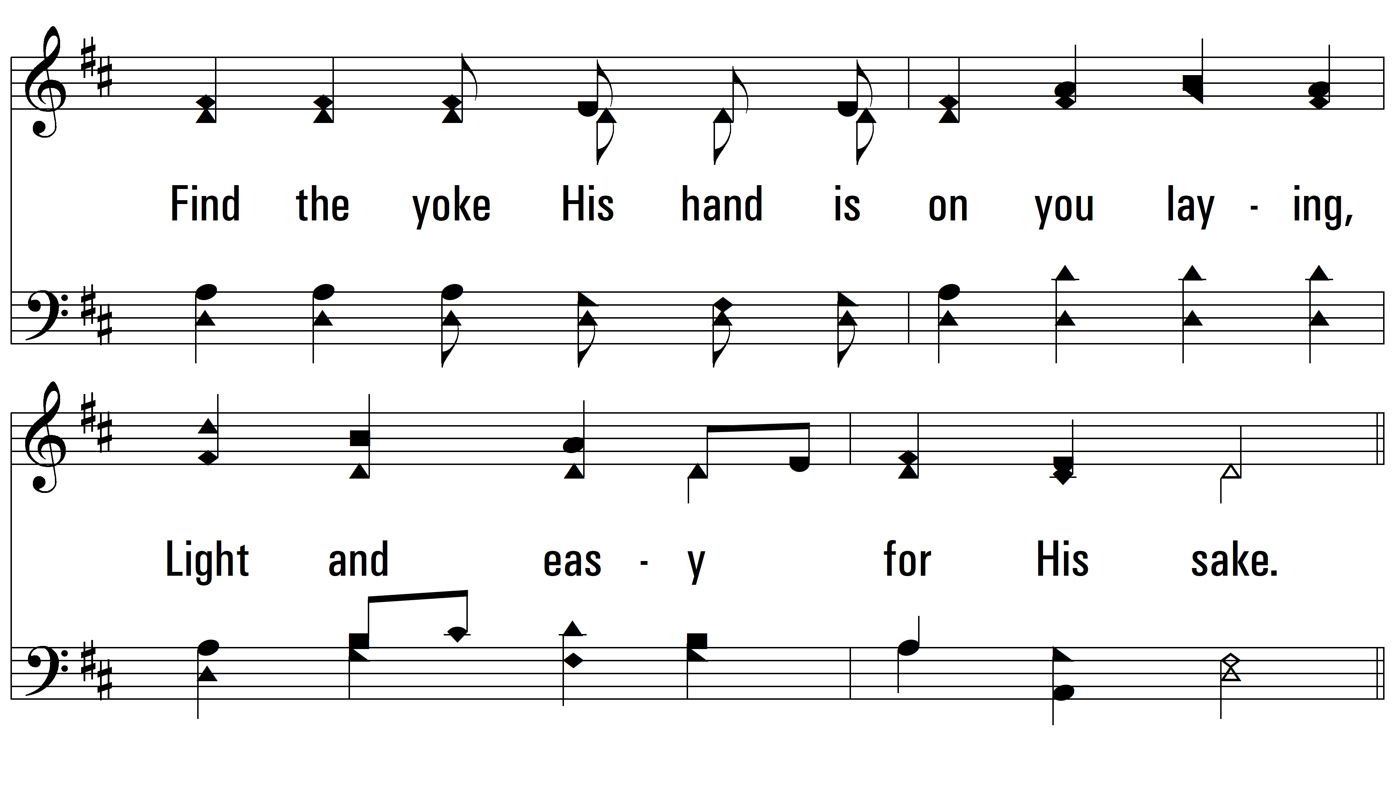
vs. 3

Slide 12
vs. 3

Slide 13
vs. 3
PDHymns.com
END

