Slide 1
Hallelujah, Praise Jehovah
Words: | William J. Kirkpatrick (1893), Psalm 148
Music: | William J. Kirkpatrick (1893)
4/4
G/D - SOL
Verses: 3/Chorus
Lead - | SOL
Alto - | SOL
Tenor - | SOL
Bass - | SOL
PDHymns.com

Slide 2
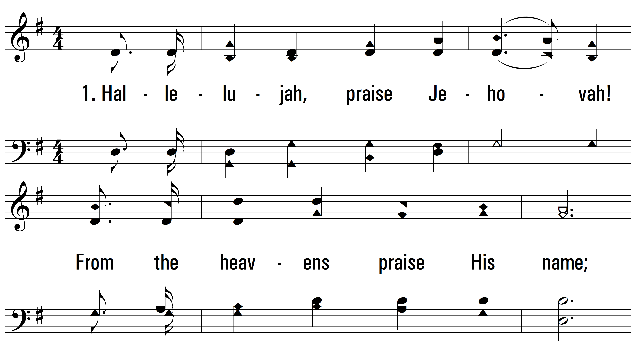
vs. 1 ~ Hallelujah, Praise Jehovah

Slide 3
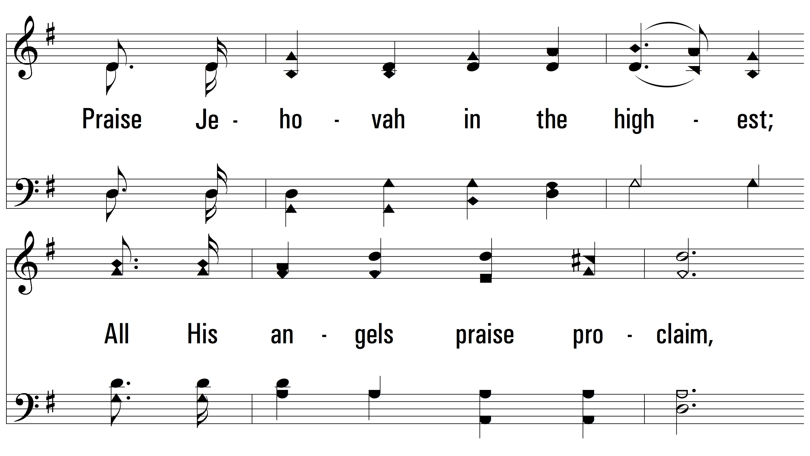
vs. 1

Slide 4
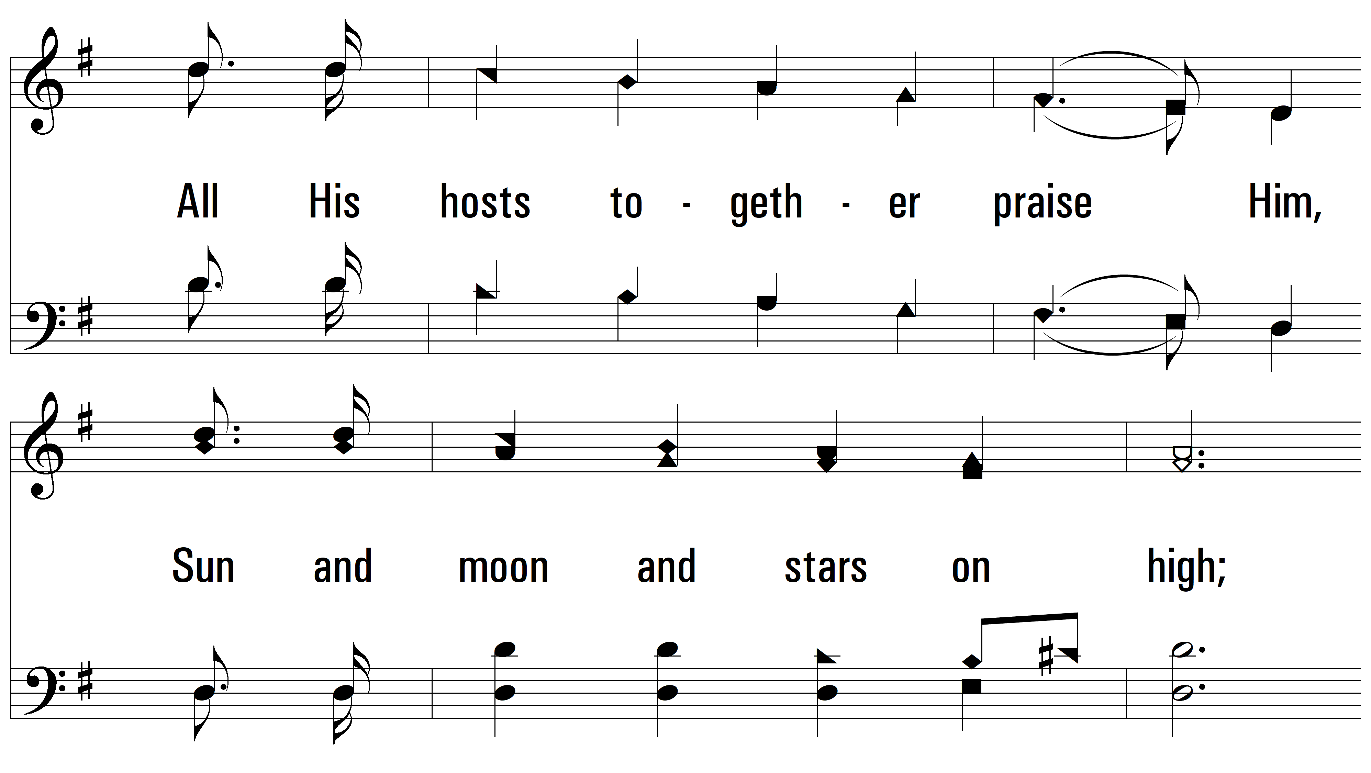
vs. 1

Slide 5
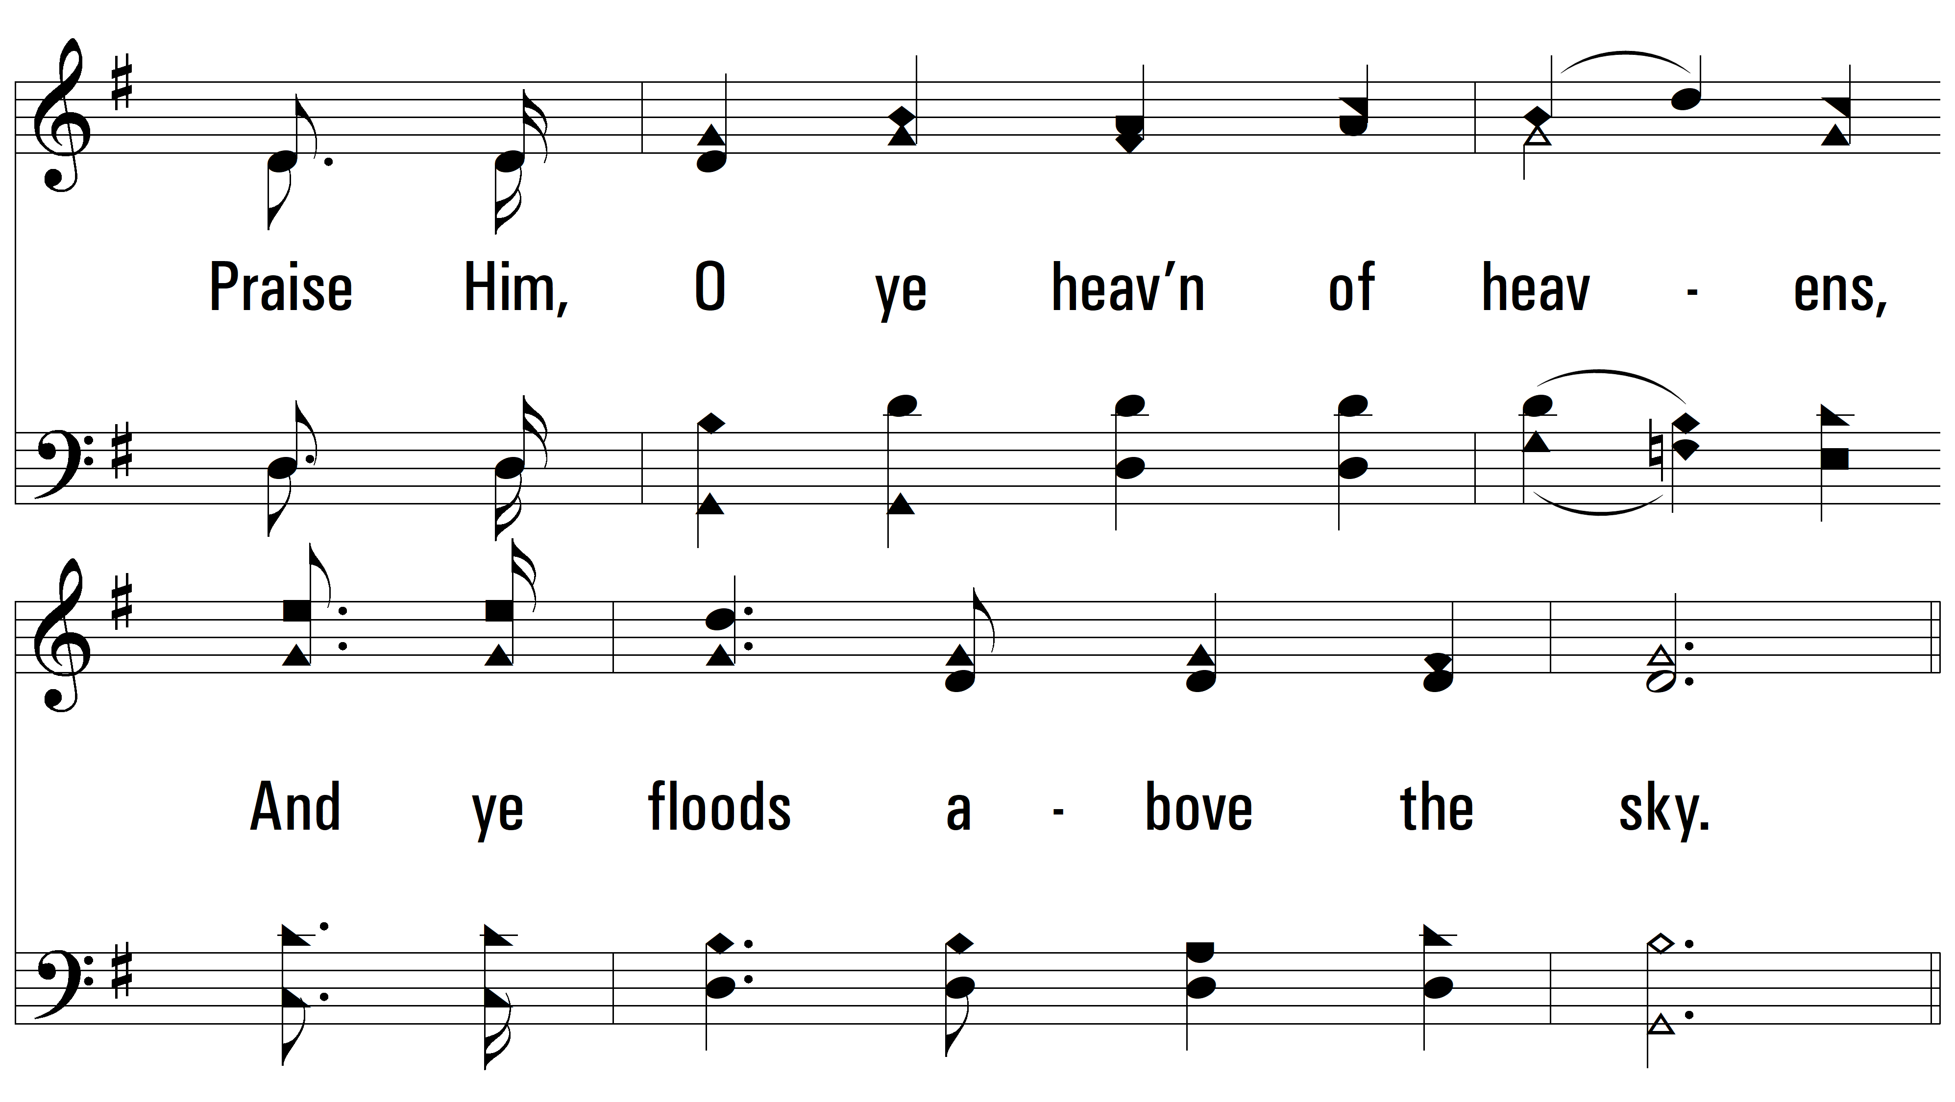
vs. 1

Slide 6
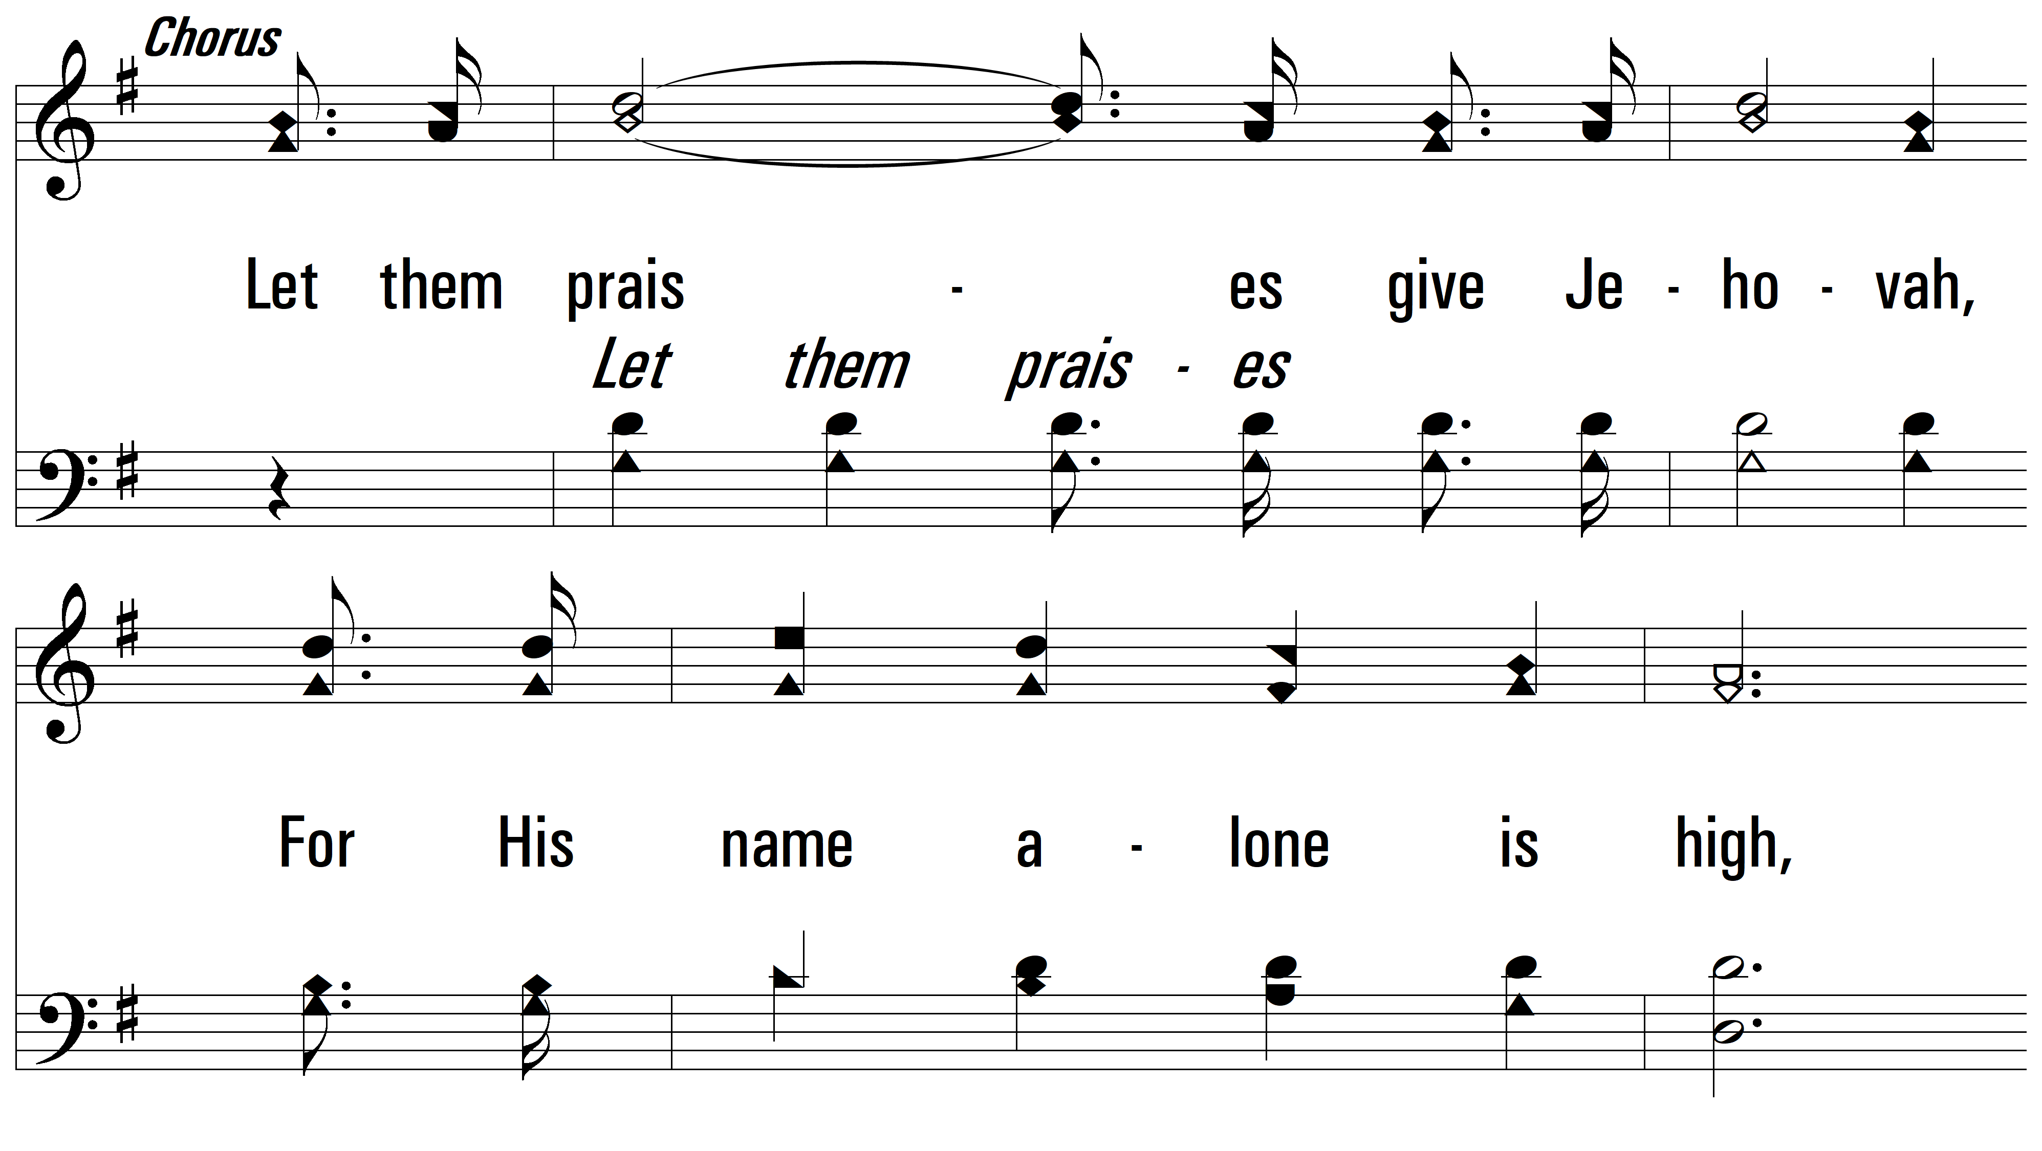
vs. 1

Slide 7
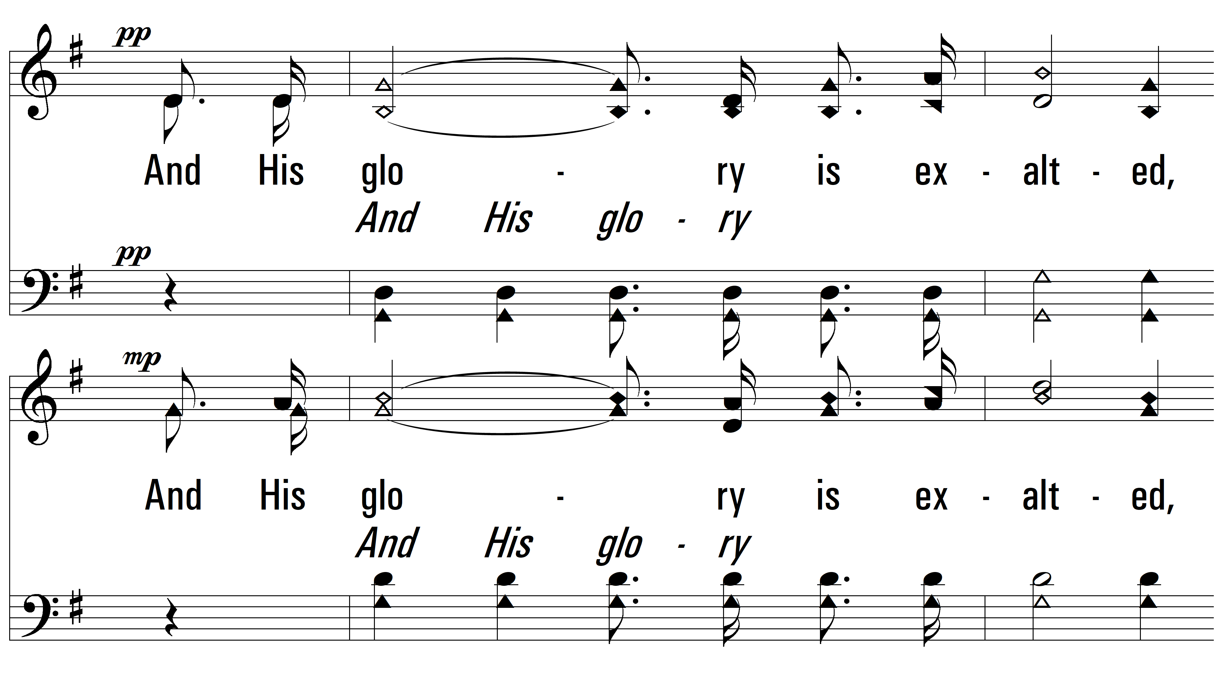
vs. 1

Slide 8
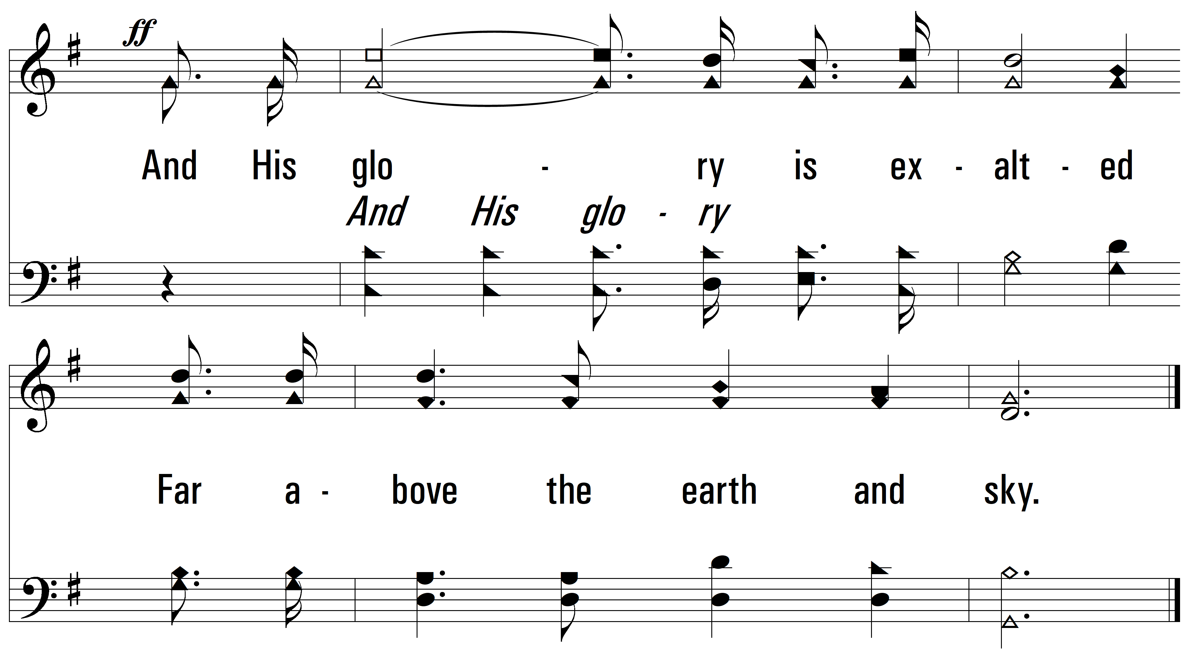
vs. 1

Slide 9
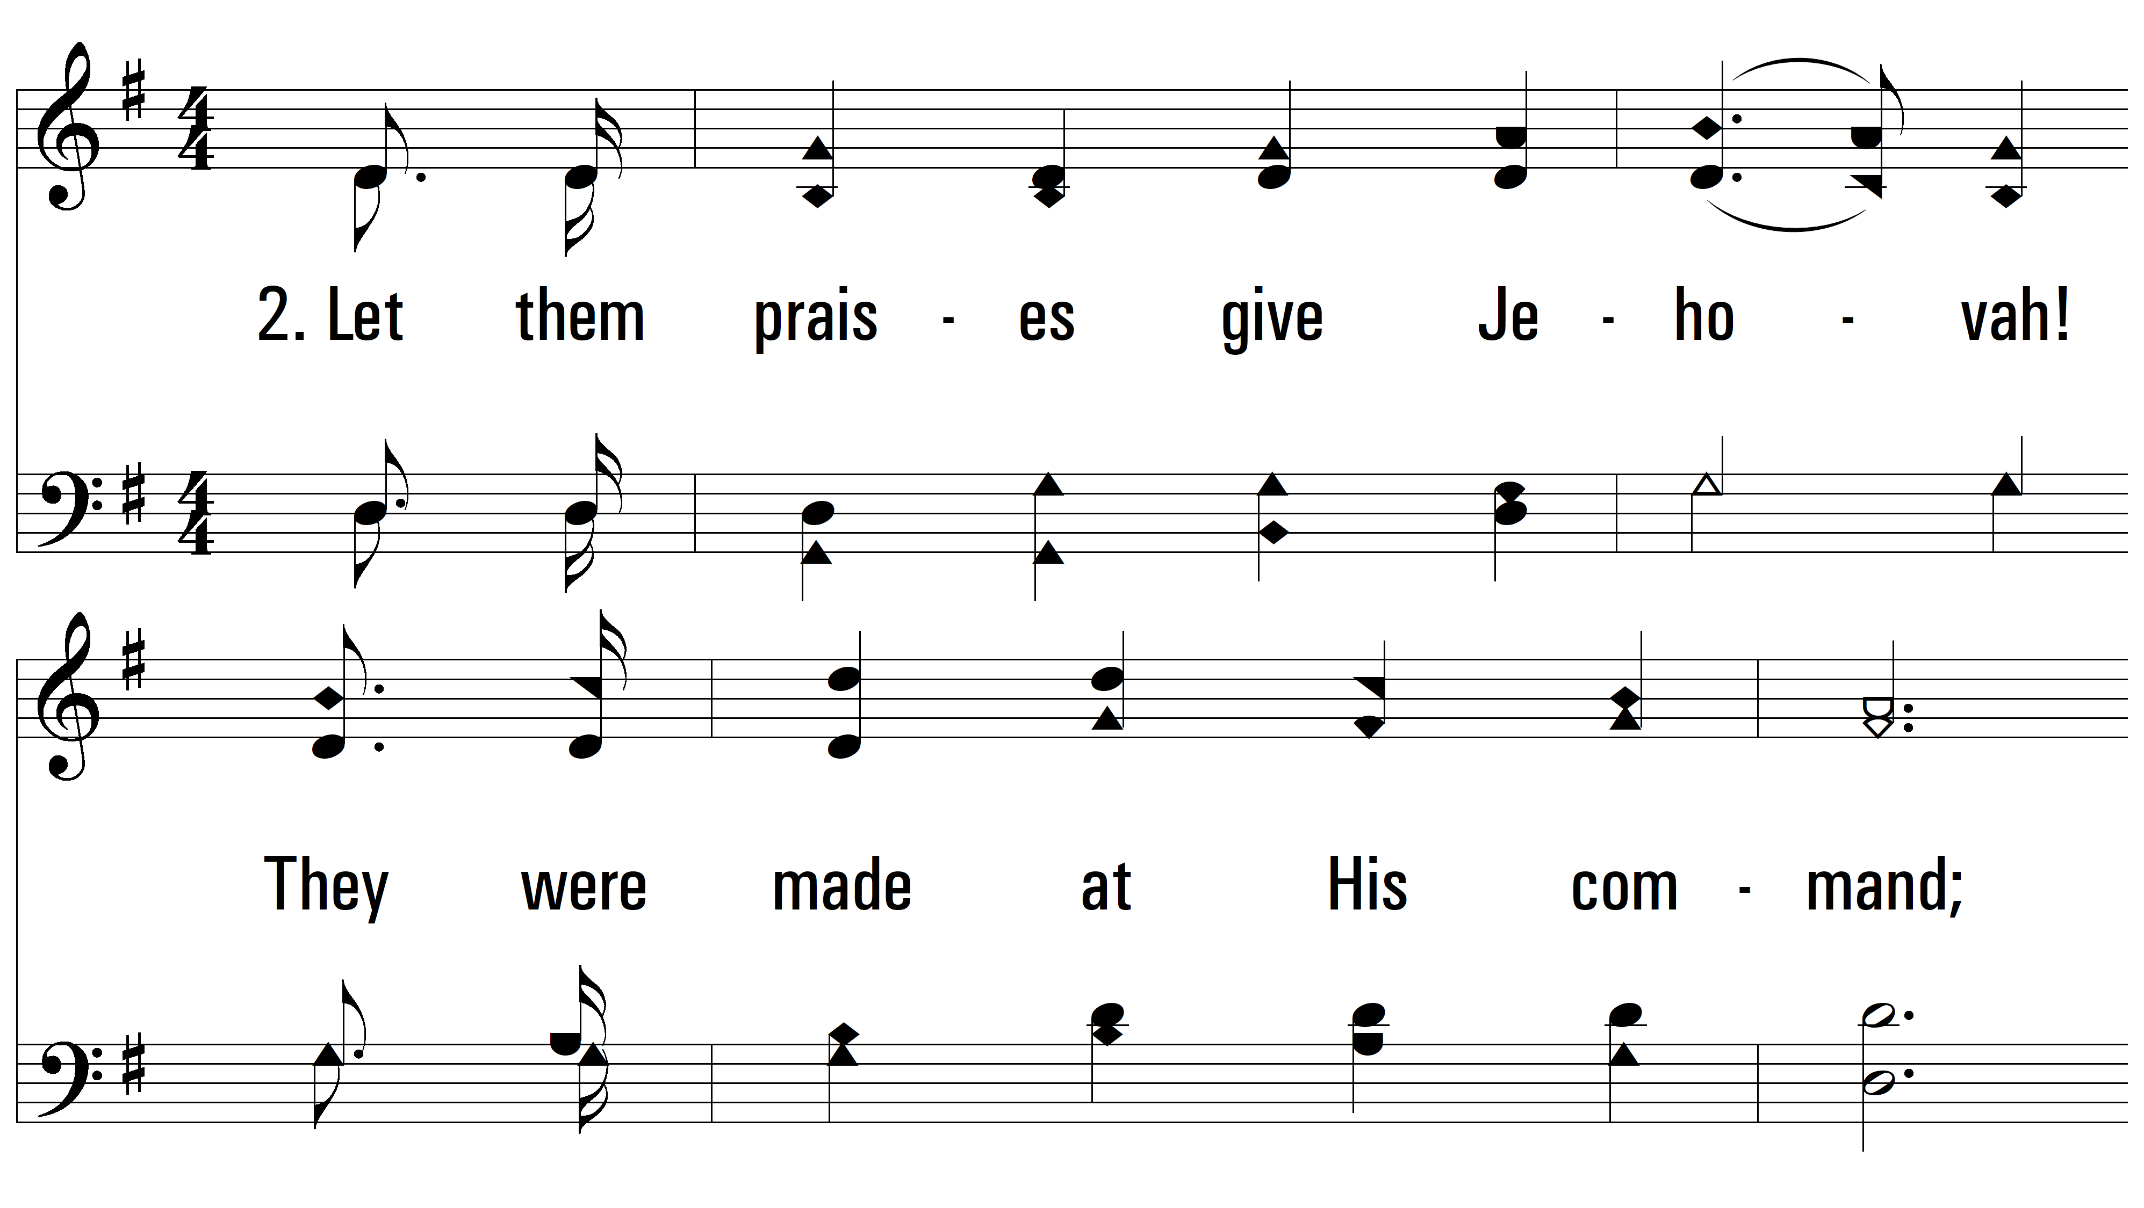
vs. 2 ~ Hallelujah, Praise Jehovah

Slide 10
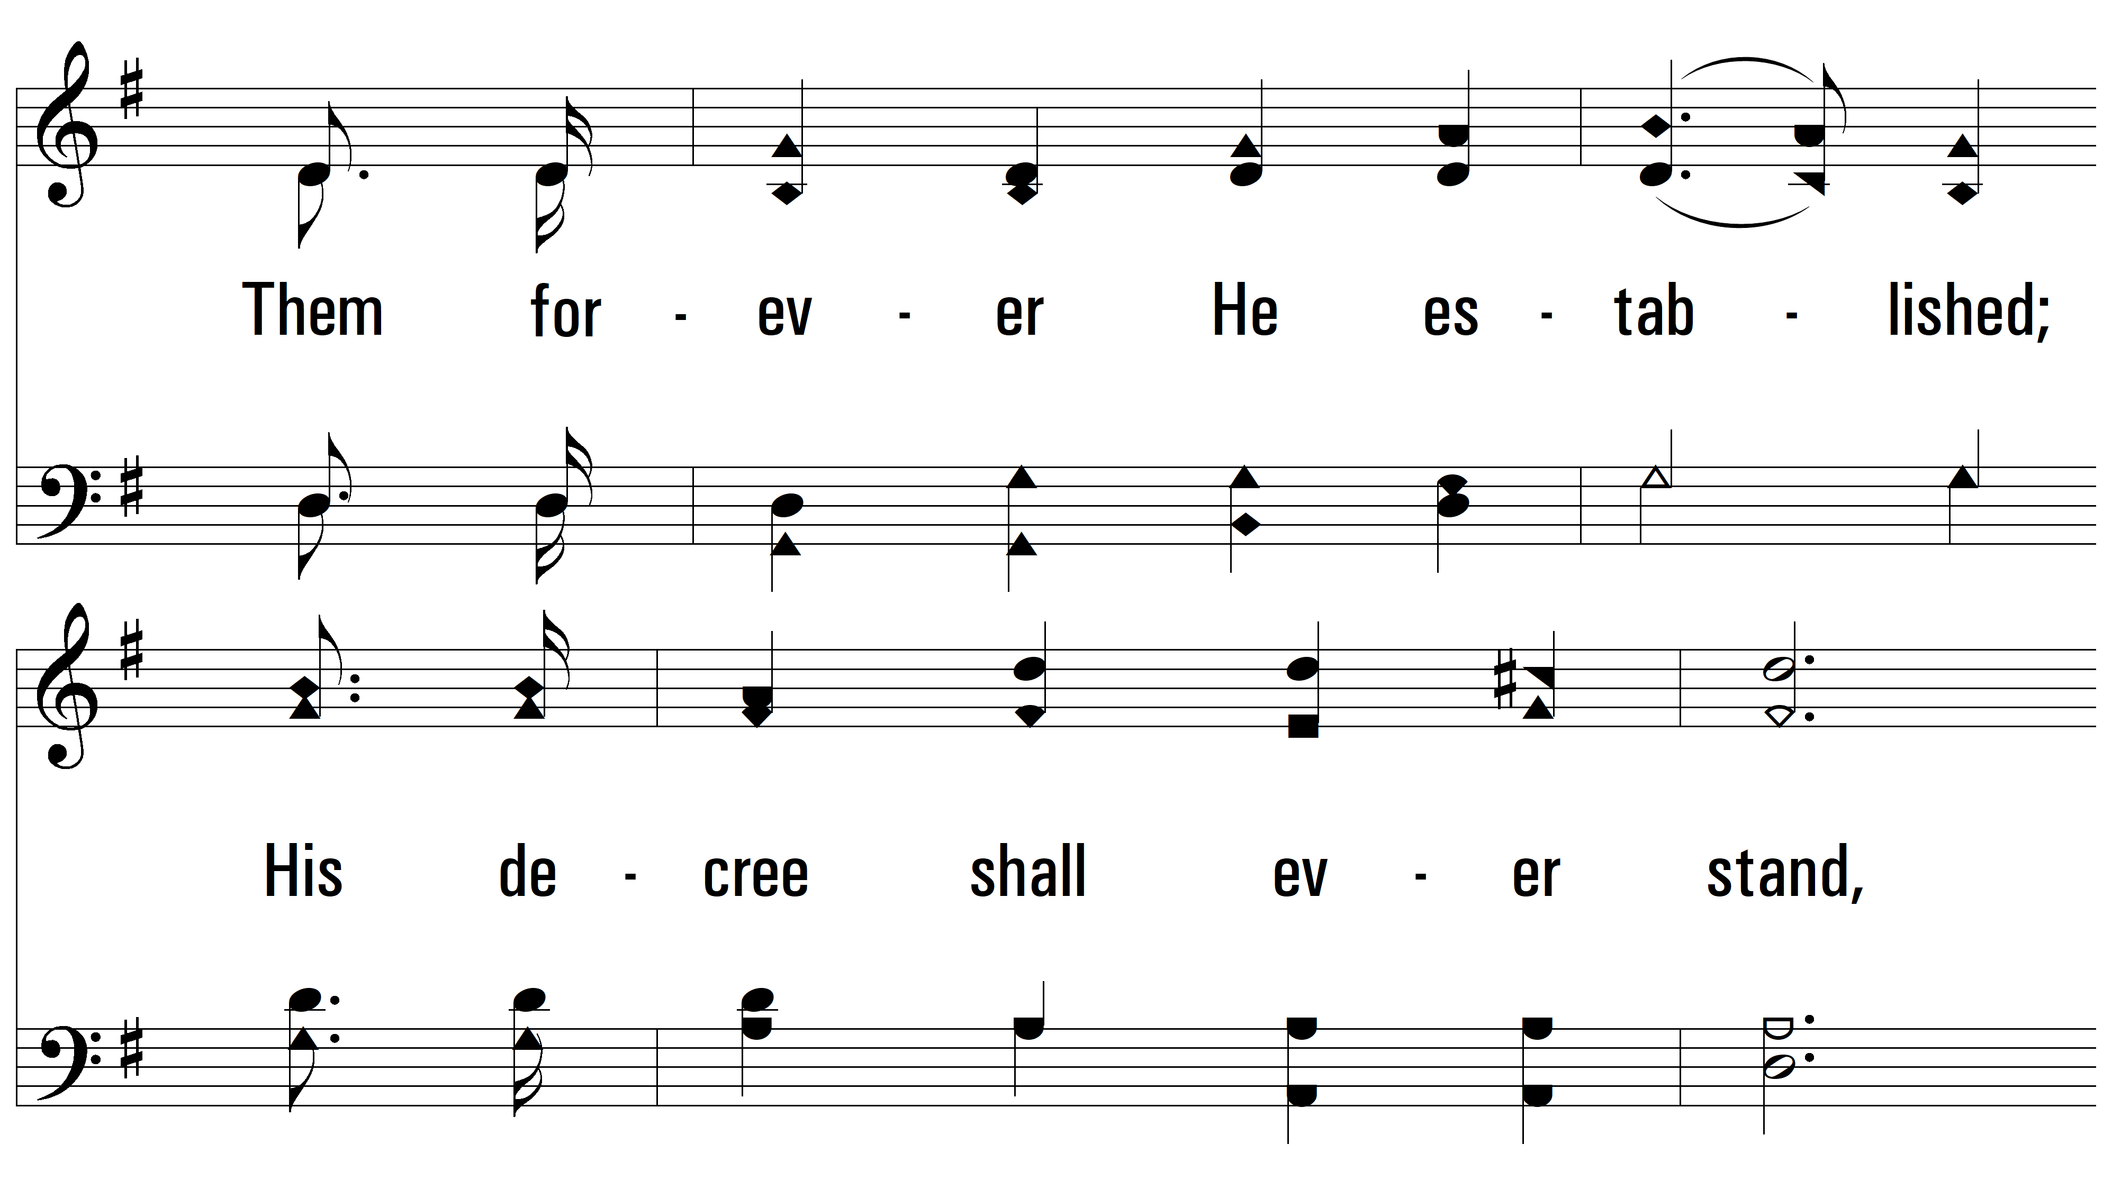
vs. 2

Slide 11
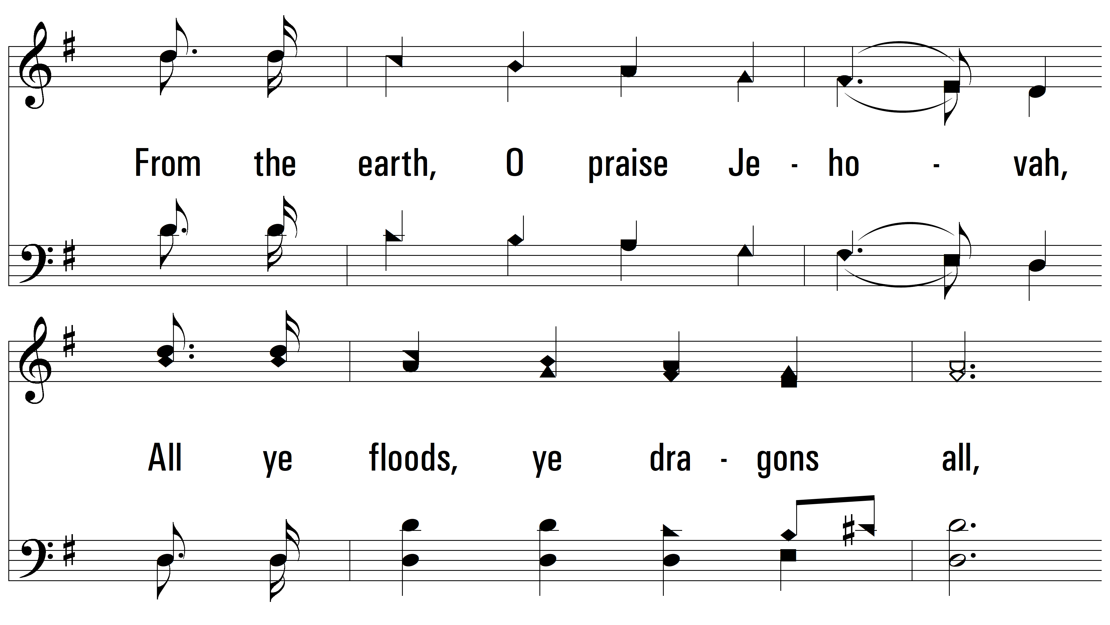
vs. 2

Slide 12
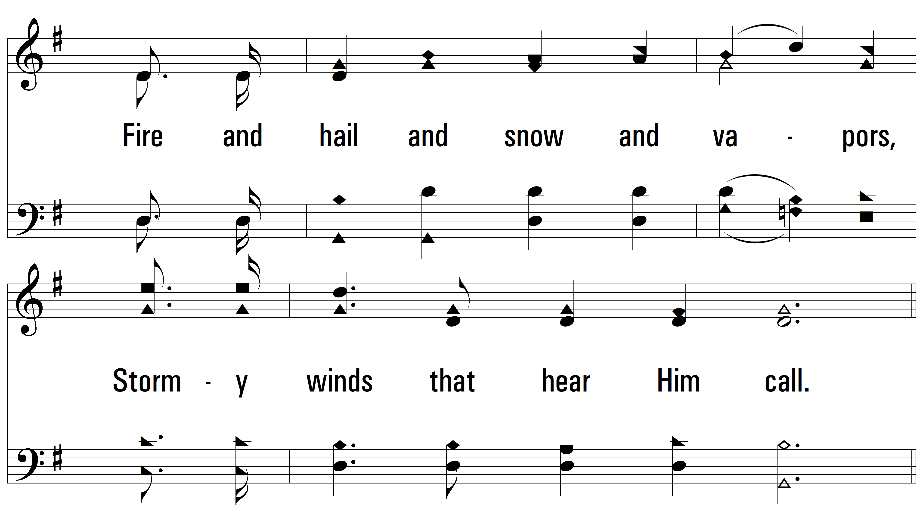
vs. 2

Slide 13
vs. 2

Slide 14
vs. 2

Slide 15
vs. 2

Slide 16
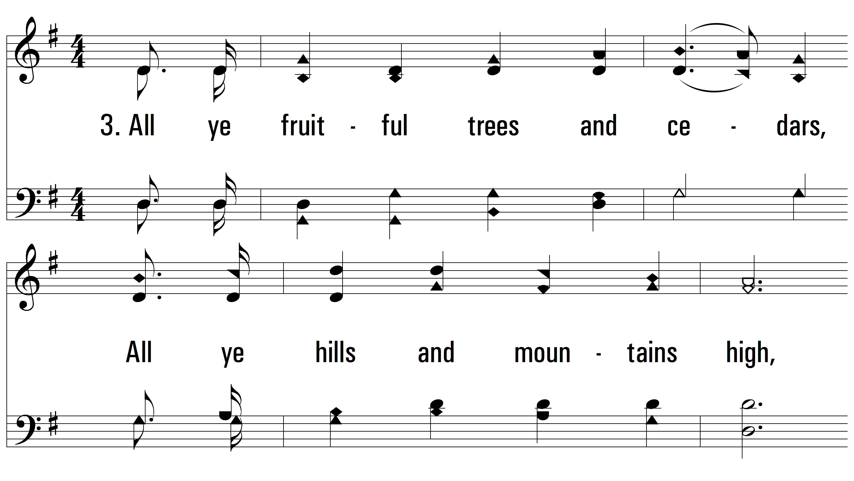
vs. 3 ~ Hallelujah, Praise Jehovah

Slide 17
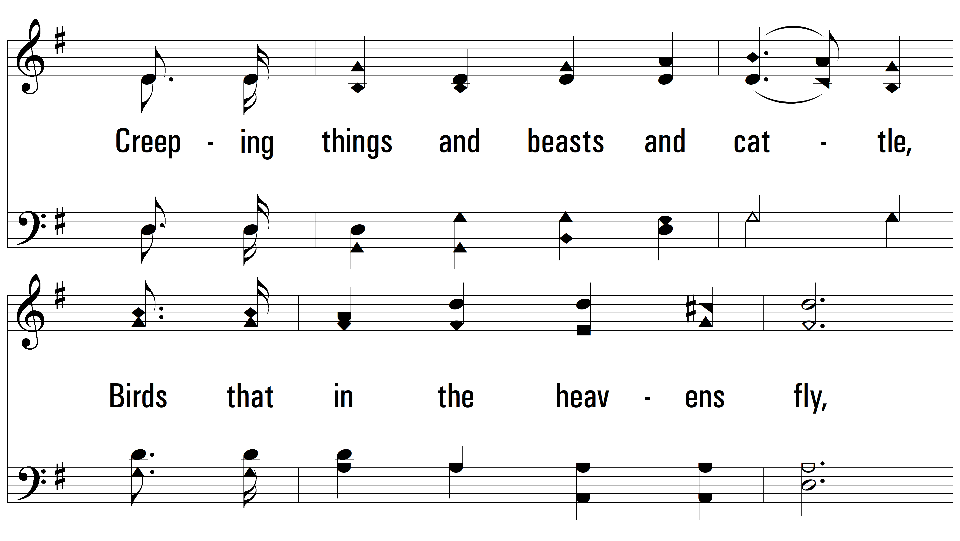
vs. 3

Slide 18
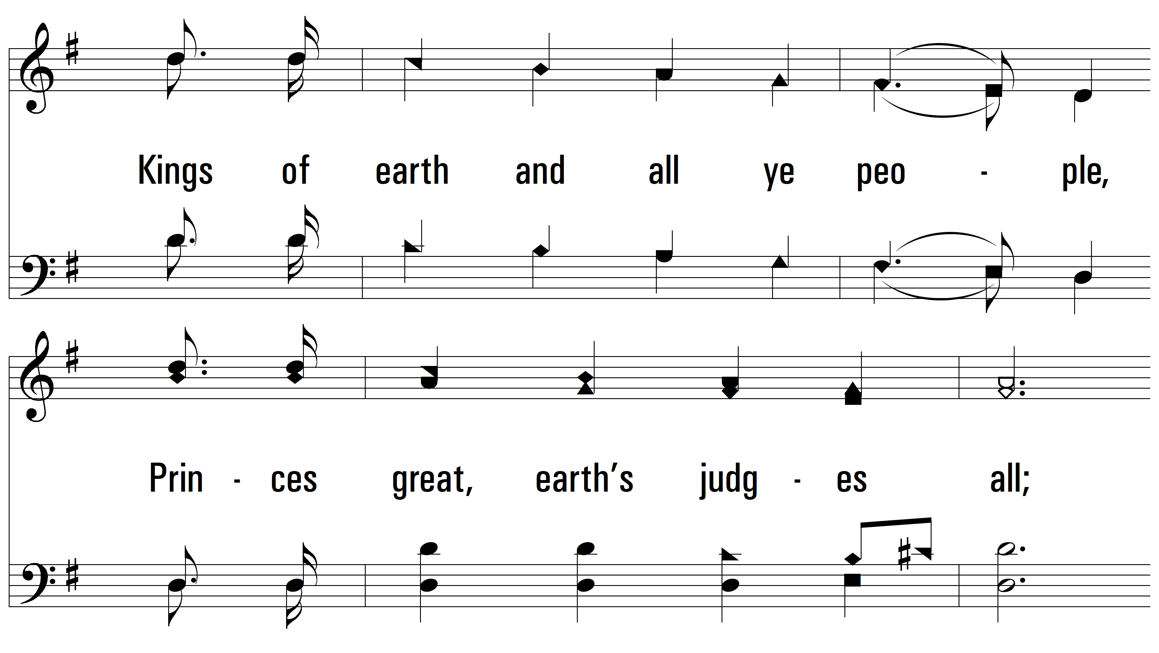
vs. 3

Slide 19
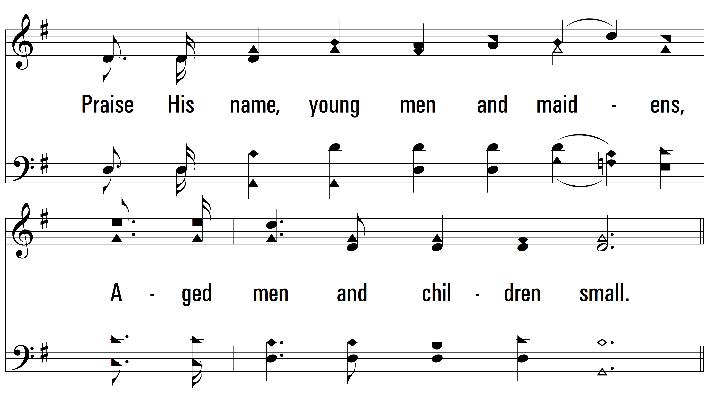
vs. 3

Slide 20
vs. 3

Slide 21
vs. 3

Slide 22
vs. 3
PDHymns.com
END

