Slide 1
God Is So Good
Words: | American Folk Hymn
Music: | American Folk Melody
4/4
E^{b}/E^{b} - DO
Verses: 4
Lead - | DO
Alto - | SOL
Tenor - | MI
Bass - | DO
PDHymns.com

Slide 2
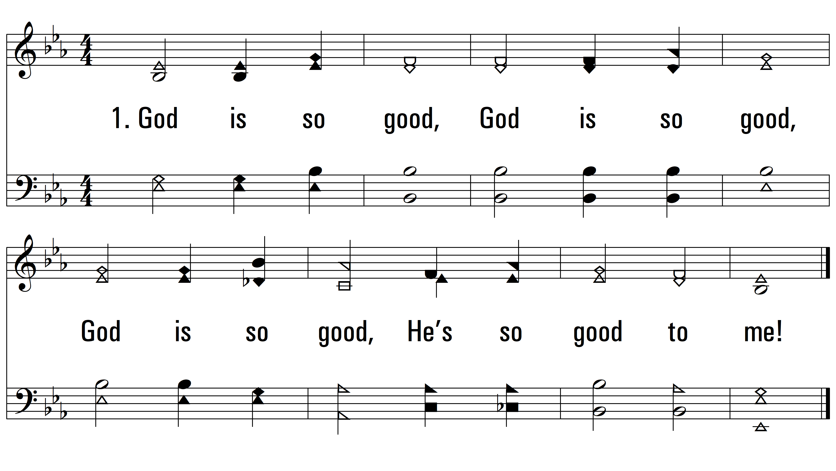
vs. 1 ~ God Is So Good

Slide 3
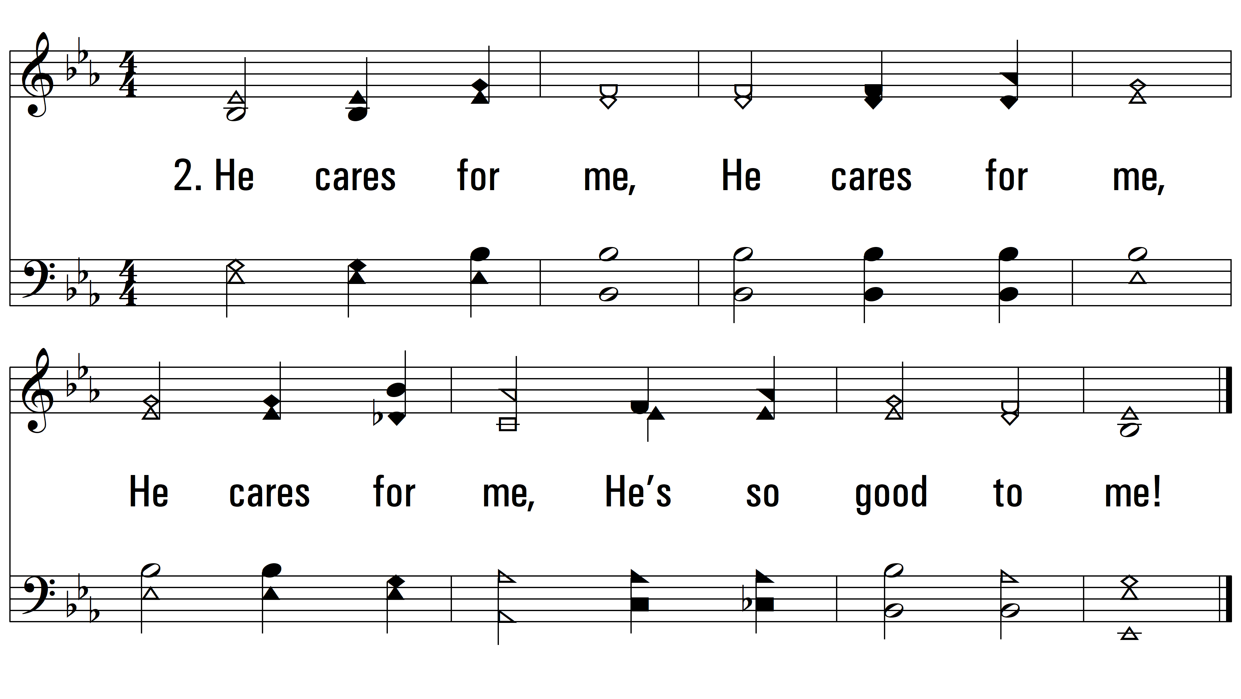
vs. 2 ~ God Is So Good

Slide 4
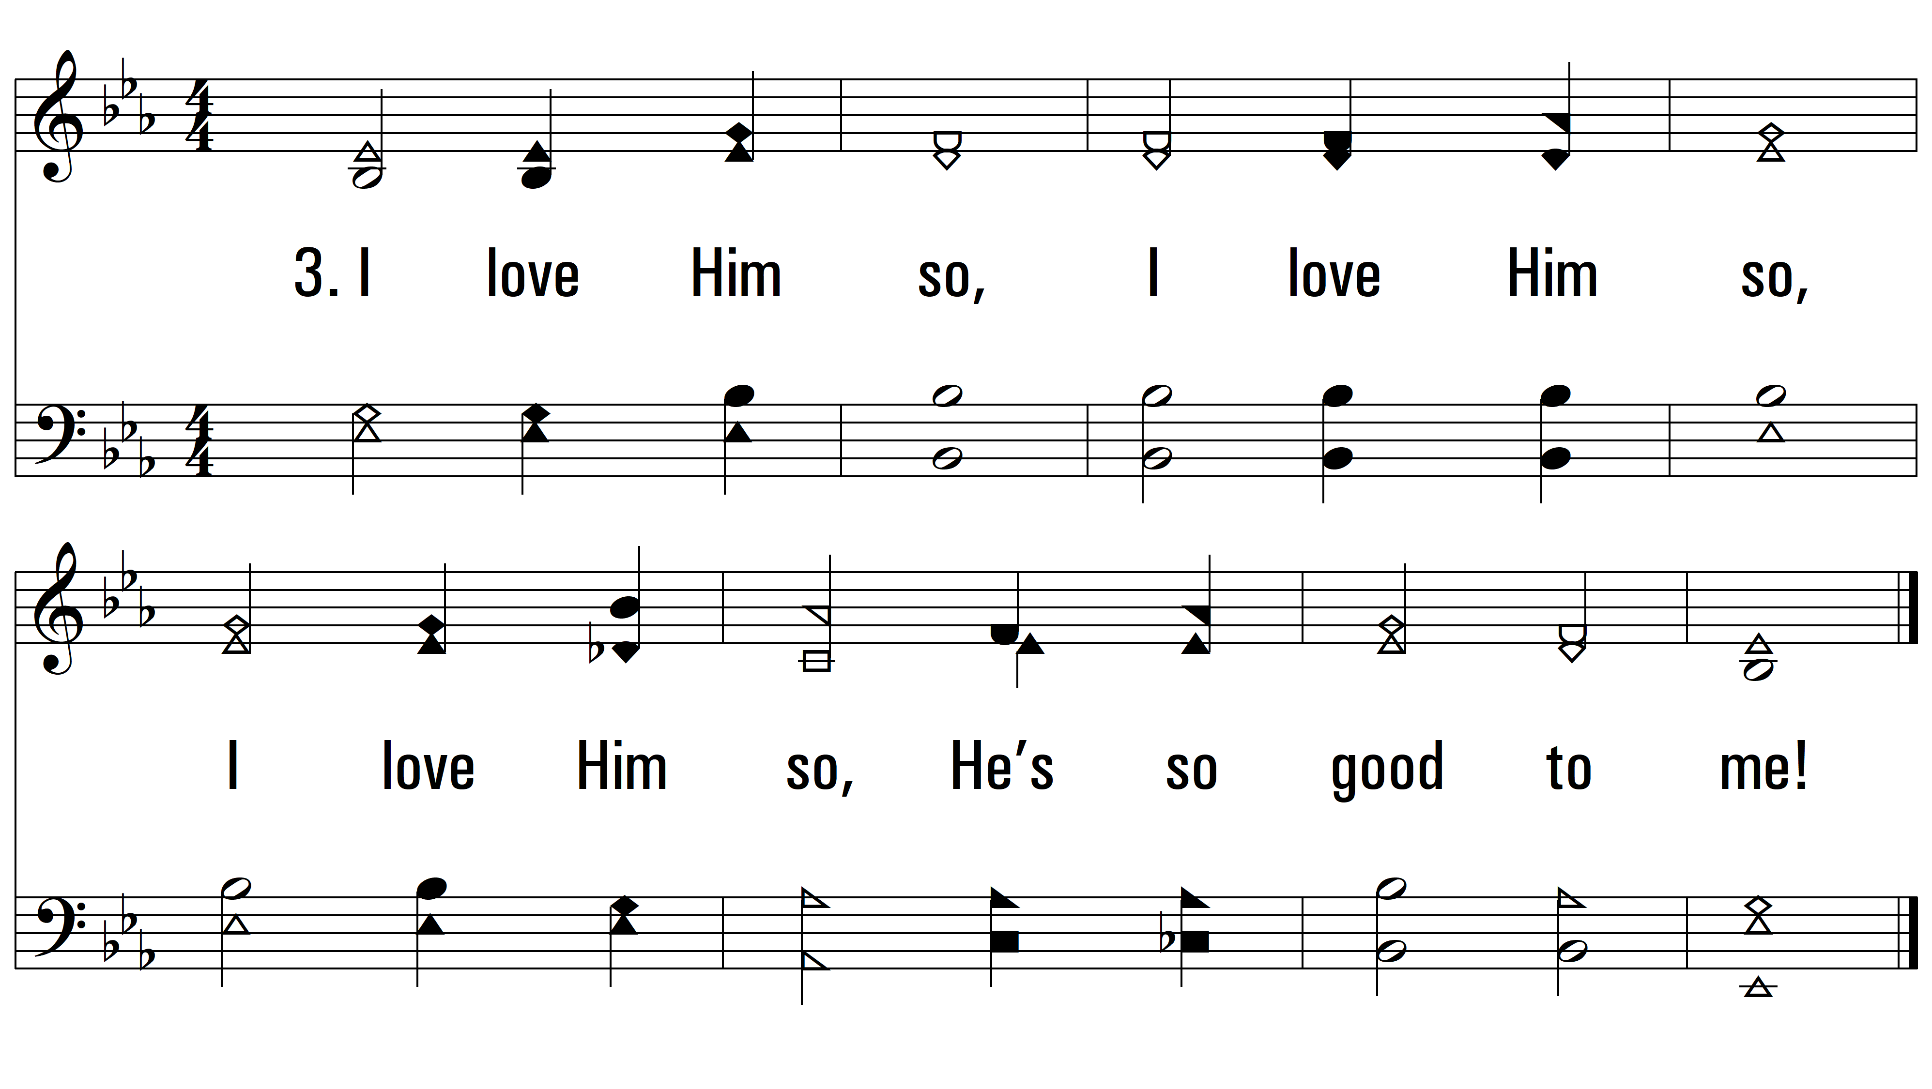
vs. 3 ~ God Is So Good

Slide 5
vs. 4 ~ God Is So Good
PDHymns.com
END

