Slide 1
Go Into The Field
Words: | Brown Roland (1916)
Music: | Samuel W. Beazley (1916)
4/4
D/D - DO
Verses: 3/Chorus
Lead - | DO
Alto - | DO
Tenor - | MI
Bass - | DO
PDHymns.com

Slide 2
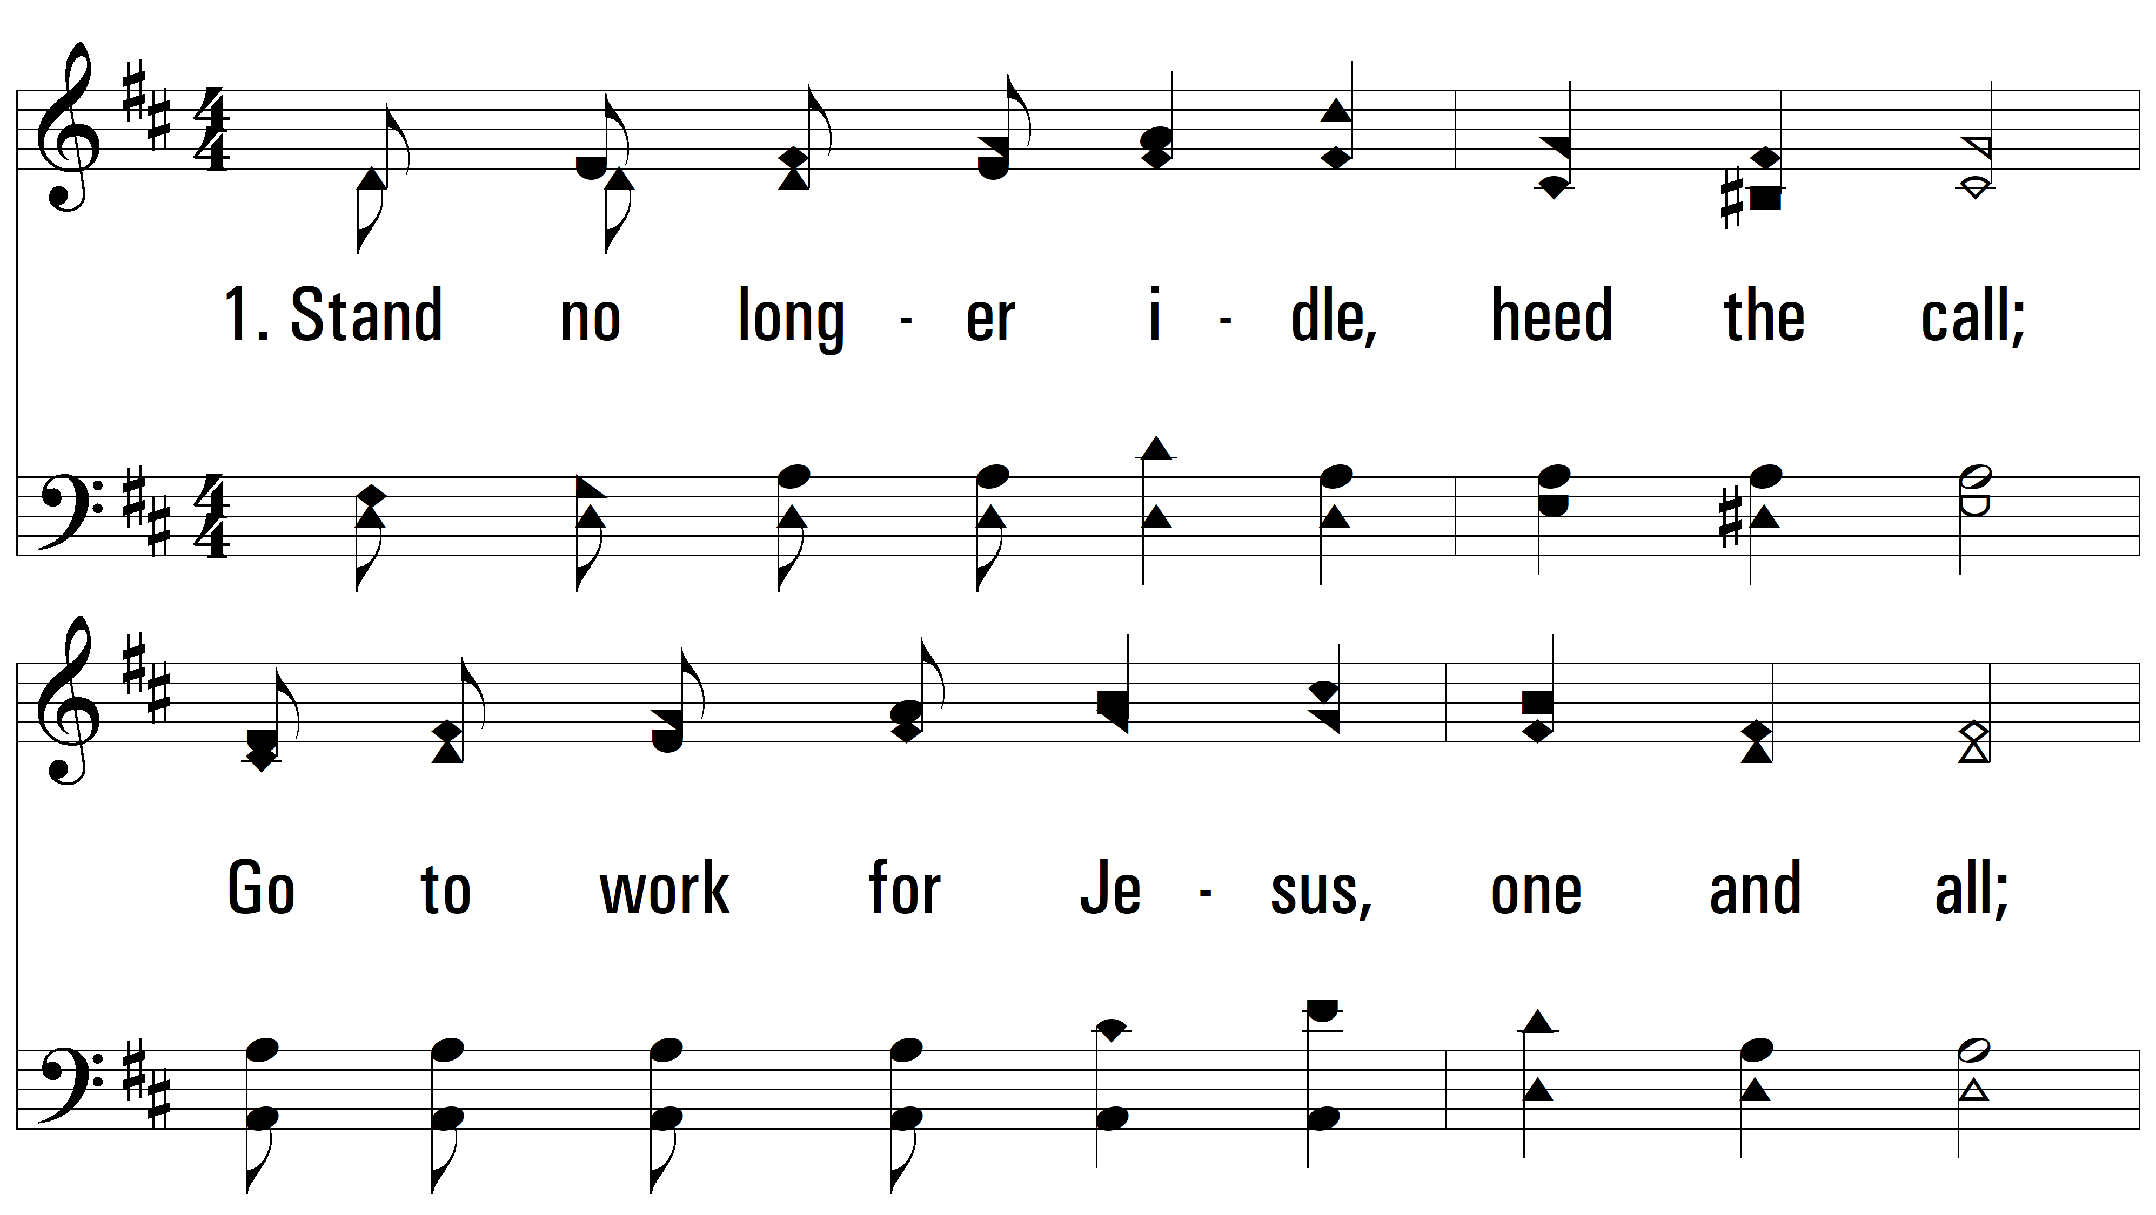
vs. 1 ~ Go Into The Field

Slide 3
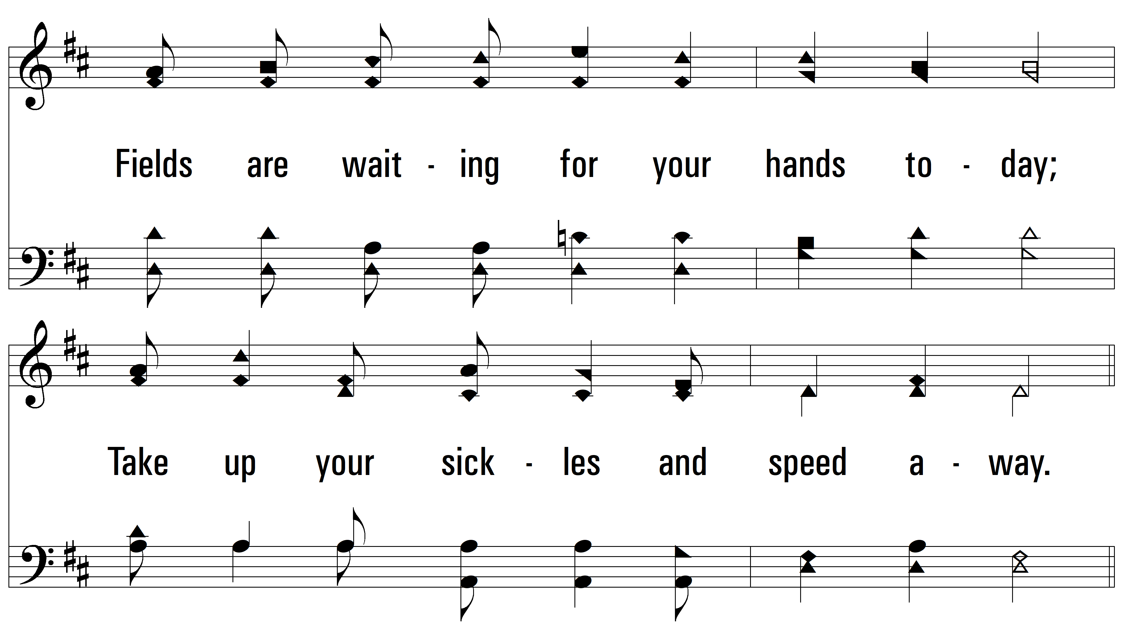
vs. 1

Slide 4
vs. 1

Slide 5
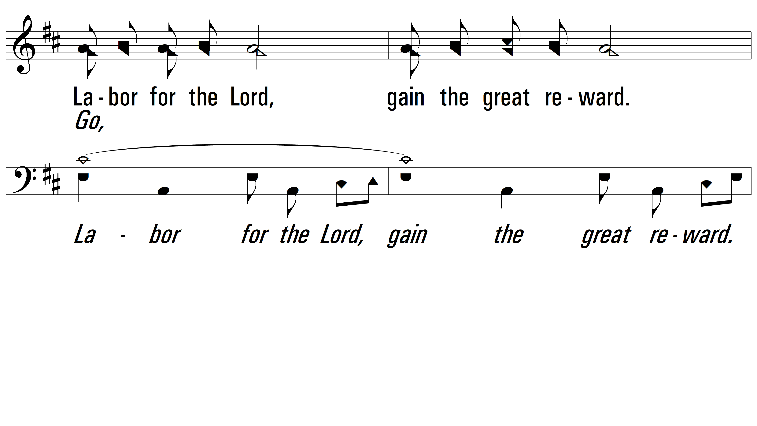
vs. 1

Slide 6
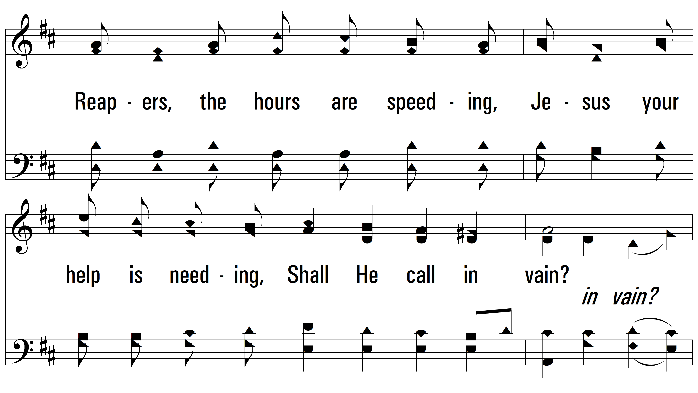
vs. 1

Slide 7
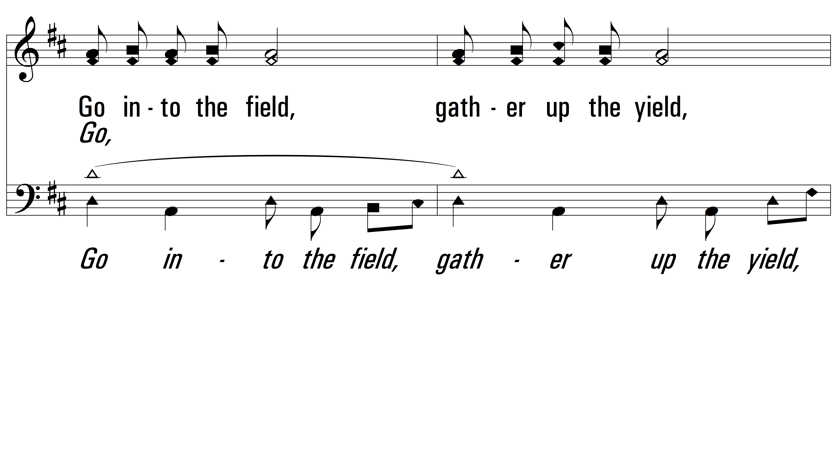
vs. 1

Slide 8
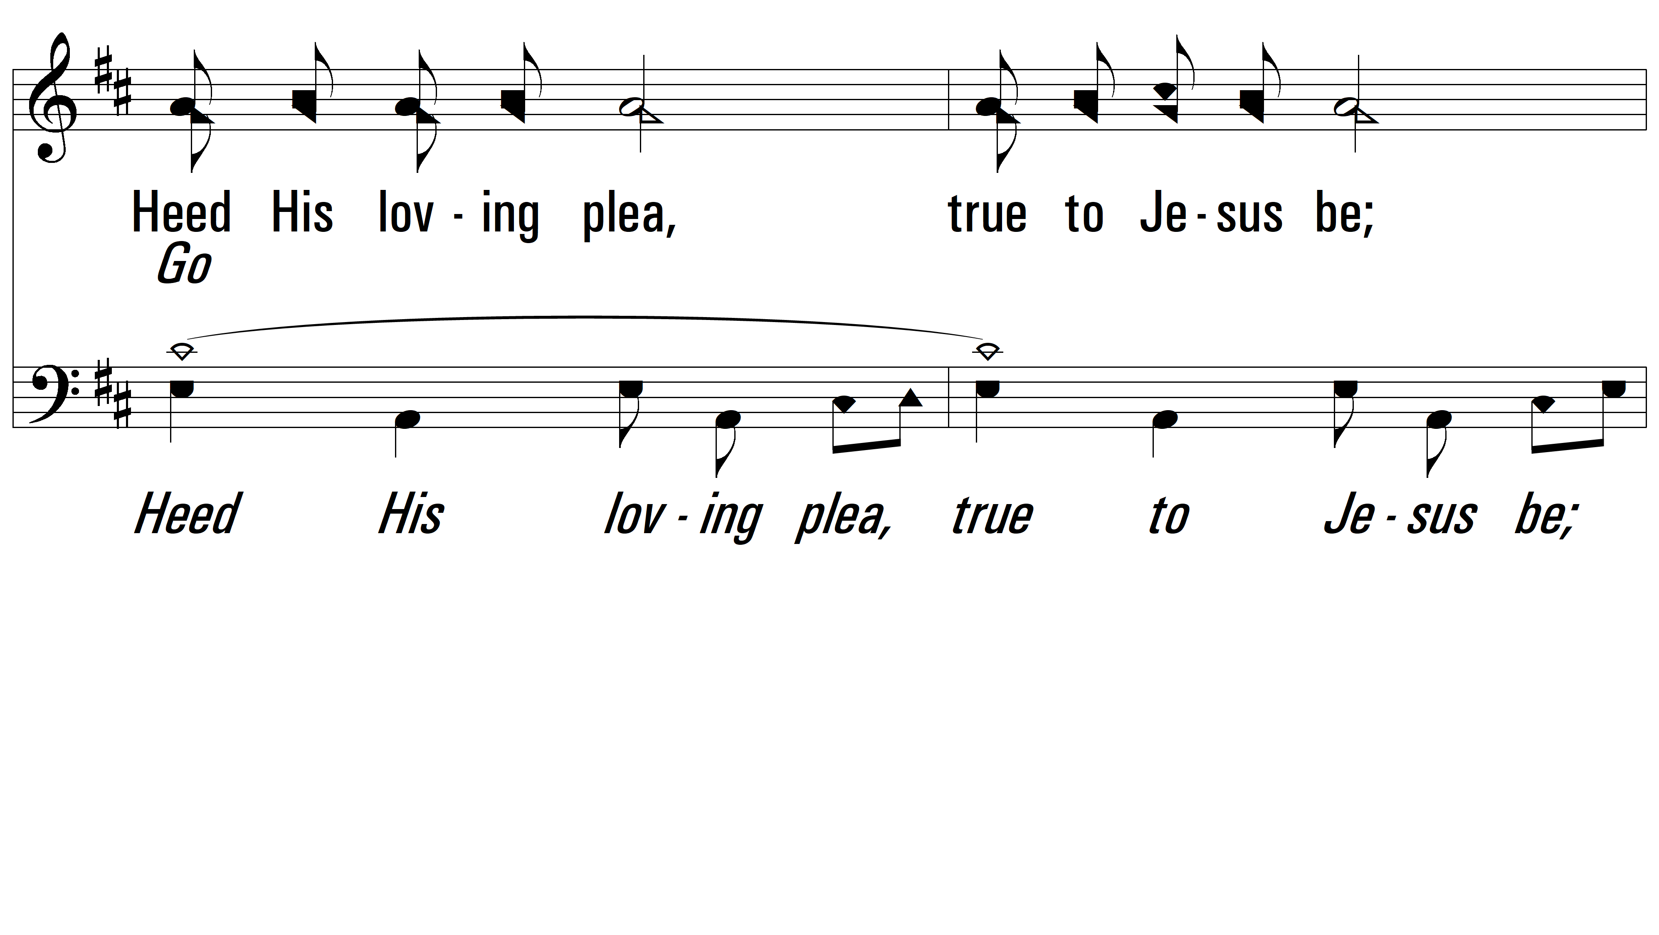
vs. 1

Slide 9
vs. 1

Slide 10
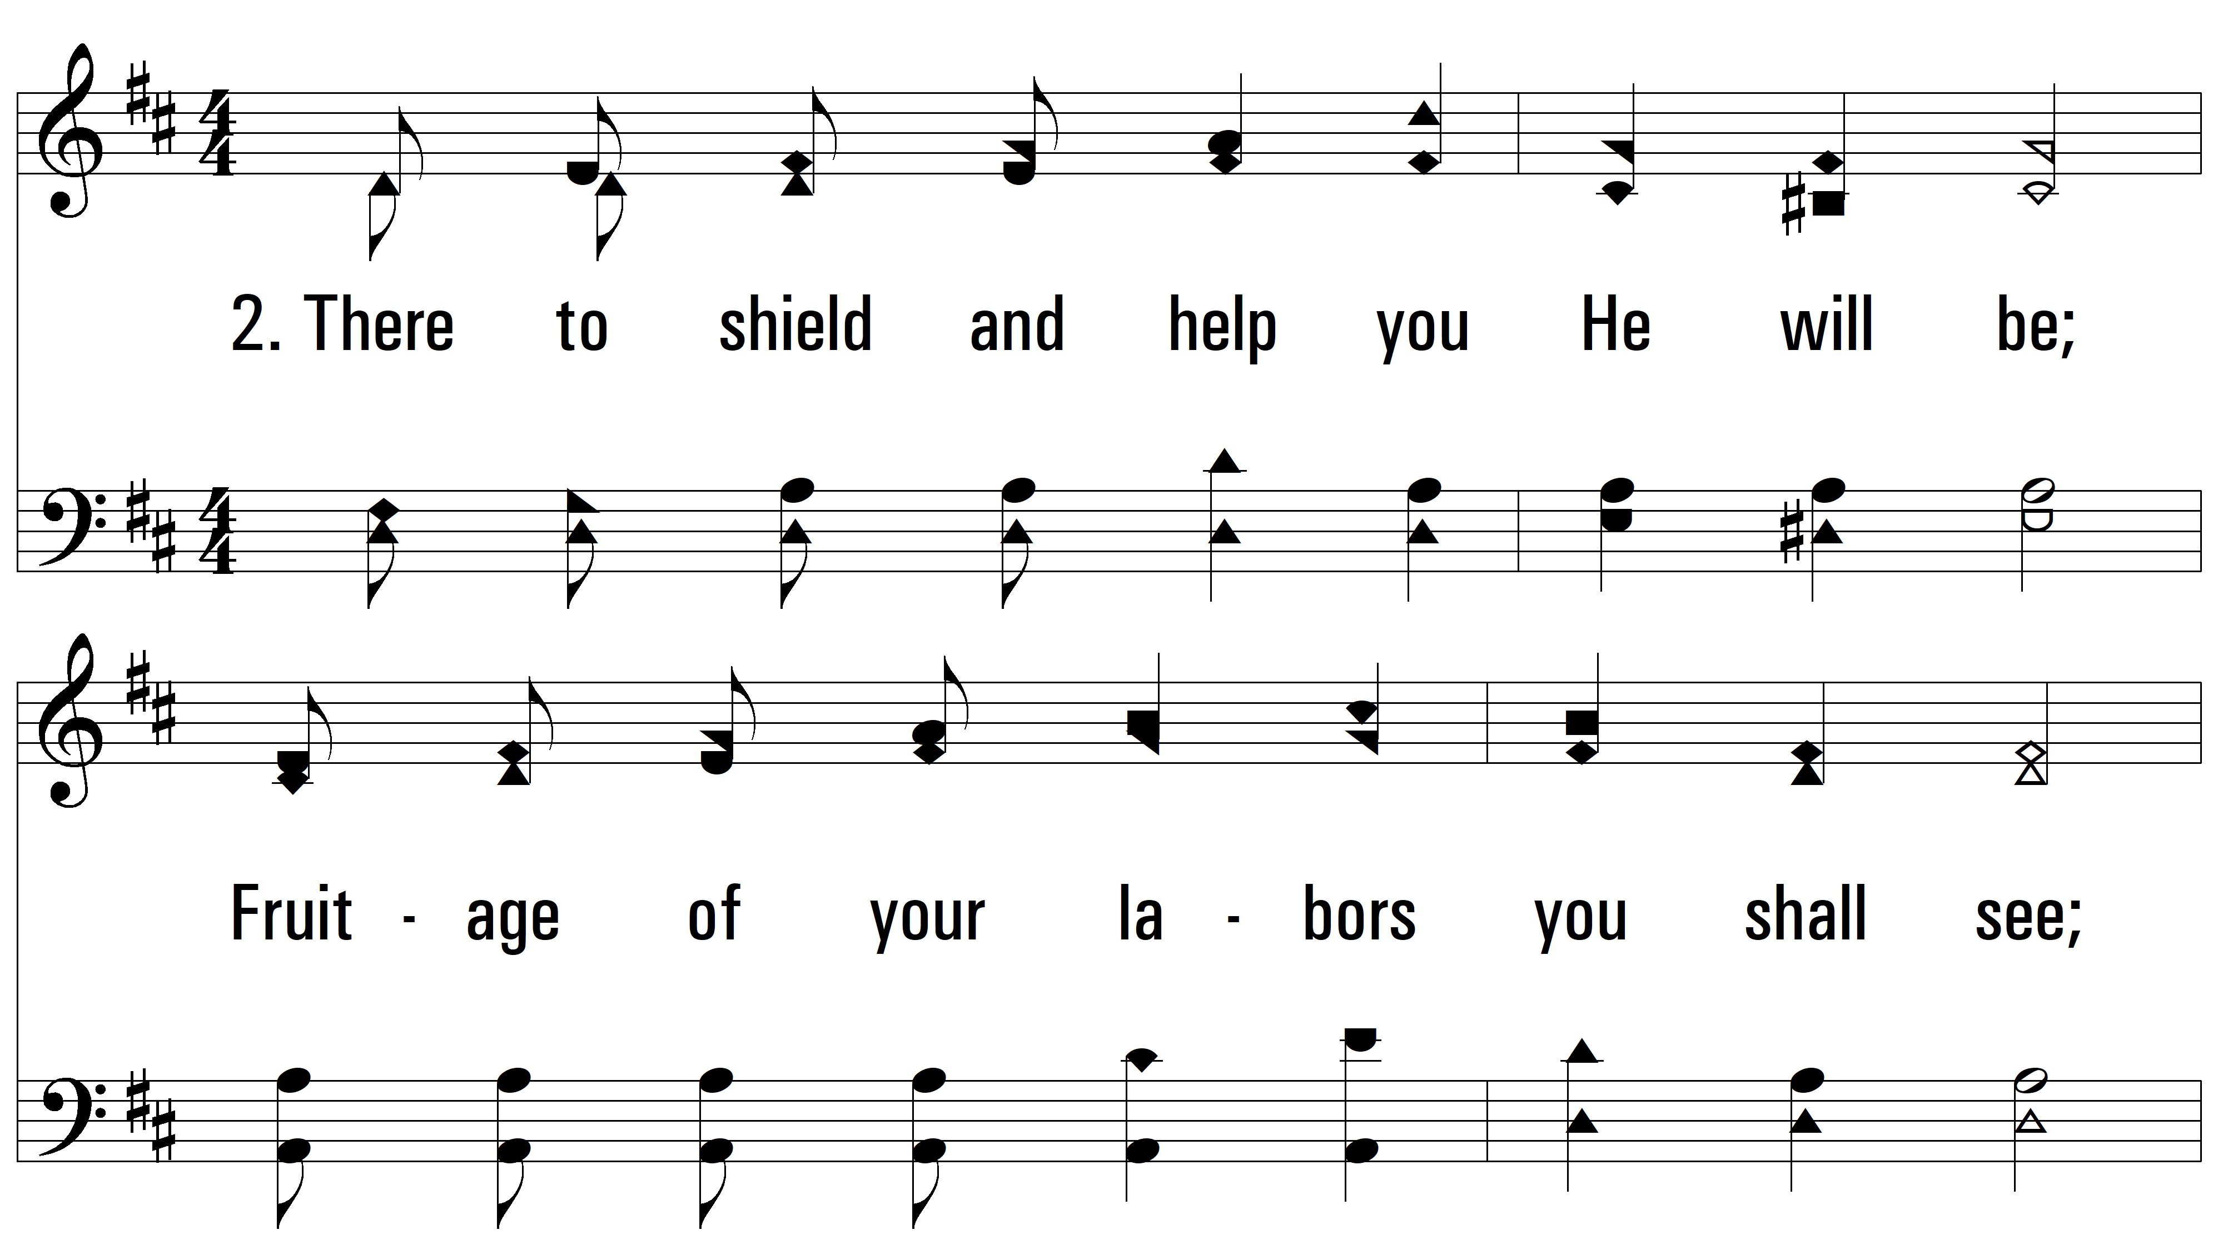
vs. 2 ~ Go Into The Field

Slide 11
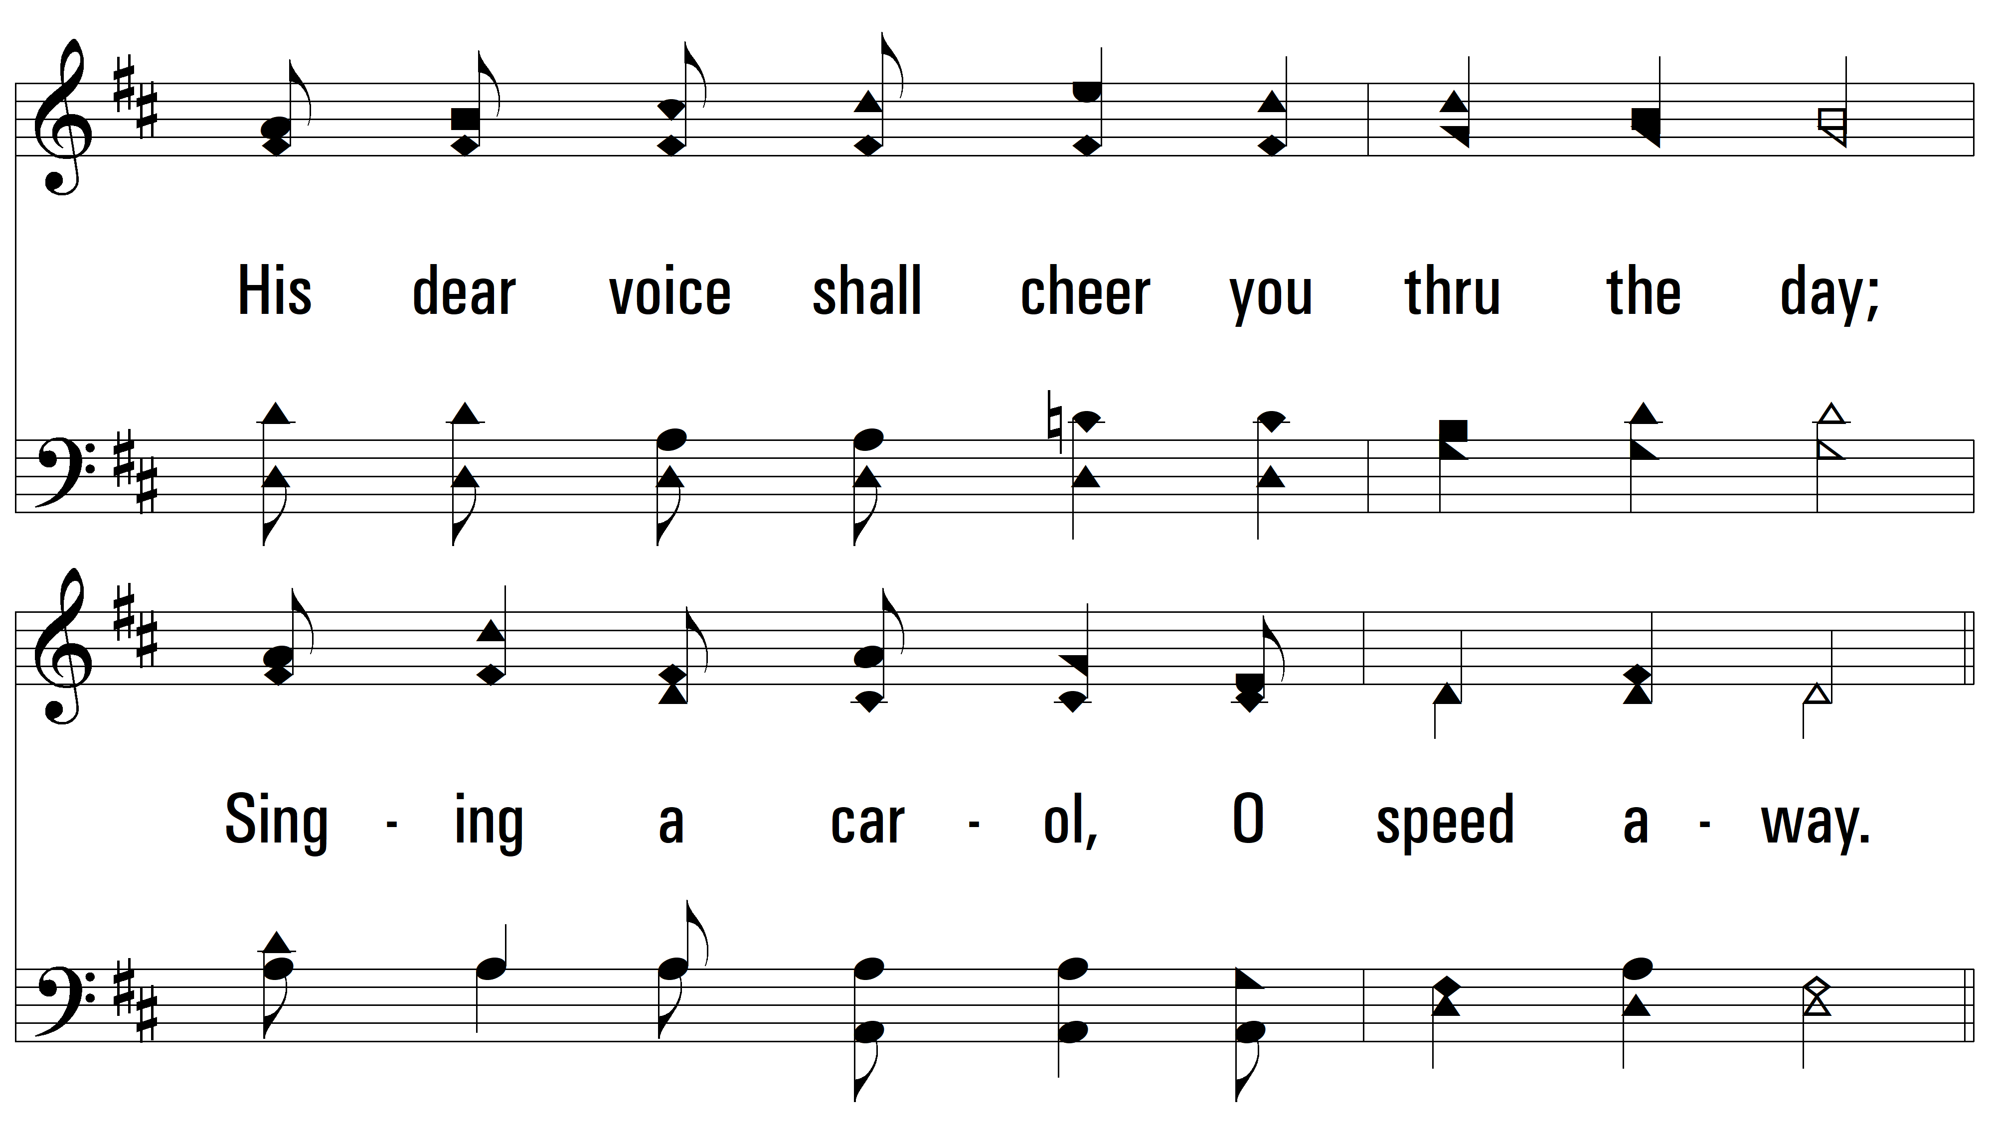
vs. 2

Slide 12
vs. 2

Slide 13
vs. 2

Slide 14
vs. 2

Slide 15
vs. 2

Slide 16
vs. 2

Slide 17
vs. 2

Slide 18
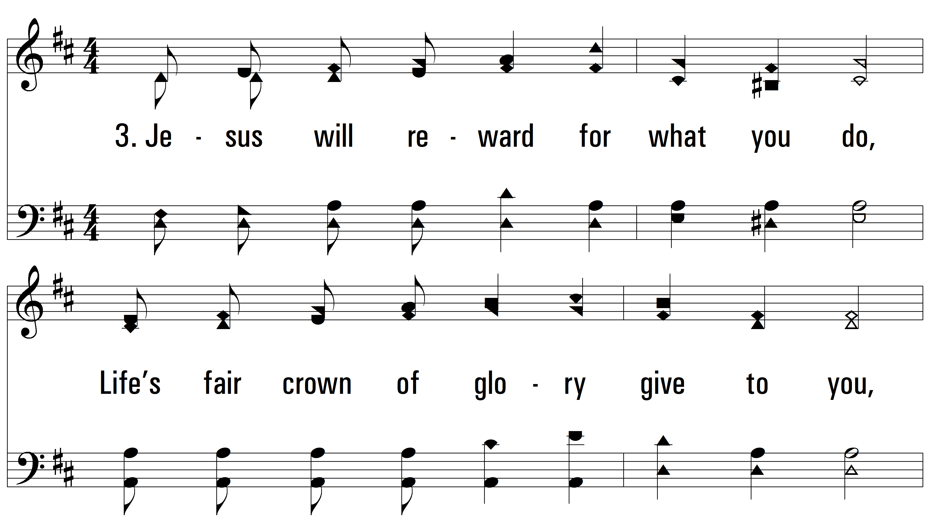
vs. 3 ~ Go Into The Field

Slide 19
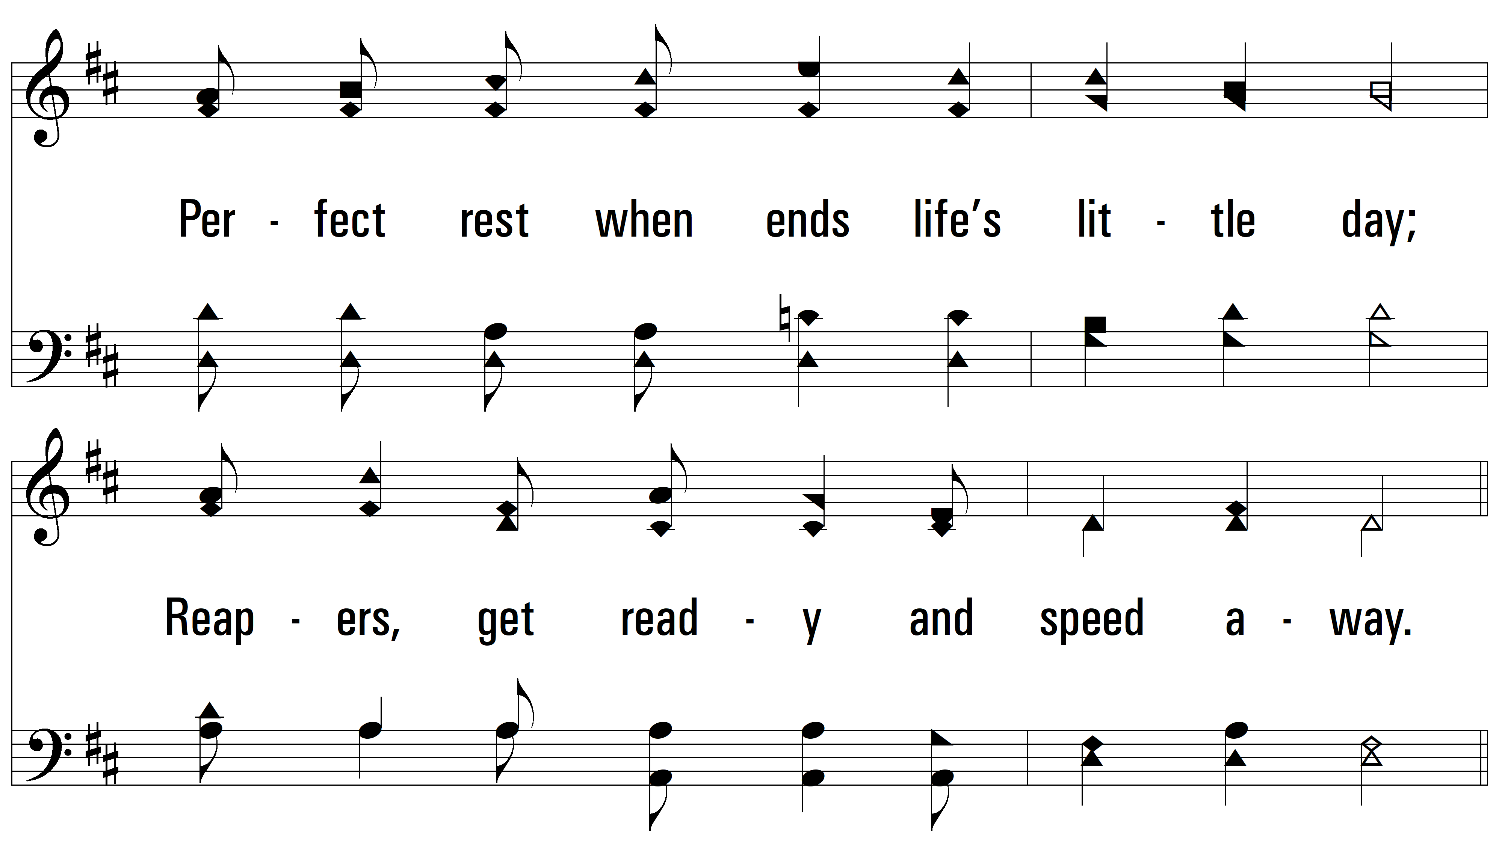
vs. 3

Slide 20
vs. 3

Slide 21
vs. 3

Slide 22
vs. 3

Slide 23
vs. 3

Slide 24
vs. 3

Slide 25
vs. 3
PDHymns.com
END

