Slide 1
Glory To His Name
Words: | E. A. Hoffman (1878)
Music: | J. H. Stockton (1878)
4/4
A^{b}/C - MI
Verses: 4/Chorus
Lead - | MI
Alto - | SOL
Tenor - | DO
Bass - | DO
PDHymns.com

Slide 2
vs. 1 ~ Glory To His Name

Slide 3
vs. 1

Slide 4
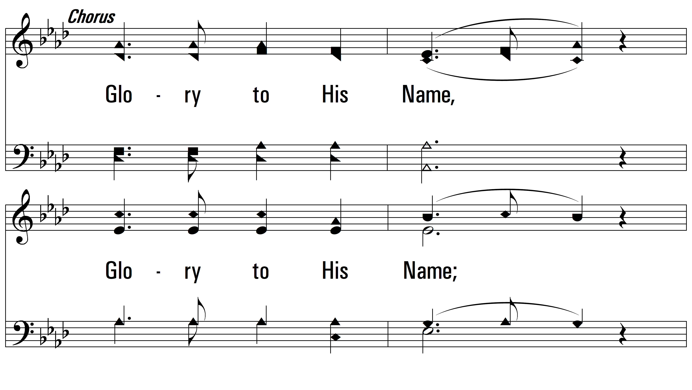
vs. 1

Slide 5
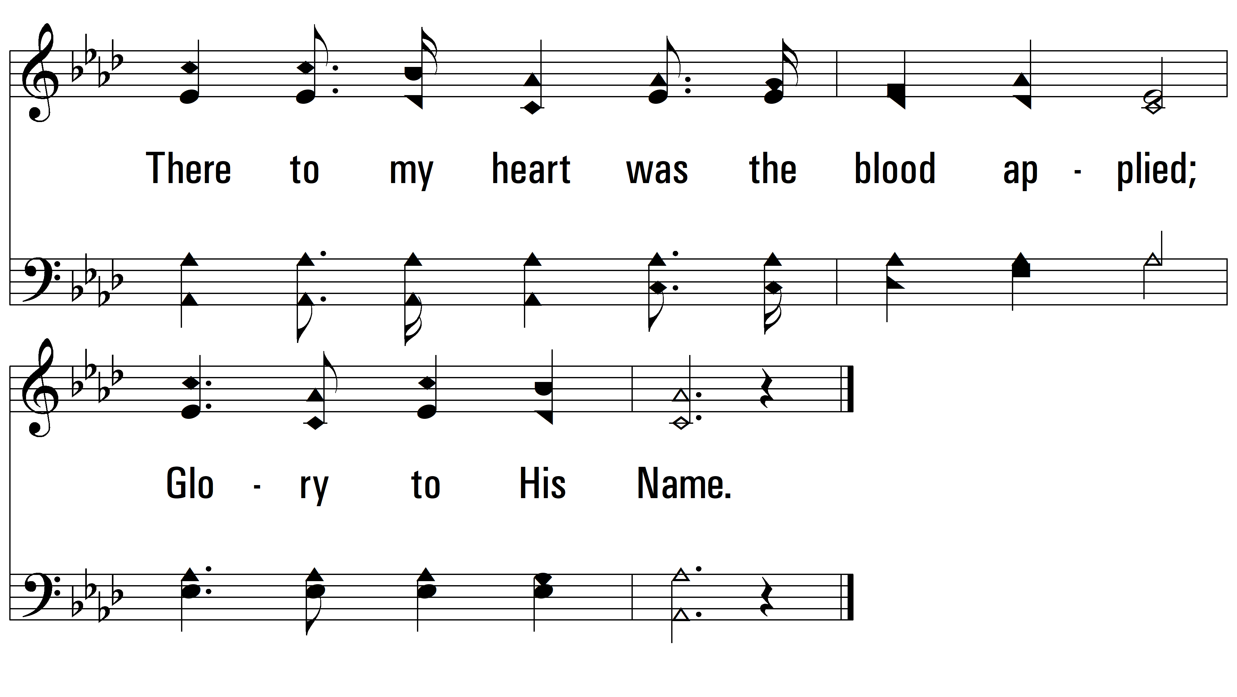
vs. 1

Slide 6
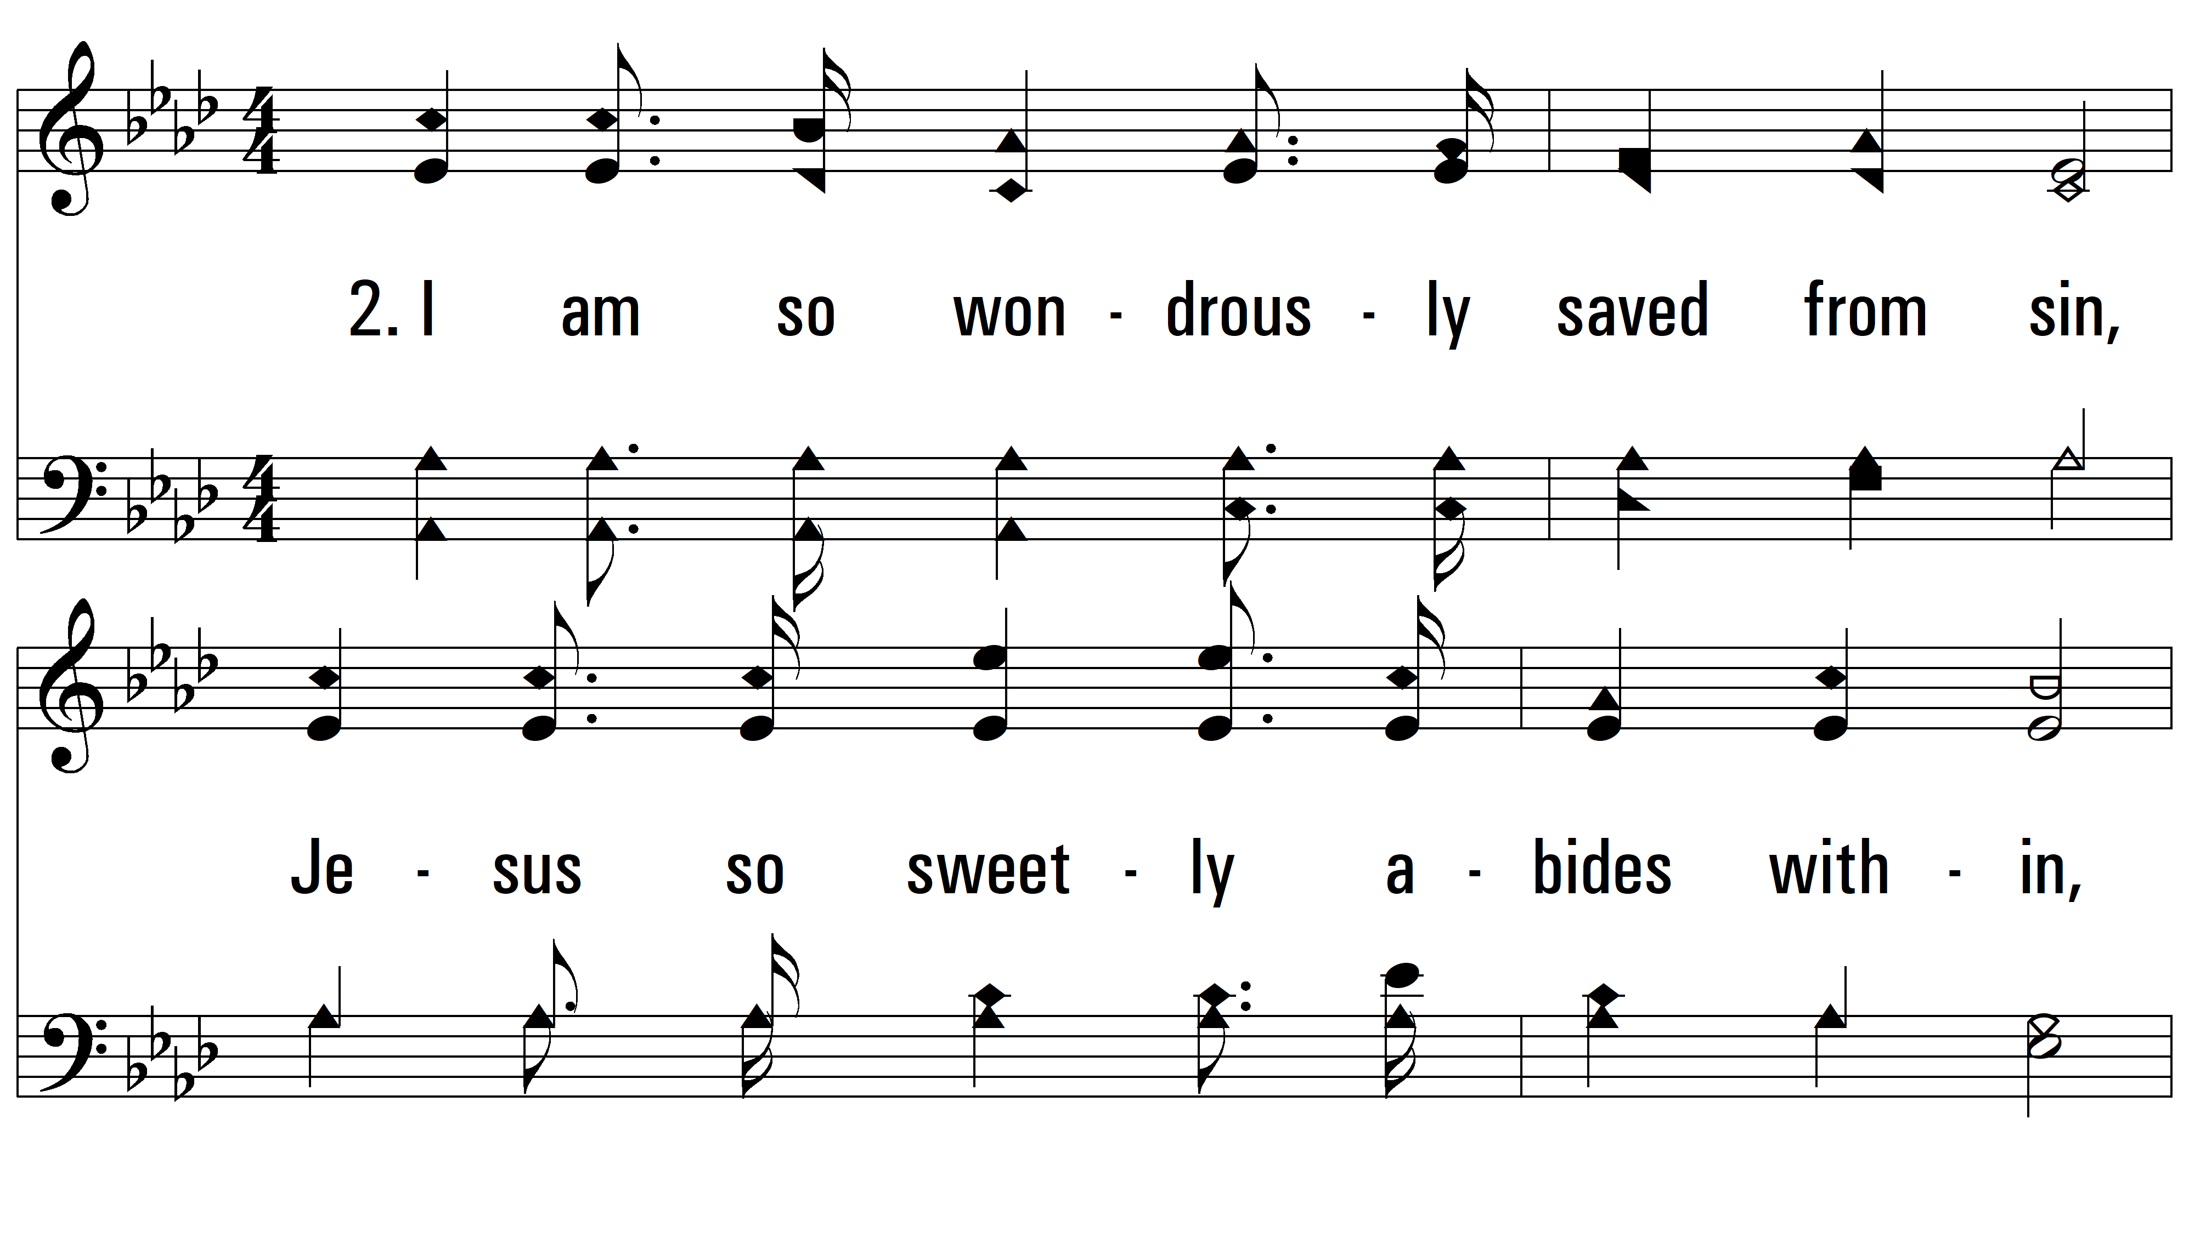
vs. 1 ~ Glory To His Name

Slide 7
vs. 2

Slide 8
vs. 2

Slide 9
vs. 2

Slide 10
vs. 3 ~ Glory To His Name

Slide 11
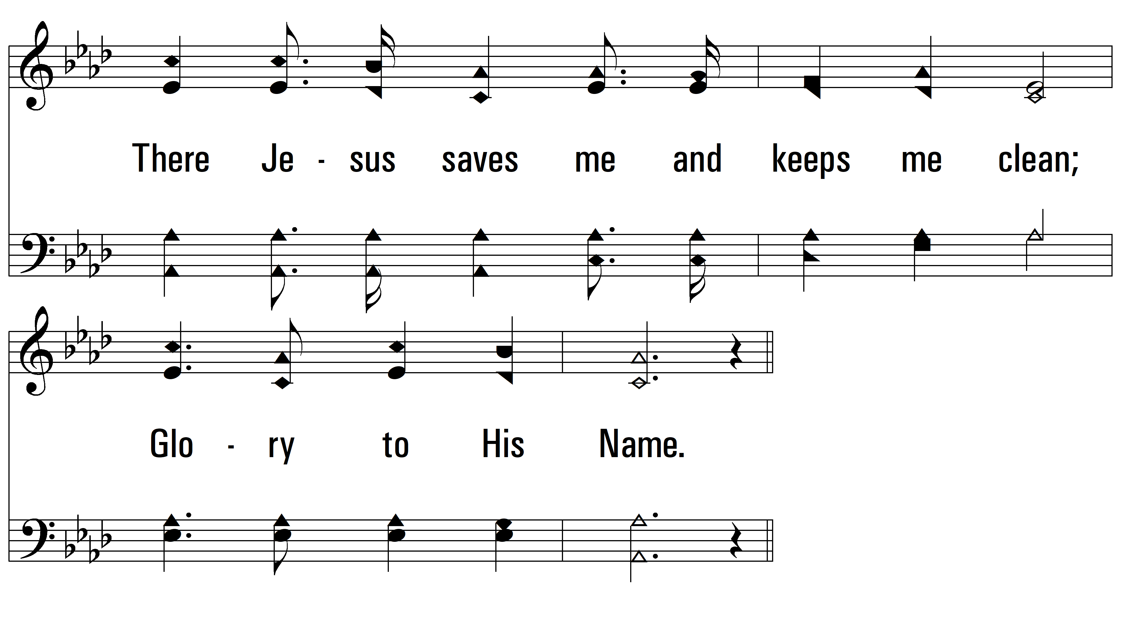
vs. 3

Slide 12
vs. 3

Slide 13
vs. 3

Slide 14
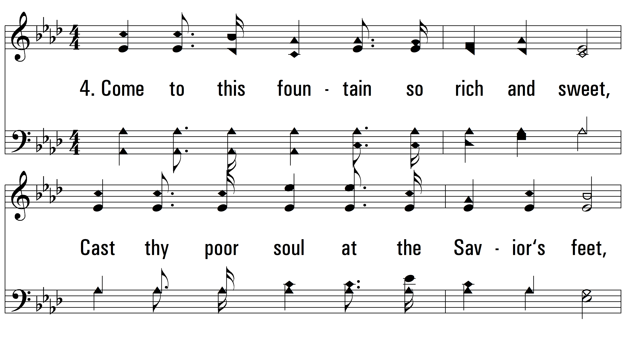
vs. 4 ~ Glory To His Name

Slide 15
vs. 4

Slide 16
vs. 4

Slide 17
vs. 4
PDHymns.com
END

