Slide 1
Flee As A Bird
IN DOMINO CONFIDO
8.7.8.7.8.8.8.8
Words: | Mary S. Dana (1842)
Music: | Spanish Air
4/4
Em(G)/E - LA
Verses: 2
Lead - | LA
Alto - | LA
Tenor - | DO
Bass - | LA
PDHymns.com

Slide 2
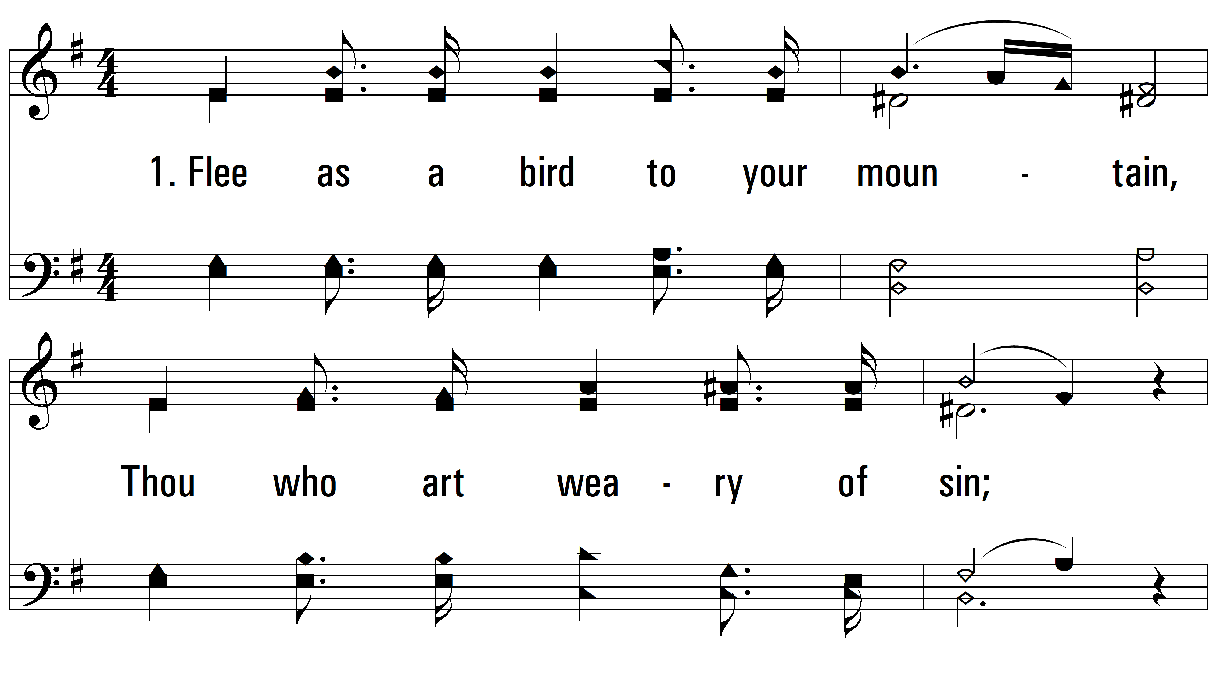
vs. 1 ~ Flee As A Bird

Slide 3
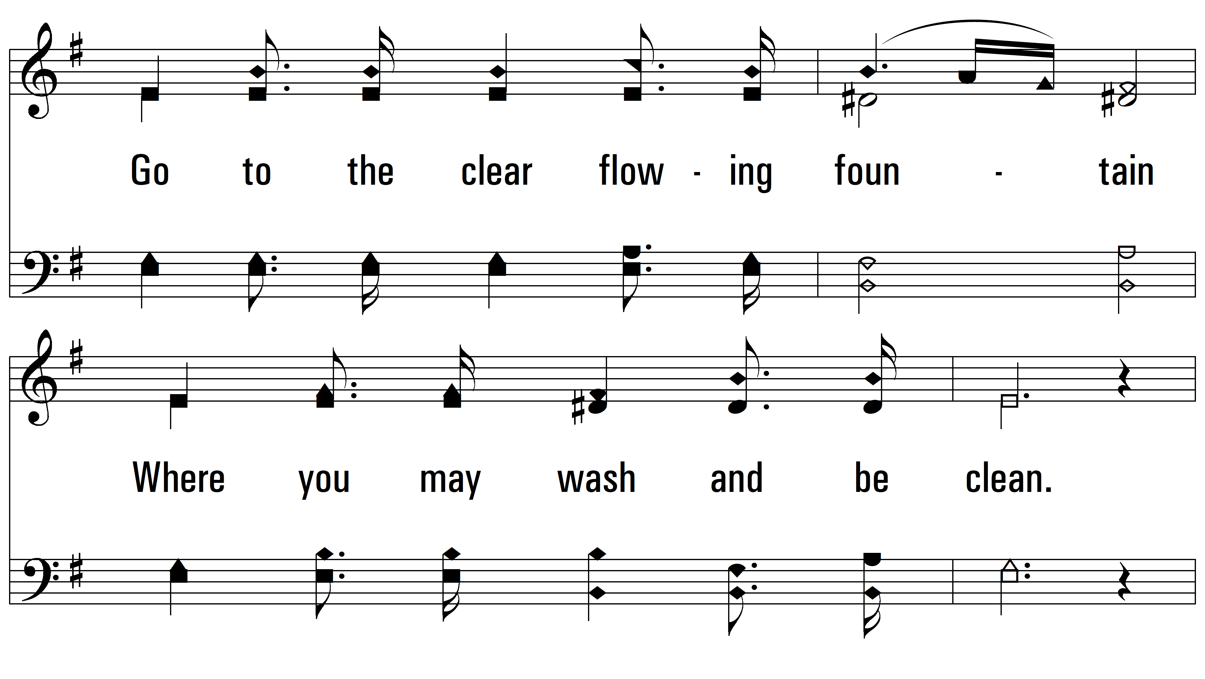
vs. 1

Slide 4
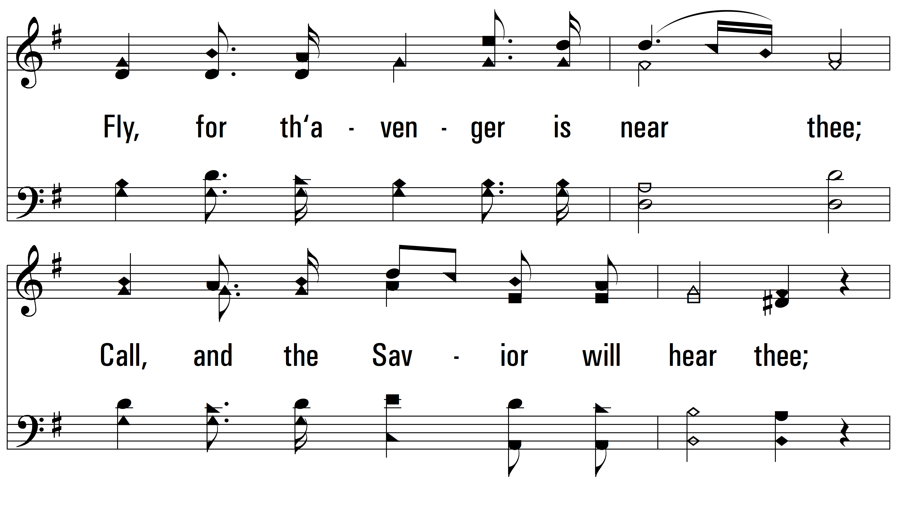
vs. 1

Slide 5
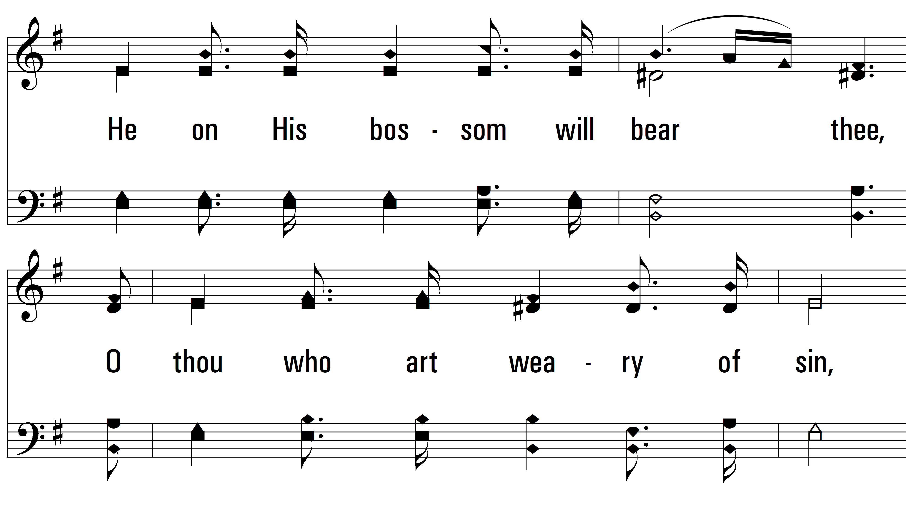
vs. 1

Slide 6
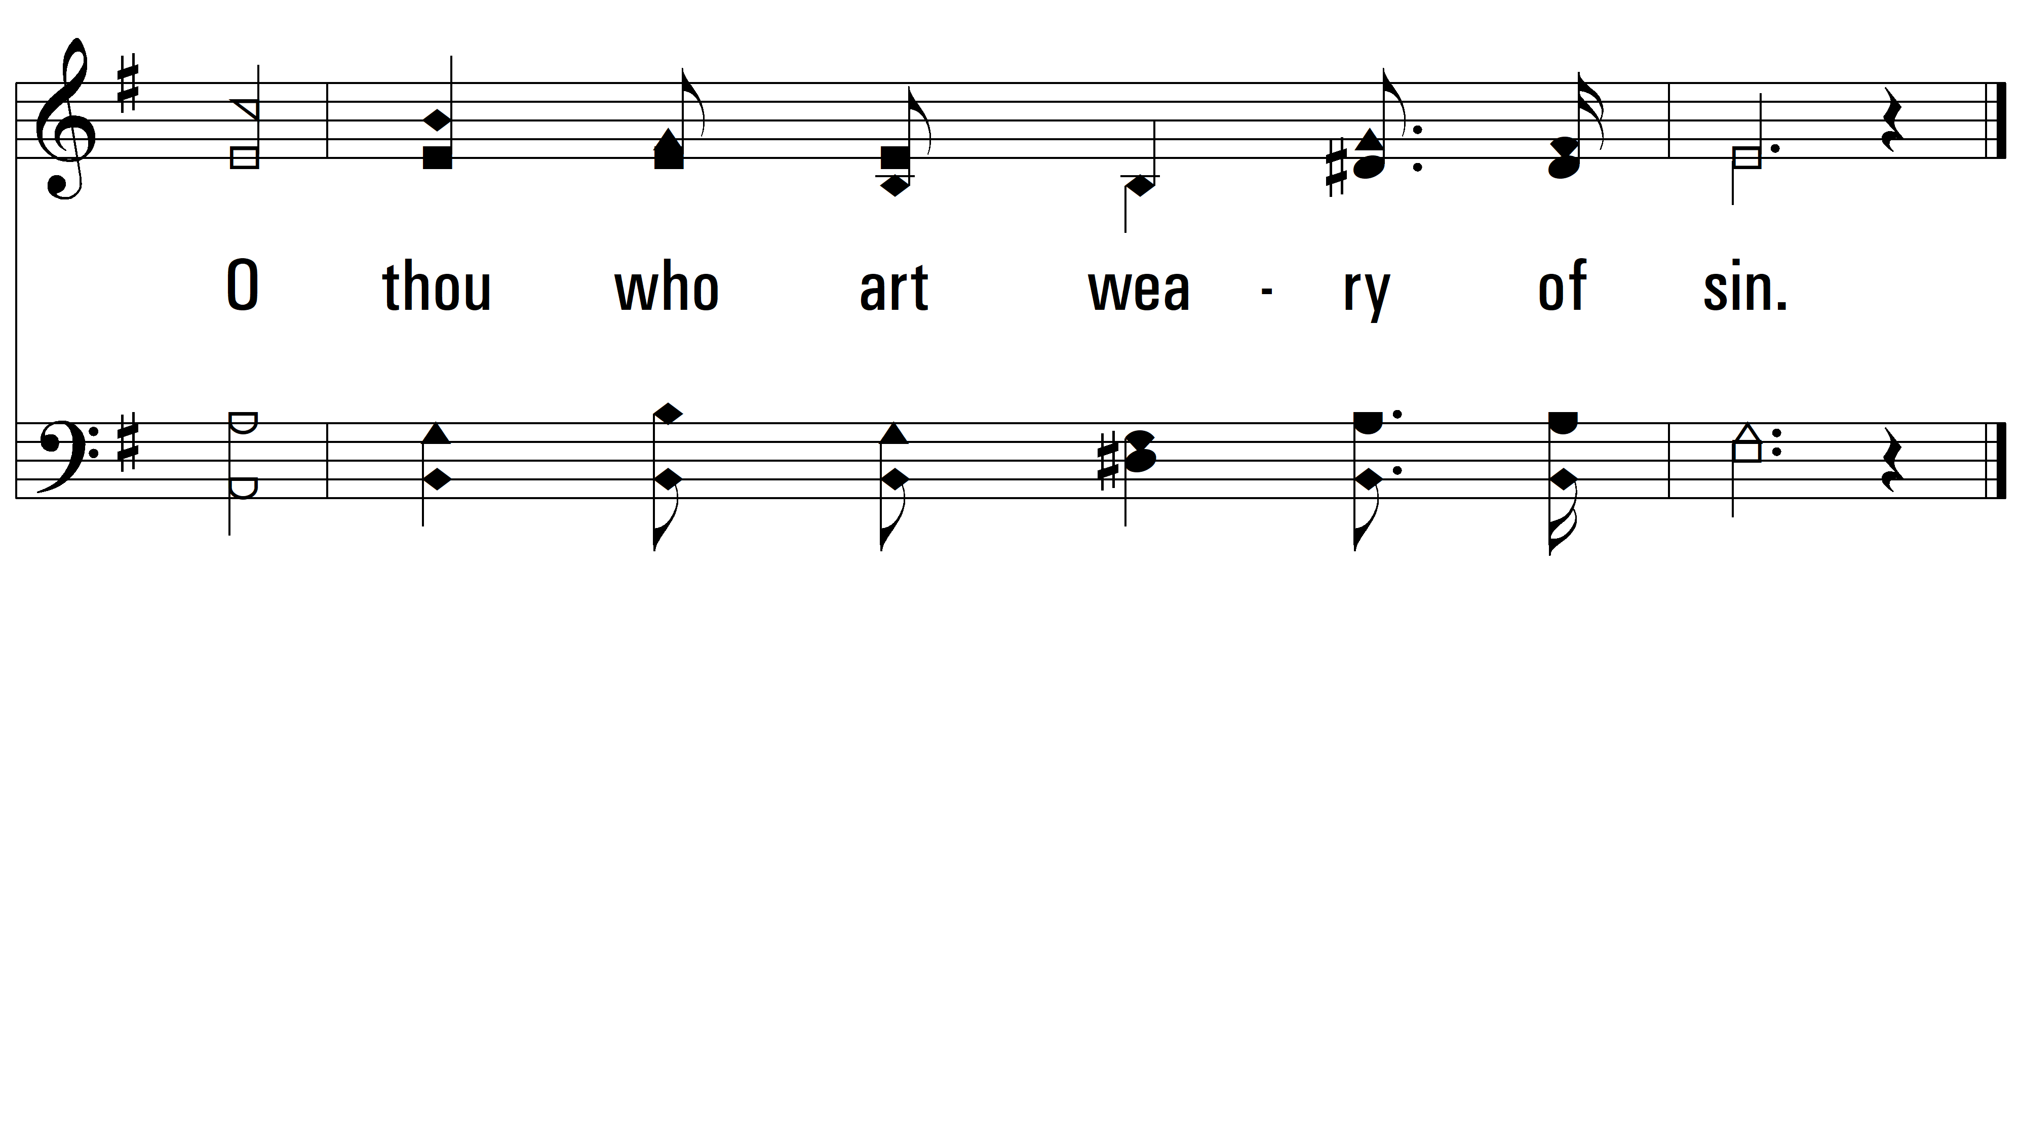
vs. 1

Slide 7
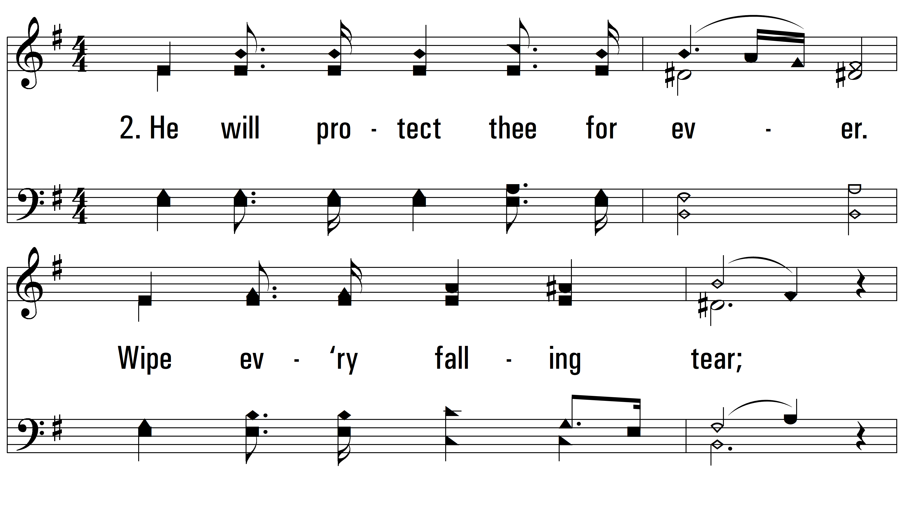
vs. 2 ~ Flee As A Bird

Slide 8
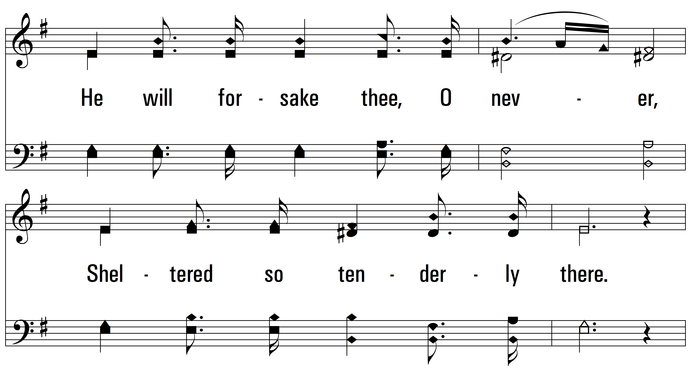
vs. 2

Slide 9
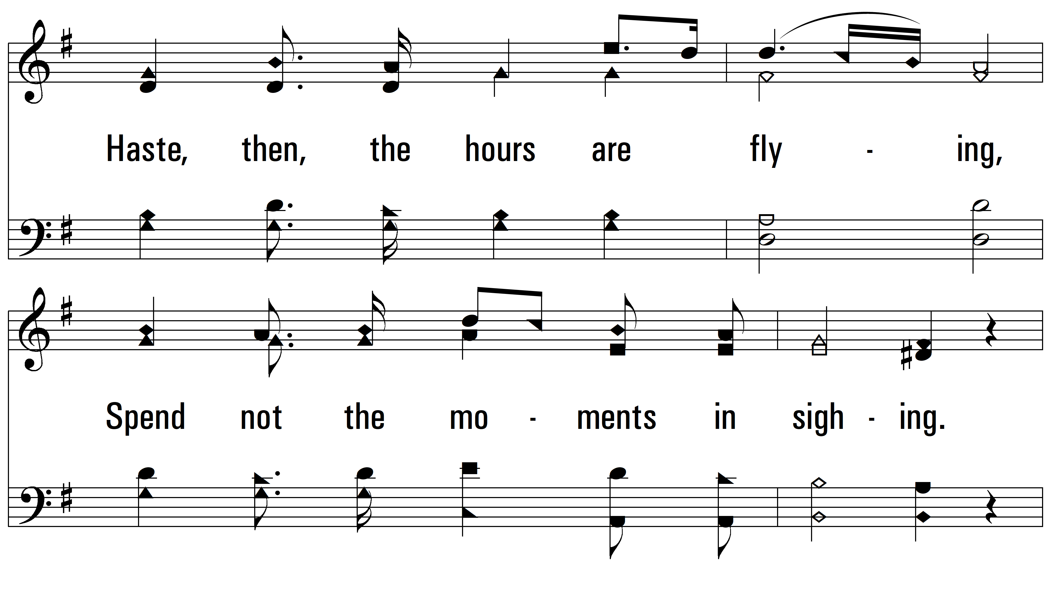
vs. 2

Slide 10
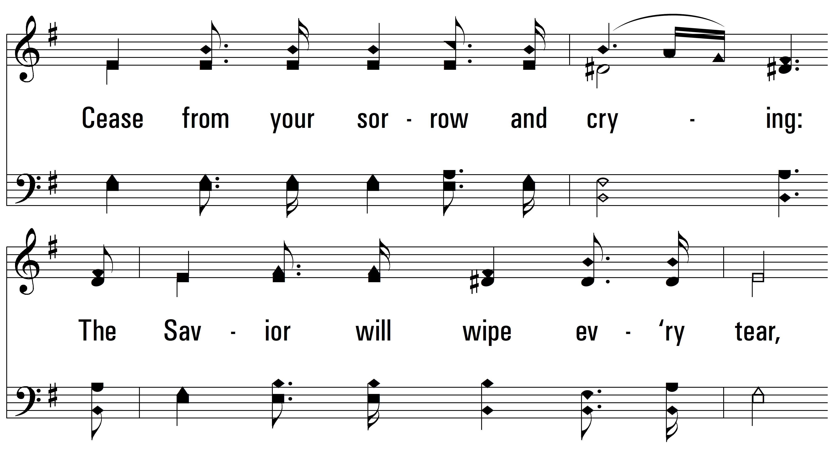
vs. 2

Slide 11
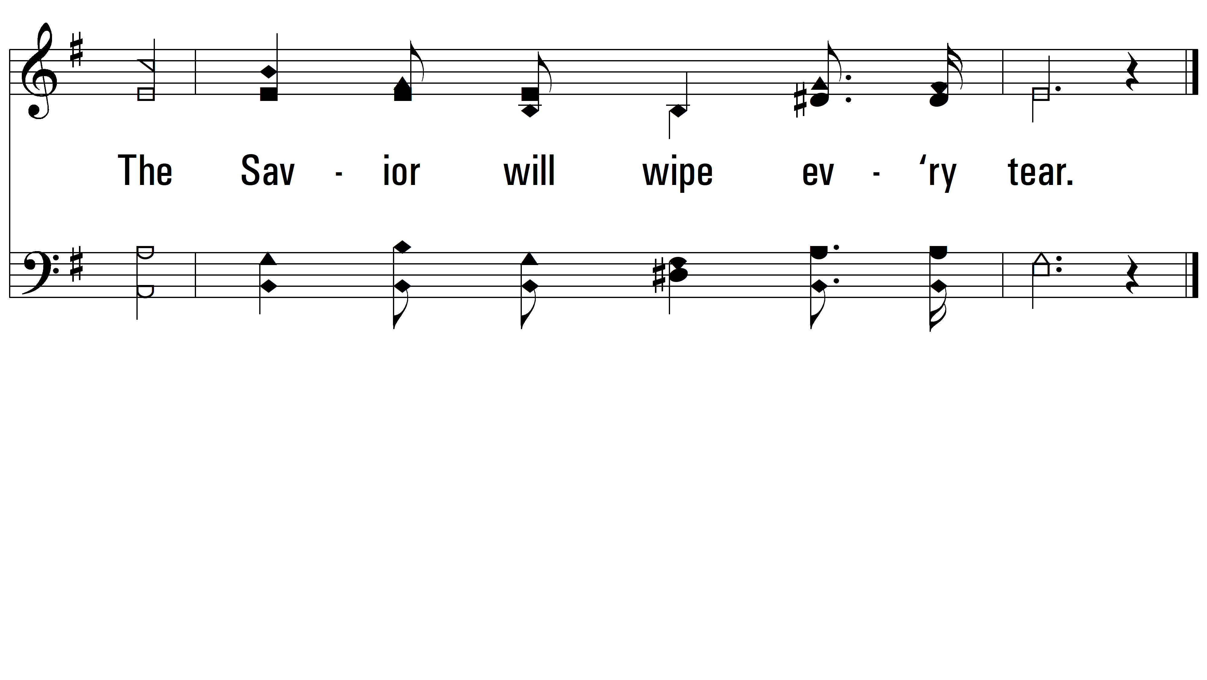
vs. 2
PDHymns.com
END

