Slide 1
Day Is Dying In The West
Words: | Mary A. Lathbury (1877 & 1890)
Music: | William F. Sherwin (1877)
6/8
A^{b}/A^{b} - DO
Verses: 4/Chorus
Lead - | DO
Alto - | MI
Tenor - | SOL
Bass - | DO
PDHymns.com

Slide 2
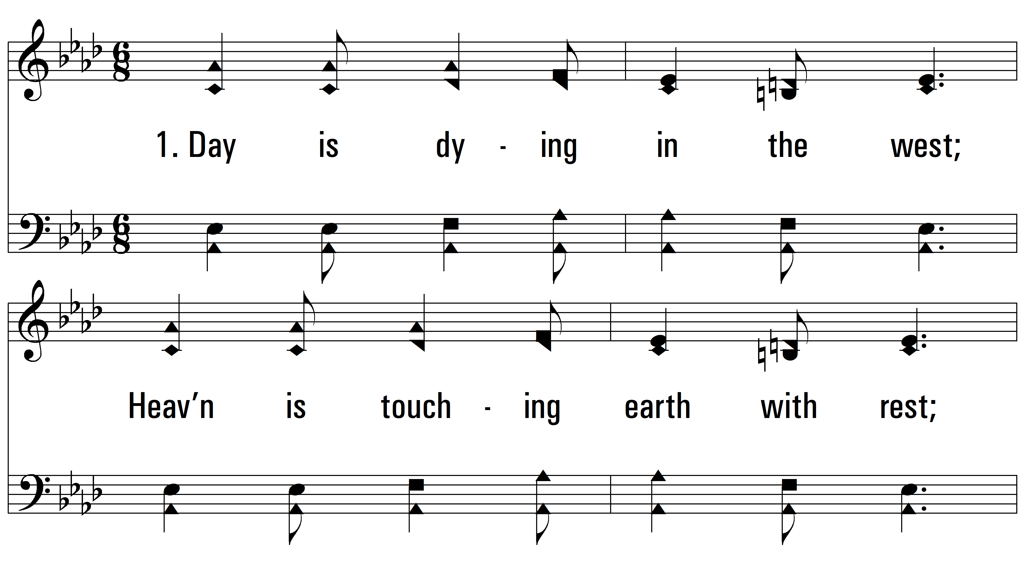
vs. 1 ~ Day Is Dying In The West

Slide 3
vs. 1

Slide 4
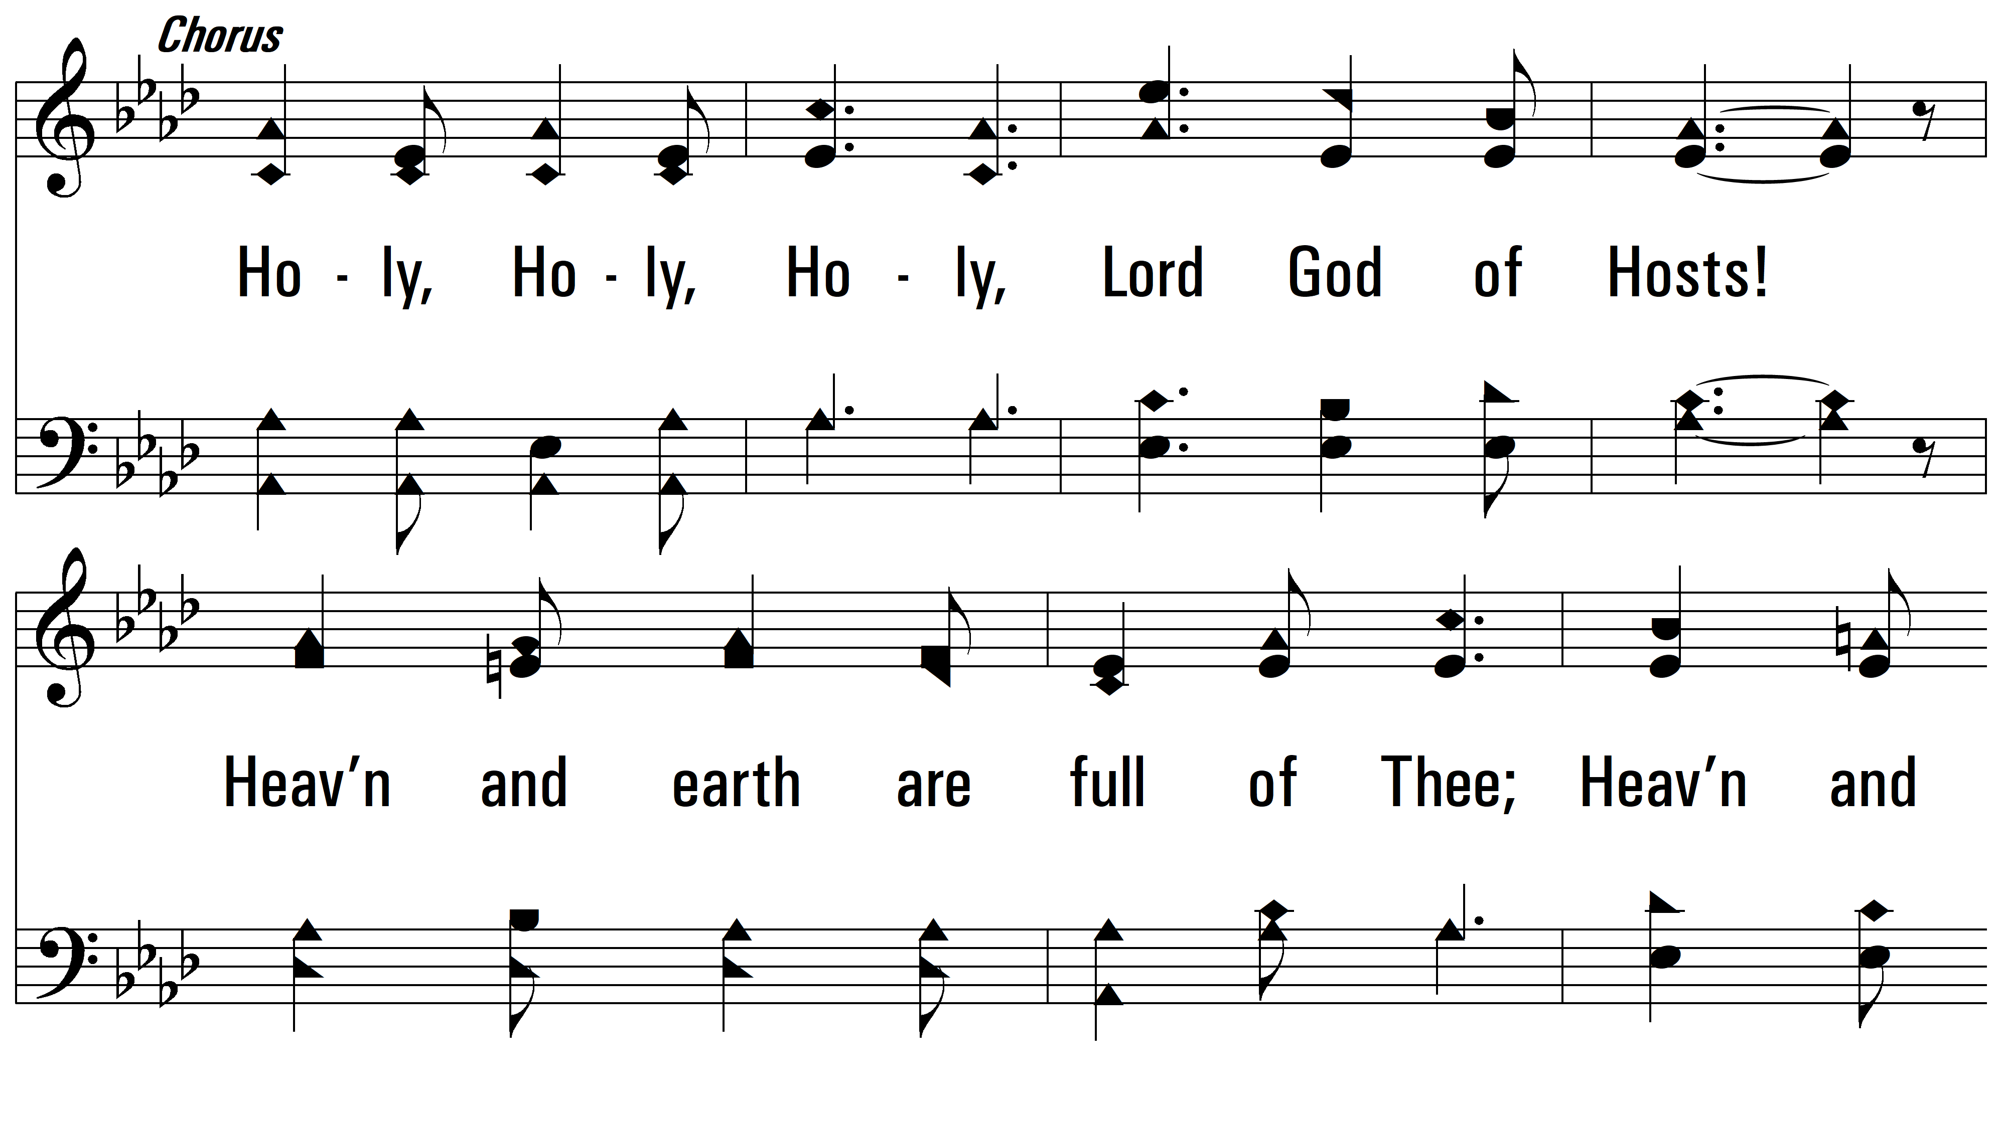
vs. 1

Slide 5
vs. 1

Slide 6
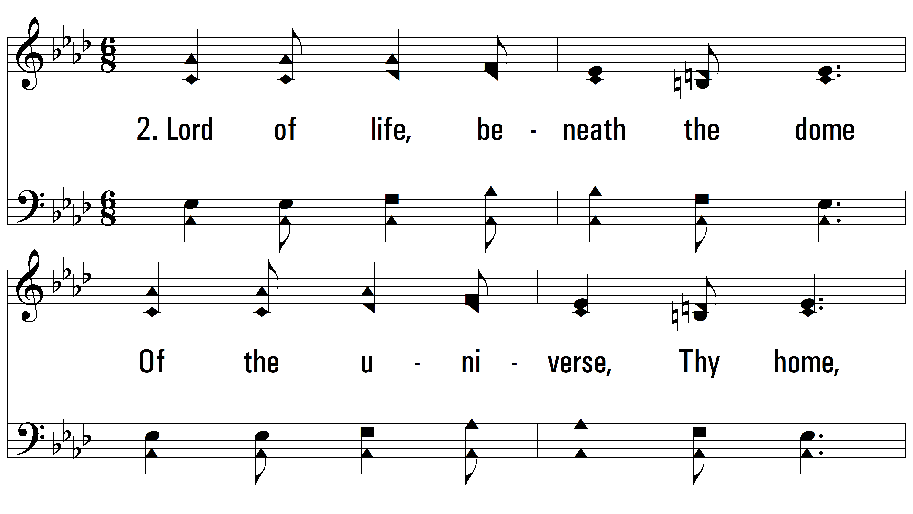
vs. 1 ~ Day Is Dying In The West

Slide 7
vs. 1

Slide 8
vs. 1

Slide 9
vs. 1

Slide 10
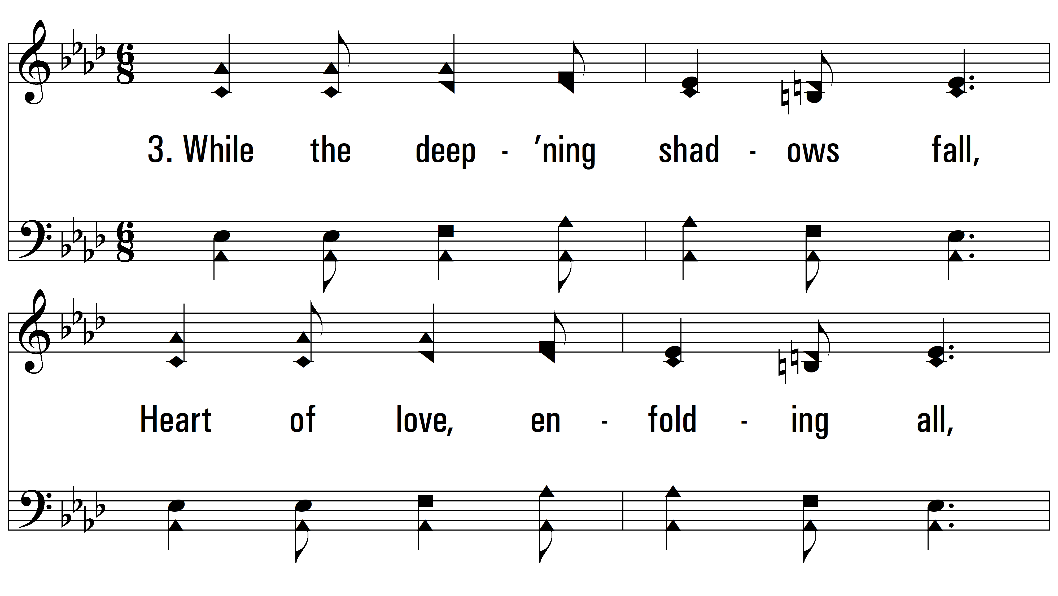
vs. 2 ~ Day Is Dying In The West

Slide 11
vs. 2

Slide 12
vs. 2

Slide 13
vs. 2

Slide 14
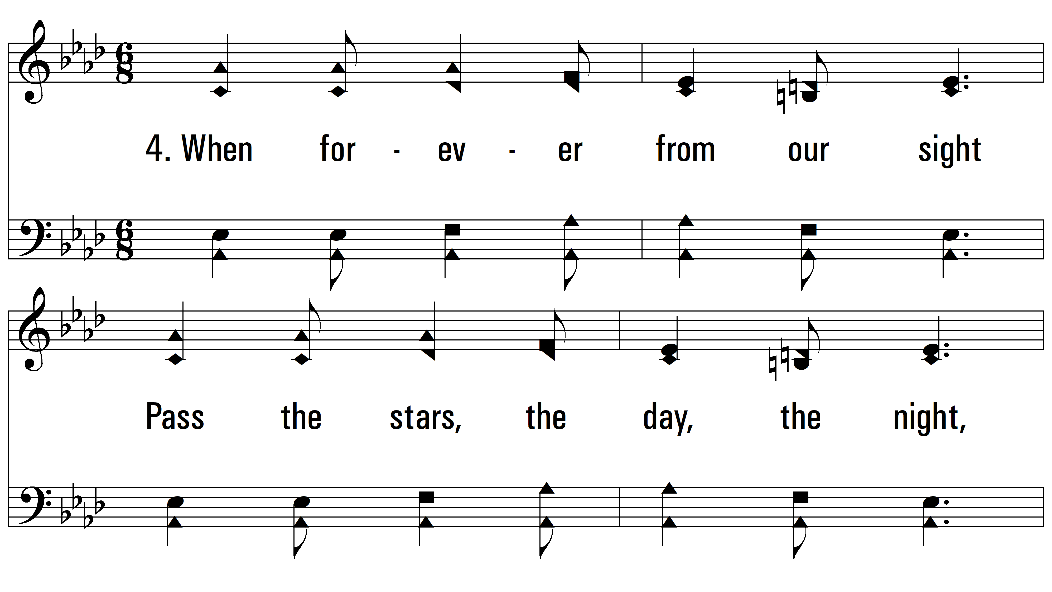
vs. 3 ~ Day Is Dying In The West

Slide 15
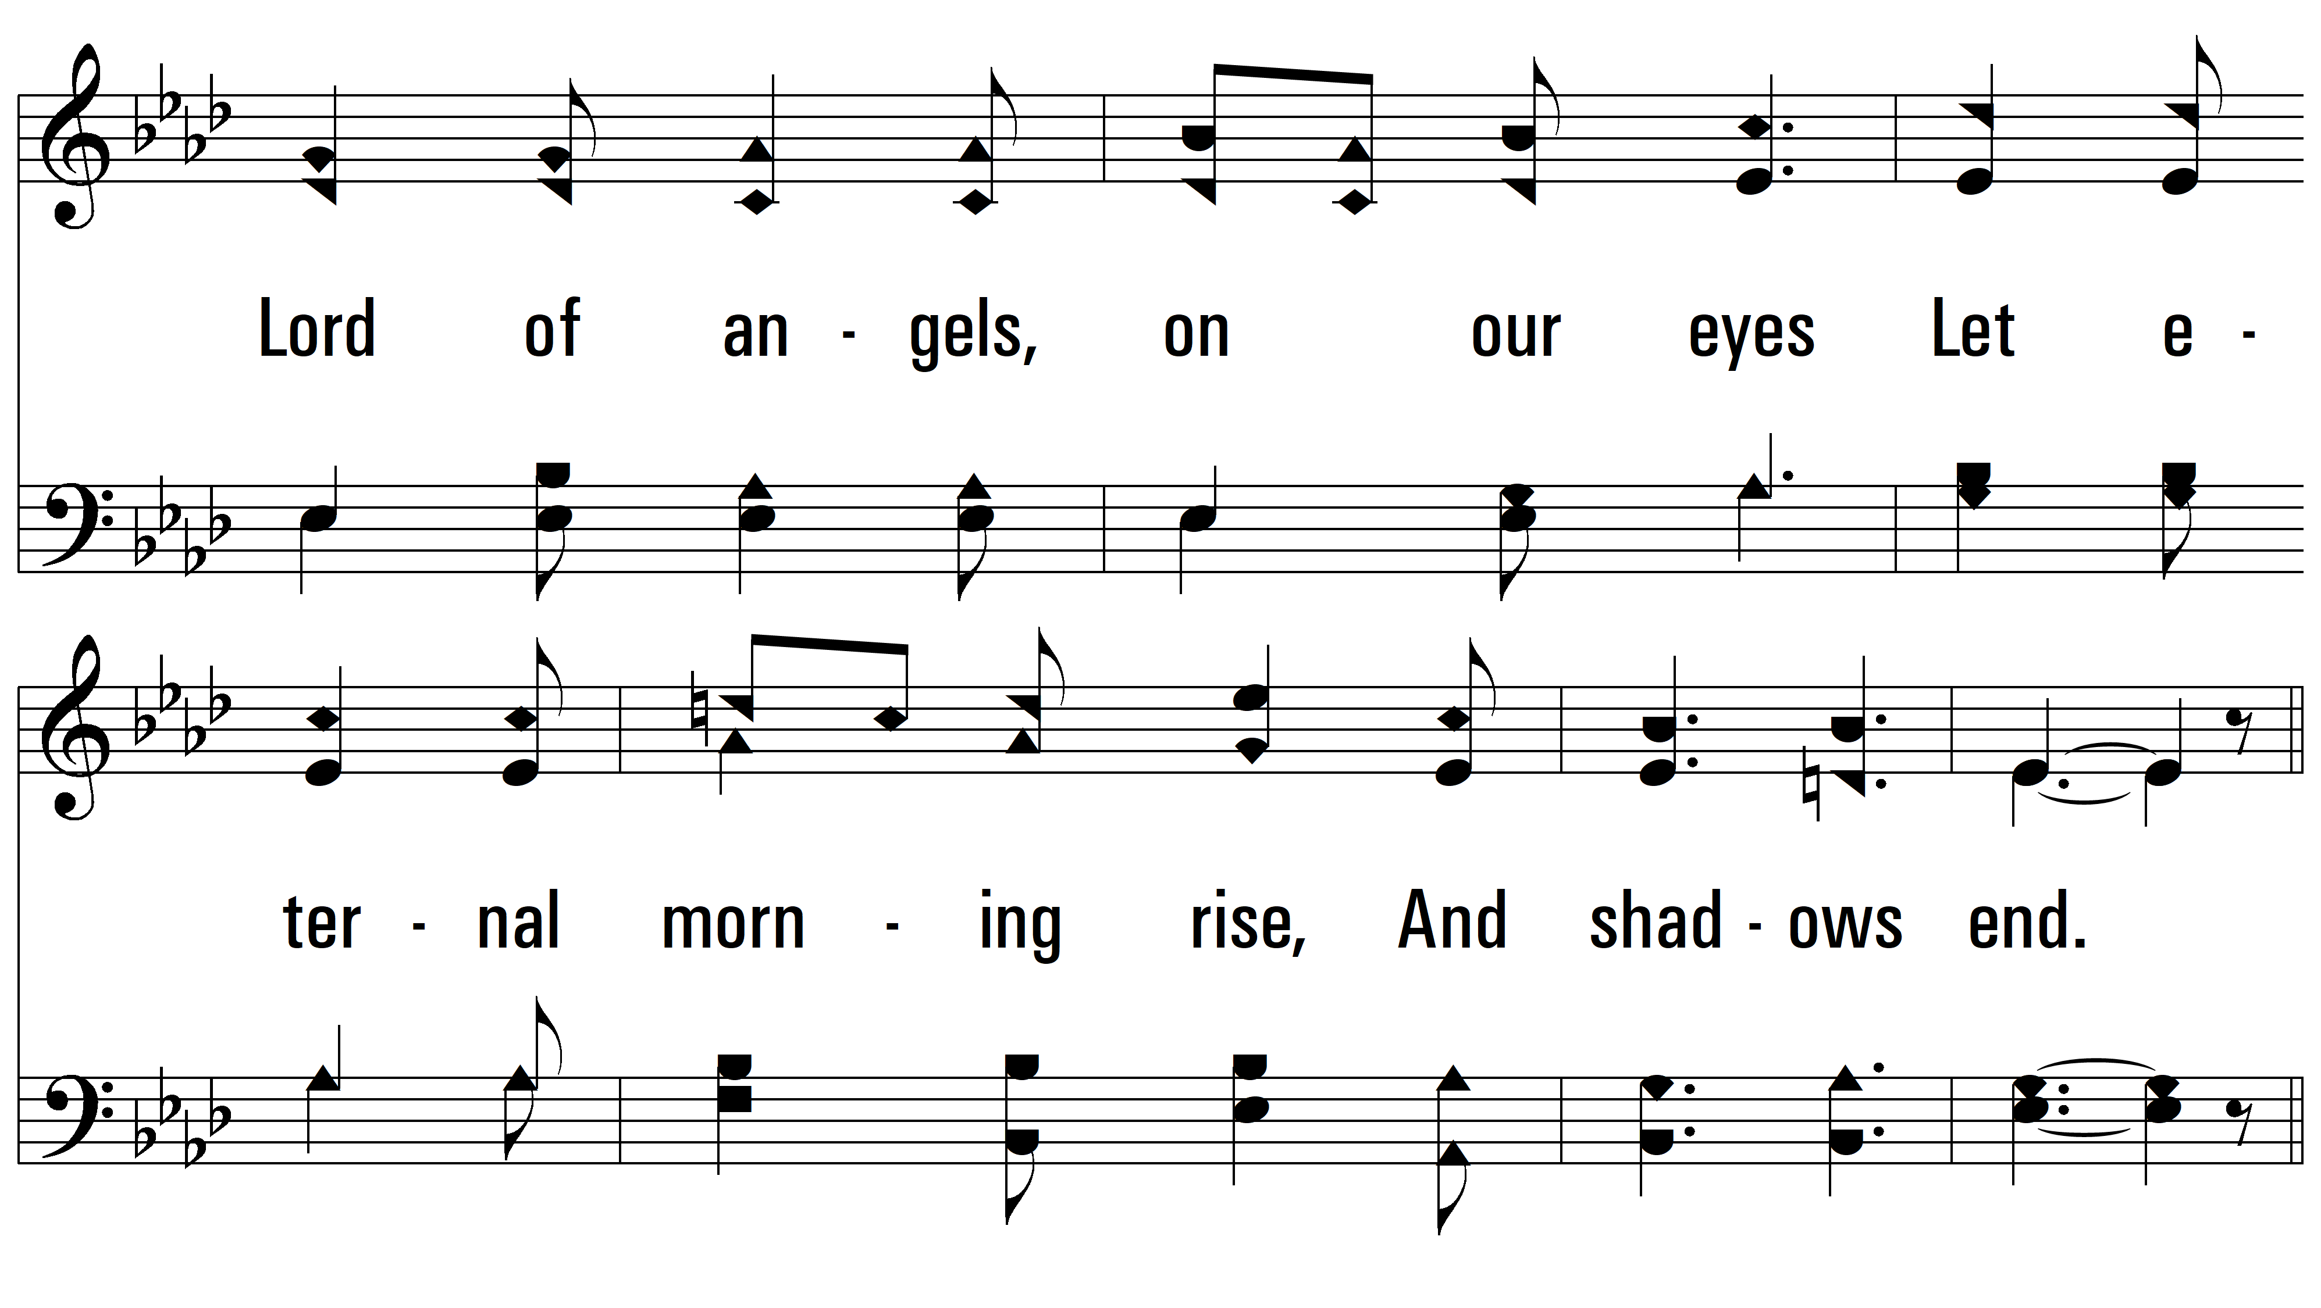
vs. 3

Slide 16
vs. 3

Slide 17
vs. 3
PDHymns.com
END

