Slide 1
Day By Day
BLOTT EN DAG
10.9.10.9.D
Words: | Carolina Sandell Berg, 1865, Tr. Andrew Skoog, 1921
Music: | Oscar Ahnfelt, 1872
4/4
E/G# - MI
Verses: 3
Lead - | MI
Alto - | SOL
Tenor - | SOL
Bass - | DO
PDHymns.com

Slide 2
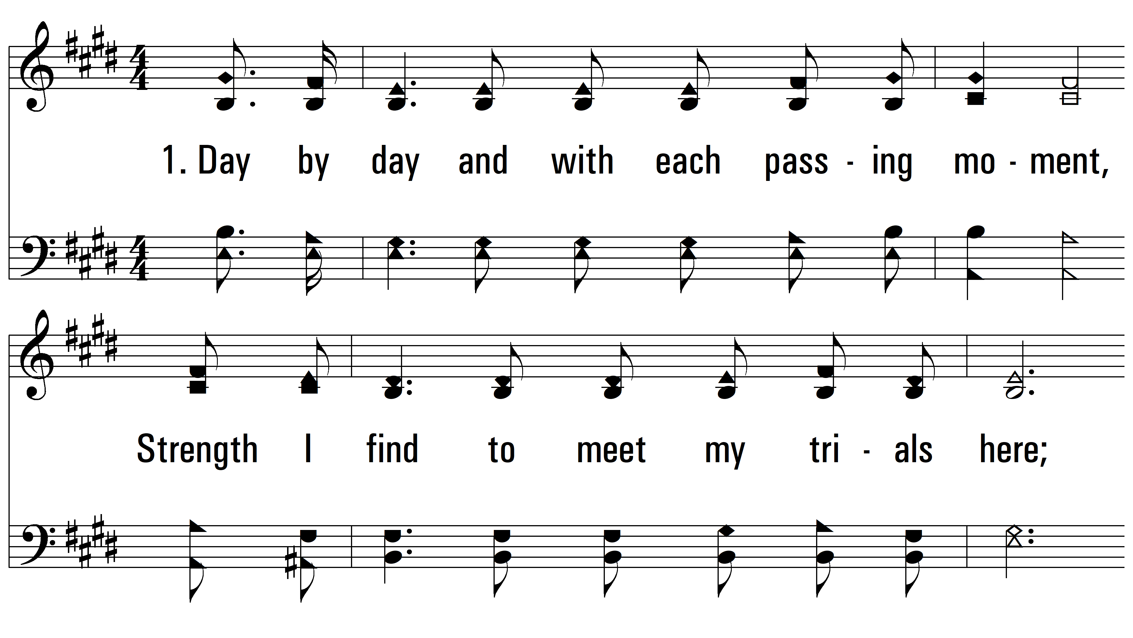
vs. 1 ~ Day By Day

Slide 3
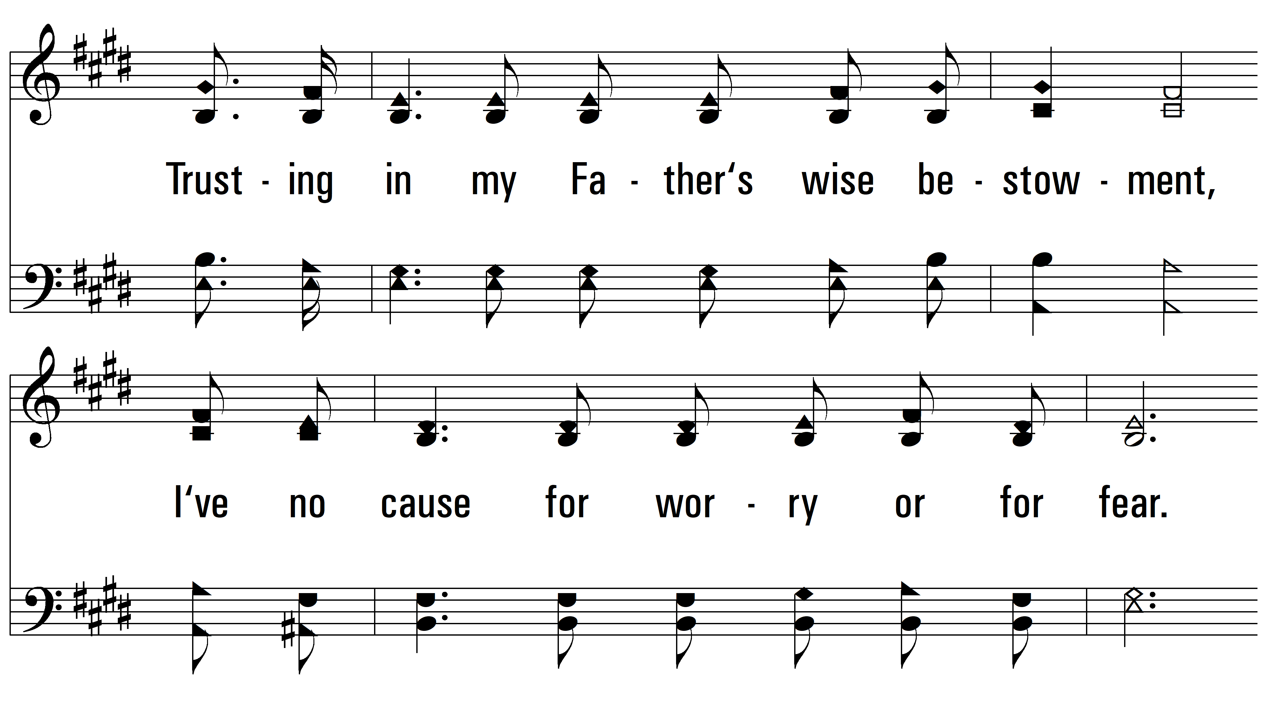
vs. 1

Slide 4
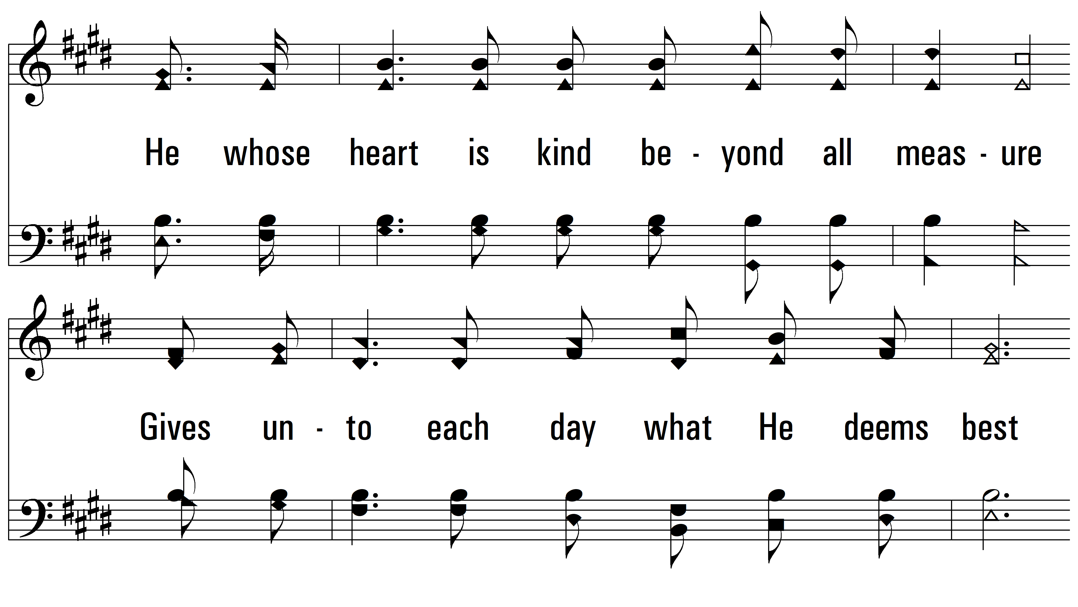
vs. 1

Slide 5
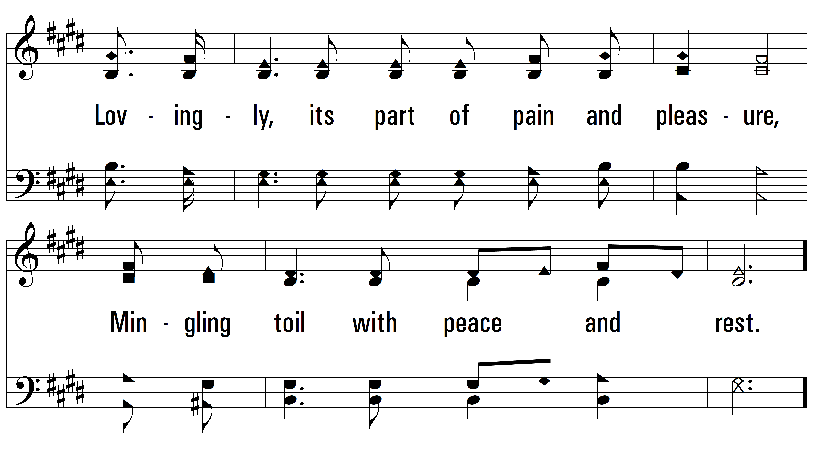
vs. 1

Slide 6
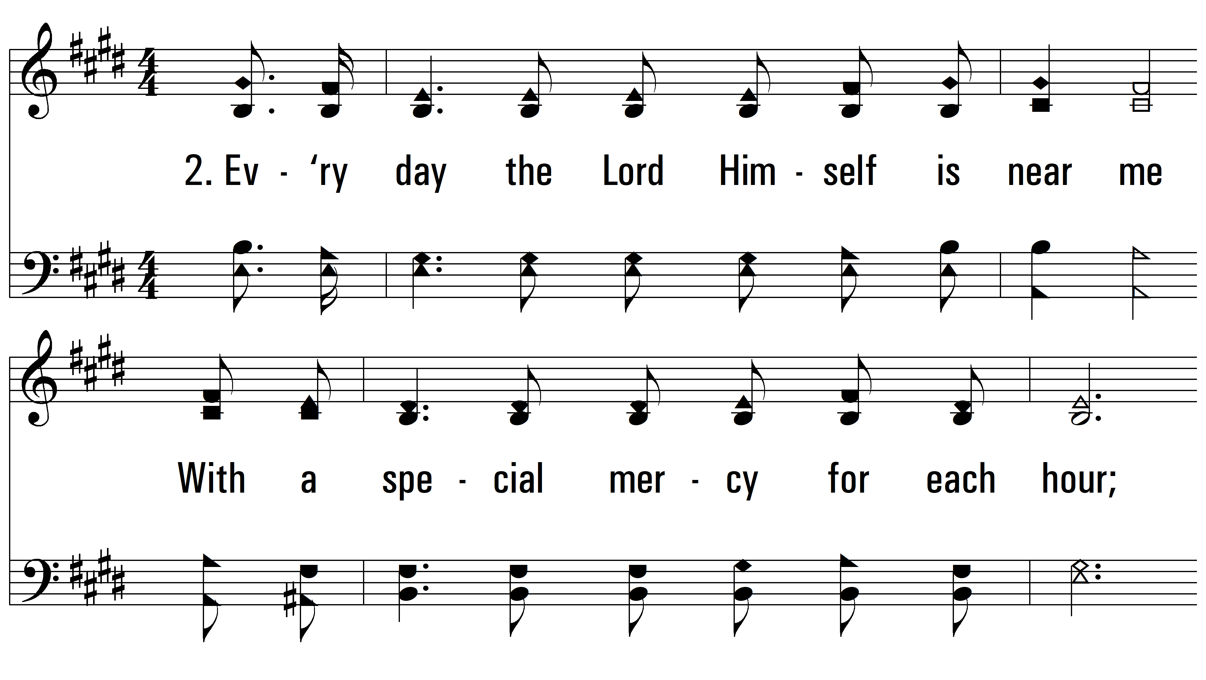
vs. 2 ~ Day By Day

Slide 7
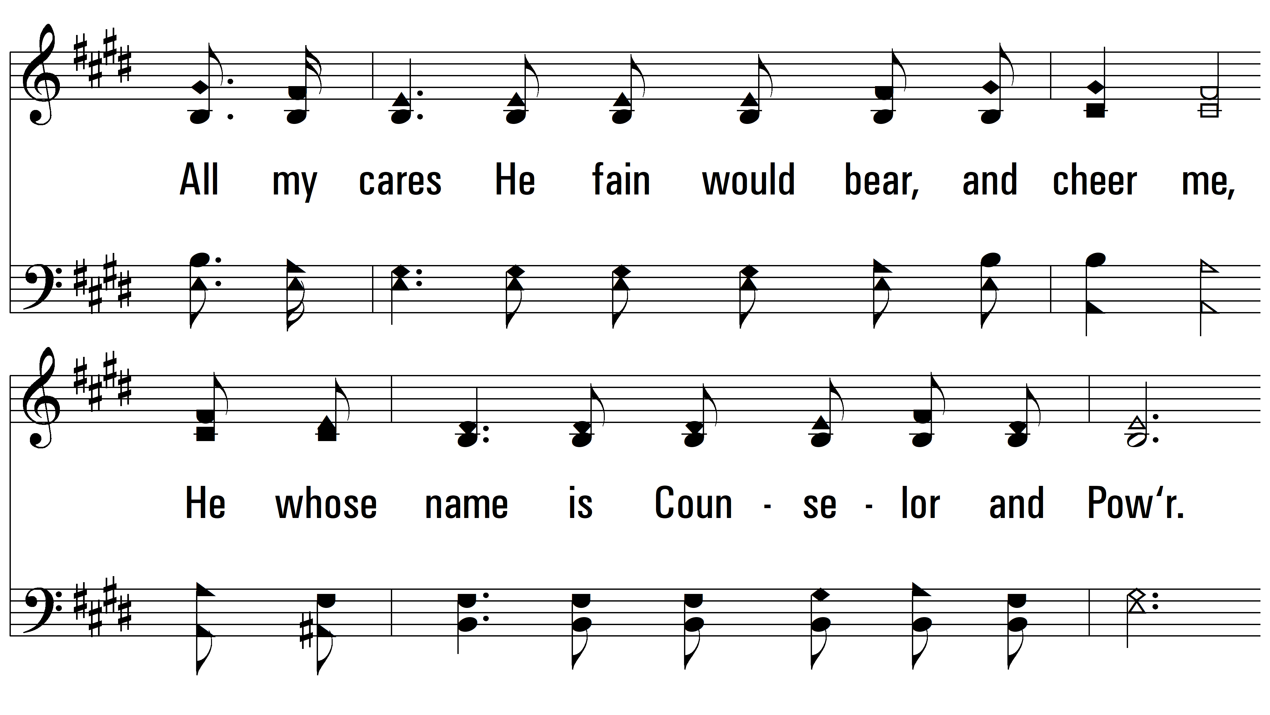
vs. 2

Slide 8
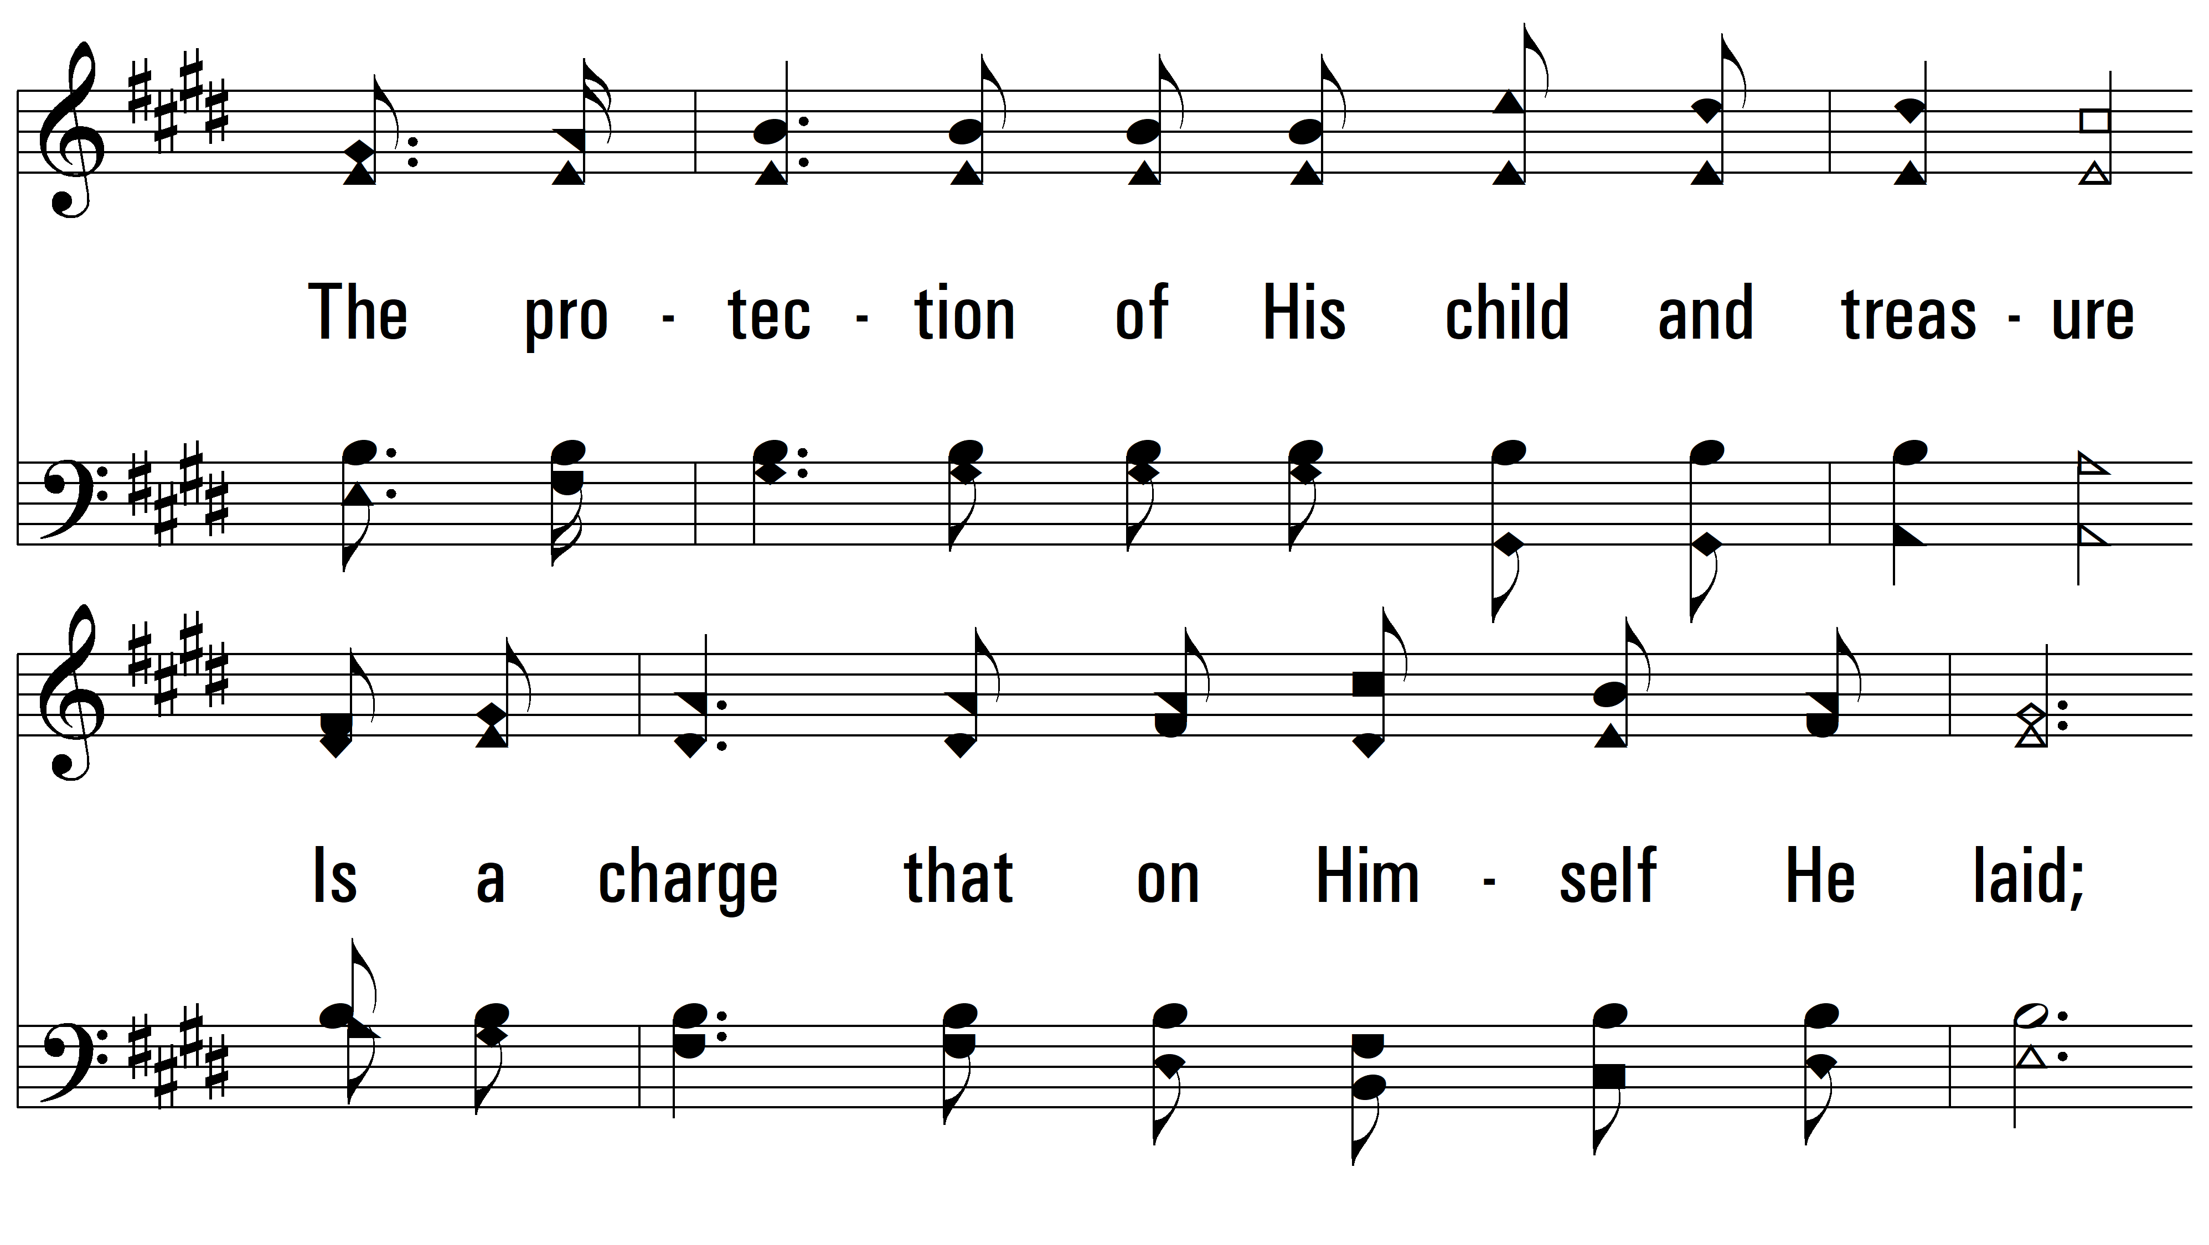
vs. 2

Slide 9
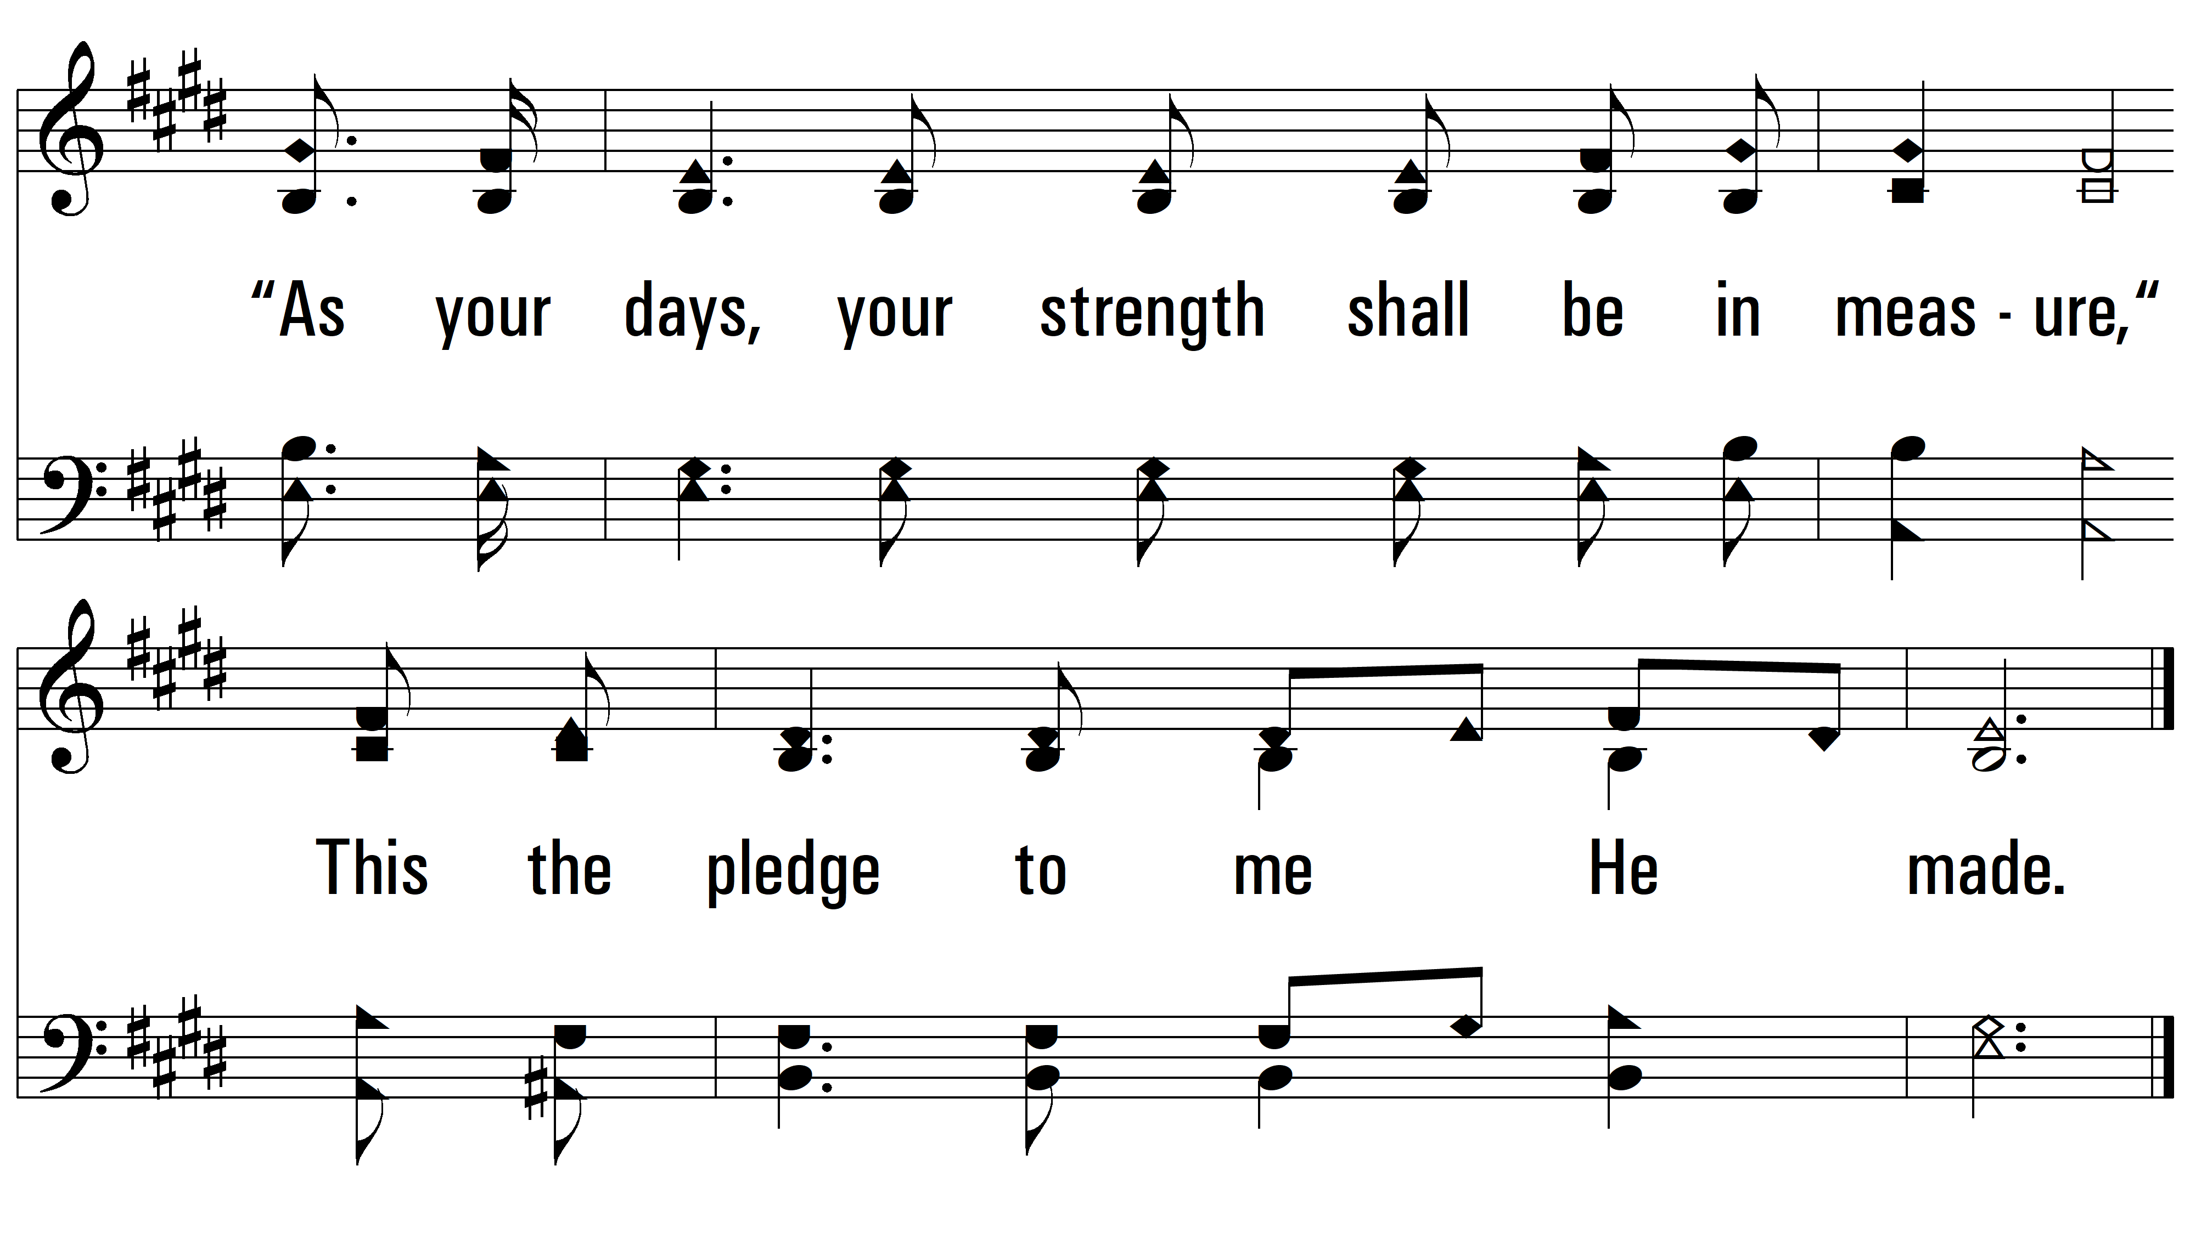
vs. 2

Slide 10
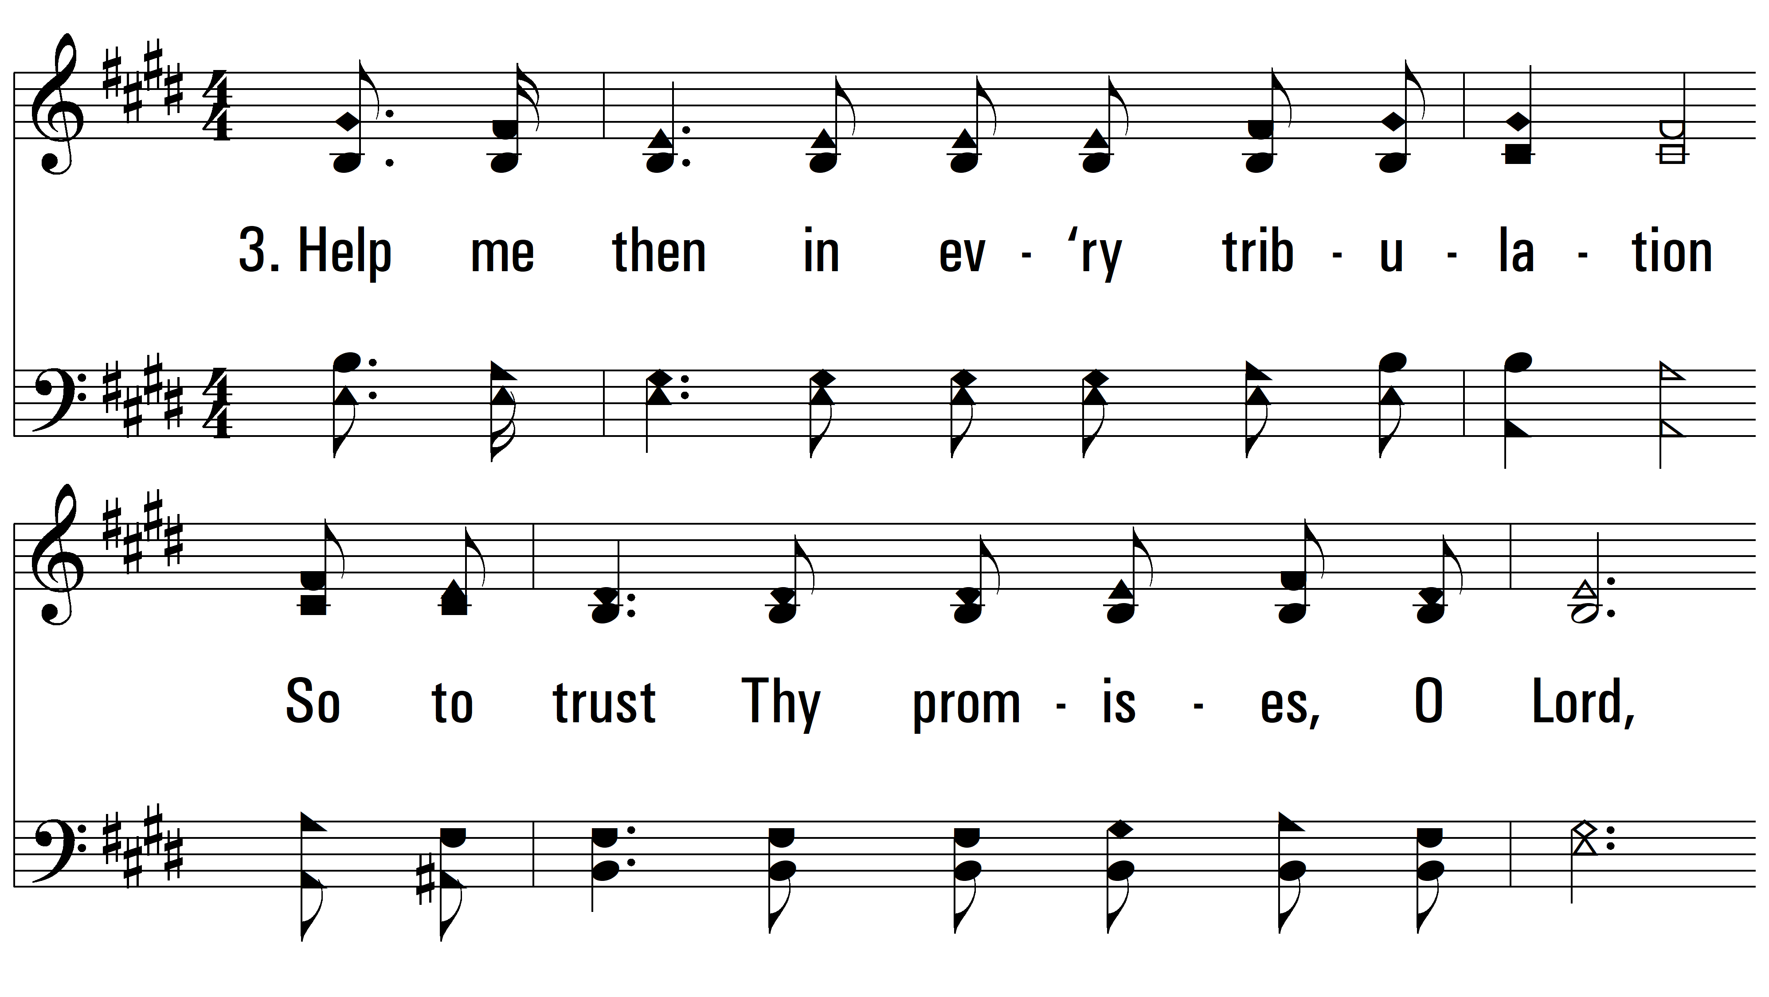
vs. 3 ~ Day By Day

Slide 11
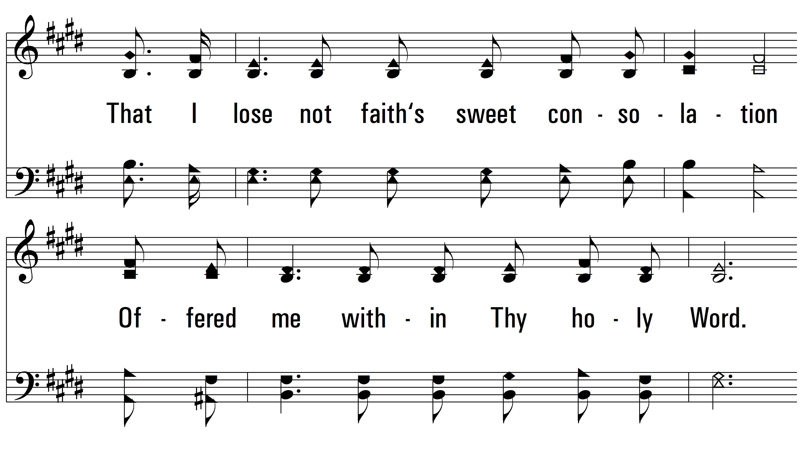
vs. 3

Slide 12
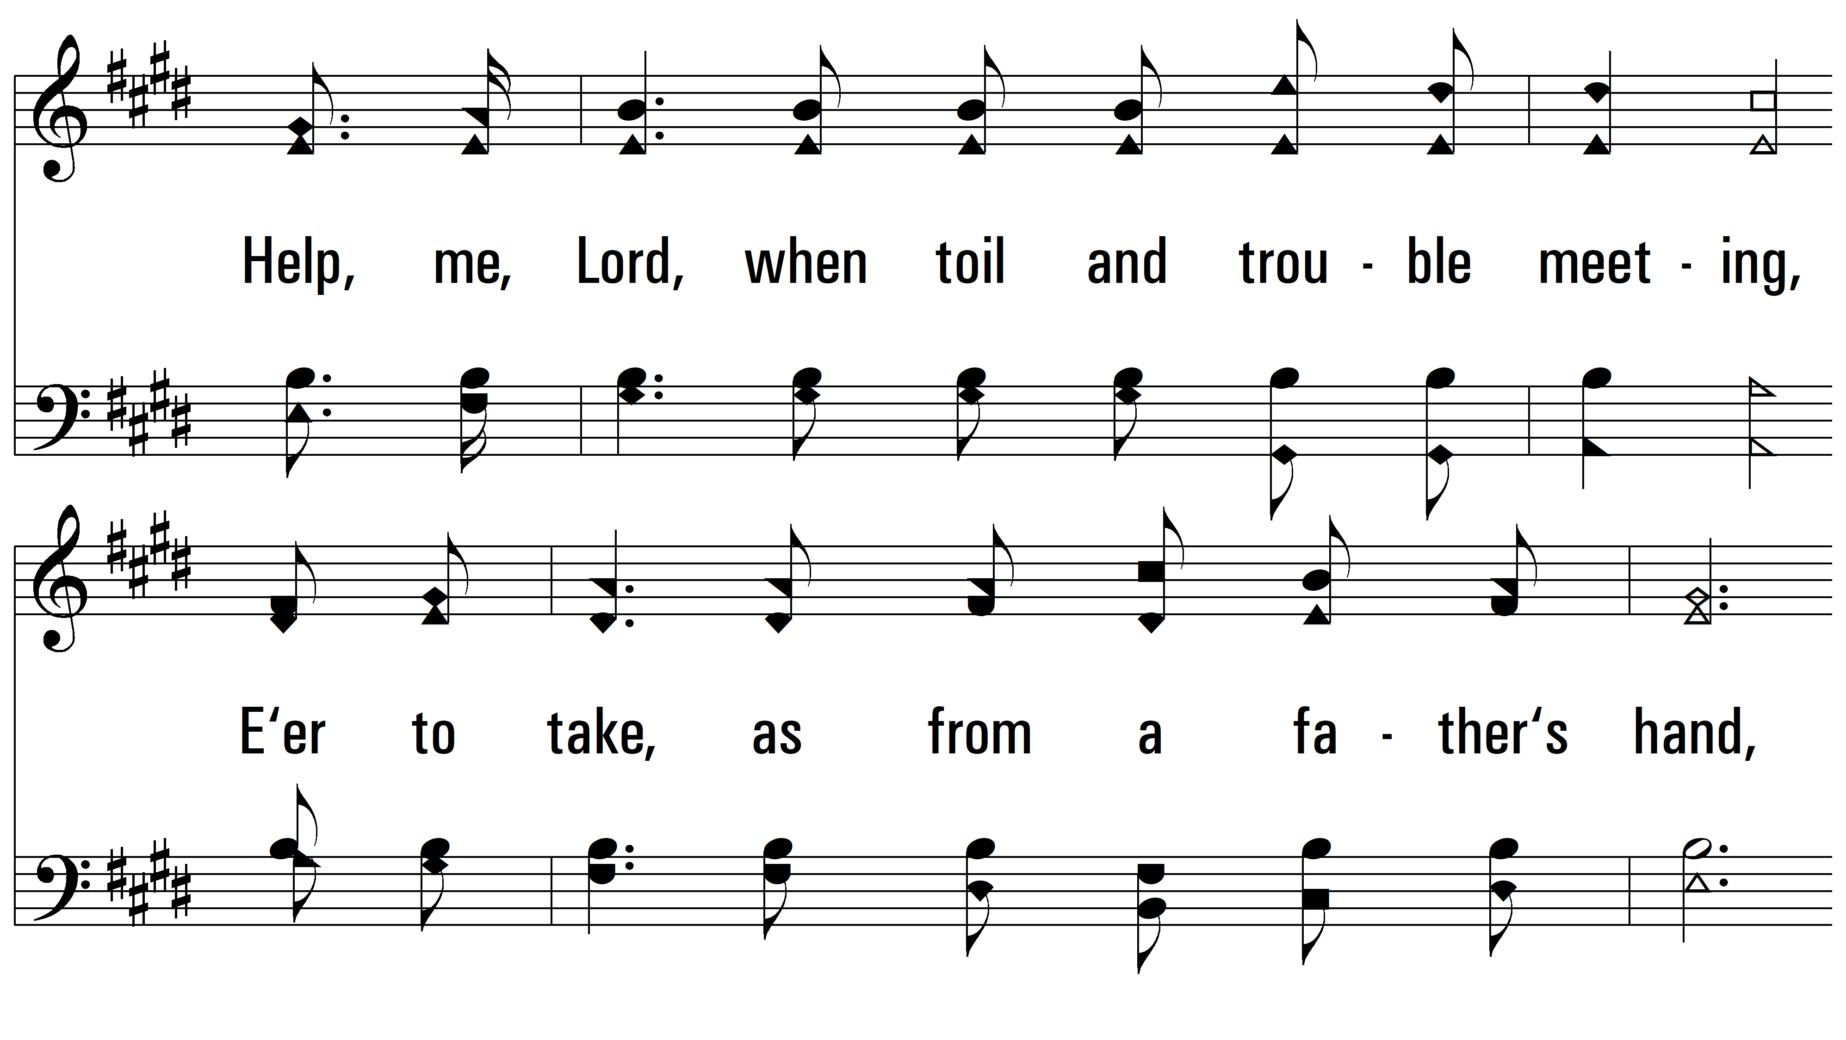
vs. 3

Slide 13
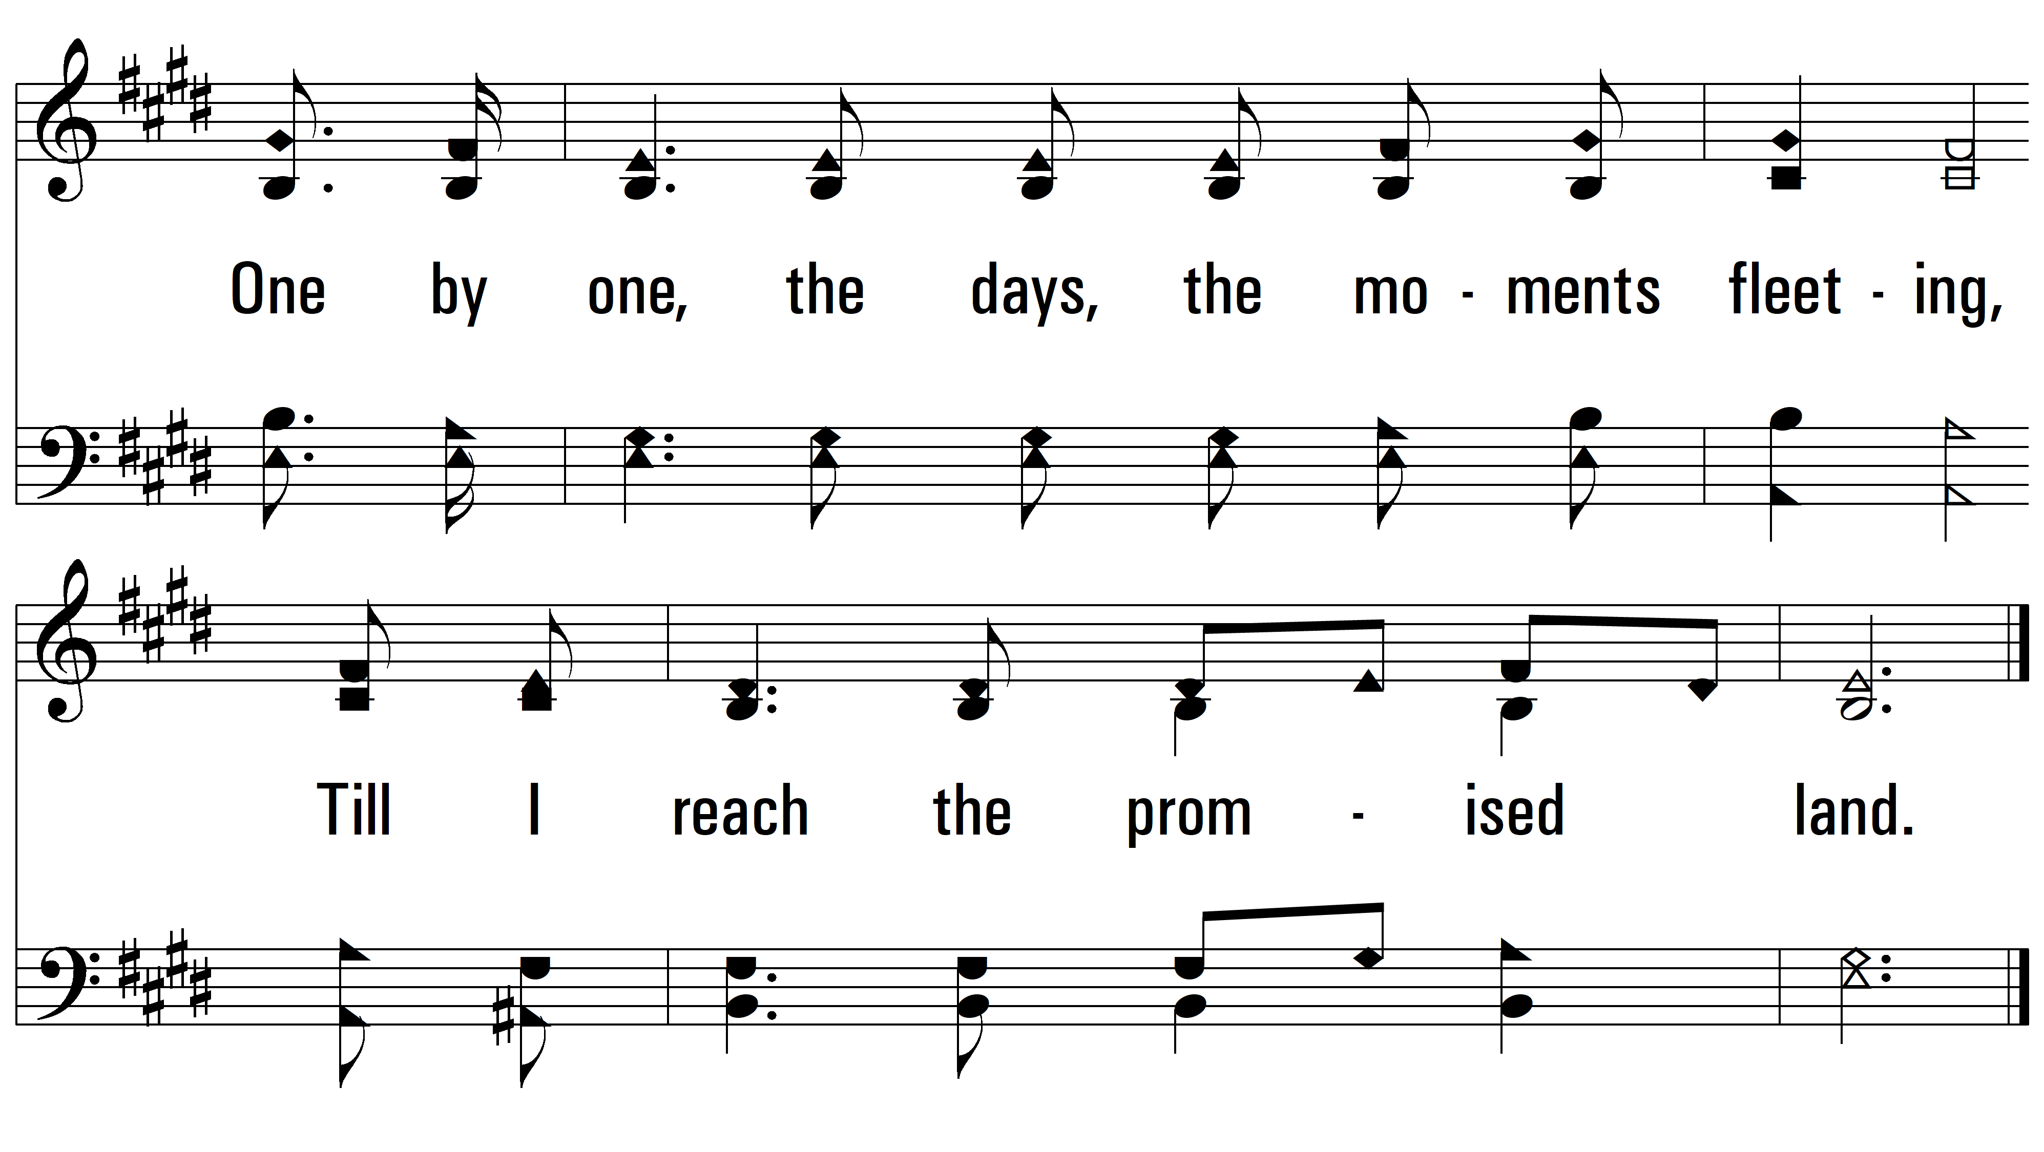
vs. 3
PDHymns.com
END

