Slide 1
Breathe On Me, Breath Of God
TRENTHAM
SM
Words: | Edwin Hatch (1878)
Music: | Robert Jackson (1888)
3/4
F/A - MI
Verses: 4
Lead - | MI
Alto - | DO
Tenor - | SOL
Bass - | DO
PDHymns.com

Slide 2
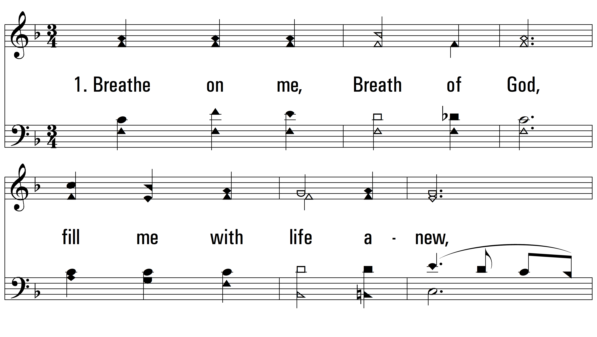
vs. 1 ~ Breathe On Me, Breath Of God

Slide 3
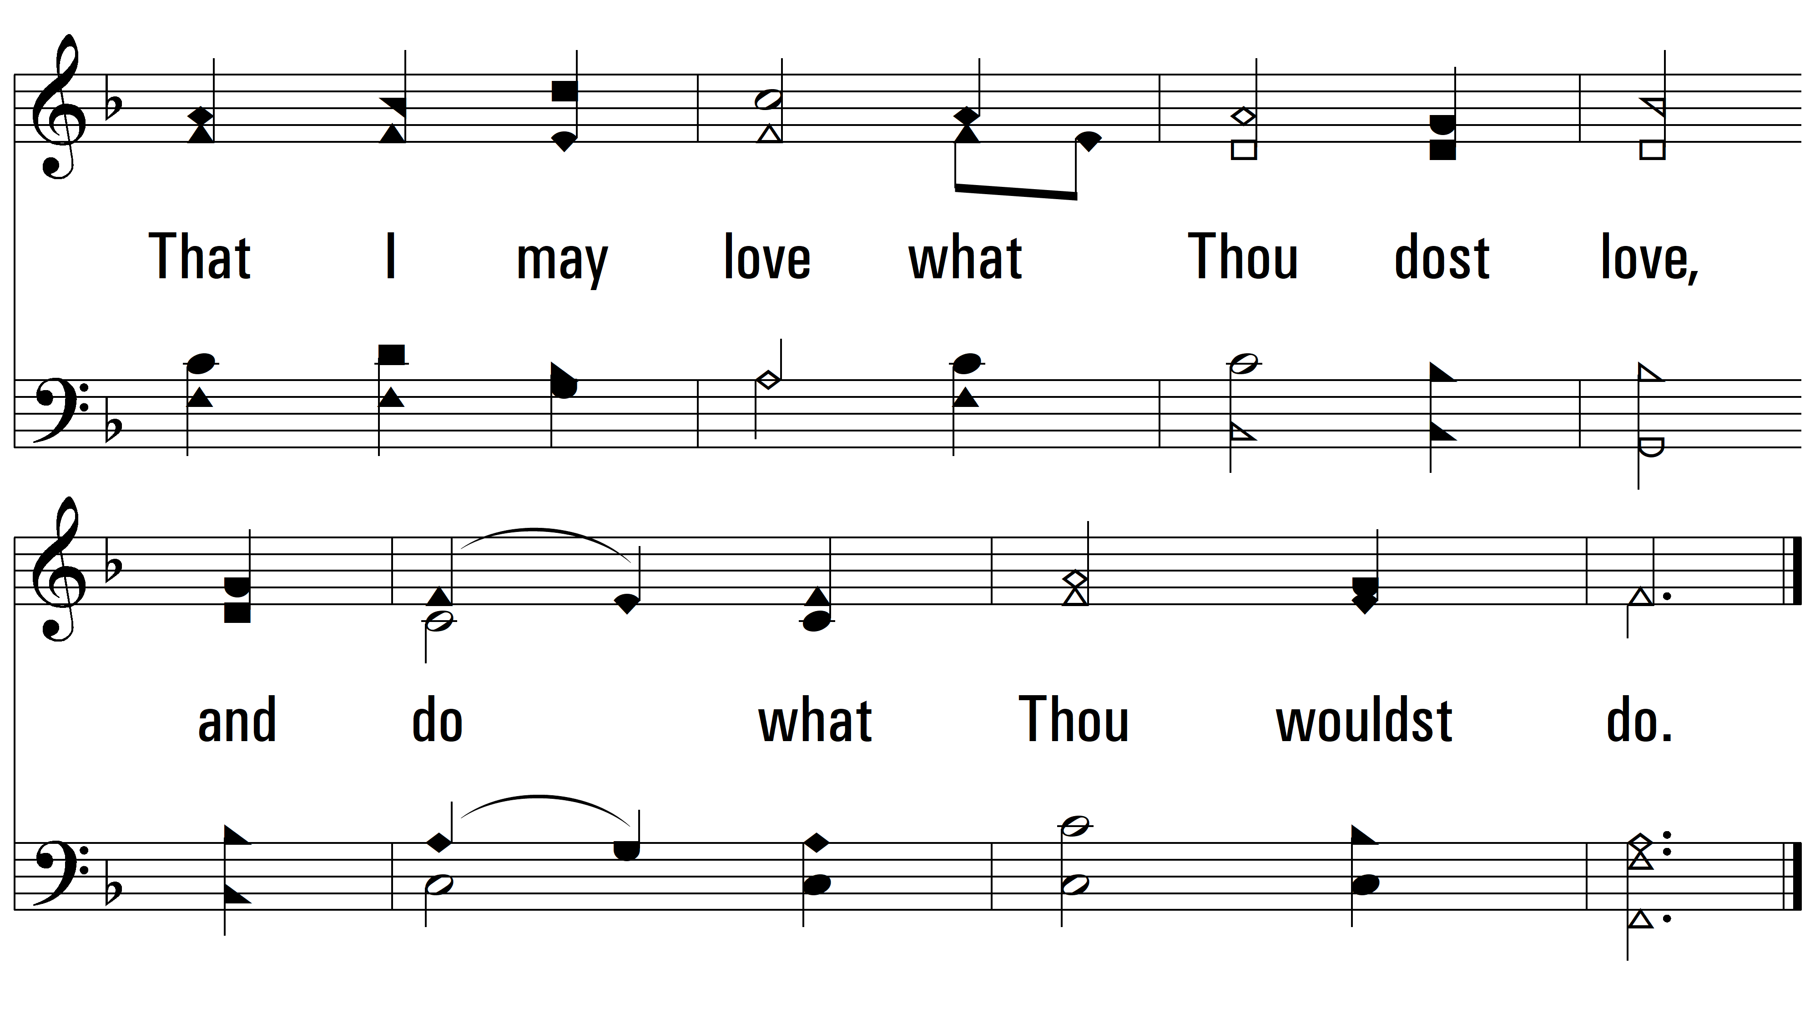
vs. 1

Slide 4
vs. 2 ~ Breathe On Me, Breath Of God

Slide 5
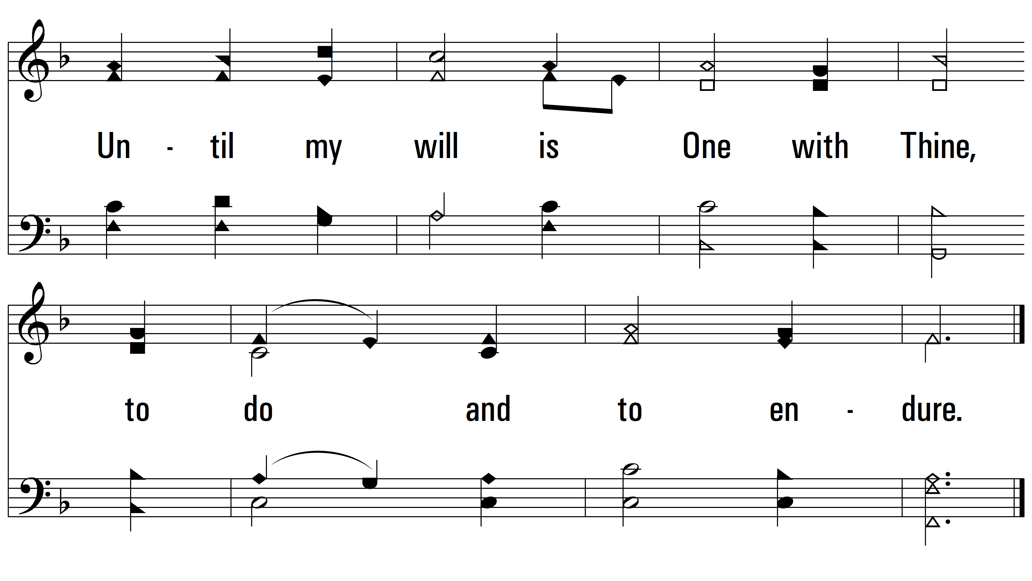
vs. 2

Slide 6
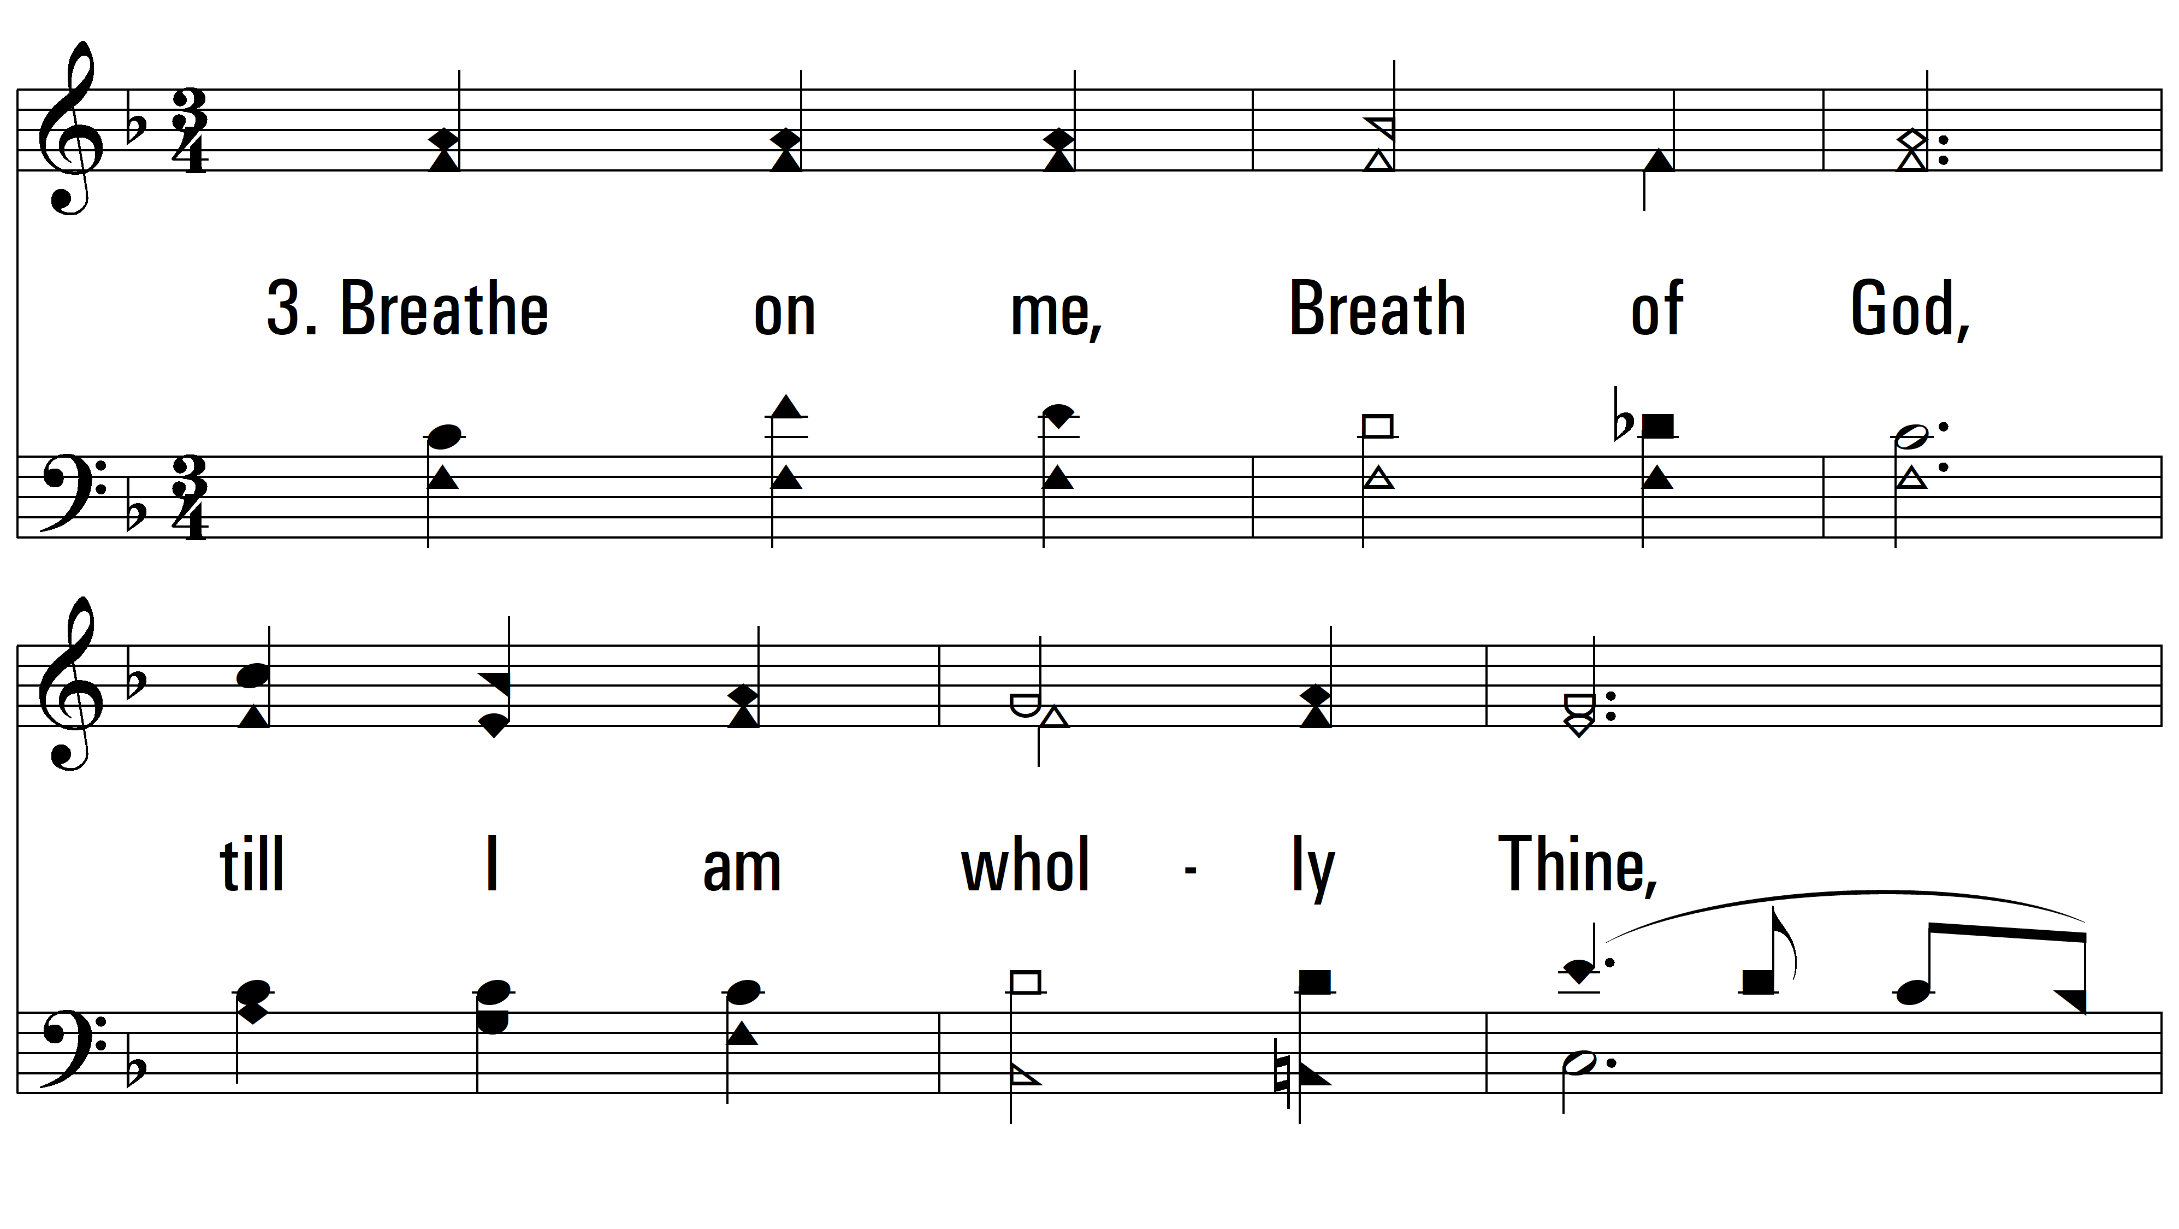
vs. 3 ~ Breathe On Me, Breath Of God

Slide 7
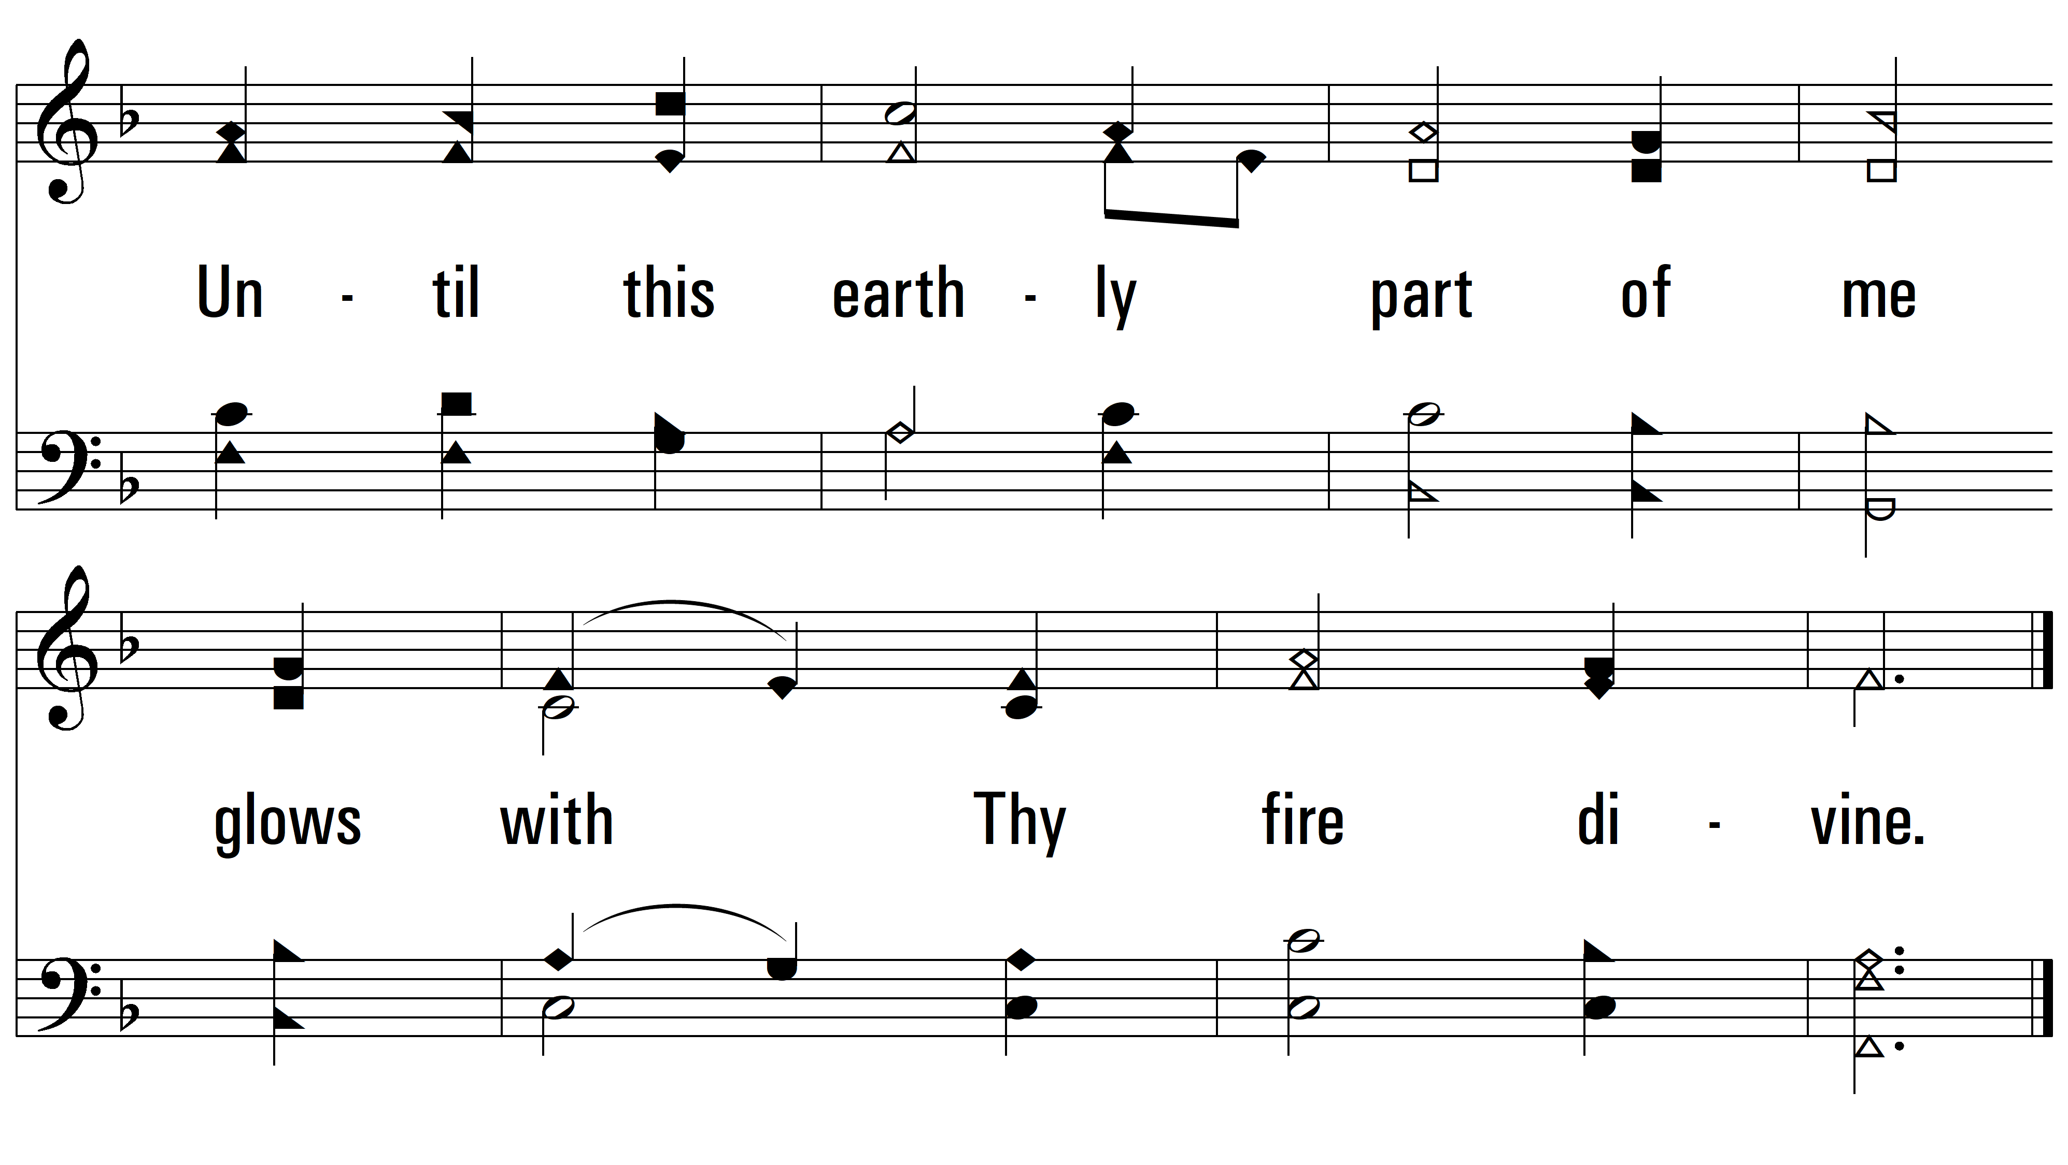
vs. 3

Slide 8
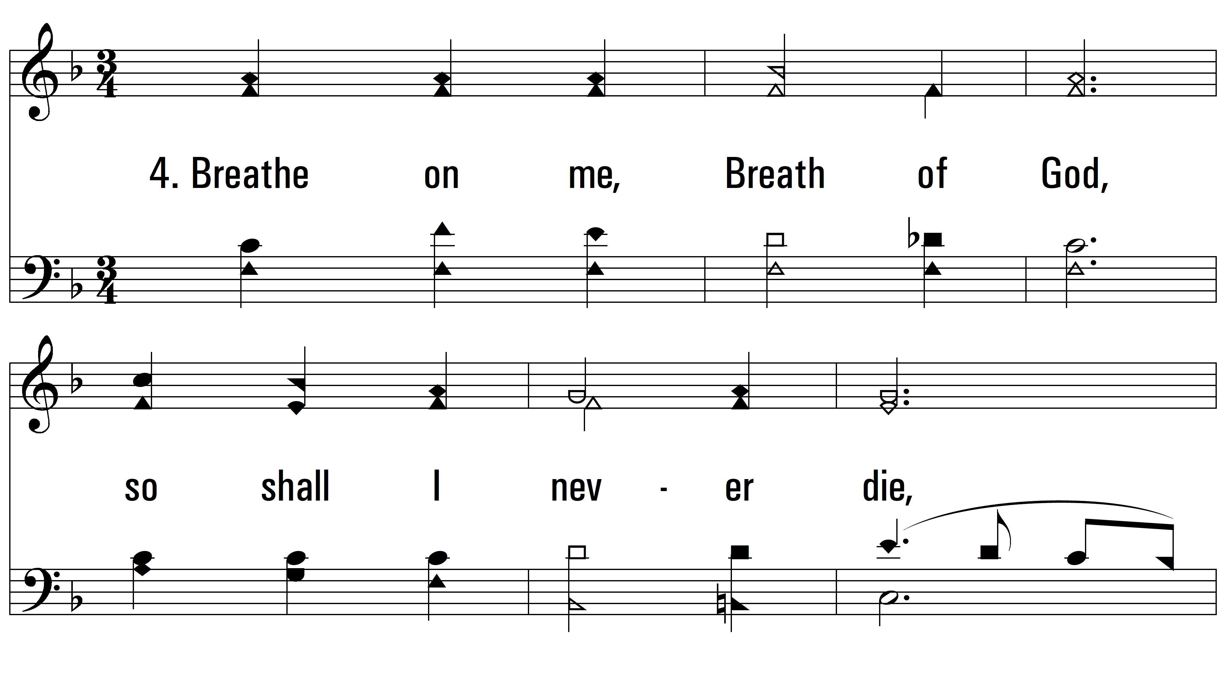
vs. 4 ~ Breathe On Me, Breath Of God

Slide 9
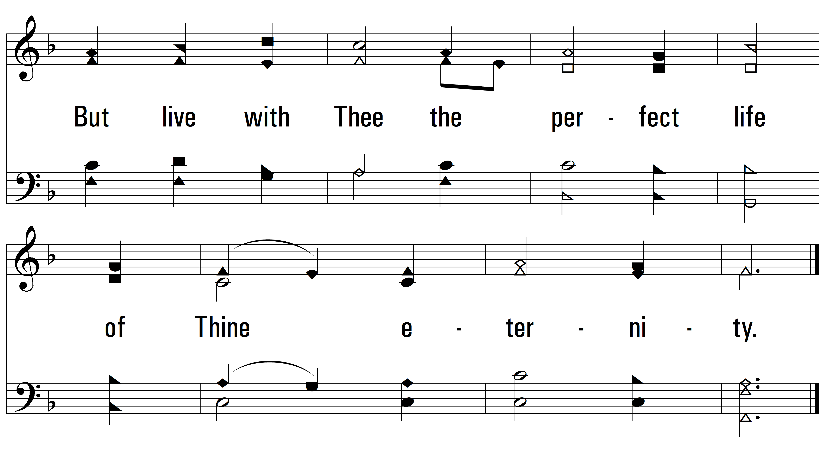
vs. 4
PDHymns.com
END

