Slide 1
A Wonderful Savior
(He Hideth My Soul)
Words: | Fanny J. Crosby (1890)
Music: | William J. Kirkpatrick (1890)
6/8
D/A - SOL
Verses: 4/Chorus
Lead - | SOL
Alto - | MI
Tenor - | DO
Bass - | DO
PDHymns.com

Slide 2
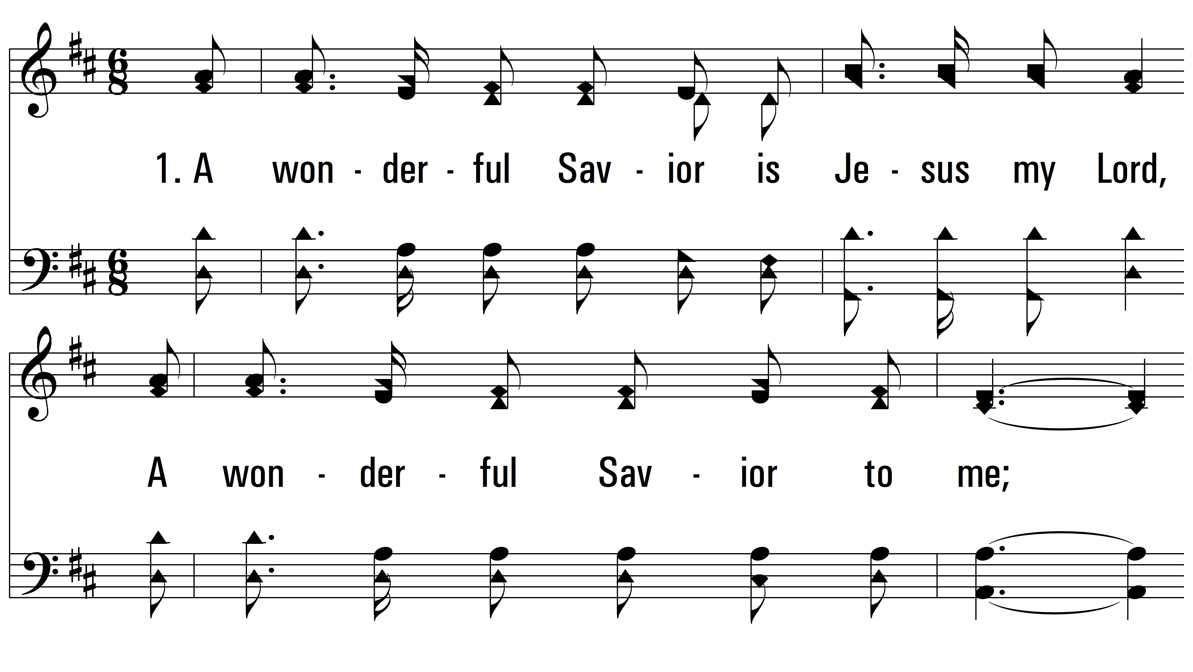
vs. 1 ~ A Wonderful Savior

Slide 3
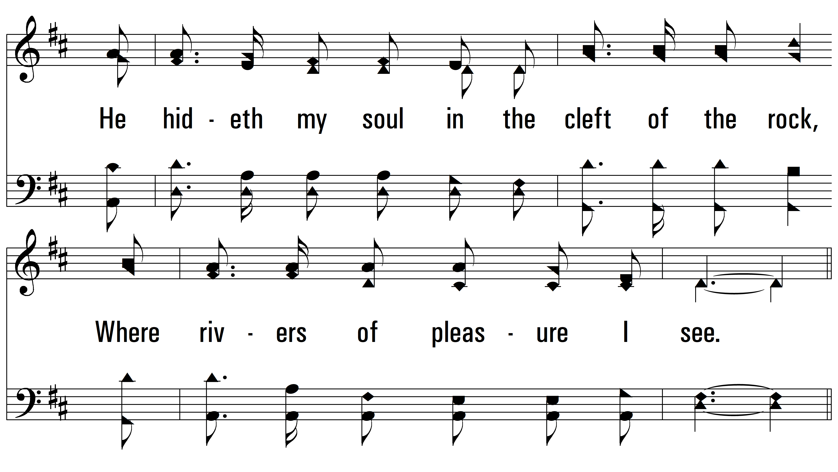
vs. 1

Slide 4
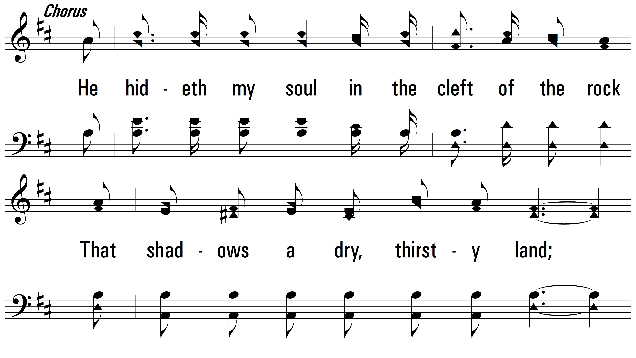
vs. 1

Slide 5
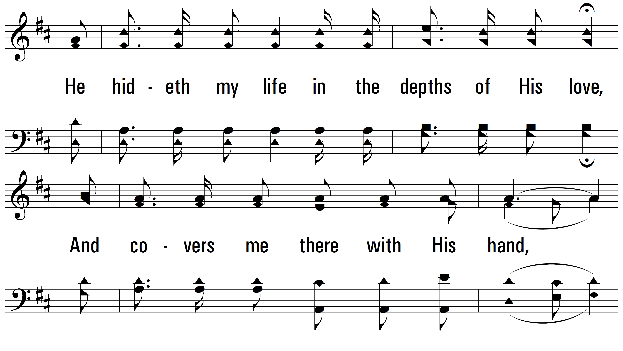
vs. 1

Slide 6
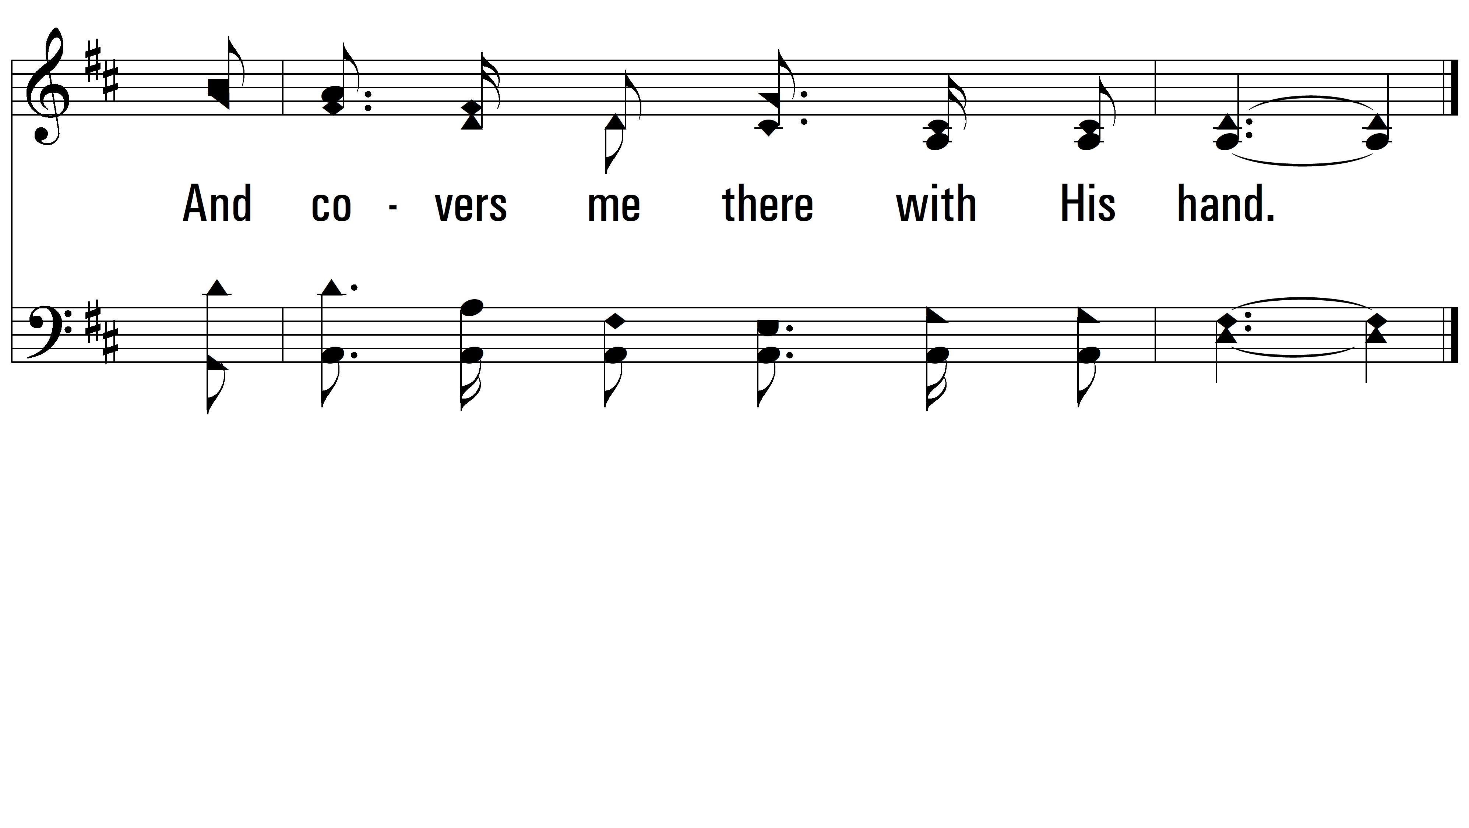
vs. 1

Slide 7
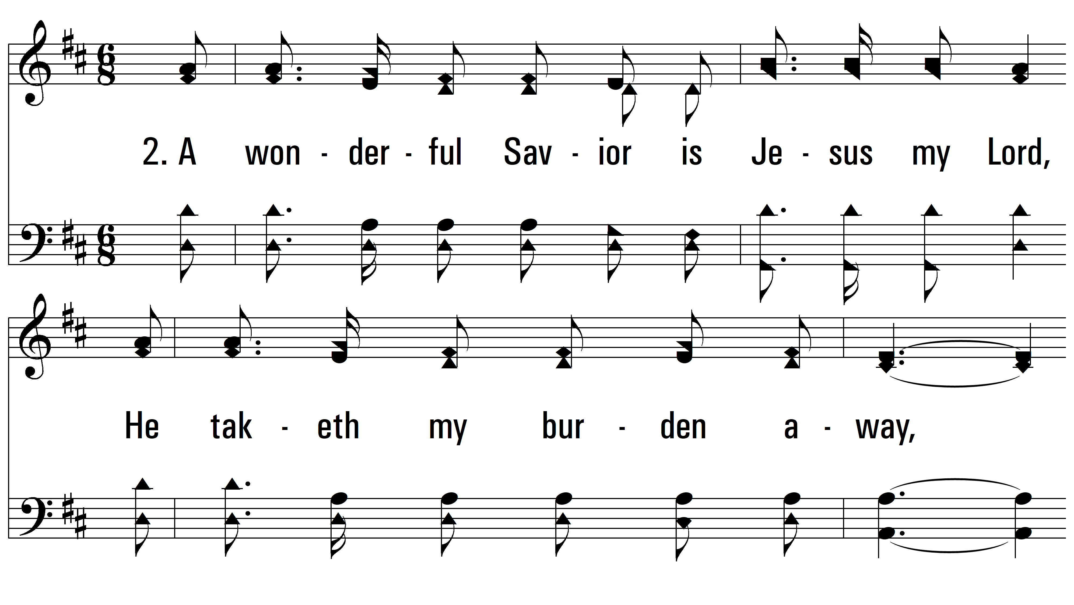
vs. 2 ~ A Wonderful Savior

Slide 8
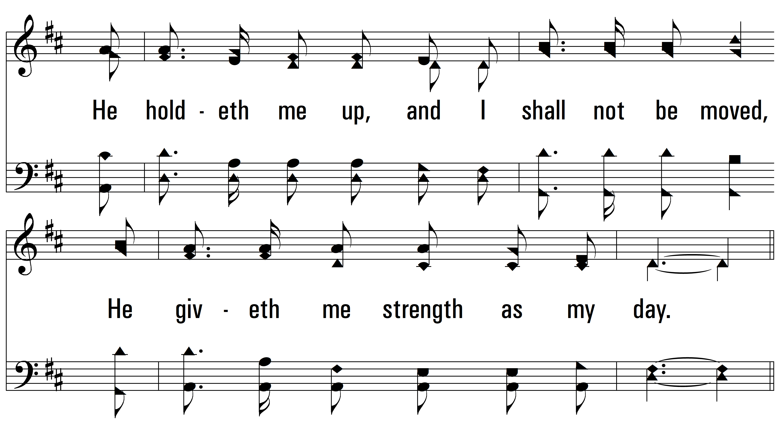
vs. 2

Slide 9
vs. 2

Slide 10
vs. 2

Slide 11
vs. 2

Slide 12
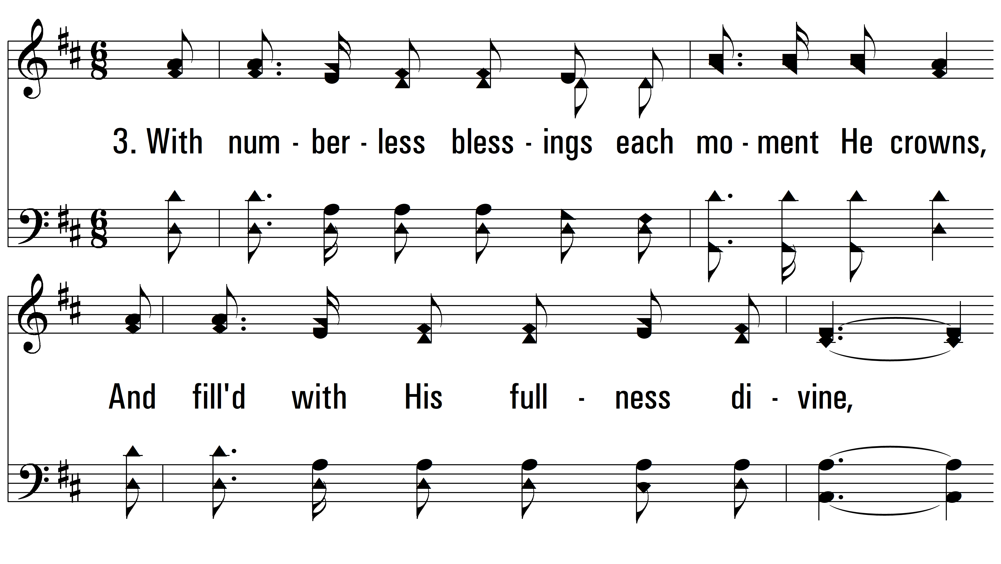
vs. 3 ~ A Wonderful Savior

Slide 13
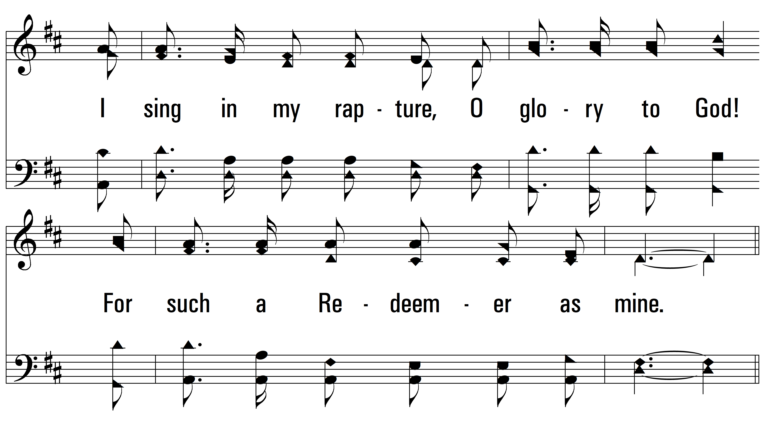
vs. 3

Slide 14
vs. 3

Slide 15
vs. 3

Slide 16
vs. 3

Slide 17
vs. 4 ~ A Wonderful Savior

Slide 18
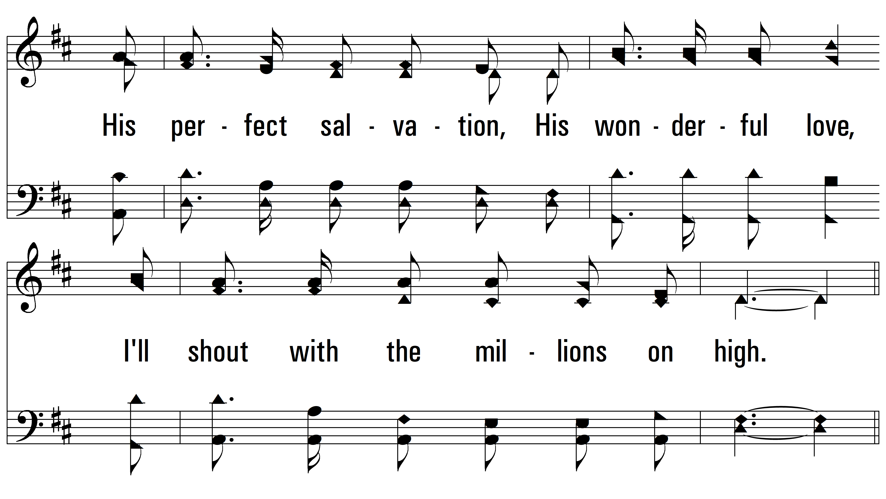
vs. 4

Slide 19
vs. 4

Slide 20
vs. 4

Slide 21
vs. 4
PDHymns.com
END

