Slide 1
Resurrection
Words: | H. F. Morris (1911)
Music: | T. B. Mosley (1911)
4/4
C/E - MI
Verses: 1
Lead - | MI
Alto - | DO
Tenor - | SOL
Bass - | DO
PDHymns.com

Slide 2
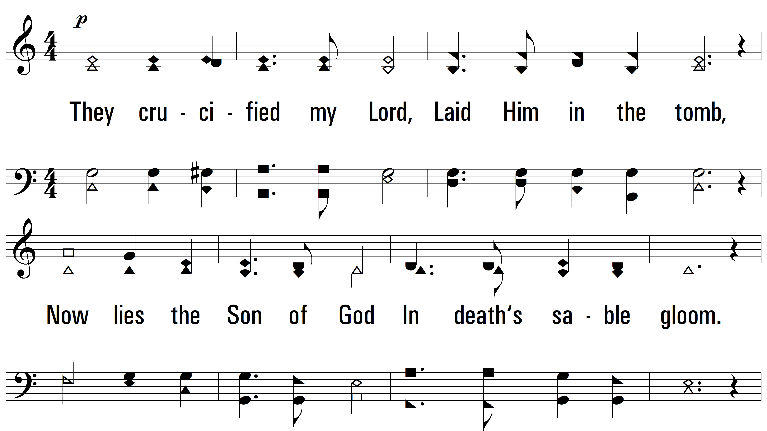
vs. 1 ~ Resurrection

Slide 3
vs. 1

Slide 4
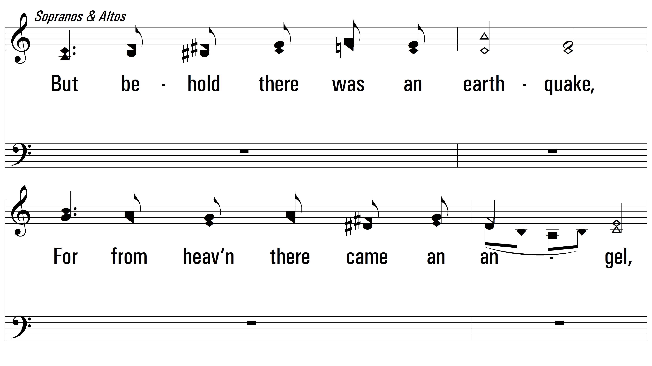
vs. 1

Slide 5
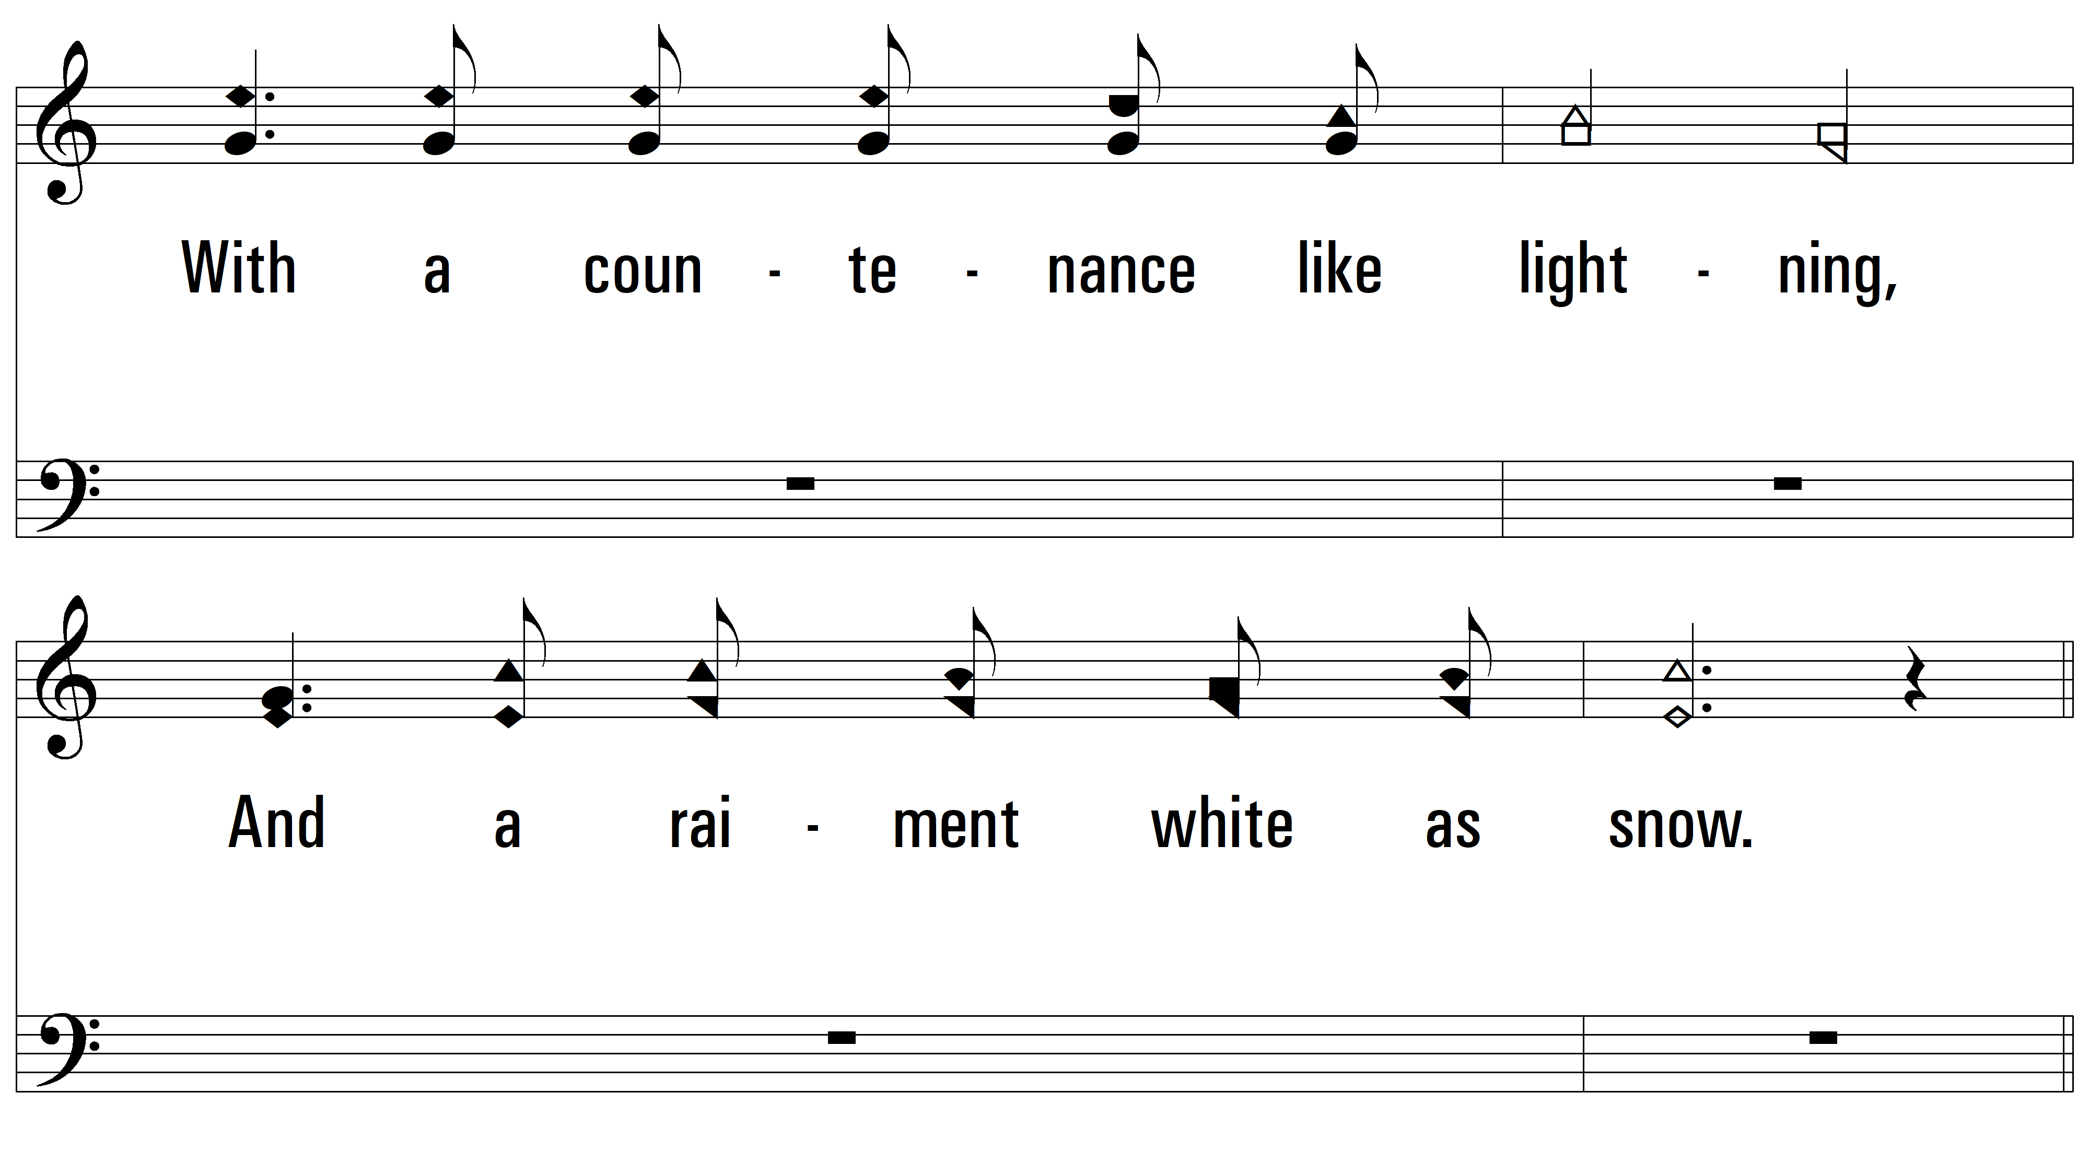
vs. 1

Slide 6
vs. 1

Slide 7
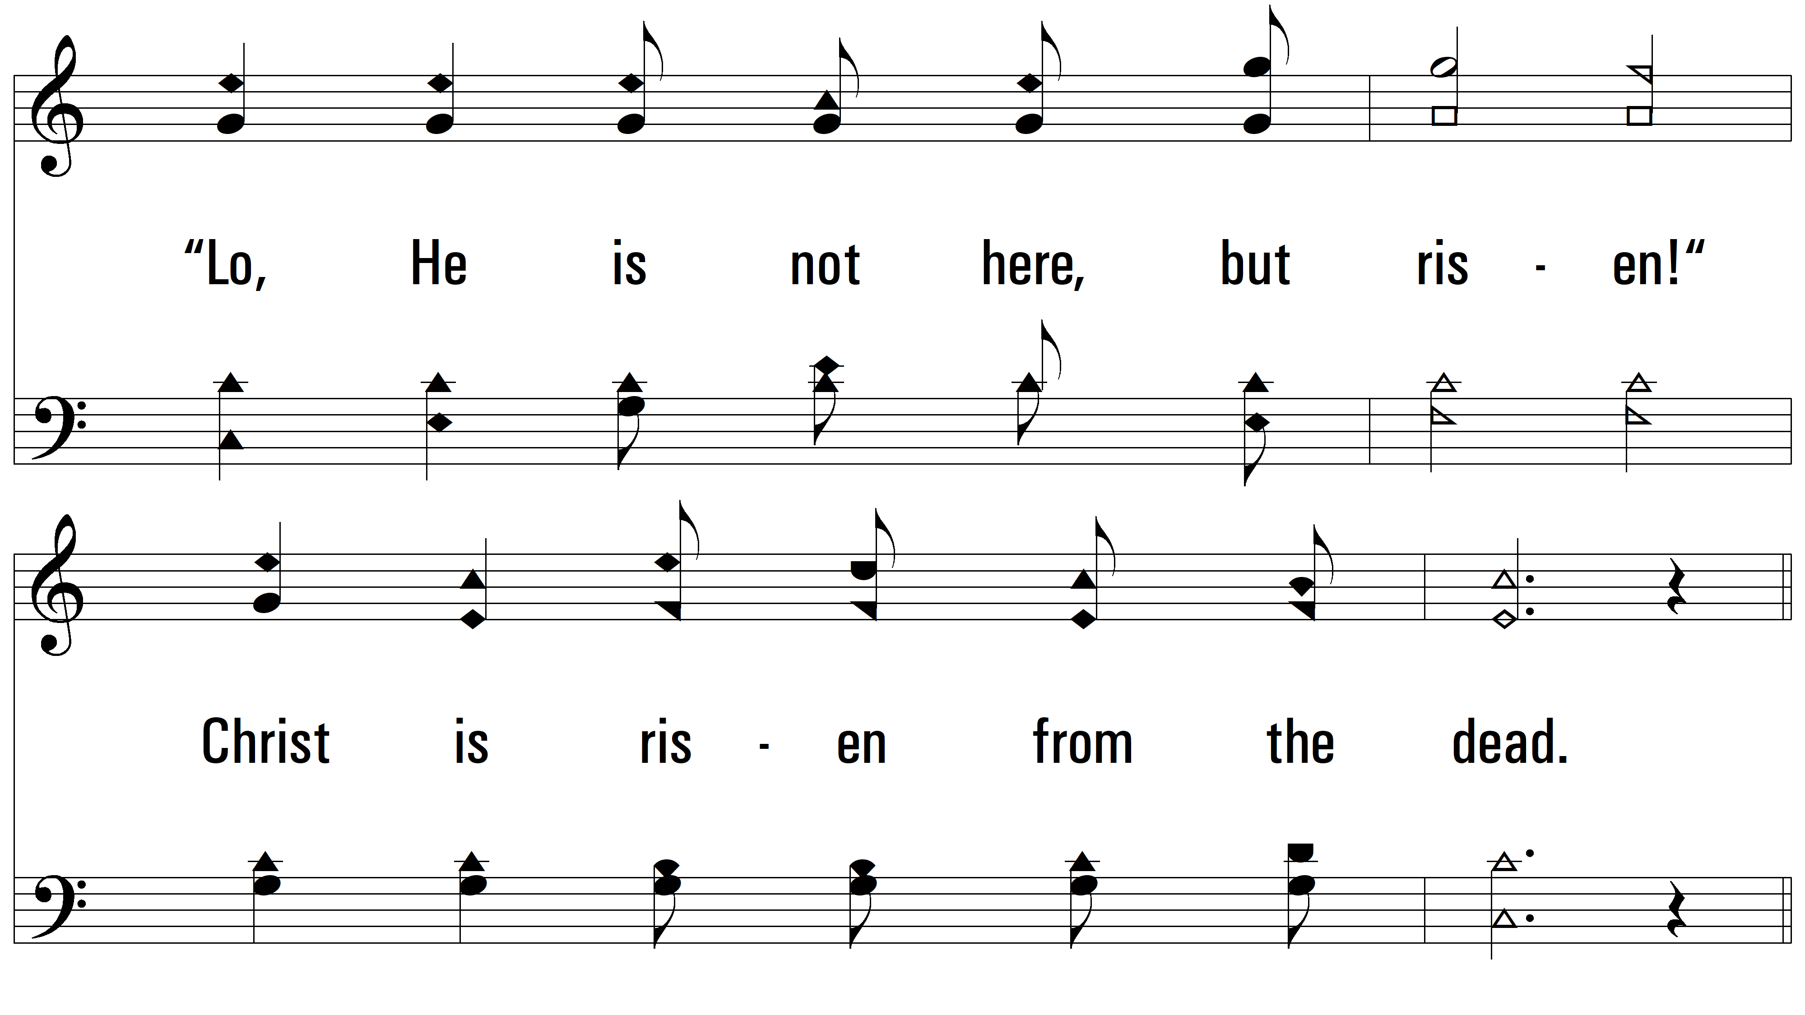
vs. 1

Slide 8
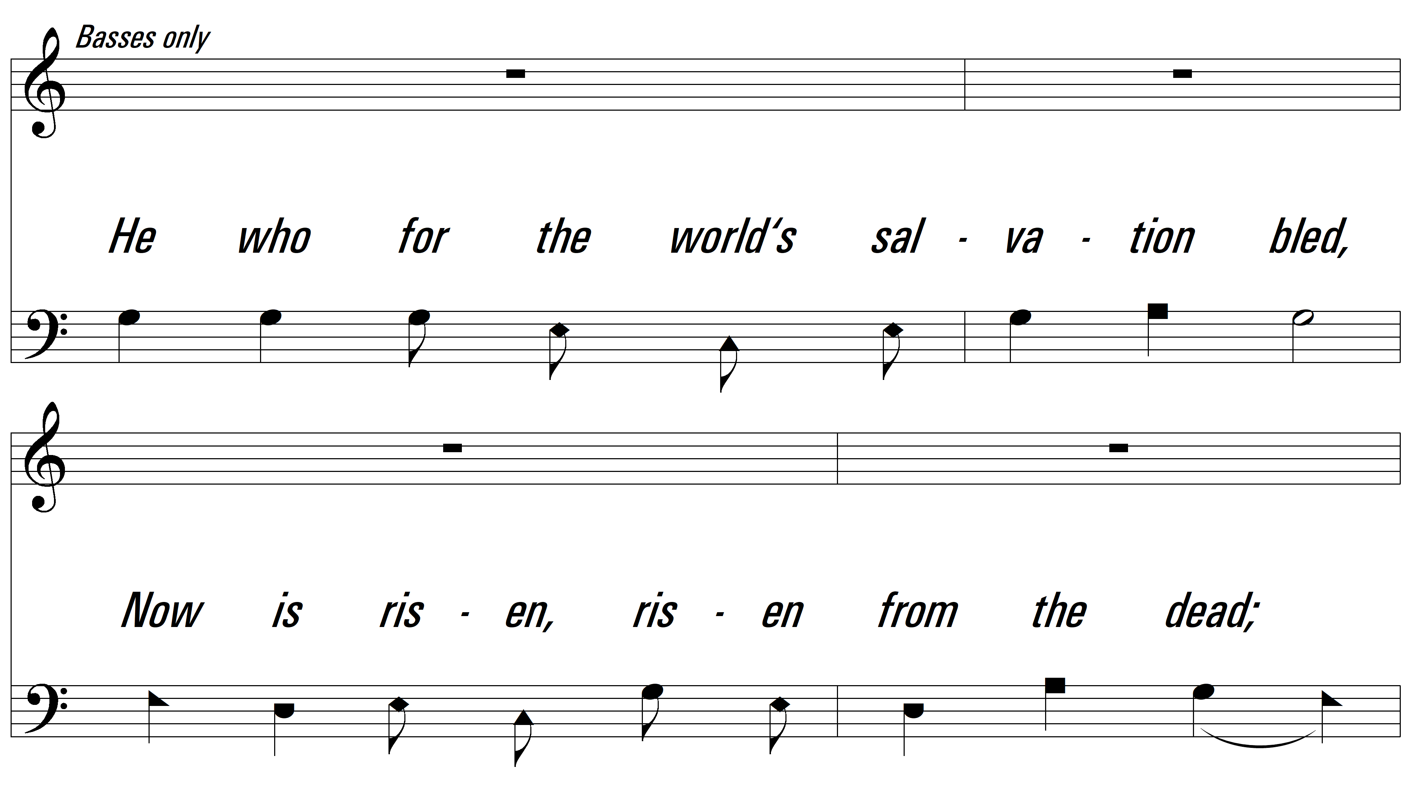
vs. 1

Slide 9
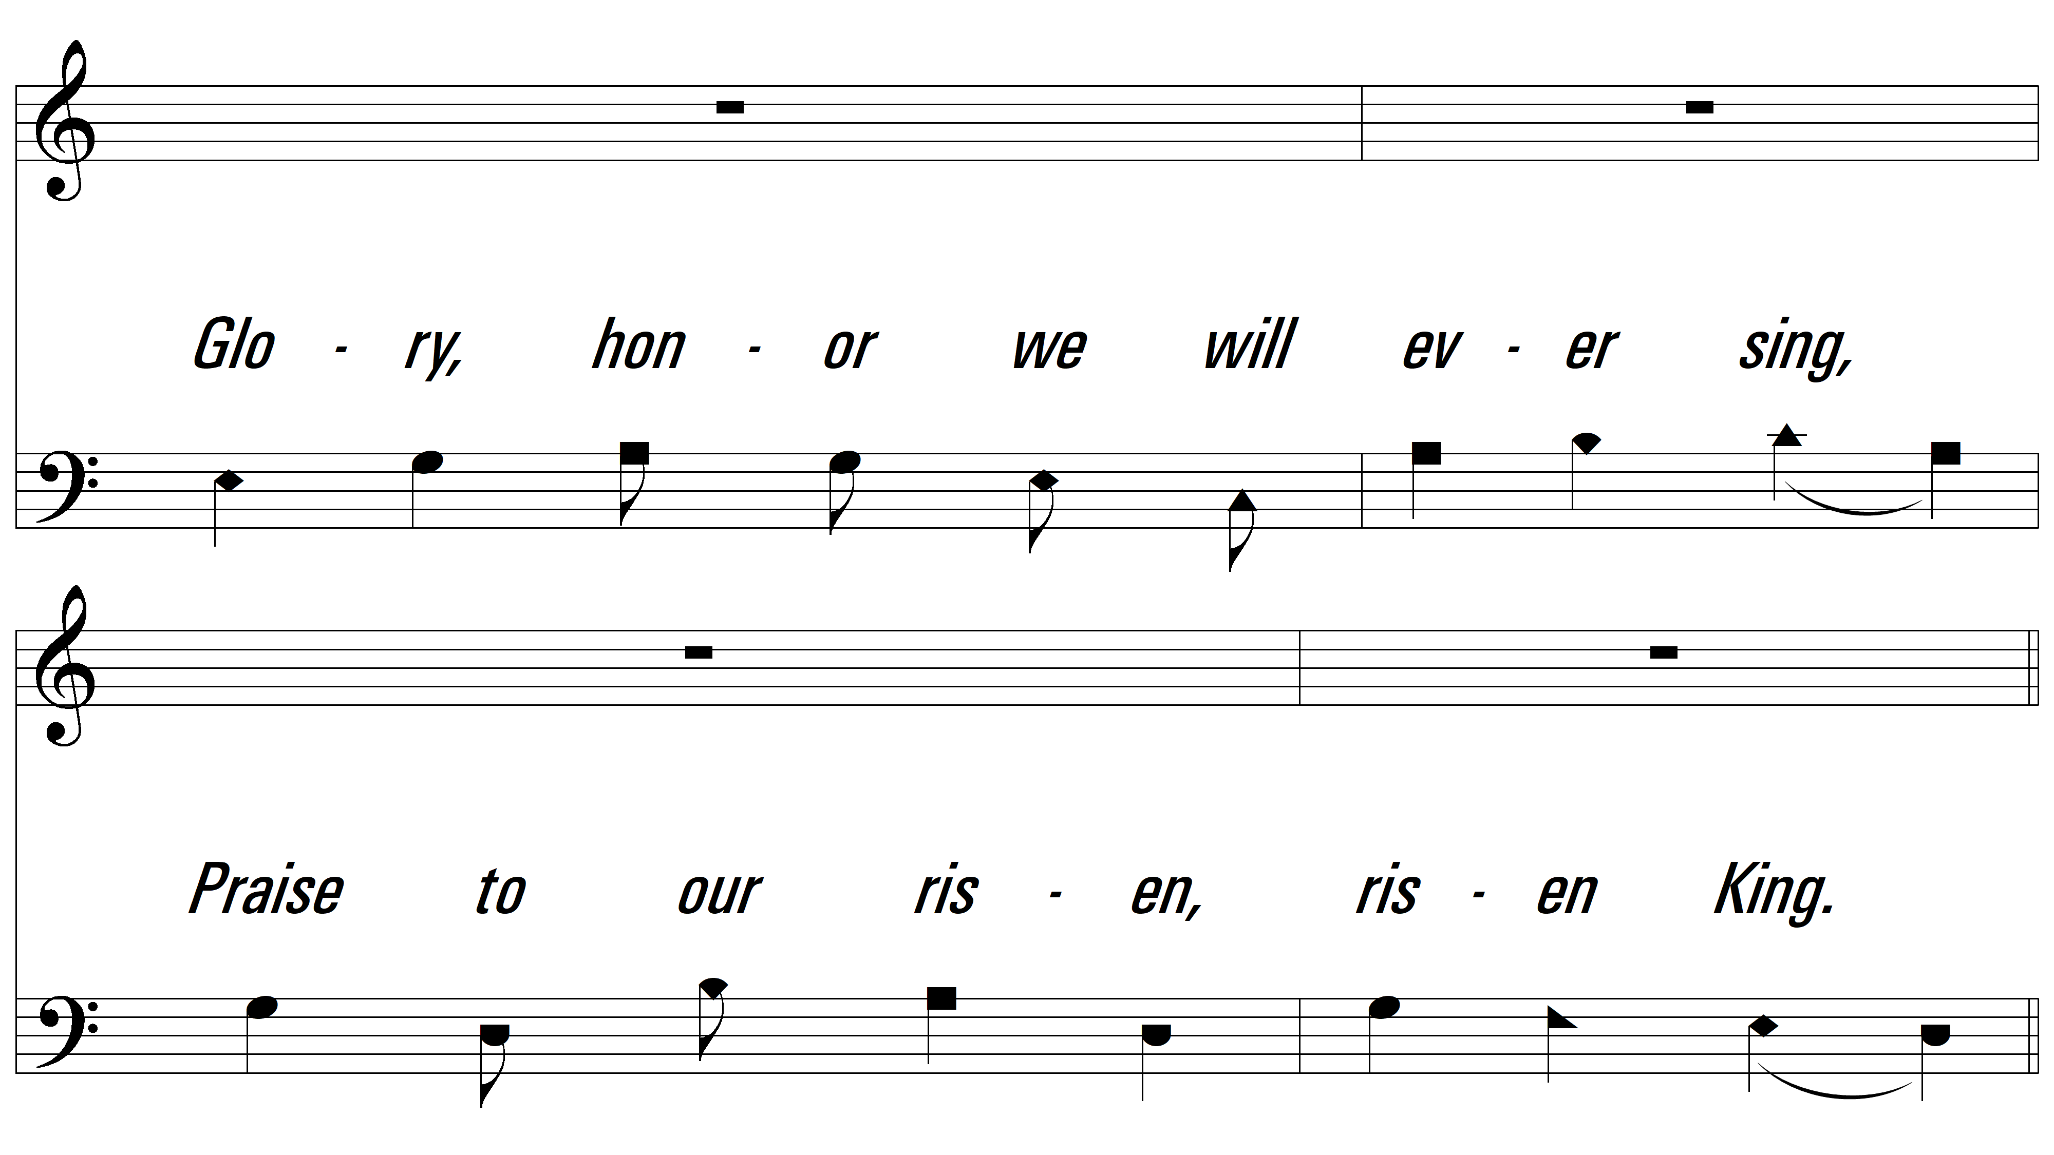
vs. 1

Slide 10
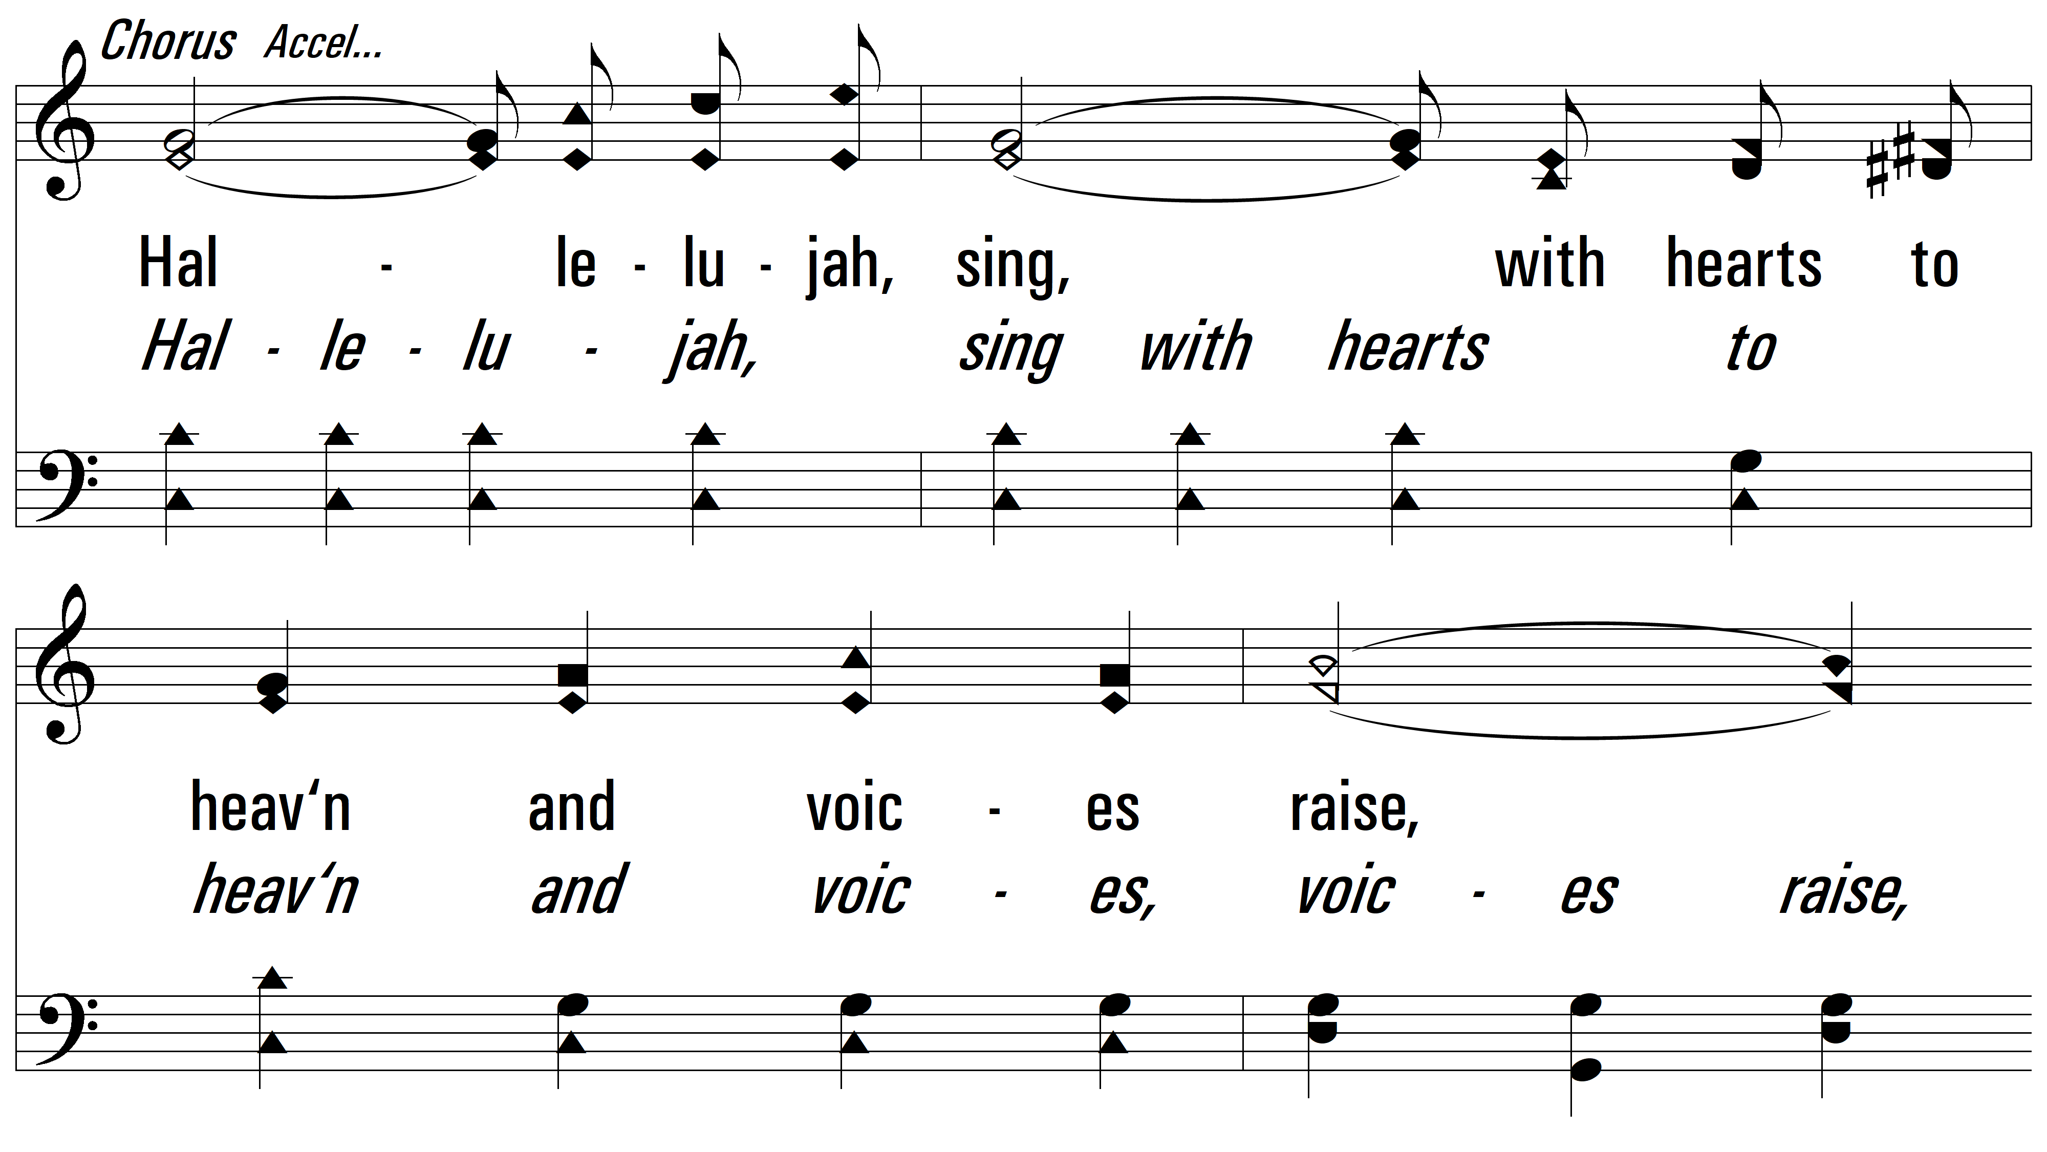
vs. 1

Slide 11
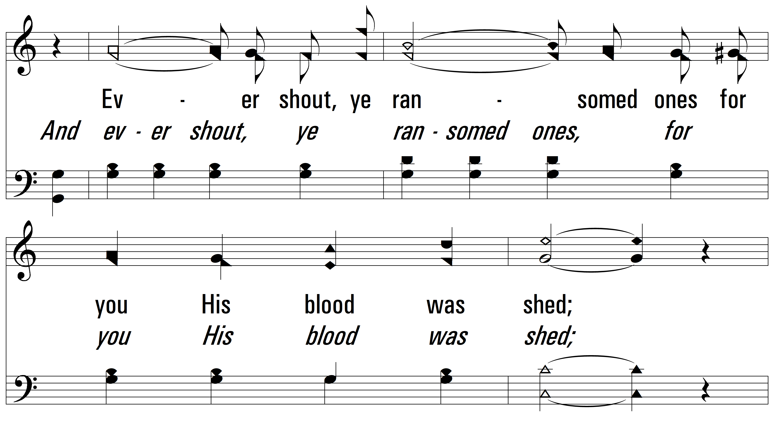
vs. 1

Slide 12
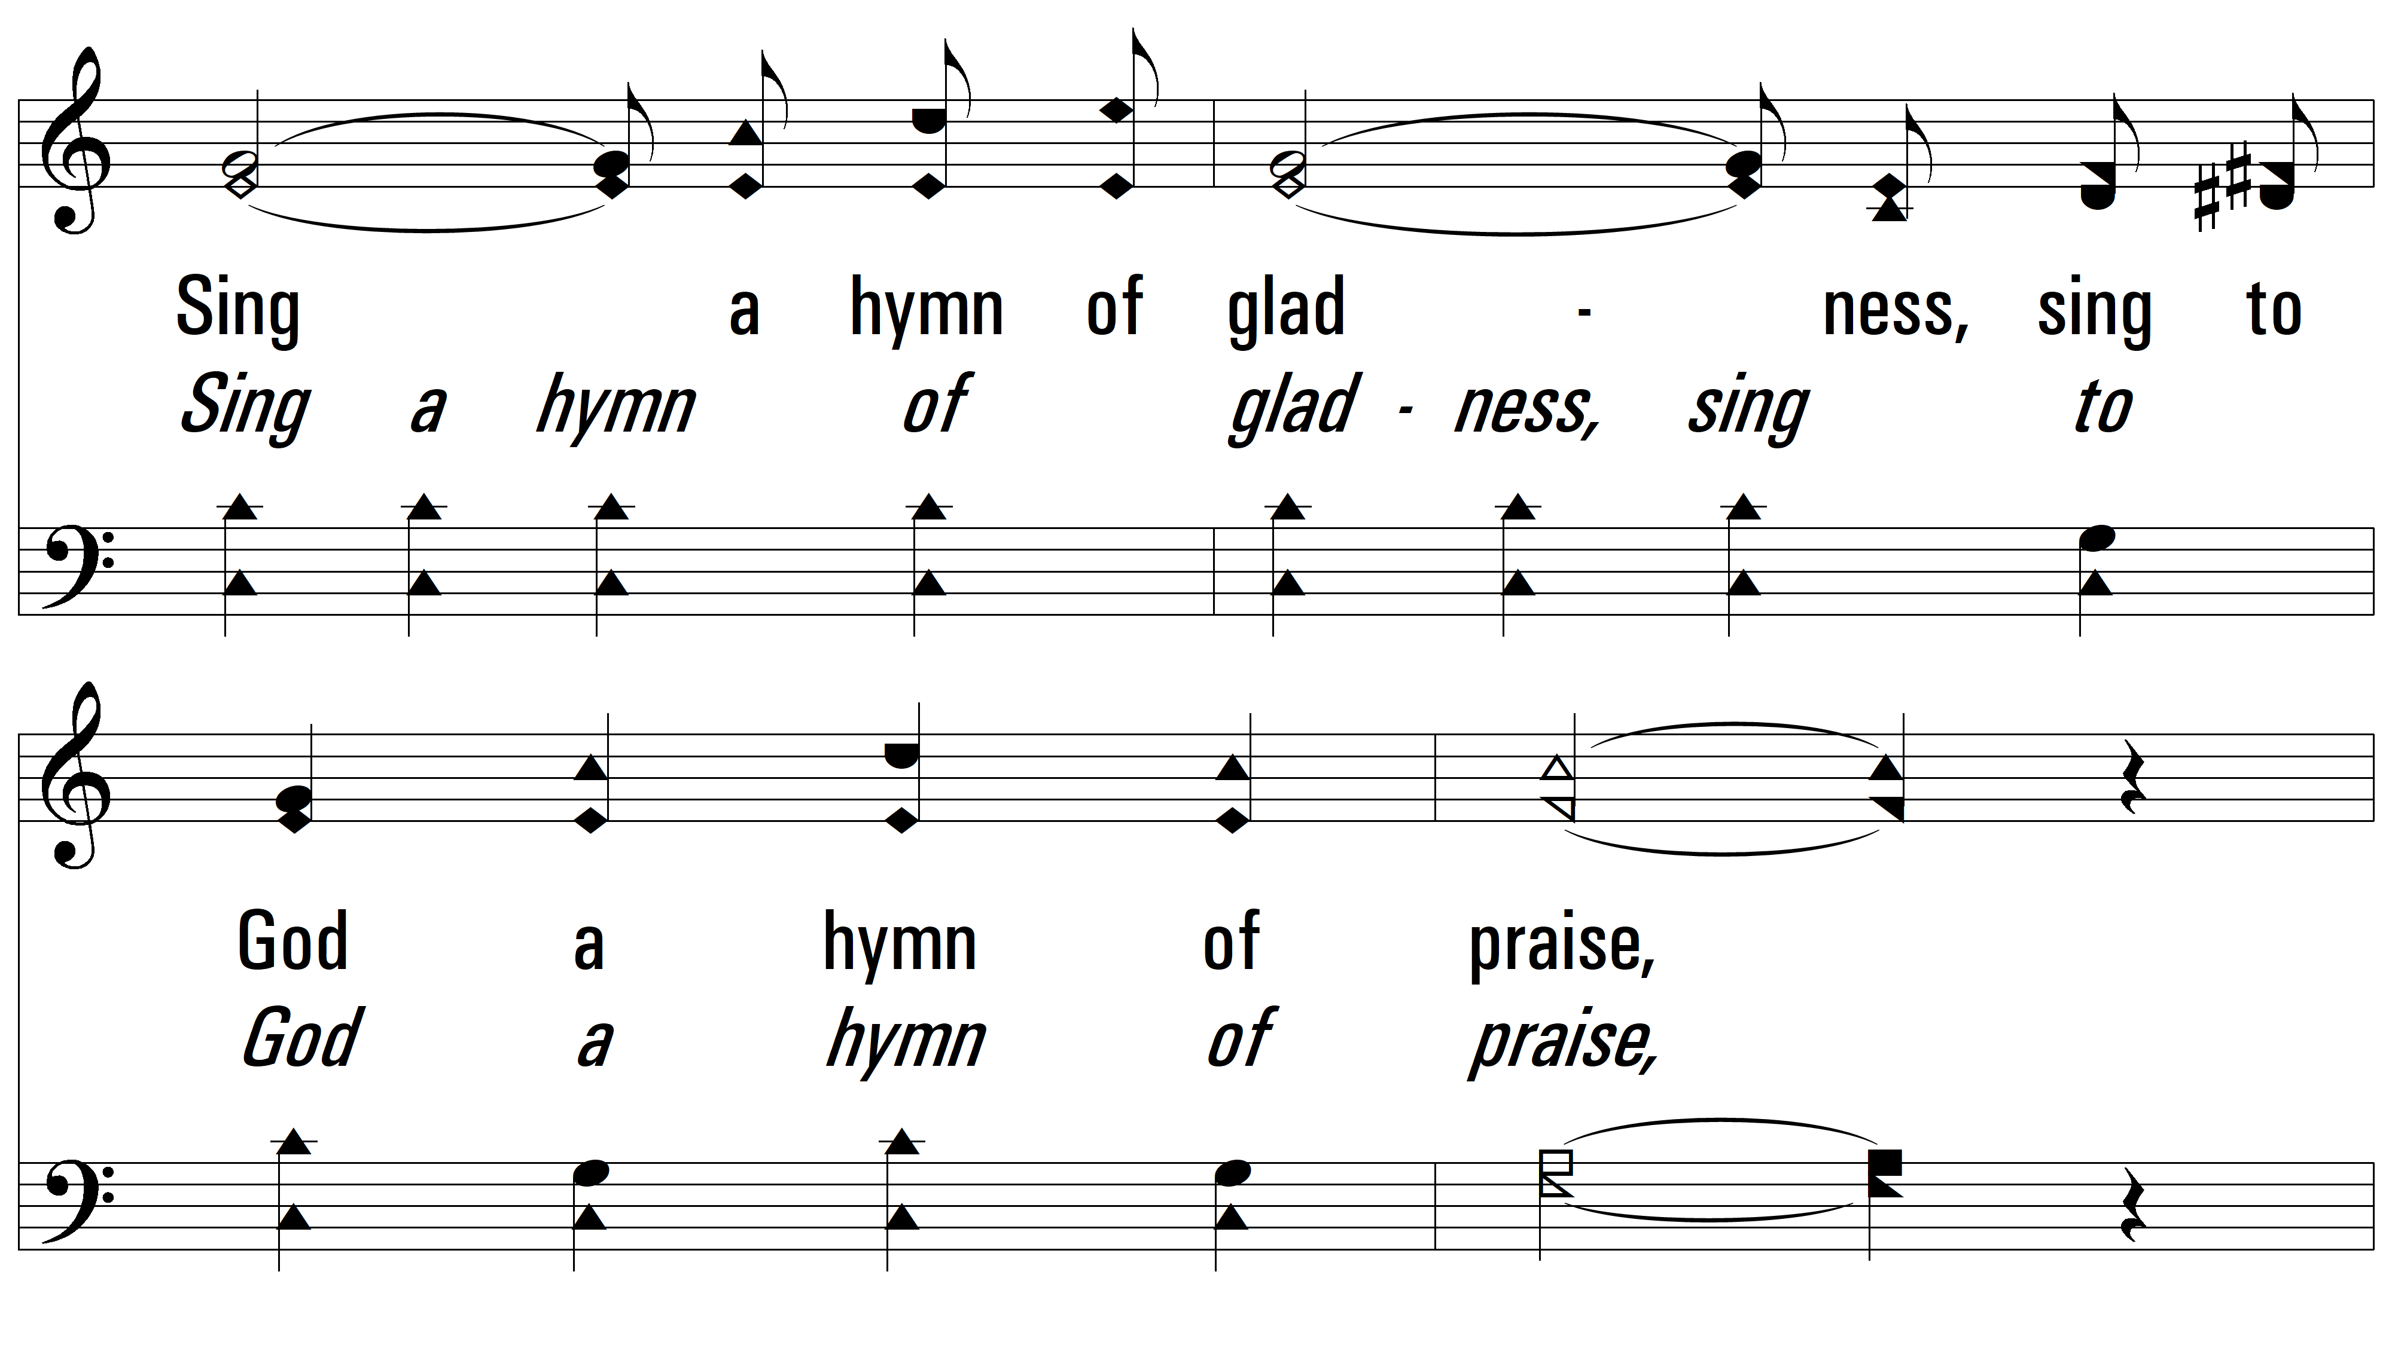
vs. 1

Slide 13
vs. 1
PDHymns.com
END

