Slide 1
Redeemed
(I’m Redeemed)
Words: | James Rowe (1916)
Music: | S. A. Ganus (1916)
12/8
B^{b}/F - SOL
Verses: 3/Chorus
Lead - | SOL
Alto - | MI
Tenor - | SOL
Bass - | DO
PDHymns.com

Slide 2
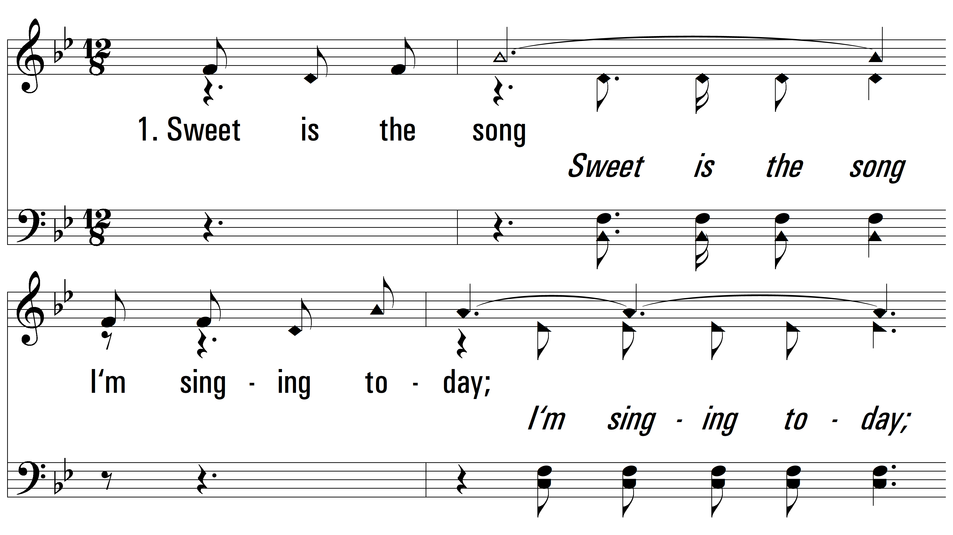
vs. 1 ~ Redeemed

Slide 3
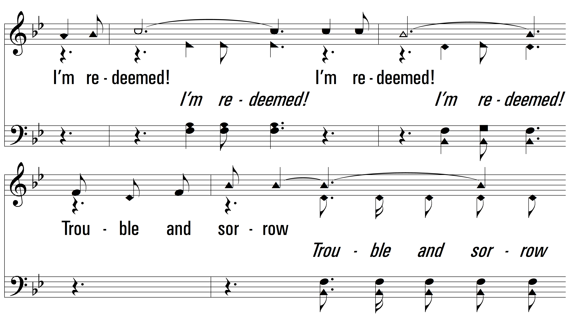
vs. 1

Slide 4
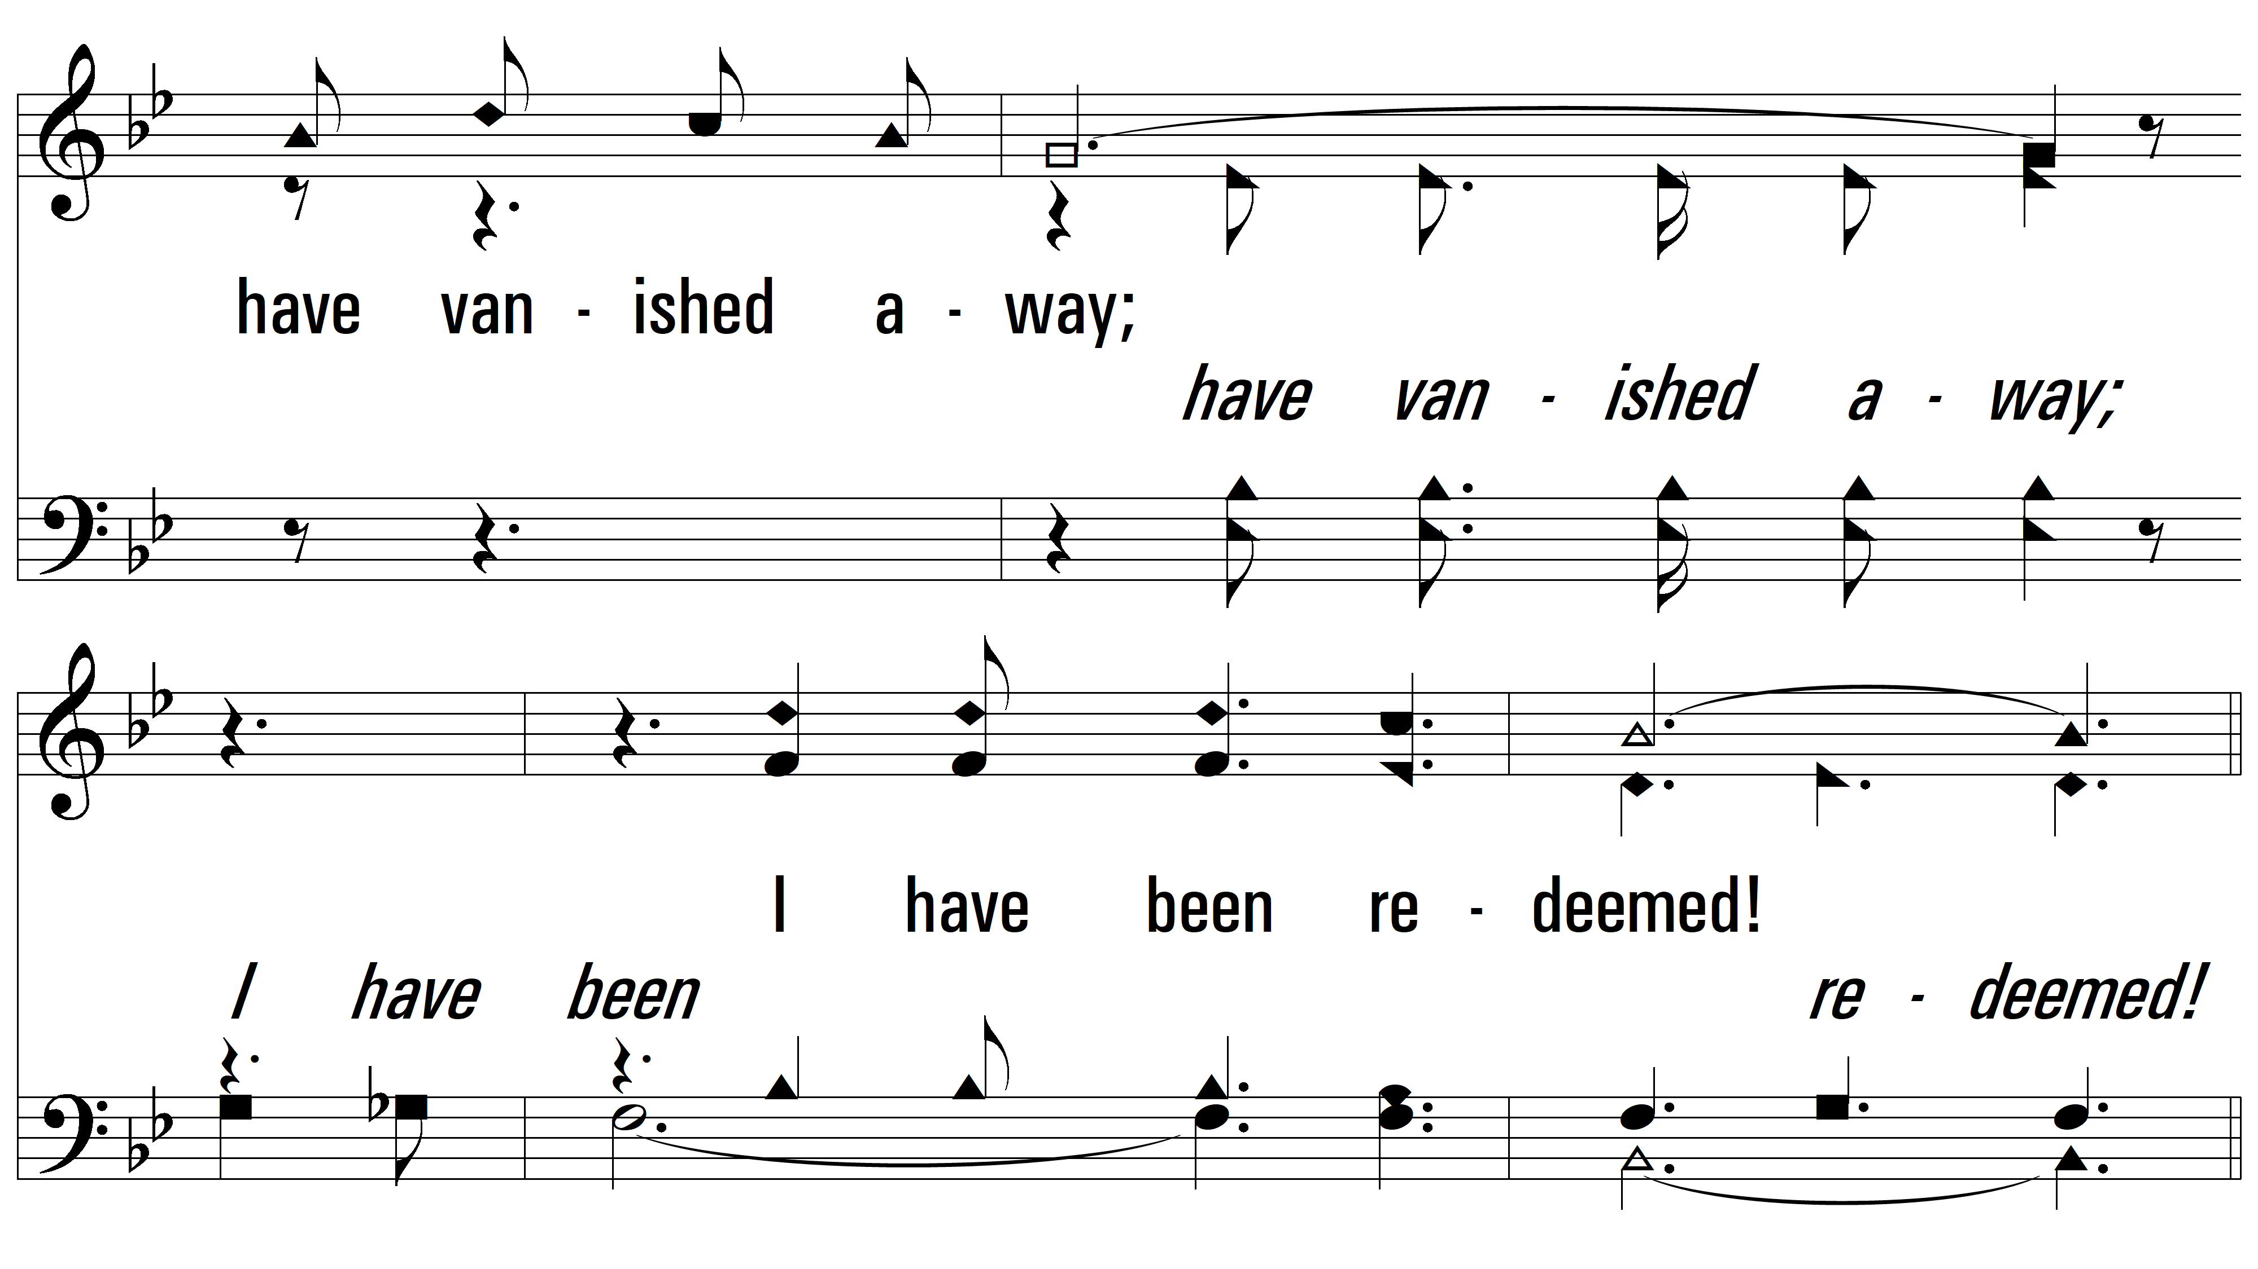
vs. 1

Slide 5
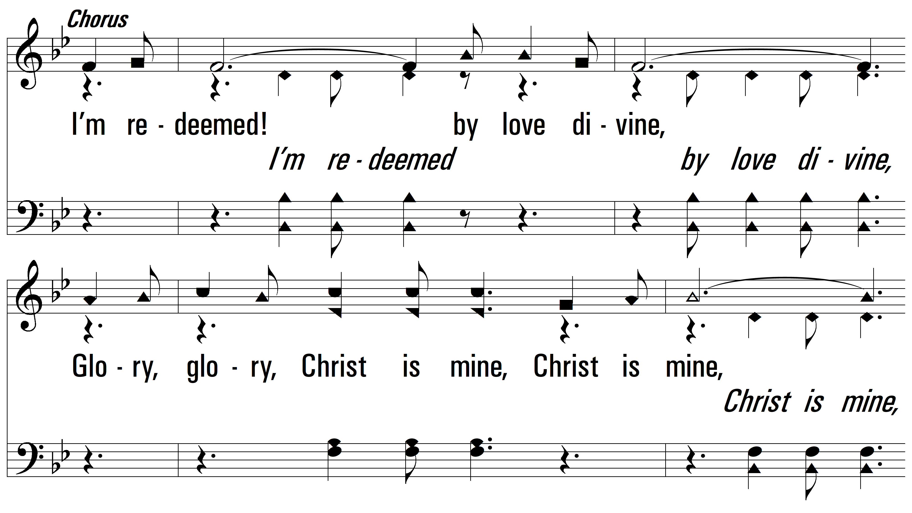
vs. 1

Slide 6
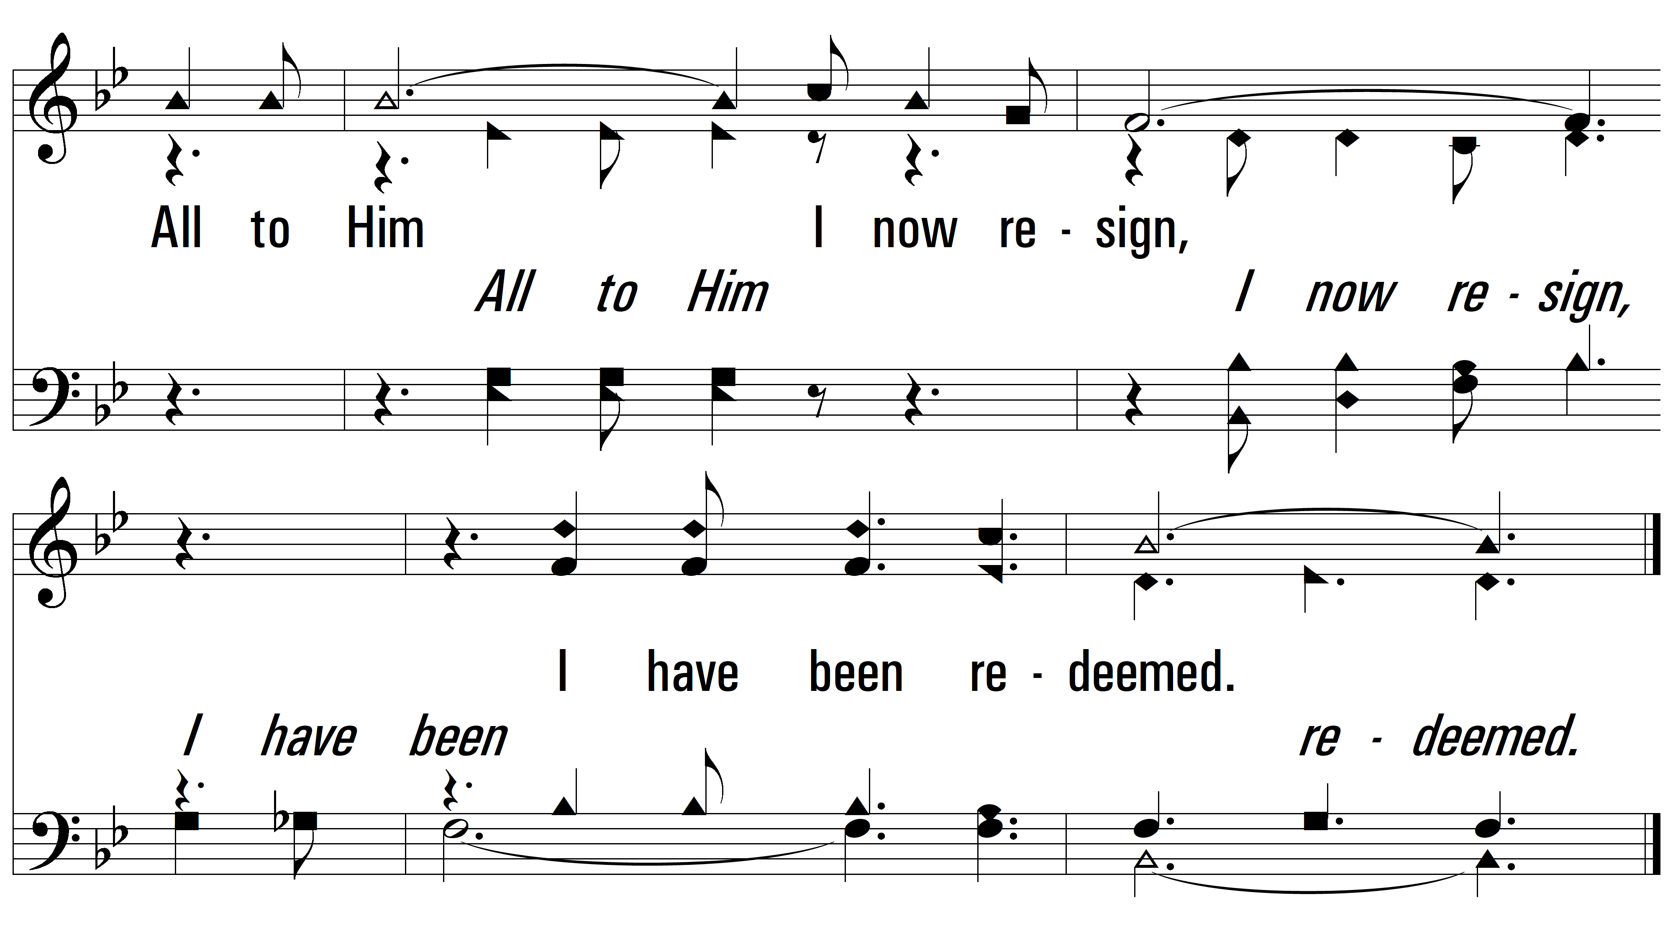
vs. 1

Slide 7
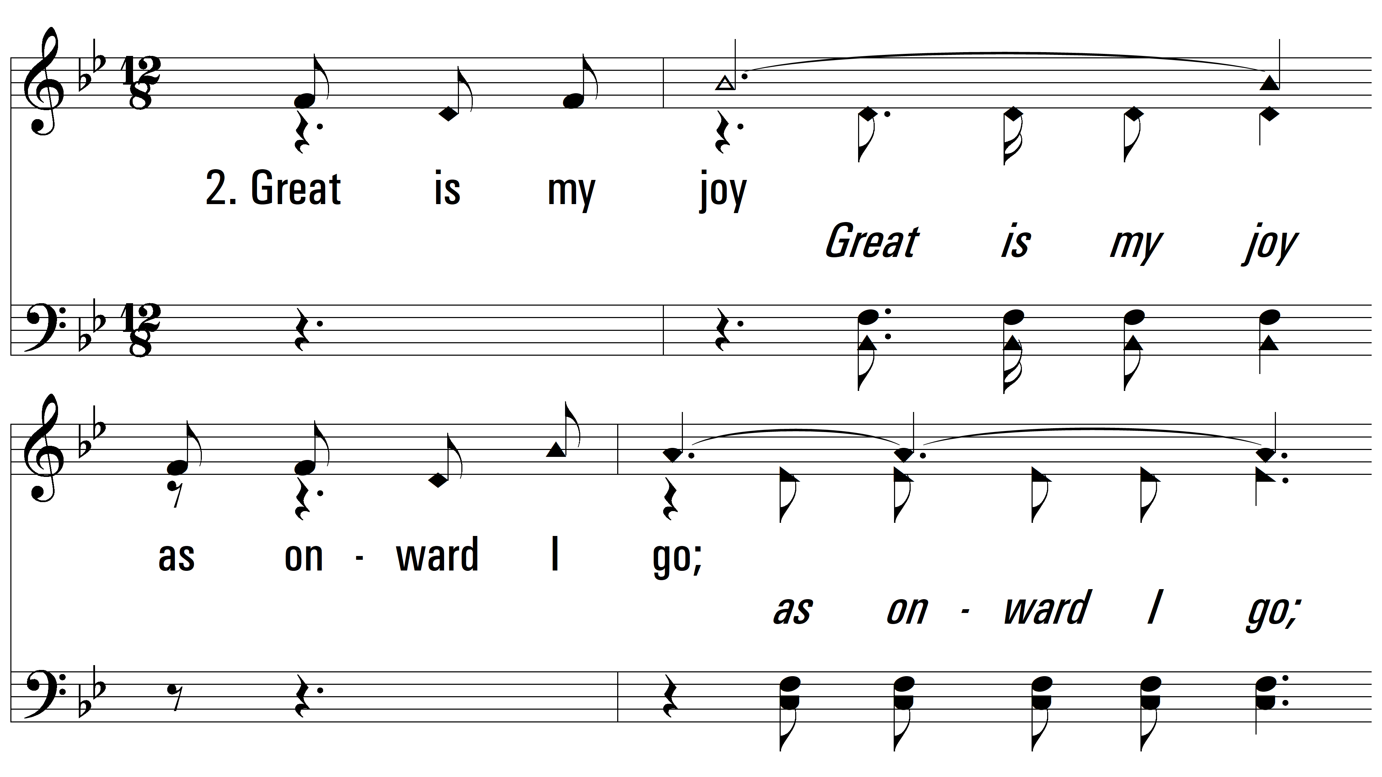
vs. 2 ~ Redeemed

Slide 8
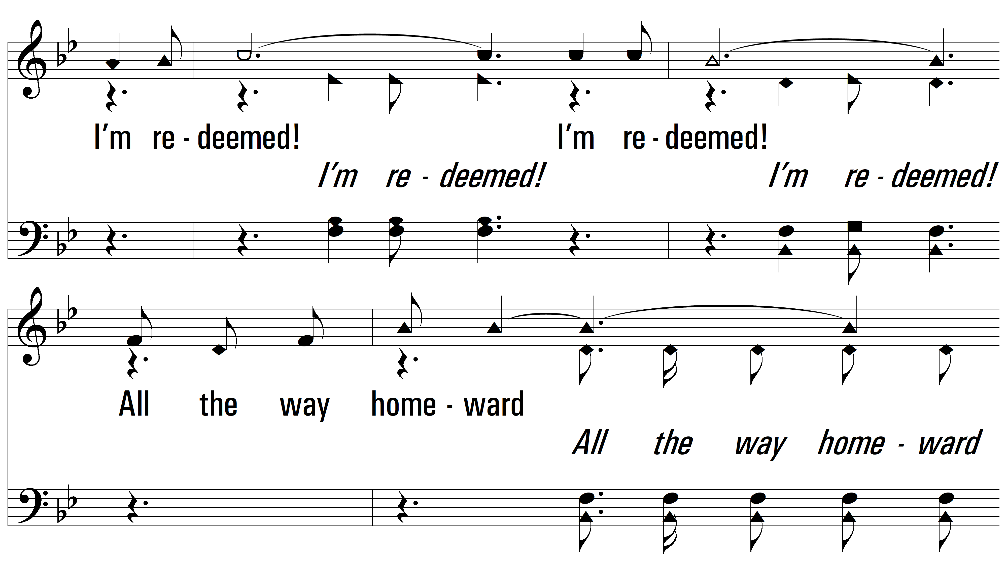
vs. 2

Slide 9
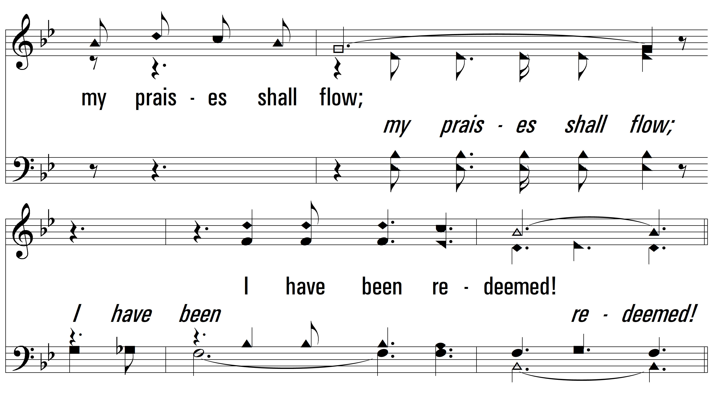
vs. 2

Slide 10
vs. 2

Slide 11
vs. 2

Slide 12
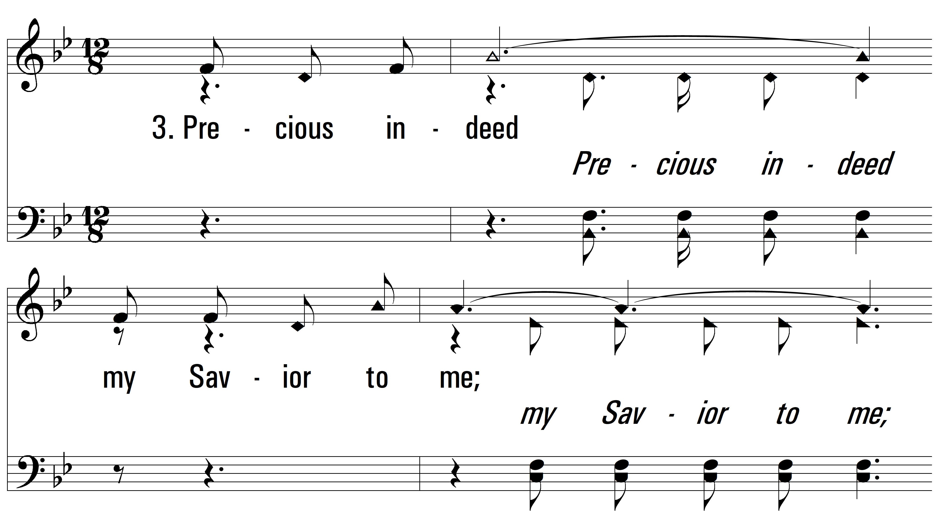
vs. 3 ~ Redeemed

Slide 13
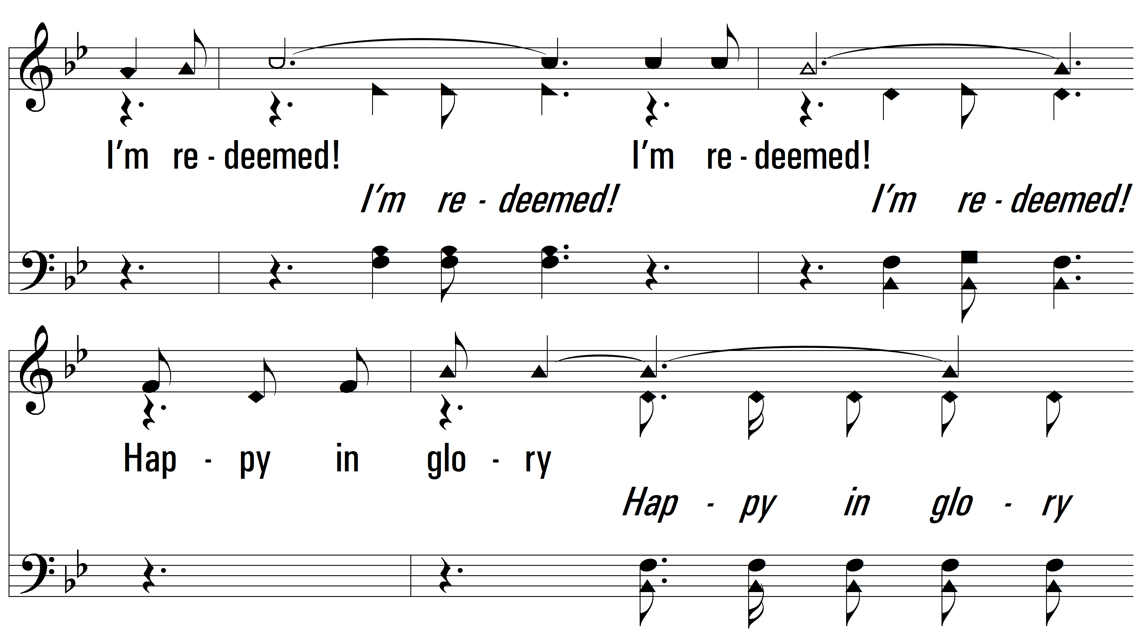
vs. 3

Slide 14
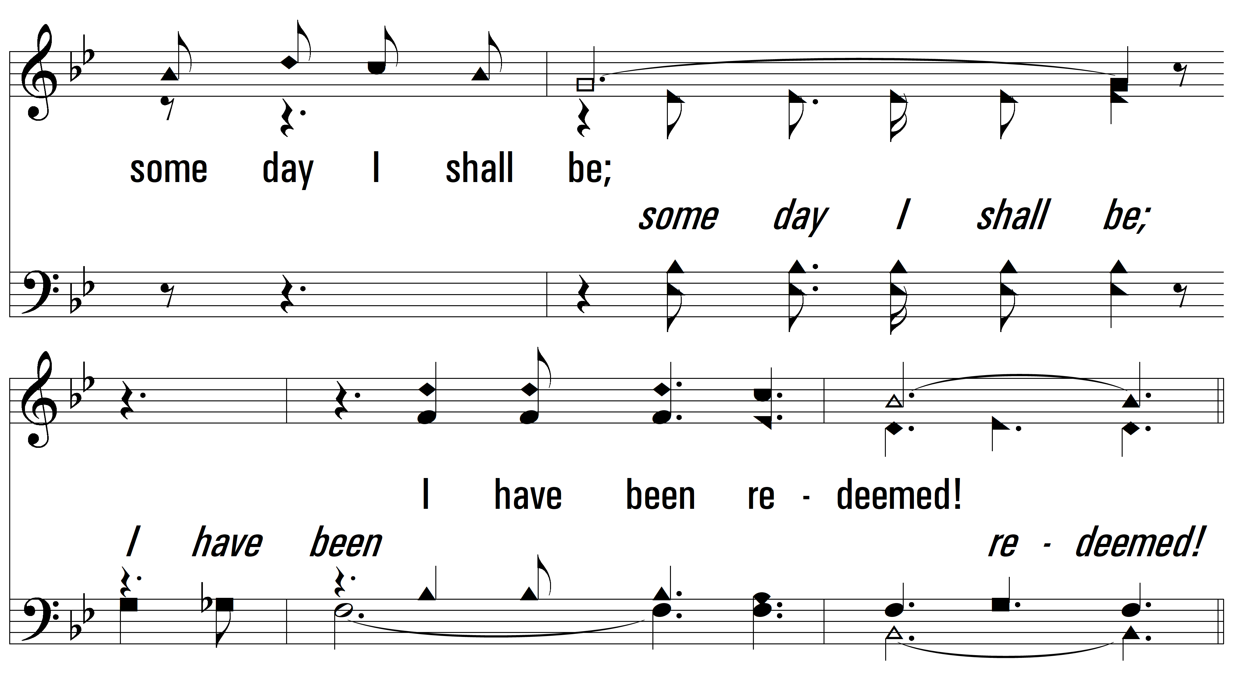
vs. 3

Slide 15
vs. 3

Slide 16
vs. 3
PDHymns.com
END

