Slide 1
Praise the Lord! O Heavens
AUSTRAIN HYMN
8.7.8.7.D
Words: | The Foundling Hospital Collection, London (1796)
Music: | Franz Joseph Haydn (1797)
4/4
E^{b}/E^{b} - DO
Verses: 2
Lead - | DO
Alto - | DO
Tenor - | MI
Bass - | DO
PDHymns.com

Slide 2
vs. 1 ~ Praise the Lord! O Heavens

Slide 3
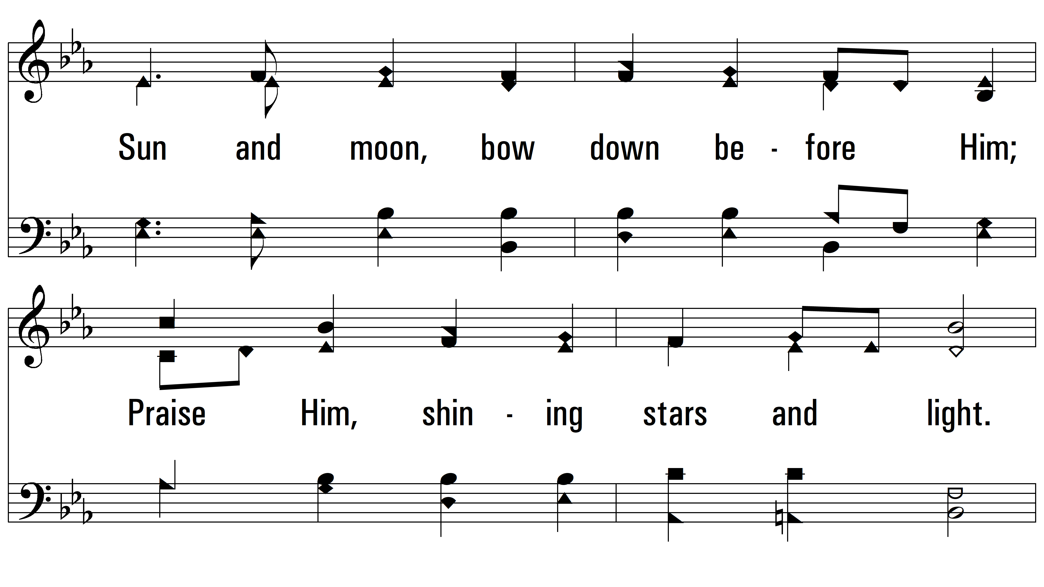
vs. 1

Slide 4
vs. 1

Slide 5
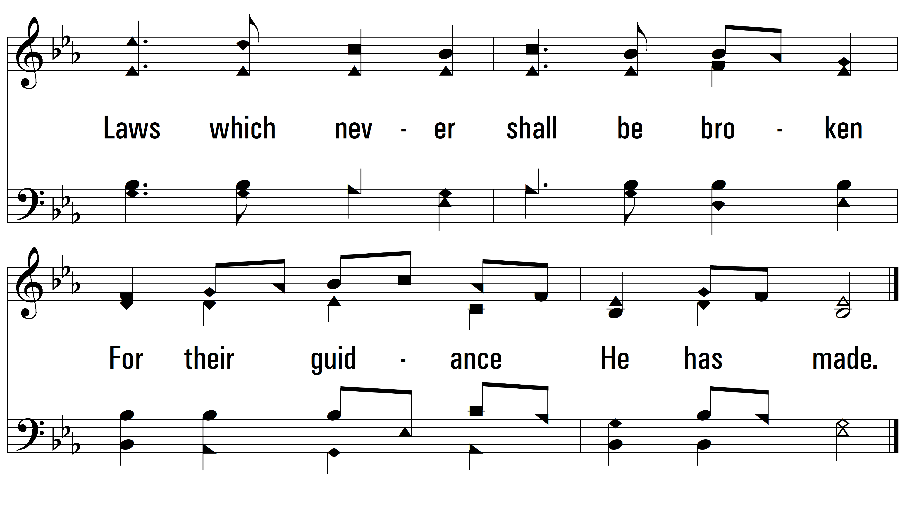
vs. 1

Slide 6
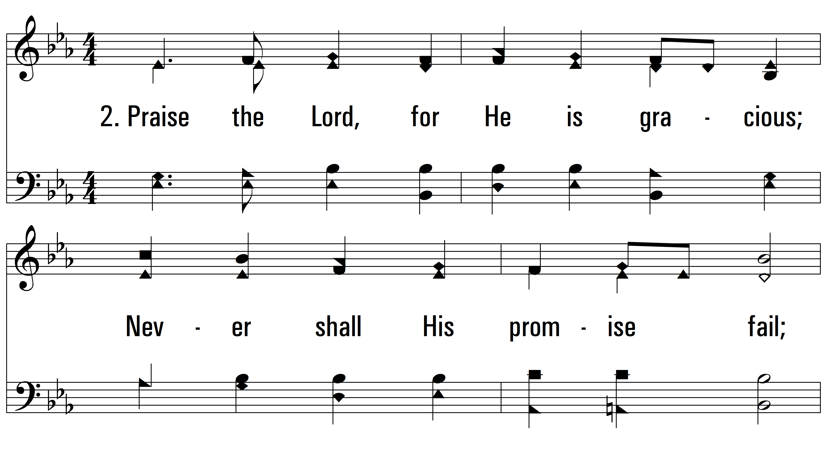
vs. 2 ~ Praise the Lord! O Heavens

Slide 7
vs. 2

Slide 8
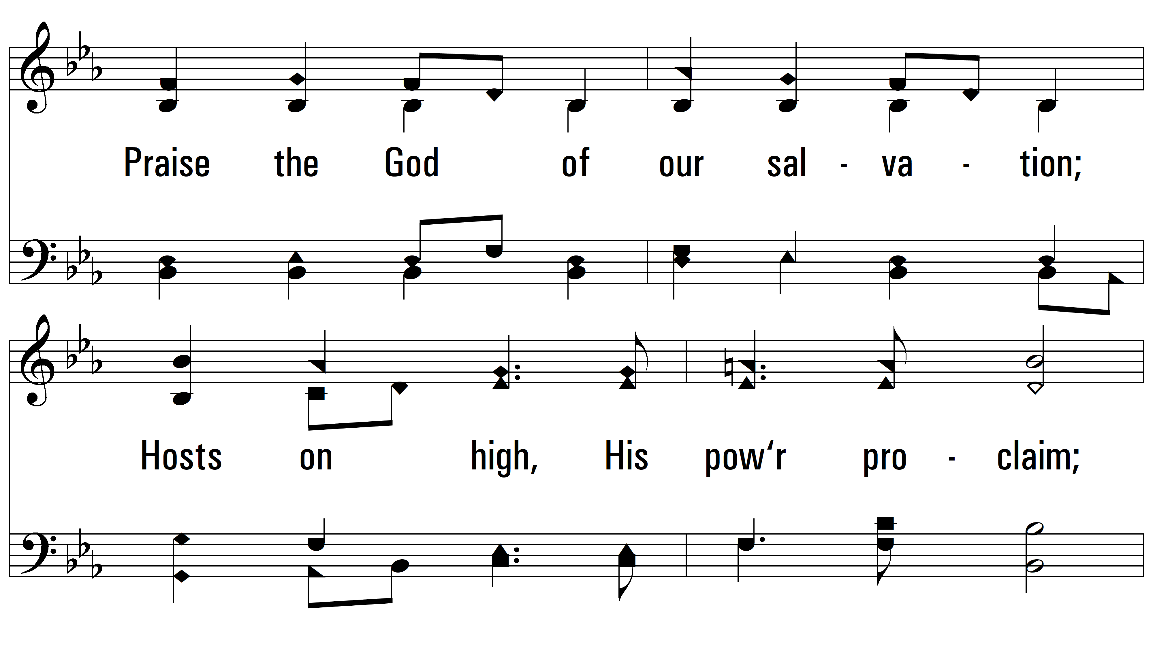
vs. 2

Slide 9
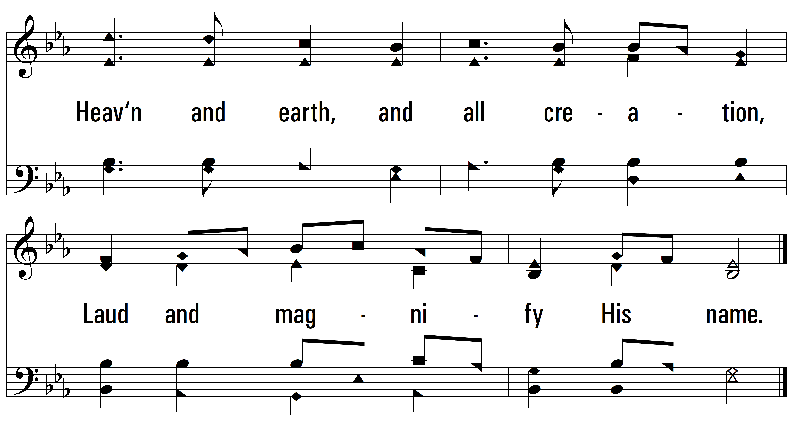
vs. 2
PDHymns.com
END

