Slide 1
Onward, Christian Soldiers
Words: | Sabine Baring-Gould (1864)
Music: | Arthur Sullivan (1871)
4/4
E/B - SOL
Verses: 5/Chorus
Lead - | SOL
Alto - | MI
Tenor - | DO
Bass - | DO
PDHymns.com

Slide 2
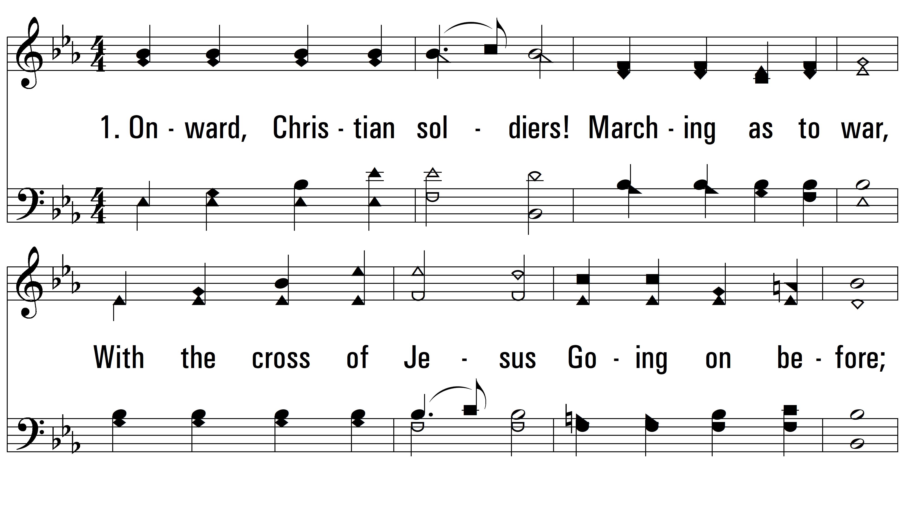
vs. 1 ~ Onward, Christian Soldiers

Slide 3
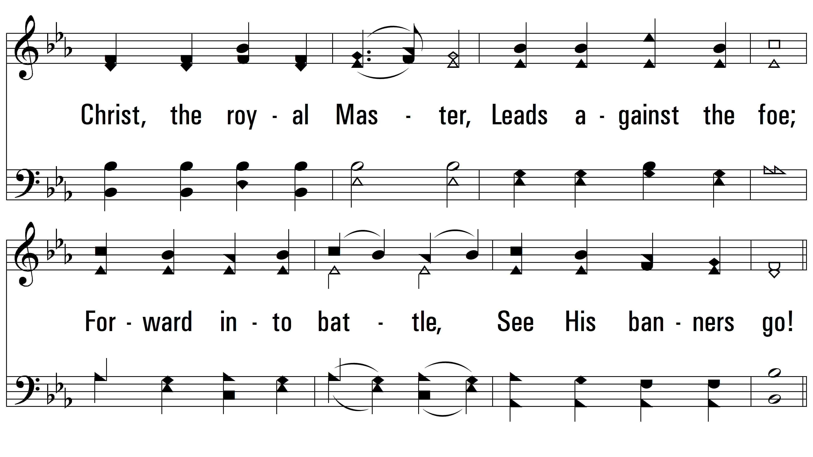
vs. 1

Slide 4
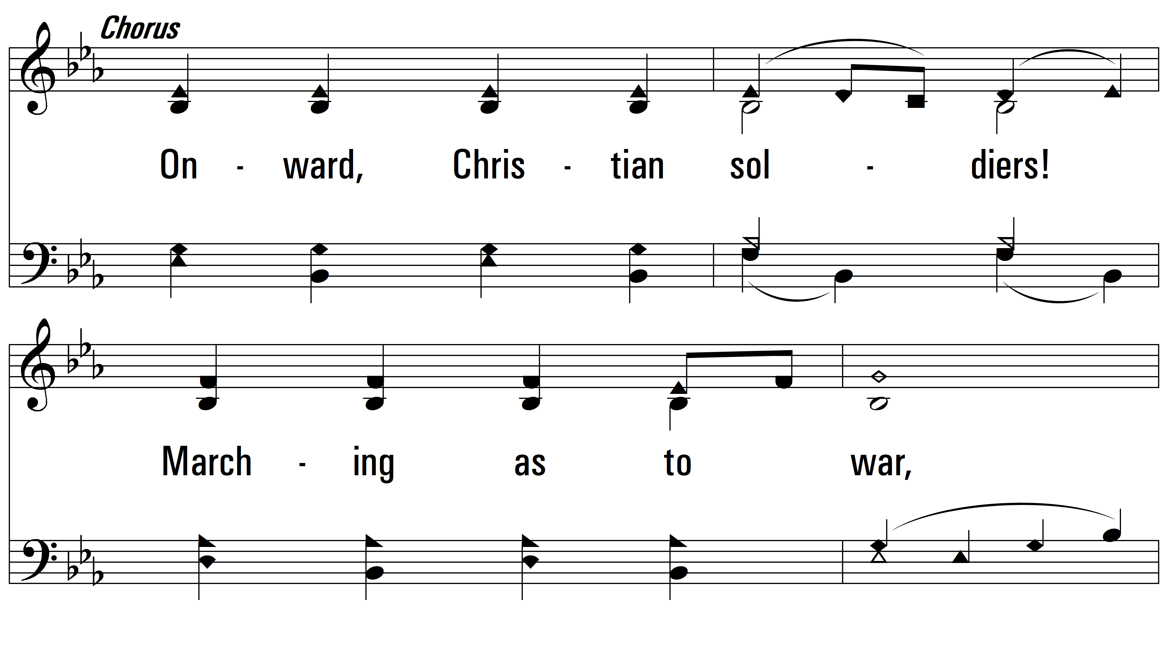
vs. 1

Slide 5
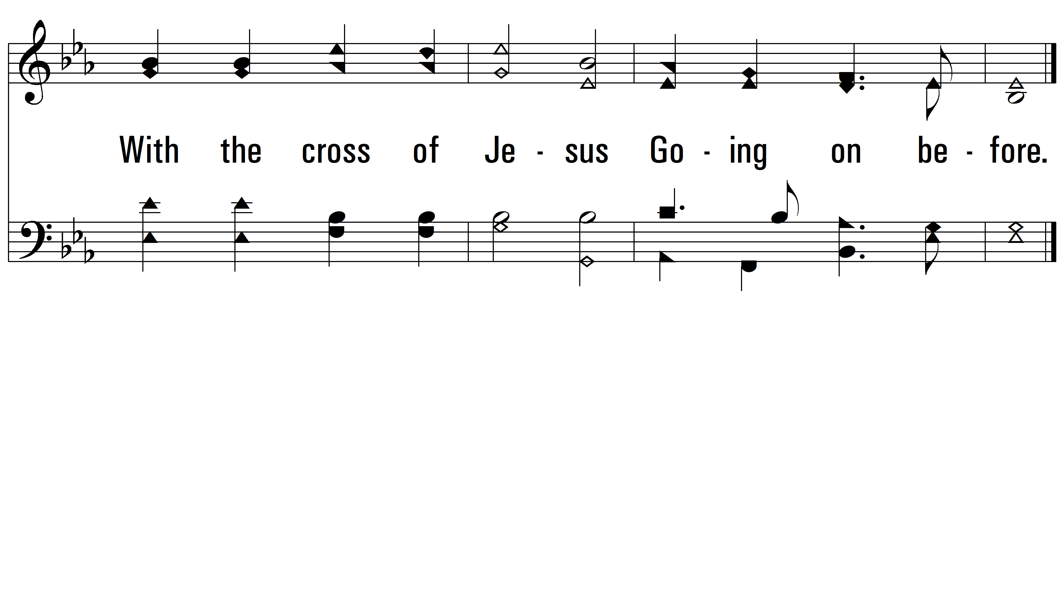
vs. 1

Slide 6
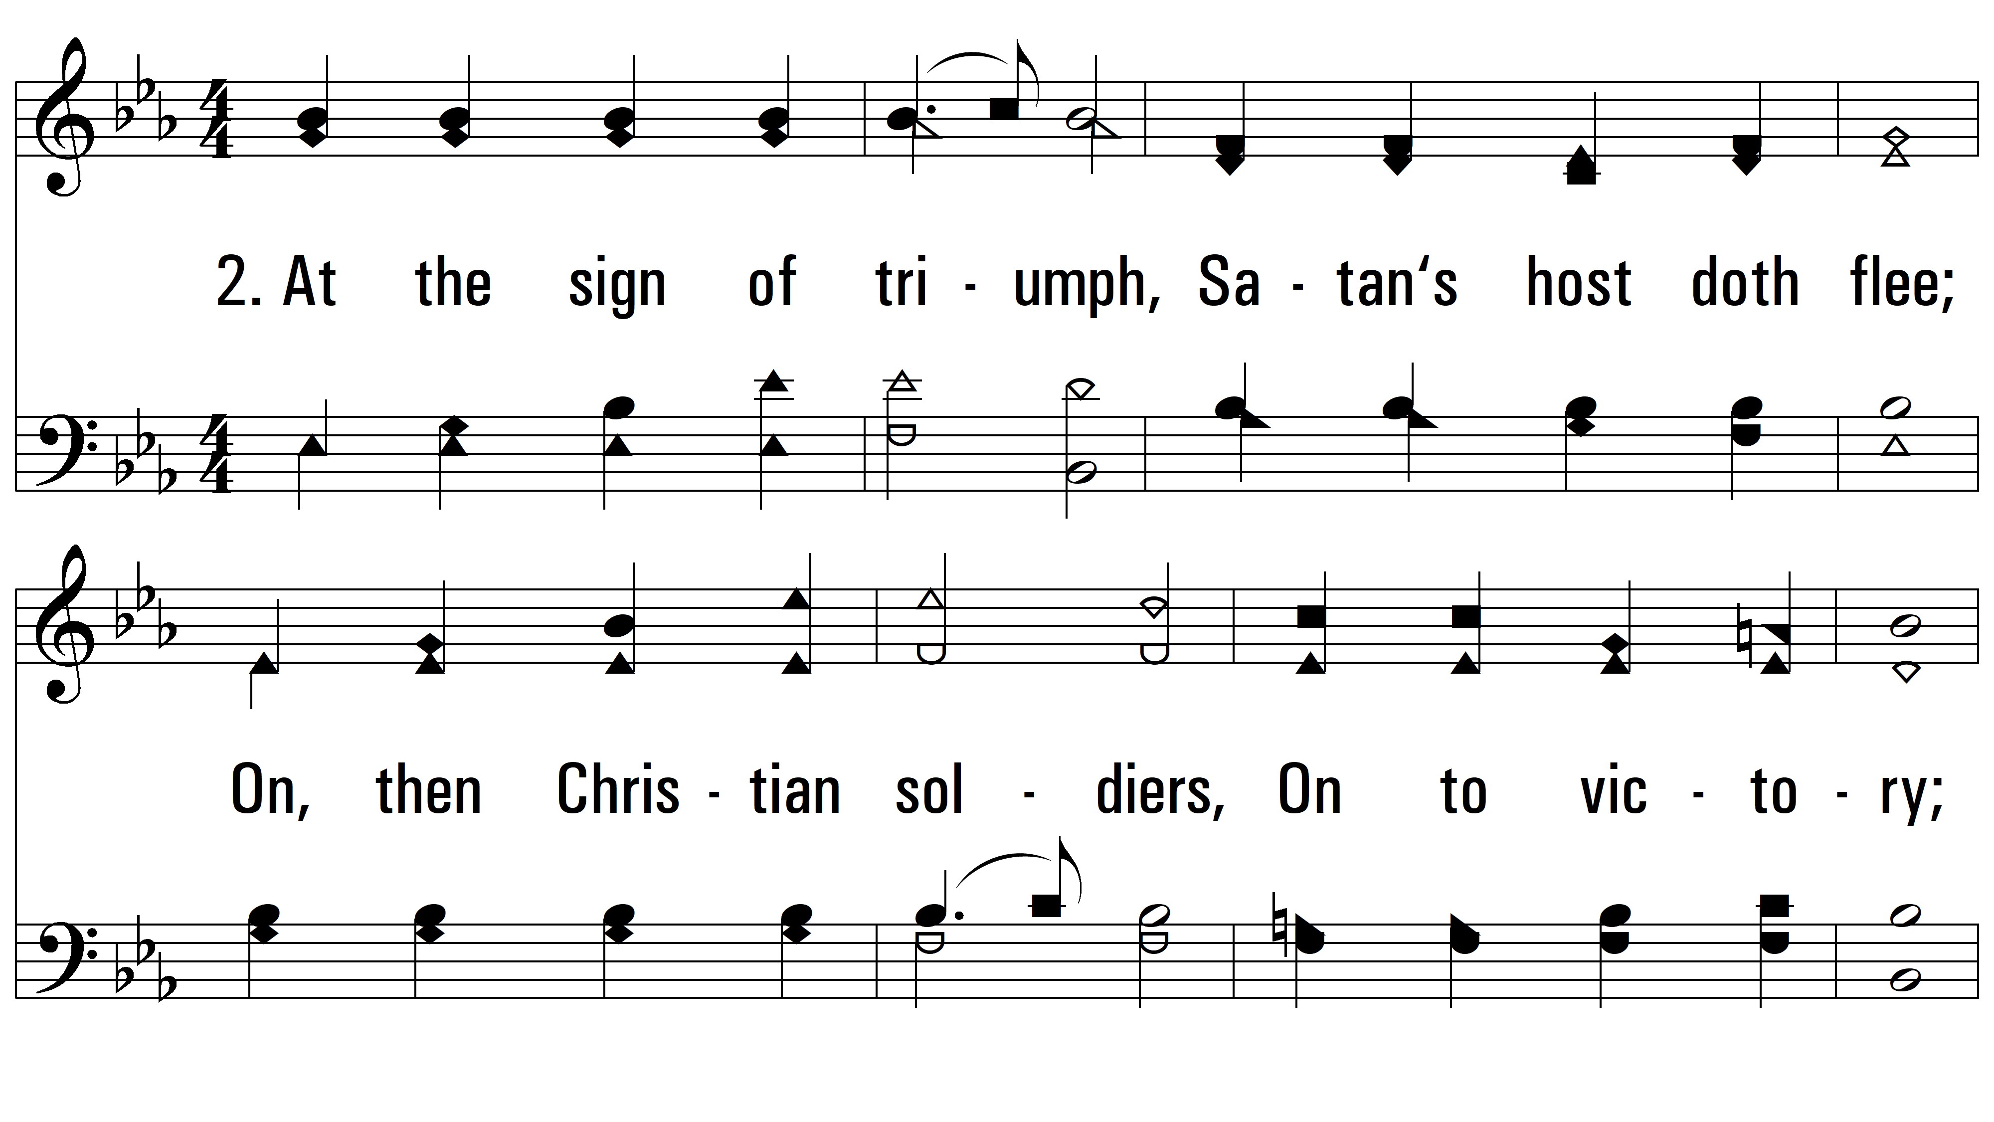
vs. 2 ~ Onward, Christian Soldiers

Slide 7
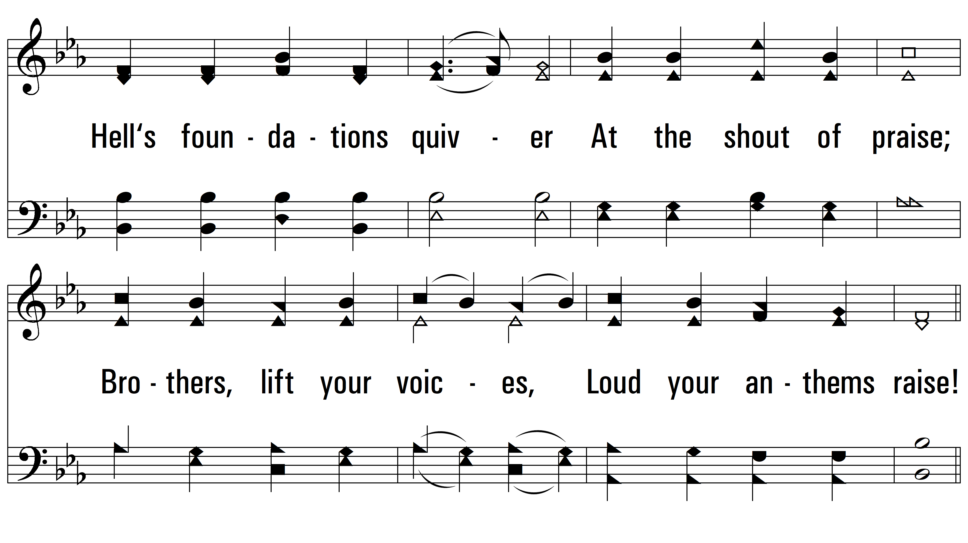
vs. 2

Slide 8
vs. 2

Slide 9
vs. 2

Slide 10
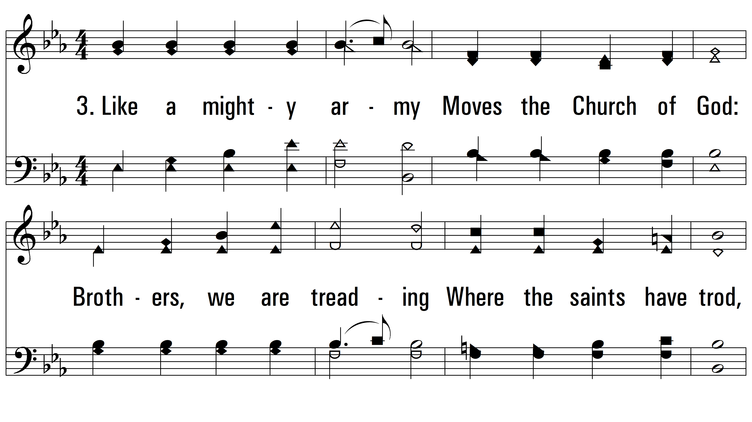
vs. 3 ~ Onward, Christian Soldiers

Slide 11
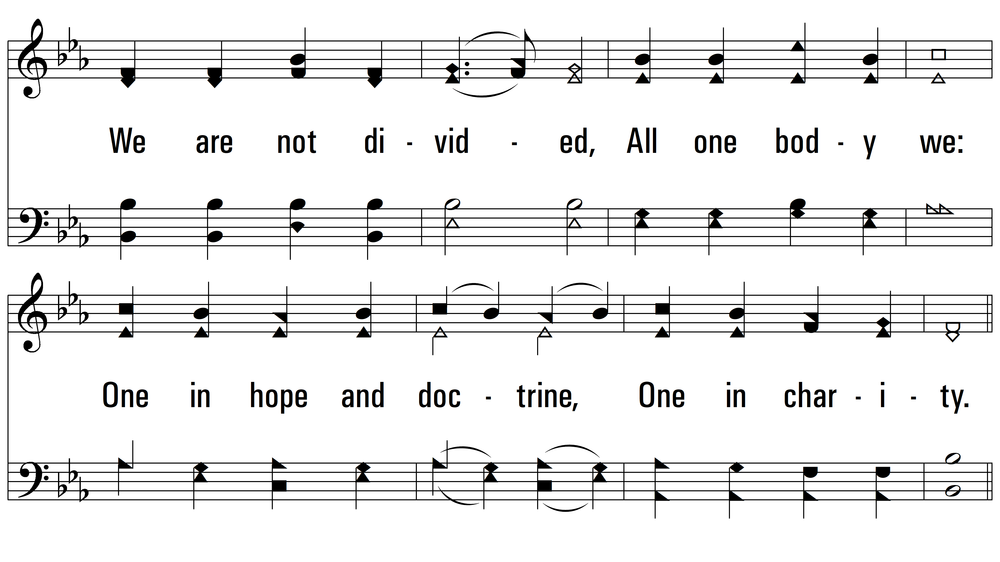
vs. 3

Slide 12
vs. 3

Slide 13
vs. 3

Slide 14
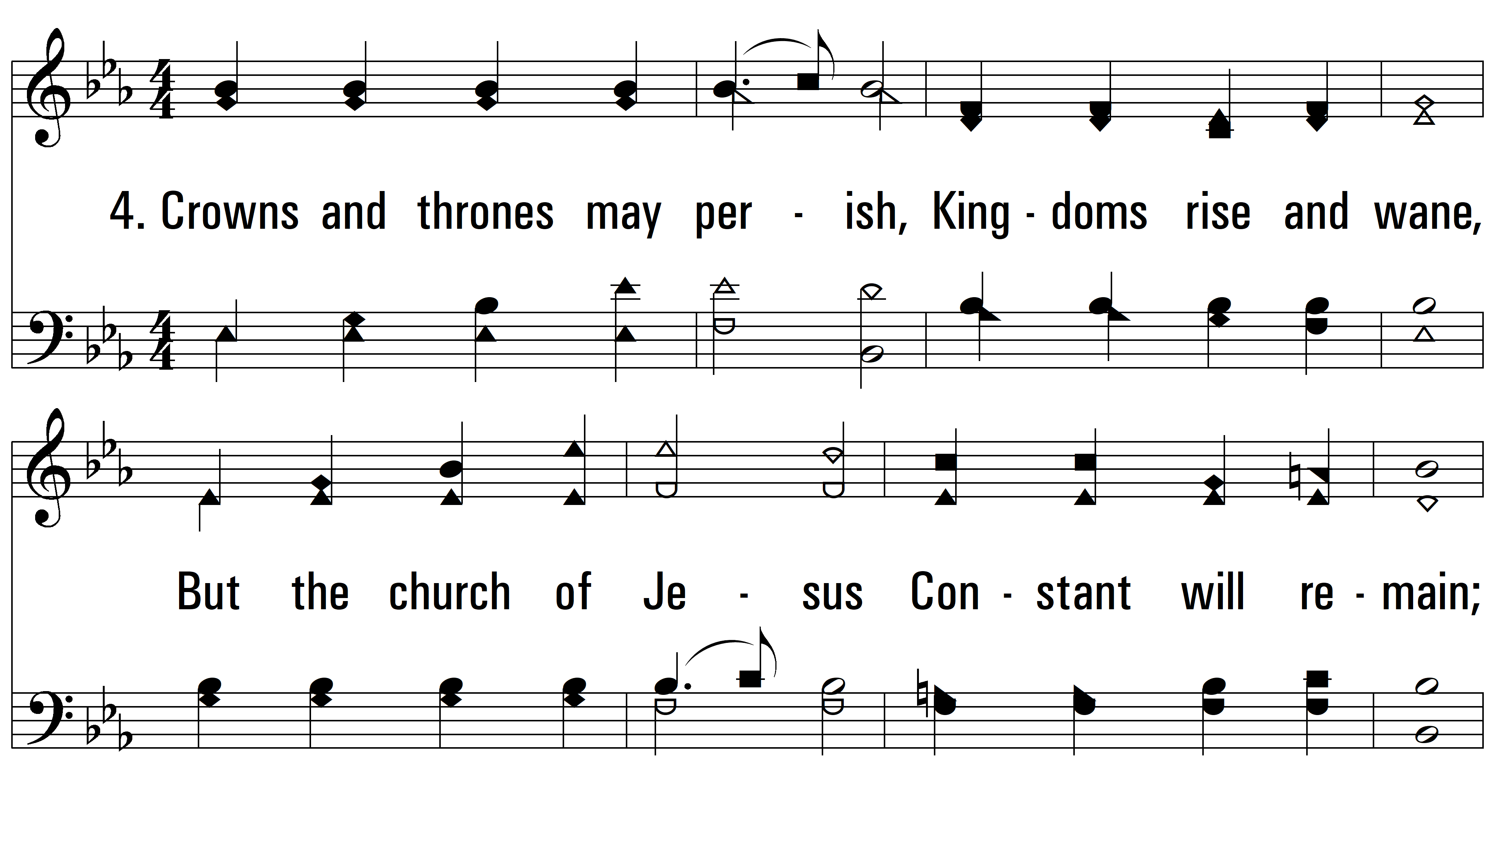
vs. 4 ~ Onward, Christian Soldiers

Slide 15
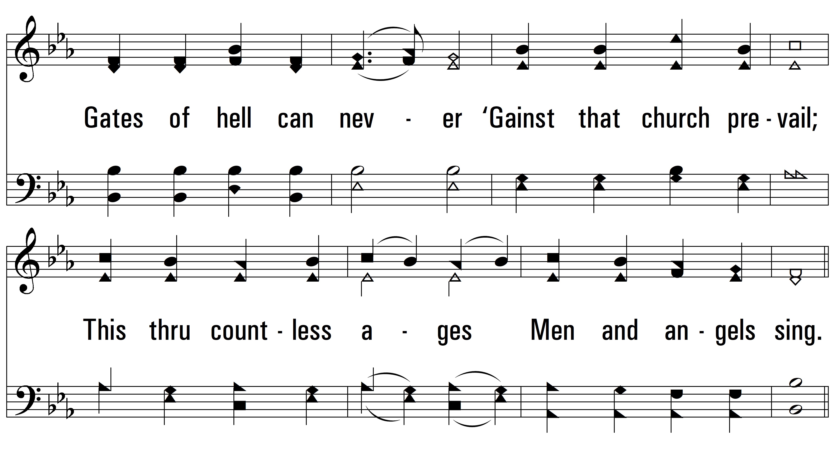
vs. 4

Slide 16
vs. 4

Slide 17
vs. 4

Slide 18
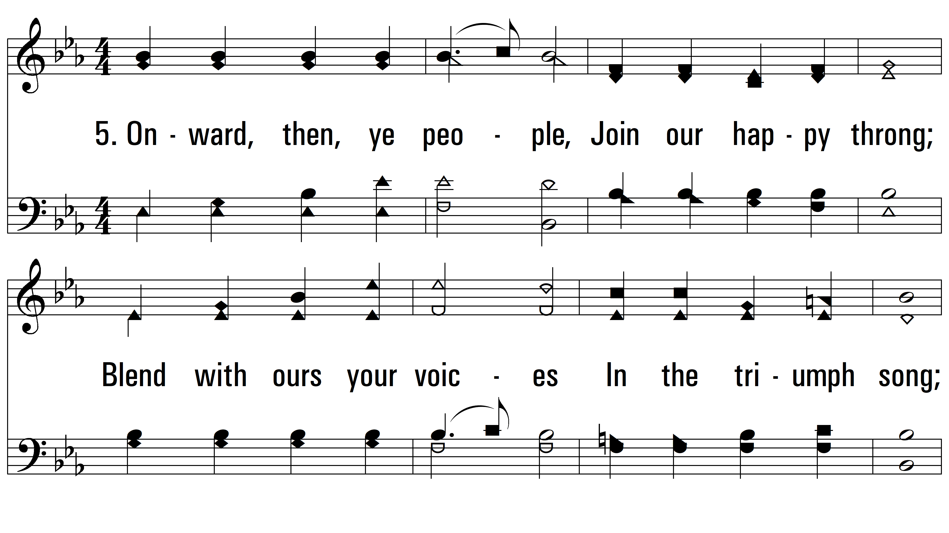
vs. 5~ Onward, Christian Soldiers

Slide 19
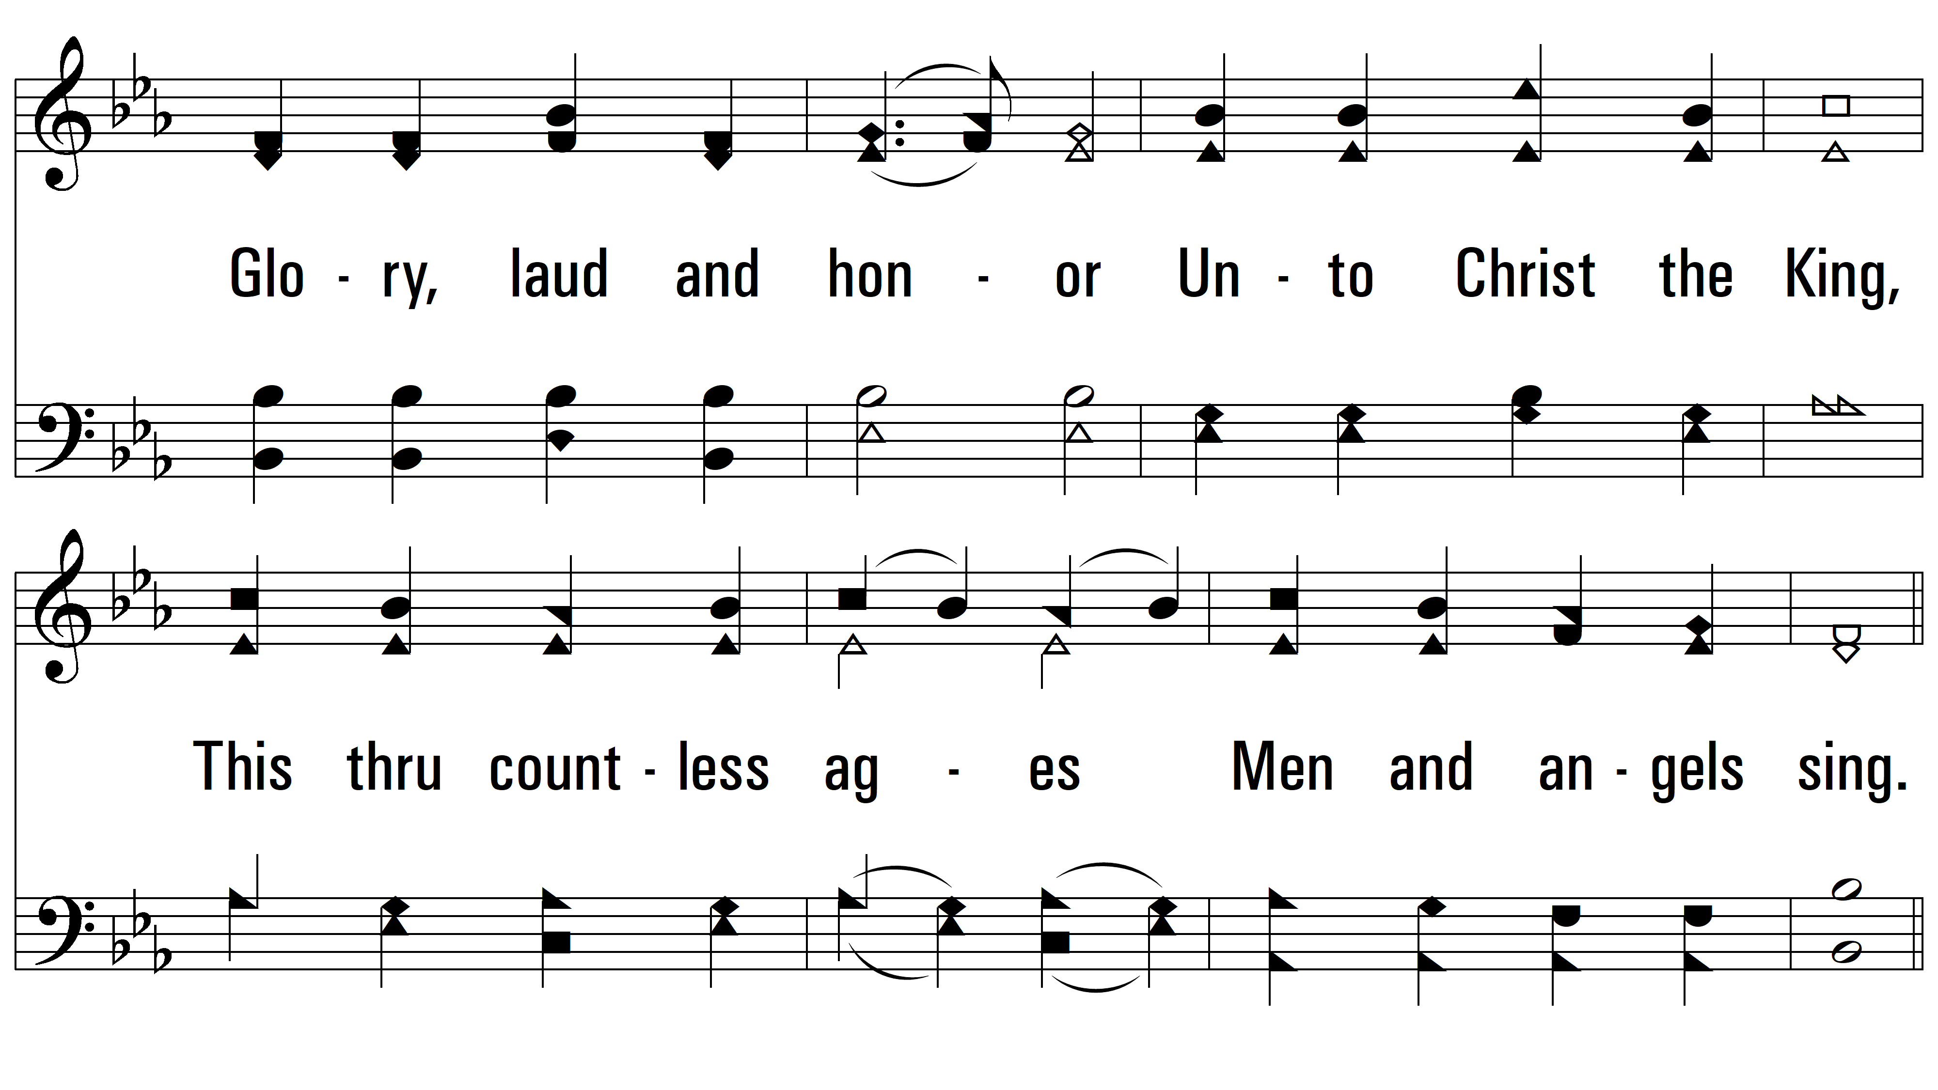
vs. 5

Slide 20
vs. 5

Slide 21
vs. 5
PDHymns.com
END

