Slide 1
Only Trust Him
(Trust The Savior)
Words: | J. H. Stockton (1869)
Music: | J. H. Stockton (1869)
4/4
G/D - SOL
Verses: 4/Chorus
Lead - | SOL
Alto - | MI
Tenor - | DO
Bass - | DO
PDHymns.com

Slide 2
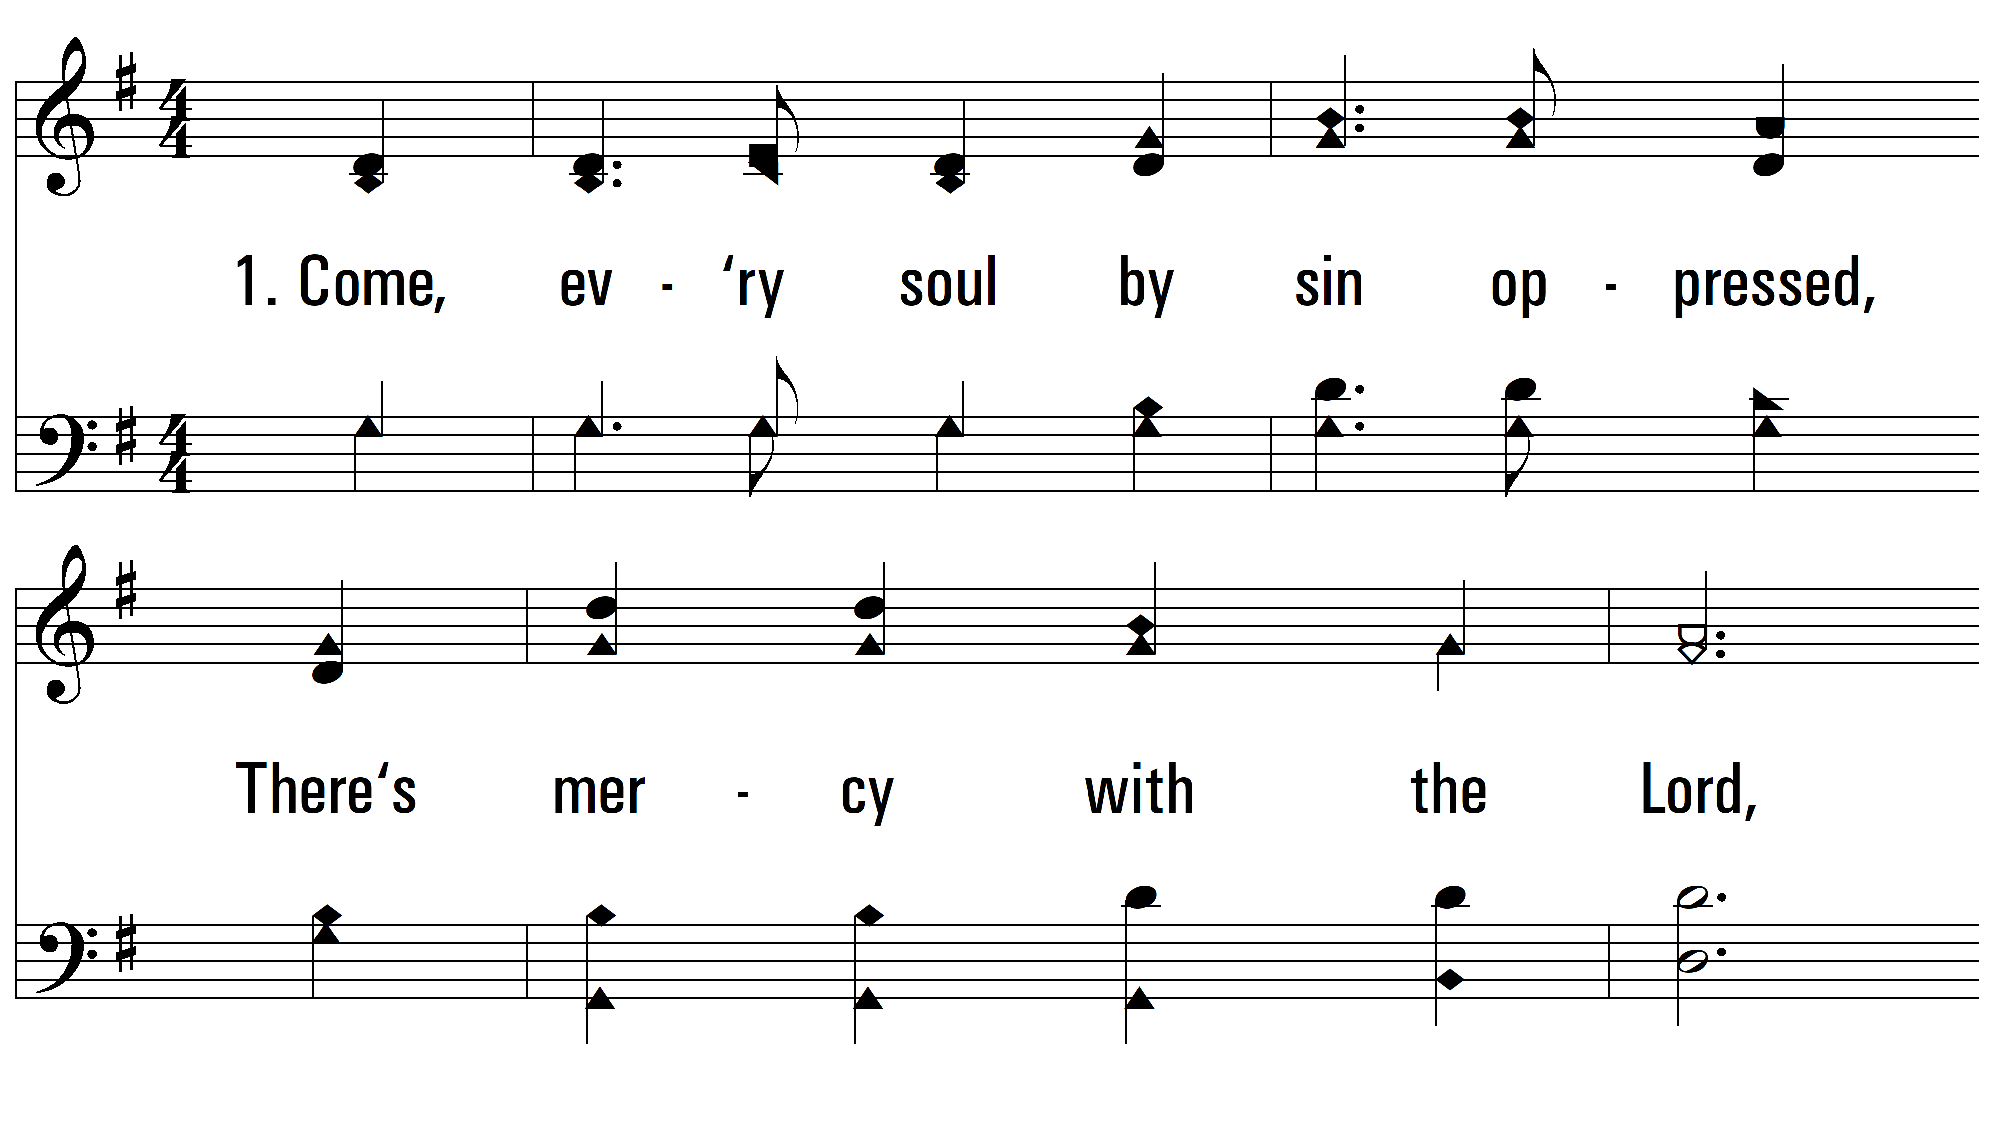
vs. 1 ~ Only Trust Him

Slide 3
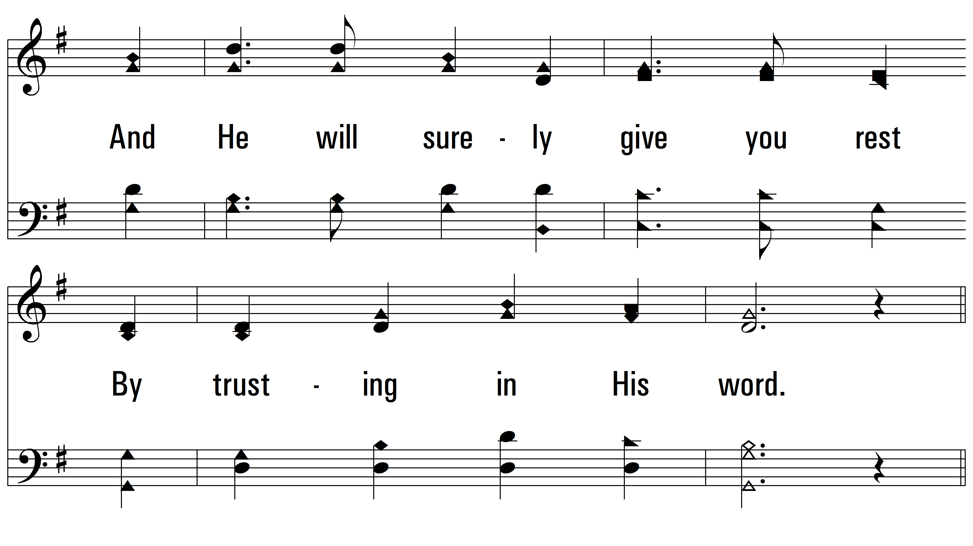
vs. 1

Slide 4
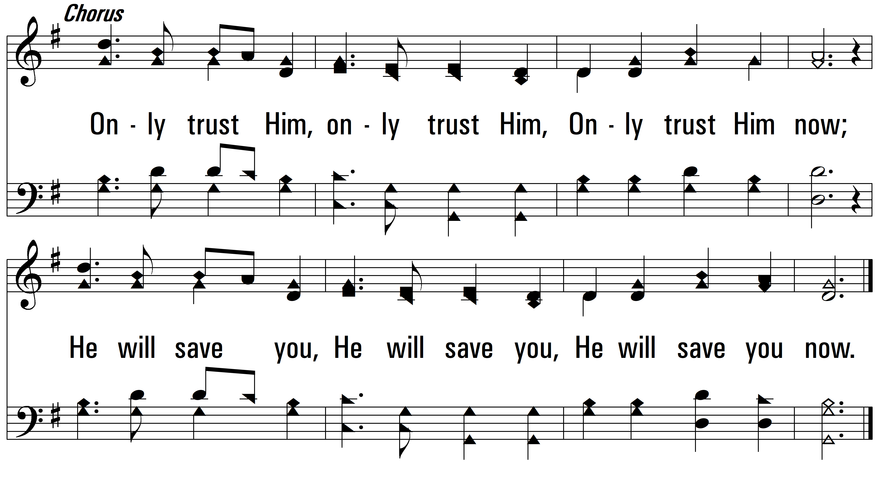
vs. 1

Slide 5
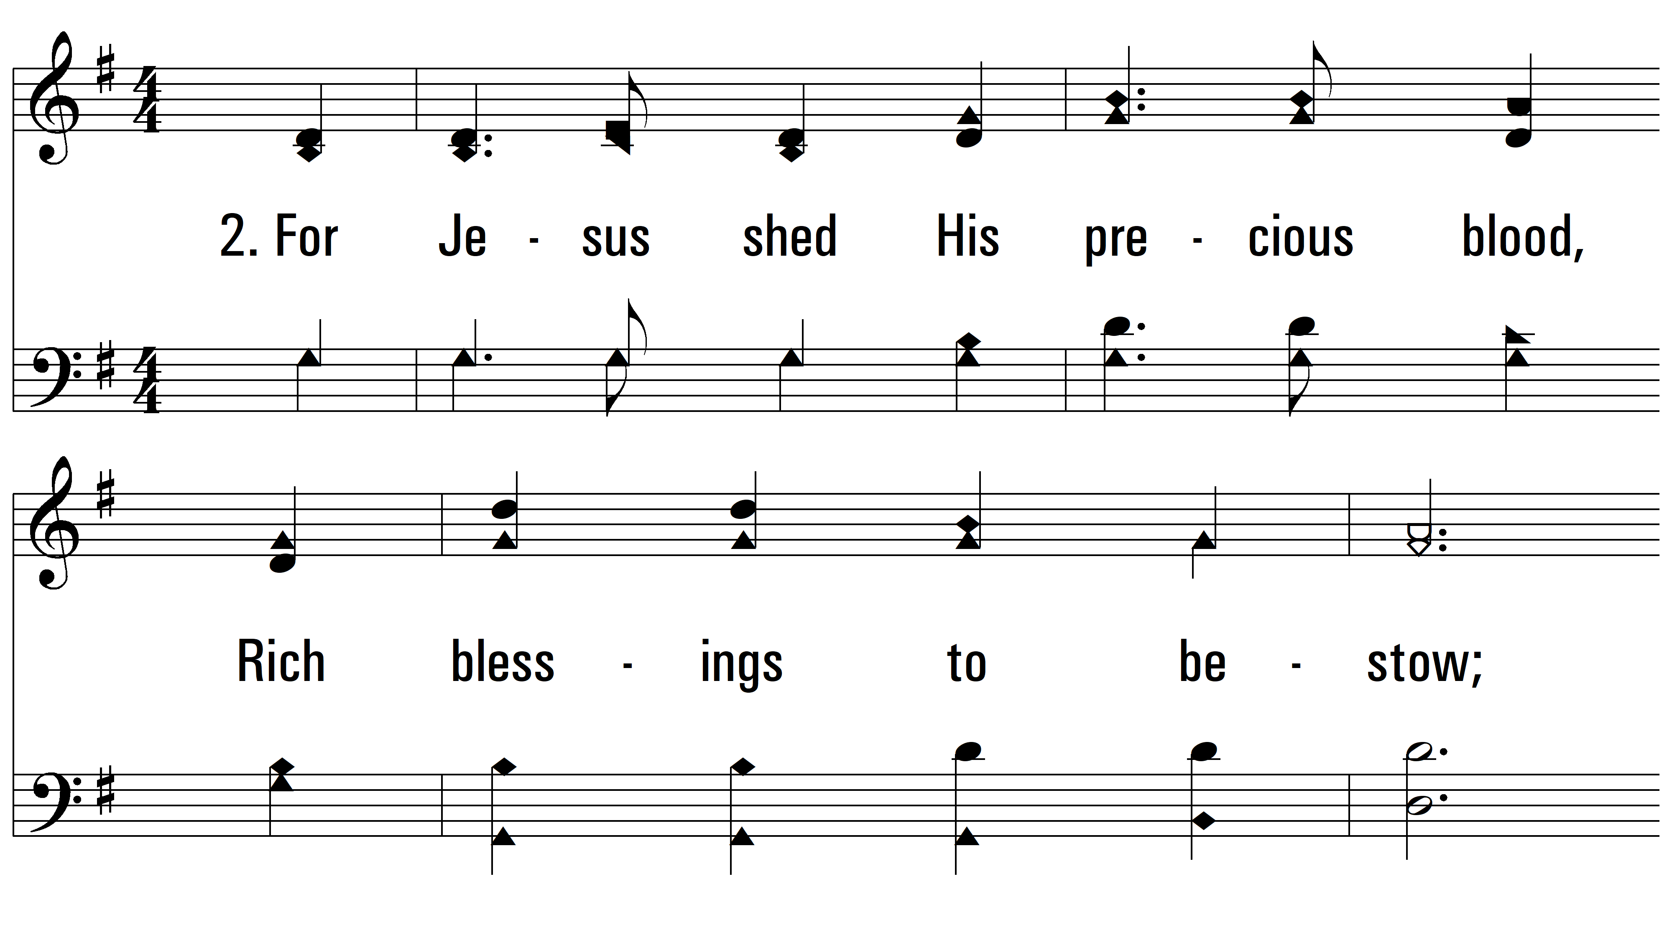
vs. 2 ~ Only Trust Him

Slide 6
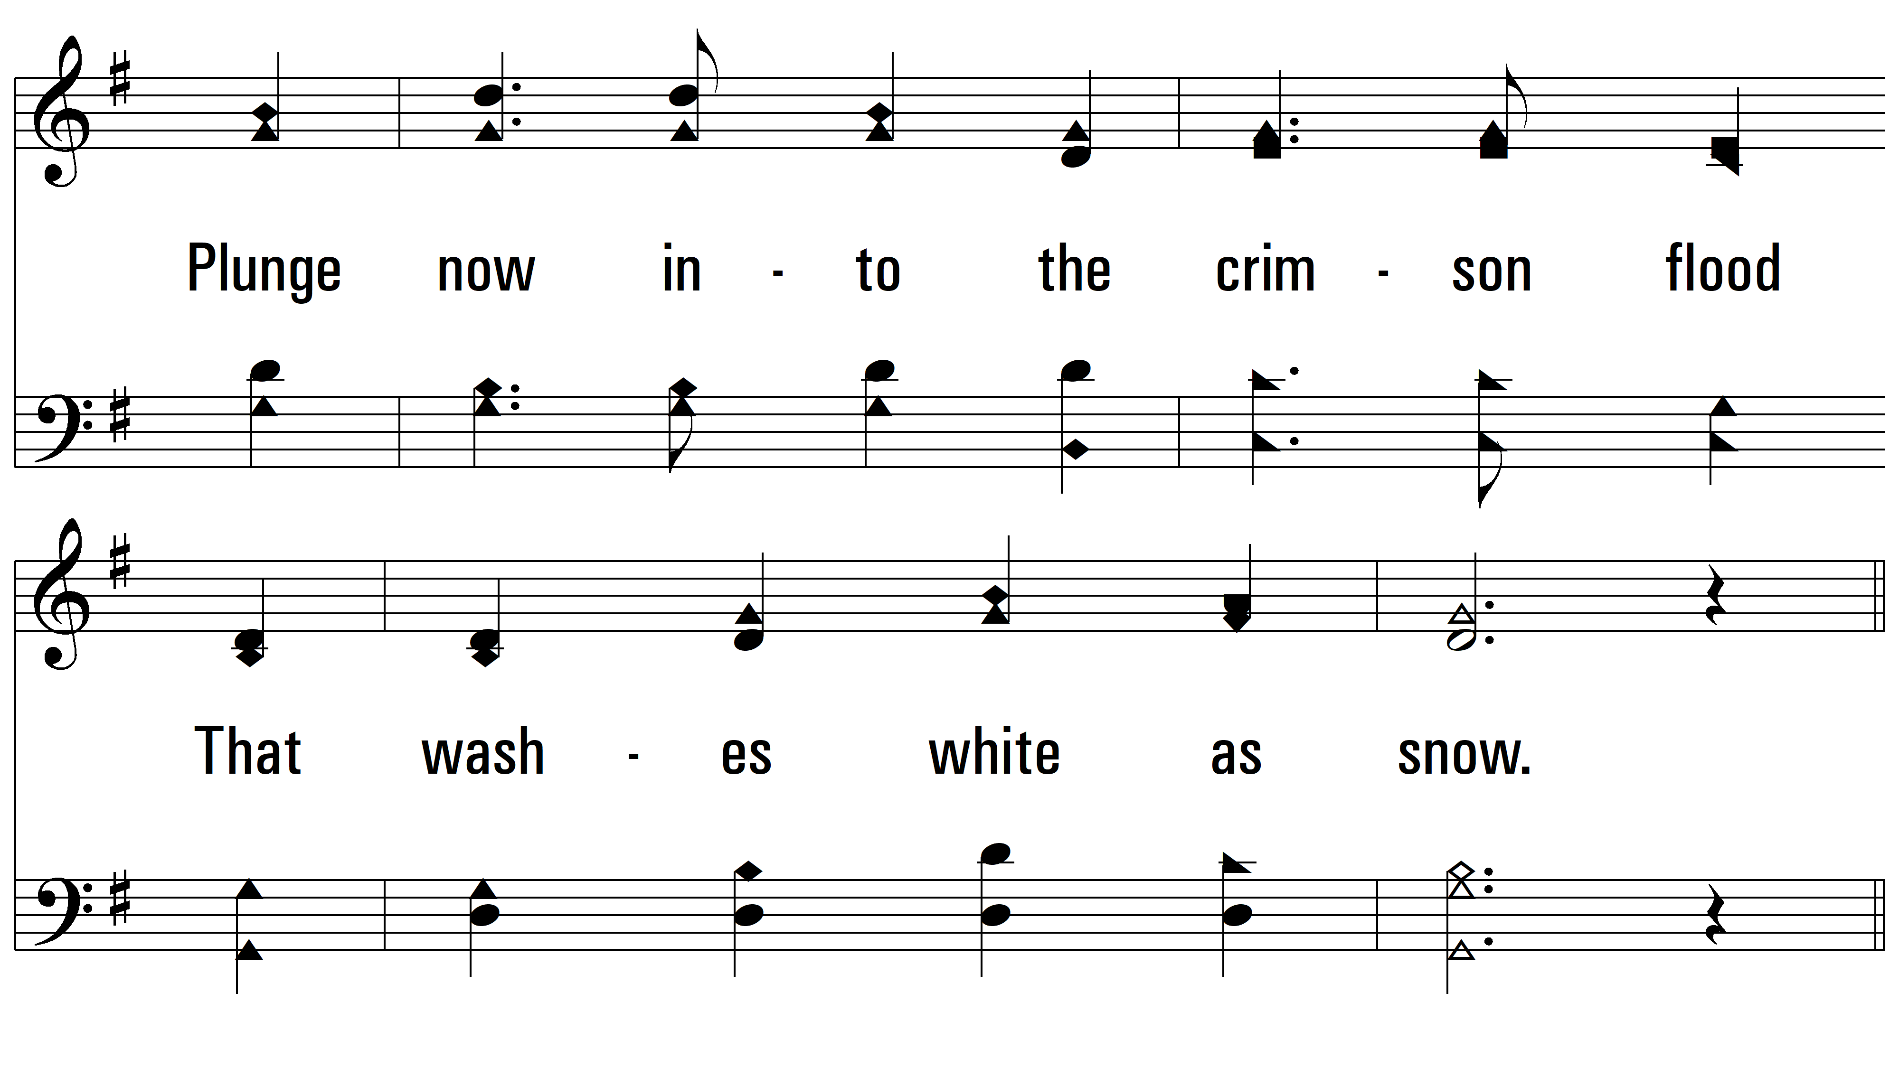
vs. 2

Slide 7
vs. 2

Slide 8
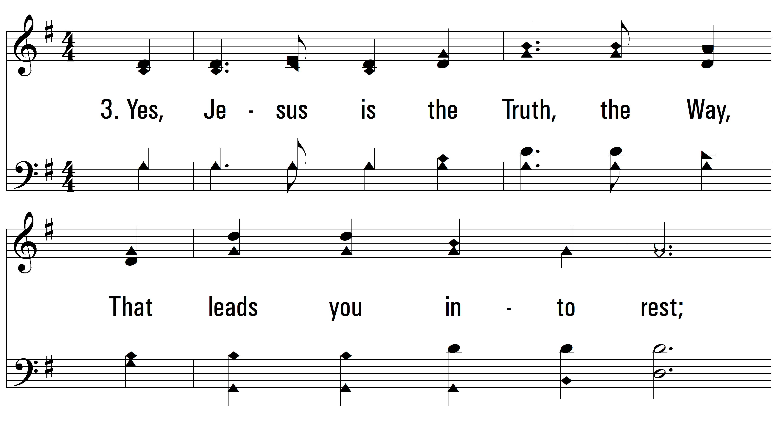
vs. 3 ~ Only Trust Him

Slide 9
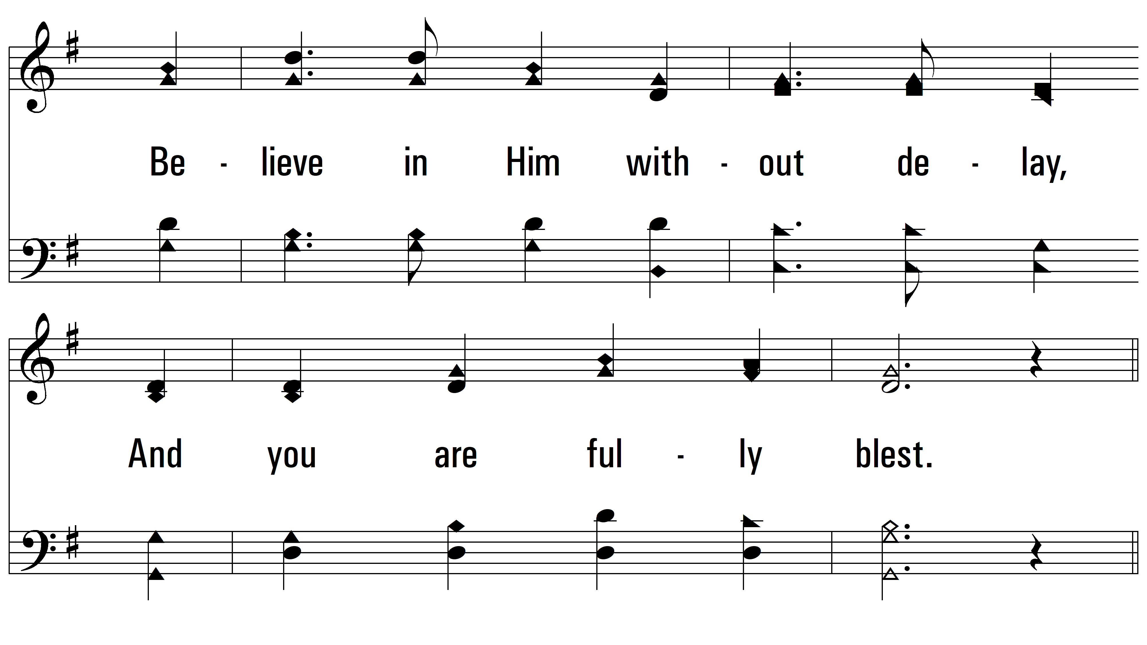
vs. 3

Slide 10
vs. 3

Slide 11
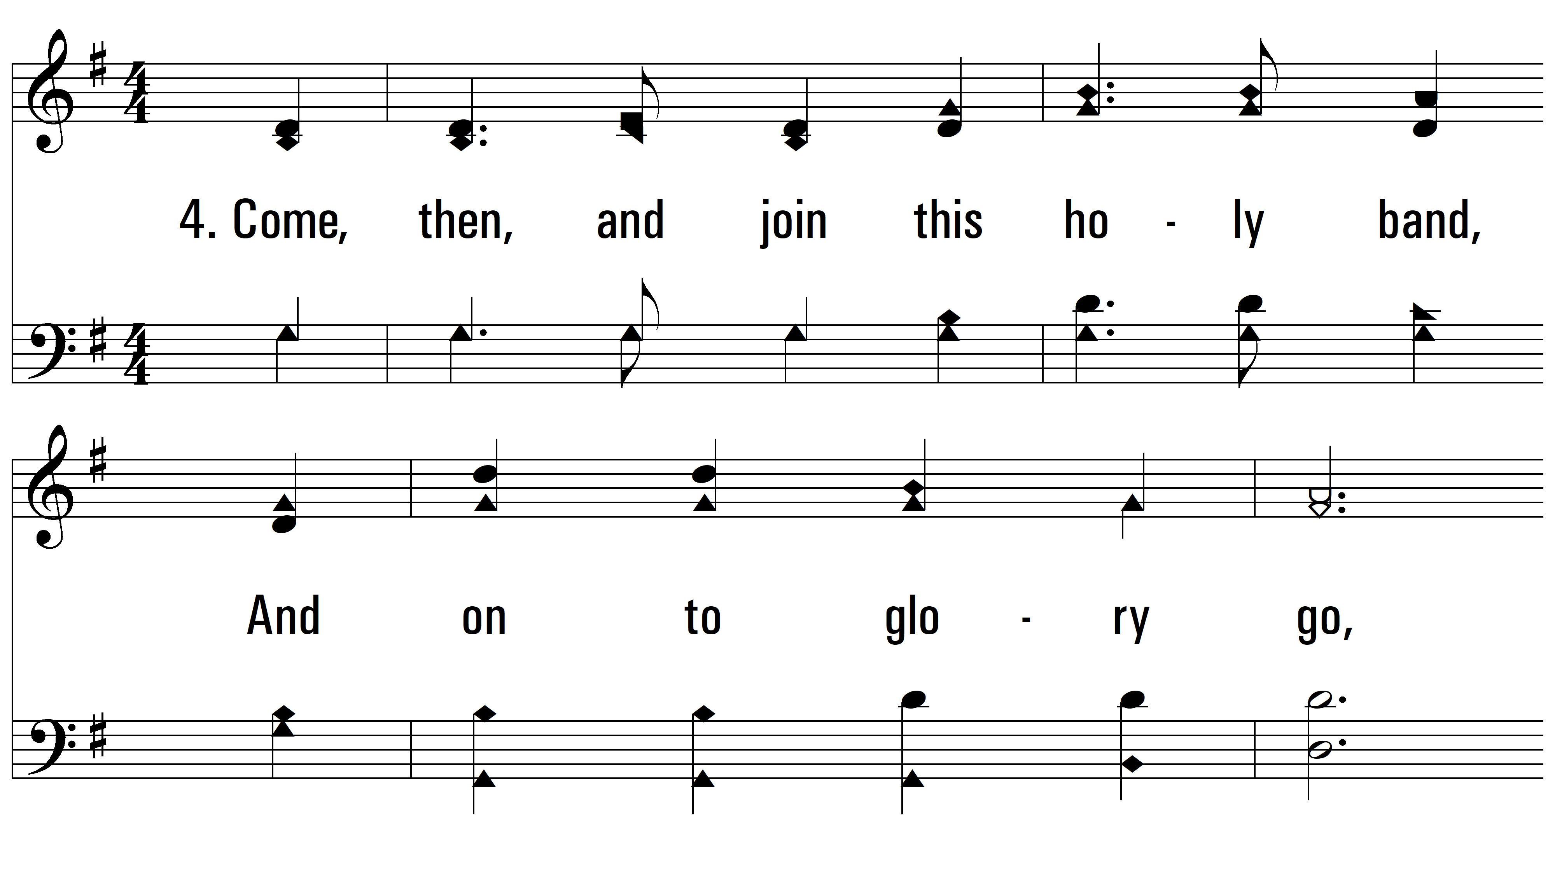
vs. 4 ~ Only Trust Him

Slide 12
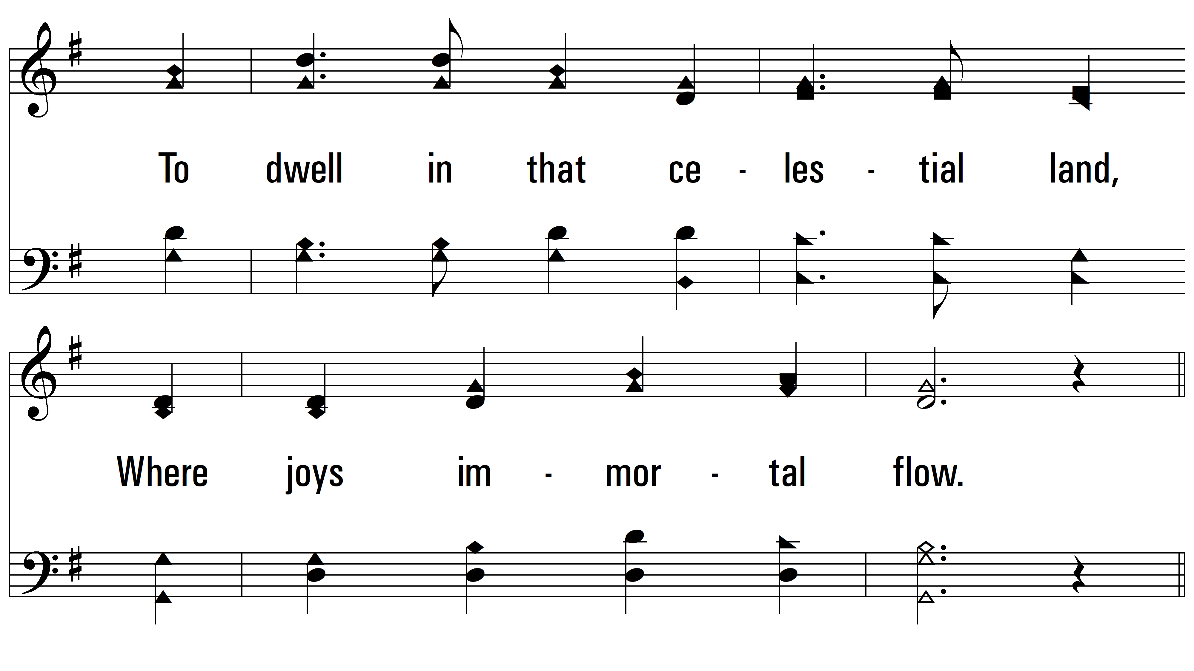
vs. 4

Slide 13
vs. 4
PDHymns.com
END

