Slide 1
On Zion's Glorious Summit
SKENE
8.8.8.8
Words: | John Kent (1803)
Music: | Robert Skene (1869)
4/4
A^{b}/E^{b} - SOL
Verses: 3/Sanctus
Lead - | SOL
Alto - | SOL
Tenor - | SOL
Bass - | SOL
PDHymns.com

Slide 2
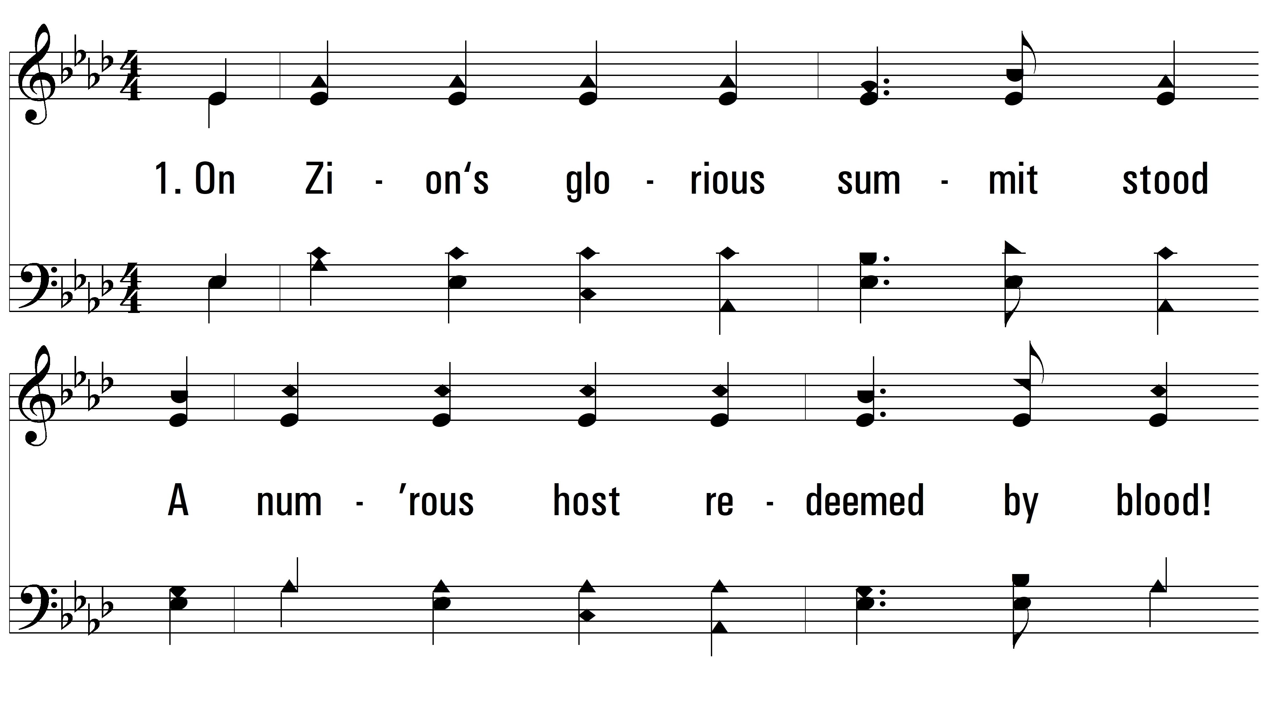
vs. 1 ~ On Zion's Glorious Summit

Slide 3
vs. 1

Slide 4
vs. 1

Slide 5
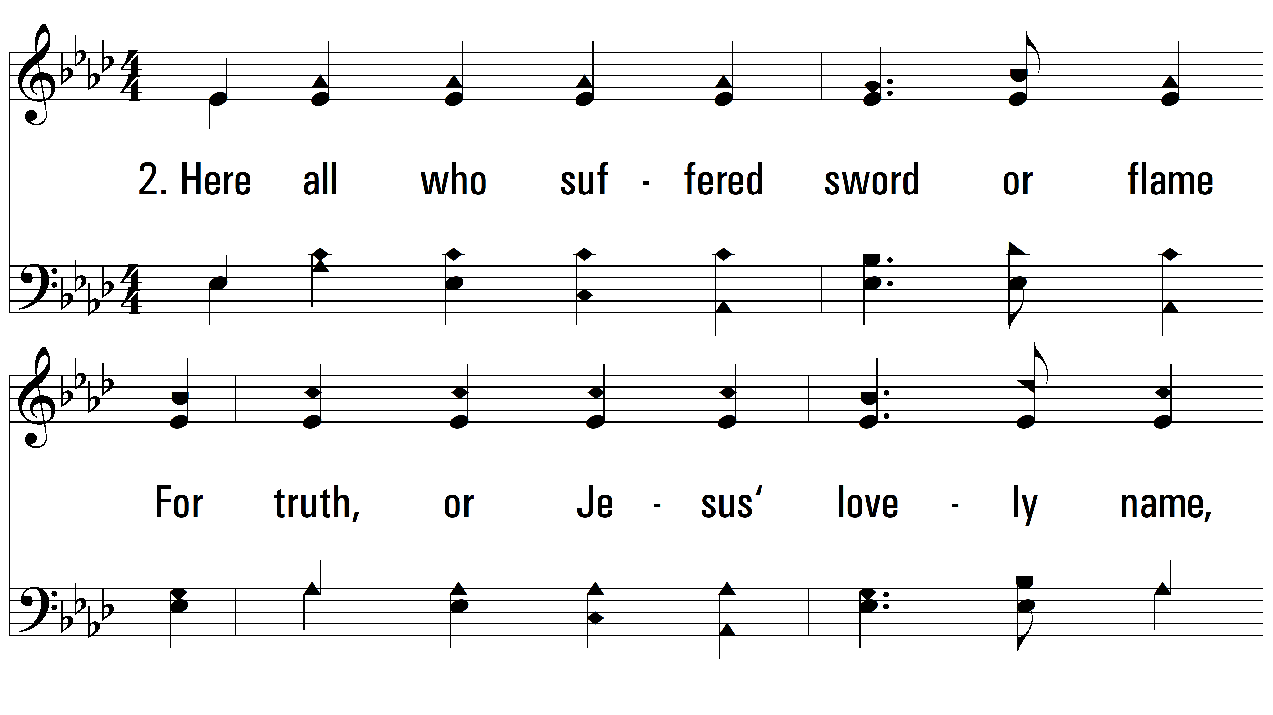
vs. 2 ~ On Zion's Glorious Summit

Slide 6
vs. 2

Slide 7
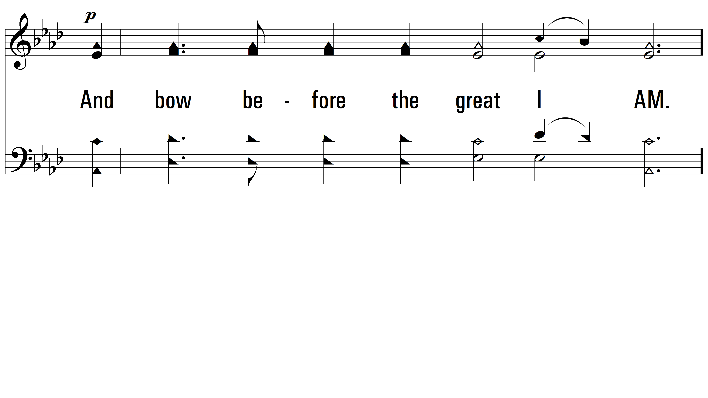
vs. 2

Slide 8
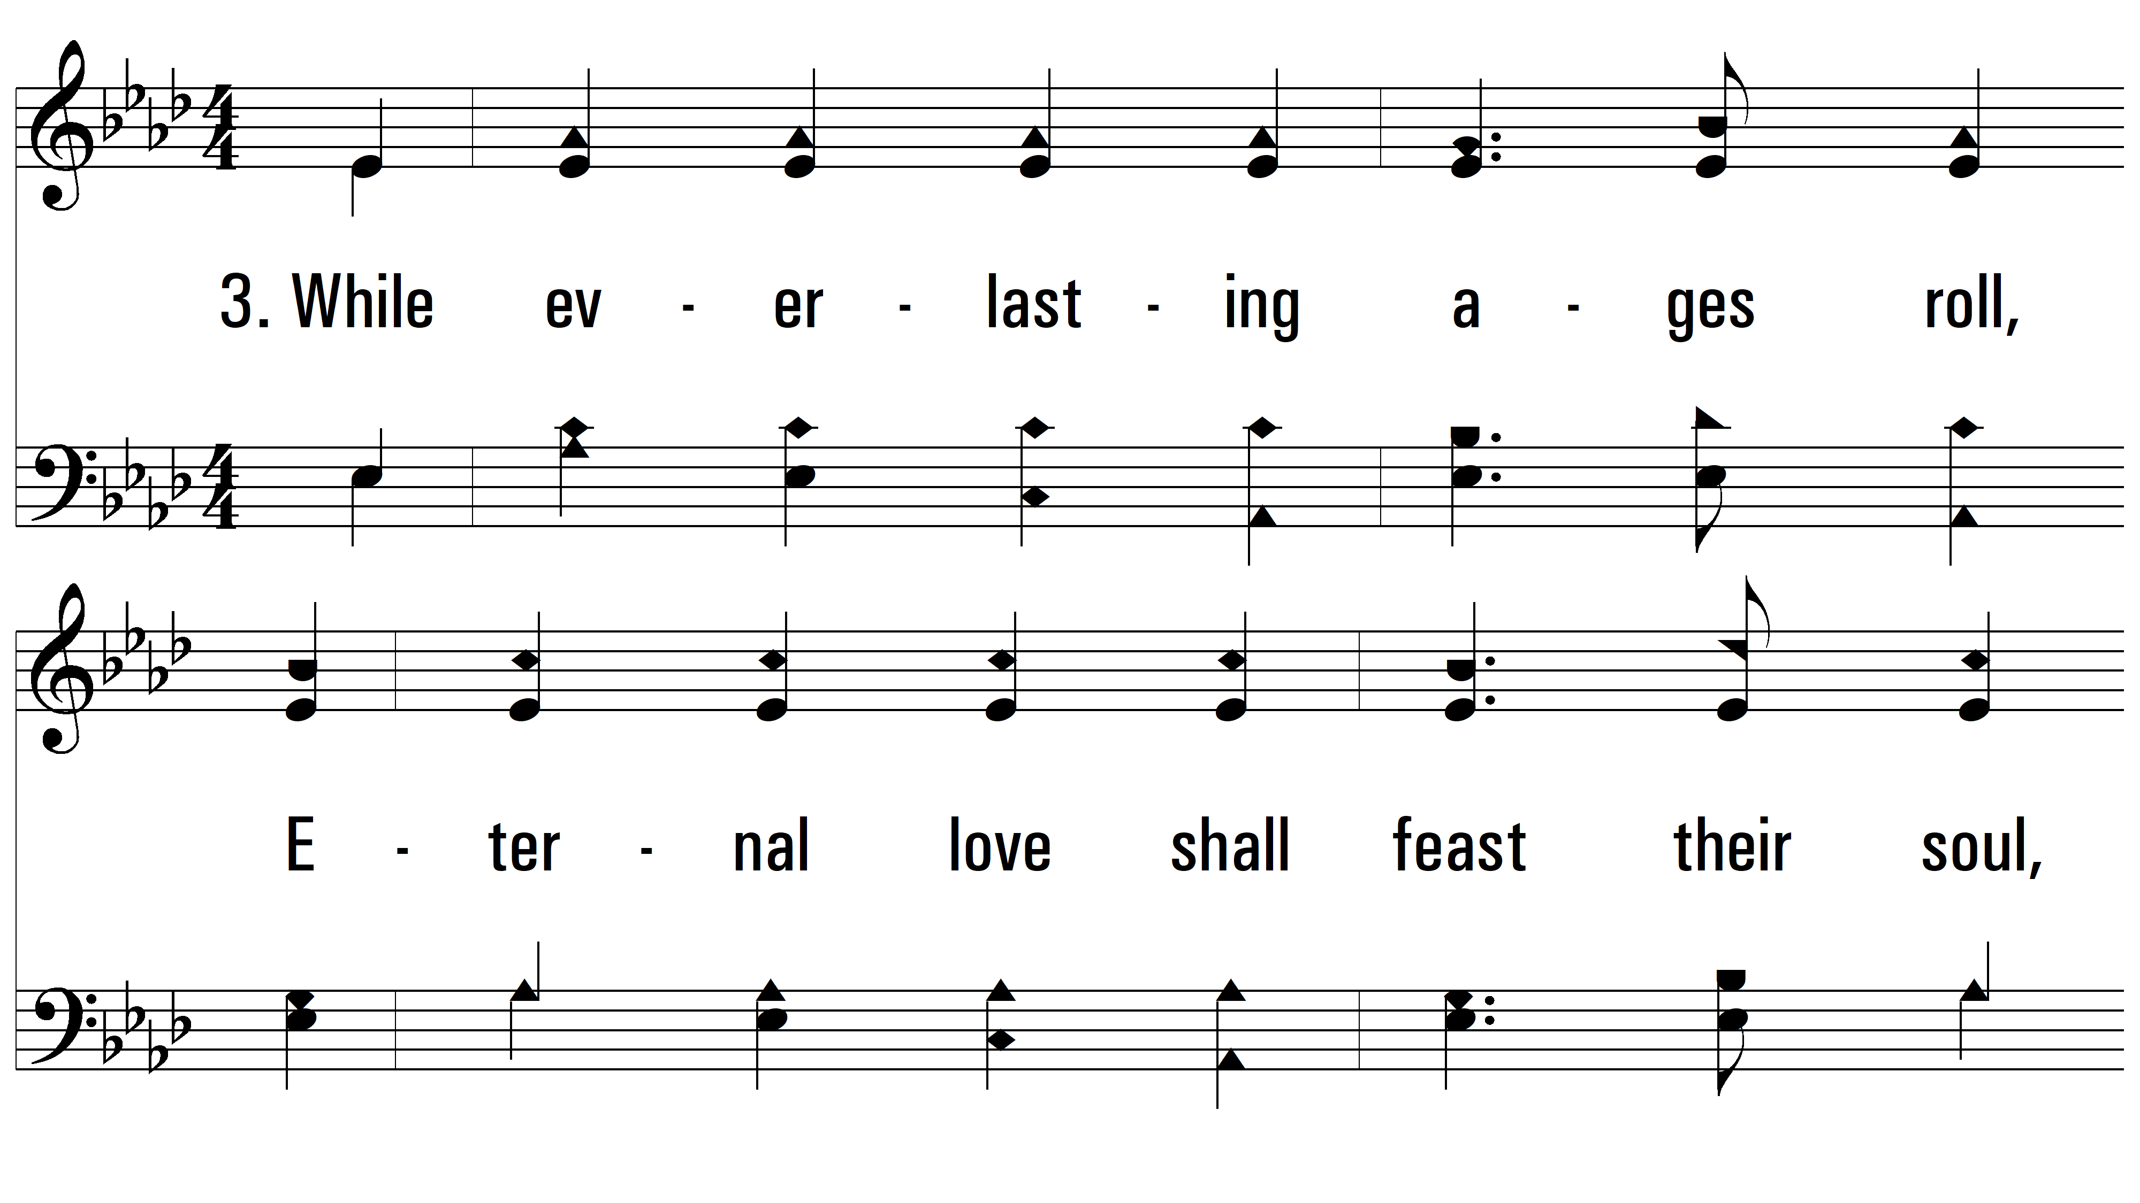
vs. 3 ~ On Zion's Glorious Summit

Slide 9
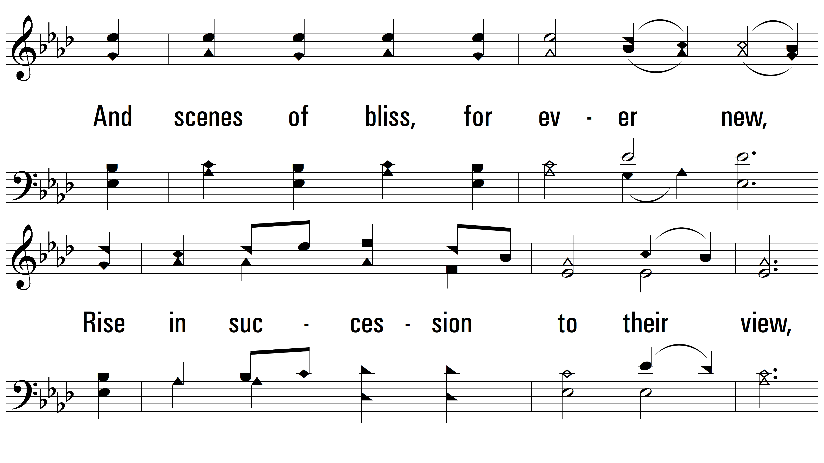
vs. 3

Slide 10
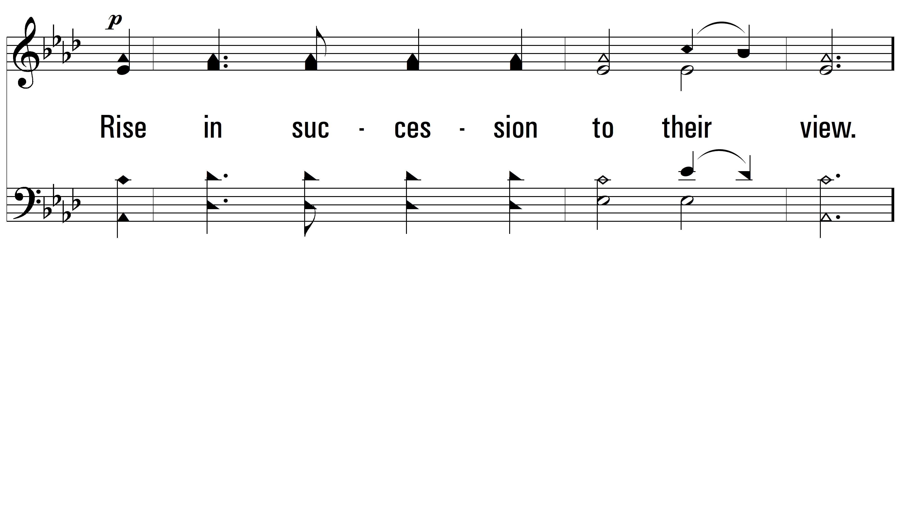
vs. 3

Slide 11
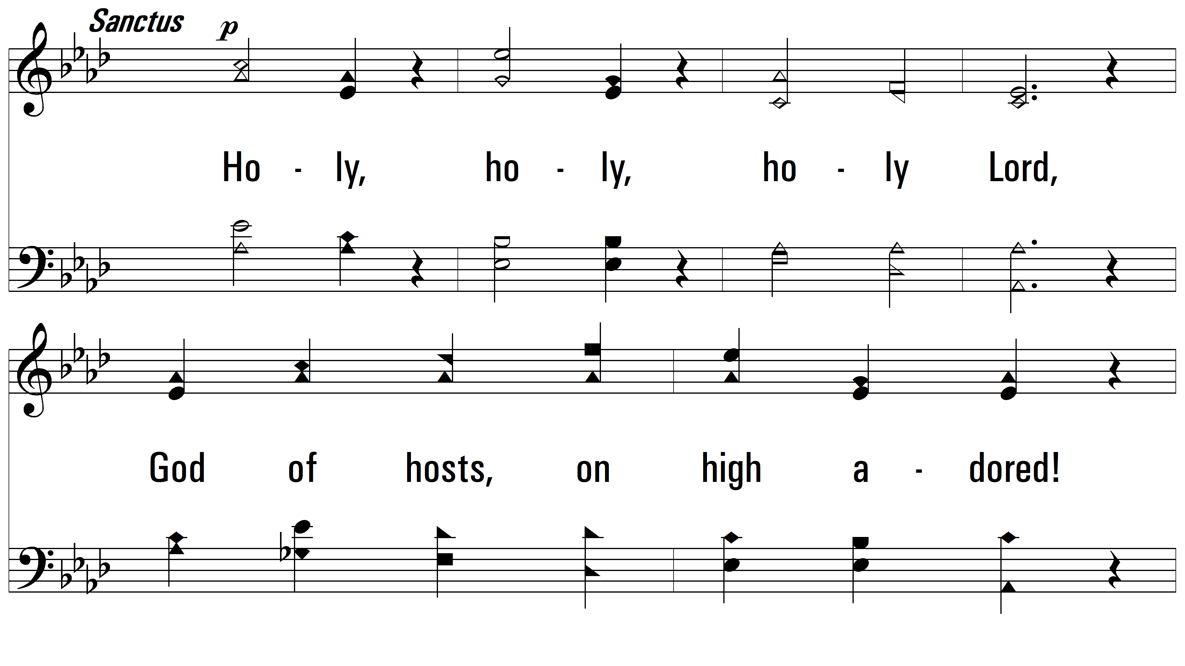
Sanctus ~ On Zion's Glorious Summit

Slide 12
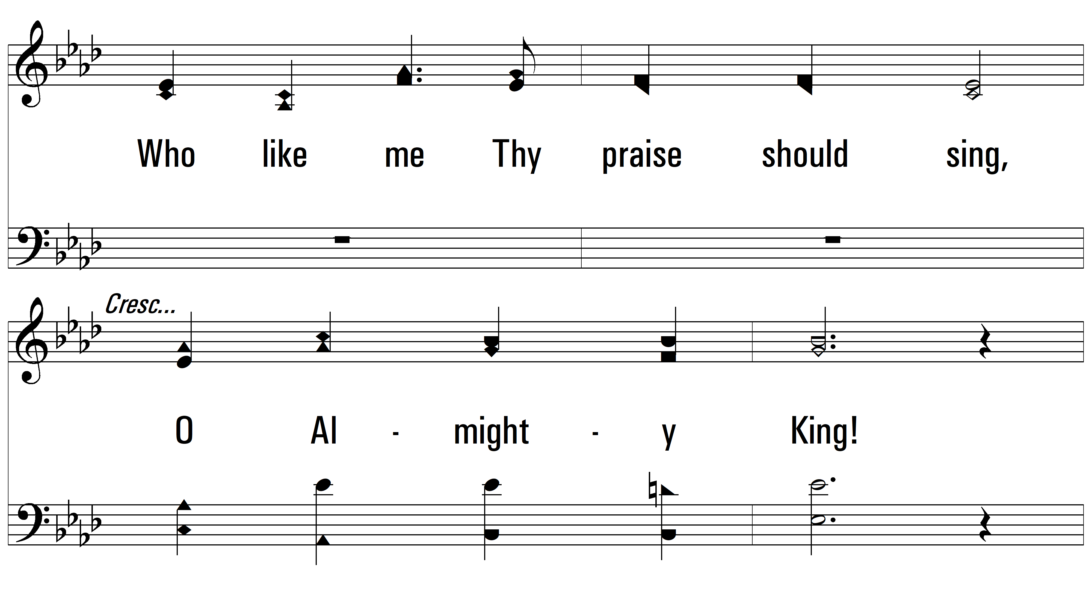
Sanctus

Slide 13
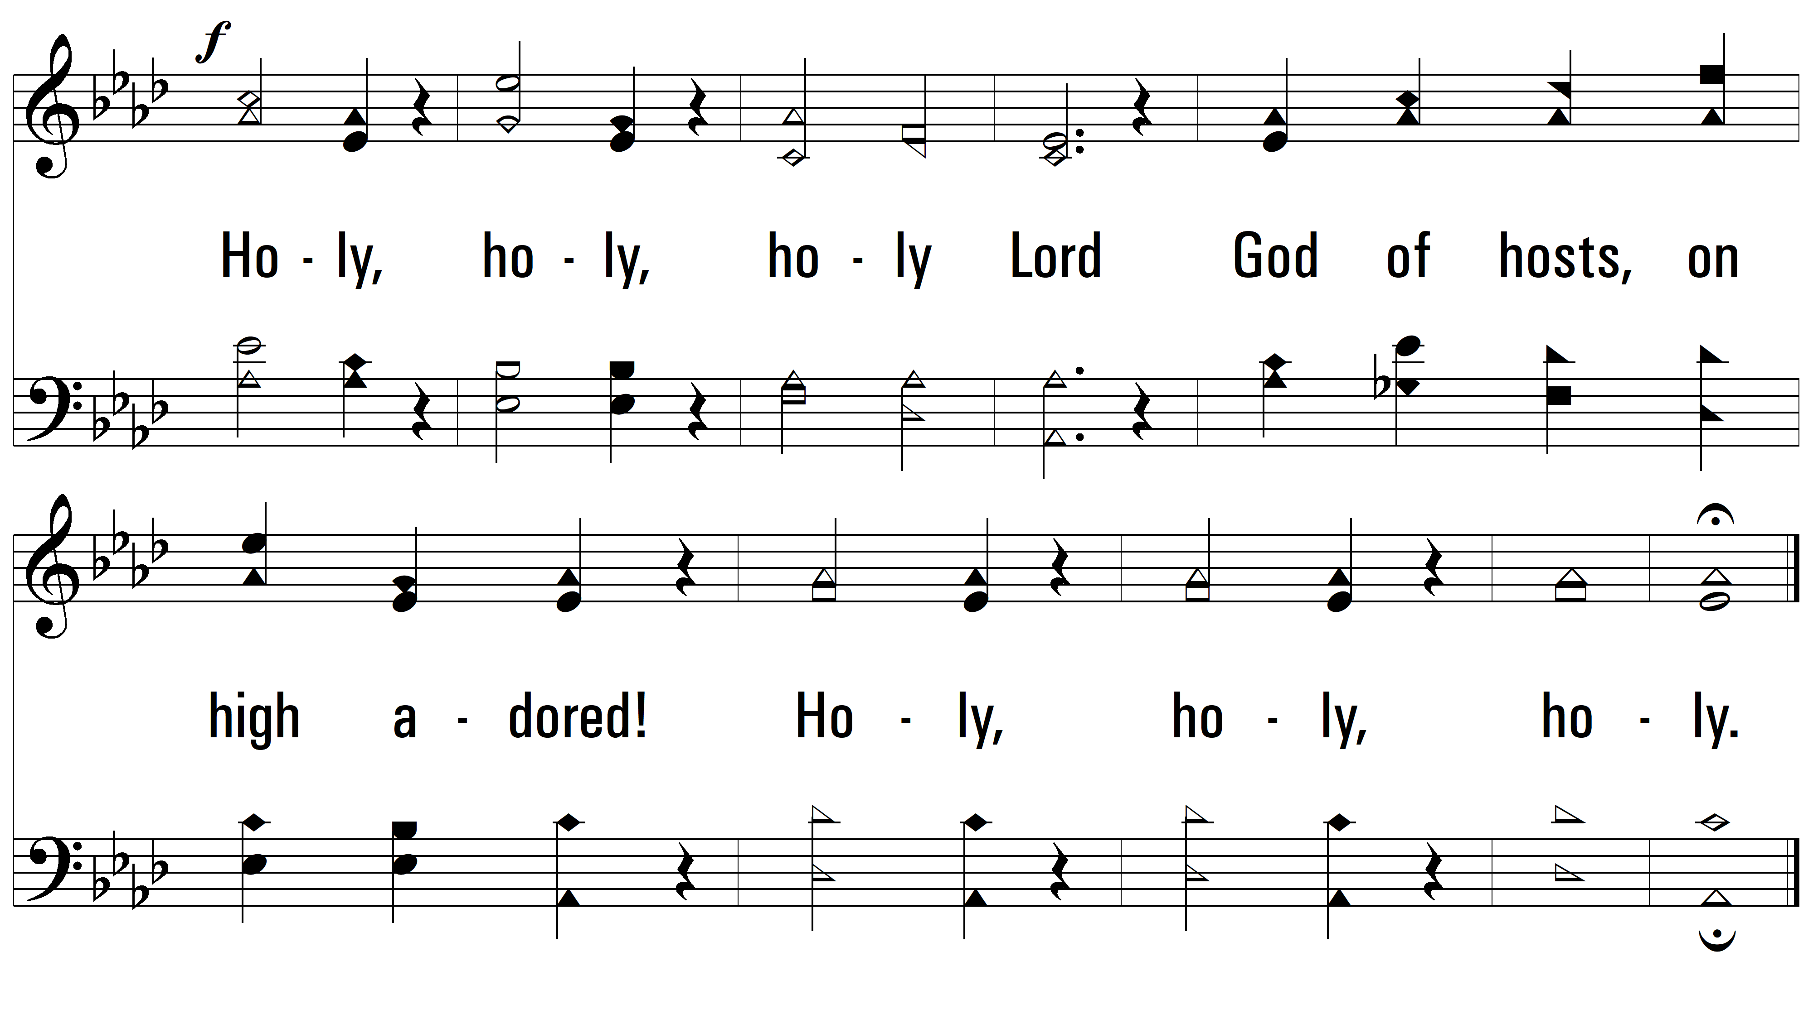
Sanctus
PDHymns.com
END

