Slide 1
On Jordan's Stormy Banks
Words: | Samuel Stennett (1787), Cho. T. C. O’Kane (1877)
Music: | T. C. O’Kane (1877)
4/4
G/G - DO
Verses: 4/Chorus
Lead - | DO
Alto - | SOL
Tenor - | DO
Bass - | DO
PDHymns.com

Slide 2
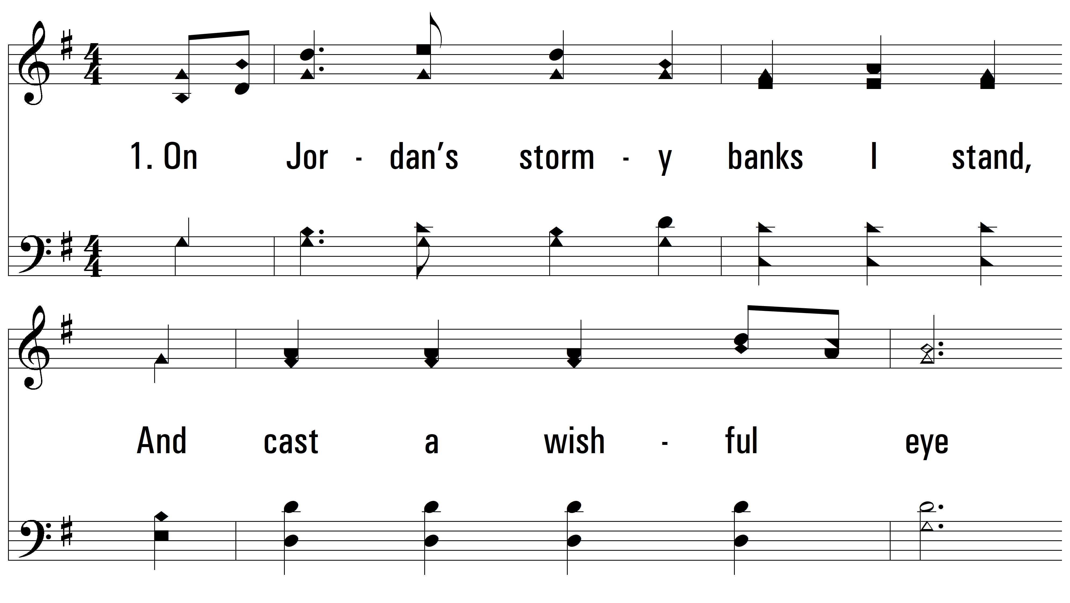
vs. 1 ~ On Jordan's Stormy Banks

Slide 3
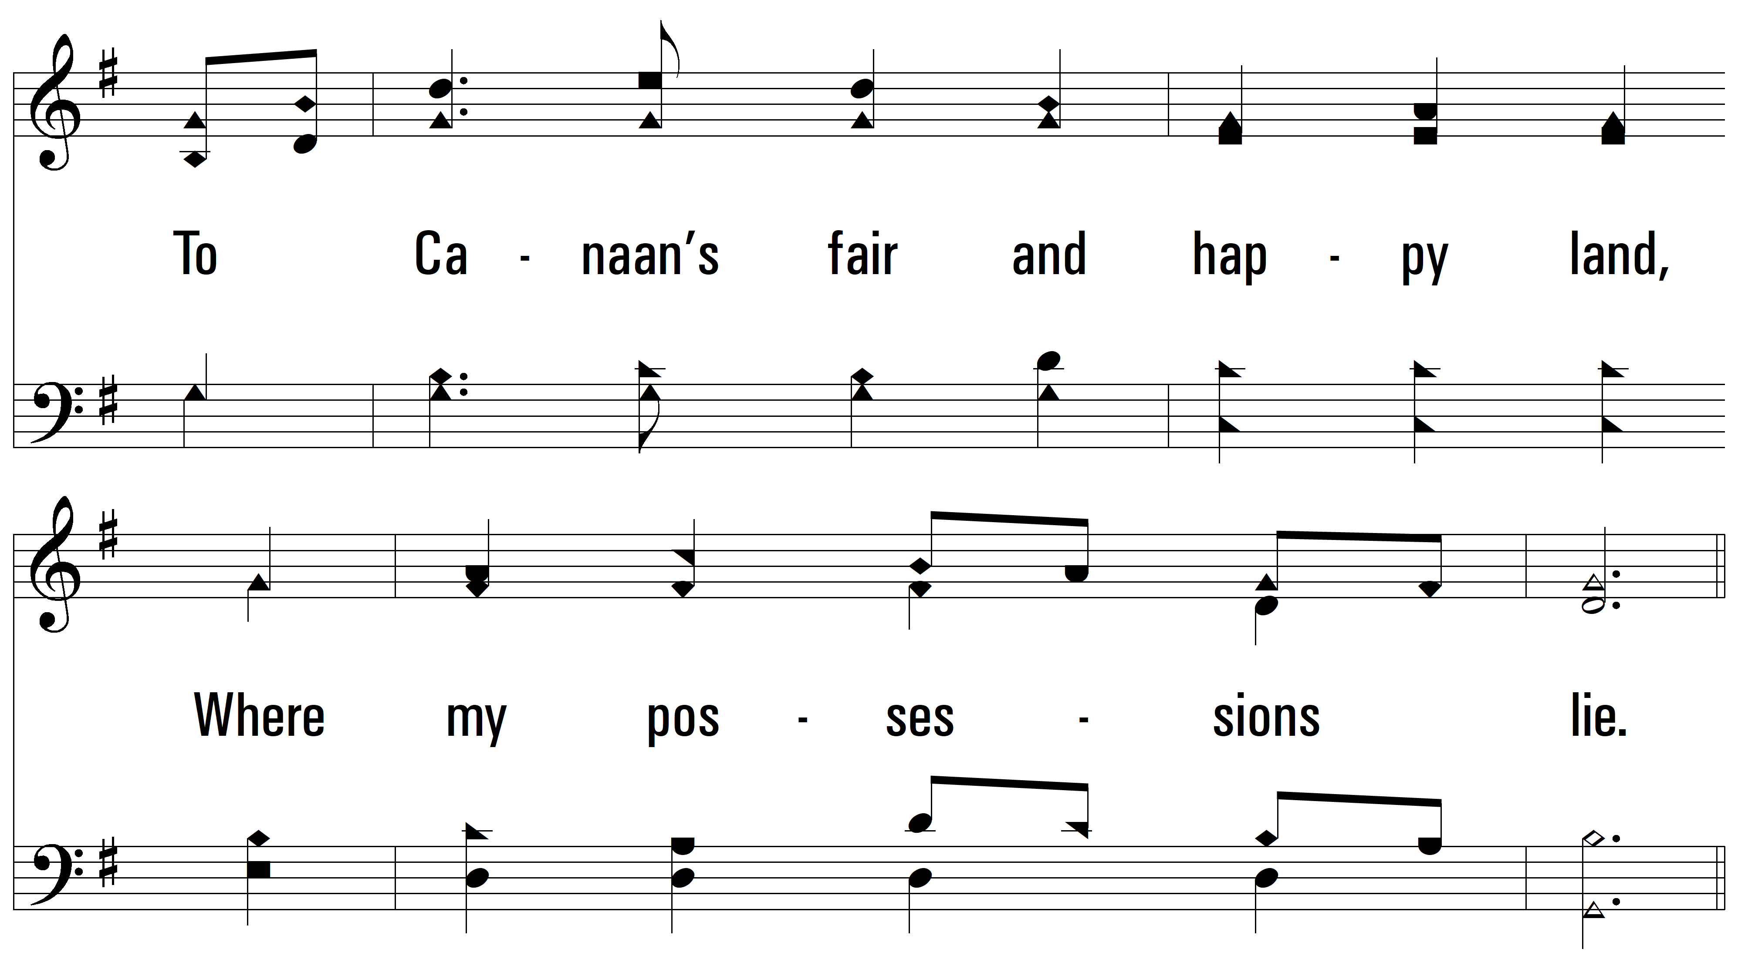
vs. 1

Slide 4
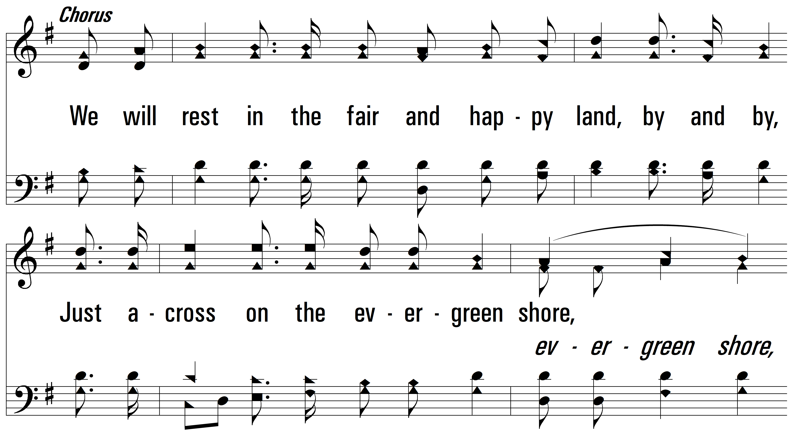
vs. 1

Slide 5
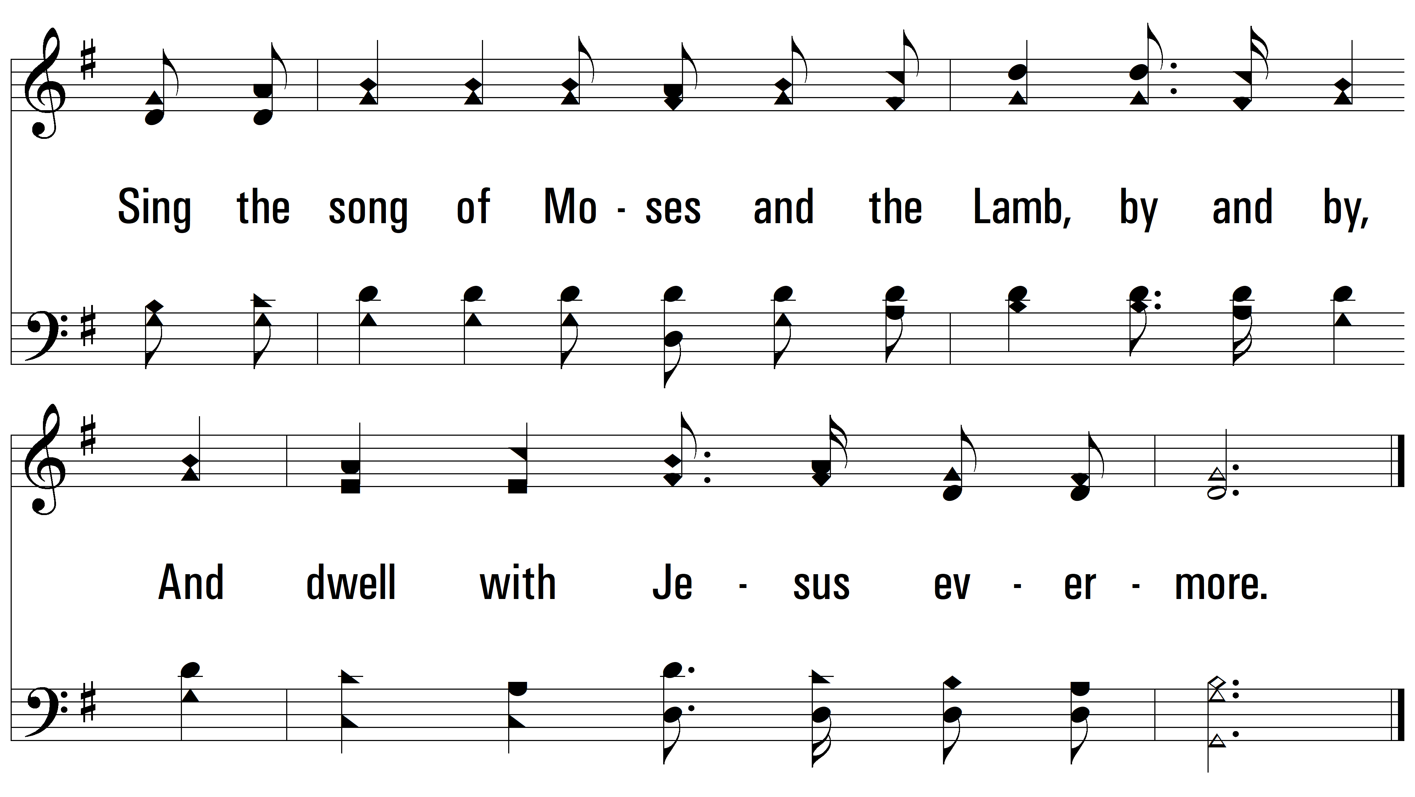
vs. 1

Slide 6
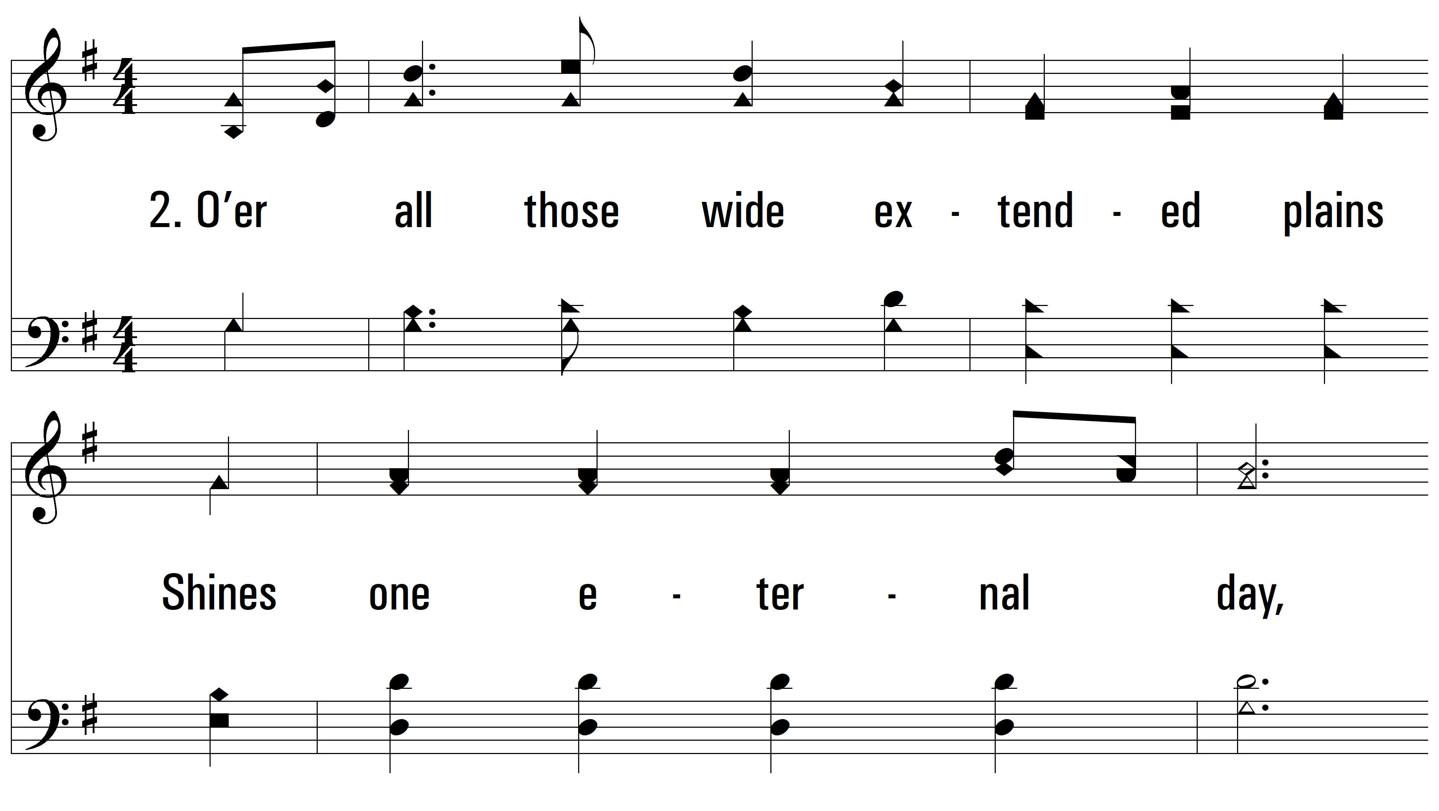
vs. 2 ~ On Jordan's Stormy Banks

Slide 7
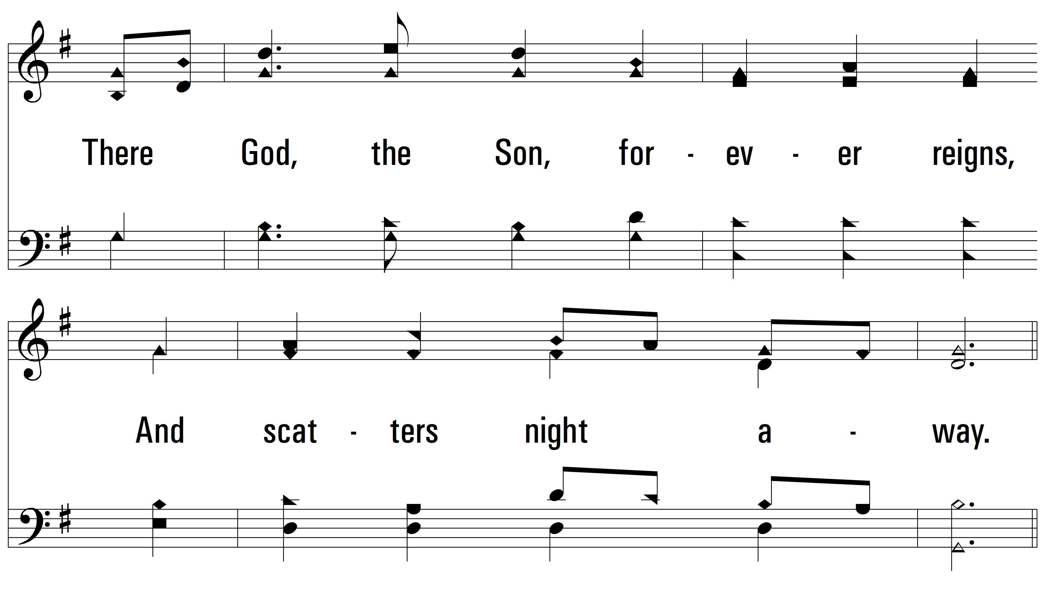
vs. 2

Slide 8
vs. 2

Slide 9
vs. 2

Slide 10
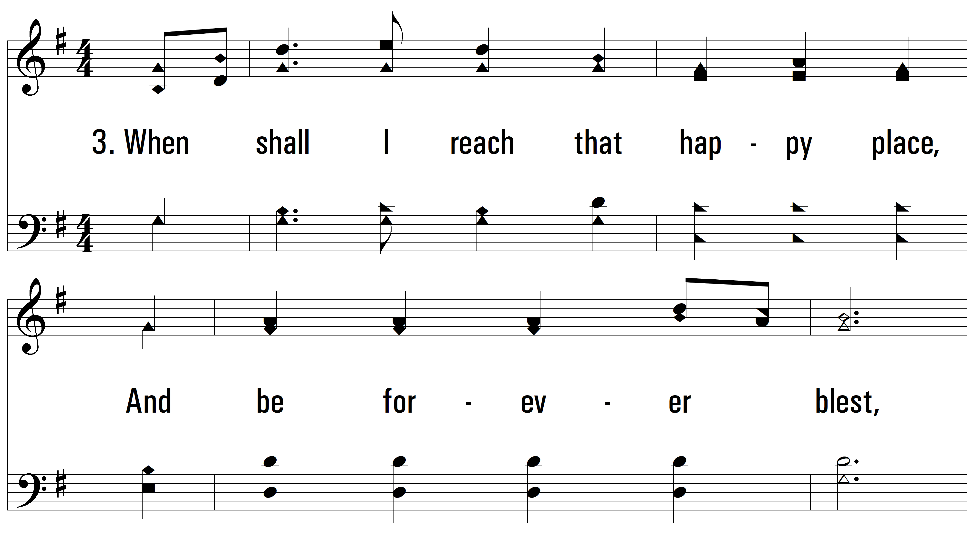
vs. 3 ~ On Jordan's Stormy Banks

Slide 11
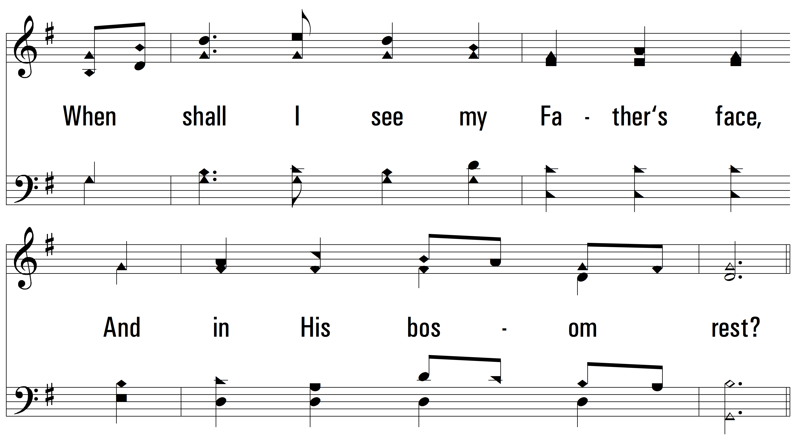
vs. 3

Slide 12
vs. 3

Slide 13
vs. 3

Slide 14
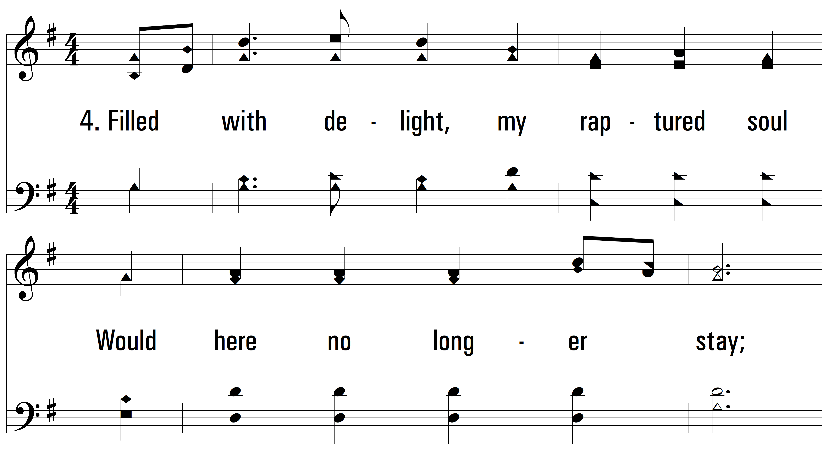
vs. 4 ~ On Jordan's Stormy Banks

Slide 15
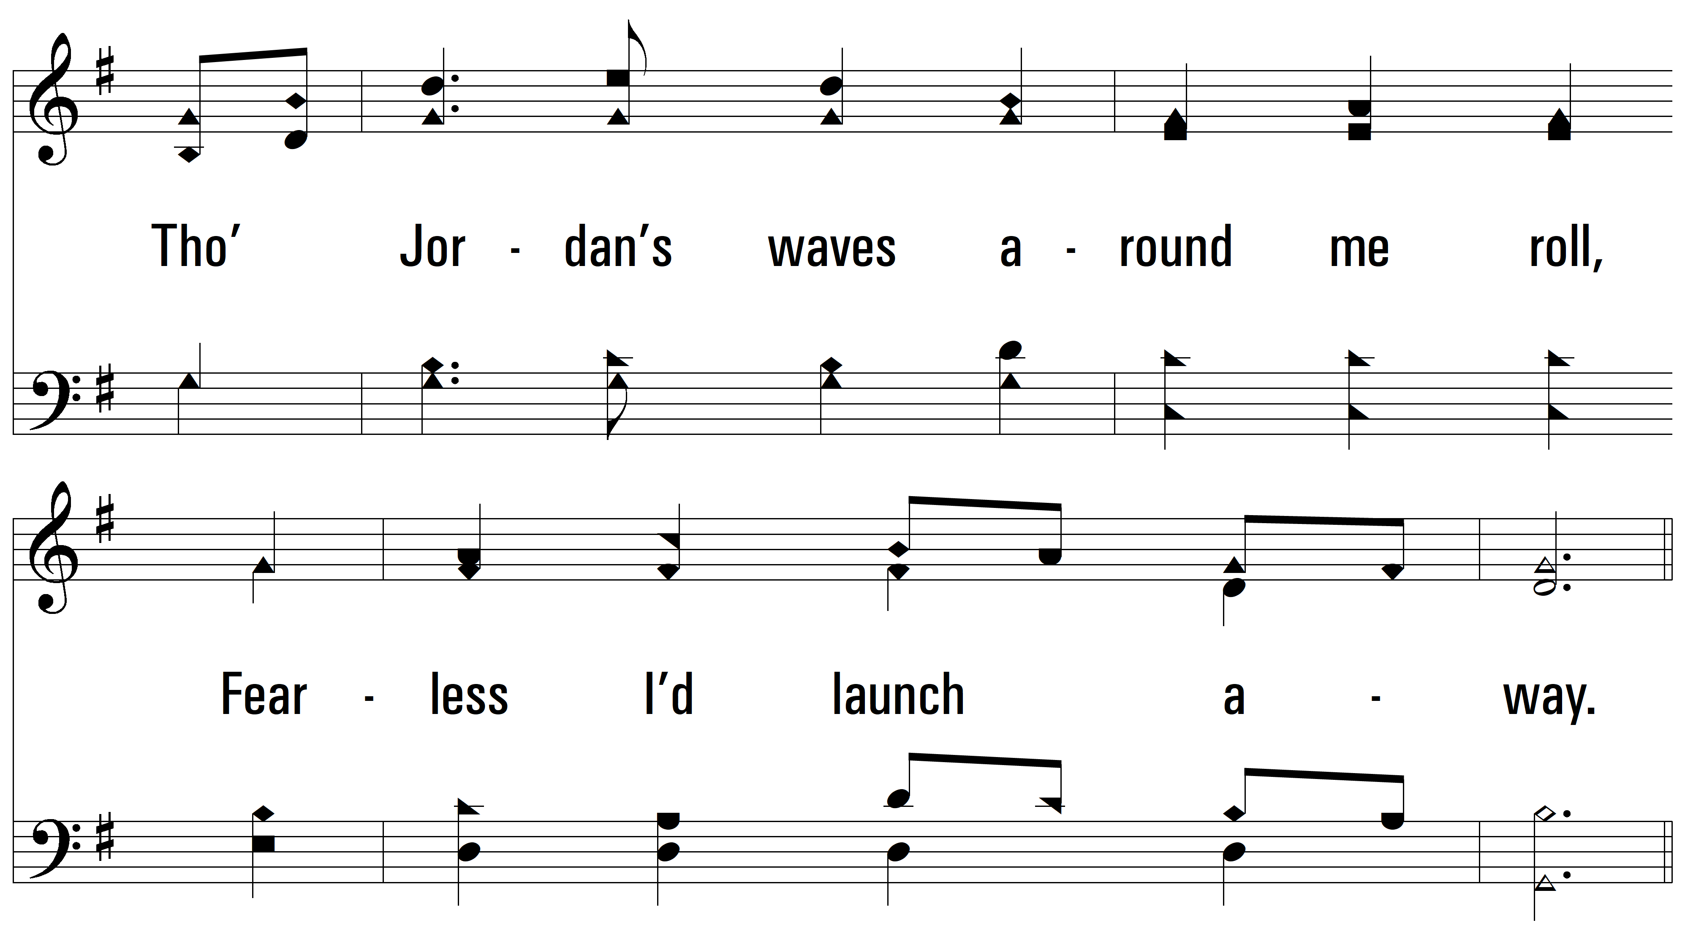
vs. 4

Slide 16
vs. 4

Slide 17
vs. 4
PDHymns.com
END

