Slide 1
On Jordan’s Stormy Banks I Stand
(I Am Bound For The Promised Land)
Words: | Samuel Stennett (1787), Cho. Rigdon M. McIntosh (1874)
Music: | Walker’s Southern Harmony (1835), Arr. Rigdon M. McIntosh (1874)
4/4
F/F - DO
Verses: 3/Chorus
Lead - | DO
Alto - | DO
Tenor - | MI
Bass - | DO
PDHymns.com

Slide 2
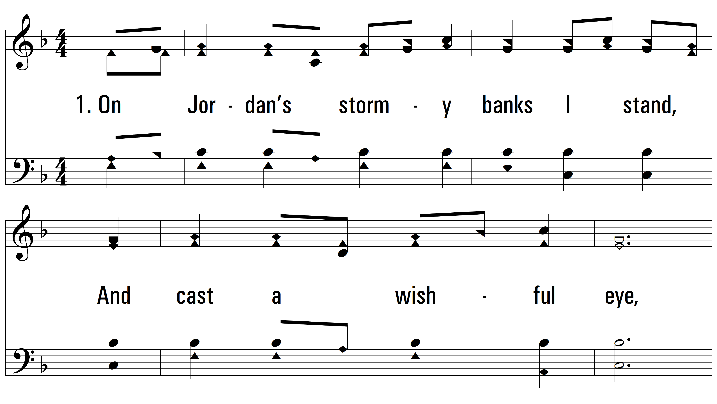
vs. 1 ~ On Jordan’s Stormy Banks I Stand

Slide 3
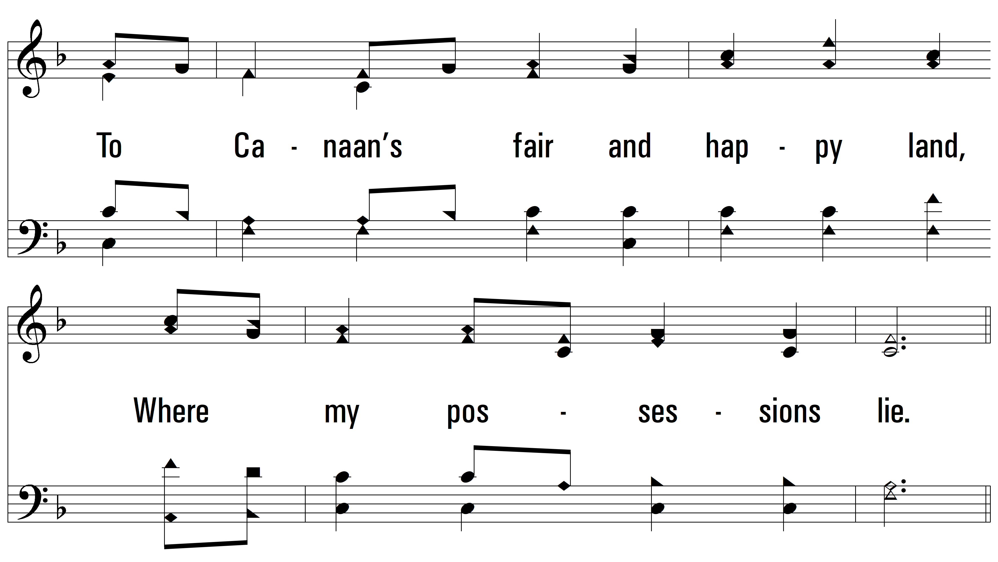
vs. 1

Slide 4
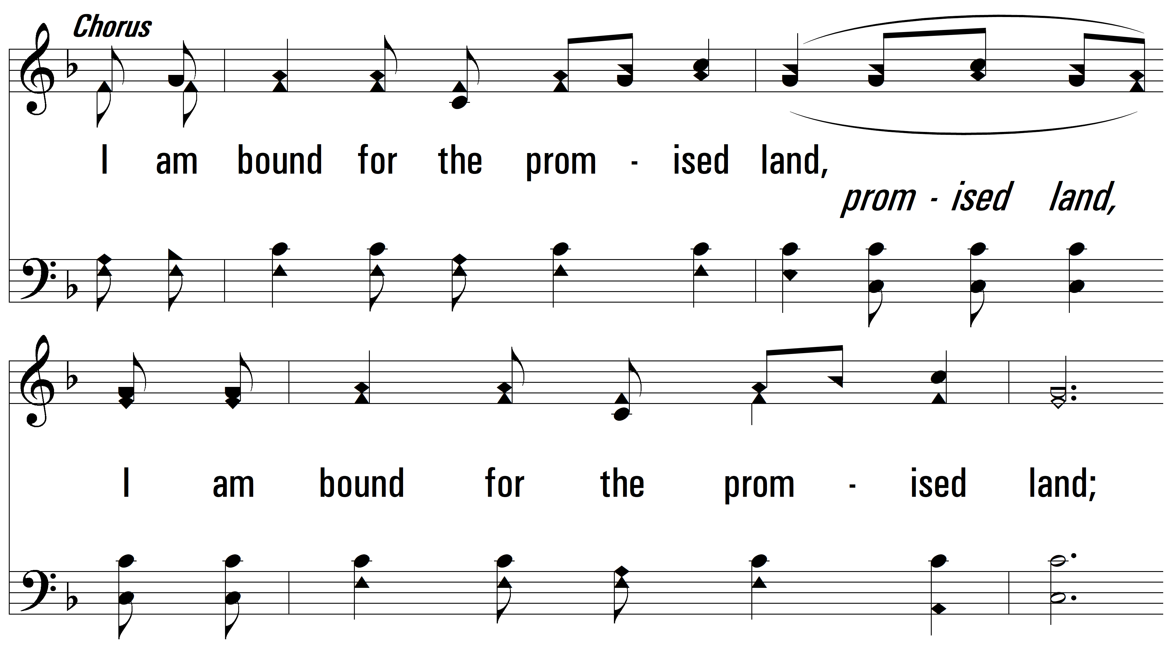
vs. 1

Slide 5
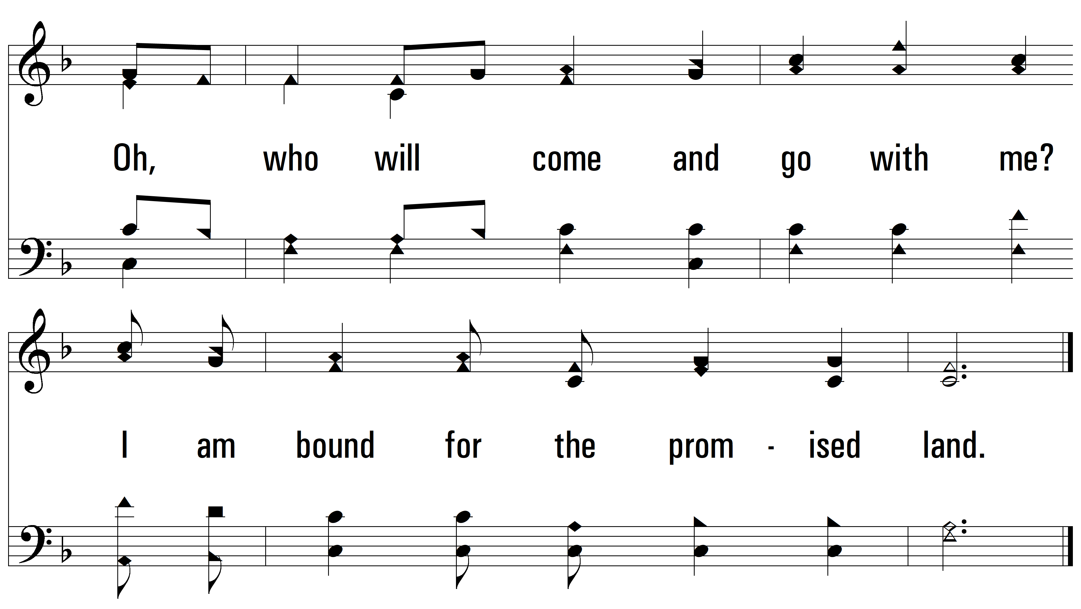
vs. 1

Slide 6
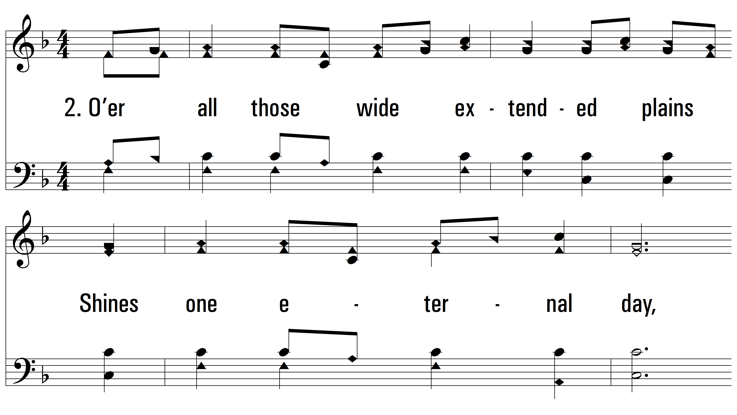
vs. 2 ~ On Jordan’s Stormy Banks I Stand

Slide 7
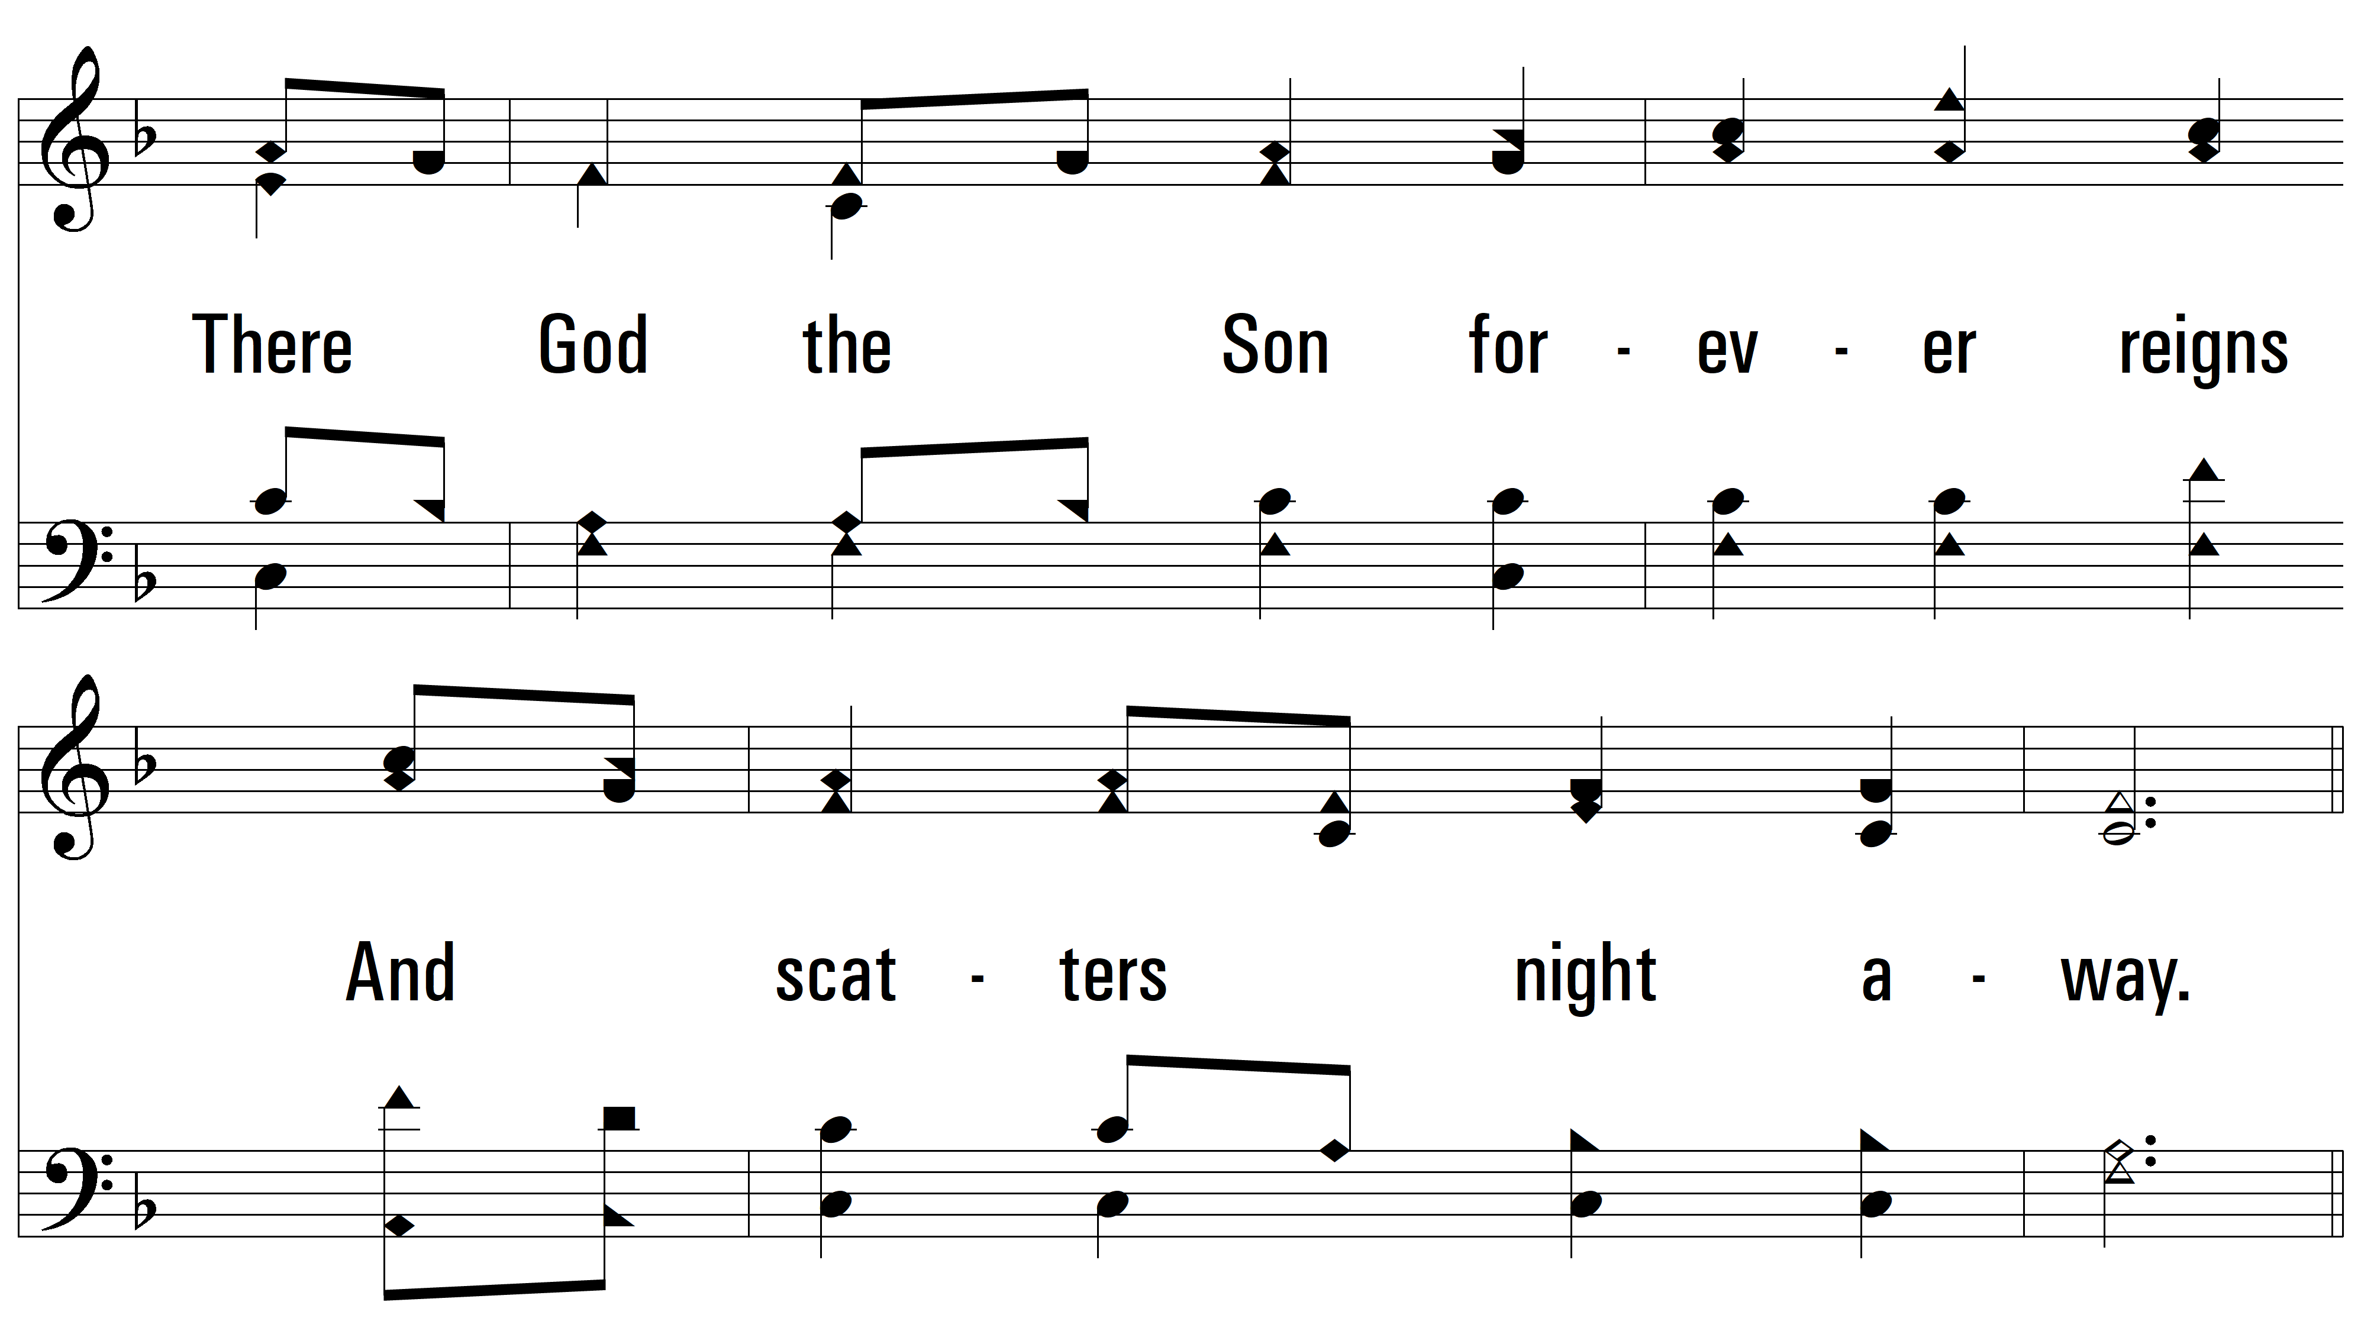
vs. 2

Slide 8
vs. 2

Slide 9
vs. 2

Slide 10
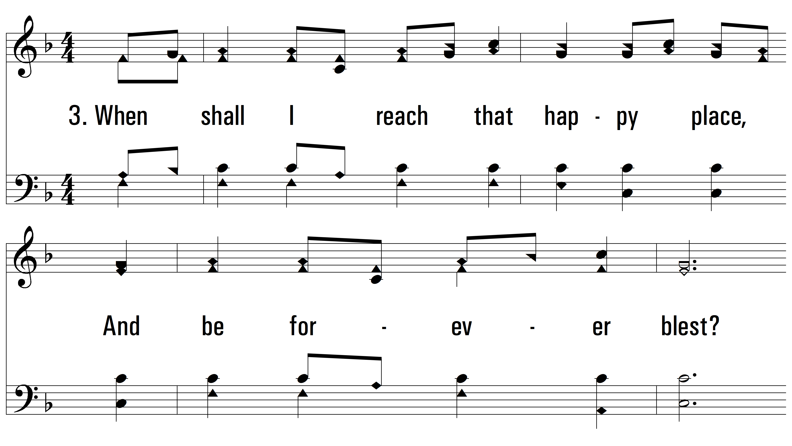
vs. 3 ~ On Jordan’s Stormy Banks I Stand

Slide 11
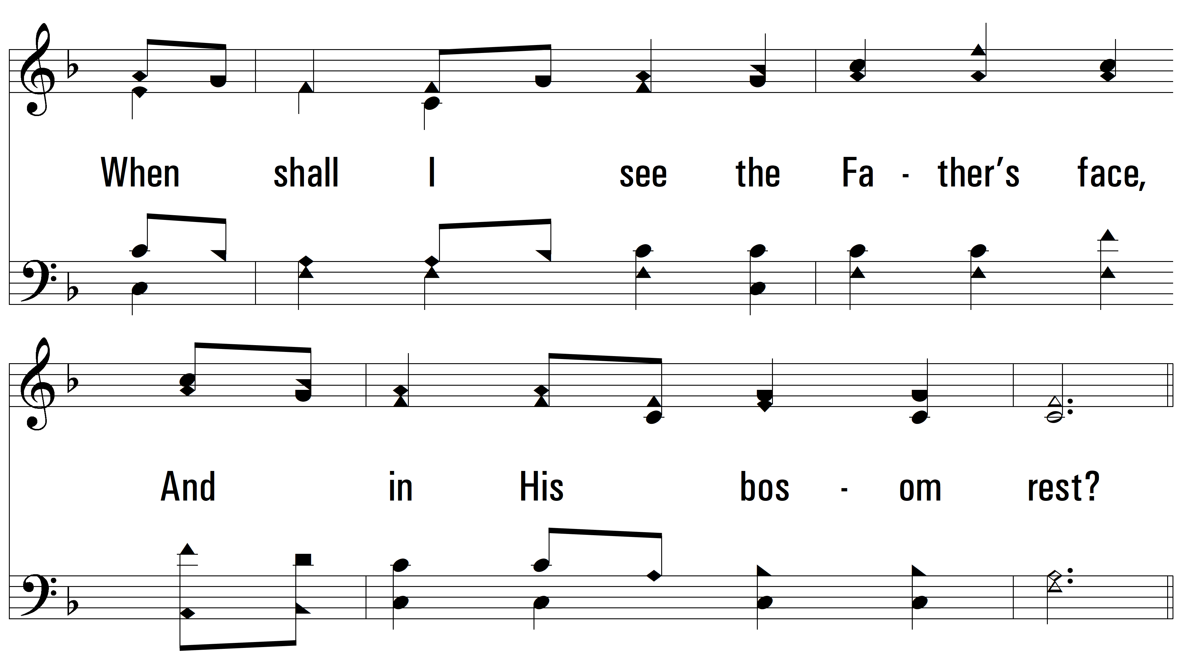
vs. 3

Slide 12
vs. 3

Slide 13
vs. 3
PDHymns.com
END

